Slide 1

Operational & vocabulary issues
OGC Hydro DWG Workshop – Reading – 2012-06-26
  Sylvain Grellet
Office International de l’Eau - Sandre

Slide 2

Table of content
Making referential datasets available,
Issue n°1: Calling external controlled vocabulary,
Issue n°2: expose XML structured info with performances/stability,
Issue n°3: Versioning.

Slide 3


Making referential datasets available
Content : Referential datasets
  Controlled vocabulary
    Parameters
    Methods
    Taxa
    WaterActors,
    Other code lists for attributes (ex : ‘flow regime’ = intermittent, permanent…),
    ….
  Spatial objects
    Rivers, Lakes,
    Surface/Ground quality/quantity monitorings facilities,
    Area management zones,
    …

Slide 4
Making referential datasets available
Exchange method : XML Webservices
  OGC WFS
  “Sandre’s ad-hoc controlled vocabulary service” defined for our national needs.
    Methods :
      getReferenceHistory (discovery): revision tree (data & set)
      getReferenceRevision (access) : to a given version (data & set),
      getReferenceElements (access): to the latest version of a dataset via thematic filters,
      updatedReferences (discovery): for a given date => number of changed elements + link to the latest version of a dataset
      getUpdatedReferences (access): to each updated entry in a dataset since a given revision
    Synchronous/asynchronous modes possible

Slide 5






Making referential datasets available
Technologies used
Exist
Controlled
vocabulary
« Sandre’s controlled vocab»
webservice
« Duplicate » geo info to allow Sandre’s webservice versioning methods
WMS, WFS Sandre/INSPIRE, WPS
Geographic
data- flow

Slide 6
Making referential datasets available
Some figures
  Rivers : 72311 (uuid for network links have to be added soon => more than 600 000 new uuid to come),
  Administrative Unit - Cities: 36695,
  Taxa (fauna/flora) : 29893,
  Lakes : 17694,
  WFD water bodies : 13845,
  Various Code lists entries : 7425,
  Parameters : 4111,
  Water actors / Resp Party : 3934 (more than 80 000 to come),
  Surface water quality monitoring stations : 6000,
  Etc ….
  Total ~200 000 entries not counting those to come

Slide 7
Issue n°1: Calling external controlled vocab
Need :
  Pointing from xml instance to an external code list (for each attribute based on a code list),
    Instead of
  + need to validate those xml instances
…
<Parametre>
<CdParametre>http://www.sandre.eaufrance.fr?urn=urn:sandre:referentiels:sa_par:1.0:Parametre:1272:2000-09-11T00:00:00</CdParametre>
</Parametre>
…
Codespace
Code
Version
…
<Parametre>
<CdParametre>1272</CdParametre> <NomParametre>Tétrachloroéthylène</NomParametre>
</Parametre>
…

Slide 8
Issue n°1: Calling external controlled vocab
Foreseen solutions :
  Xpointer : dead solution (doesn’t work on most xsd validators)
  Store it in Xsd’s : data model’s xsd calling (import) controlled vocabulary also stored in xsd => auto-generate a <xsd:restriction on <xsd:enumeration value,
    Ex (see previous slide) :
    Only tested on a centralized system : Sandre’s manages both model & code lists. <xsd:union could also help.
    On a shared system : no generic attribute allows to define in the xml (/!\ not xsd /!\) where the code list content is defined => no xsd validation possible => schematron only
<xsd:simpleContent>
<xsd:restriction base="cct:CodeType">
<xsd:maxLength value="11"/>
<xsd:enumeration value="1272">
…
</xsd:restriction>
</xsd:simpleContent>

Slide 9
Issue n°1: Calling external controlled vocab
Foreseen solutions :
  See workshop held at CSIRO (outcome in GML 3.3 ) https://www.seegrid.csiro.au/wiki/AppSchemas/VocabularyBindingMechanismsWorkshop
  Latest GML 3.3 revision note (11.3 ‘Code list conversion rule’)
    GML Dictionary was developed as a stop-gap,
    “Best-practice is to generally use URIs for referring to items in vocabularies, and RDF (OWL, SKOS) for encoding their descriptions.”
    The use of gml:CodeType to reference code list entries is deprecated.
  Ontologies : use of ontologies (standardized?) services ?
  Use of Gazetteer (WFS-G) to invoke a vocab service ?

Slide 10
Issue n°1: Calling external controlled vocab
Open issues :
  When validating an xml file pointing to external controlled vocab, each call to an entry in a controlled vocab has to be resolved by the xml validation process : xsd + schematron,
  How do we tie xsd and schematron ? Can the xsd refer to the schematron to be used ?
  Need to store somewhere which code list is the reference one
  others are automatically discarded,
  need to separate codespace from the rest.

Slide 11
Issue n°1: Calling external controlled vocab
Open issues :
  Need standardized error messages when
    the link to the actual entry does not exist/resolve (404),
    it resolves but the use of the targeted value is flagged ‘deprecated’ in the system.
  How to store for each attribute ‘codespace + code’ in a relational DB ? As a pure character string ? A XML aware solution would be better.

Slide 12
Issue n°2: expose XML structured info with performances/stability
Rationale :
  Service Oriented Architecture,
  Need to validate xml files exchanged country wide.
Constraints :
  Each xml instance will point to :
    All the other linked feature instances,
    The nomenclature entry (urn + value) for each attribute based on controlled vocab :
  Huge stress for the site exposing those nomenclatures ,
  Heavier solution than with CodeList maintained in an xsd outside the datamodel,
  Need lightweight data exchange format,
  Need offline validation mechanism.

Slide 13
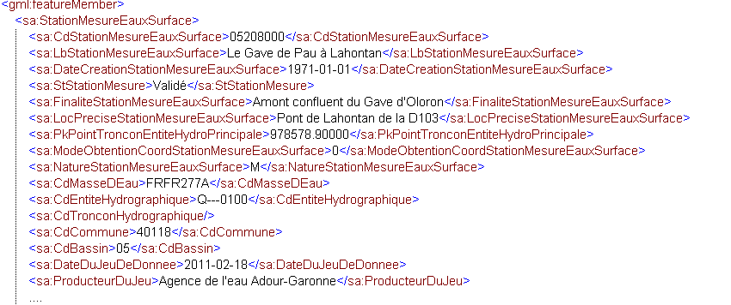
Issue n°2: expose XML structured info with performances/stability
Ex :
  7 calls (in green, URI missing) to an external source for only 1 water quality station with half its attributes filled
  => How can we deal with this in operational mode with thousands of this example every day ?

Slide 14
Issue n°3a: Versioning on features
Objectives :
  allow geographic use of older versions via standardized services,
  stop duplicating geographic info (see slide 5).
Solutions explored :
  Storage
    PostGIS with pgVersion
    Not Geoserver-Postgis using WFS-T because data ingestion using also ETLs

Slide 15
Issue n°3a: Versioning on features
Solutions explored :
  Putting data online
    Constraint : reuse version number stored in PostGIS
    Use FilterEncoding 2.0 ? : fes:ResourceId,
    Existing Implementations out there ?
    Use WFS 2.0 ?
    Existing Implementations out there ?

Slide 16
Issue n°3a: Versioning on features
What to use for version number? :
  One created by a versioning system :
    Pro : more concise,
    Cons :
      We can’t force versioning solutions to use a provided id,
      We also have to import versioned referential datasets from other partners,
      What if we change the versioning solution ?
  Latest update time & date of the instance => dateTime
    Pro : solves the cons above
    Cons : less concise

Slide 17
Issue n°3b: Versioning of referential datasets
Needs to version the dataset (not only each instance in it)
    Ex : the Rhine river has a given code & version but the same version could appear in many aggregations of the French rivers dataset (‘BD Carthage’ 2010, 2011,…).
    don’t want to store the Rhine river instance twice,
    it’s just an aggregation,
    need to call either on the dataset version or the instance version

Slide 18
Issue n°3c: Versioning in data models
Each core featureType being versioned, the rationale in the association between featureTypes changes
  Before : A -------linked with → B
  After : A (version xx) ------------ linked with → B (version yy)
  Ex : Water Well “A” linked with GroundWaterBody “B” (version yy)
Some data model need really frequent updates
  Stop the versioned approach (data model V1.0 then V1.1…)
  Have models always open and deal with version at the featureType level (+ association, attributes)?

Slide 19
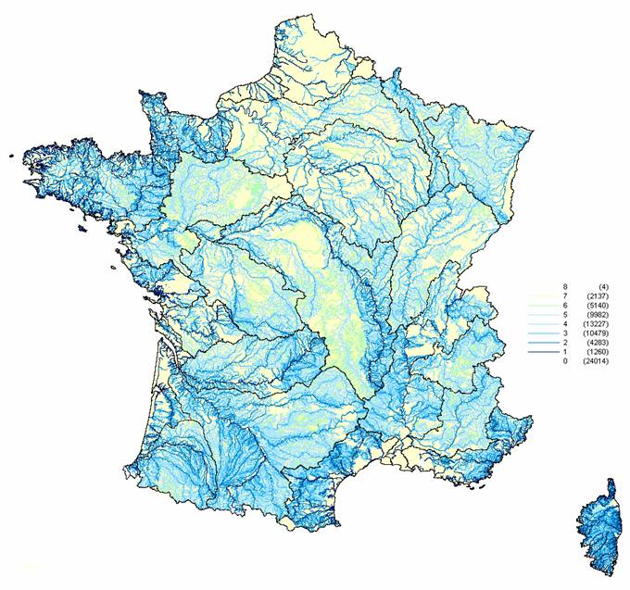

Thank you
Sylvain Grellet : s.grellet@oieau.fr

