Slide 1
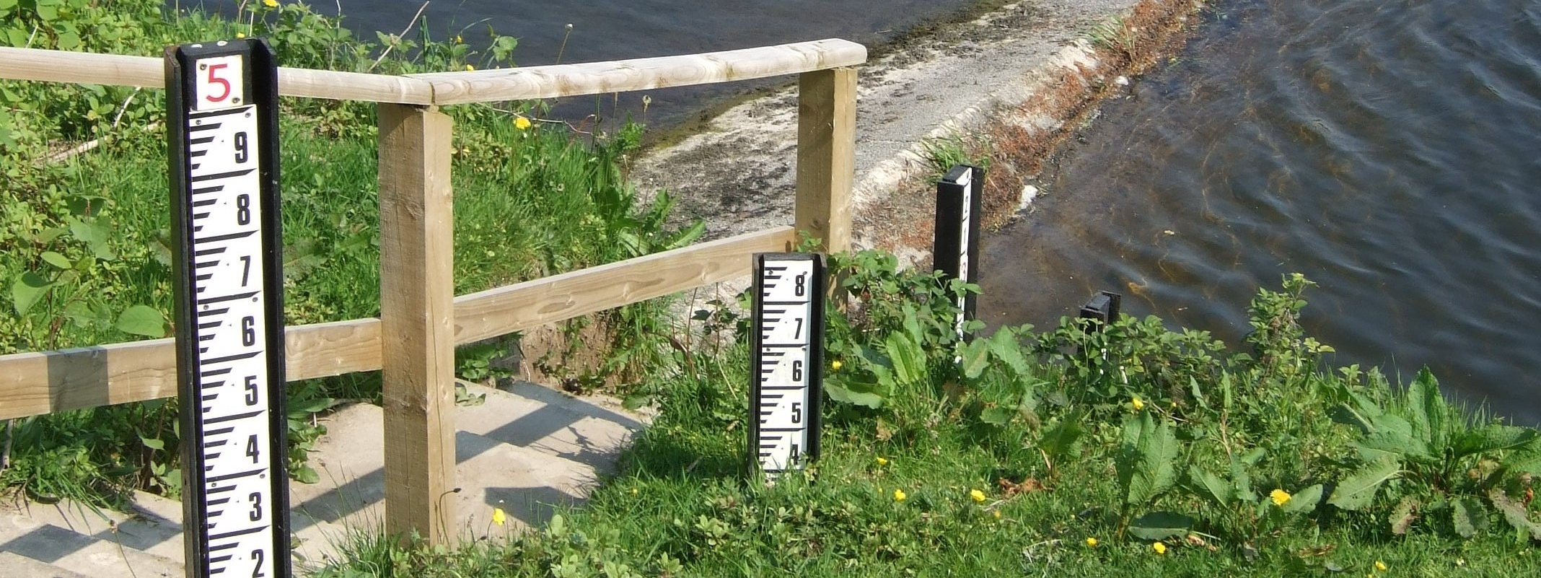
INTRODUCTION TO THE UK’S NATIONAL RIVER FLOW ARCHIVE
Matt Fry
Systems Development Manager
National River Flow Archive

Slide 2
UK National River Flow Archive
Background to hydrometry in UK
What we do
Who else uses the data
Systems
Where things might be going...

Slide 3
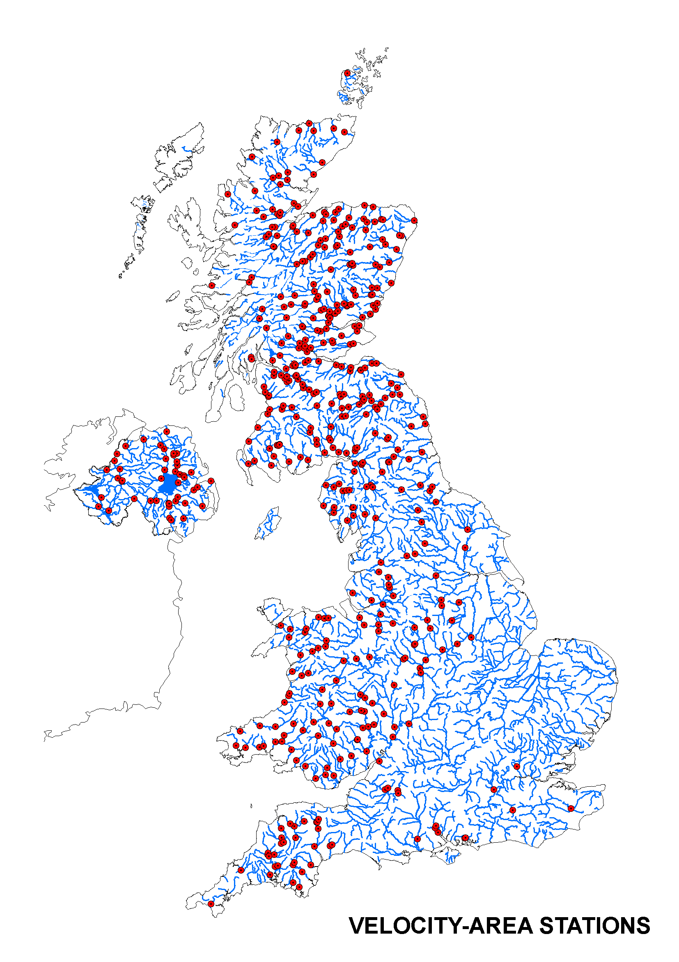
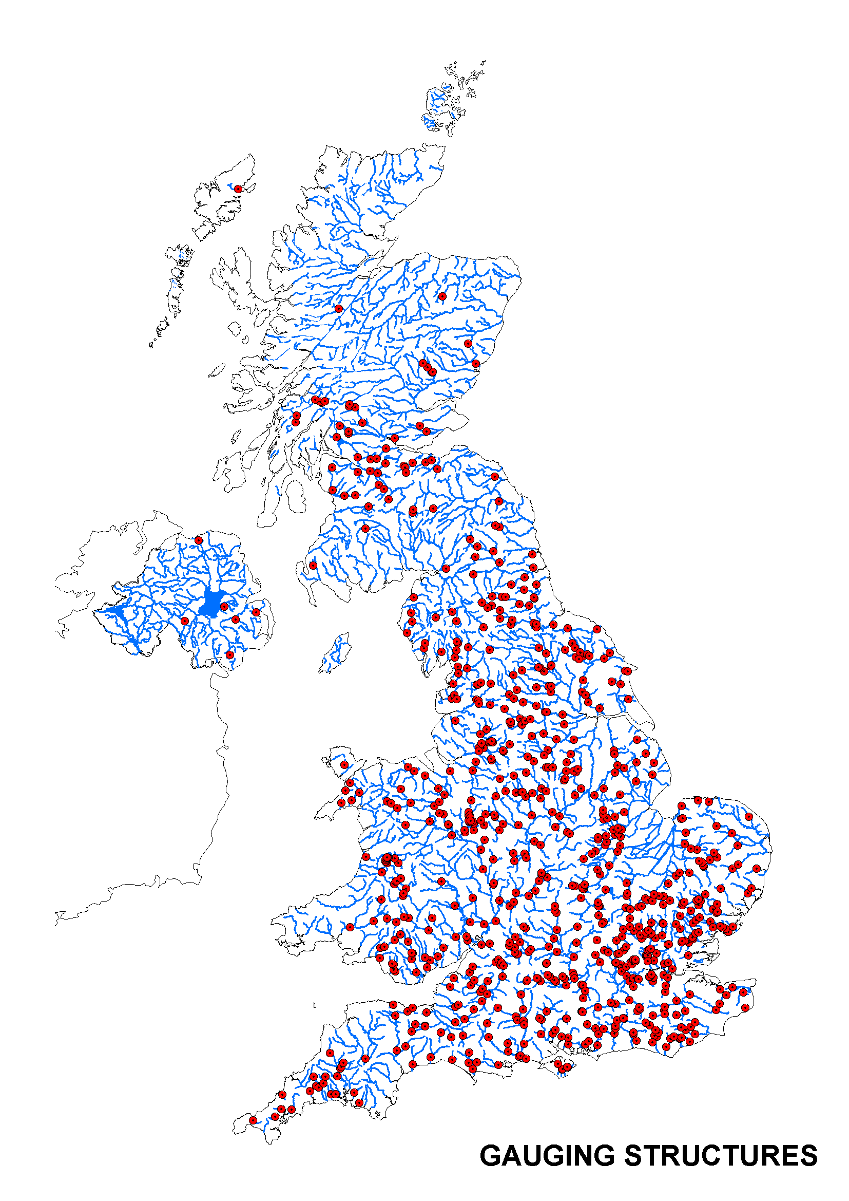
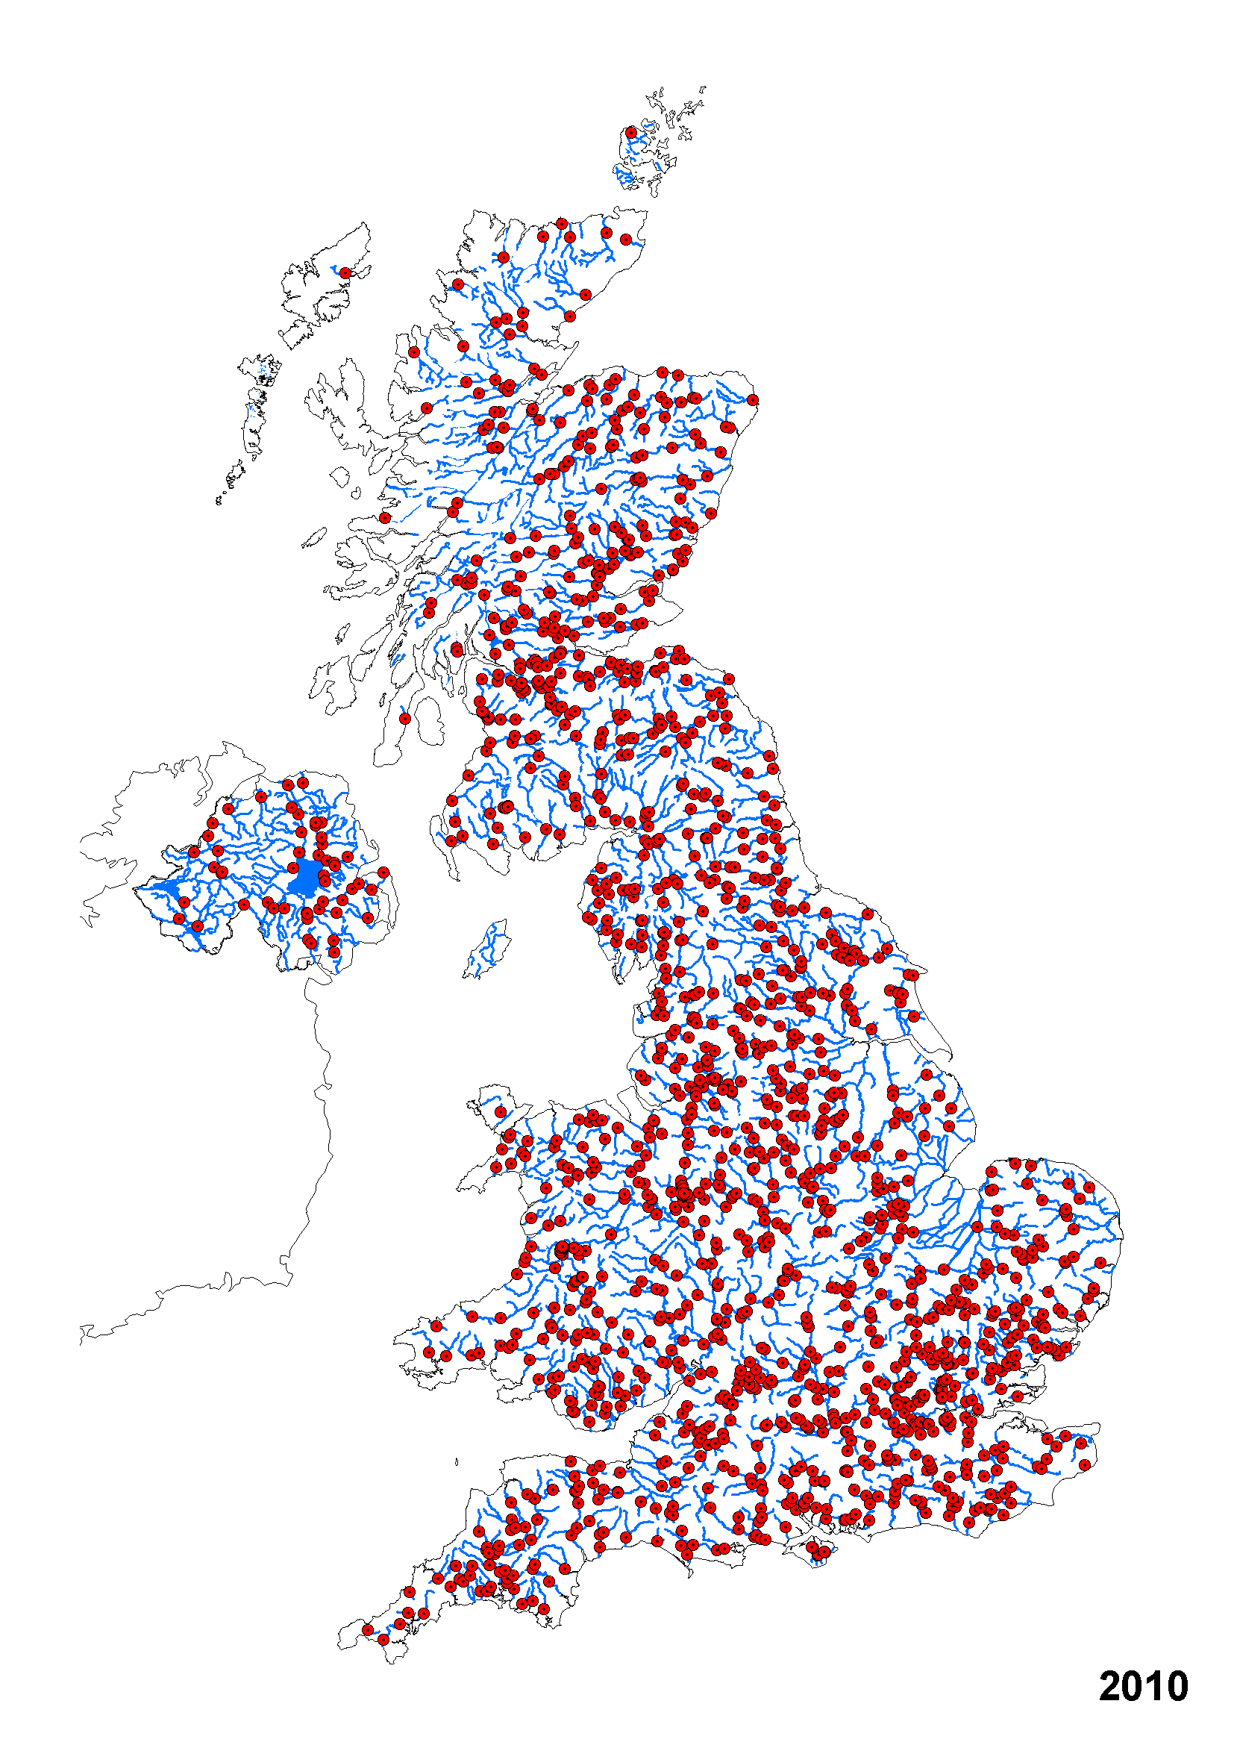
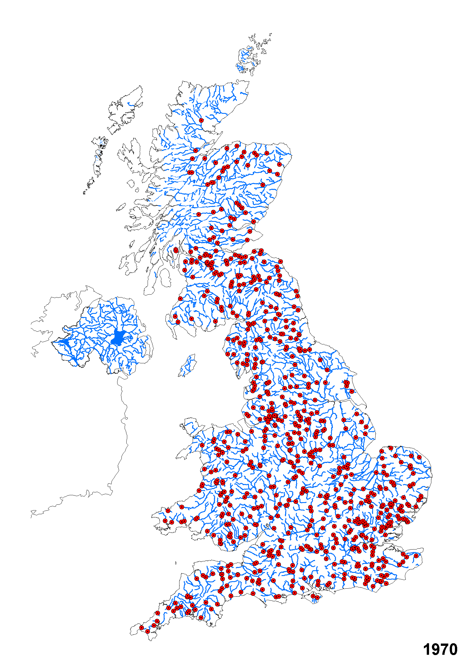
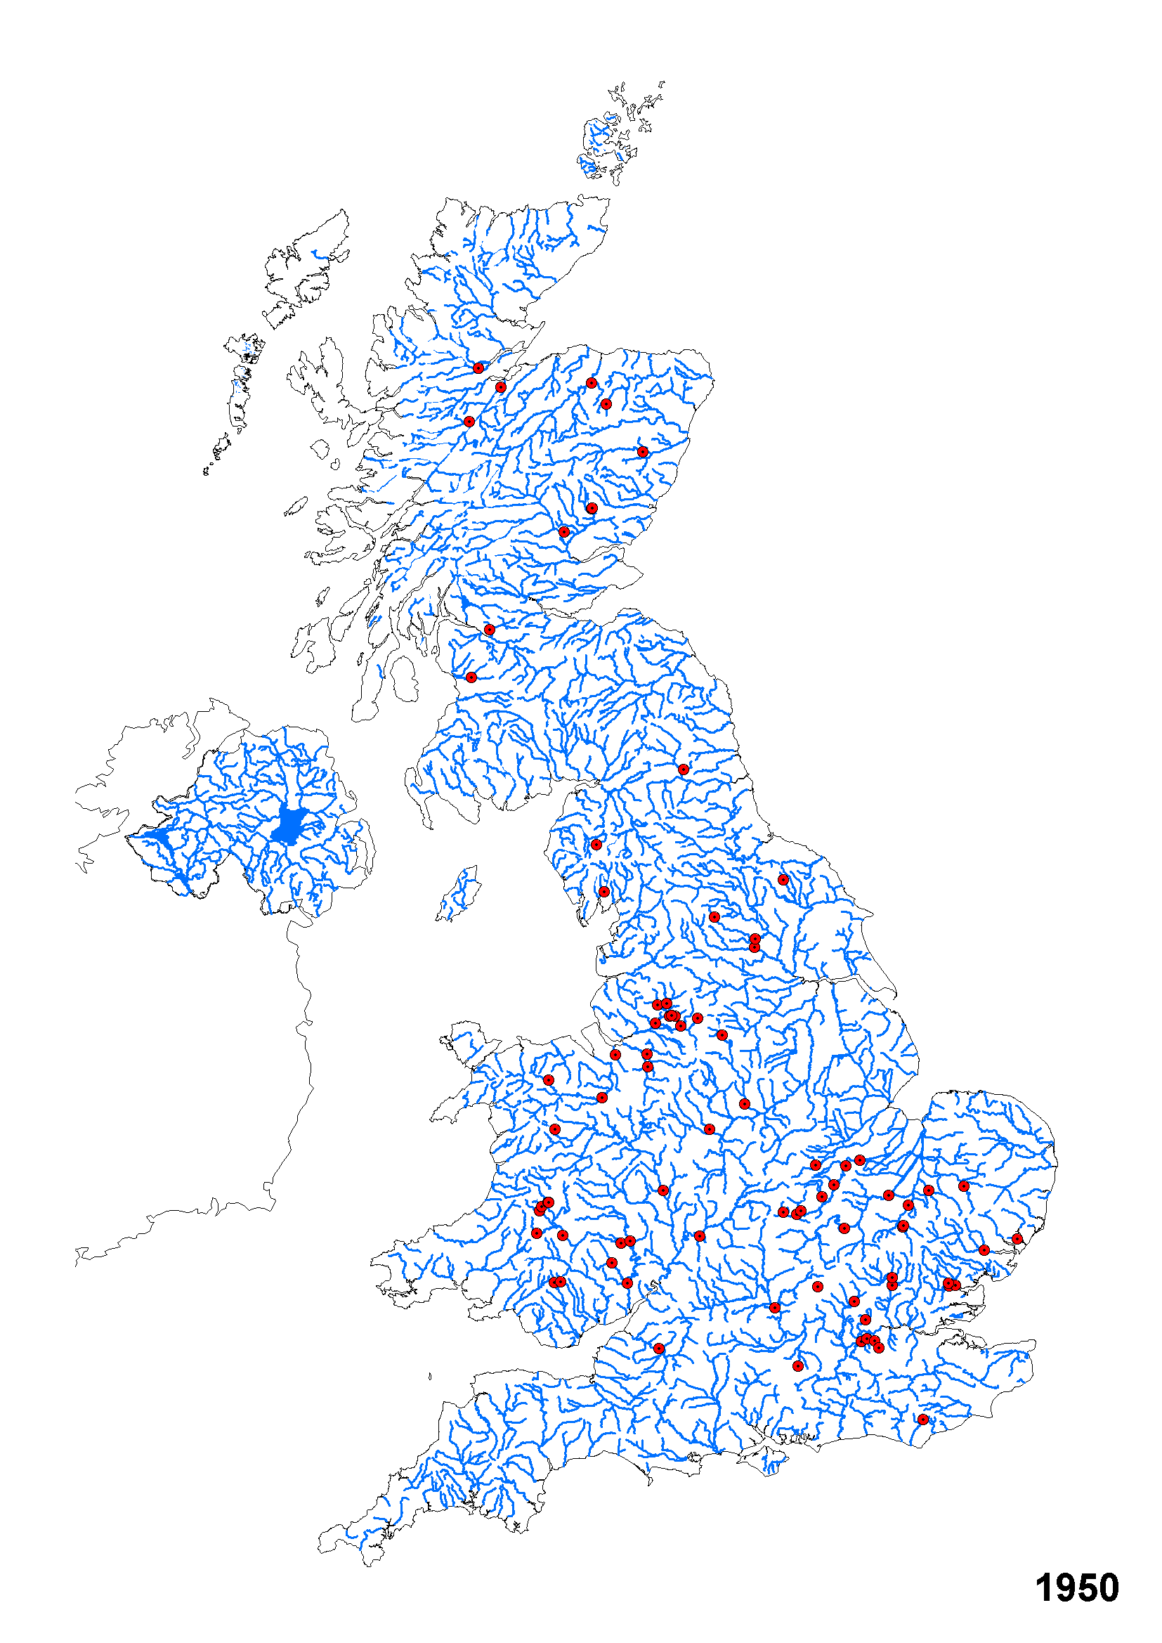
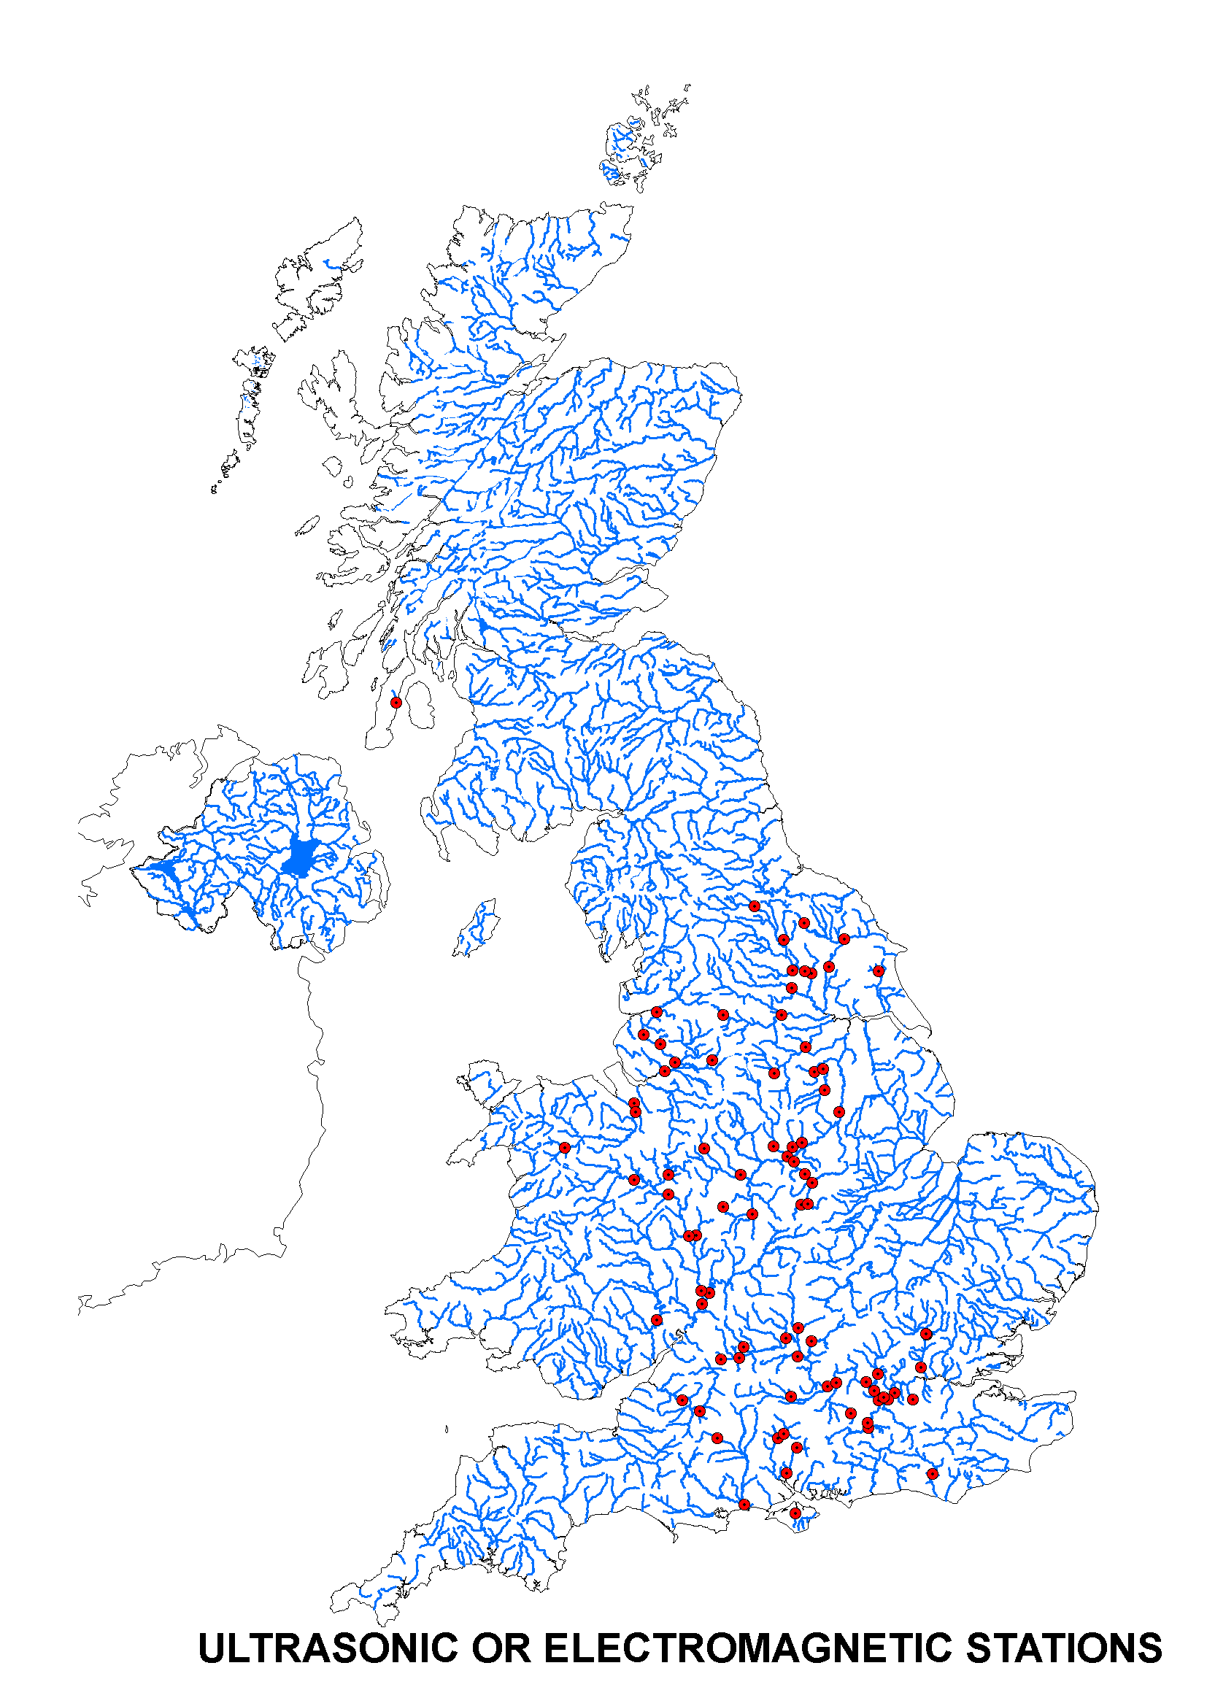
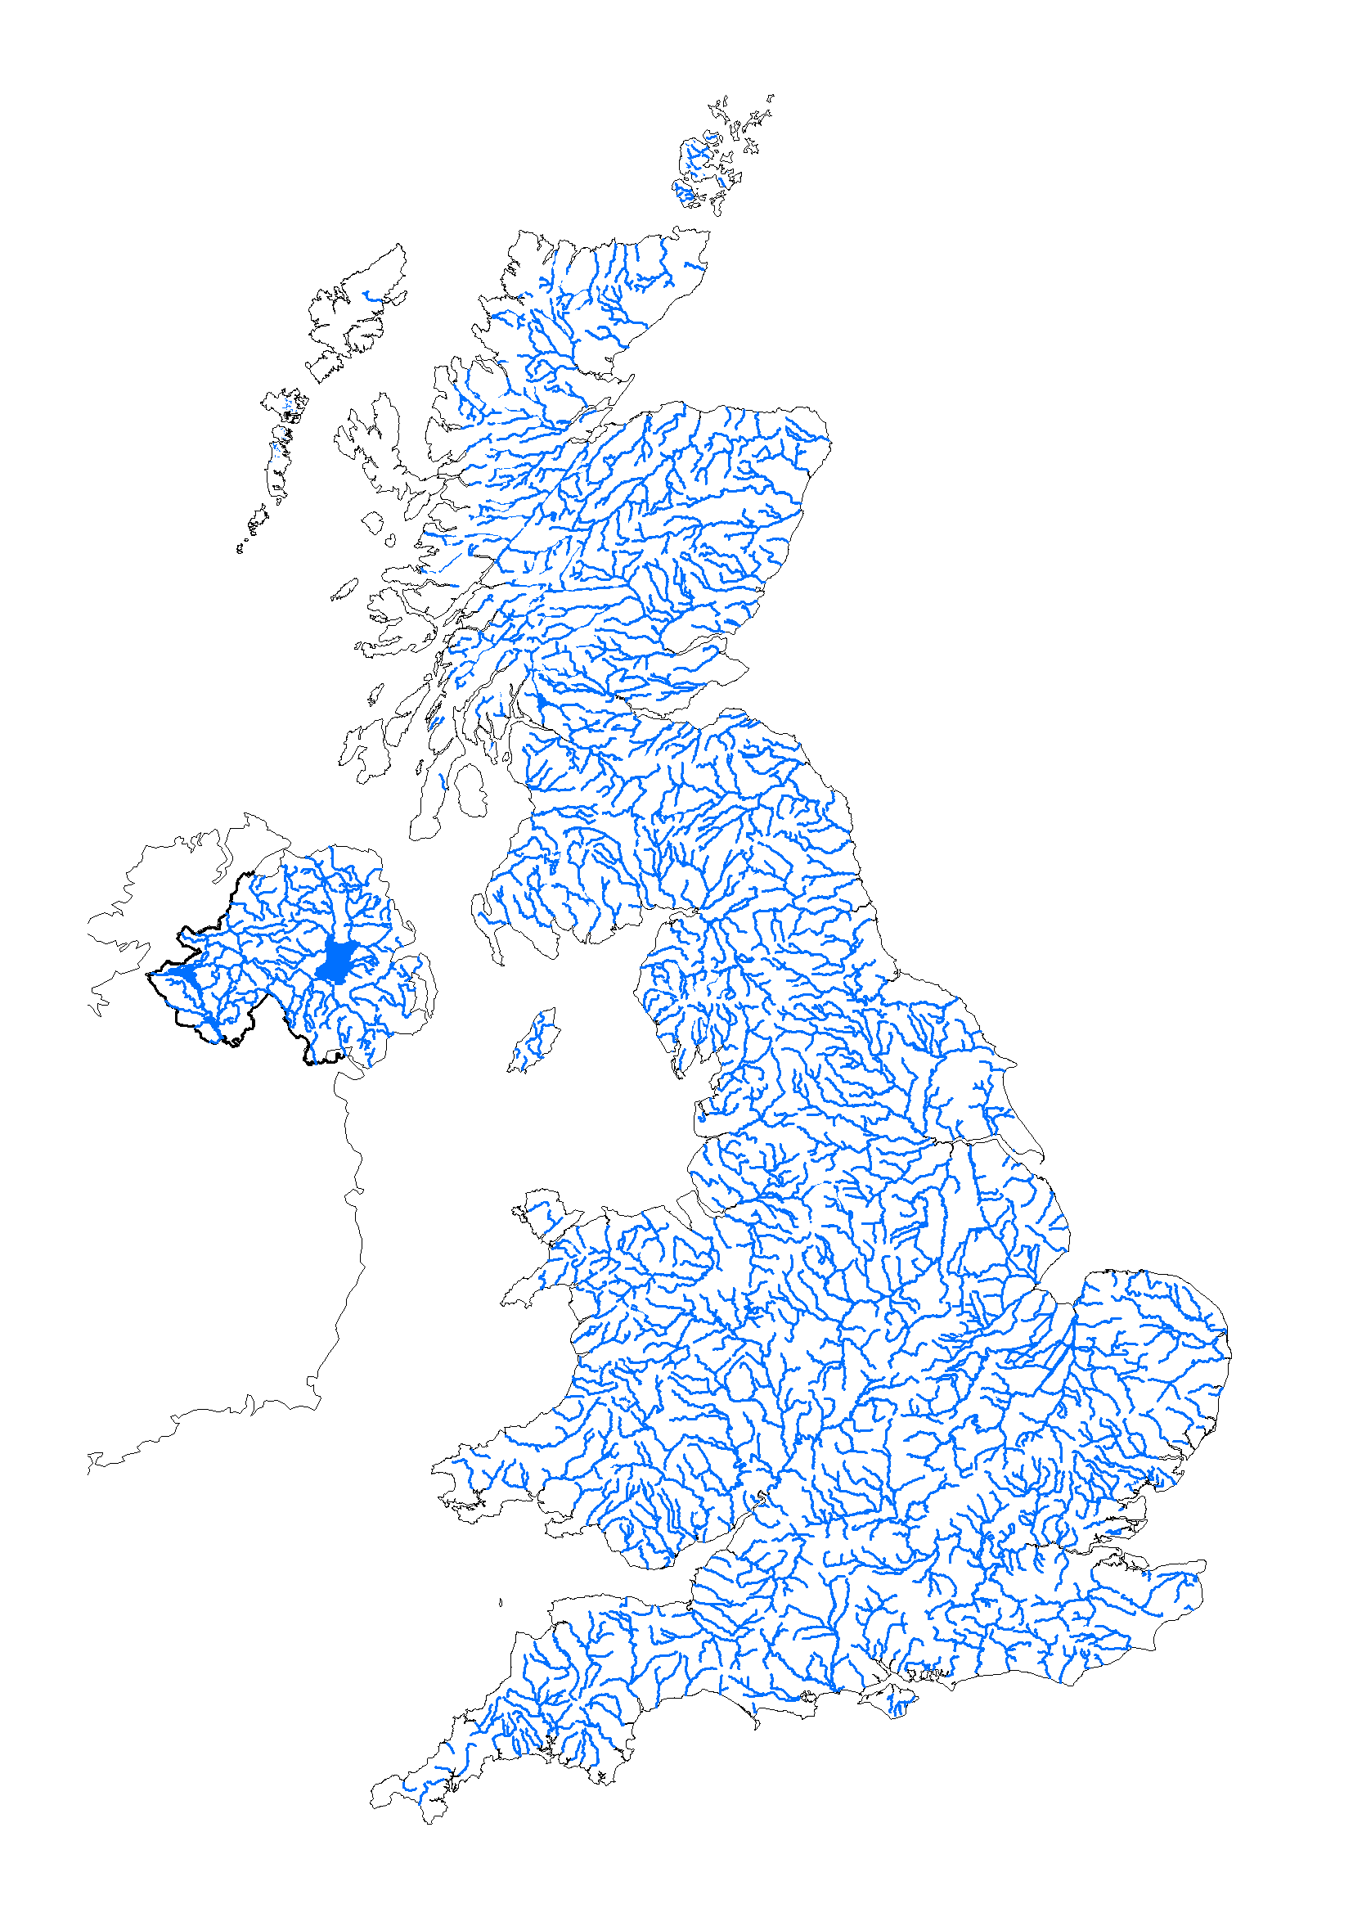
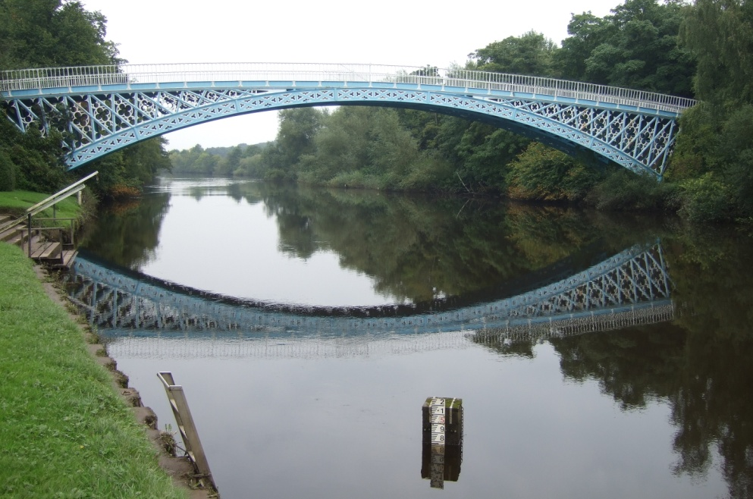
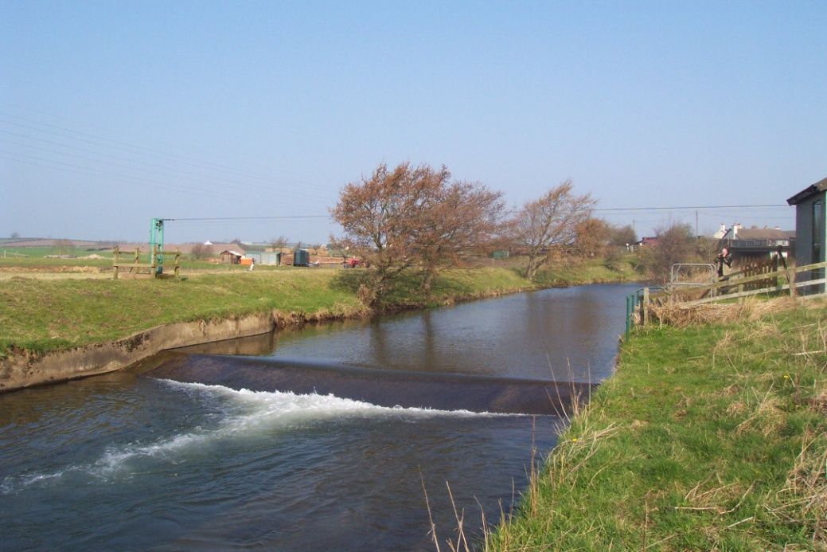
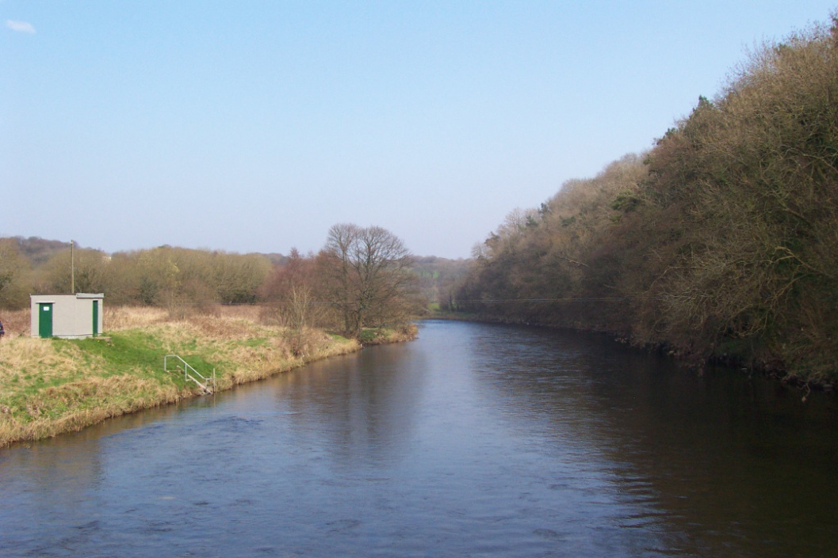
UK Hydrometric Network
Dense hydrometric network
Evolved to meet range of needs
Earliest data from 1841
Considerable growth in 1960/70s
Mixture of hydrometric techniques
1444
784
88

Slide 4
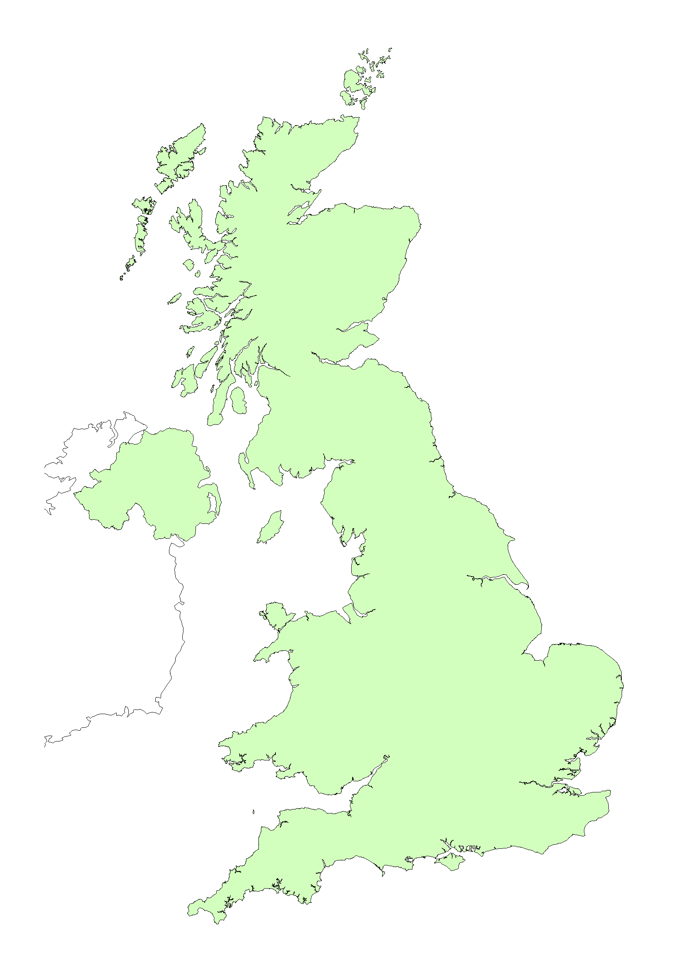
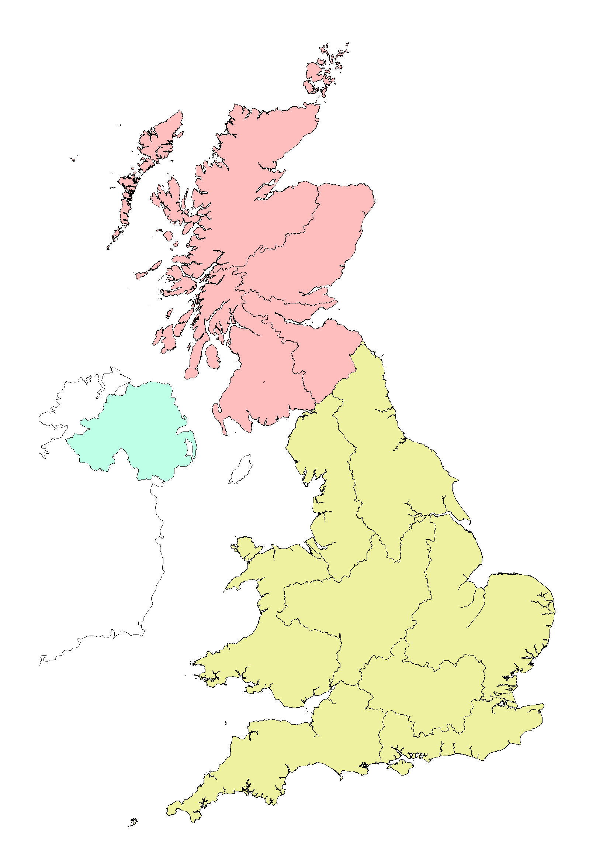




UK National River Flow Archive
Archiving data for UK
Daily mean flow archive fit for a range of purposes
Historical mandate!
Data from 4 national hydrometric Measuring Authorities
Each has own centralised database (WISKI users)
4 Regions
NATIONAL RIVER FLOW ARCHIVE
8 Regions

Slide 5
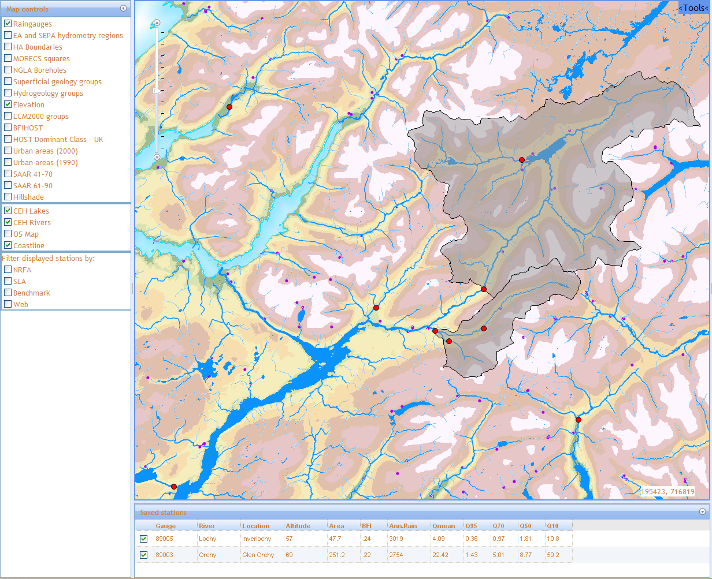
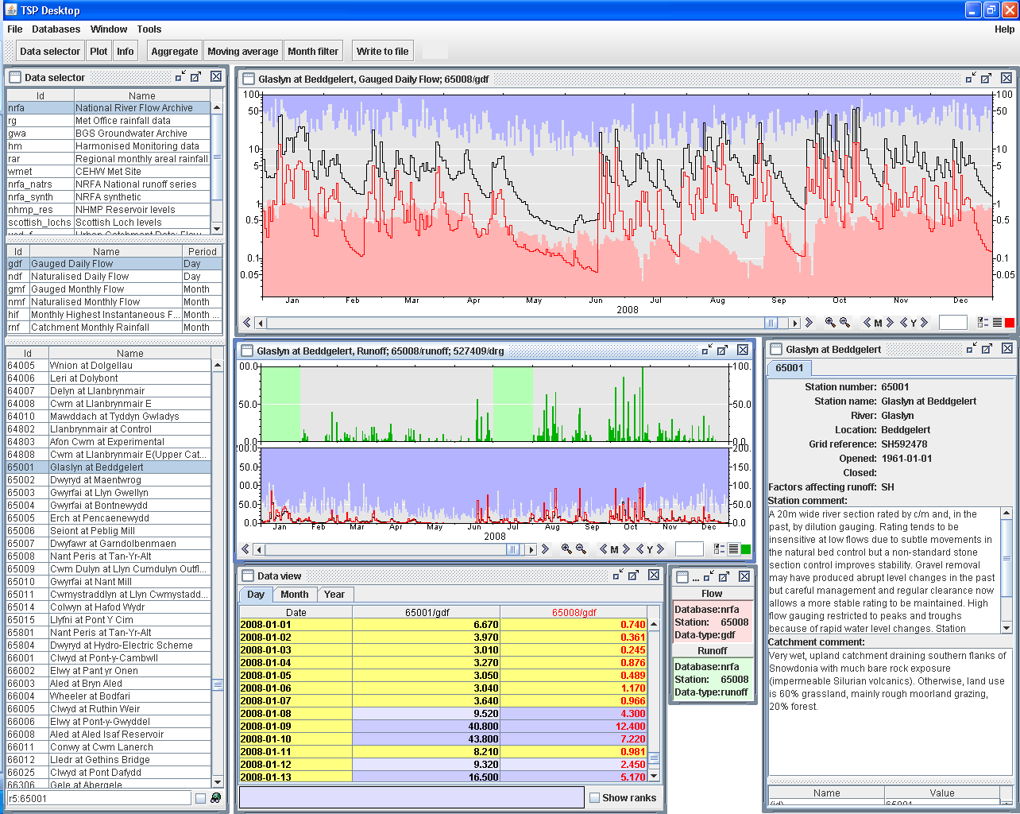
Data Validation and Archival
Annual data acquisition:
Data validation by regional NRFA specialists before data is added to the national archive
Secondary validation
Data queries lead to improved data for all parties
Bespoke data handling systems developed for visual and automated checking:

Slide 6
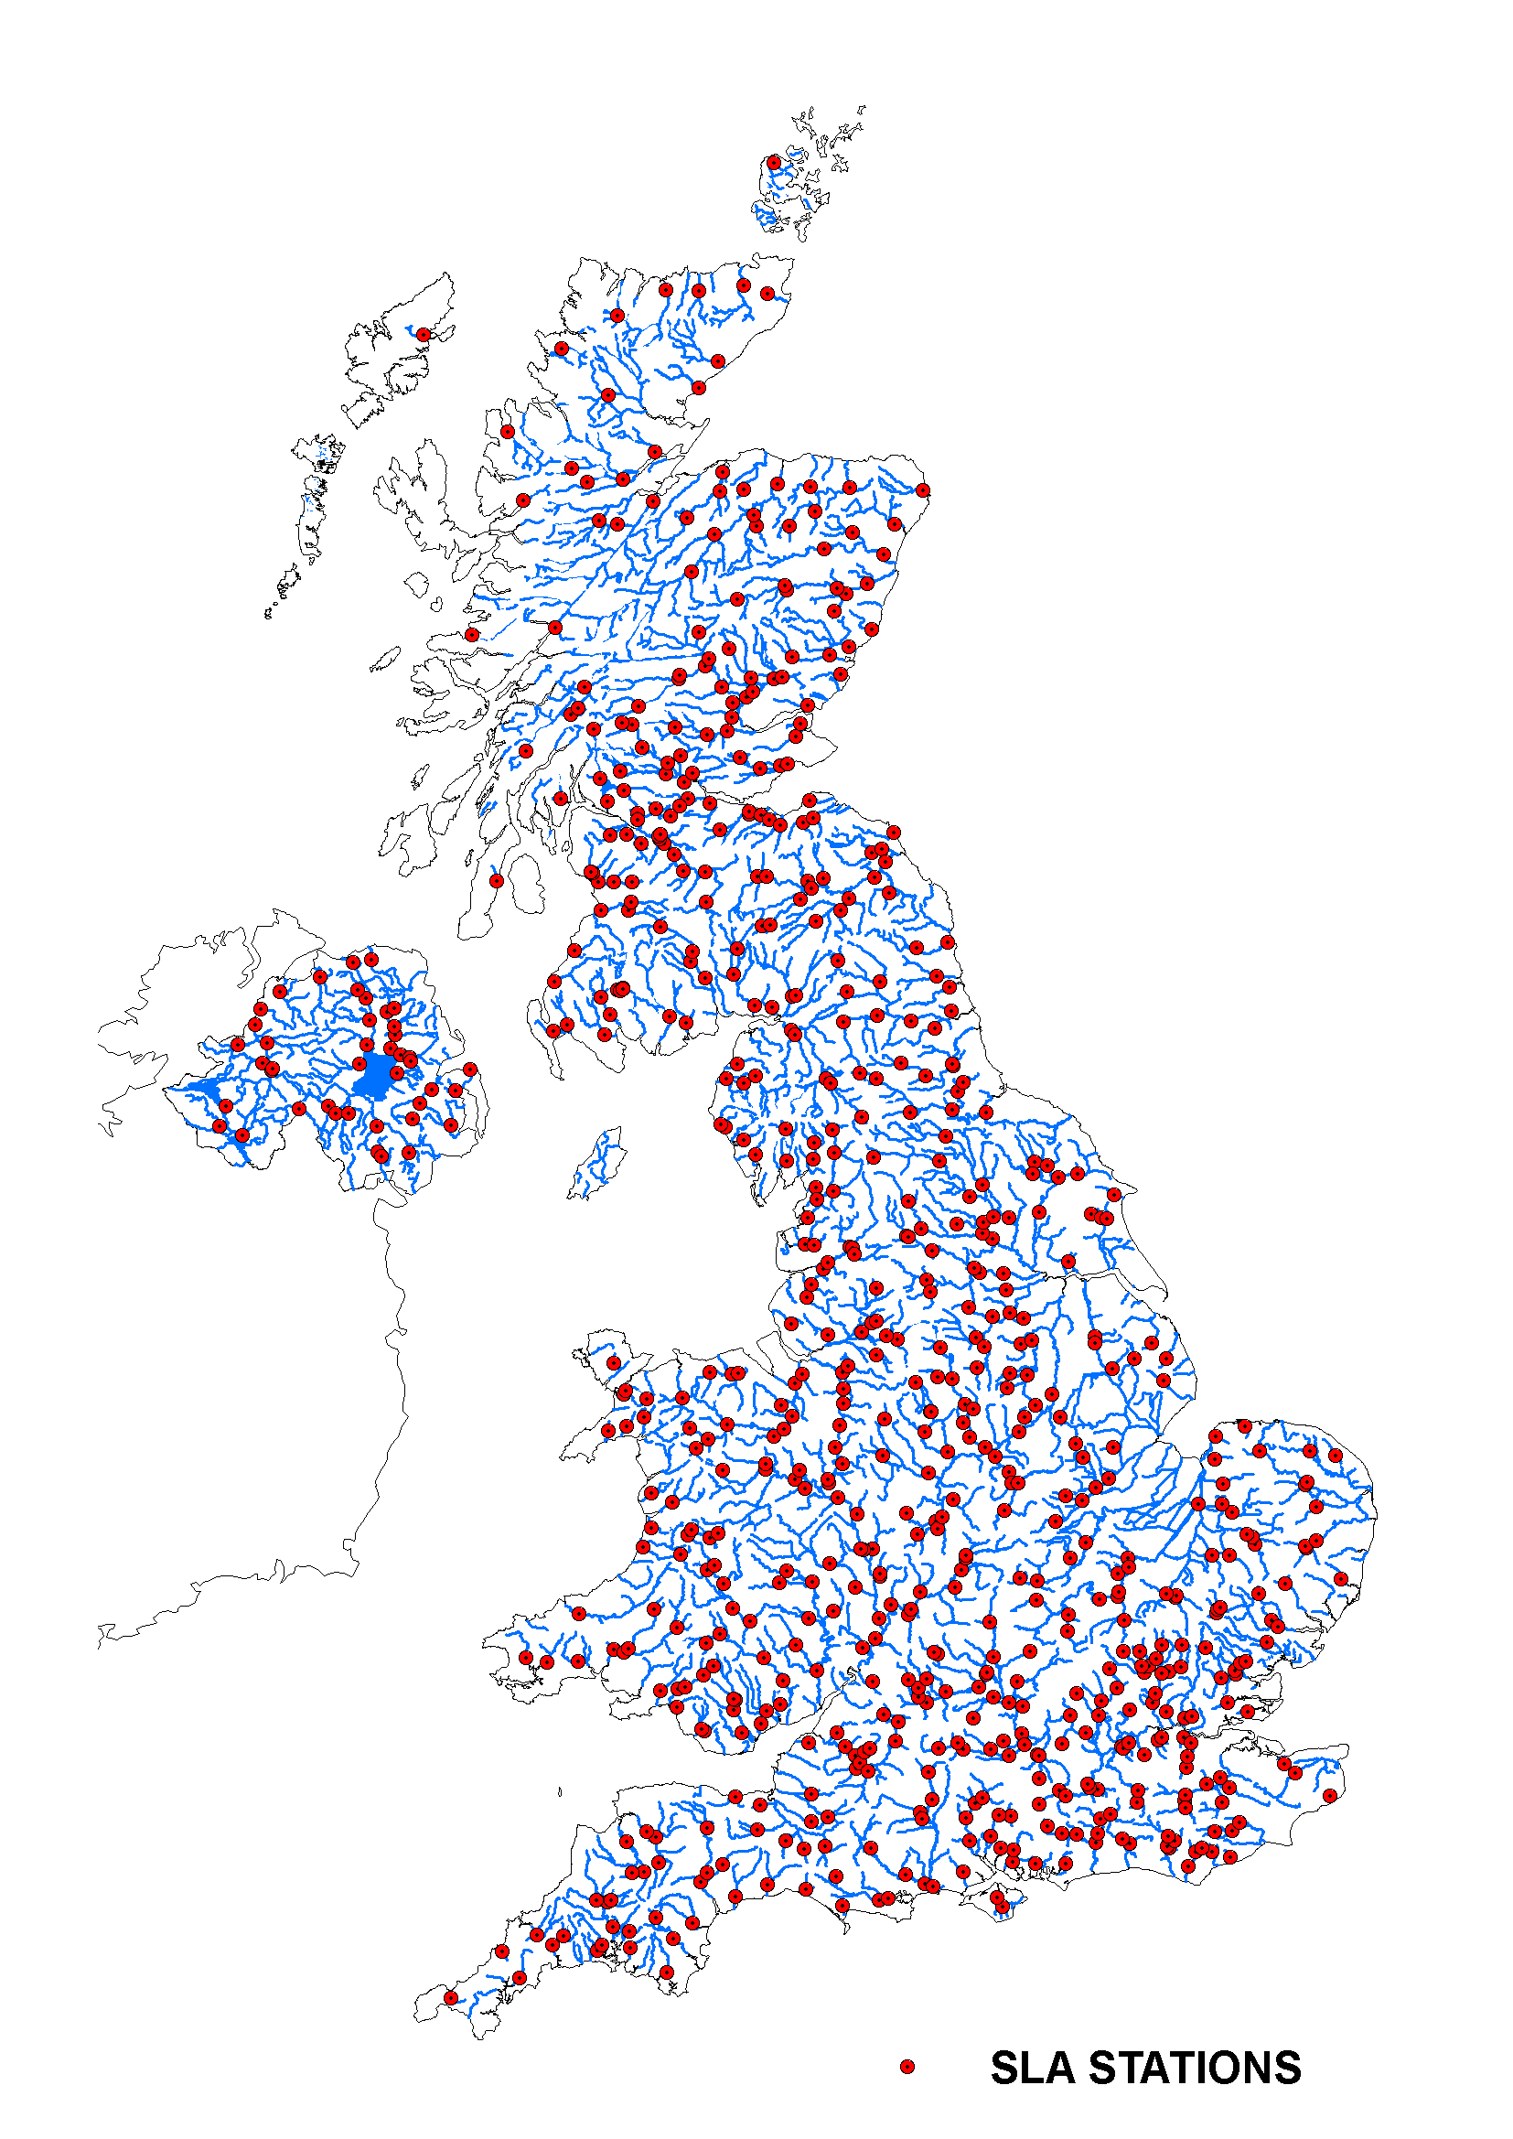
Data Validation and Archival
Controlling data provision to the national archive:
Service Level Agreement since 2002
Aims:
Promote stability in national network
Improve data quality
Increase data completeness
Subset of network monitored through Performance Indicators
Data provision timeliness
Data completeness
Data queries
Non-Queried Stations (%)
Non-Queried Data (%)
Overall Data Completeness (%)
Stations with Complete Data (%)

Slide 7
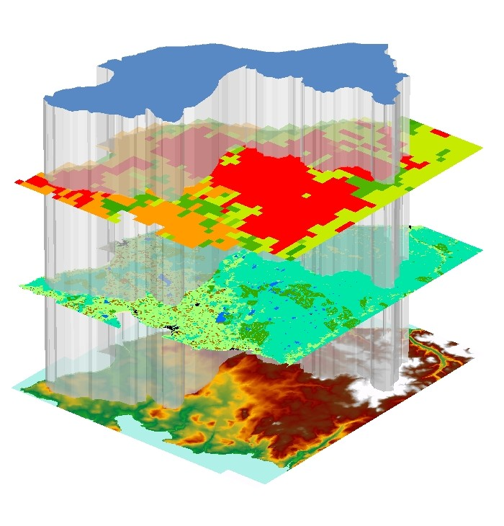
Monitoring and Network Design
Network assessment:
Tools for network assessment and review:
Representative Catchment Index
Catchment Utility Index
Network review
Important that all user needs are considered
Operational AND strategic needs
Web-based user tools for catchment assessment
Assessment tools: Laizé et al (2008)
Network Review: Hannaford et al (2011)

Slide 8
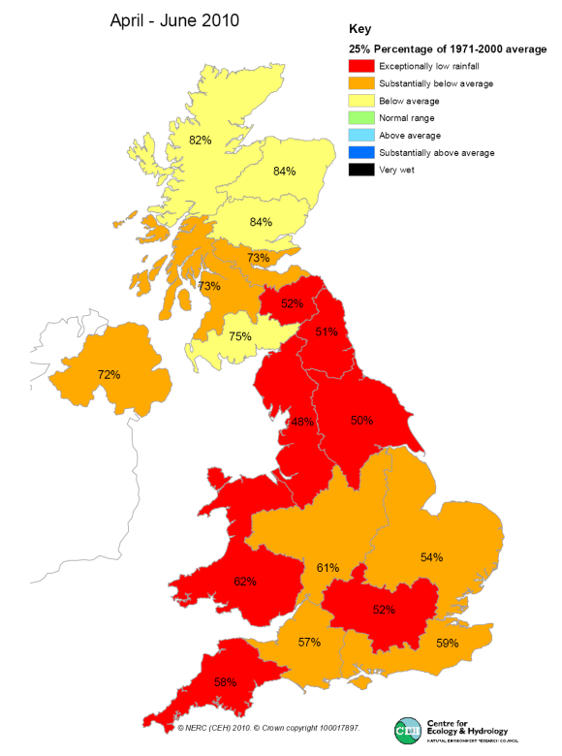
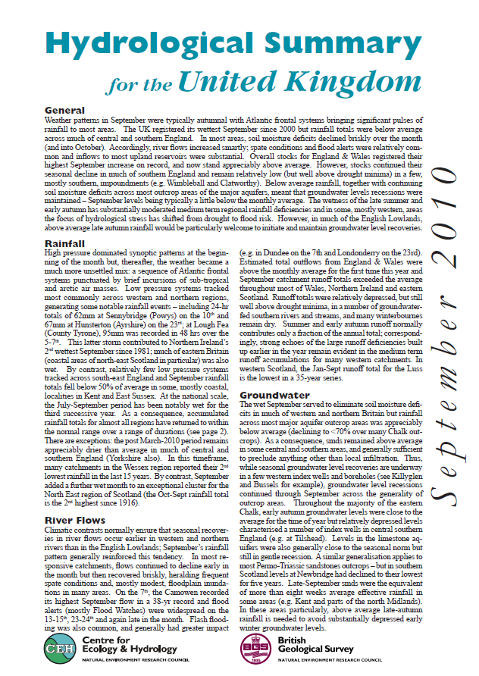
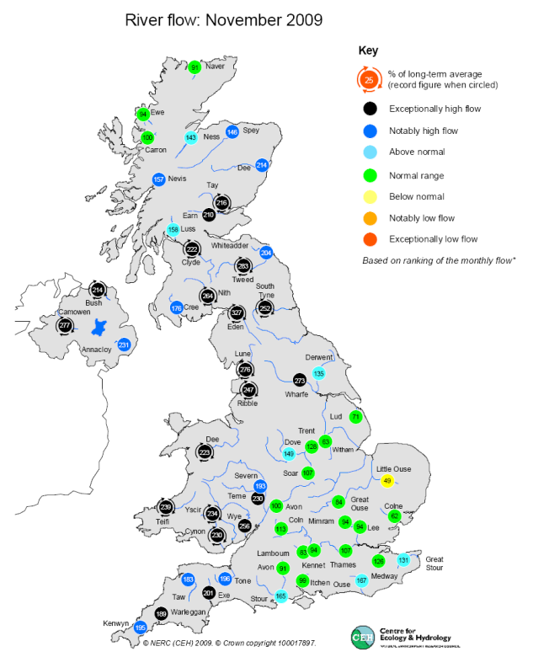
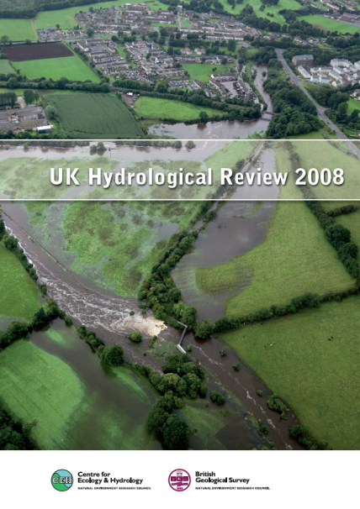
Contemporary Reporting and Analysis
National Hydrological Monitoring Programme
Started in 1982
Monthly situation reporting
Hydrological reviews of
major events
Media briefings
Audience: operational, policy, research, public interest/media

Slide 9
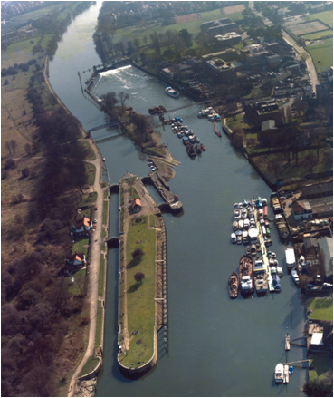
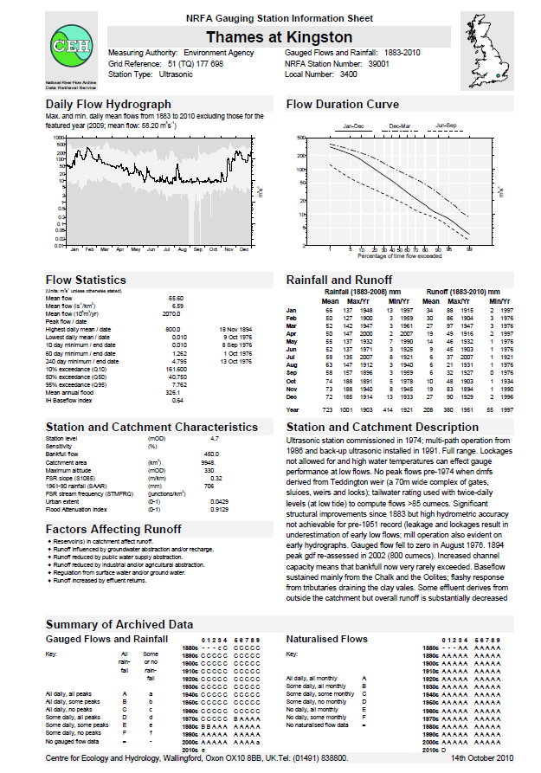
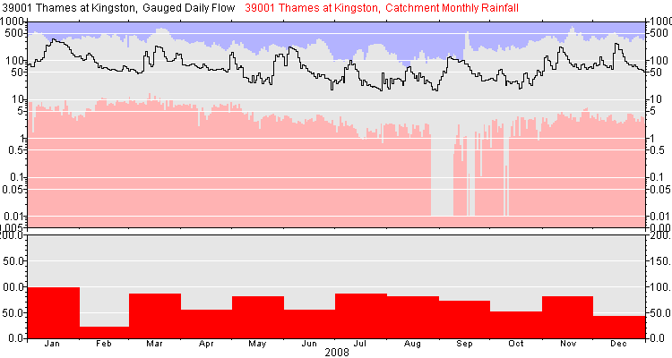
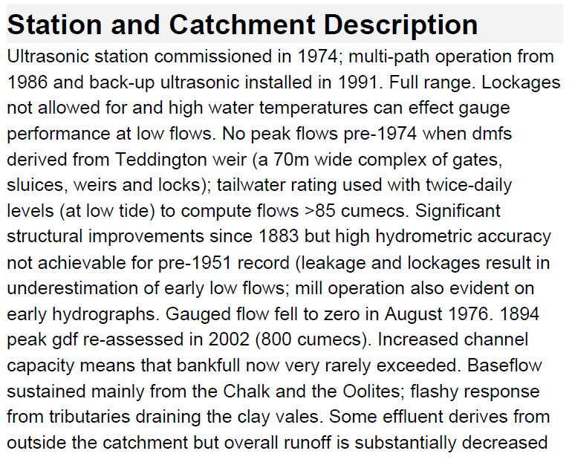
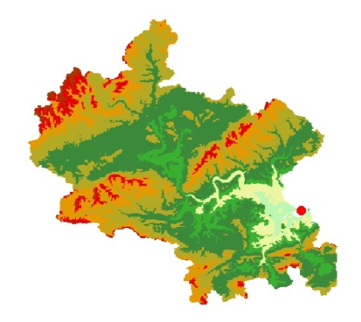
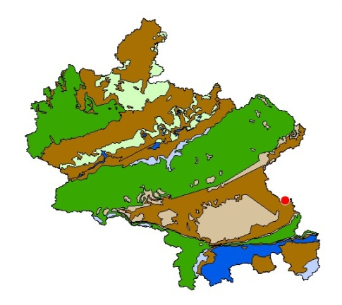
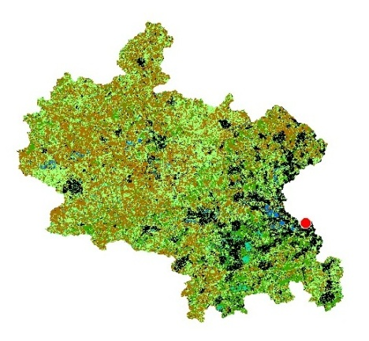
Information Dissemination
Core datasets:
Time Series
Gauged Daily Mean Flows
Naturalised Flows (some)
Catchment monthly rainfall
Basic Metadata
Location, Catchment area, Station type
Photos
User Guidance Information
Station descriptions
Catchment characteristics
Factors affecting runoff
Catchment Metadata
Elevation, Geology, Land use
Maintaining metadata is a vital part of data stewardship

Slide 10
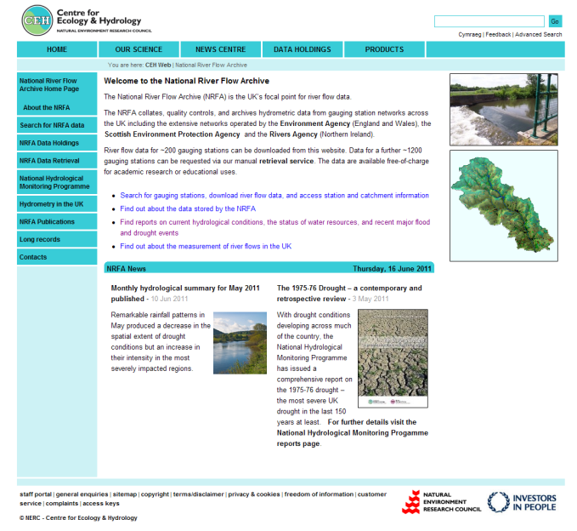







Information Dissemination
Main dissemination routes:
Publications:
Yearbooks (1935-1995)
Hydrometric Register (Latest 2008)
Manual enquiry service
(derived statistics, guidance)
~ 400 p.a.
Internet:
~30k downloads in 2010/11
National water balance reporting:
UK Government
EU / OECD
INSPIRE
UK contributions to international data centres:
WMO Global Runoff Data Centre
UNESCO IHP-FRIEND European Water Archive

Slide 11
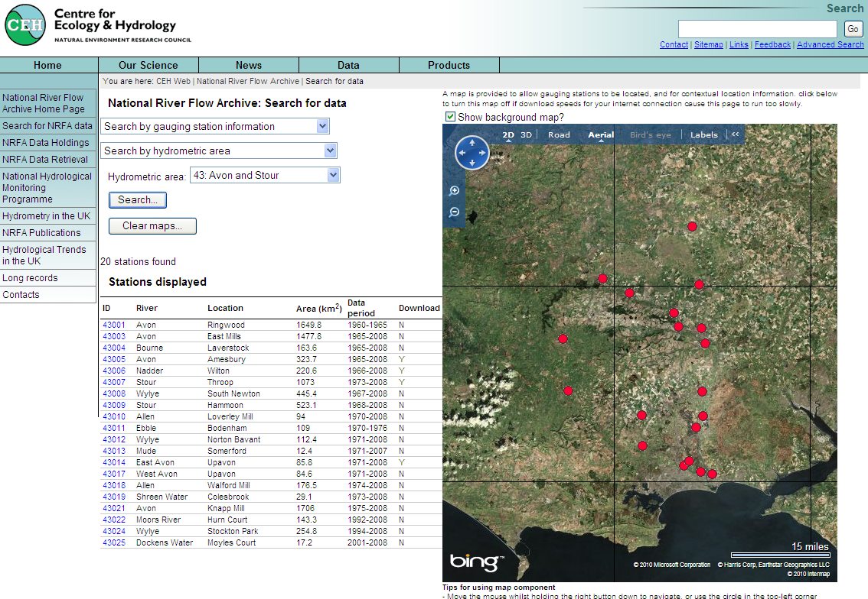
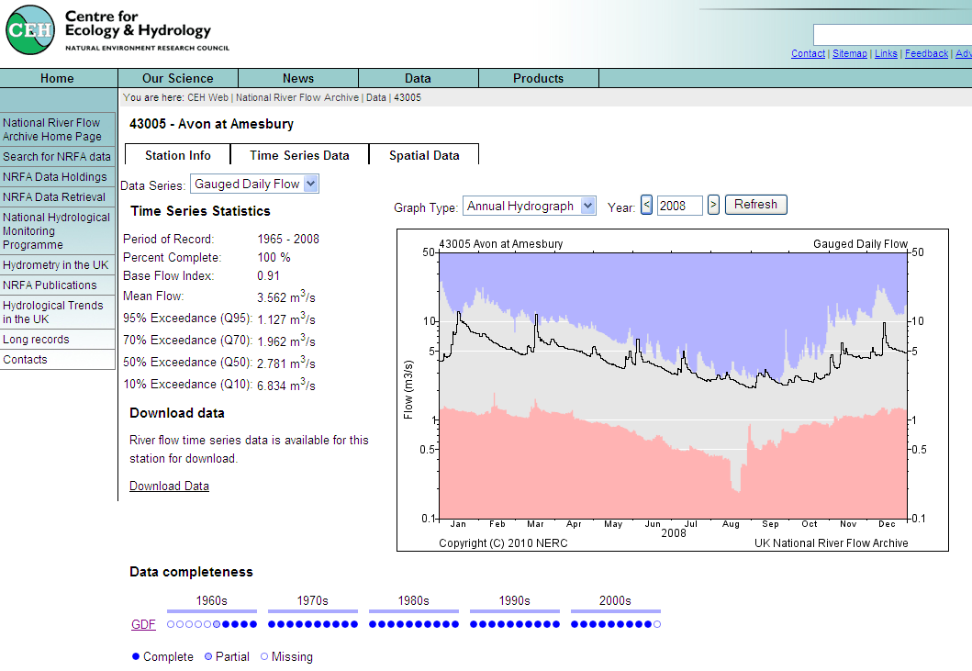
Information Dissemination
Recent:
Website developments:
Discovery: map and metadata based searching
Viewing: Dynamic time series graphing and metadata comparison
Download: Currently ~ 400 stations
Future:
Catchment ‘explorer’ tools
‘Trends’ website
Other technological opportunities?

Slide 12
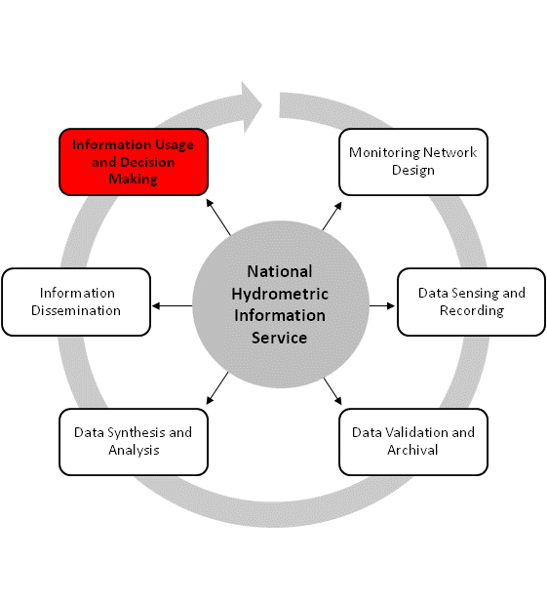
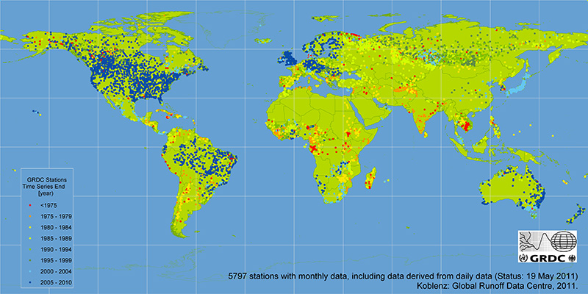
Information Use
Public access to national hydrometric information
User community:
Current:
Direct Users
Indirect users through:
Government reporting (ONS, Defra)
Media
Other data centres
Measuring Authorities
Future:
Increased international users
Increased public awareness
New user communities

Slide 13
Systems: Time series
Java code for ‘generic’ time series handling
Visual tools for validation and publications
Analysis tools, inc scripting
Code drives website, some functionality exposed as web-services
WaterML2 export

Slide 14
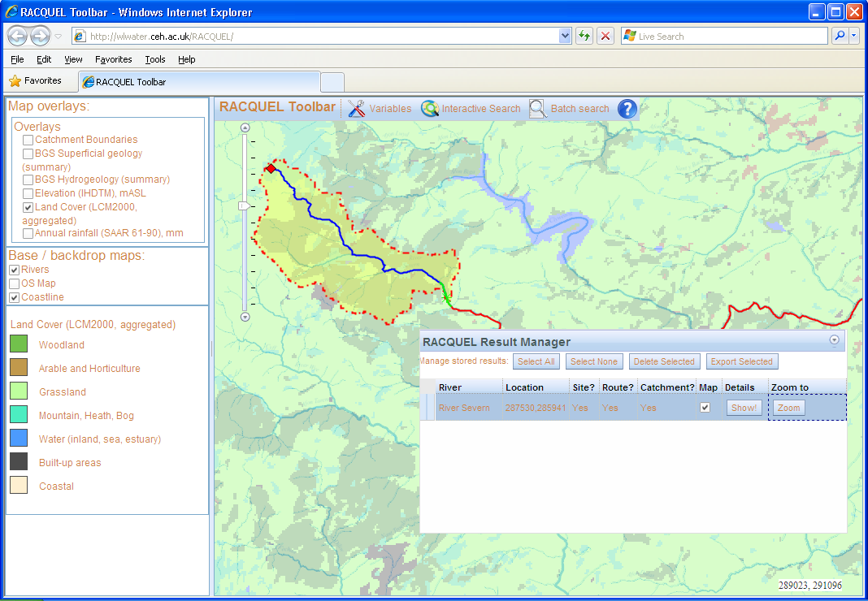
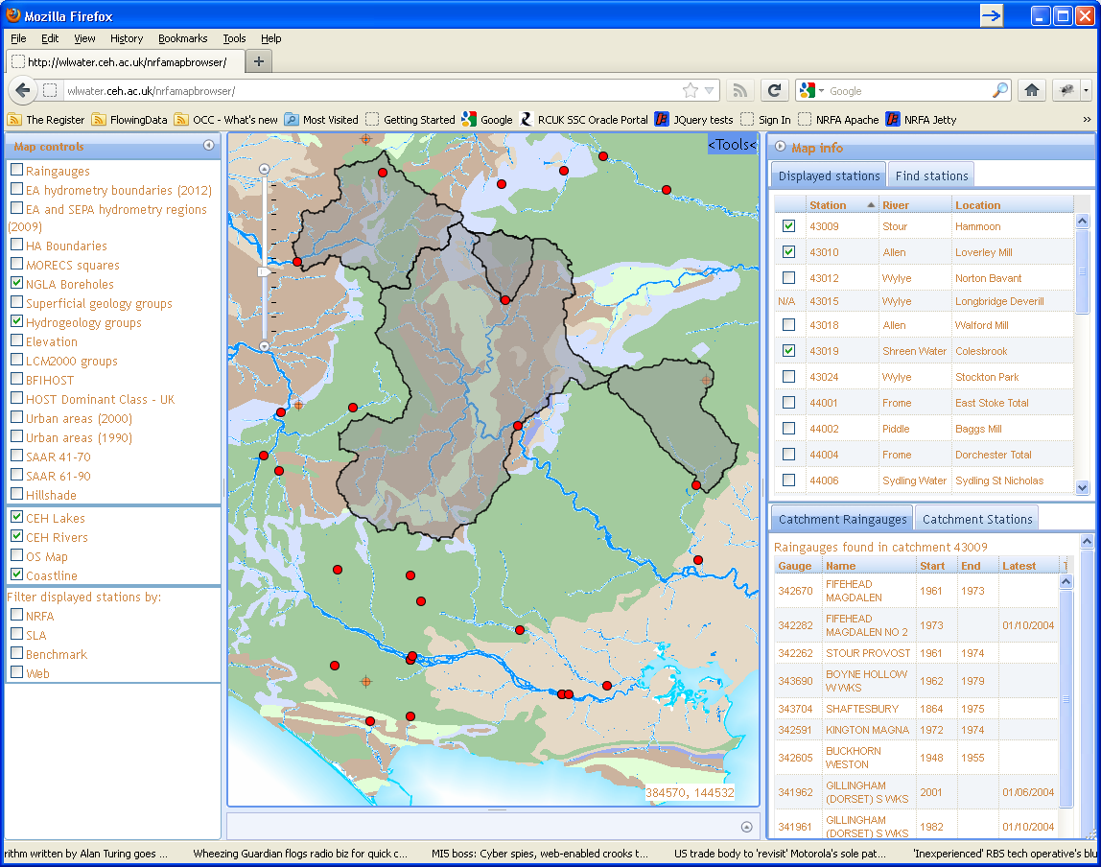
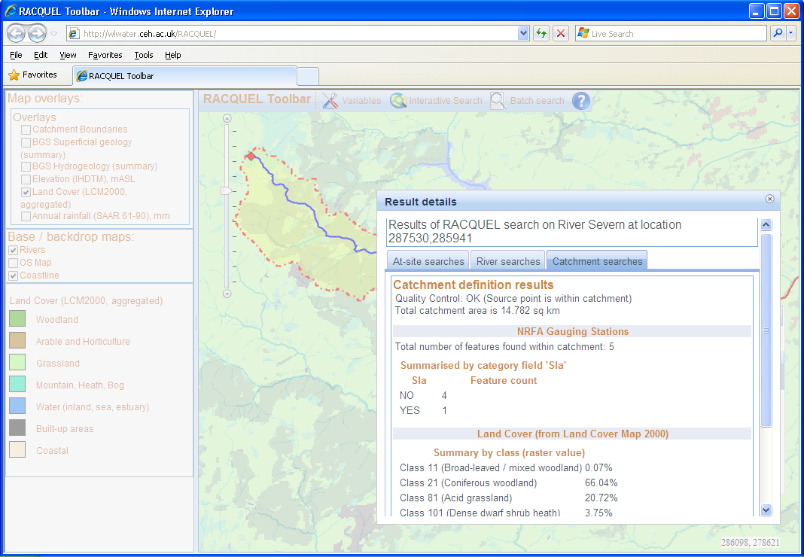
Systems: spatial
Catchment visualisation tools
Catchment definition tools
Define catchments
Obtain catchment statistics for selected layers
Batch process
WPS?

Slide 15
Future
Benchmark network
SOS / WaterML2
Uncertainty
Uptake of services within research community (EVO?)

Slide 16
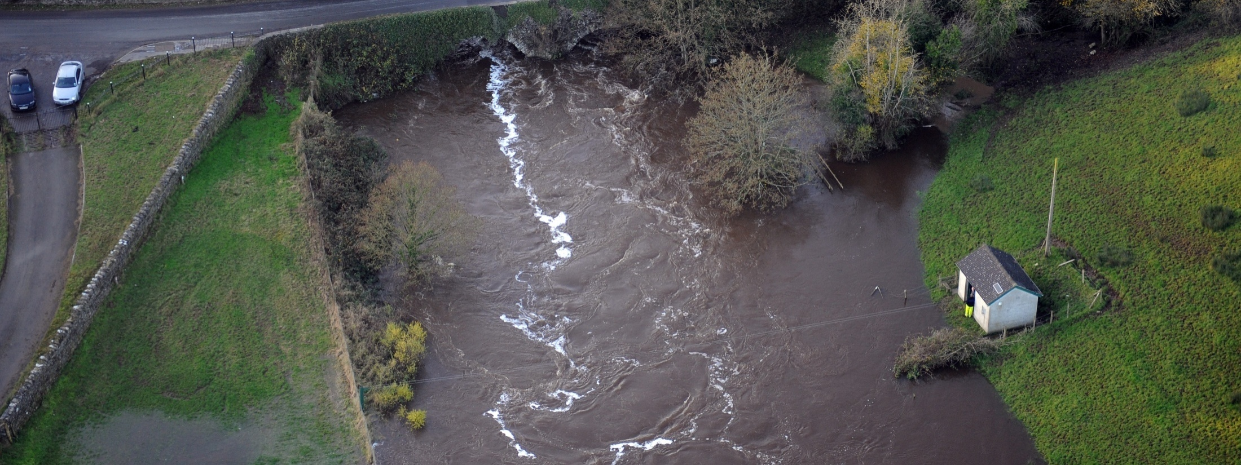
Photo - Noel Higginson, Rivers Agency
NRFA: CEH Wallingford
http://www.ceh.ac.uk/data/nrfa
nrfa@ceh.ac.uk

