Slide 1
Overview of
Climate-Hydrologic Information Sharing Pilot (CHISP) to the OGC HDWG
Lew Leinenweber
Director, Interoperability Program, OGC
June 2012
© 2012 Open Geospatial Consortium

Slide 2
CHISP Overview
Status of project staffing
Updates by sponsors
Engineering components for RFQ
Draft Schedule
© 2012 Open Geospatial Consortium

Slide 3
CHISP Staffing
David Arctur
  Expertise in geosciences has been just what was needed for the definition phase
  Will continue in building the geosciences in OGC with members
Lew Leinenweber
  New member of OGC staff, as of June 18
  Multiple years of experience in OGC as a member
© 2012 Open Geospatial Consortium

Slide 4
Lew Leinenweber
OWS-3 GeoDecision Support Services Thread Architect
OWS-4 Initiative Manager and Lead Architect
  Received special recognition from OGC Board of Directors for “superior dedication and exemplary performance in leading the OWS-4 Testbed to be one of the most successful in OGC’s history”
OWS-5 GeoProcessing Workflow (GPW) Thread Architect
OWS-6 GPW and Web Services Security Thread Architect
  21 participant organizations; 40 OGC web services, 8 ERs
  Co-authored OGC 09-035, OWS-6 Web Services Security ER
  Major contributor to OWS Architectural Profile for the National System for Geospatial Intelligence (NSG), OGC Doc 07-009r3
Recent activity with US-DHS, NIEM, OASIS EDXL, and FEMA Web Services Development Guidelines
© 2012 Open Geospatial Consortium

Slide 5
CHISP Sponsors
NRCan GeoConnections
USGS
EPA
US Army Corps of Engineers (USACE)
© 2012 Open Geospatial Consortium

Slide 6
Scenarios
Cross-border hydrologic data exchange and alerts
  accessing river gage and groundwater well information for a river network that crosses US-Canada border
  Alerts based on water levels result in CAP message
Calculating nutrient loads to the Great Lakes
  Great Lakes basin and the tributaries from Canada and the U. S.
  Nutrient (N and P) loads calculated from water quality observations and stream flow rates
  Historic and near real-time water quality observations
  calculation model wrapped as a web processing service
© 2012 Open Geospatial Consortium
Notes:
1. Exchanging cross-border hydrologic data (stream flow and groundwater levels) with a unified alert service. Selected river basins cross the U.S./Canada border.
Data providers include state, provincial, and federal agencies.
Standard encodings and web services for data exchange, as well as decision support applications will be developed by CHISP participants, In some cases by CHISP sponsors with in-kind resources.
2. Calculate nutrient loads to the Great Lakes.
Computing nutrient (P and N) loadings from tributaries, for input to a mass balance model for the Great Lakes system.

Slide 7
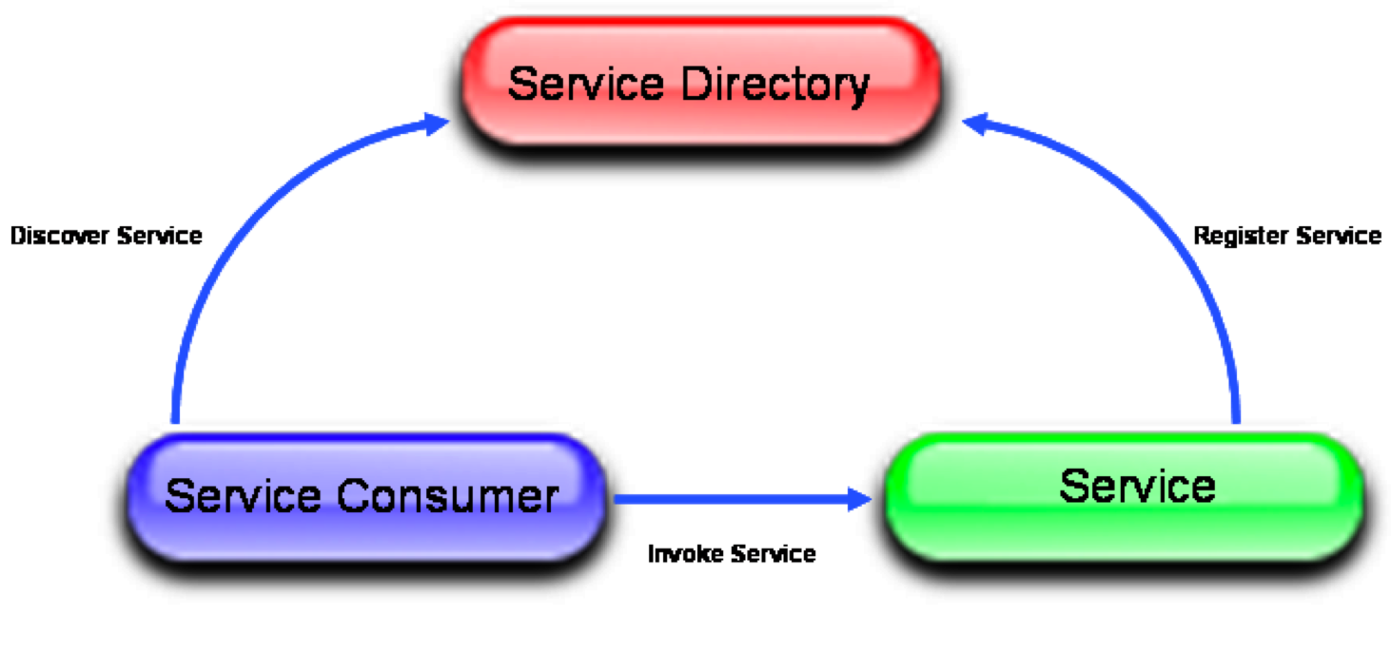
Engineering Components
Publish, Find, Bind
Catalog Services
(Main and Distributed)
Find
Publish
Bind
Portals
and
Client Applications
Data Stores
(WMS, WFS, SOS, etc)
© 2012 Open Geospatial Consortium

Slide 8
Draft Engineering Components for Scenario #1
Client Tier
Portals ?
Client
Applications
CSW
WMS
CSW
WMS
WPS
Access
CSW/ISO
WPS
Mediation Tier
“hi-level”
Catalogue
Upstream Service – Geometry
UI/WMS
CAP Publisher
(NRCan)
CSW
Access
WPS
WPS
GeoRSS
CSW
Upstream Service – Gauges
Event Service
“low-level”
Catalogues
Access
Access
SOS
WFS
Access Tier
NRCan SOS Wrapper
SOS
WFS
WMS
SOS
WFS
WMS
SOS
WFS
WMS
WMS
WMS
EC archiveData
Server (may merge with Wrapper)
USGS Data
Server
NRCan Data
Server
NOAA Snow Depth
Data Server
Basemap
Server
(GeoBase, others)
EC real-time SOAP XML
server
© 2012 Open Geospatial Consortium

Slide 9
Draft Engineering Components for Scenario #2
Same as #1 with
Addition of a WPS for nutrient load calculation from USGS
WQ data (EPA) Nutrients from USGS Portal

Slide 10
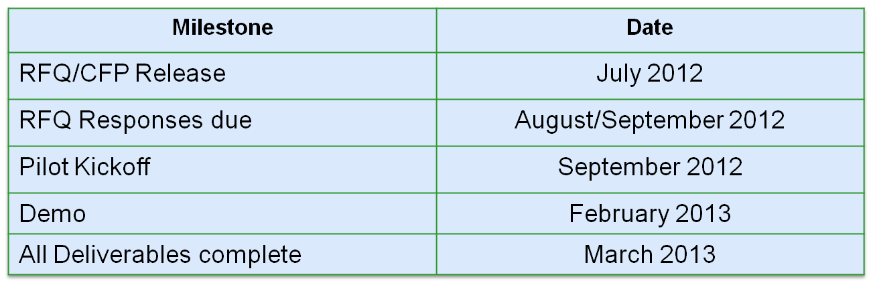
Tentative CHISP Schedule
Final stages to settle on location for Kickoff Workshop
© 2012 Open Geospatial Consortium

Slide 11
Additional Slides
© 2012 Open Geospatial Consortium

Slide 12
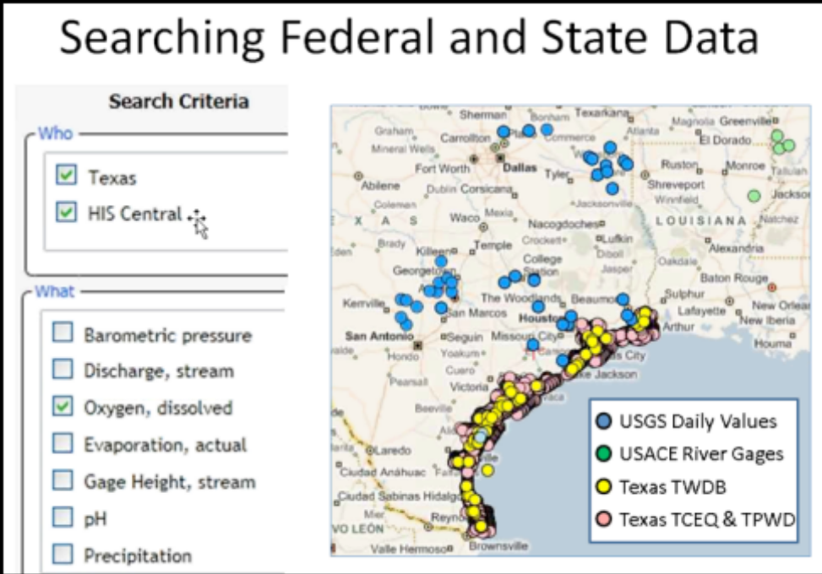
Concept Development Study
CUAHSI Water Information System Concept Development Study – Final Report, 14-July-2011, OGC 11-013r6,
http://portal.opengeospatial.org/files/?artifact_id=44834
Copyright © 2011 Open Geospatial Consortium

Slide 13


OGC Testbeds and Pilots
Task A
Concept
Development
OGC staff manages the entire process
with policies and procedures
proven to produce results.
Task B
RFQ/CFP*
Development
Over 40 initiatives have been successfully completed since 1999. Most OGC standards are advanced through this process.
http://www.opengeospatial.org/projects/initiatives
Task C
Kick-off
Preparation
Task D
Execution
*RFQ/CFP = Request for Quotation / Call for Participation

Slide 14
Interoperability Programs Comparison
Specification
Program
Types of Interoperability Program Initiatives
OGC Network
Pilot
Experiment
Technology Maturation
Testbed
Specifications
Implementations
Demonstrations

Slide 15
Types of OGC-IP Initiatives
 | OGC Testbed | OGC Interoperability Experiment | OGC Pilot | OGC Network
Purpose | Develop new specs & refine existing specs | Refine & extend existing specs | Test existing specs in operational environment | Persistent, widespread infrastructure
Project Management | OGC IP Team | OGC Members | OGC IP Team | OGC Members and IP Team
Sponsorship | Yes | No | Yes | Both
Participation | OGC Members | OGC Members | Members & operational partners | Members & public
The OGC Interoperability Program (OGC Document 05-127)
© 2006, Open Geospatial Consortium, Inc.
Notes:
The main differences between Interoperability Experiments and Pilots are that IE’s are self-organized and self-funded by OGC member participants, while Pilots have specific project funding, usually pooled among multiple sponsors, and OGC’s Interoperability Program (IP) team provides the project management. With an IE, the only contracts are agreements by participants to observe all relevant IPR guidelines. With OGC Pilots, OGC itself contracts to develop an RFP, screen applicants subject to sponsors’ wishes, and fulfill the sponsors’ requirements.

Slide 16
Pilot vs. Interoperability Experiment (IE)
Reasons for conducting a project as an IE:
  Cost reduction; all participation is in-kind
  Least external management overhead; participating organizations self-organize
  Challenge: effectively managing diverse, multi-organization, multi-national team
Reasons for conducting a project as a Pilot:
  OGC assumes management role; issues RFP, screens responses, contracts for delivering sponsors’ stated requirements
  OGC IP staff handle all meeting & admin tasks; submit monthly reports
  Project follows milestones closely; regular sponsor reporting is enforced
  Requirements may include level-of-performance guidelines
  Deliverables include documentation subject to peer review
Copyright © 2011 Open Geospatial Consortium

Slide 17
Reference Documents
The OGC Interoperability Program: 05-127r5, Sept 2010
Current active initiatives: http://www.opengeospatial.org/projects/initiatives/active
Interoperability Experiment Policies & Procedures
  05-130r3, April 2009
OGC Interoperability Pilot Policies & Procedures
  05-131r1, March 2006
The OGC Reference Model (ORM)
  The OGC Standards Baseline consists of the approved OpenGIS® Abstract and Implementation Standards (Interface, Encoding, Profile, Application Schema) and Best Practice documents
  http://www.opengeospatial.org/standards/orm
  08-062r4, Nov 2008
OGC Intellectual Property Rights Policies and Procedures
  http://www.opengeospatial.org/about/ipr
  http://portal.opengeospatial.org/files/?artifact_id=32268
© 2009 Open Geospatial Consortium, Inc.

