Slide 1

EF - Environmental Monitoring Facilities
Facilitators: Franz Daffner, Sylvain Grellet

Slide 2
Definition
Location and operation of environmental monitoring facilities includes observation and measurement of emissions, of the state of environmental media and of other ecosystem parameters (biodiversity, ecological conditions of vegetation, etc.) by or on behalf of public authorities.

Slide 3
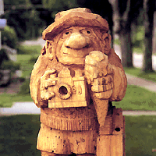
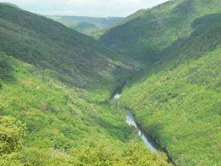
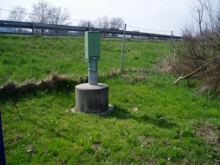
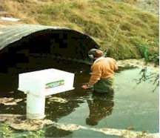
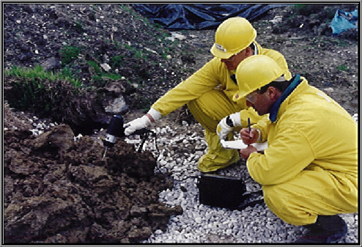
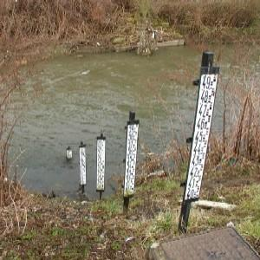
What is an EF ?

Slide 4
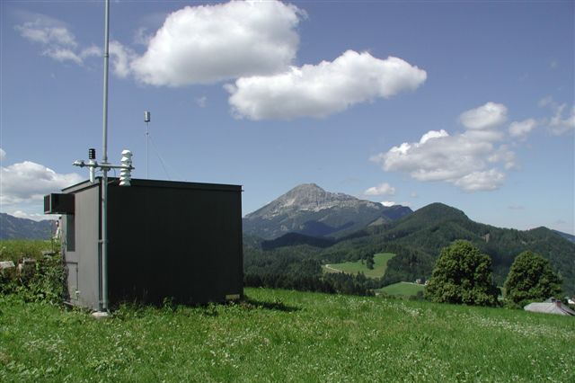
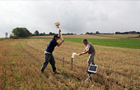
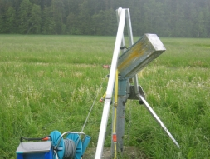
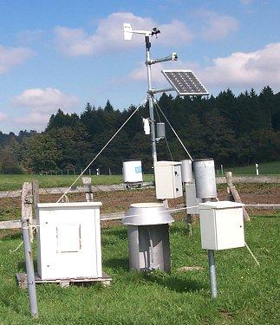

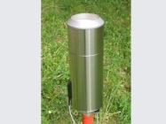
What is an EF ?

Slide 5
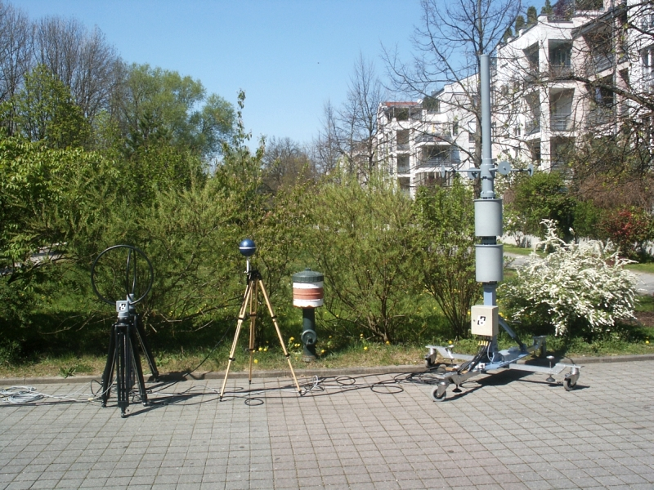
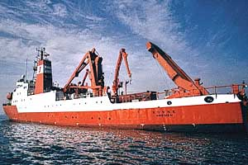
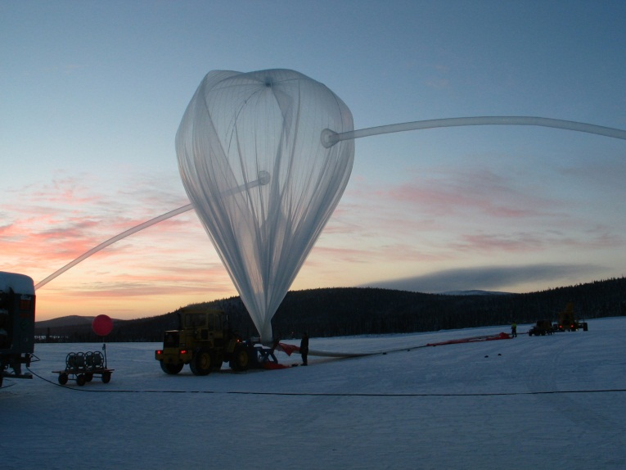

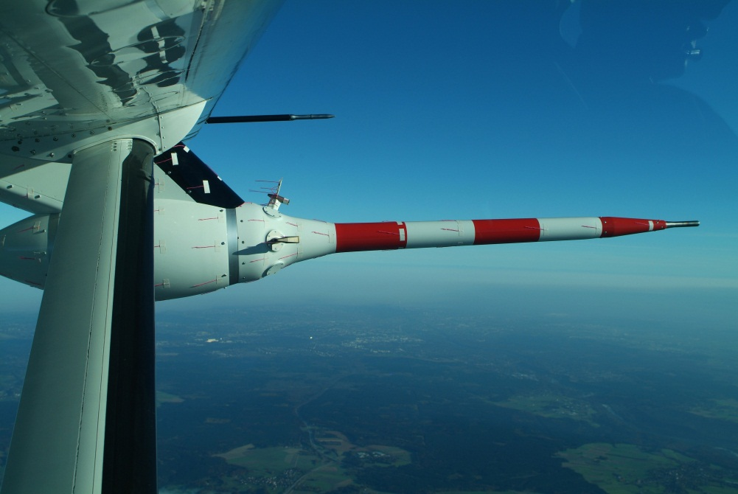
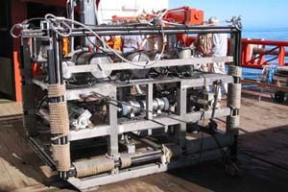
What is an EF ?

Slide 6
Data modelling context
Reference material & Use Cases were all domain specific,
Two aspects
  (Network of) monitoring facilities incl. metadata and background information,
  Observations and Measurements.
Generic data model that has to be specialised by domains,
Observations & measurements are linked : use of ISO 19156:2011 O&M standard (See D2.9 “Guidelines for the use of Observations & Measurements and Sensor Web Enablement-related standards in INSPIRE Annex II and III data specification development”),
55 webconferences, 7 physical meetings over 2 years.

Slide 7
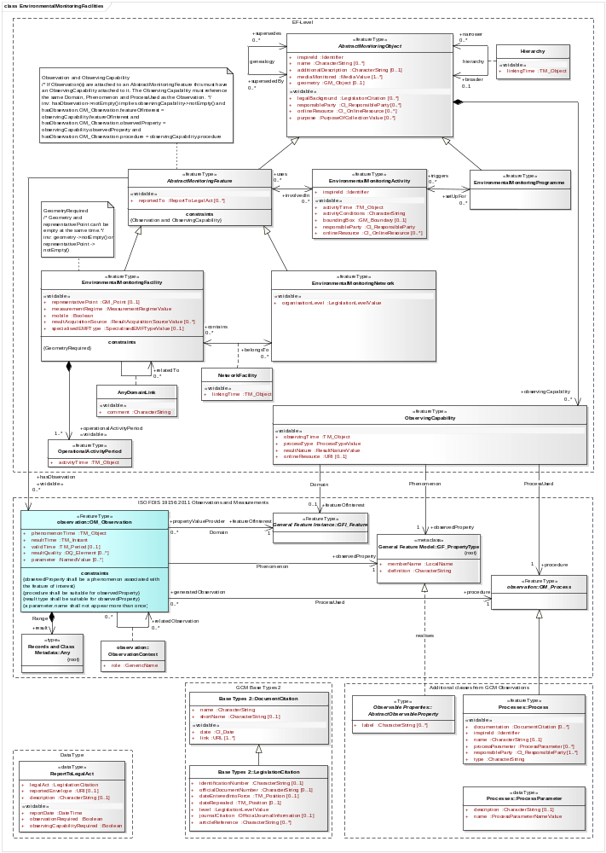
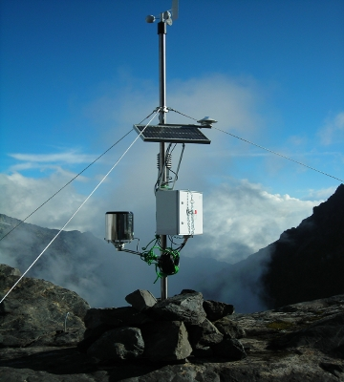
The EF-model
Environmental Monitoring Facilities
ISO 19156:2011
Observations and Measurements
GCM, INSPIRE O&M classes
10001101011101101010
11101110001010101000
Data Type

Slide 8
The EF-model (Facility part)
Genealogy
Hierarchy
Abstract
Monitoring program / activity
Abstract
Facility
Network
Belongs to
Thematic link
Activity period
Observing Capability

Slide 9
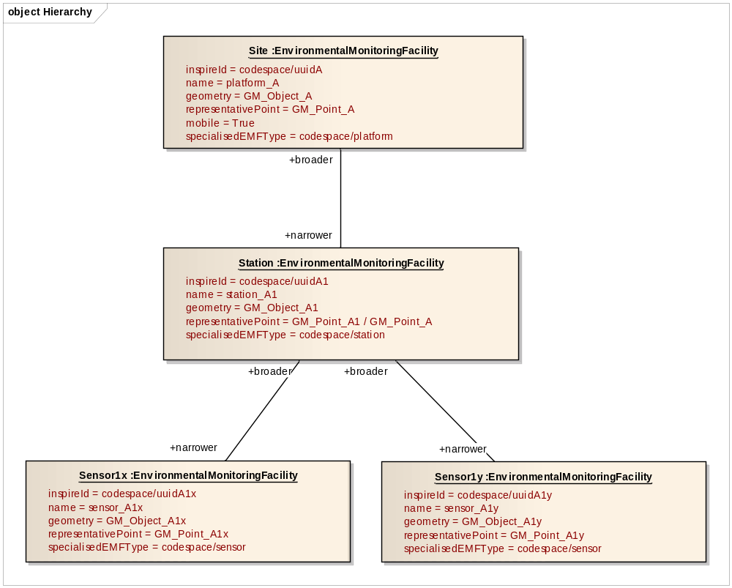
Environmental Monitoring Facility
Hierarchy

Slide 10
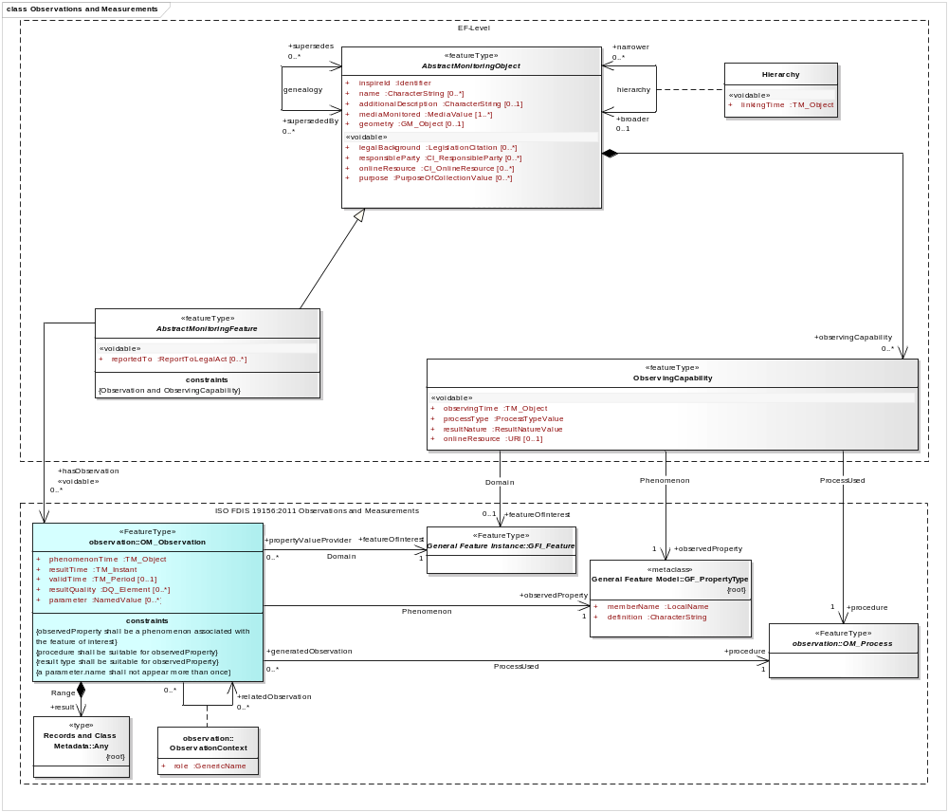
The EF-model (link to OM_Observation)
Abstract
Abstract : Facility/Network
Observing Capability
Link to domain specific semantic/systematic. Ex:
Feature Of Interest: Loire River
Observations & Measurements
Observed property: River flow
Method: automatic sampling device

Slide 11
The EF-model (link to OM_Observation)
Only one theme specific requirement
The observations and measurements linked to an AbstractMonitoringFeature shall be provided only if they are required as part of a data flow that implements an environmental reporting obligation or that has been voluntarily agreed and whose data structure is based on the INSPIRE Environmental Monitoring Facilities data model. The provision of such observations and measurements shall be implemented using the hasObservation role of the AbstractMonitoringFeature.
1°/ Is there any environmental reporting obligation or agreement forcing you to put observations online ?
2°/ If yes, is this previous point specifying a "data structure based on the INSPIRE Environmental Monitoring Facilities data model" for the data flow ?

Slide 12
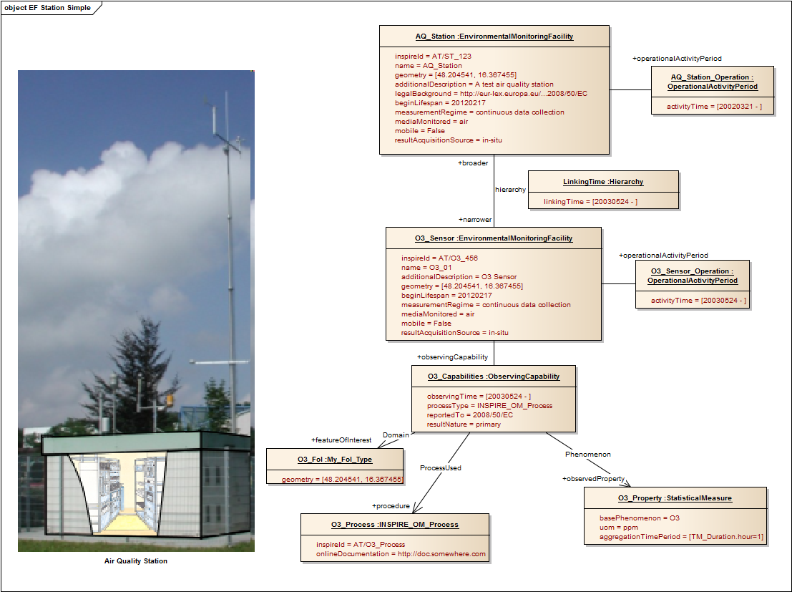

Slide 13
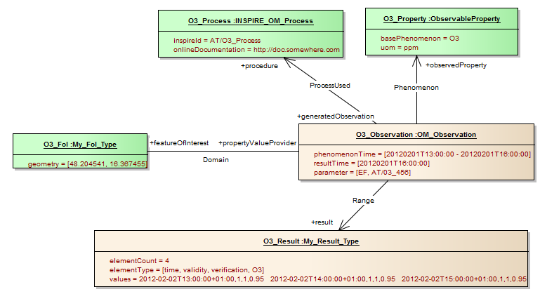

Scope
(B) Dataset "Zones and Agglomerations"
(C) Dataset "Assessment Regime"
(D) Dataset "Information about Assessment Methods“
      D.a: Dataset "General”
      D.b: Dataset "Fixed measurement Information"
      D.c: Dataset "Indicative Measurement Information"
      D.d: Dataset "Modelling Information"
      D.e: Dataset "Objective Estimation Information"
(E) Dataset "Primary data“
(F) Generated Dataset "Aggregated Data"
(G) Dataset "Attainment of Environmental Objectives"
INSPIRE Themes:
EF
OM

Slide 14

Thank You
EF – quite a span
Franz Daffner | Co-facilitator | Franz.Daffner@eea.europa.eu
Sylvain Grellet | Co-facilitator | s.grellet@oieau.fr
Heino Rudolf | Editor | hrudolf@moss.de
Christiane Lutz-Holzhauer | Expert | Christiane.Lutz@lubw.bwl.de
Katharina Schleidt | Expert | katharina.schleidt@umweltbundesamt.at
Johan Abenius | Expert | Johan.Abenius@naturvardsverket.se
Trevor Alcorn | Expert | talcorn@marine.ie
(Nicolas Bertrand) | Expert | nsb@ceh.ac.uk
(Peter Pastorek) | Expert | peter.pastorek@sopsr.sk
Tomas Reznik | JRC contact point | tomas.reznik@jrc.ec.europa.eu
Alessandro Sarretta | JRC contact point | alessandro.sarretta@jrc.ec.europa.eu

Slide 15
Support Slide : Use cases
Identify Facilities and Networks available for a given area of interest and domain,
Access to background information behind the Monitoring Feature,
Providing information on what an EF is actually monitoring,
Providing the observations and/or measurements acquired at a Fixed/Mobile EF level,
Providing the observations and/or measurements acquired when a sample is being made,
Reporting of monitoring features,
Reporting of monitoring features and Observations/Measurements.

Slide 16
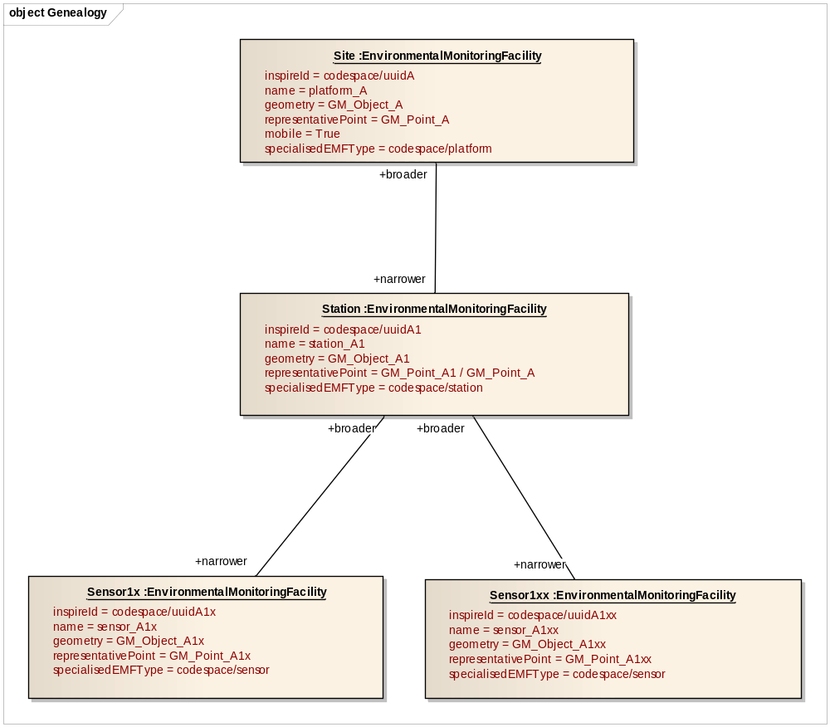
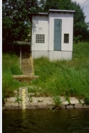
Support Slide : Genealogy
Hierarchy
Genealogy
Genealogy
Time

Slide 17
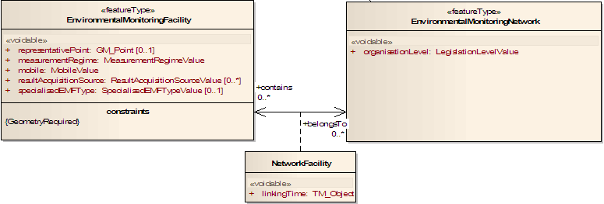
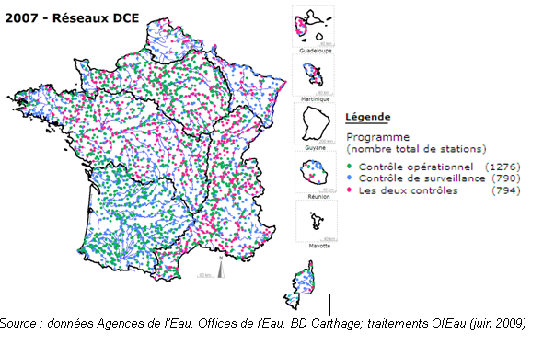

Support Slide : Network
Restart here
Same Facility Type
2007 : WFD networks
Various Facility
Types

