Slide 1
GEOSS AIP 5 Water SBA Update
HDWG June 2012
Matt Austin NOAA
Stefan Fuest KISTERS
Jochen Schmidt NIWA

Slide 2
Background
GEOSS is a system of systems from countries that are members of GEO
GEO is made up of 88 countries that coordinate building GEOSS
Goal: Seeks to connect the producers of environmental data and decision-support tools with the end users of these products, with the aim of enhancing the relevance of Earth observations to global issues.
GEOSS Architecture Implementation Pilot (AIP) develops and deploys new process and infrastructure components for the GEOSS Common Infrastructure (GCI) and the broader GEOSS architecture
© 2012 Open Geospatial Consortium

Slide 3
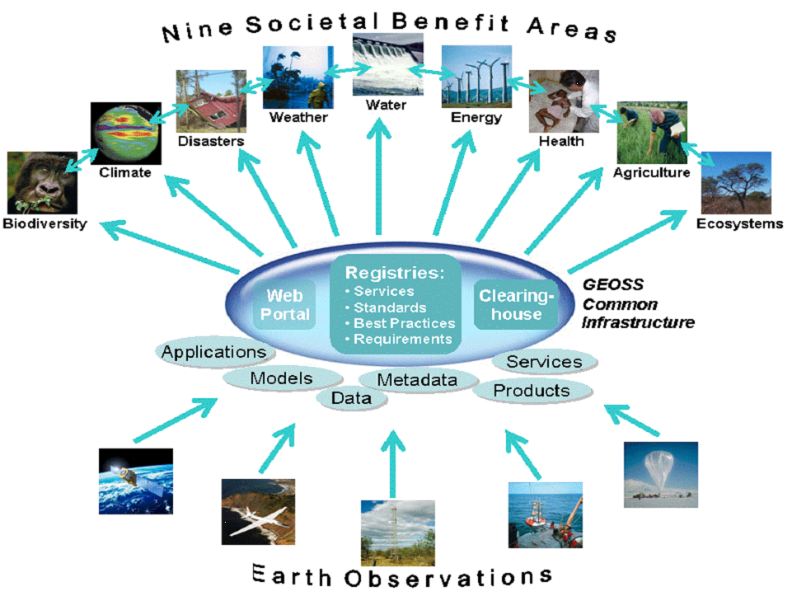
GEOSS Societal Benefit Areas
© 2012 Open Geospatial Consortium

Slide 4
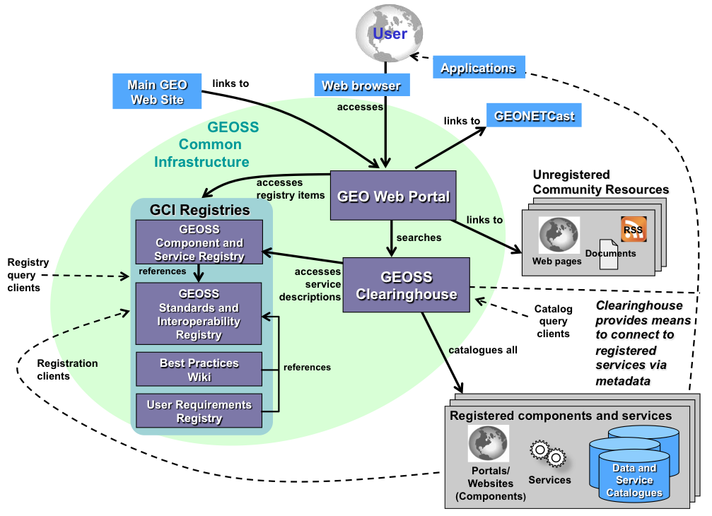
GEOSS Architecture

Slide 5
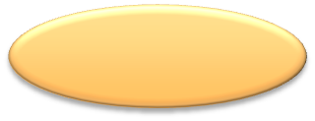
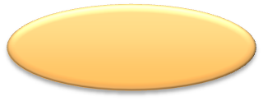
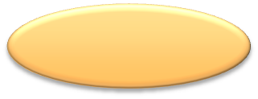
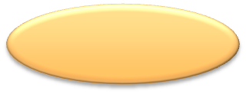
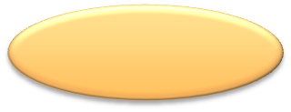





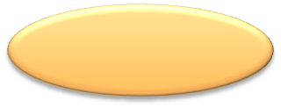
Evolution of Architectural Focus
Provider
Provider
Publish
Provider
Provider
Publish
Provider
Register
Mediate
GCI
Bind
SIF
Broker/Mediator
Find
Find
GCI
SIF
Bind
Consumer
Find
Consumer
GeoViQua Workshop
February 18, 2011

Slide 6
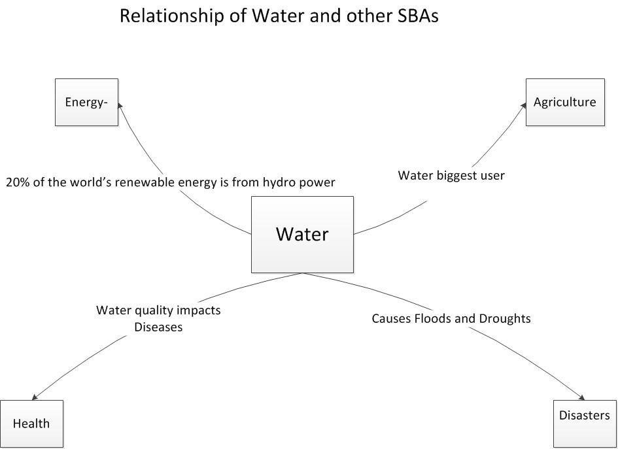
Water SBA for AIP-5 Vision
Research methods to bring together in-situ and Remote Sensing observation and data systems into a world water catalogue that will help users find water cycle information that pertaining in a global context using the GEOSS framework.
© 2012 Open Geospatial Consortium

Slide 7
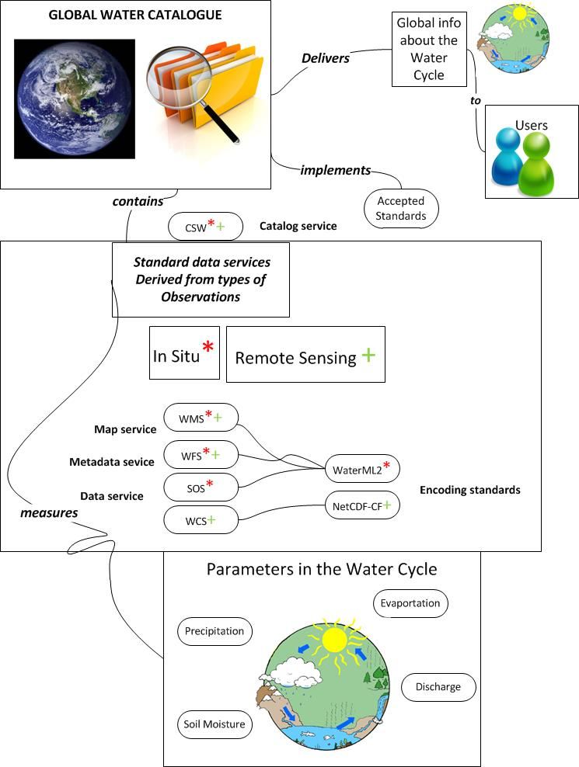

© 2012 Open Geospatial Consortium

Slide 8
Objectives
Assess the current state of water resource data and services available in GEOSS.
Work with contributors and partners to increase the quality and usability of standard data and services relevant to the Water SBA.
Provide recommendations on improving the GEOSS architectures ability to provide water information.
Contribute to the development of standard catalogue services for water information sharing.
Provide support to the joint WMO/OGC HDWG in championing the adoption of standards that facilitate global water information sharing such as WaterML2
© 2012 Open Geospatial Consortium

Slide 9
Provide outreach to the broaden awareness of the importance water sharing in a global context.
Develop use cases and scenarios for the Water SBA. This includes integration with the other SBA scenarios and use cases and broader cross societal benefit goals.
Water Resources stakeholder analysis survey---COMPLETED by US Water Agencies
© 2012 Open Geospatial Consortium

Slide 10
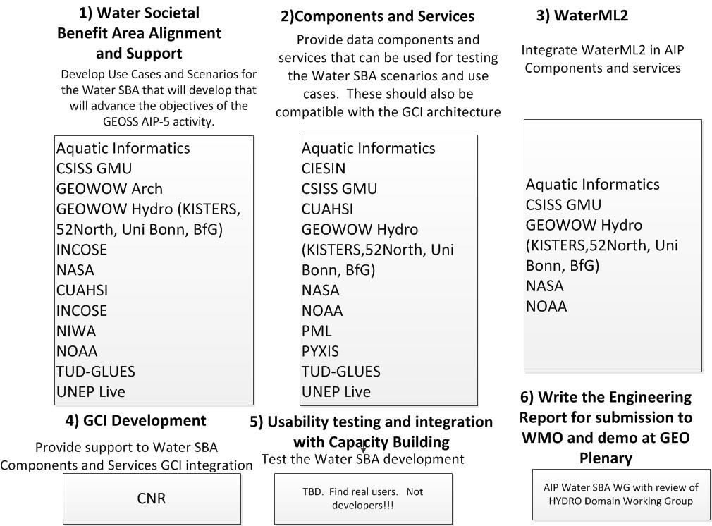
AIP-5 Water SBA
© 2012 Open Geospatial Consortium

Slide 11
Water Resources Stakeholder Analysis Survey-
Participants- Water Domain Subject Matter Experts from US Federal Agencies.
  USGS, NOAA, EPA, USDA, others
Key Objectives-What is the observing system data used for?
  Data Sources and Tools
  Intermediate Products and Models
  Known Future Data Sources and Tools
  Information captured in spreadsheets
© 2012 Open Geospatial Consortium

Slide 12
Background
National Earth Observations Task Force established by OSTP
  Feb 2011 – Aug 2012
  Responsibilities:
    Develop National Strategy and governance plan for Earth observations
      Provides a framework for a National Earth observing system portfolio assessment
        Assessment will be used to create a 10-year Implementation Plan to inform OMB and OSTP; triennial updates
NEO Task Force Assessment Working Group (AWG)
  Conduct and deliver the first National assessment by July 1, 2012
  “Societal Benefit Areas” (SBAs) are the organizing construct
    12 SBA Teams + 1 Reference Measurements Team formed to conduct the assessment

Slide 13
NEO Task Force Deliverables
Assessment Working Group Deliverable:
  From the National Earth Observation Strategy:
    “The assessment will document the baseline current portfolio and define an integrated portfolio of observing systems, networks and platforms for internal Federal use that will provide optimal continuity, fulfillment, and advancement of required measurements over the 10-year planning period.”
  What we plan to deliver:
    Phase 1:
      National Observing System Portfolio (current portfolio of observing systems)
      Baseline assessment of the current portfolio, tiered by relative criticality
        Both individual SBAs and an overall NEO integrated assessment
    Phase 2:
      10-Year National Observing System Portfolio
        Recommended portfolio (current, planned, and new capabilities required) tiered by relative criticality over 10-year planning horizon
        Both individual SBAs and an overall NEO portfolio

Slide 14








Value Chain Approach
Value Chain
The value chain is a linked collection of activities that begins with an Earth observation, adds value to it to ultimately achieve a key objective or deliver a product or service, which in turn contributes to a societal benefit
SBA Sub-Areas provide a natural breakdown of the SBA into topical/application areas that encompass the major functions within the SBA
Key Objectives represent the most important things to be accomplished within the Sub-Area
Data Sources and Tools include direct observations, model output, intermediate products, and tools that require Earth observations to achieve the Key Objectives
Overall goal is to connect observing systems to the value they provide / service delivery
Observing Systems
Societal Benefit Areas
SBA Sub-Areas
Key Objectives
Data Sources and Tools
Models
Tools
Direct Observations
Observing Systems

Slide 15
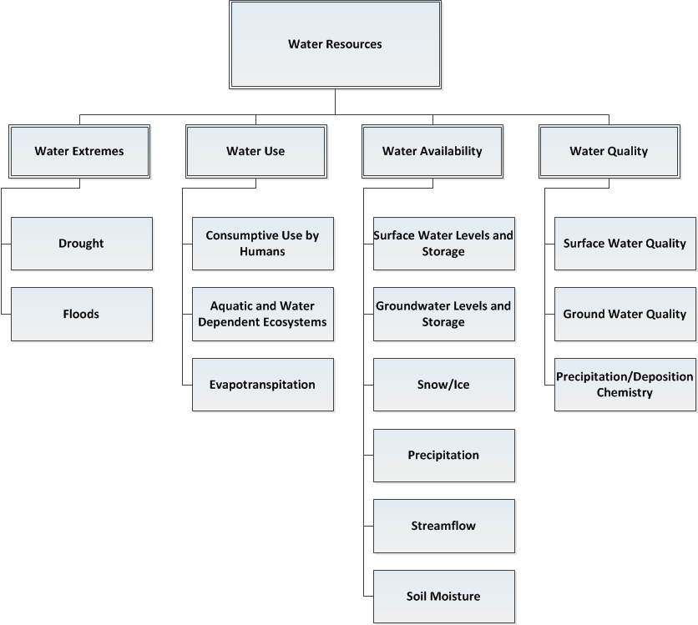
Water SBA Sub Areas
© 2012 Open Geospatial Consortium

Slide 16
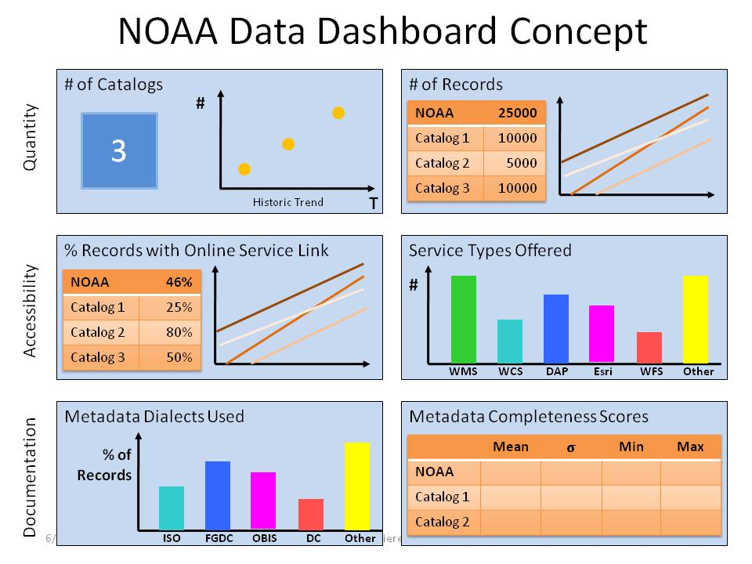
© 2012 Open Geospatial Consortium

Slide 17
Process for Assessing Water Data in GEOSS
Use Observing System, Models, Intermediate Products and future systems Identified by NEO as the search criteria for measuring data available in the GEOSS Broker (GI-CAT)
Search for available OGC Services via CSW POST Requests
  WMS
  WCS
  SOS
    WaterML2
    NETCDF
© 2012 Open Geospatial Consortium

Slide 18
Output from Metadata and Service Metadata
Who, -Responsible Party
What,- Description
Where, -Spatial Extent of Service
When, -Date of metadata, date of data
Why, -Is there an intended use/user
Service-availability -URL Checking
Quality- Does the metadata have accuracy and precision?
© 2012 Open Geospatial Consortium

Slide 19
GEOSS Interoperability Challenges
• Registering data and services in the GCI is a
manual data entry driven process
GEOSS tasks that are interdependent such as
Ontology, AIP and GCI development need to be better coordinated
GEOSS Clearinghouse needs to be kept current
Old metadata
GEOSS standards not updated frequently
© 2012 Open Geospatial Consortium

Slide 20
How better metadata can simplify integrating data into GEOSS
The relationship between data, services,
products and clients can be described using metadata
Publishing this metadata in a Web Accessible Folders recognized by the GCI could automate the registration process for data and services resulting improved usability for GEOSS providers and users
© 2012 Open Geospatial Consortium

