Slide 1

Moving the HY_Features model towards adoption as a standard
OGC Hydrology Domain Working Group
3rd Meeting, Reading, UK, June (25-29), 2012
Irina Dornblut, Global Runoff Data Centre of WMO
Rob Atkinson, CSIRO Land and Water
Copyright © 2012 Open Geospatial Consortium

Slide 2
HY_Features towards adoption as a standard
HY_Features model in brief
  Common semantics of hydrologic features
Role within OGC
  Domain-specific instance of GF_FeatureType
  WMO-CHy endorsed semantics of hydrologic features types
  Domain feature concept decoupled from data products
Role within WIS/WIGOS
  ISO/OGC conform concept of hydrologic features
  Component of hydrologic metadata concept within WIGOS
  Reference concept
Next steps
Copyright © 2012 Open Geospatial Consortium

Slide 3
HY_Features conceptual model in brief
associate real-world hydrologic objects
  Water bodies, e.g. river, lake, or segments of these
  Water body confines, e.g. channel, aquifer
  Hydrometric stations, e.g. water monitoring station
to the corresponding basin or a reporting region
referencing a point identified by coordinates
  point on a water body in downstream / upstream direction
  cross-section point
  extraction point of a well
  location of a hydrometric feature
Copyright © 2012 Open Geospatial Consortium

Slide 4
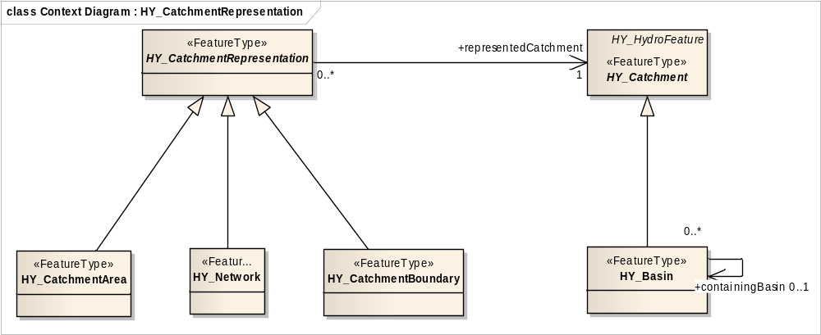
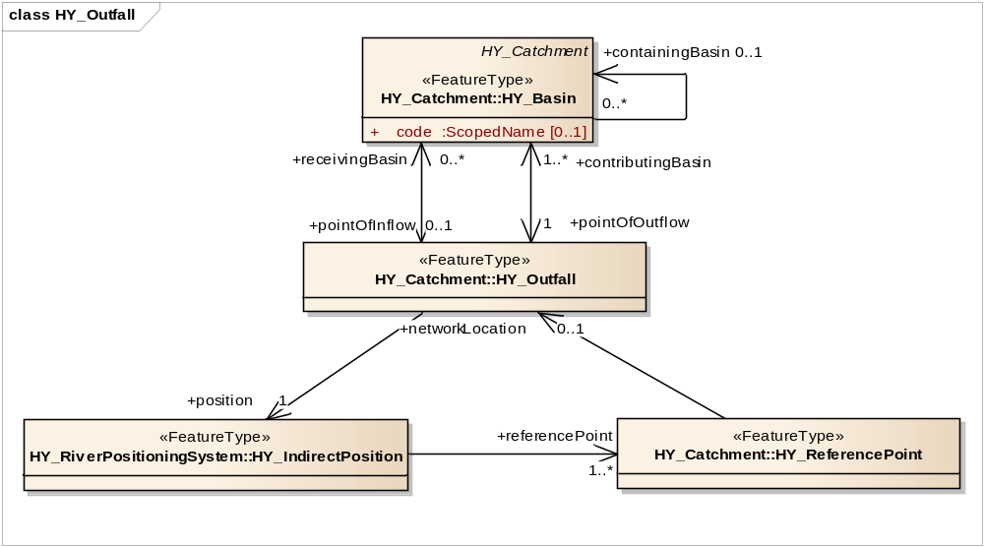
HY_Features conceptual model in brief
Basic concepts of catchment, basin and outfall
catchment spec. basin
shared unit of study
multiple represented
outfall feat. basin outlet
identifies a basin topologically by its outlet
topological relationships between basins
realtes point on, or projected onto, the land surface to basin
identifiable reference point to which alternative representations may refer
Copyright © 2012 Open Geospatial Consortium

Slide 5
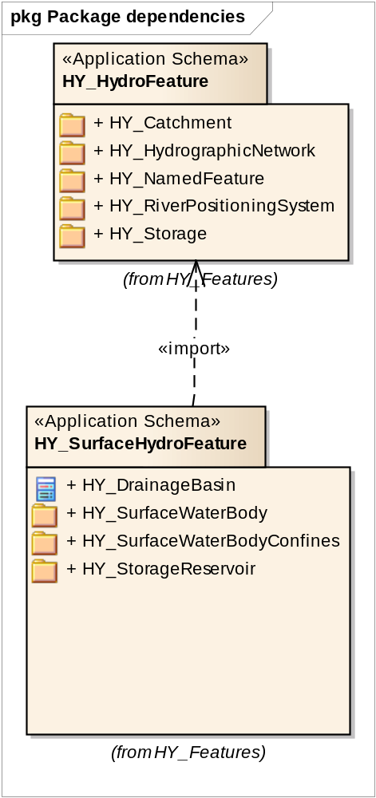
HY_Features - SurfaceHydroFeature
SurfaceHydroFeature package
relation of surface hydro feature concepts to basin
summarises the most popular water bodies on the land surface, each special by the property to move, by origin, by size, by the phase of the contained water, or by their interaction with others.
depending on the application, special types of hydrographic feature may be described by suitable attributes.
Copyright © 2012 Open Geospatial Consortium

Slide 6
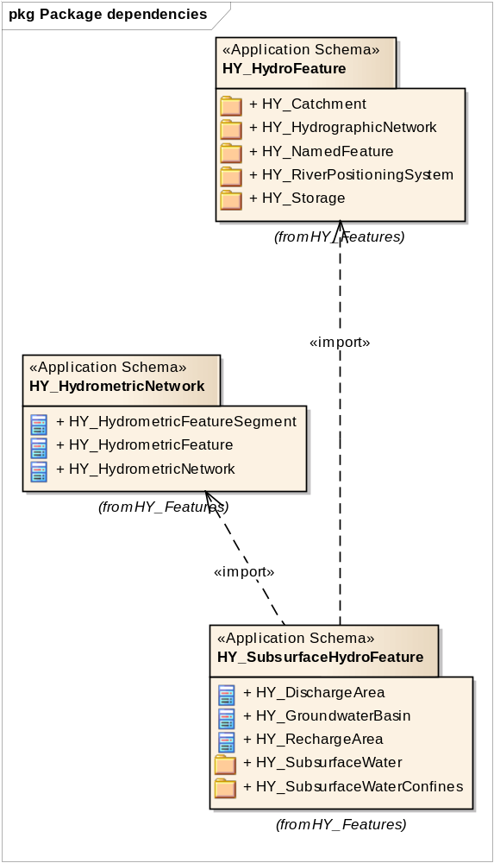
HY_Features - SubsurfaceHydroFeature
SubsurfaceHydroFeature package
relation of subsurface hydrology feature concepts to basin
water accumulated below the Earth's surface occupying a formation of rock or soil, each special by pressure head and the property to move due to gravity and capillary action.
depending on the application, special types may be described by suitable attributes.
Copyright © 2012 Open Geospatial Consortium

Slide 7
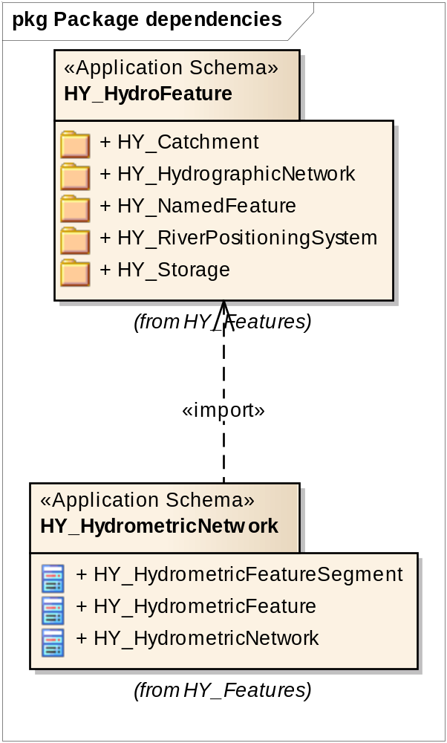
HY_Features - SubsurfaceHydroFeature
HydrometricNetwork package
relation of hydrometric feature concepts to basin
Segmentation of hydrometric features
depending on the application, special subtypes may be defined described by suitable attributes.
Copyright © 2012 Open Geospatial Consortium

Slide 8
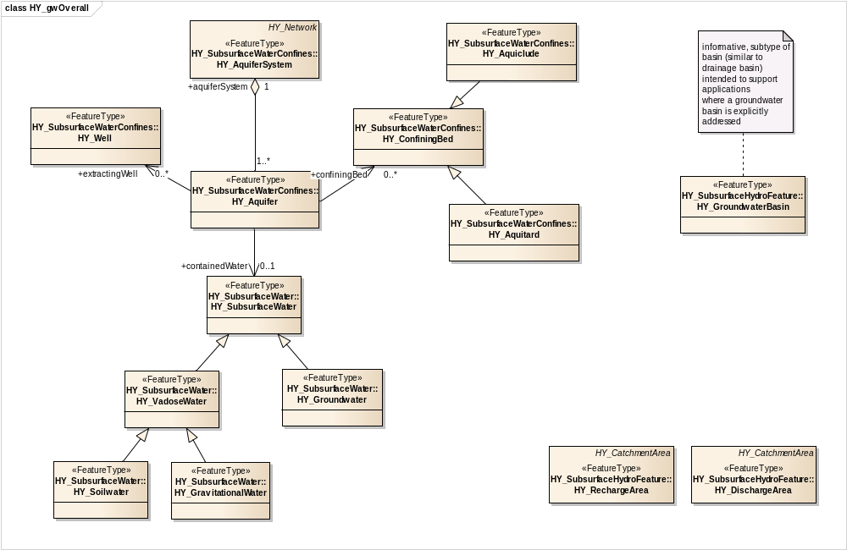
HY_Features for „Groundwater“
Classes (feature types) concerning groundwater theme
Copyright © 2012 Open Geospatial Consortium

Slide 9
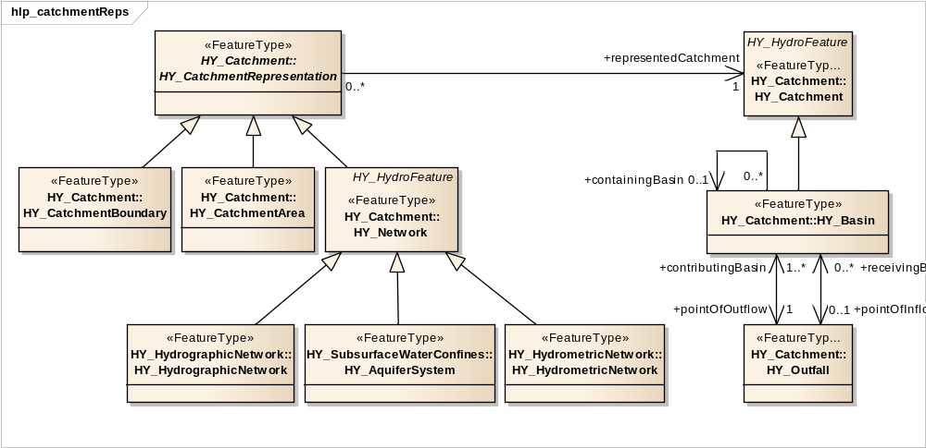
HY_Features for „Groundwater“
Aquifer system is a representation of catchment spec. basin
Copyright © 2012 Open Geospatial Consortium

Slide 10
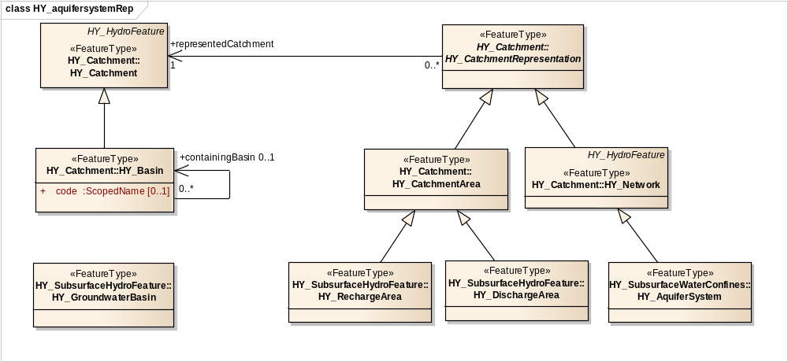
HY_Features for „Groundwater“
Recharge and discharge area are catchment representations
Copyright © 2012 Open Geospatial Consortium

Slide 11
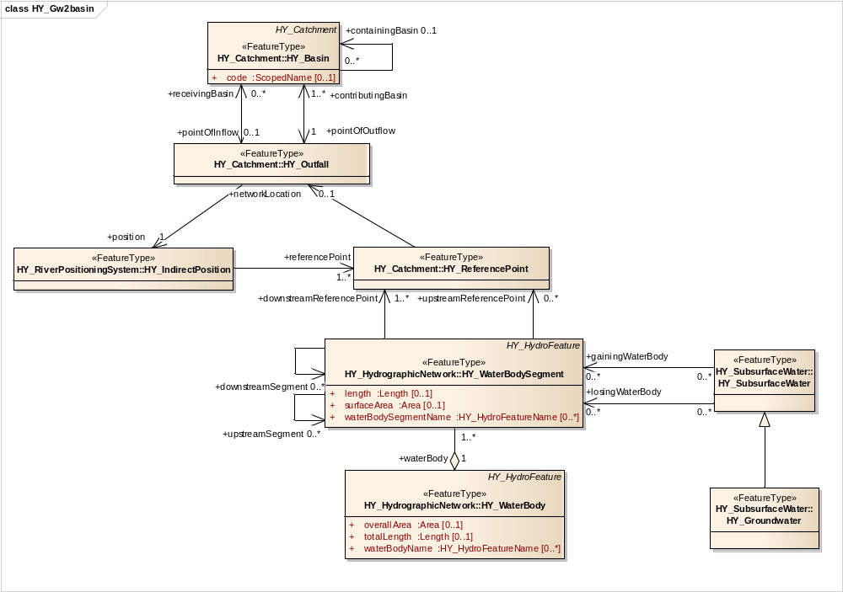
HY_Features for „Groundwater“
Scope of HY-Features: water accumulated in a water body
→ Subsurface water spec. groundwater is related to the gaining or losing water body
Copyright © 2012 Open Geospatial Consortium

Slide 12
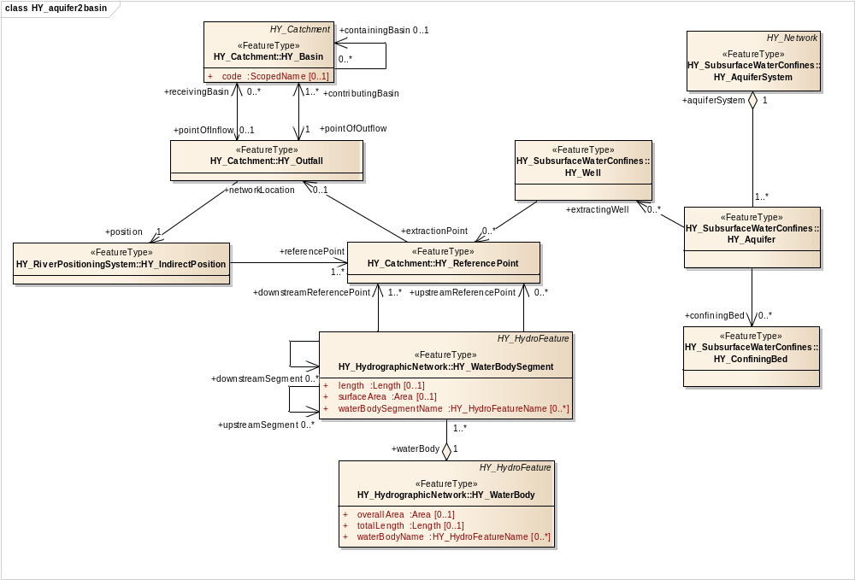
HY_Features for „Groundwater“
Water body is confined by the occupied landform or the containing formation
→ aquifer is the container for groundwater
Copyright © 2012 Open Geospatial Consortium

Slide 13
HY_Features conceptual model – Role within OGC
Specifying GFI_DomainFeature for the hydrology domain
  specifies the featureOfInterest, as required by ISO19156:2011 (Observation & Measurements)
  supports the sampledFeature in hydrology domain (e.g. WML2 implementation of ISO19156:2011)
  supports the monitoringPoint of WML2
  supports the relatedFeature of SOS2 applications in hydrology
WMO-CHy endorsed semantics of hydrologic features types
Feature concept decoupled from data sets and products
Copyright © 2012 Open Geospatial Consortium

Slide 14
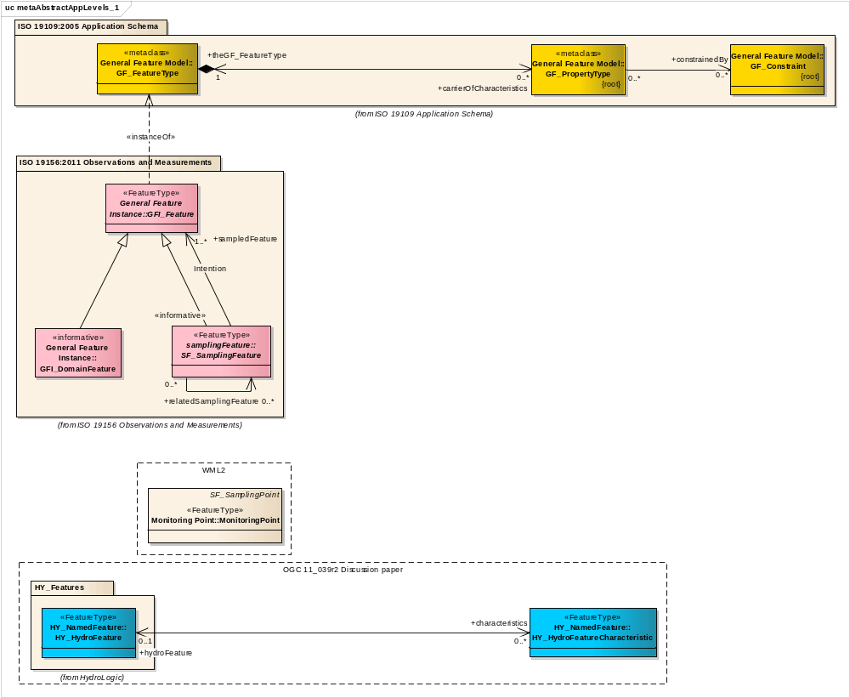

HY_Features conceptual model in brief
+sampledFeature
+ positionOnRiver
Copyright © 2012 Open Geospatial Consortium

Slide 15
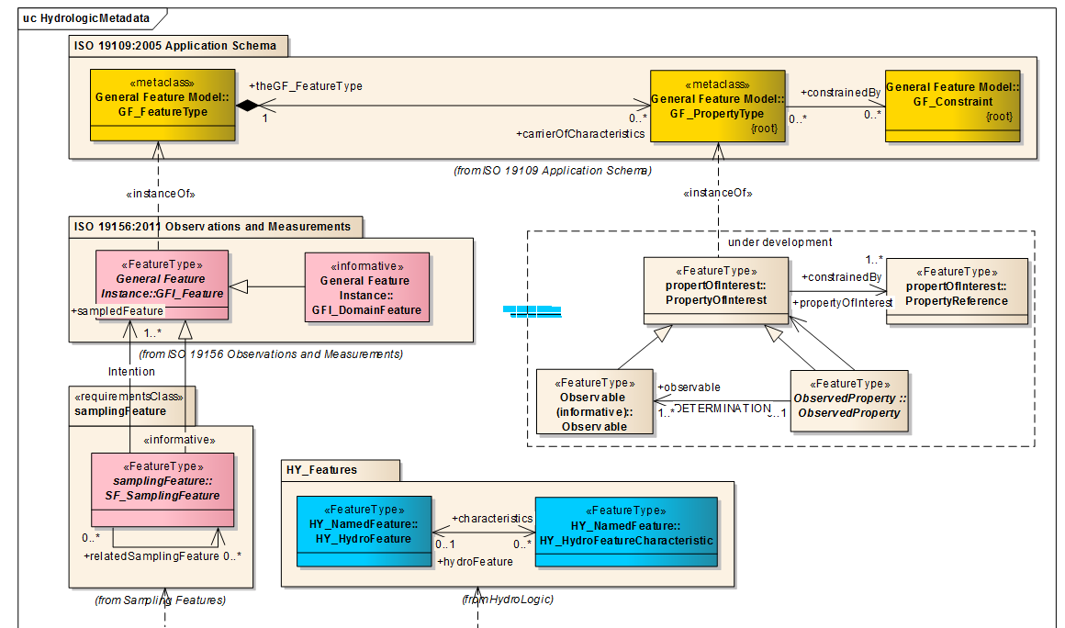
HY_Features conceptual model – Role within OGC
Domain-specific instance of GF_FeatureType
Copyright © 2012 Open Geospatial Consortium

Slide 16
HY_Features conceptual model – Role within WIS
WIS – WMO Information System
ISO-/OGC-conform concept of feature identification
  according to the General Feature concept (ISO 19109:2005)
  in line with Observation & Measurements model (ISO 19156:2010)
  expressed in GML (ISO 19136:2007)
Component of hydrologic metadata concept within WIGOS
  object of study and reporting in hydrology (hydrologic feature)
  feature, sampled to determine a values of its properties
  feature whose multiple representations are referenced in alternate data sets and products
Reference concept
  dereference data sets and products to a common/standard concept
  using Linked Data principles, i.e. using URL identifier (URI)
Copyright © 2012 Open Geospatial Consortium

Slide 17
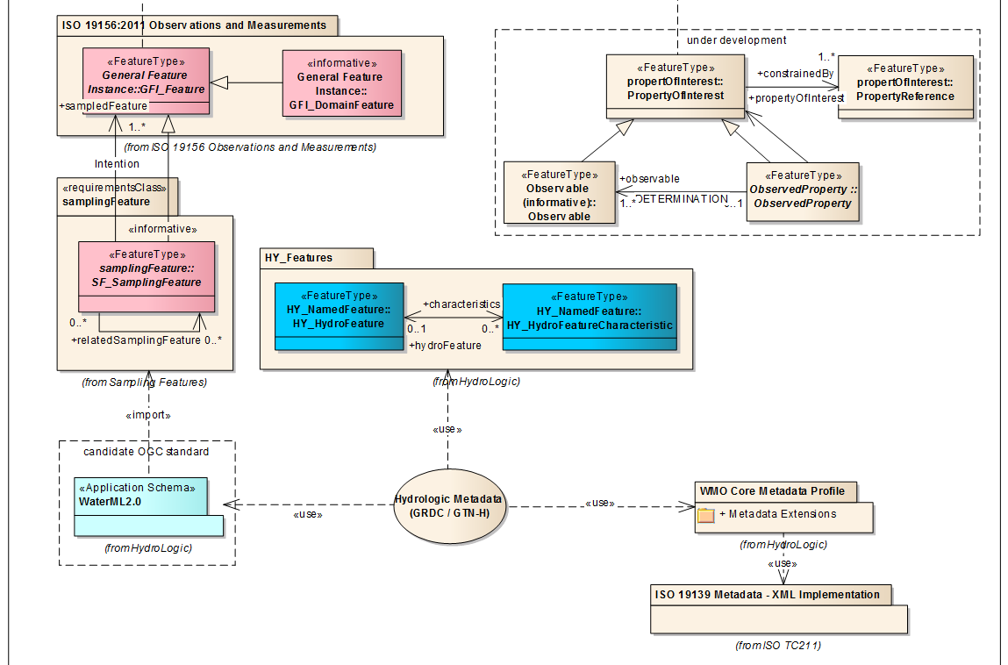
HY_Features conceptual model – Role within WIS
Component of hydrologic metadata concept within WIGOS
Copyright © 2012 Open Geospatial Consortium

Slide 18
HY_Features model towards adoption as a standard
“outcomes of [HydroDWG] work and further requirements related to data management, sharing of data and information including cross-links to WIGOS and WIS and the GEO-Infrastructure will be described in a document that will be prepared for CHy”
(WMO-CLW, W. Grabs to D. Maidment, e-mail of 22 May 2012 in respect to the 14th session of CHy)
Next Steps, from WMO-CHy perspective
  adoption of HY_Features concepts by CHy community
    using CHy e-Forum (started in May 2012)
  recommendation of HY_Features model by OGC
    OGC-WMO Best Practice document
    XML implementation of model components (Feb 2012 at SDSC)
    Test applications for use in web services, e.g. AHGF, GEOWOW SBA Water, CUAHSI, …
  schema location for access by WMO member countries (OGC --> WIS)
  documentation (data dictionary) for WMO CHy (GRDC, Oct 2012)
→ adoption of HY_Features at 14th session of CHy in October 2012
Copyright © 2012 Open Geospatial Consortium

