Slide 1

A Hydrology Profile For The SOS
Stefan Fuest, Product Manager Web/GIS, KISTERS
Michael Utech, Software Developer, KISTERS
Reading June 2012

Slide 2
GEOWOW
GEO – Group on Earth Observations
GEOWOW is a project co-funded under the European Community's Seventh Framework Programme
Work packages for domains are Weather, Ocean and Water
Within WP5 - Water the profile will be specified and compliant services and clients be developed
Done by BFG, Uni Bonn, 52North, and KISTERS
waterml waterml2 time series server encoding standard hydrological information system sos sensor observation service measurements gml geography markup language water kisters wiski his
© KISTERS AG KISTERS Partner Week 2011 <number> 07/11/26

Slide 3
Previously identified problems
Within the scope of the Groundwater and Surface Water IEs, several difficulties in the usage of SOS for hydrological data have been identified
They mainly led to several different semantic mappings that we listed as SOS types A to C
These SOS setups were mostly interoperable from a technical point of view, but not regarding semantics
© KISTERS AG KISTERS Partner Week 2011 <number> 07/11/26

Slide 4
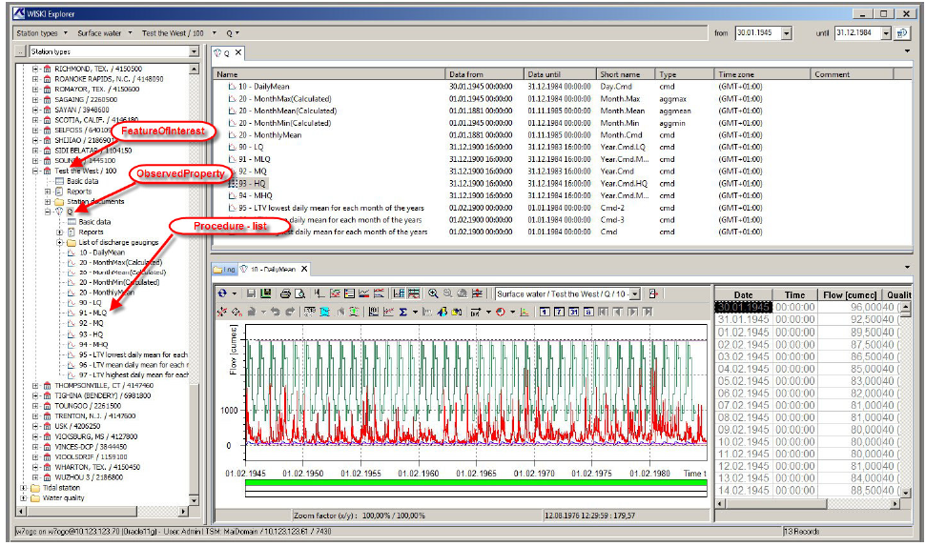
Entities in WISKI7 Hydrological Information Management
(with full support of WaterML 1 and 2)
© KISTERS AG Fachausschuss GIS & GDI, 22. November 2011 <number> 07/11/26

Slide 5
Hydrology Profile Objectives
Must be valid primarily for SOS2 but also for SOS1
Specifies WaterML2.0 as the language for timeseries data
Results in a technically and semantically interoperable hydrological SOS
Guide developers to ONE specific way of doing (instead supporting multiple variants)
© KISTERS AG KISTERS Partner Week 2011 <number> 07/11/26

Slide 6
Profile Structure
Terms and Definitions will cover all entity related topics
Requests and Responses will cover all topics related to the querying and retrieving data with the available requests
Technical issues will cover purely technical topics like what to respond if e.g. a client requests half the database content
Where possible, definitions will also be expressed through e.g. extensions or schemas
Definition 1
The profile shall announce itself in the ServiceIdentification section as attribute profile with the value ‘Hydrology Profile For SOS And WaterML2’.
© KISTERS AG KISTERS Partner Week 2011 <number> 07/11/26

Slide 7
Terms and Definitions
FeatureOfInterest
Procedure
  In general the procedure is to be seen as an algorithm, sensor type or timeseries type, NOT as a timeseries instance
Definition 2
All sampling features within the scope of this profile shall be restricted to the type wml2:MonitoringPoint.
Definition 3
All procedures within the scope of this profile shall be restricted to the type wml2:ObservationProcess.
© KISTERS AG KISTERS Partner Week 2011 <number> 07/11/26

Slide 8
Terms and Definitions
Identification of entities
  exactly one URI pointer for an object
  at least one human readable name which serves for labelling that object
  Current plan is:
  These definitions ensure unique identification (within the service) and provide readable labels too
Definition 4
Identification of entities shall refer to the gml:identifier field of the entity wherever possible, while the gml:name field shall hold a label name for it.
Definition 5
If the entity is not listed as a complex element and therefore does not feature a gml:identifier, the xlink:href attribute shall be used as identifier, while the xlink:title attribute shall hold a label name for it.
© KISTERS AG KISTERS Partner Week 2011 <number> 07/11/26

Slide 9
Requests and Responses
GetCapabilities
  (falsely) indicates homegeneous distribution of timeseries
  This could be overcome with the expected GetDataAvailability extension
  The list of sampling features often is too large to be provided in GetCapabilities
Definition 6
The GetCapabilities content section shall list sampled features only as related features, no sampling features shall be exposed.
© KISTERS AG KISTERS Partner Week 2011 <number> 07/11/26

Slide 10
Requests and Responses
GetFeatureOfInterest
  The response could be limited to wml2:MonitoringPoint or be extended with feature types to also provide and filter sampled features or a more complex feature model
DescribeSensor
  Less useful if the procedure is not an instance
  wml2:observationProcess can be either defined as format or mapped to SensorML
GetDataAvailability
  Is expected as extension and probably will be mandatory
Definition 7
The GetFeatureOfInterest request shall be mandatory.
© KISTERS AG KISTERS Partner Week 2011 <number> 07/11/26

Slide 11
Requests and Responses
GetObservation
  SOS spec requires a service to return all timeseries values if no temporal filter is provided
  With this definition one overcomes unintended large requests plus gets a new feature to return the most current value of a timeseries
Definition 10
The GetObservation request shall return metadata of all existing timeseries in form of the wml2:Timeseries element even if they do not contain any values for the requested time range.
Definition 12
If the GetObservation request does not contain a temporal filter the service shall only return the last value of each timeseries instead of the full content.
© KISTERS AG KISTERS Partner Week 2011 <number> 07/11/26

Slide 12
Technical Issues
Simples versus complex elements
  A simple element is a one-liner using href/title from gml:referenceType
  A complex element is more detailed (like wml2:MonitoringPoint) but does NOT have the referenceType
  Mostly relevant for the ID handling
SOAP binding
  Non for SOS1
  Basic (but useless WSDL) for SOS2
  Maybe a specific WSDL could be defined for a SOS2 with this profile later
© KISTERS AG KISTERS Partner Week 2011 <number> 07/11/26

Slide 13
Technical Issues
Response limits
  SOS is too open for making accidental or intended bulk requests
  A GetObservation call with one property and offering could easily have to return 1000+ timeseries
  Probably a response size limit will be introduced, it is still to be discusses if that will be done with fixed or service individual values
  This can be done for the sum of values as well as the number of different timeseries per response
© KISTERS AG KISTERS Partner Week 2011 <number> 07/11/26

Slide 14
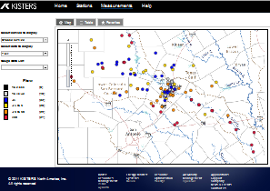


Outlook - SOS for small systems
Client App
Browser
Time Series Information
Observations and Derived Series
SiteList (FOI list)
Time Series List (via getDataAvailybility)
REST services
getCapabilities
getFeatureOfInterest
getObservation
getDataAvailability
SOS
(core profile)
Server

Slide 15
Outlook - SOS & WFS in medium/large systems
Client App
Browser
Time Series Information
Observations and Derived Series
SiteList (FOI list)
Time Series List (as FeatureType)
REST services
getCapabilities
(getFeatureOfInterest)
getObservation
(getDataAvailability)
getCapabilities
getFeatures
Using flexible filter criteria
SOS
(core profile)
WFS
(extension for
larger systems)
Server

Slide 16
Outlook - Next steps / Roadmap
Q3/2012 Geowow: Finalize first core version
Q4/2012 Geowow: Finalize extended version
Q1/2013 OGC: Introduce Best Practices paper (or discussion paper)

Slide 17
Thank you for your attentation…
Any questions?

Slide 18
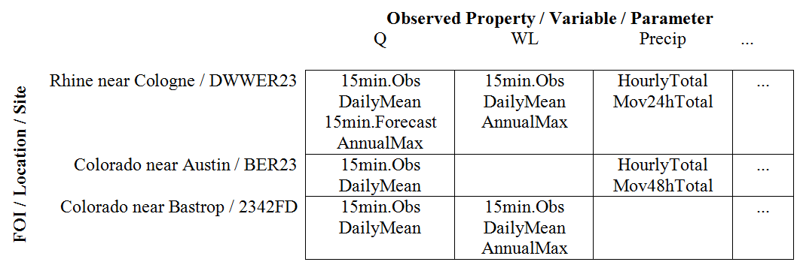
Real World Time Series do not occur homogeneous
Processes /
Time Series Types

