Slide 1

Observed Observable Properties - from HY_Features perspective -
OGC Hydrology Domain Working Group
3rd Meeting, Reading, UK, June 25-29, 2012
Irina Dornblut, Global Runoff Data Centre of WMO
Copyright © 2012 Open Geospatial Consortium

Slide 2
Observed Observable Properties
Hydrologic Variables
Existing concepts of feature property
Basic concept of observed observable properties
Next Steps ? How to proceed ?
Copyright © 2012 Open Geospatial Consortium

Slide 3
Hydrologic Variables
Quantity: expressed by means of a number and a reference,
  Discrete: representing a multitude created from counting entities, i.e answering the question "how many?"
  Extensive: whose magnitude increase/decrease with the extent, i.e. is additive.
  Intensive: whose magnitude is independent of the extent of the system or the amount of the entities inside, i.e. not additive
Ordinal quantity: total ordering relation with quantities of the same kind, but no algebraic operations among those quantities
Nominal property: representing a logic concept, where the property has a category value expressed by words, codes, etc.
Copyright © 2012 Open Geospatial Consortium

Slide 4
Hydrologic Variables
Quantities
same physical dimension, but different kind/type
carried by the hydrologic feature independent from possible values
may be derived from one or more base quantities
may be component of another property
may be created from combination of one or more non-related component quantities in respect to the feature of interest
descriptive names, e.g. expressing an accepted reference
Copyright © 2012 Open Geospatial Consortium

Slide 5
Hydrologic Variable Names, e.g. terms from IGH
specific discharge (from a basin)
discharge coefficient
bankfull discharge
specific discharge (of groundwater)
critical discharge
peak discharge
discharge (rate of flow)
Discharge
maximum instantaneous discharge
bed-load discharge
sediment discharge
mean monthly discharge
groundwater discharge
minimum annual discharge
modulus of groundwater discharge
(source: WMO (2009), WMO International Glossary of Hydrology. )
Copyright © 2012 Open Geospatial Consortium

Slide 6
Observed Observable Properties
Characteristic attributes of hydrologic features
  Carried by the hydrologic feature of interest,
  Observable, i.e. amendable for observation
  Determined by applying multiple constraints referencing a material, substance, organism, or specific procedure
  Observed when the result, a distinct value, is „fixed“,
  Descriptive names, usually referencing an applied constraint,
  Identified by referencing a name and the constraints
Key classifiers for discovery of data and data products
  → „Property of interest“ of different Web services
  → Common concept of observed observable properties required
Copyright © 2012 Open Geospatial Consortium

Slide 7
Observed Observable Properties
Variables observed in hydrology, examples
Existing concepts of feature property
  GF_PropertyType of the General Feature Model (meta-level)
  HY_HydroFeatureCharacteristics of HY_Features model
  observedProperty of Observation & Measurements model
  phenomenon in SWE SensorML
  measure of Conceptual Schema Language
  „physical properties“ in SWEET ontology
  „Quantities and Units“ in ISO 80000 series
Basic concept of observed observable property
Next Steps ? How to proceed ?
Copyright © 2012 Open Geospatial Consortium

Slide 8
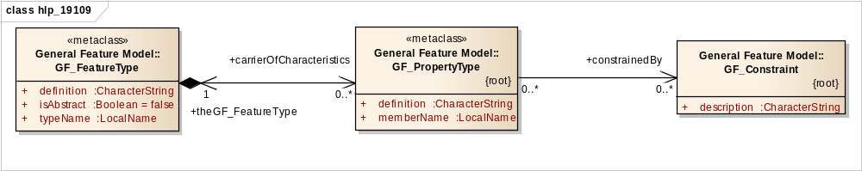
Existing concepts of feature property
GF_PropertyType of the GFM (ISO 19109:2005)
Attributes, behaviour, or relationships of a feature.
Referenced by a name and an optional constraint.
Constraint defined by application „to ensure integrity“ of the value
GF_ThematicAttributeType subtype representing attributes … whose value types and values are usually defined by application.
Variable is thematic attribute carried by the feature of interest
Each variable may be considered as constrained property
Copyright © 2012 Open Geospatial Consortium

Slide 9
Existing concepts of feature property
Observation properties of O&M model (ISO 19156:2010)
“… observation results in a value being assigned to a phenomenon”.
“… phenomenon is a property of a feature, the latter being the feature of interest of the observation. “
“… key idea is that the observation result is an estimate of the value of some property of the feature of interest, and the other observation properties provide context or metadata to support evaluation, interpretation and use of the result. “
“… property of interest may be indirect, relying on direct observation of a more convenient parameter, which is a proxy for the ultimate property of interest [whose value is obtained] applying an algorithm or processing chain.”
“… observation model requires that the feature of interest of the initial observation be of a type that carries the observed property within its properties. Thus, if the proxy property is not a member of the ultimate feature of interest, a proxy feature with a suitable model must be involved. “
Copyright © 2012 Open Geospatial Consortium

Slide 10
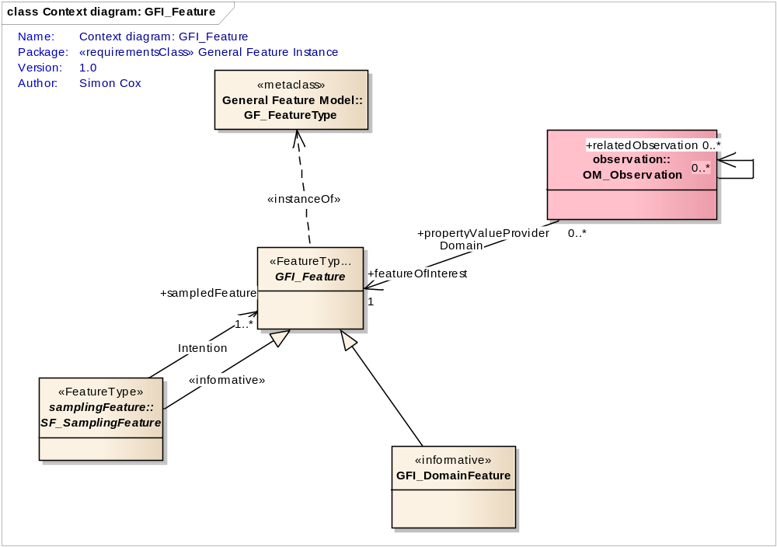



Existing concepts of feature property
observedProperty of O&M model (ISO 19156:2010)
Phenomenon
+observedProperty
+ characteristics
Copyright © 2012 Open Geospatial Consortium

Slide 11
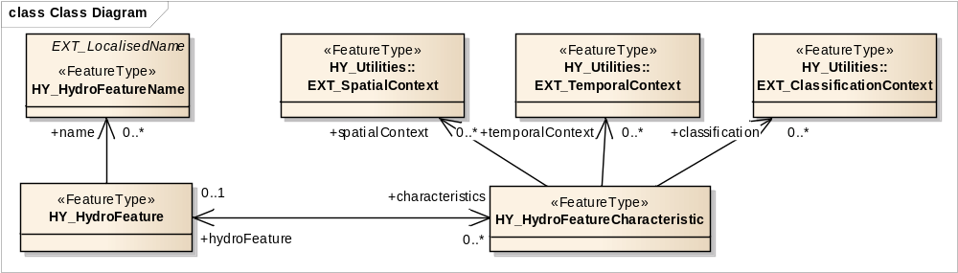

Existing concepts of feature property
HY_HydroFeatureCharacteristics of HY_Features (OGC 11-039r2)
observable characteristics of a „hydroFeature“
in spatial, temporal or classification contexts
intended to use a common concept to identify separately
  observable property by name and reference
  observed property by name and reference
may be substituted by an appropriate common concept
Copyright © 2012 Open Geospatial Consortium

Slide 12
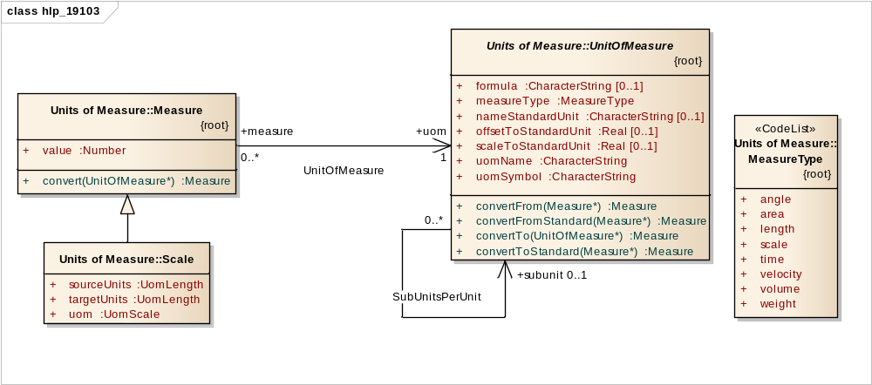
Existing concepts of feature property
measure of Conceptual Schema Language (ISO 19103:2005)
„UnitOfMeasure“ = Unit Of Measurement
„Measure“ = result, i.e. value expressing a magnitude or multitude
„Scale“ not to be confused with value scale (set of arranged values)
Values of nominal and ordinal properties not in the concern
„… systems devised to measure some physical quantity such distance or area or a system devised to measure such things as the passage of time.“
„result from performing the act or process of ascertaining the extent, dimensions, or quantity of some entity.“
„ratio of one quantity to another, often unitless in the case where the two quantities use the same unit“
Copyright © 2012 Open Geospatial Consortium

Slide 13
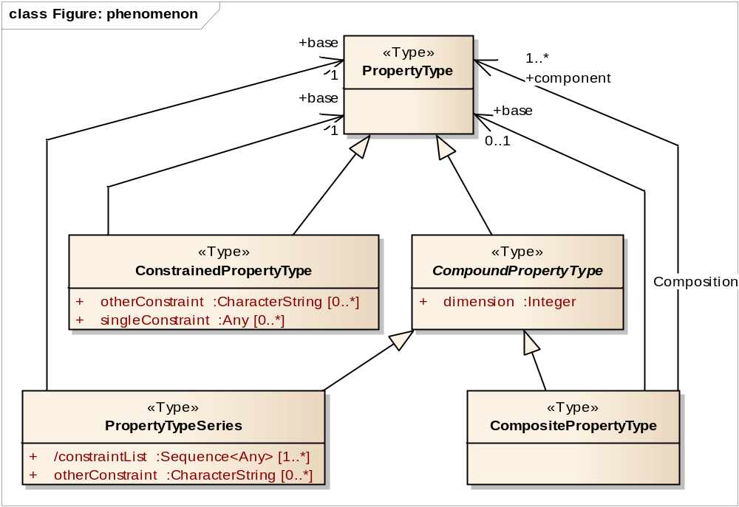
Existing concepts of feature property
phenomenon of SWE SensorML (OGC 07-000)
„dimension“ not to be confused with quantity dimension (dimQ)
Constraint (subtype of property) vs. GF_Constraint
… modifies a base property-type by adding singleConstraints, each specifying a value …
… several components, whose count is indicated by dimension.
… applies one or more constraintLists …, each providing a set of values …
… set of component property-types … [that] may not be related to each other …
Copyright © 2012 Open Geospatial Consortium

Slide 14
Existing concepts of feature property
„Quantities and Units“ (ISO 80000 series, substitutes ISO 31 series)
ISO 80000-1: general information and definitions concerning quantities, systems of quantities, units, quantity and unit symbols, and coherent unit systems, especially the International System of Quantities, ISQ, and the International System of Units, SI.
Principles intended for general use within the various fields of science and technology, i.e. domains of application
Referencing ISO/IEC Guide 99:2007, International vocabulary of metrology — Basic and general concepts and associated terms (VIM)
Concept of base and derived quantities and units
Ordinal quantities and nominal properties are outside the scope, but the basic principles are applicable to these
→ Key reference for a concept of properties, i.e. thematic attributes
Copyright © 2012 Open Geospatial Consortium

Slide 15
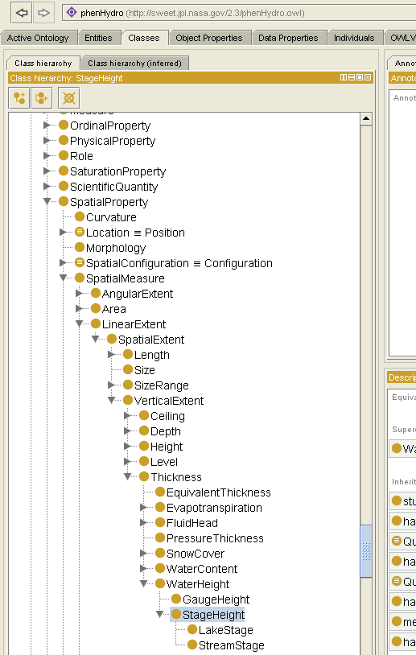
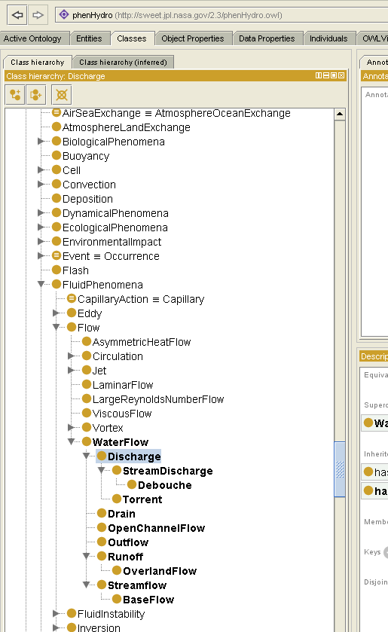
Existing concepts of feature property
„physical properties“ of SWEET ontology
“mirror scientist’s dual methods of reductionism and synthesis”
  „decomposition“ of individual concepts of properties
    „physical property“ (i.e. quantity)
    „element that the property applies to” (i.e. referenced medium)
    „numerics” applied within observation (i.e. referenced procedure)
    „units“ (i.e. referenced unit of measurement)
  “unifying ... concepts” in respect to the feature of interest
  (source: Raskin (n.d.): Guide to SWEET Ontologies )
Copyright © 2012 Open Geospatial Consortium

Slide 16
Observed Observable Properties
Hydrologic Variables, examples
Existing concepts of feature property
Basic concept of observed observable properties
  propertyOfInterest
  constrainedBy reference
  observable property
  observed observable
Next Steps ? How to proceed ?
Copyright © 2012 Open Geospatial Consortium

Slide 17
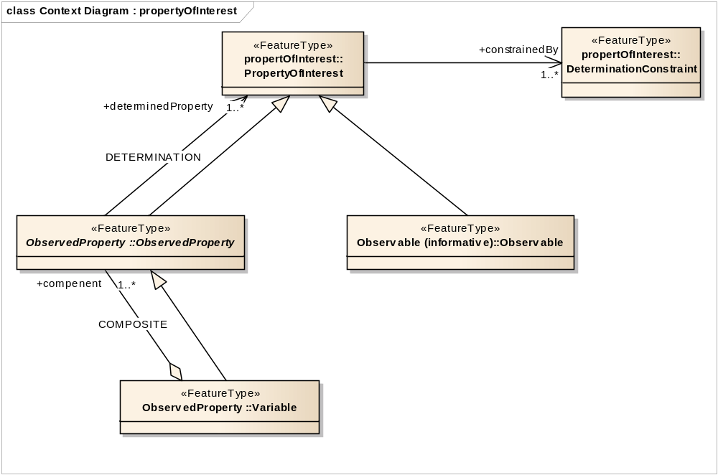
Observed Observable Property – Basic concept
PropertyOfInterest
particular observable property, or
observed property (i.e. variable): one determined, but constrained, property of the sampled feature (one of many)
Variable which may take any value of a specified set of values (IGH)
Copyright © 2012 Open Geospatial Consortium

Slide 18
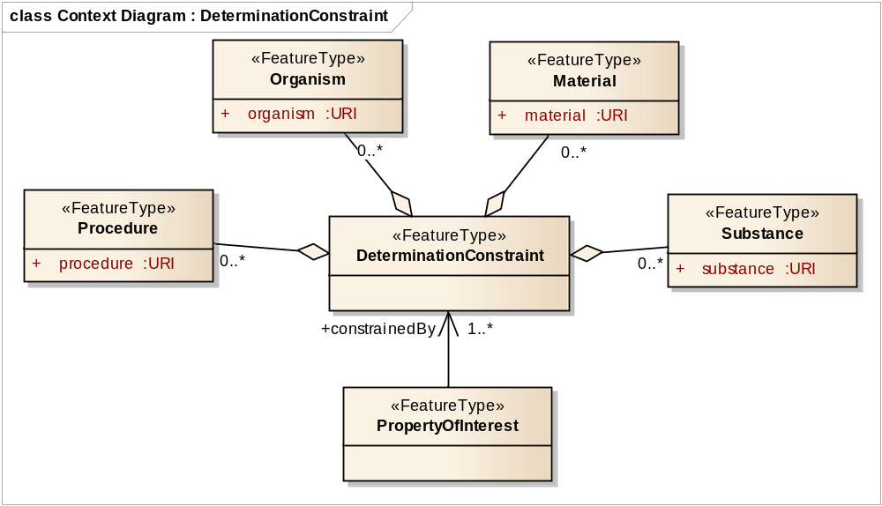
Observed Observable Property – Basic concept
constrainedBy Determination
Copyright © 2012 Open Geospatial Consortium

Slide 19
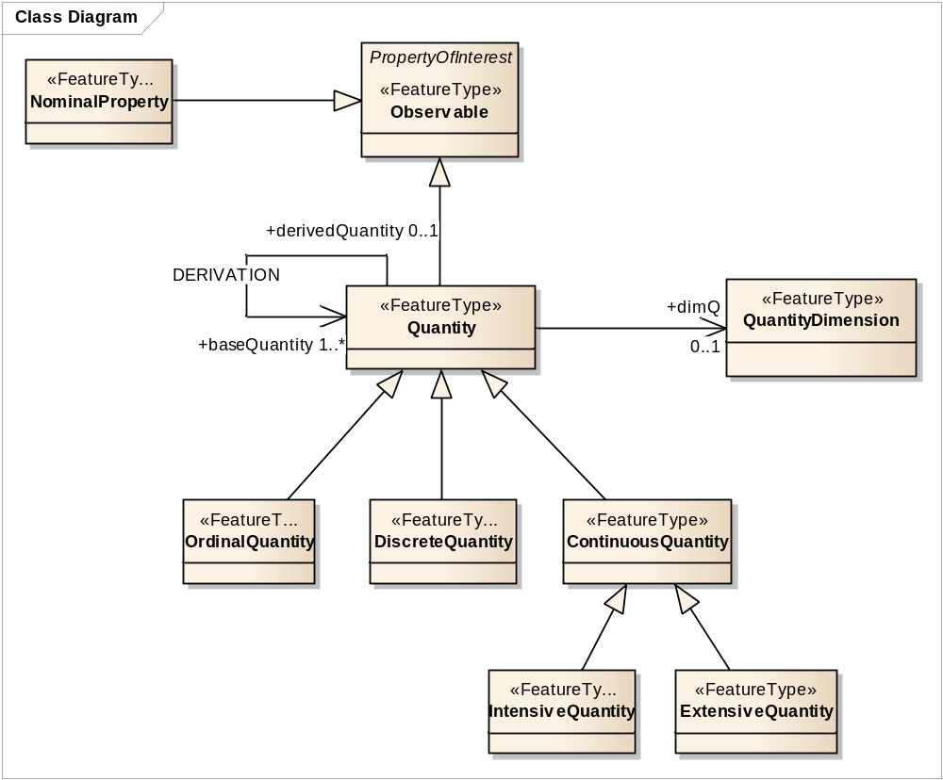
Observed Observable Property – Basic concept
Observable
(informative)
Copyright © 2012 Open Geospatial Consortium

Slide 20
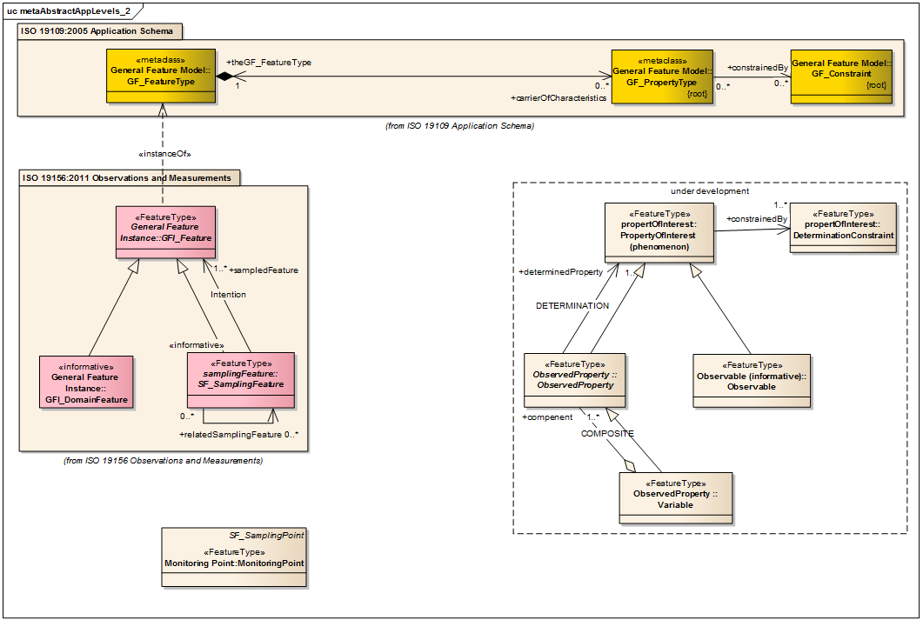
Observed Observable Property of GFI_Feature
?

Slide 21

O&M: Result is an estimate of the value …
+observedProperty
ESTIMATE
…..
Measure
Coverage
Record
Category
…..

Slide 22
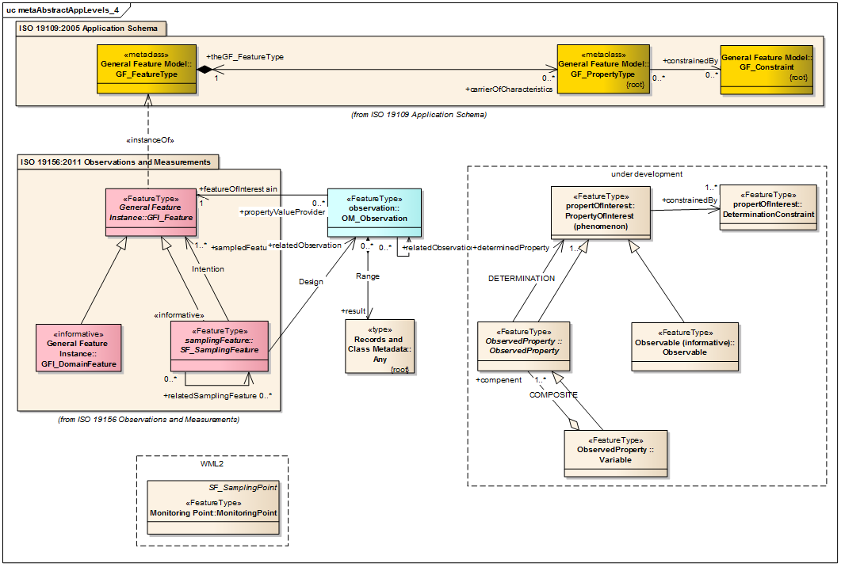
O&M: Observation properties provide metadata …
+propertyOfInterest
PHENOMENON
…..
Measure
Coverage
Record
Category
…..
Copyright © 2012 Open Geospatial Consortium

Slide 23
Separation of concerns
+propertyOfInterest
PHENOMENON
+observedProperty
ESTIMATE
…..
Measure
Coverage
Record
Category
…..
Copyright © 2012 Open Geospatial Consortium

Slide 24


Separation of concerns
+propertyOfInterest
PHENOMENON
+observedProperty
ESTIMATE
+ positionOnRiver
…..
Measure
Coverage
Record
Category
…..
Copyright © 2012 Open Geospatial Consortium

Slide 25
Observed Observable Property
Concept to identify the property of interest
in the sense of General Feature Model (ISO 19109)
in the sense of Observation & Measurement model (ISO 19156)
  particular observable property, or
  observed property as a proxy for the ultimate POI
in line with the definitions of ISO 80000-1: Quantities and Units
  expressing a variable by the property value and the reference (constraint)
  applying the basic principles to all types of a property of interest
considering the basic principles of SWEET
  „decomposition“ - by reference to multiple constraints
  „unifying“ - by adressing a ultimate property of interest
may support separate queries and offerings adressing
  (non-observed) observable
  the observed property
Copyright © 2012 Open Geospatial Consortium

Slide 26
Observed Observable Properties
Hydrologic Variables, examples
Existing concepts of feature property
Basic concept of observed observable properties
Next Steps ? How to proceed ?
Copyright © 2012 Open Geospatial Consortium

Slide 27
How to proceed? Next steps?
Consolidation of concepts
OGC Discussion paper
….. …..
Part of Hydrologic Metadata concept within WIS / WIGOS
→ 14th session of WMO-CHy (November 2012)
5. Best Practice Doc ?
Thank you for attention !
Copyright © 2012 Open Geospatial Consortium

