Slide 1
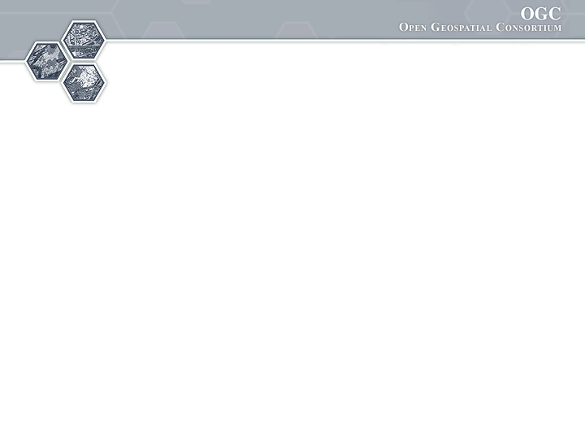

®
Sponsored and hosted by
Groundwater Interoperability Experiment - Update
73rd OGC Technical Committee
Silver Spring, MD USA
B.Brodaric, N.Booth
June 15, 2010

Slide 2
IE Context
GW is a significant source of water for humans
Ground/water feature and observation data
- distributed: many data providers (~1000 in Canada alone)
- heterogeneous: structure and content (e.g. level, flow, quality)
- massive instances: millions of wells (features/sensors) & time series (observ.)
- massive schema: thousands of properties (e.g. for quality)
- few standard services: very few OGC gr/water services
Existing schema standards for water
- WaterML (USA), GroundwaterML (CAN), WTDF (AU), WQX (USA), OGC O&M, SensorML,…
- consolidation in WaterML 2 via OGC HDWG
Relevant OGC Web service standards
- SOS, WFS, WMS, CSW

Slide 3




IE Participants (to date--alphabetical)
CSIRO
Peter Taylor
UnivCalgary
Steve Liang
GSC
Boyan Brodaric
Eric Boisvert
Heryk Julien
Francois Letourneau
Dave Sharpe
Alex Smirnoff
34N
Ayme Osti
Nathan Hemenway
IL Water Survey
Yong Liu
Kisters
Stephen Fuest
USGS
Nate Booth
Dave Briar
Tom Kunicki
I-Lin Kuo
SDSC /
CUAHSI
David Valentine

Slide 4
Sensor sites & well locations

Slide 5
IE Objectives
Ground/Water feature and observation interop:
Advance design of WaterML 2 schema
- harmonize existing schemas
Advance fit of OGC services with gr/water data
- SOS, WFS, WMS, CSW
Advance GW data exchange between US & CAN
- in cross-border Great Lakes area (Lake Superior) for water wells and levels

Slide 6
IE Issues
Advance design of WaterML 2 schema
- merge or link existing schemas (WaterML, O&M, GWML)?
- when to restrict: what is special about gr/water observations?
- when not to restrict: does it need to be extensible?
Advance fit of OGC services with gr/water data
- SOS 1: not designed for massive networks (i.e. GetCap lists each sensor)
- CSW: include individual sensors?
Advance GW data exchange between US & CAN
- what is a gr/water observation?
1/n sensors, 1/n time points, 1/n time series, 1/n properties?

Slide 7
IE Use-Case
View, query and download water wells & levels:
View US & CAN well/sensor locations
- WMS (GetMap)
Query on one well/sensor and display data
- WMS (GetFeatureInfo)
- well: WFS (getFeature via BBOX) or
- level: SOS (GetObservation via BBOX)
- return GWML or WaterML and display as HTML
Download cross-border wells and levels
- Zoom to area of interest (find BBOX)
- well: WFS (GetFeature via BBOX and thematic filter) or
- level: SOS (GetObservation via BBOX and time filter)
- Export as GWML, WaterML, Excell, or KML

Slide 8
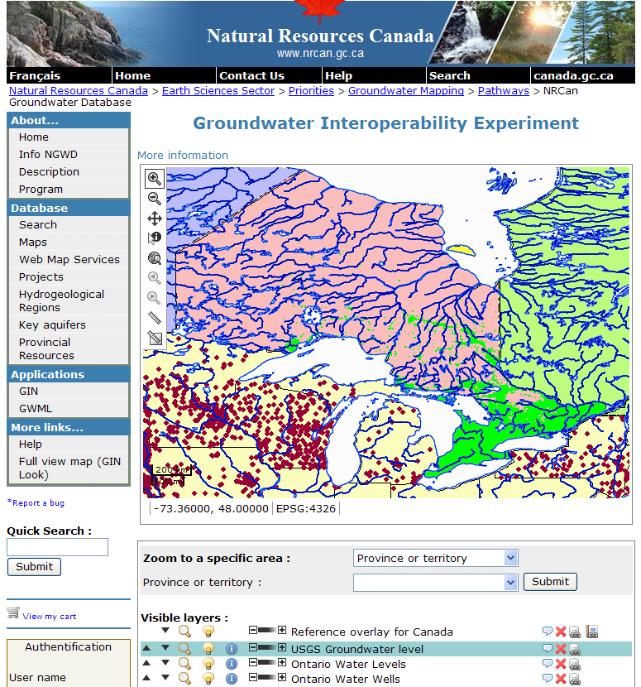
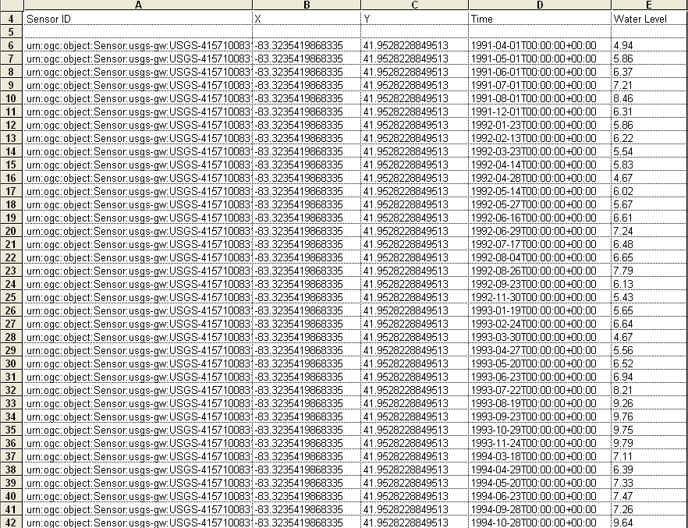
IE Milestone 1 Results
Advance fit of OGC services with gr/water data
- preliminary services established: SOS (WaterML2) and WFS (GWML—GSC)
Advance GW data exchange between US & CAN
- cross-border groundwater levels displayed, queried, downloaded
query
download
view

Slide 9
IE Update
WaterML2 development – weekly meetings
June 2010
  WaterML2 freeze
  September timeframe for standing up this version of WaterML2 through SOS
USGS – WFS for well lithology
USGS to symbolize wells that have vs don't have lithology differently
Feedback to 34N on client

Slide 10
IE TO-DO
SOS2 - getCapabilities -- Eric will make a stopgap proposal spec for getCap for the IE
USGS to symbolize wells that have vs don't have lithology differently
Kisters to stand up WISKI client
Calgary to stand up services
Unify units

Slide 11
Final notes
Public IE Wiki
http://external.opengis.org/twiki_public/bin/view/HydrologyDWG/GroundwaterInteroperabilityExperiment
Thank you!

Slide 12
demo

Slide 13
Design issues:
- Conceptual model for Sampling and Sampled Features for gr and surface water
- Nested Sampling and Sampled Feature
- content profile to determine what to put in the Sampled and Sampled Feature boxes for gr/water
- result: TimeSeries (one sensor, many times, one phenomena type, many values)
Quality (one sensor, one time, many phenomena type, one value)
need conceptual model for consistent results
Services issues:
- use-case for sensor data discovery that is not visual based
Next milestone:
- temporal filters, value filters, sampled featured: June 2010 (multiple phenomena in March?)
- WFS results for GWML: March 2010
- constrain results model in schema/profile (instances, schema): March 2010
- SOS return new results schema: June 2010
- CSW prototype for services as well as sensor metadata: June 2010

