Slide 1
Using Existing And Emerging OGC Standards to Support Hydrologic Models
Nate Booth, Roland Viger, Tom Kunicki, Dave Blodgett, Ivan Suftin

Slide 2
Project Scope
Build software to catalog, access and assimilate data for model parameterization and input
Develop techniques and software to archive models and document data lineage
Work with data providers to make datasets more readily available to hydrologic models via open standards

Slide 3
Geo Data Portal
Provide modelers with easier access to large geospatial datasets
  Provide “best available data” catalog
  Apply spatial and temporal pre/post-processing
  Output to model-friendly formats
  Architecture to support new modules and tools

Slide 4
(Current) Geo Data Portal Workflow
Define area of interest: Any polygon shape file
Select a target dataset to intersect with above
Select time range of interest
Submit
Weighted statistics of gridded data sets are calculated for user specified polygons
Point data is passed through for area of interest

Slide 5



Datasets
Meteorological
Global Summary of Day Station Data
River Forecasting Center's Radar-Rain Gage-PRISM 4km Gridded Rainfall
North American Regional Reanalysis 32km Gridded Data
12km Gridded Meteorological Observations from Climate Change Community
National Solar Radiation Database
PRISM Parameter-Elevation Regression on independent Slopes Model Downscaled climate models
Land
National Land Cover Dataset
10m National Elevation Dataset
SSURGO Polygons with Horizons for Lake Michigan
Vertically Averaged SSURGO on a 10m National Grid
Global Shuttle Radar Topography

Slide 6
Geo Data Portal
1
Common Data Model (NetCDF- Java)
Modeling extent(s)
-BBOX, Shpfile, GML
Point Timeseries
(NetCDF-CF SOS, JDBC)
GCMs to climate stations
Streamflow
Geoprocessing
Web Service
4
2
Formatted model input.
Retrieve, Subset
Grid Timeseries
(OpenDAP)
GCMs
Meteorological Observations
Aggregate, summarize
3
Grid static
(OpenDAP, WCS)
-DEM, Soils, Landcover

Slide 7
Demo

Slide 8
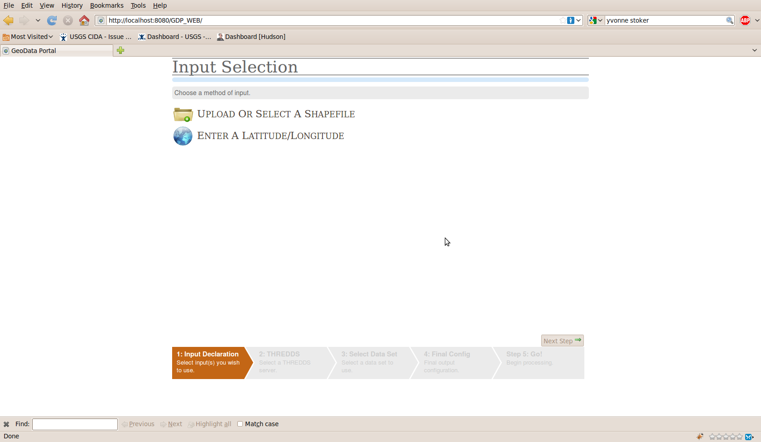

Slide 11
GSOD = Global Summary of Day (NOAA NCDC)

