Slide 1
CF Conventions for Discrete Sampling (aka Point) Data
Ben Domenico
(based on netCDF and CF community documents)
for
Hydrology DWG at OGC TC
June 2010

Slide 2
NetCDF Background
Mainly Unidata developed, maintained, supported
Backward compatible for since 1989
Fully supported
Dedicated staff
Email lists
Training workshops
Widespread usage in many diverse disciplines
Integrated into scores of commercial and freely available applications packages

Slide 3
Sampling of International Installations
(Australia) CSIRO Marine and Atmospheric Research (CMAR) Remote Sensing
(Australia) Centre for Australian Weather and Climate Research (CAWCR)
(France) AVISO (satellite data)
(France) French Research Institute for Exploitation of the Sea (IFREMER)
(Italy) International Centre for Theoretical Physics (ICTP)
(South Korea) Seoul National University (SNU)
(Netherlands) European Climate Assessment (ECA), Atmospheric Data Access for the Geospatial User Community (ADAGUC) product standard

Slide 4
Sampling of NOAA Installations
GFDL
NCEP NOMADS service
PMEL
FSL
NCDC NOMADS service
NDBC (National Buoy Data Center)
NOS/COOPS
NMFS/PFEL
ESRL (formerly CDC)
NODC (under development)

Slide 5
Other US Agencies
DOE/PCMDI
NASA/JPL
NASA/GSFC
GHRSST-PP community
US Navy/ Fleet Numerical/GODAE Data Server
OceanSITES.org
National Snow and Ice Data Center (NSIDC)
USGS, Woods Hole Field Center (WHFC)
National Center for Atmospheric Research (NCAR)
Center for Ocean-Land-Atmosphere Studies (COLA)
George Mason University (GMU) Center for Earth Observing and Space Research

Slide 6
Commercial netCDF Apps
Mathematica
MATLAB
Noesys
Origin
PPLUS
PV-Wave
Slicer Dicer
vGeo
VISAGE and Decimate
ASA ViewNcDap
AVS
EnSight
Environmental WorkBench
ESRI
IDL Interface
Intel Array Visualizer
InterFormat
IRIS Explorer Module
LeoNetCDF
Plus more than 60 freely available packages.

Slide 7
NetCDF Overview
Model for scientific data: variables, dimensions, attributes, coordinates
Libraries for data access: C, Fortran, C++, Java, Perl, Python, Ruby, Matlab, IDL, ...
Format for portable binary data that supports direct access, metadata, appending new data, shared access
Users need not know anything about format

Slide 8
NetCDF Data Model
Variables: name, shape (list of Dimensions), type, Attributes, values
Dimensions: name, length
Attributes: name, type, value(s)
Coordinate Variables: values associated with Dimensions

Slide 9
NetCDF Data Model
Dataset
location: String
Attribute
Dimension
name: String
value: Vector
type: DataType
name: String
length: int
isUnlimited: boolean
Variable
name: String
shape: Dimension[ ]
type: DataType
same name
CoordinateVariable
ValuesArray
name: String
shape: Dimension[1]
type: DataType
type: primitive
shape: int[ ]

Slide 10
netCDF Variables
Name: e.g. air_temperature
Type: byte, short, int, float, double, string
Shape: e.g. (time, height, lon, lat)
Attributes: e.g. units, long_name, ...
Values: scalar or multidimensional array

Slide 11
NetCDF CF Conventions
Climate and Forecast metadata conventions
  Metadata for use, not discovery
  http://www.cgd.ucar.edu/cms/eaton/cf-metadata/CF-1.0.html
  Adopted by: PCMDI, PRISM, ESMF, NCAR, Hadley Centre, GFDL, various EU projects
  Developed by volunteers, active email list
Includes georeferencing conventions for multidimensional coordinate systems
Includes a “Standard Name Table” for quantities
  Google for “CF standard name table”
  76 of 416 entries (as of June 3, 2004) relate to hydrology

Slide 12
Historically for Gridded Data
Examples: model outputs, reanalysis archives
Typically dependent variables located on multidimensional grid with coordinates, e.g. lat, lon, level, time
dimensions:
lat=18; lon=36; pres=15; time=UNLIMITED;
variables:
float xwind(time, pres, lat, lon);
xwind:long_name = “zonal wind”;
xwind:units = ”m/s”;
float relHumidity(time, pres, lat, lon);
relHumidity:units = “percent”;
double lon(lon); lon:units = “degrees_E”;
double lat(lat); lat:units = “degrees_N”;
int pres(pres); pres:units = “millibars”;
double time(time); time:units = “days since 1990-1-1 0:0:0”;
xwind(n,k,j,i) is associated with lon(i), lat(j), pres(k), time(n)

Slide 13
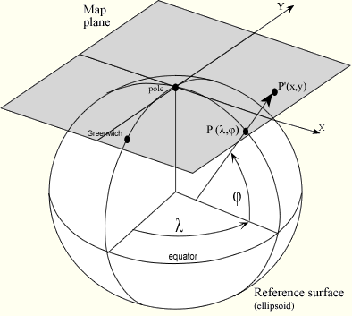
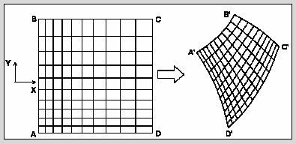
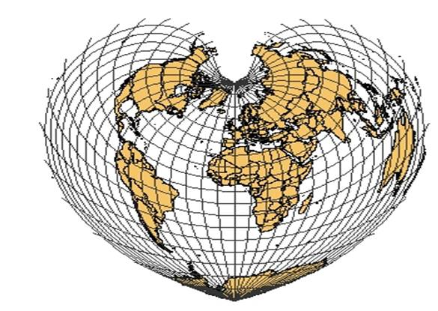
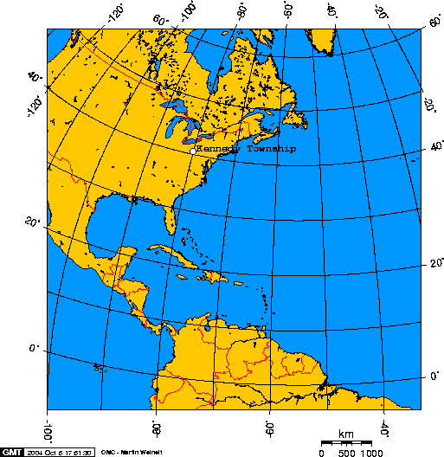

Gridded Data

Slide 14
Discrete Sampling Data Types
point: one or more parameters measured at a set of points in time and space
timeSeries: a time-series of data points at the same location, with varying time
trajectory: a connected set of data points along a 1D curve in time and space
profile: a set of data points along a vertical line
timeSeriesProfile: a time-series of profiles at a named location
trajectoryProfile: a collection of profiles which originate along a trajectory.

Slide 16
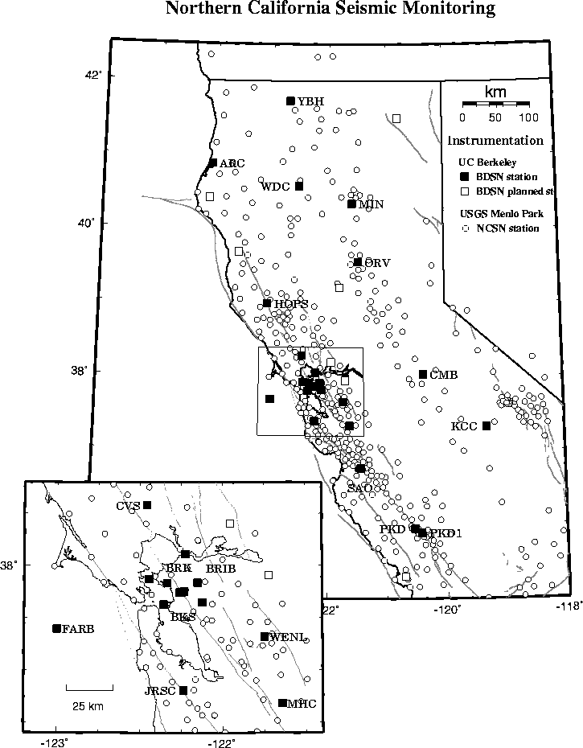
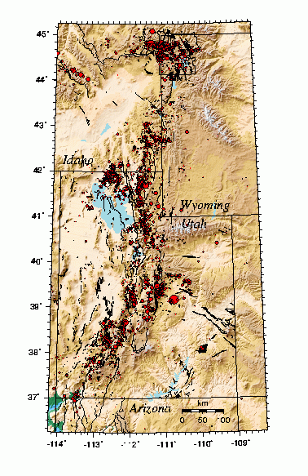
Point Observation Data

Slide 17
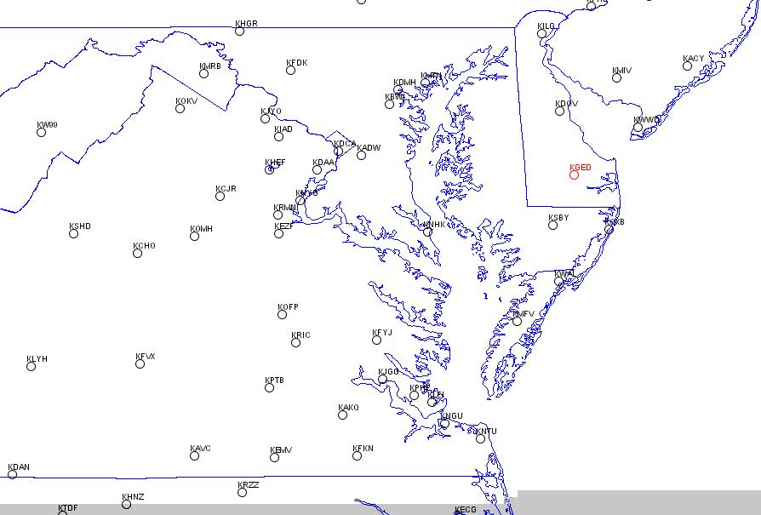
Station Data

Slide 18
Trajectory Data

Slide 19
Coordinates:
Geospatial and Temporal Location
The coordinates attribute must identify the variables needed to geospatially position and time locate the observation. The lat, lon and time coordinates must always exist; a vertical coordinate may exist.
The geospatial/time location must be unambiguous, and so the coordinates attribute must not point to multiple lat, lon, alt/depth or time coordinates.
The coordinates attribute may optionally include other station info, such as station name and other metadata.
If a useful station name exists, that name should be included as a station variable and the attribute standard_name = "station_id" should be included on this variable.
The vertical coordinate is optional but strongly recommended.

Slide 20
For netCDF Classic:
Two Ways to Represent Point Data
the multidimensional (rectangular array) representation is simpler but requires that the same amount of space be reserved for each feature stored in the file
the ragged array representation allows different features to be stored with different lengths in the file
Note: enhanced netCDF has structures and groups so the representation is simpler

Slide 21
Representations
Single observation set (point, profile, trajectory)
Time series (of points, profiles, trajectories?)
Rectangular array (aka multidimensional)
Ragged array (contiguous)
Ragged array (indexed)

Slide 22
Platforms and Observations
Station: named observing platform, fixed in space (e.g., weather station, river gaging station, tethered buoy)
Trajectory: named observing platform, moving in space (e.g., aircraft flight, ship track, drifting buoy path, ocean glider path)
Point observation: observation local to observing platform (station or trajectory)
Profile: vertical sounding relative to horizontal position of observing platform. (Profiles are not named but can be associated with a named station or trajectory.)

Slide 23
Ben’s Observations
In all cases, it is possible to simply include the lat, lon, z, and time with each observation value
Observations from individual stations or trajectories may be grouped within a netCDF file (rectangular or ragged contiguous)
Obs from different platforms may be interspersed within a netCDF (indexed ragged) with the station or trajectory name given for each observation
All obs from a given profile (not named) are always grouped together within a netCDF.

Slide 24
Interchanging Semantics
NetCDF defines syntax
CF provides
  coordinate semantics
  framework for discipline semantics (standard names)
Valuable exercise to transform from ODM and WaterML back and forth to CF-netCDF
CUAHSI ODM and WaterML are rich in hydro semantic meaning
A very useful project would be to incorporate hydrology semantics into CF standard names

Slide 25
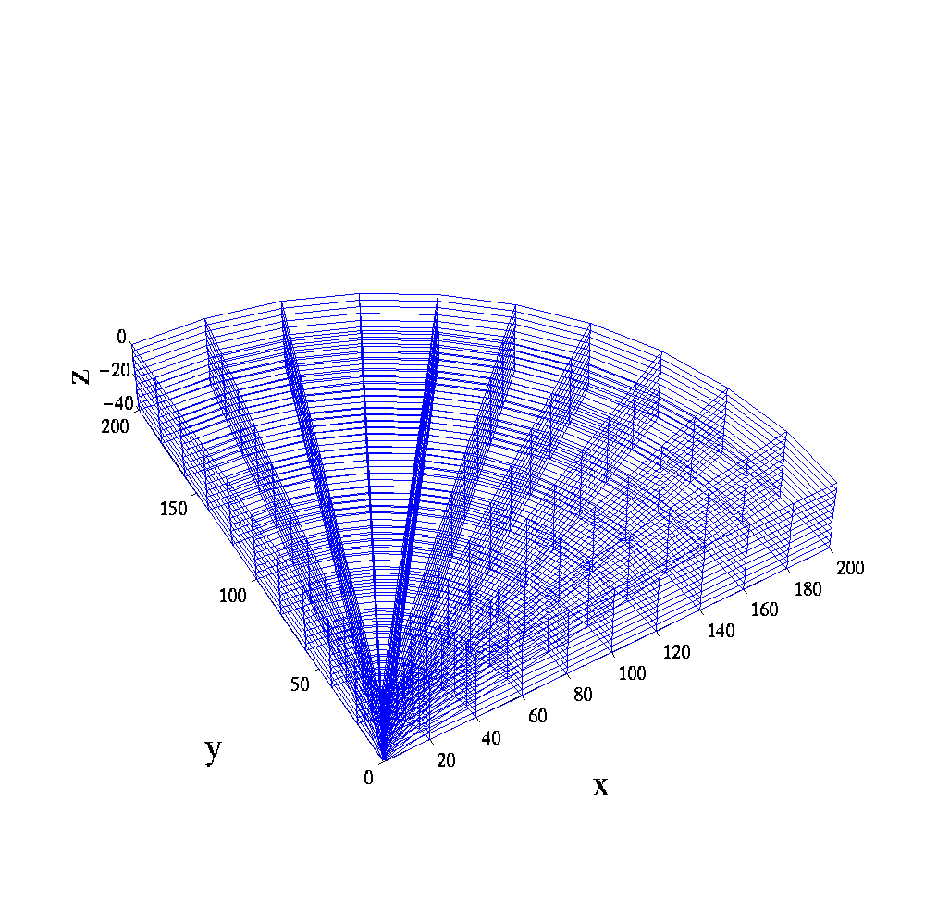
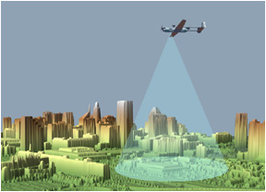
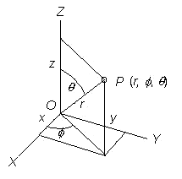
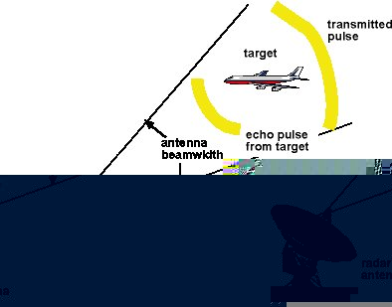
Radial Data

Slide 26
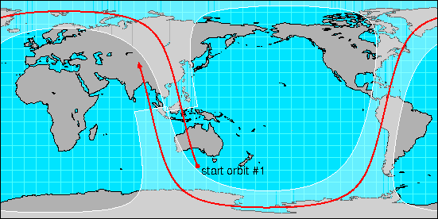
Image/Swath

Slide 27
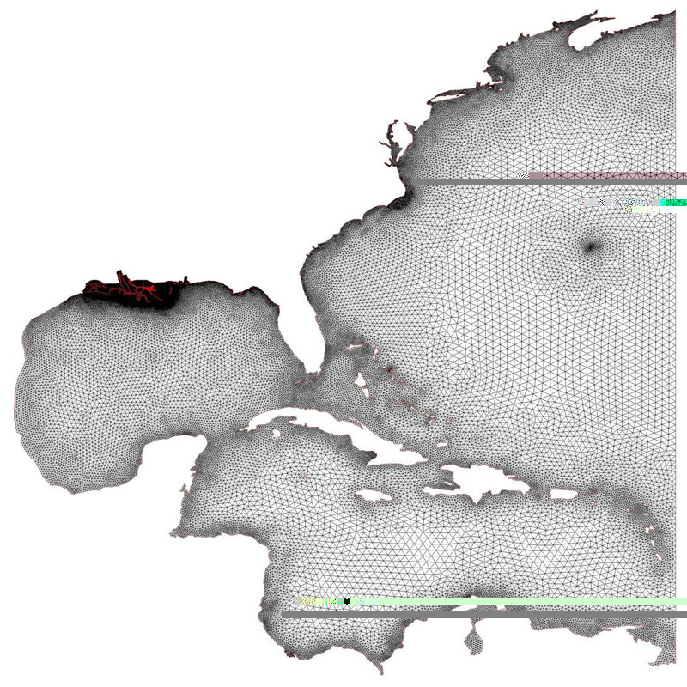
Unstructured Grids
© Copyright 2008 The University of Texas at Austin

Slide 28
More Information
NetCDF
  http://www.unidata.ucar.edu/software/netcdf/
  http://www.unidata.ucar.edu/software/netcdf-java/
CF Conventions
  CF Conventions Home page
  Proposed CF Convention for Point Observation Data
  CF Point Observation Data encoding Table
Email
  support@unidata.ucar.edu
  ben@unidata.ucar.edu

