Slide 1
Feedback from 1st Workshop of the Hydro DWG and
Moving Forward
David Lemon (CSIRO)
OGC/WMO Hydrology Domain Working Group
June OGC TC 2010

Slide 2
Ispra Workshop

Slide 3
Ispra Workshop
15 – 18th March 2010
Held at JRC, Ispra, Italy
  A big Thank You to staff at JRC for hosting
Attended by
  23 people (at least)
  Australia, US, Canada, UK, Germany, France, Sweden, Belgium, The Netherlands, Italy, Switzerland
  CSIRO, USGS, JRC, OGC, GSC, 52 North, Kisters, GRDC, CEH, Deltares, IOW, disy, BRGM, SUAS, IDSIA, BOM, CUAHSI, UNESCO-IHE

Slide 4
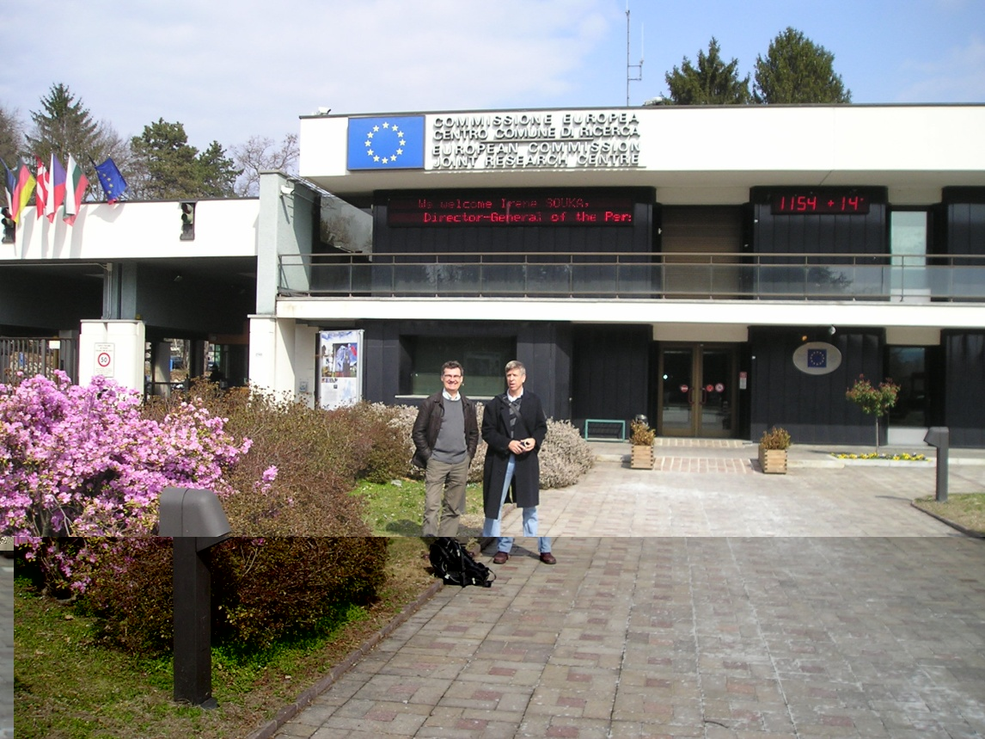
Ispra Workshop
Very full agenda
  Monday and Thursday focussed on WaterML2.0 and IEs (Groundwater and Surface Water)
  Tuesday and Wednesday for formal presentations
    INSPIRE
    IEs
    Public Seminar
    Model Integration
    Real World Use Cases
    Information Modelling
    Review of Workplan
  Presentations (mostly)
  on Hydro DWG Twiki

Slide 5
Next Meeting
Offer from Ann van Griensven
  UNESCO-IHE Institute for Water Education, Delft
  Held in association with Open Water Symposium
  April 18/19 2011
Alternative
  Align with Bonn TC meeting
  hosted by GRDC
Or
  Somewhere in North America

Slide 6
The Hydrology Domain Working Group

Slide 7
WMO
‘... the UN system's authoritative voice on the state and behaviour of the Earth's atmosphere, its interaction with the oceans, the climate it produces and the resulting distribution of water resources’
‘... facilitates the free and unrestricted exchange
of data and information, products and services in real- or near-real time ...’

Slide 8
Hydrology Domain Working Group
A joint working group of the OGC and WMO constituted as an OGC Domain Working Group.
Brings together interested parties to develop and promote the technology for greatly improving the way in which water information is described and shared.
Co-chaired by representatives nominated by the OGC TC and the World Meteorological Organisation’s (WMO) Commission for Hydrology (CHy).
    Current Co-Chairs: Ilya Zaslavsky (SDSC), Ulrich Looser (GRDC) and David Lemon (CSIRO)
    > 50 Participants, > 30 Organisations

Slide 9
Charter
To provide a venue and mechanism for seeking technical and institutional solutions to the challenge of describing and exchanging data describing the state and location of water resources, both above and below the ground surface.
The path to adoption will be through OGC papers and standards, advanced to ISO where appropriate, and also through the WMO’s CHy and WIS activities.
The Hydrology DWG will provide a means of developing candidate standards for adoption by CHy as appropriate.

Slide 10
Expected Outcomes
An agreed feature model (ie. what are the features of the hydrosphere (from an information perspective) and how are they related.)
An agreed observation model.
Agreed vocabularies, endorsed by the community, and by WMO in particular. Agreeing on semantics is a long process, but we should be able to recommend some vocabularies
Also: services carrying the above
© 2009 Open Geospatial Consortium, Inc.

Slide 11
Activities
Analysis and harmonization of existing commonly used protocols and standards in the domain
Interoperability Experiments (IEs) focused on selected sub-domains of water data (e.g. surface water, groundwater, water quality, water use, hydrologic forecasts, real time data)
Participation in GEO Architecture Implementation Pilots (AIPs), focused on broader scenarios within the entire domain and across domains
Submission of discussion papers and best practice papers (the latter following IE and AIP experiences)
Collaboration with other DWGs, in particular ESS (on modeling), MetOcean (on handling gridded data), SWE (on real time data management)
© 2009 Open Geospatial Consortium, Inc.

Slide 12
Timeline
September 2009: Discussion paper on harmonization of water data exchange formats (1st version) ; IE1 announced
December 2009: Update on the harmonization report; Proposed WaterML 2.0 schema announced; IE1 officially launched, IE 2 announced
June 2010: WaterML 2.0 submitted as a discussion paper ; IE2 launched Ontology task force started (with GRDC, CSIRO, CUAHSI, others) ; IE1 preliminary report;
December 2010: IE1 final report, a best practice paper based on the results
June 2011: IE2 final report, and a paper
December 2011: ???
© 2009 Open Geospatial Consortium, Inc.

Slide 13
The Hydrology Domain Working Group - Workplan

Slide 14
Hydro DWG Workplan
Two intersecting tracts of work
  Artefact Design
    Primarily responsible for developing standards\profiles
    So far have:
      WaterML 2.0
      GRDC Metadata Profile
    Need:
      Water Feature model(s)
      Vocabularies
  Interoperability Experiments
    Testing of artefacts within context of real use cases
    To date we have been testing WaterML2.0 (bits) as well as OGC specs

Slide 15
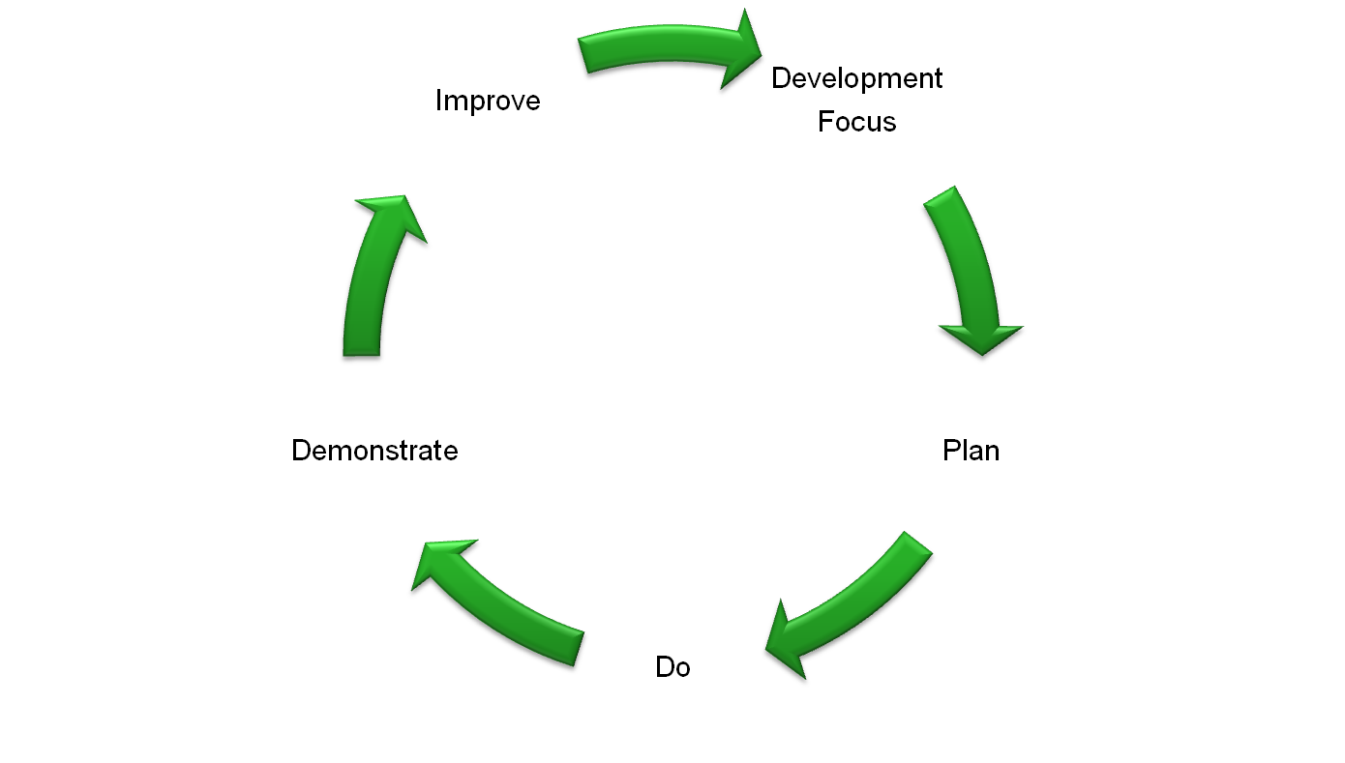
Iterative Development
Feedback to standards and services
Hydro-DWG workplan priority
Conclude IE
Demonstration
Observation Model
Feature Model
Develop
IE
Vocabularies
Services stack
Complete
IE
Thanks to Peter Fitch for this slide

Slide 16
Design Projects
Experience from WaterML2.0 suggests
  Start with Harmonisation Report (Discussion Paper)
    Looks at what’s been\being done
    Proposes way forward
  Develop RFC Package
    Use this to form SWG
  SWG does work to develop package for public comment
  SWG considers comments and takes appropriate action
    Halt, or
    Amend and send to vote by TC

Slide 17
Design Projects
Currently have:
  WaterML 2.0 – led by Peter Taylor (CSIRO)
  ISO19115 Profile – led by Irina Dornblut (GRDC)

Slide 18
Design Projects
Need:
  Water Features model(s)
    Look at INSPIRE, NHD+, GRDC work, AHGF, Swedish SS637008, GWML
    Needs to cope with: network behaviour at different scales, groundwater surface water interaction, …
  Water Vocabularies
    Should any be standardised? Which ones?
    Ontology Taskforce
  Profiles of OGC Stack
    HydroSOS? Hydro CSW? Hydro ???
  Volunteers!!!

Slide 19
Developing an IE
Experience from Groundwater and Surface Water suggests
  Process takes 6 months from initial discussion (over a beer) to kickoff
  Needs a dedicated leader (ie. Someone who cares a lot)
    The workload is not small (ask Peter F)
  Needs clearly articulated use cases that others are interested in.
    It helps if these are real.

Slide 20
Interoperability Experiments
Groundwater
  GSC\USGS
  Dec 09 – Dec 10
Surface Water
  CSIRO
  Jul 10 – Jul 11
Forecasting
  NWS\Deltares?
  Dec 10 – Dec 11
Water Quality
Water Use

Slide 21
Public mailing list https://lists.opengeospatial.org/mailman/listinfo/hydro.dwg
Twiki http://external.opengis.org/twiki_public/bin/view/HydrologyDWG
Thank you ...

