Slide 1

WaterML2.0/harmonization update
Sponsored and hosted by
NOAA
73rd OGC Technical Committee
Silver Springs, Maryland, USA
Peter Taylor & WaterML2 dev group
June 15, 2010
© 2010 Open Geospatial Consortium, Inc.

Slide 2
Overview
Brief history
Overview of current specification
Proposed process going forward
Services with WaterML2
Release of harmonisation report
© 2010 Open Geospatial Consortium, Inc.

Slide 3
Overview of current spec
Submission of WaterML1 document to OGC - 2007
Discussions began on aligning existing standards (WDTF, WML1…) - 2007
Formation of Hydrology Domain Working Group - 2008
More interested groups join (SANDRE, Kisters, USGS, NOAA,…) - 2009
Release of harmonisation report analysing current specifications - 2009
March meeting of WaterML2 group in Ispra, Italy - 2010
© 2010 Open Geospatial Consortium, Inc.

Slide 4
Current specification
First draft submitted here
Will be used as a basis for testing within the Surface Water and Groundwater Interoperability Experiments
Open for feedback!
  Thanks to everyone already for the feedback
  Issues raised will be addressed in coming weeks
© 2010 Open Geospatial Consortium, Inc.

Slide 5
Current specification
Features:
  In-situ time series observations
  Explains semantics aspects of hydrological time series
    Point relationships
    Correct interpretation for archive synchronisation
  Describing monitoring points and relationships (e.g. observing networks)
  Describing the observation process
  Collections of observational data
  Flexibility mechanisms for extension
    Extension points
    Soft-typed metadata properties
© 2010 Open Geospatial Consortium, Inc.

Slide 6
Current specification
A UML model that describes:
  Specialisation of Observations & Measurements
  Extra feature types/classes for use in data exchange
XML schema – generated from the model
Requirements specifications to allow explicit conformance and testing, e.g.
“A WaterMonitoringObservation shall have a result of type Timeseries, as defined in section 10 of this standard”
Example XML instances showing usage
UML & XML will need to be separated in the specification
© 2010 Open Geospatial Consortium, Inc.

Slide 7
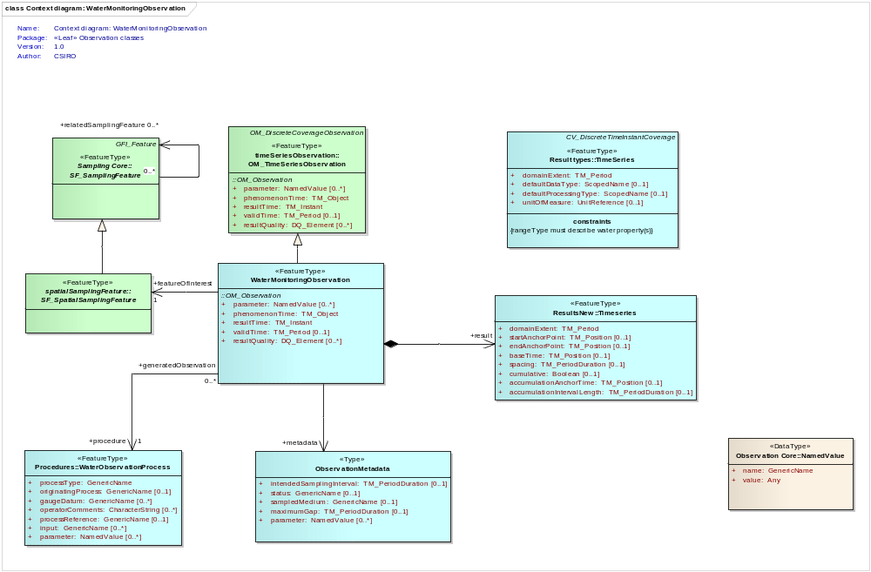
© 2010 Open Geospatial Consortium, Inc.

Slide 8
<!-- The time series data -->
<om:result>
<wml2:Timeseries gml:id="ts_data">
<gml:identifier codeSpace="">GUID identifier</gml:identifier>
<wml2:domainExtent>
<gml:TimePeriod gml:id="ts_period_1">
<gml:beginPosition>2001-07-31T20:12:01+10:00</gml:beginPosition>
<gml:endPosition>2001-08-02T20:10:01+10:00</gml:endPosition>
</gml:TimePeriod>
</wml2:domainExtent>
<!-- Sets the default values for time-value pairs across the series -->
<wml2:defaultTimeValuePair>
<wml2:TimeValuePair>
<wml2:time></wml2:time>
<wml2:value>
<swe:Quantity>
<swe:quality xlink:href="#QUALITY_good"/>
<swe:uom xlink:href="cfs"></swe:uom>
</swe:Quantity>
</wml2:value>
<wml2:dataType xlink:href="http://www.opengis.net/WaterML2.0/def/timeseriesType/AveragePrec"/>
<wml2:qualifier xlink:href="#QUAL_edited"/>
</wml2:TimeValuePair>
</wml2:defaultTimeValuePair>
<!-- Data -->
<wml2:element>
<wml2:TimeValuePair>
<wml2:time>2009-05-08</wml2:time>
<wml2:value>
<swe:Quantity>
<swe:uom xlink:href="cfs"></swe:uom>
<swe:value>3.4</swe:value>
</swe:Quantity>
</wml2:value>
<wml2:comment>System comment</wml2:comment>
</wml2:TimeValuePair>
</wml2:element>
Example time seryes
© 2010 Open Geospatial Consortium, Inc.

Slide 9
Outstanding issues - technical
Use of ISO19115/19139
Inclusion of sample use cases/scenarios
Work on process descriptions
Soft typing of parameters/metadata
  Do we have the right balance?
  Soft typing allows flexibility but removes ability to interpret semantics
Use of URI/URL for referencing
  Ability of people to support/use
  Show how best to roll URI scheme in WaterML2 scenarios
Clarify the use of collections/sites/networks
Domain feature sets (with IE’s)
More examples

Slide 10
Outstanding issues - scoping
Support for compound/complex time series results
  Multiple values/value types per point
Water quality
  Full support will be developed, current schema would support some simple use cases
Rating curves & future work
  DWG to inform on priorities
© 2010 Open Geospatial Consortium, Inc.

Slide 11
Proposed process
The WaterML2 development group will work on a Request For Comment (RFC) package
  Requires 3 supporters
  Anyone welcome to assist
Submit RFC to OGC
Triggers formation of a Standards Working Group (SWG)
  Allows a group to continue working on the specification
  Allows the group to motion for public comment and formal adoption as an OGC standard
  Open to OGC members
© 2010 Open Geospatial Consortium, Inc.

Slide 12
RFC Package
Contains:
  Specification document
  XML Schema
  XML Examples
  Cover letter
  Signed OGC technology forms (covers IP)
© 2010 Open Geospatial Consortium, Inc.

Slide 13
Potential timeline
Now: Silver Spring (June 2010)
June-July: clean up current specification and develop RFC package
July-August: inform OGC of intent to submit RFC package
July-August: develop a SWG charter (with assistance from OGC architecture board)
September: formation of SWG
September: A broader look into harmonization
Sep-Dec: address issues from OAB and continue to develop specification.
Dec/March2011: SWG votes to release for public comment
~ 2011 TC adopts ☺
© 2010 Open Geospatial Consortium, Inc.

Slide 14
Services with WaterML2
Using Sensor Observation Service (SOS) to serve WaterML2
  Current specification is version 1.0
  Uses GML 3.1.1
  Uses O&M version 1.0
WaterML2.0
  GML version 3.2
  O&M version 2.0
  SWE Common 2.0 (not a large dependency)
SOS version 2.0 is in the works
  Aligned to GML 3.2, O&M 2.0 & SWE Common 2.0
© 2010 Open Geospatial Consortium, Inc.

Slide 15
Implementations
52North is most ‘complete’:
  JAVA over Postgres/PostGIS
  Custom schema
  CSIRO have started working on implementation to serve WaterML2 over other RDBMS or different storage layers
Natural Resources Canada (NRCan)
  Using Cocoon with XML pipelines
Other implementations:
  Degree
  PySOS
Cross cutting group to deal with services?
© 2010 Open Geospatial Consortium, Inc.

Slide 16
Feedback from IE’s
Valuable feedback already obtained from GW IE
Now with two, should we provide a mechanism for tracking issues?
  Carsten (disy) has setup a JIRA for WaterML2
  Could use this to register change requests/issues/ideas
© 2010 Open Geospatial Consortium, Inc.

Slide 17
Release harmonization report
The Hydrology Domain Working Group recommends that the OGC Technical Committee approve release of 09-124r2 Harmonising Standards for Water Observation Data - Discussion Paper” as an OGC Discussion Paper
  Pending and final edits and review by OGC staff
  <Any Discussion Points that the TC needs to be aware of>
  Motion: <Name of person making the motion>
  Second: <name of the person seconding the motion>
  If there is a hand vote, the results of the vote. Otherwise, the phrase <There was no objection to unanimous consent> should be used
© 2010 Open Geospatial Consortium, Inc.

Slide 18
Actions
Hydro DWG to discuss future scope
People to register interest in joining the RFC submission
Discussion between IE’s on service implementations
  Develop ‘best practice’ / plan of attack to reduce redundancy of work
  Sharing of implementations
Potential to use of JIRA for tracking issues
© 2010 Open Geospatial Consortium, Inc.

