Slide 1
GroundwaterML2 (GWML2) HDWG Update
103rd OGC Technical Committee Meeting
St. John’s, Newfoundland and Labrador, Canada
Boyan Brodaric – Geological Survey of Canada
28 June 2017

Slide 2
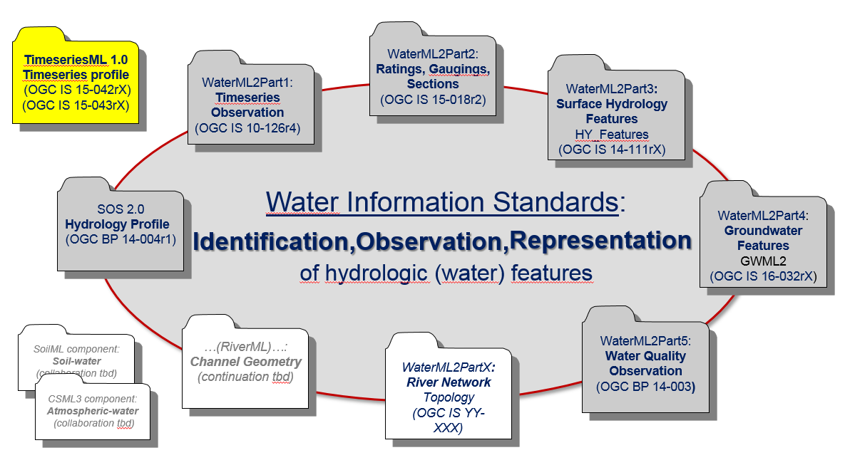
WaterML2
OGC Hydro Domain Working Group (HDWG)
WaterML2 suite of OGC hydrologic data standards
GWML2

Slide 3
GWML2: History
2009-2011: GW1 IE (OGC HDWG)
Test GW data interoperability: OGC standards and GWML1
2012-2015: GW2 IE (OGC HDWG)
Objectives: develop and test GWML2 candidate standard
Participants: 13 agencies (N. America, EU, AU/NZ)
Activities: 49 meetings since June 2012 Kick-off
Results: Eng Report (15-082), 14 web services, 17 change requests
2016-2017: GWML2 (OGC GW SWG)
Objectives: refine and submit GWML2 (from 15-082)
Participants: ~ same as above
Activities: 5 meetings (>Feb 2016); 3 reviews: OAB, OGC-NA, Public
Results: 16-032, 16-032r1, 16-032r2

Slide 4
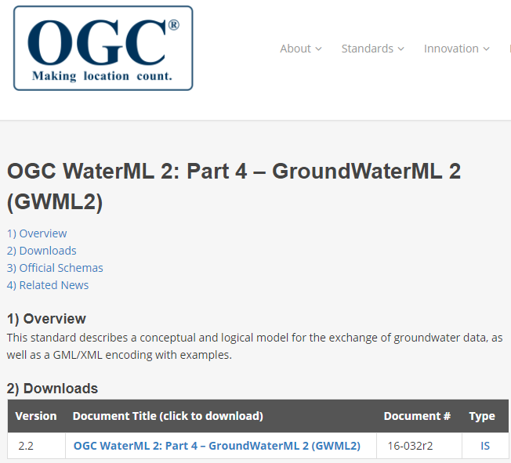
GWML2: Recent Progress
… since OGC TC Dublin June 2016
2016 July GWML2 spec submitted
2016 Aug GWML2 spec approved (OGC TC)
2016 Sept GWML2 spec approved (OGC PC)
2017 Feb GWML2 paper submitted (HJ)
2017 Mar GWML2 spec published!

Slide 5
GWML2: Use Cases
Commercial - find water wells, estimate water well cost
http://external.opengis.org/twiki_public/HydrologyDWG/UseCase1
Policy - meet EU Water Framework Directive needs
http://external.opengis.org/twiki_public/HydrologyDWG/UseCase2
Environmental - risks to gw dependent ecosystems
http://external.opengis.org/twiki_public/HydrologyDWG/UseCase3
Scientific - groundwater flow modeling
http://external.opengis.org/twiki_public/HydrologyDWG/UseCase4
Technologic – map GWML2 to existing info models
http://external.opengis.org/twiki_public/HydrologyDWG/UseCase5

Slide 6
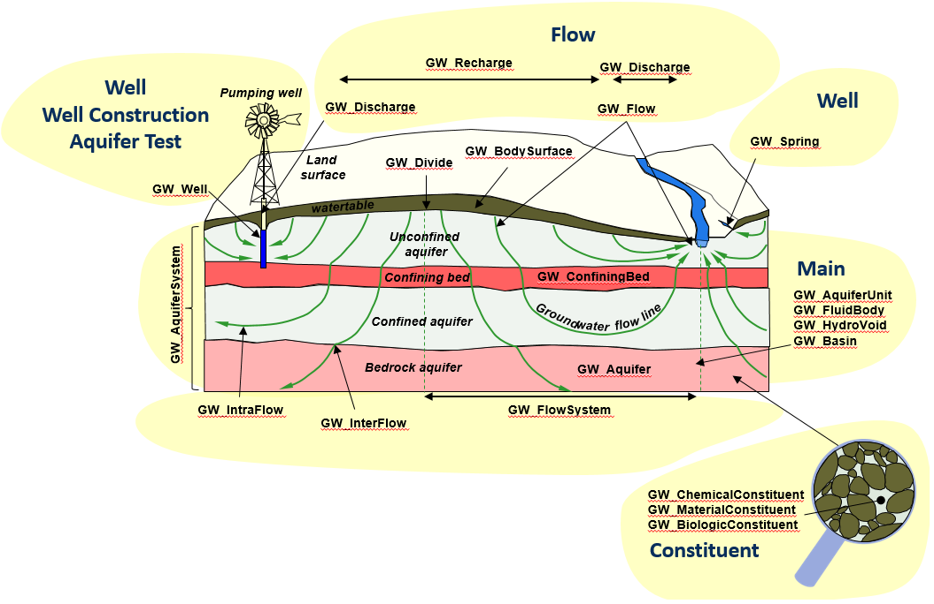
GWML2: Scope and Packaging
subsurface water features and observations

Slide 7
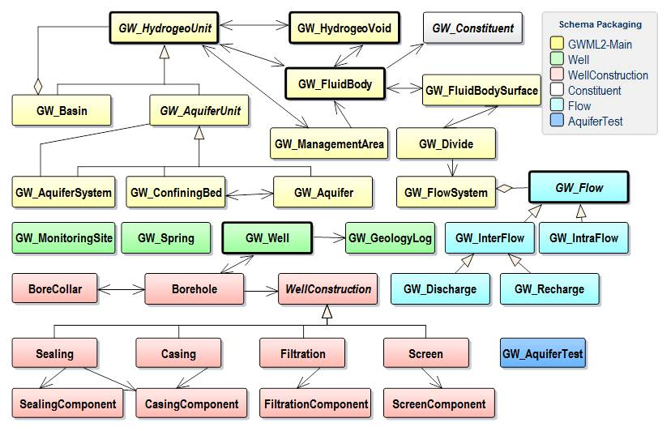
GWML2: Scope and Packaging

Slide 8
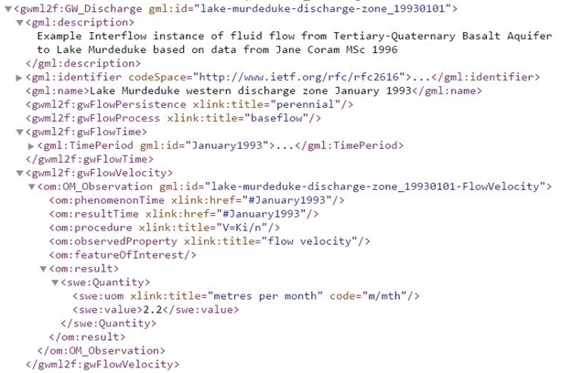
GWML2: Development Method
In GWIE2
Use Cases
Vocabulary
Conceptual Schema
Logical Schema
Physical Schema
Example Data Encodings

Slide 9
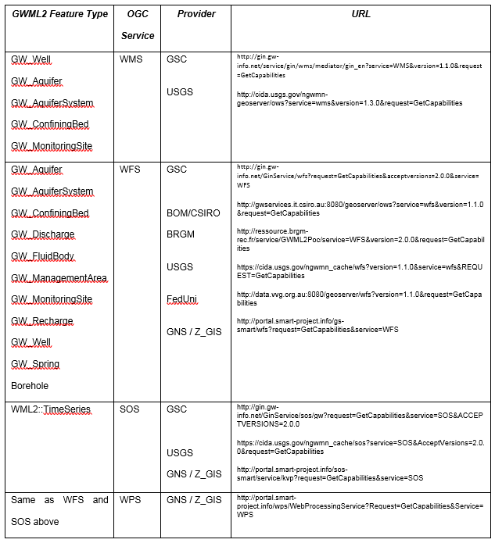
GWML2: Testing
In GWIE2

Slide 10
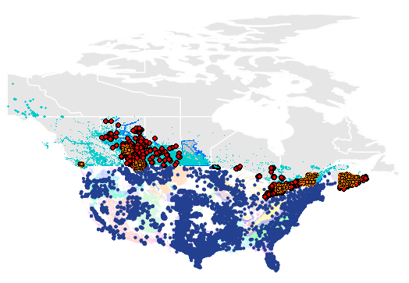
GWML2: In Action
CAN-US groundwater data interoperability
Canadian Groundwater Information Network (GIN)
US National Groundwater Monitoring Network (NGWMN)

Slide 11

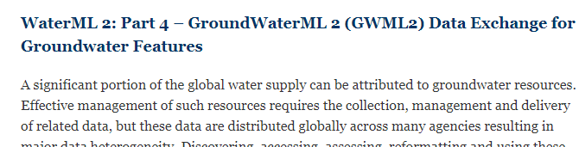
GWML2: Next Steps
ongoing maintenance: e.g. change requests (none)
paper revision (Sept 2017)
GW SWG meeting soon – to regroup
WMO submission: within WaterML2 suite

Slide 12
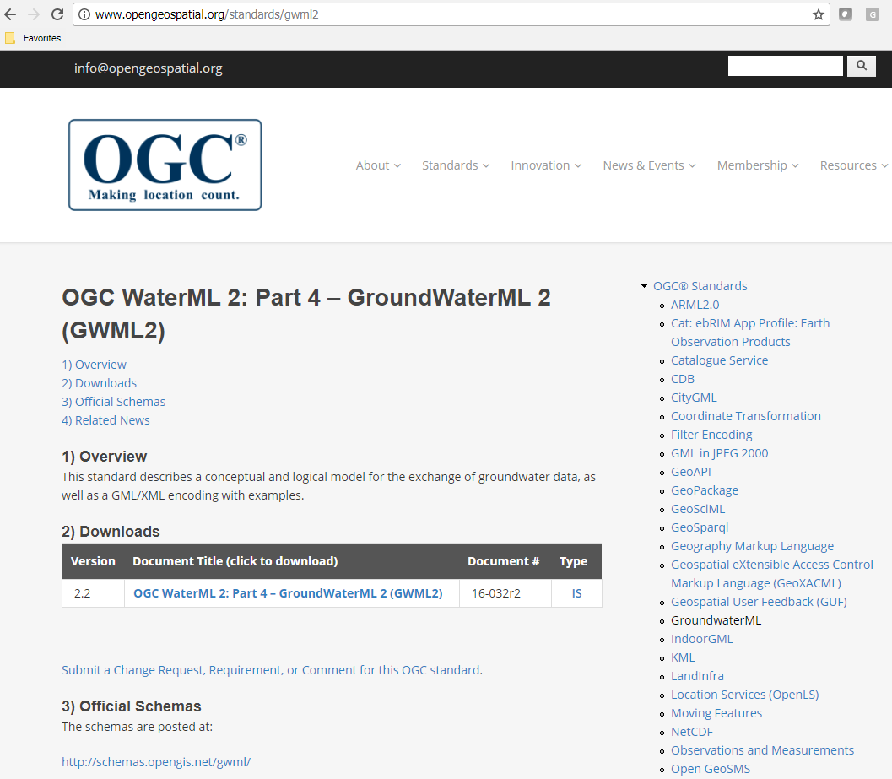
Thank you
http://www.opengeospatial.org/standards/gwml2

