Slide 1
HydroDWG workshop outcomes
103rd OGC Technical Committee
St. John’s, Newfoundland and Labrador, Canada
Tony Boston
28 June 2017

Slide 2
8th HydroDWG workshop
20-23 June 2017 (last week)
Tuscaloosa Alabama – US National Water Center
Main focus area of the meeting:
ELFIE (Environmental Linked Features Interoperability Experiment) – User stories and use case development
Reporting, or (nearly) completed work:
WMO standards adoption and WHOS – Silvano Pecora
GWML2 – Eric Boisvert for Boyan Brodaric
INSPIRE O&M and SWE profile update – Sylvain Grellet
HY_Features – Dave Blodgett

Slide 3
8th HydroDWG workshop
Projects/activities/reports of interest
ASPEN Institute – Internet of Water
US - FloodCast – TRB, Dewberry - Alaurah Moss, Siva Selvanathan
NZ - Environmental Observation Systems NZ – Alistair Ritchie
NZ - LAWA – Federated hydrological infrastructure – Brent Watson
US - NHDPlus and Network Linked Data – Dave Blodgett
US – Interoperable Watersheds Network – Dwanne Young
Netherlands - Informatiehuis Water – Aquo model - Edwin Wisse
RDA – GWIIG – Ilya Zaslavsky
US – NWC and National Water Model (NWM) – Ed Clark
US – NWC Summer Institute Students – Many NWM related projects

Slide 4
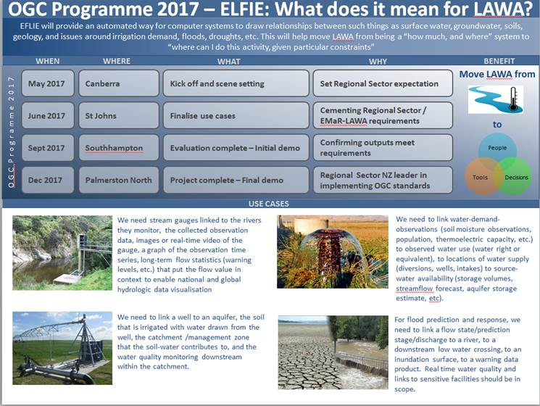
8th HydroDWG workshop
ELFIE use cases and user stories drafted

Slide 5
Key activities summary
Hydro DWG: workshop held at US National Water Center June 20-23 2017 – Main focus areas: ELFIE (Environmental Linked Features Interoperability Experiment) and water quality/samples
HY_Features SWG: Candidate standard for Surface Hydrology Features (HY_Features) Conceptual Model submitted to OGC pending documents – Request for electronic vote at St John’s closing plenary
GWML2 – Standard published March 2017. Planning to engage WMO to include GWML2 example implementations in WHOS (WMO Hydrological Observing System)
ELFIE – Use cases in development. Planning to complete engineering report by late 2017/early 2018. Target: NZ TC

