Slide 1
HY_Features Sydney TC
97th OGC Technical Committee
Sydney, Australia
David Blodgett
2 December 2015
Copyright © 2015 Open Geospatial Consortium

Slide 2
Progress Overview
Changes from Orleans discussion applied to the model
Draft specification document well underway
Started conversation with OAB regarding testing methodology
Have proposal to eliminate the Basin concept by adding an identifier to catchment
Discussion of indirect position (riverReferencingSystem) is ongoing
Copyright © 2015 Open Geospatial Consortium

Slide 3
Model Changes
Set SubsurfaceHydroFeature and AtmosphericHydroFeature package to informative.
Reviewed HydroFeature SurfaceHydroFeature and HydrometricFeature package
Copyright © 2015 Open Geospatial Consortium

Slide 4
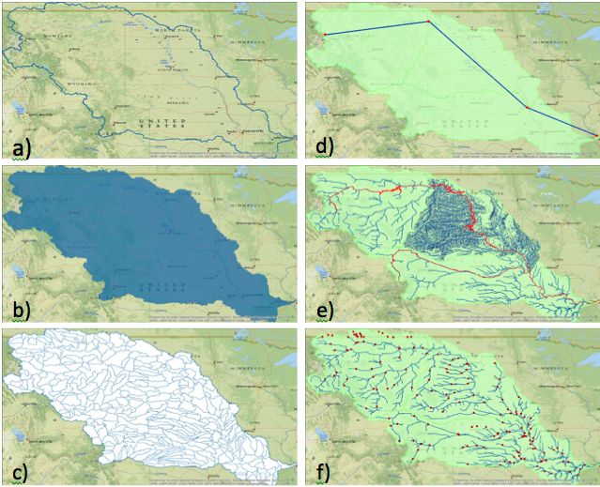
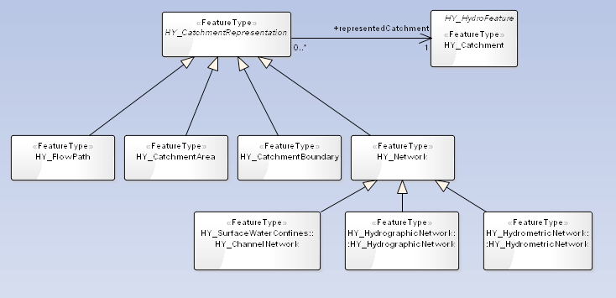
Plan to ‘test’ the conceptual model.
Conceptual Cartoon => Narrative Description => UML
In the spec body: e.g. ...
A real world catchment can be represented as it’s boundary (a), area (b), contained catchments (c), flow path (d) network (e), or hydrometric station network (f).
Copyright © 2015 Open Geospatial Consortium

Slide 5
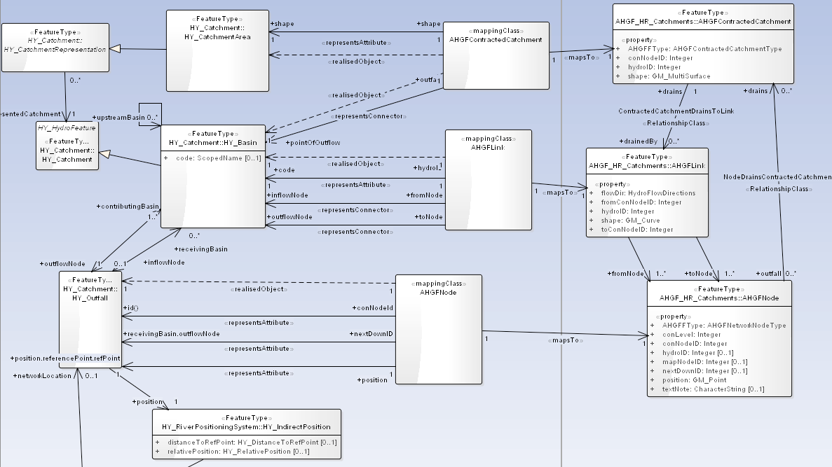
Plan to ‘test’ the conceptual model.
Annex with UML Mappings between hydrography datasets and HY_Features with narrative to explain.
Copyright © 2015 Open Geospatial Consortium

Slide 6
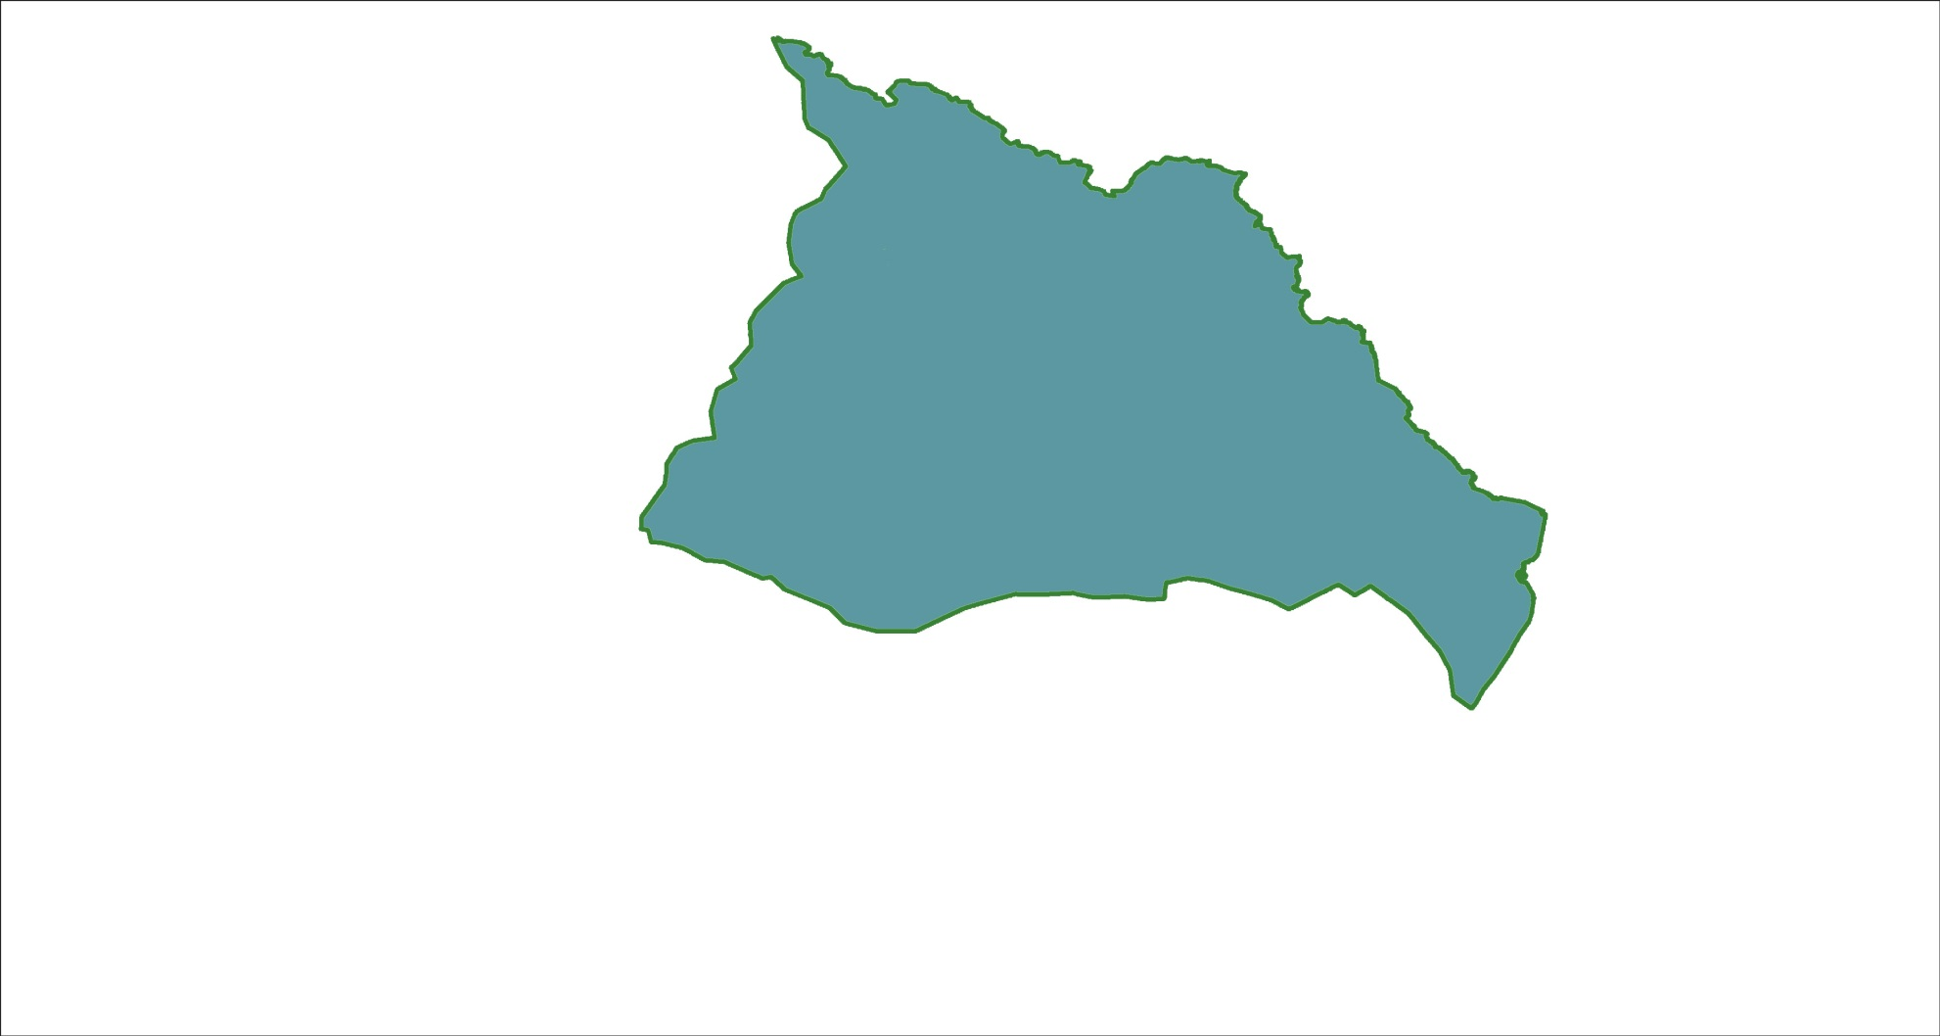
Plan to ‘test’ the conceptual model.
Annex with cartoon of HY_Feature with data set specific name, and HY_Features name.
NHD+ catchment – NHN workunit – AHGF Catchment – WBD Hydrologic Unit – HY_Catchment …
Copyright © 2015 Open Geospatial Consortium

Slide 7
‘Simply catchment’ –
A catchment has 0..1 Outfall
Unification of HY_Catchment and HY_Basin by allowing a catchment to have 0 or 1 identified outflow node or outfall.
Network connectivity in a dendritic network is inherent in the basin concept, now possible with identified outflow.
We lose the unambiguous differentiation of dendritic or not.
Open for review, we lose the assumption of dendritic that comes with basin… Latest idea is to rename HY_Basin to HY_DendriticCatchment
Copyright © 2015 Open Geospatial Consortium

Slide 8
HY_RiverPositioningSystem Changes
RivermileageCS becomes RiverReferenceSystem
Outfall is the origin of the RiverReferenceSystem
  Note: Each catchment has its own ReferenceSystem – these can be combined as necessary using catchment topology.
  Note: Each ReferenceSystem must have 1 outfall and one FlowPath.
RiverMileageAxis becomes RiverReferenceAxis
DRAFT: Linear reference system used to assign a position to an arbitrary objects (e.g. water monitoring points) along a Flowpath (i.e. along the linear representation of the catchment) whereby the Outfall is the located start (origin) of the linear feature. RiverReferenceSystem shall support one axis
Note: This type may use ISO19148:LinearReferencing understanding the indirect position as location associated with an Outfall (understood as an event in terms of ISO19148), providing the distance absolute, relative or interpolative to this to a reference point (in terms of the referent).
Copyright © 2015 Open Geospatial Consortium

