Slide 1
Freshwater Environmental Monitoring and Reporting System
97th OGC Technical Committee
Sydney, Australia
Byron Cochrane, LINZ
2 December 2015
Copyright © 2015 Open Geospatial Consortium

Slide 2
Problem
We need to be able to attach Environmental Features to Environmental Observation Data (EOD) (such as “this observation is from a lake/river/aquifer”) to enable data harmonisation for data exchange cross domains.
Pilot project
  Focus on freshwater (river networks)
  Focus on resilience to flooding (fluvial)
”It’s the role of technologists to create options for policy-makers.”
- Saul Griffith
Copyright © 2015 Open Geospatial Consortium

Slide 3
Goals
Authoritative view of hydrometric sites in NZ river network
  registry of authoritative data providers
  harmonisation of data models
  EODP implementation
Linking of observations to observed river segments
Topological search enabled across the observation/river network
Language conversion English/Maori
Exploring the best option of time series data display
Empowering a federated architecture for any temporal/spatial environmental observation in a national context
Copyright © 2015 Open Geospatial Consortium

Slide 4
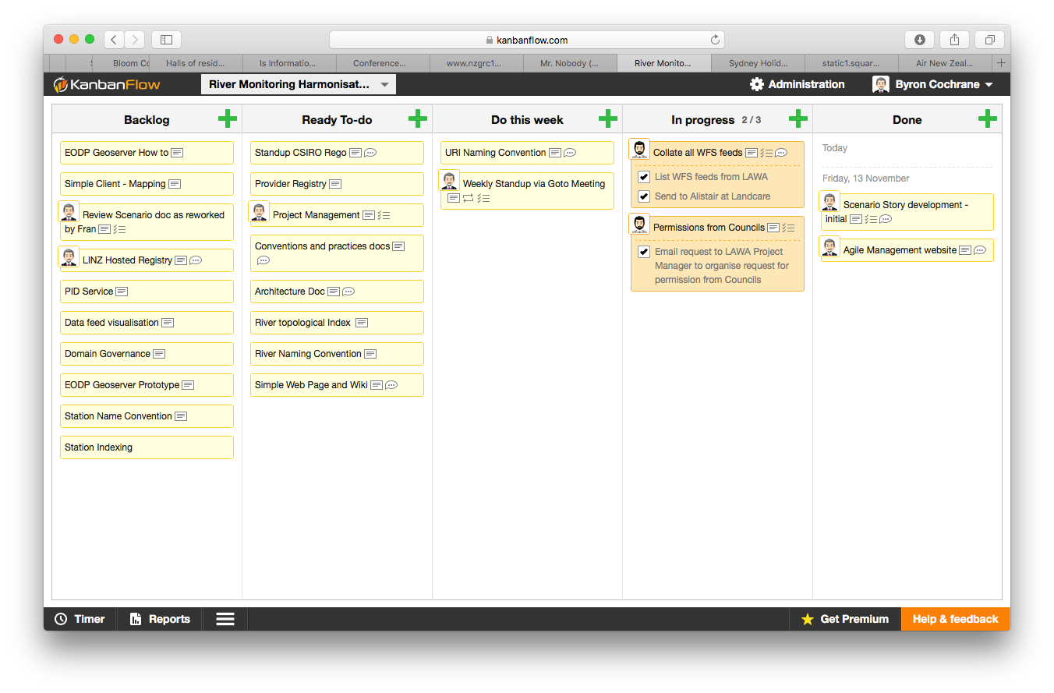
Copyright © 2015 Open Geospatial Consortium

Slide 5
Tasks
Collate use cases & existing material e.g.
  “Give me all data from a river”
  “Give me all WQ data for land use type xxx”
Identify environmental phenomena and features required
Collate existing relevant NZ Environmental Feature sets
Identify existing ontologies/models that describe features
Relevant (int’l) activities (leverage from)
  HyFeatures OGC WG
Write guidelines on how to implement components e.g.
  Ontologies
  Registries
  Vocabulary services
Copyright © 2015 Open Geospatial Consortium

Slide 6
Timeline
Nov 2015 - Kickoff meeting
Feb 2016 - Mid project review
May 2016 - Complete Pilot
June 2016 - Present at OGC TC
July 2016? - Linked data service adhoc proposal
…
Copyright © 2015 Open Geospatial Consortium

