Slide 1
Hydrology DWG Meeting
Surface Water IE – Use Case 1
OGC Technical Committee
Toulouse, France
Chris Michl, Carsten Heidmann, Sylvain Grellet
September 22, 2010
© 2010 Open Geospatial Consortium, Inc.

Slide 2
Agenda
Regional Focus
Overview
High-Level Status Update
Status of the Different Participants
    DLZ-IT
    IOW Sandre
    disy
    52north
    KISTERS
Problems Encountered
Next Steps
© 2009 Open Geospatial Consortium, Inc.

Slide 3
Regional Focus: Rhine River
SOS DLZ-IT
SOS SANDRE
© 2010 Open Geospatial Consortium, Inc.

Slide 4
Overview
Aim:
  Test WaterML2.0 with surface water data
  By disseminating surface water data from Rhin - Rhein - between Germany & France to all participants
  Using OGC SOS, WFS, WMS web services and WaterML2.0 encoding
  Demonstrate cross border surface water data interoperability
Coordination:
  Chris Michl (DLZ-IT) and Carsten Heidmann (disy)
Participants:
  France: IOW-SANDRE
  Germany: DLZ-IT, disy, Kisters and 52°North
© 2010 Open Geospatial Consortium, Inc.

Slide 5
High-Level Status Update
Group structure established
Biweekly phone conferences (six until today)
Interaction with WaterML2.0 group
Mailing list: sw.ie.case1@lists.opengeospatial.org
TWiki: http://external.opengis.org/twiki_public/bin/view/HydrologyDWG/UseCase1CrossborderDataExchange
Central web client (planned): http://crossborder-ie.disy.net/
Web clients (available):
  http://v-wupper.uni-muenster.de/ThinSweClient2.0_Beta/Client.html?locale=en
  WISKI client for SOS will be started once the group has defined which specific SOS profile should be used
© 2009 Open Geospatial Consortium, Inc.

Slide 6
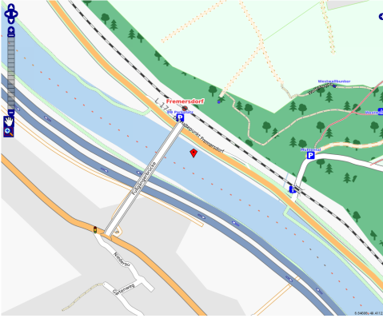
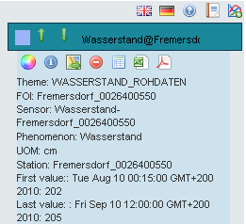
Status – DLZ-IT
SOS for the German federal hydrometric network
  Implementations see 52°North and Kisters (over 500 stations, parameter: water level and discharge)
Primary Contact:
Chris Michl (christian.michl@dlz-it-bvbs.bund.de)
© 2010 Open Geospatial Consortium, Inc.

Slide 7
Status – IOW Sandre
IOW/Sandre aims at :
  Making the hydrometric Sandre O&M DB readable by a SOS,
  Testing the transmission of water information that fits WML2.0 schema.
SOSOnline (52nSOS) : http://services.sandre.eaufrance.fr/52nSOSv3/sos
Data availability : flood prevention service for the Rhin sector facing delays in their system evolution -> leads to have their data on the Rhine river for end of 2010/beginning of 2011 -> test on ‘Garonne‘ river to validate the technical part of our architecture.
Primary Contact:
Sylvain Grellet (s.grellet@oieau.fr)
© 2010 Open Geospatial Consortium, Inc.

Slide 8
Status – disy
Coordination together with DLZ-IT
  Road Map
  Phone Conferences
Hosting of Web Client for SOS
  In development: http://crossborder-ie.disy.net/xyz123
  TODO: Screenshot of web client if possible
Will provide CSW instance later in the experiment if needed
Primary Contact:
Carsten Heidmann (carsten.heidmann@disy.net)
© 2010 Open Geospatial Consortium, Inc.

Slide 9
Status – 52°North
Technical overview
  Development of client and server components: SOS and SOS client
  SOS instances available at DLZ-IT and IOW Sandre
  New version of a web based SOS client has been developed (in a project with DLZ-IT)
    Time series display (diagrams)
    Map display
  Developments currently based on the SOS, O&M and SensorML specifications; later WaterML 2.0 will be used instead of O&M
Link to demonstration:
http://v-wupper.uni-muenster.de/ThinSweClient2.0_Beta/Client.html?locale=en
Primary Contact:
Simon Jirka (jirka@52north.org)
© 2010 Open Geospatial Consortium, Inc.

Slide 10
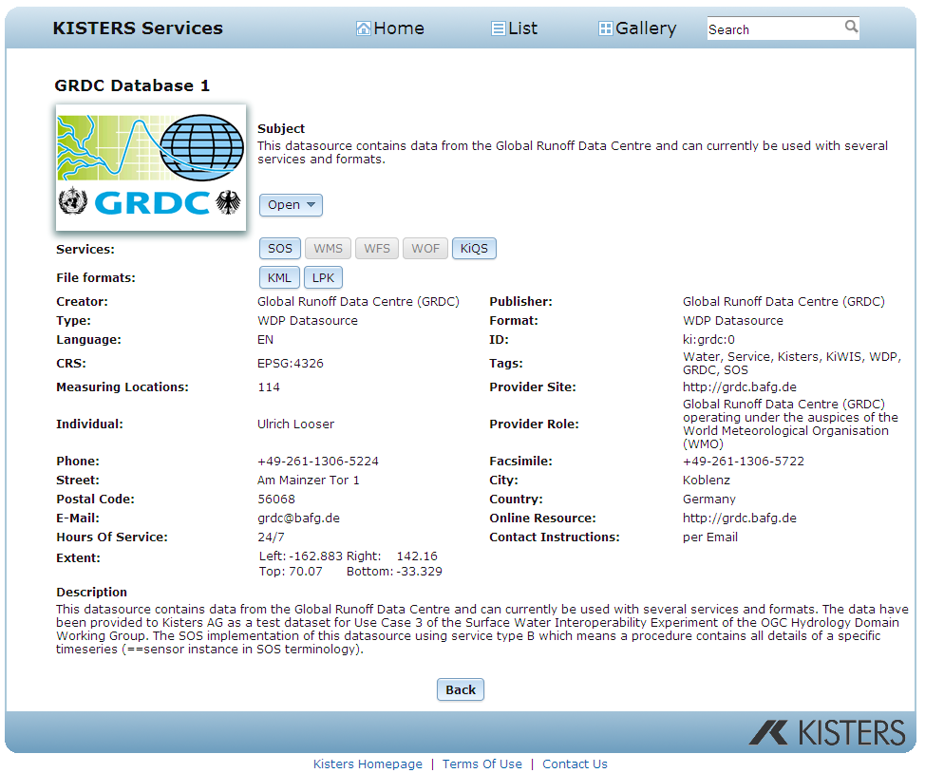
Status - Kisters
Technical overview
  Service module has
  been started
  SOS1/O&M1 service is
  provisional as long as the
  group has not agreed to a
  certain profile
  WISKI client for SOS will be
  started once the group has
  defined which specific SOS
  profile should be used
Link to demonstration:
  http://kiwis.kisters.de
Primary Contact:
Stefan Fuest (stefan.fuest@kisters.de)
Michael Natschke (michael.natschke@kisters.de)
© 2010 Open Geospatial Consortium, Inc.

Slide 11
Major Problems Encountered
WaterML2.0 – SOS2.0 interaction
  Implementation SOS2.0 and WaterML2.0 development waiting for each other
  NO WaterML2.0 until now – waiting for stable version of schemas!
Need for a „specific“ SOS profile
  Structuring the SOS instances
  Discovery procedures for time series (SOS, WFS, WMS, CSW)
  -> major issue for interoperability (agreement for surface water IE needed, common understanding with IE groundwater should be discussed)
Data Availability
© 2010 Open Geospatial Consortium, Inc.

Slide 12
Problems: Example IOW-Sandre
IOW-Sandre :
  « current 52N is light-application for transmitting O&M style data » (HydroDWG Twiki) → we had to adapt our O&M schema into 52N’s for SWIE,
  In our opinion, critical issue in not really taking into account « time-series » modeling (currently one value per observation in 52N SOS DB), whereas O&M / WML2.0 require it,
  To display markers on the 52N thin client map, geom comes from the procedure and not from the FOI ; shouldn’t we use FOI’s geom instead ?
© 2010 Open Geospatial Consortium, Inc.

Slide 13
Problems: SOS terminology
What Sandre SOS DB provides as :
What 52nSOS Client waits for :
Hydrometric site
SOS terms
Theme
Refers to the largest observation scale.Is also a FOI.
Refers to the property the user wants to explore
Offering (entry point)
Site, station, sensor
Site, station
Sensor : a SF_SamplingFeature
feature-of-interest
No sensors, which are delegated to procedure
method
Sensor, method
The sampling method only, no geographic data in Sandre’s format.
One Sandre’s method can apply for many FOI and multiple phenomenons.
procedure
Procedure are meant as part of a localisable sensor.
Structure needed to be adaptated
added geometry + 1 method per FOI & per Phenomenon
Phenomenon
Phenomenon
Same object on both sides
phenomenon
Same object on both sides
© 2010 Open Geospatial Consortium, Inc.

Slide 14
Next Steps
Harmonization of SOS structure
  Main issue for discussion
  Agreement needed!
Installation of WaterML2.0 SOS when available
  Time line: demostration available OGC TC Sydney
Feedback to WaterML2.0 group, SOS, Hydro DWG
© 2010 Open Geospatial Consortium, Inc.

Slide 15




Thank You
Carsten Heidmann
Christian Michl
Dietmar Mothes
Sylvain Grellet
Simon Jirka
Arne Broering
Michael Natschke
Stefan Fuest
DLZ-IT BMVBS
© 2010 Open Geospatial Consortium, Inc.

