Slide 1
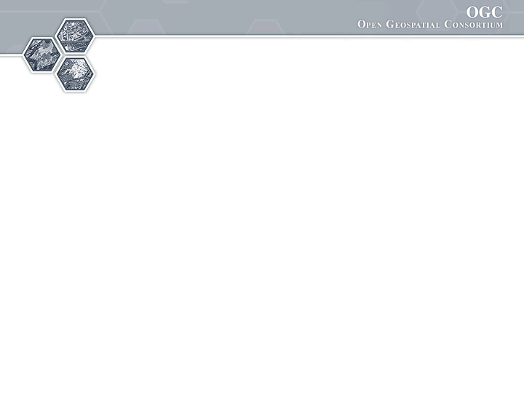
®
Groundwater Interoperability Experiment - Update
74th OGC Technical Committee
Toulouse, France
N.Booth, B.Brodaric
Sept 22, 2010

Slide 2




IE Participants (to date--alphabetical)
CSIRO
Peter Taylor
UnivCalgary
Steve Liang
GSC
Boyan Brodaric
Eric Boisvert
Heryk Julien
Francois Letourneau
Dave Sharpe
Alex Smirnoff
34N
Ayme Osti
Nathan Hemenway
IL Water Survey
Yong Liu
Kisters
Stephen Fuest
USGS
Nate Booth
Dave Briar
Tom Kunicki
I-Lin Kuo
SDSC /
CUAHSI
David Valentine

Slide 3
IE Objectives
Ground/Water feature and observation interop:
Advance design of WaterML 2 schema
Advance fit of OGC services with gr/water data
- SOS, WFS, WMS
Advance GW data exchange between US & CAN
- in cross-border Great Lakes area (Lake Superior) for water wells and levels

Slide 4
IE Use-Case
View, query and download water wells & levels:
View US & CAN well/sensor locations
- WMS (GetMap)
Query on one well/sensor and display data
- WMS (GetFeatureInfo)
- well: WFS (getFeature via BBOX) or
- level: SOS (GetObservation via BBOX)
- return GWML or WaterML and display as HTML
Download cross-border wells and levels
- Zoom to area of interest (find BBOX)
- well: WFS (GetFeature via BBOX and thematic filter) or
- level: SOS (GetObservation via BBOX and time filter)
- Export as GWML, WaterML, Excel, or KML

Slide 5
Sensor sites & well locations

Slide 6
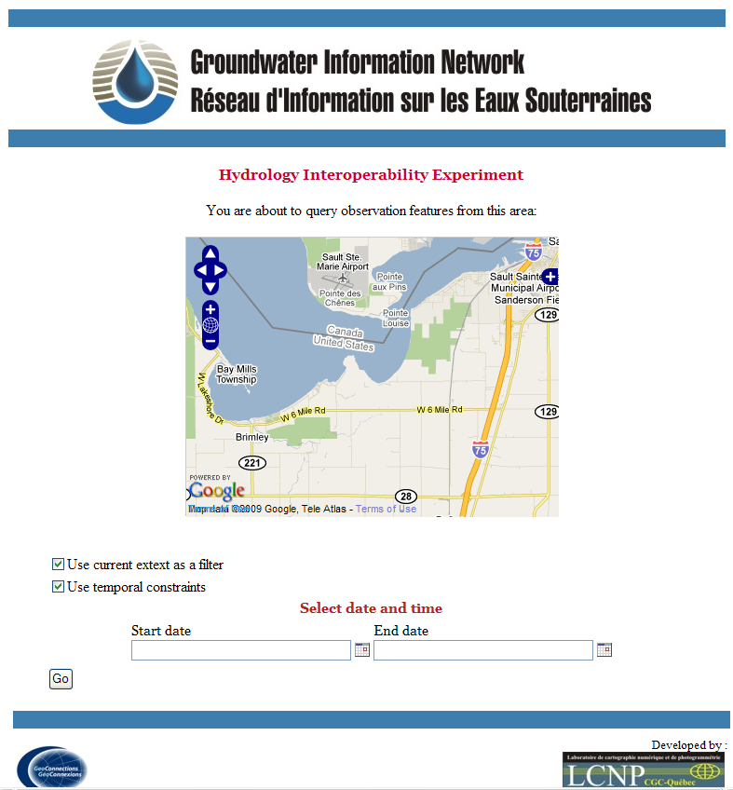
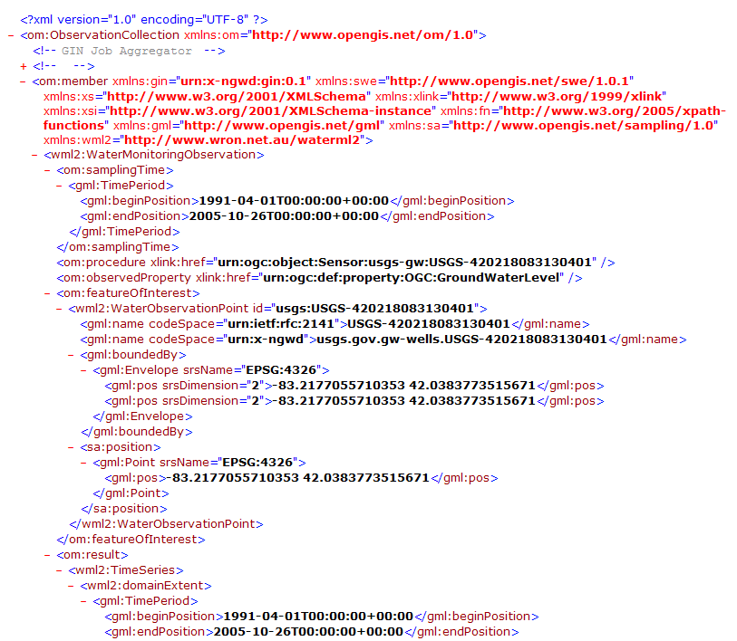
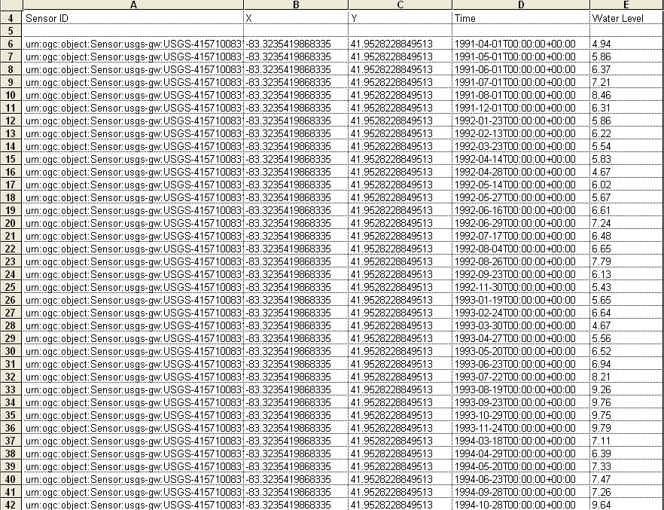
IE Milestone 1 Results
Advance fit of OGC services with gr/water data
- preliminary services established: SOS (WaterML2) and WFS (GWML—GSC)
Advance GW data exchange between US & CAN
- cross-border groundwater levels displayed, queried, downloaded
query
download
view

Slide 7
IE Update
Finalize services with denser networks and WaterML2 changes
New client from 34N
Switch to GML 3.2 for WaterML2 still served over SOS 1
Lithology crosswalk to GWML (GeoSciML)
Services and client app freeze Oct 5 to start write-up: target December TC to report out
Workaround for SOS getCap: FOI links to sampling network
  http://external.opengis.org/twiki_public/bin/view/HydrologyDWG/GwIeGetCapabilitiesBestPractices
Units mediated at client (not finished)

Slide 8
demo

Slide 15
Final notes
Public IE Wiki
http://external.opengis.org/twiki_public/bin/view/HydrologyDWG/GroundwaterInteroperabilityExperiment
Thank you!

