Slide 1

September 2010
Sponsored and hosted by
Hydrology DWG
Toulouse, FR
Peter Gijsbers (Deltares)
John Halquist (NOAA/NWS)
September 22, 2010
© 2010 Open Geospatial Consortium, Inc.

Slide 2

Background
Real time applications (e.g. forecasting) poses specific requirements on WaterML2 and its usage regarding
  information model (time and ensembles)
  data transfer
The Surface Water IE will address a portion of this
  frequent incremental data ingest (Mississippi)
Other requirements are foreseen to be evaluated in a Forecasting Interoperability Experiment
Deltares USA
© 2010 Open Geospatial Consortium, Inc.

Slide 3
Forecasting Use Cases
SWEI-UC2 (OF0) – Surface Water IE should provide necessary demonstration – test frequent incremental data ingest to the forecast modeling system
FEI-OF1 – Operational Forecasting in support of flooding related emergencies
FEI-OF2 – Routine operational forecasting in support of infrastructure operation
FEI-OF3 – Joint forecasting use case with Met-Ocean DWG (???)
Deltares USA
© 2010 Open Geospatial Consortium, Inc.

Slide 4
OF0 – Operational Hydrologic Ingest
Forecasts require a variety of observations from multiple sources whose data records progress over time
Characteristics of data retrieval
real-time
incremental updates over time
new and changed (QC’ed) data
high performance need (forecast lead time)
Deltares USA
© 2010 Open Geospatial Consortium, Inc.

Slide 5
OF1 – Operational Hydrologic Forecasting
Forecasting generally performed by authorized entity – in USA, NOAA National Weather Service
Requires a variety of observations from multiple sources
Simulation(s) of future conditions
  deterministic timeseries
  ensembles
Results provided to end users – subscription service
  alerts
  data updates
  infrastructure operators
  emergency services and decision makers
  public
Deltares USA
© 2010 Open Geospatial Consortium, Inc.

Slide 6
OF2 – Hydrologic Infrastructure Operation
Initial processes similar to OF1 (i.e. data ingest and simulation)
Difference is the dependency on infrastructure operations performed by independent entities
  Reservoir operators – public/private
  Water Supply
Data sources include both in-situ observations as well as computed and projected timeseries
Two-way interaction, often includes feedback loop
Includes alerts and data updates
Deltares USA
© 2010 Open Geospatial Consortium, Inc.

Slide 7
OF3 – Meteo-Hydro Forecasts
Initial processes similar to OF1+OF2 (i.e. data ingest and simulation)
Difference is the emphasize on the co-operation with the Met-Ocean group, with specific attention to the time information and ensembles
Deltares USA
© 2010 Open Geospatial Consortium, Inc.

Slide 8
OF0: Operational Hydrologic Ingest
(DWGH-SWIE)
OF0=
Hydro Forecasting system is SOS-client
for hydro data retrieval
→ incremental timeseries updates
requested on fixed time interval
requested after update notification
via SOS insert
Hydro forecasting system may act as WCS/THREDDS client to retrieve gridded weather data
OF0
© 2010 Open Geospatial Consortium, Inc.

Slide 9
OF1: Operational Hydrologic Forecasting
(DWGH-FIE)
OF1=OF0+
Hydro Forecasting system is SOS-service providing forecast data
deterministic forecasts
update notification
OF0
OF1
Deltares USA
© 2010 Open Geospatial Consortium, Inc.

Slide 10
OF2: Hydrologic Infrastructure Operation
(DWGH-FIE)
OF2
OF2=OF0+OF1 in new context
Hydro Forecasting system is SOS-service providing forecast data
deterministic forecasts
update notification
Hydro Forecasting system is SOS-client ingesting infrastructure operators data
requested after update notification
via SOS insert
OF0
OF1
Deltares USA
© 2010 Open Geospatial Consortium, Inc.

Slide 11
OF3 ?: Operational Meteo-Hydro forecasting
(IE co-operation between DWGH+DWGMO)
OF2
OF3=OF0+OF1 (+OF2) +
Hydro Forecasting system is SOS-client ingesting hydro data
requested after update notification
via SOS insert
Hydro Forecasting system is WCS/THREDDS-client ingesting griddedweather data
observed estimates
deterministic forecasts
ensemble forecasts
Hydro Forecasting system is SOS-service providing forecast data
deterministic forecasts
ensemble forecasts
update notification
OF0
OF1
OF3
Deltares USA
© 2010 Open Geospatial Consortium, Inc.

Slide 12
OF0 – Operational Hydrologic Ingest
OF0 is preparatory step for remaining use cases
OF0 evaluates suitability for 3 methods for data retrieval
pull increment on clock interval (triggered by client)
pull increment after update notifications (triggered by service)
push increment via SOS insert (triggered by service)
Deltares USA
© 2010 Open Geospatial Consortium, Inc.

Slide 13
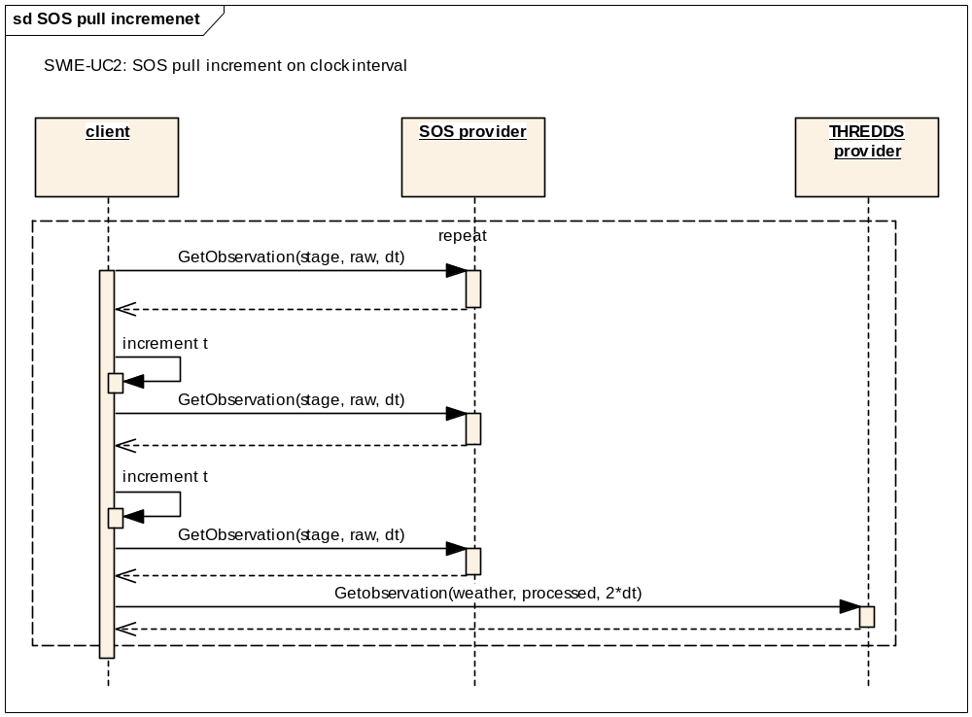
Data retrieval method: SOS pull increment

Slide 14
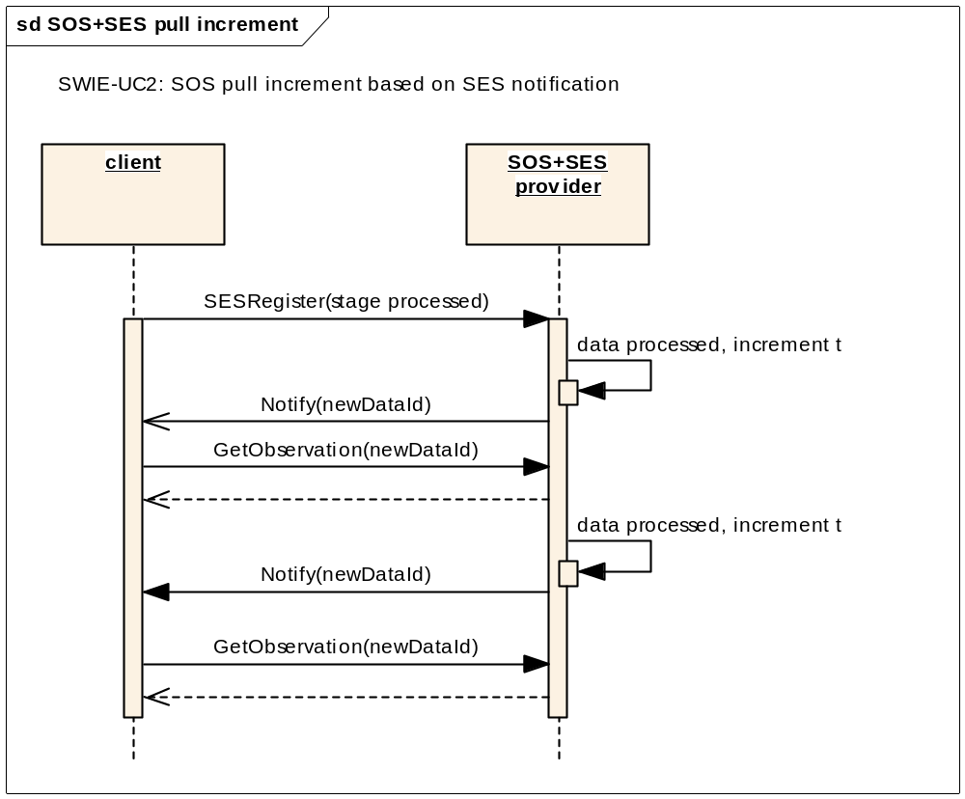
Data retrieval method SOS+SES pull increment

Slide 15
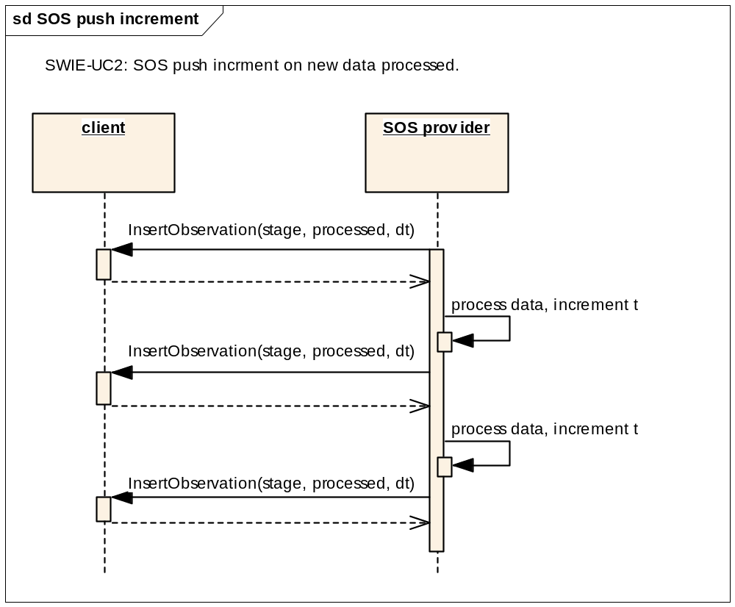
Data retrieval method: SOS push increment

Slide 16
OF0 – Operational Hydrologic Ingest
Service providers
Unidata
(weather)
USGS
(hydro)
BoM
CSIRO
WFS
THREDDS
SOS
WFS
THREDDS
SOS
SOS
SES
WaterML2.0 encoding
Clients
ASA
NOAA/NWS
(+Deltares)
CSIRO
(+Deltares)
CSIRO
Client software:
EDC
FEWS
other
client
Deltares USA
© 2010 Open Geospatial Consortium, Inc.

Slide 17
OF0 – Operational hydrologic ingest
Team 1:
USGS (data provision)
NOAA/NWS (data client)
Deltares USA (forecasting software provider)
Data provision:
WaterML2 encoded SOS service for selected observations
  Chippewa, Wisconsin, and Rock tributaries of the Mississippi river
  The St.Louis river draining into Lake Superior (Great Lakes basin)
  Stage and discharge observations (raw and QC’ed)
WFS service for associated stations
experimental rating curve service (e.g. using USGS-xml format)
optional THREDDS service for gridded weather data (Nexrad QPE)
Deltares USA
© 2010 Open Geospatial Consortium, Inc.

Slide 18
OF0 – Operational hydrologic ingest
Evaluation priority:
SOS pull increment on clock interval
SOS push increment
SES notification and SOS pull increment
Handling rating curves
THREDDS gridded weather data provision/ingest
Time line:
WaterML2 encoded SOS client implementation completed Dec. 2010
WaterML2 encoded SOS service available Dec. 2010
Experiment 1-3 begin early 2011
Experiment 4 and possibly 5 begin April/May 2011
Deltares USA
© 2010 Open Geospatial Consortium, Inc.

Slide 19
OF0 – Operational Hydrologic Ingest
Team 2:
CSIRO (data provider, data client, service and client software provider)
BOM (data provider)
Deltares (forecasting software provider)
Data provision:
WaterML2 encoded SOS service for selected observations in
Evaluation priority:
SOS pull increment on clock interval
SES notification and SOS pull increment
SOS push increment
Time line:
same as team 1
Deltares USA
© 2010 Open Geospatial Consortium, Inc.

Slide 20
Hydrologic Forecasting IE – OF1
Case OF1 team 1:
Application area
  Mississippi or Great Lakes
Parties:
  NWS-NOHRSC and a River Forecast Center
  Deltares USA
  USGS
Case OF1 team 2:
Application area
  South Esk, Tasmania
Parties:
  CSIRO
  (Deltares, BoM)
Deltares USA
© 2010 Open Geospatial Consortium, Inc.

Slide 21
Hydrologic Forecasting IE – OF2
Case OF2.1:
  Mississippi or Great Lakes area
Parties:
  NWS-NOHRSC and a River Forecast Center
  Deltares USA
  USGS
  Reservoir operators (USACE)
Deltares USA
© 2010 Open Geospatial Consortium, Inc.

Slide 22
Hydrologic Forecasting IE – OF3
Case OF3
  to be agreed with DWG Met-Ocean
Parties:
  Deltares USA
  NOAA/NWS ???
  Unidata ???
  UK MetOffice ??? (in co-op with UKMO-EA FFC ?)
  CSIRO ??? (in co-op with BoM)
Deltares USA
© 2010 Open Geospatial Consortium, Inc.

Slide 23
Hydrological Forecasting IE -Planning
Team lead:
NOAA/NWS + Deltares USA
Participants:
NOAA/NWS
USGS
Deltares USA
CSIRO
??? open for more participants
Time line
Draft workplan Dec.2010
Submission to OGC Feb. 2011
Kickoff March 2011
Deltares USA
© 2010 Open Geospatial Consortium, Inc.

Slide 24
Deltares USA
© 2010 Open Geospatial Consortium, Inc.

Slide 25
cross-domain cases
Great Lakes/Mississippi/Great Barrier Reef
IOOS data integration framework
riverrine and marine/oceanographic monitoring platforms
situation awareness tools
catalogue system
Beach WQ forecasting Use Case
transport of pollutants
Deltares USA
© 2010 Open Geospatial Consortium, Inc.

