Slide 1
The Australian Hydrological Geospatial Fabric Implementation Project
Water for a Healthy Country
Rob Atkinson
WIRADA Projects Kick-off
September 5 2008

Slide 2
Context
Australia does not have a good national hydrology data set
Best we have is a coarse (1:250K) “glue together” of cartographic datasets
  Fairly old at that
People build local models, and they live in drawers afterwards
=> 3 yrs to work out how much water we have compared to need!
Not possible to capture more detailed data systematically
  And it changes over time

Slide 3
Complex divergence and convergence
High flow only…
Changing over time….

Slide 4



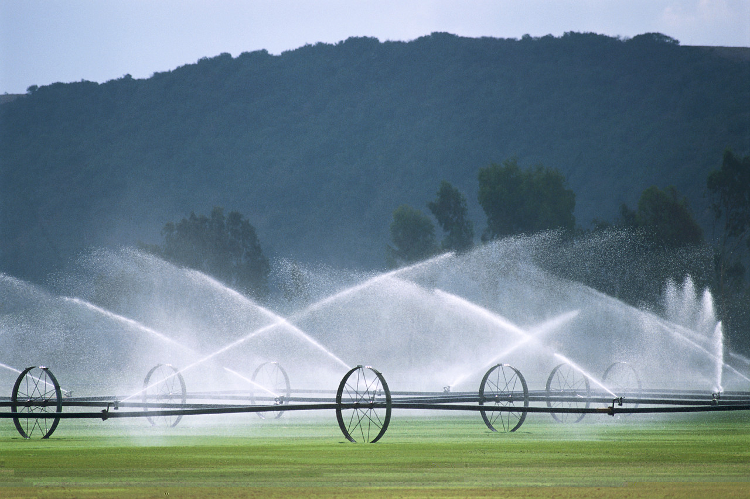
Water Accounting
inflow
outflow
extraction

Slide 5

Issues
And we don’t agree on what constitutes a stream….
(within a single state!)

Slide 6
Issues
Or agree on what they are called so we can store, share, integrate safely..
100121
10011
Frogspawn Dam
10012
1001
1002
100

Slide 7
Issues
And we cant afford high detail everywhere
10011
10012
1001
1002
100

Slide 8
So…
Bureau of Meteorology (BoM) is charged with creating a water resources information system
The “Hydrological GeoFabric” will provide a common basis for integrating related data
What must it look like?
Not like what has gone before…
  Needs to be maintainable
  Extensible to cover other aspects
  Provide stability for identifiers
  Allow piece-wise addition of detail
CSIRO will design and test a solution over the coming 12 months

Slide 9
Implications for OGC
CSIRO has helped initiate this DWG so we don’t operate in vacuum
We will be using definitions from international sources
  But refactoring from single-use implementations into reusable model components
  (We have a superset of INSPIRE, NHD Use Cases, for example)
BoM holds chair of the WMO Commission for Hydrology
If we can develop a AHGF that uses an implementation-neutral conceptual model, WMO can adopt.
This project will be directly testing INSPIRE Hydrography theme and proposing a modular approach that allows WMO/INSPIRE/AHGF to share a common conceptual model
  Validating against ArcHydro implementation of derived data products

Slide 10
Using Best Practice
We have different Use Cases from INSPIRE
  We are not creating a lowest-common denominator from existing data sets
Or US, Spain
  We can not generalise data products from available detailed data
We are building data sets through a combination of refinement and piecewise integration of more detailed components
  Extended INSPIRE/ISO methodology and conceptual model
  OGC governance of the meta-model (during development?)
    A la O&M
Is anyone else looking at Model Driven approaches to this problem?

Slide 11
Key challenges
A set of problems to be solved:
  Known issues with status quo – motivation for investment.
Domain specific:
  What objects? What scales?
  Hydrological connectivity
  Identifiers
Common (“framework data set”):
  Update cycles
  Partitioning of large problem into phased work packages
  Multiple scales
  Maintaining versions
  Topological consistency
  Derivation of multiple products from a knowledge base
  Documentation – ease of creation, maintenance and use
  Stakeholder engagement – value accrues through adoption

Slide 12
Project Activities
Methodology
  Will explain ideas now..
Design maintenance and implementation models
  Document Use Cases (OGC members?)
  Model to handle all aspects (data maintenance)
  Implementation (derived data products)
Specify
  Data Product Specification
  Framework for creating derived data product design and doc.
Test
  Build and test models and technology options.

Slide 13
Current maintenance model
A
A
A
Very simple topology generated
A

Slide 14
A Very Conceptual Architecture

Slide 15

Role of conceptual model
Conceptual Model
Data maintenance
environment
ArcHydro
Implementation
Cartographic
Product
Gazetteers
(lists of controlled
identifiers)
Node/
Link
Analysis
AWRIS
discovery
Related data
specifications
Models
“Model data integration” exploiting ids and common semantics

Slide 16
Structural implications
Conceptual Model
Data maintenance
environment
Normalised:
lots of linked pieces
no duplication
simple transactions
more “Object Oriented”

Slide 17
Concrete data products
Conceptual Model
Data maintenance
Environment
?
Implementation
Specifications
Logical Views
A
A | B
A | C
A | C
A | B
Data
ArcHydro
Implementation
Cartographic
Product
Gazetteers
(lists of controlled
identifiers)
Node/
Link

Slide 18
Research topics for modelling
Role of ontologies in conceptual model
  Or vice versa?
Multi-scale representations
  Vertical topology
Extensibility of data models
  Design patterns
Cross-domain integration
  Design patterns
  Vertical topology
Versioning
  Horizontal topology
Encapsulation of topology and Data quality rules in modular packages

Slide 19
External context
PSMA manages simpler data sets…
PSMA
Business
rules
ANZLIC
Harmonised
Data Model
Core
distribute
collate
Topo
“LYNX 2”
Cadastre
Web services
import
State
system
State
system
UI

Slide 20
C’wealth SDI concept
ANZLIC
Harmonised
Data Model
Multi-
scale
PSMA
Core
Business
rules
Topo
versioning
Business
rules
Business
rules
Business
rules
Cadastre
??
AHGF
Business
rules
Business
rules
Commonwealth
Agency
Commonwealth
Agency
Exploit LYNX2, data and tools
allowing agencies to extend and
share ?
Extend HDM through tested modules.
BoM
GA

Slide 21

Refactoring
?
?
?
Formalise
Initial questions
Extended capabilities
Initial questions
Refactor
Extension
Initial data model
Extensible data model

Slide 22
Adoption
WMO Hydrology Model
Domain
Ontology
Extension
Extensible data model

Slide 23
Development Activities
Identify Source Data | Supply Contract (SLA & DPS) | Common Architecture
 |  | AHGF Conceptual Model | Service Design | Define Delivery Products (DPS)
 |  | AHGF DB | Service Implementation | Prototype Client Tools
 |  | Populate | Deploy | Evaluate
Identity Management
Technical Integration
Test cases

Slide 24


Thank you
CSIRO Land and Water
Rob Atkinson
AHGF Activity Leader
Phone: +61 419202973
Email: Rob.Atkinson@csiro.au
Web: www.csiro.au/clw
Dr David Lemon
Research Stream Leader – Water Informatics
Phone: +61 2 6246 5724
Email: David.Lemon@csiro.au
Web: www.csiro.au/clw
https://wiki.csiro.au/confluence/display/WaterInformatics/AHGF+Implementation
Contact Us
Phone: 1300 363 400 or +61 3 9545 2176
Email: Enquiries@csiro.au Web: www.csiro.au

Slide 25
Key Use Cases
Provide a set of identifiers for hydrologic features for monitoring and observational data
  featureOfInterest, sampledFeature references in O&M, WaterML
  Link to Water Data Transfer Standards project as a “user”
Provide topological connectivity information
  Accounting, Modelling, Flood forecasting etc
Provide a set of statistical reporting units for monitoring trends
  Water Accounting Project
Provide a landscape partitioning framework for capturing higher detail where necessary
  Eg Flood forecasting as user of AHGF 2
Provide a means of collating the sum total of available knowledge about the hydrosphere
  Flow
  Ratings
  Monitoring
  Groundwater interactions
  Channel shape
  Studies (document index)

