Slide 1


Inspire O&M & SWE requirements - profile
BRGM – S.Grellet
52N – S.Jirka

Slide 2
Context
Several INSPIRE themes refer to O&M & SWE
Geology
Oceanographic geographical features and Sea Regions
Atmospheric conditions and Meteorological geographical features
Environmental monitoring facilities
Soil
First guidelines document produced in 2011 (slightly updated in 2013)
Current V2 version : http://inspire.jrc.ec.europa.eu/documents/Data_Specifications/D2.9_O&M_Guidelines_v2.0.pdf
Current running contracts (BRGM and 52N) to, respectively,
update guidelines document (D2.9) and recommendation for SOS as an Inspire download service
and provide the corresponding reference implementation
Notes:
2
2

Slide 3
Context
Inspire maintenance group
Set up with experts from various EU organisations
Identifies implementation UseCases
Provides feedback on previous guidelines document
Objective
Refine the guidelines document (D2.9) based on inputs above
Push it as an OGC profile
Refine the INSPIRE SOS dowload service technical guidance
Better link together the two documents
Notes:
2
2

Slide 4
O&M Design patterns
Decision tree
Screenshot
from the previous
one
Leading to specialisedObservations
Most of which derived from OM_DiscreteCoverageObservation
Notes:
2
2

Slide 5
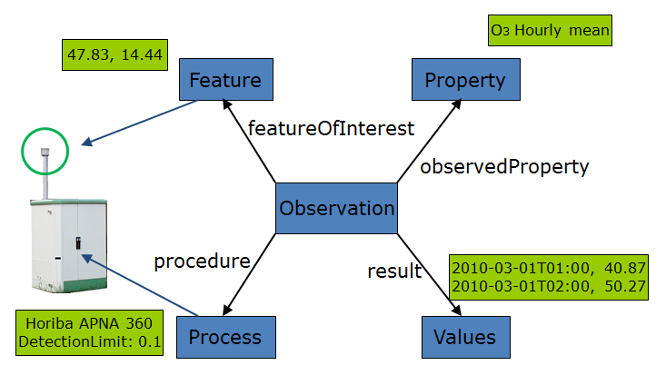
O&M Design patterns
specialisedObservation example
PointTimeSeries
An example of such case could be an air quality monitoring station providing hourly ozone measurements.
The featureOfInterest represents the direct surrounds of the air intake (i.e. the air bubble surrounding the air intake).
The location for the measurements is provided through this featureOfInterest.
As this design pattern usually provides a time series (temporal coverage) result,
the phenomenonTime and/or resultTime will often be provided together with the result values.
/req/inspire-om-design-patterns/pointTimeSeriesObservation | When the Observation represents a time-series of point measurements of a property at a fixed location in space the specialised observation ‘PointTimeSeriesObservation’ SHOULD be used
Notes:
2
2

Slide 6
O&M Design patterns
specialisedObservation
PointTimeSeries
Notes:
2
2

Slide 7
O&M Design patterns
Other specialised observations
point, multiPoint, pointObservationCollection
profile & trajectory
grid & gridTimeSeries
specimen & specimenTimeSeries (under discussion)
Notes:
2
2

Slide 8
O&M profile
Core Observation profile
Requirement classes : most of them are recommendation (only few are requirements)
OM_Observation : identifier, time (ISO 8601)
observedProperty :
communityVocabulary, SKOS
observableProperty (inspired from CSML3 : Dominic Lowe - British Atmospheric Data Centre – BADC) initially recommended (in V2) : few implementation feedback available -> moved to informative annex.
featureOfInterest :
SF_SamplingFeature ,
provision of sampledFeature : either domain feature or Nasa SWEET entry
pattern for depth/elevation provision
Notes:
2
2

Slide 9
O&M profile
Core Observation profile
Procedure
sensorType not instance (as in SOS hydro profile)
dedicated Process specialisation in Inspire (xsd and mapping to SensorML)
Link to monitoringFacility or monitoringNetwork generating the observation :
Pattern defined using om:parameter. With value pointing to URI of the facility/network
Metadata
No clear need identified
Notes:
2
2

Slide 10
O&M profile
Result encoding
TimeSeriesML support: issue to be clarified is the backward compatibility with WaterML2 (specialised observation use it)
JSON encoding to OM
Need for a resultType information ?
Especially for out-of-band results
So that the client knows before retrieving the observation result its type
A discussion paper was produced during the previous work phase.
No decision was taken so far.
Attached in an informative annex to the document produced
Notes:
2
2

Slide 11
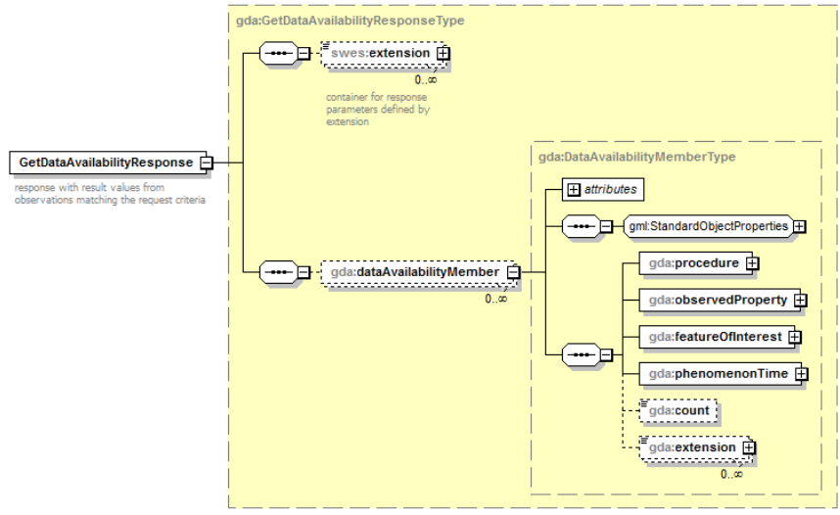
Service Layer
Work on updating GetDataAvailability
SOS hydrology profile
Adding offeringID and observationType in the response
Notes:
2
2

Slide 12
Service Layer
Recommended service patterns (WFS / SOS)
1°/ WFS : access Monitoring Facility/Network description
2°/ SOS: getDataAvailability to test ground for observation available at the monitoring feature level
retrieve offeringID
3°/ SOS: getObservation on a given OfferingID
Notes:
2
2

Slide 13
Technical guidelines for SOS as an INSPIRE download service
Extended capabilities for metadata
Mapping Inspire terminology to SOS operations
Ex : INSPIRE dataset -> Offerings
Remaining points
DescribeSensor operation behaviour to be confronted to Inspire Enviromental Monitoring Facilities theme
Observation identifier handling : getObservationById should reuse gml:identifier. Inspire ‘identifier’ is a dedicated type that is not gml:identifier…
Notes:
2
2

Slide 14
Next steps
Gather more profiles
New Zealand Environmental Observation Data Profile
Environment Canada Common Observation and Measurement Profile (nealy collected)
More ?
Communicate
Raise awareness at this TC : SWE DWG, HydroDWG
In between both TCs : circulate document to gather comments
Next TC (Dublin) : discuss into more details. SWE ? HydroDWG ?
Notes:
2
2

Slide 15
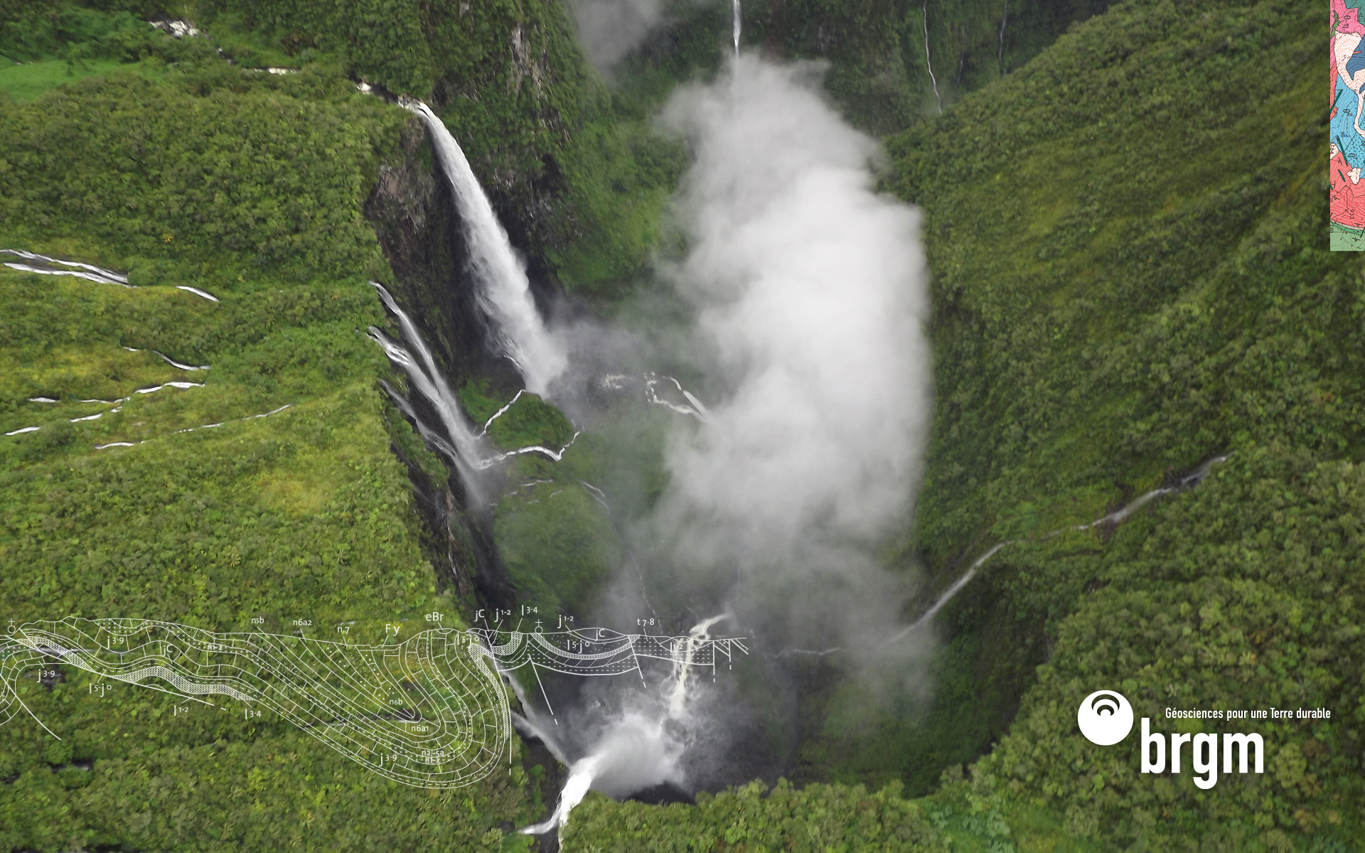
Thank you
s.grellet@brgm.fr
jirka@52north.org
Notes:
2
2

