Slide 1


River BAsin Standards: interopErability Pilot
RiBASE
98th OGC Technical Committee
Washington, DC USA
Joan Masó
9th March 2016
Copyright © 2016 Open Geospatial Consortium

Slide 2
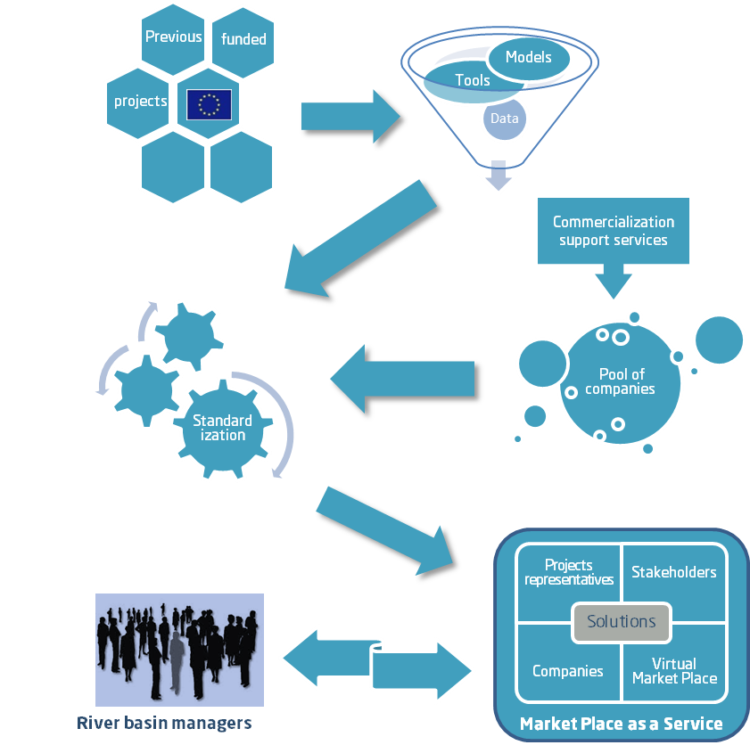
WaterInnEU project

Slide 3
WaterInnEU strategic objectives
Aggregate and screen the outcomes of previously unexploited European funded projects to identify those that potentially address the market need, and actively promote their dissemination and exploitation
Assess the level of standardization and interoperability of these tools and models, and promote opportunities for open source platforms to support data sharing processes

Slide 4
WaterInnEU strategic objectives
Create the marketplace as a service: this includes both the virtual platform and the provision of supporting and enabling services from the Consortium Partners.
Actively demonstrate the applicability of the marketplace in trans-national river basins by working directly with river basin managers to match their needs with appropriate products and services

Slide 5
WP5 Promote interoperable solutions
Deal with integration and harmonization of the different tools and initiatives into a common framework applying the relevant standards (in the INSPIRE context as well as into the WFD)
Examine the current standards and tools and assess the level of interoperability between them
Determine where there is a need to make progress and conduct interoperability experiments

Slide 6
Types of Interoperability Program Initiatives
Standards
Program
OGC Network
Plugfest
Pilot
Technology Maturation And Compliance
Interoperability
Experiment
Specifications
Implementations
Demonstrations
Testbed
Copyright © 2015 Open Geospatial Consortium

Slide 7

River BAsin Standards: interopErability Pilot
RiBASE
Copyright © 2016 Open Geospatial Consortium

Slide 8



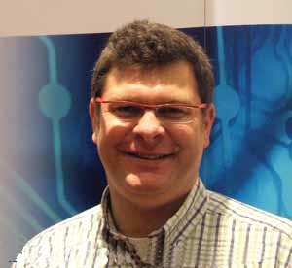
Kick-off meeting
http://www.eip-water.eu/side-meetings-eipwater2016
With the support of the OGC staff: Bart De Lathouwer

Slide 9
Kick-off meeting objectives
Know each other
Better define the scenario
Assign participants (and components) to the different steps of the scenario and defined efforts
Find the data to work with
Couple e-learning materials to the practical pilot
Step up a calendar of regular virtual meetings
Agree on the communication tools and next steps

Slide 10
Agenda
13:00-13:05 Welcome and agenda, Lluís Pesquer (CREAF)
13:05-13:20 Participants: short 1st round, All
13:20-13:35 OGC's view, Bart De Lathouwer (OGC)
13:35-13:55 Description of Interoperability Pilot, Joan Masó (CREAF)
13:55-14:10 Advisory board's vision, David Arctur (University of Texas)
14:10-14:25 WaterML, SOS and WPS, Simon Jirka and Christoph Stasch (52North)
14:25-14:45 Break
14:45-15:45 Open discussion and components implementation, All
15:45-16:00 Wrap up, Joan Masó (CREAF)

Slide 11
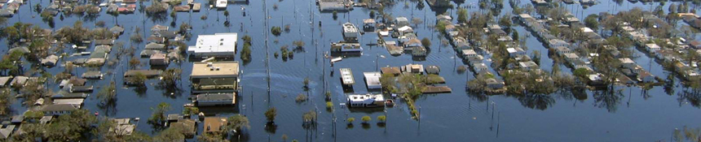
Scenario
An extreme weather situation is forecasted, river gauges data is continuously monitored. An increase in water flow is detected.
Flooding models are executed and affected areas are determined.
Emergency services are mobilized, lives are saved and damages on property and crops are estimated.
Notes:
The IE is the main task of WP5 Promote interoperable solutions

Slide 12
Real world scenario to put into practice
The primary focus of this IE is to demonstrate the applicability of OGC standards for the water domain:
Data formats:
  WaterML 2.0, TimeSeriesML, NetCDF, GeoTIFF…
Interfaces:
  Use of SOS 2.0 Hydrology Profile Best Practice for providing WaterML 2.0 data access.
  WPS 2.0 to execute flooding modeling (WaterML 2.0 as input)
  Download and view of Water models results as interoperable OGC web services.
  Alerting/notification services.
Notes:
The IE is the main task of WP5 Promote interoperable solutions

Slide 13
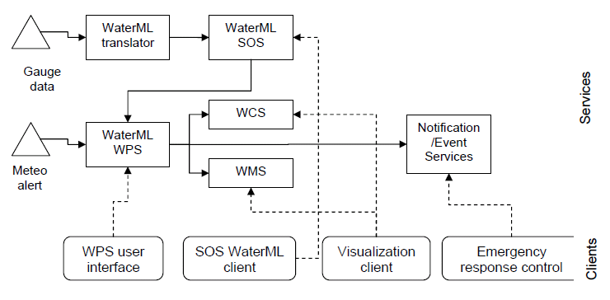
Architecture diagram
Consequences
WPS
Internet

Slide 14
Where?
River basin candidates
Data we need
Depending on the data available we will do this in the river basins of
Maritsa (Bulgaria)
Scheldt (Belgium)
Severn (UK)
The river network
High resolution DEMs
Gauge height (sensor)
Meteorological data
Soil data
Land Cover

Slide 15
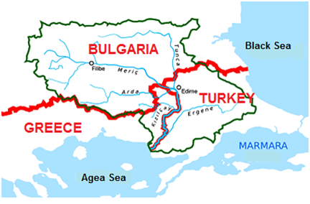
Maritsa
Trans-boundary river :
Bulgaria, Turkey and Greece)
with 6 main tributaries which discharge to it abroad.
East Aegean River Basin (EARB) is located in Ecoregion 7 – Eastern Balkan according to Annex XI of WFD.

Slide 16
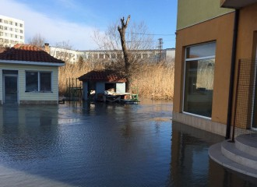
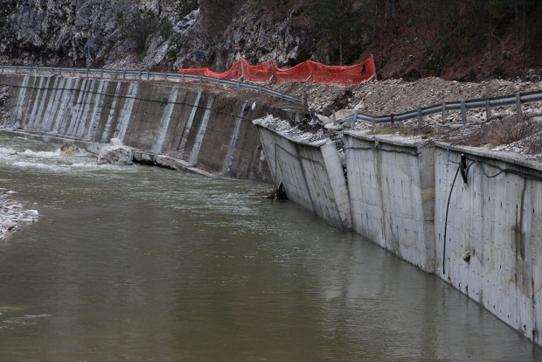
Floods in Maritsa River Basin, 2015

Slide 17
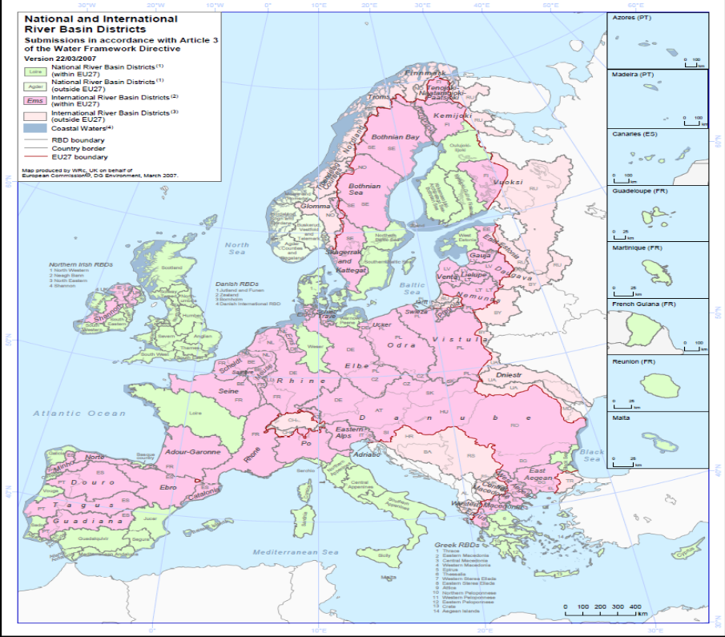


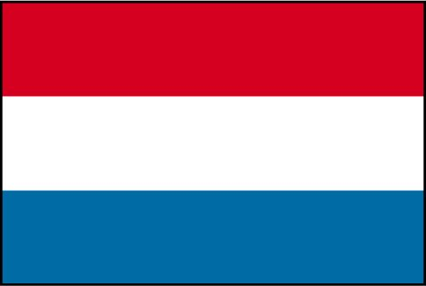



Scheldt Complex political context
6 district authorities:
3 states:F, B, NL
3 regions:W, VL, BXL
Scheldt District

Slide 18
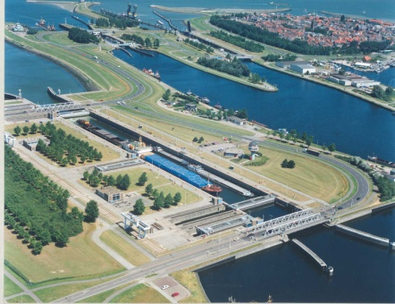
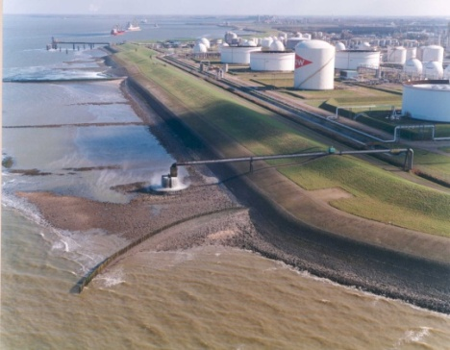
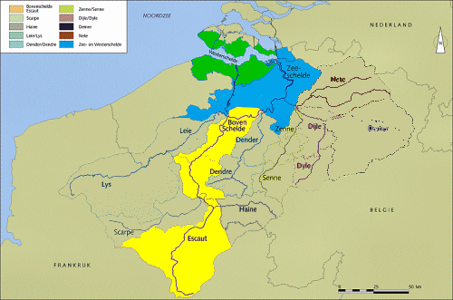
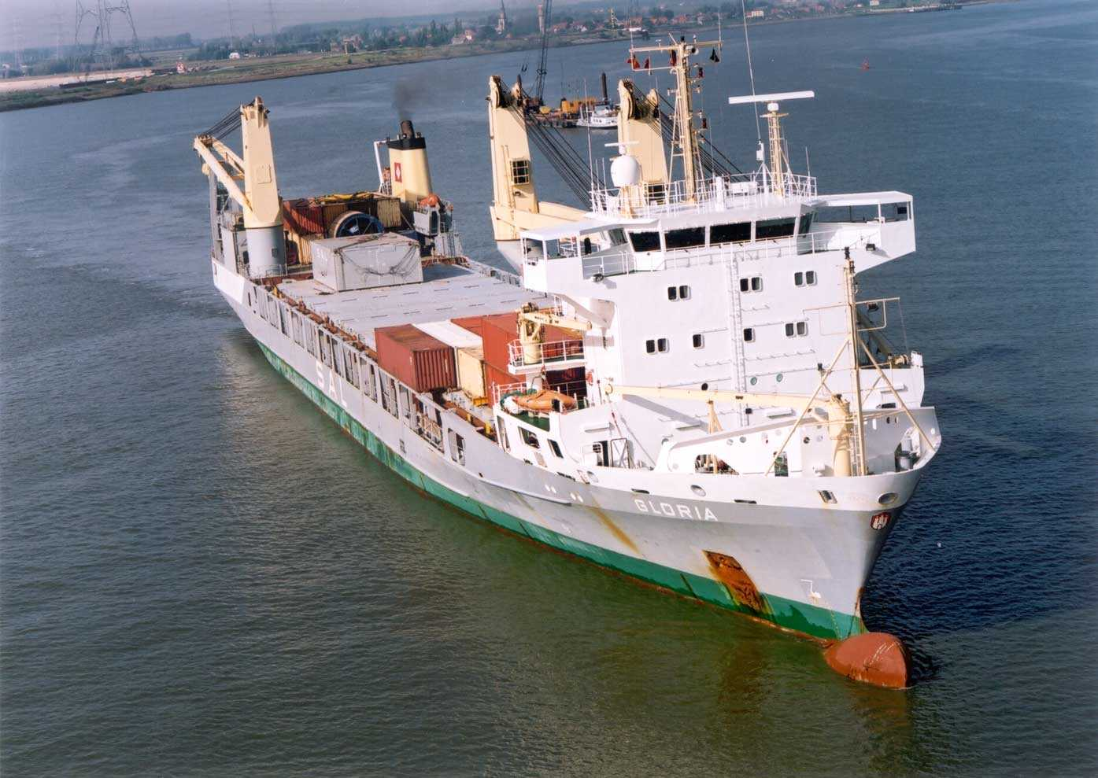
Scheldt Geographic key factors
A small district : Surface : 37.170 km2
A flat land (+150m to -5m under sea)
Population: +/-13.500.000 inhabitants
High density of population
Old industrial and urban structure
Strongly developed inland navigation
Intensive agriculture.

Slide 19
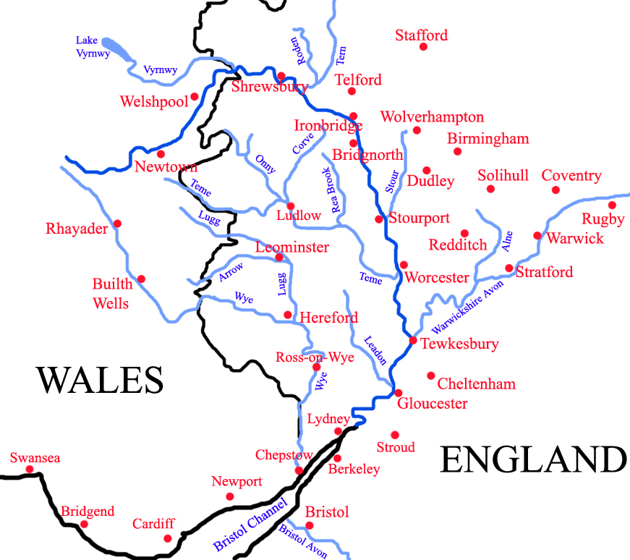
River Severn
Longest river in the United Kingdom, at about 220 miles (354 km)
England and Wales
Copyright © 2016 Open Geospatial Consortium

Slide 20
Experiment details
The IP attempts to address the following steps
Transform initial data to WaterML 2.0 & others
Extract WaterML 2.0 from the SOS 2.0 Hydrology Profile for the desired area and time.
If the readings exceed a threshold, start a WPS 2.0 execution with a hydrological model (and weather data).
Expose the results of the model using geospatial services to download data suitable for visualization.
Notify alerts to the relevant emergency services using Sensor Notification Services (this might be more experimental, since there is a lack of official standards)

Slide 21
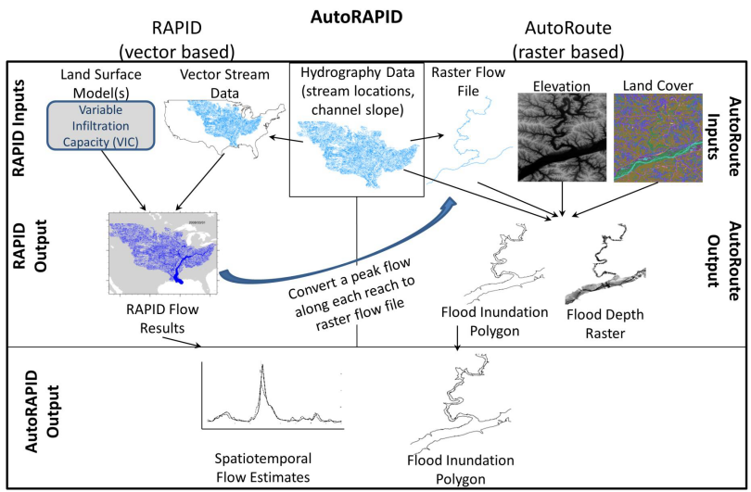
Possible integration of AutoRapid
Colaboration with Ahmad A. Tavakoly (ERDC)
High-Resolution Large Scale Inundation model
Copyright © 2016 Open Geospatial Consortium

Slide 22
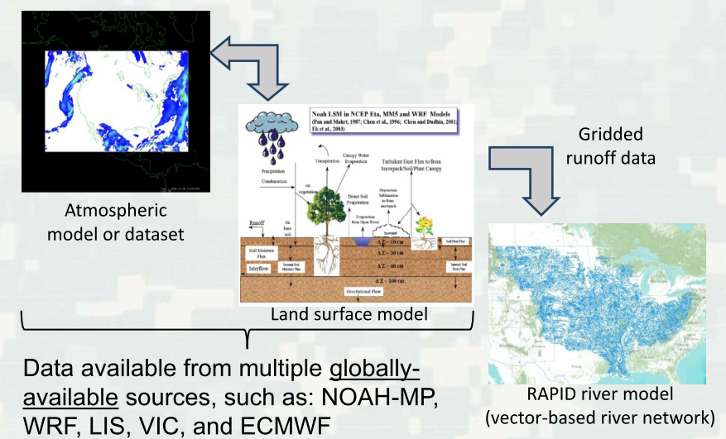

Interesting combination of data
Copyright © 2016 Open Geospatial Consortium

Slide 23
Level of participation
Sponsor
Initiator
Participant
Technology provider
Data provider
Observer

Slide 24
Benefits for participants
Early market development
  By implementing (and increasing support) to current standards in Europe
Accelerate development
  By being involved in a creative environment
  Moving research results to real implementations
Test interfaces
  With other participants
  With real water data
Demonstrate technologies in action
  A showcase easy to understand is used (video demo)
  Engineering report contribution as open document in OGC
Influence the standards
  By providing feedback to the OGC
  Detecting gaps in current standards
  Detecting the need for a new standard

Slide 25
Time table
2 Sprints
1 month for the scenarios (first)
Break of 3 weeks for bug fixing
2 weeks for the scenarios (second)
2 weeks preparation of demos and draft of the ER
Startup
Activity Plan submission | November 30th, 2015
Definition of the scenarios | December 1st, 2015
Start of participation request period | December 15th, 2015
Execution
Kick-off date (Leeuwarden *) | February 9th, 2016
Development, testing and bug fixing | February – June 2016
Intermediate presentation in a OGC- TC (Washington DC) | March 7th – 11st 2016
Wrap-up and Reporting
Technology Demonstration in a OGC -TC (Dublin) | June 21st – 24th 2016
Final report submission | September 2016

Slide 26
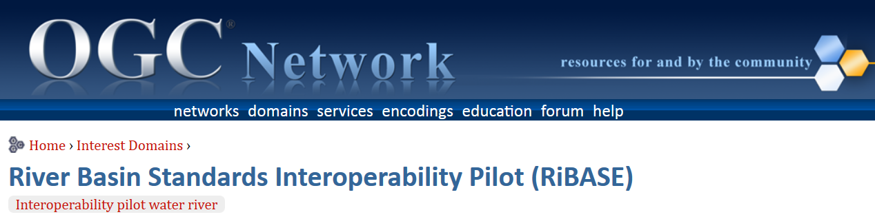
Tools for working together
Email list:
ribase@creaf.uab.cat
OGC network portal
http://www.ogcnetwork.net/node/1976

Slide 27
Participants
Confirmed attendance:
WaterInnEU: Christoph Stasch, Ronald van Nooyen, Simon Jirka, Annika Kramer*, Lisa Kreutzmann*, Joan Masó, Lluís Pesquer
(OGC: Bart De Lathouwer and David Arctur)
WatERP/WIDEST: Gabriel Anzaldi and Xavier Domingo
FREEWAT: Massimiliano Cannata
Umweltbundesamt: Zhenya Valcheva
Deltares: Bert Jagers
Interested people:
Gilles Neveu (OIeau), Matthew Fry (CEH)… and attenders of the EIP Water Conference.

Slide 28
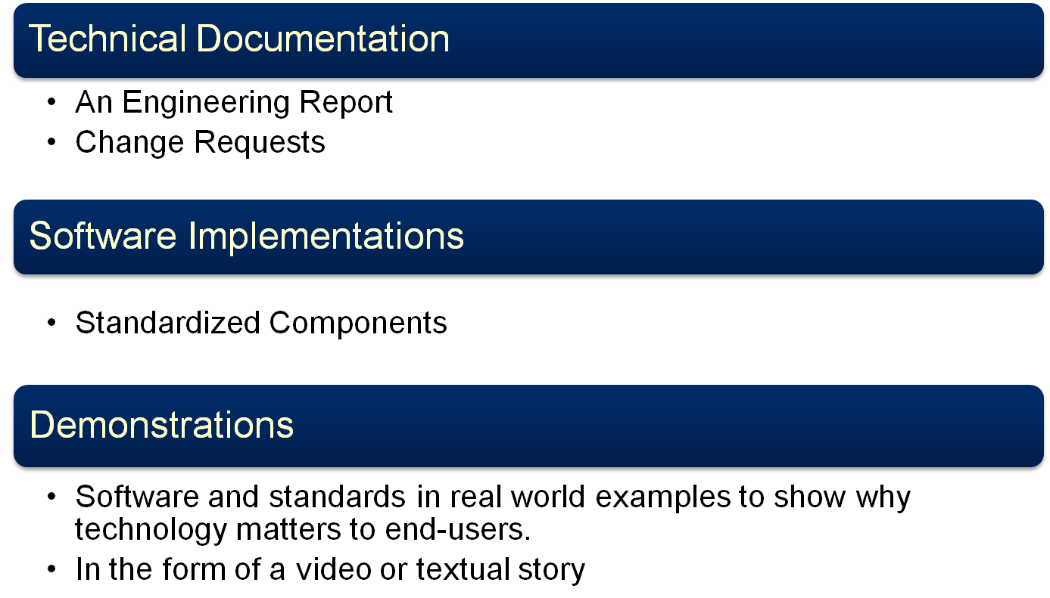
What are the deliverables?

Slide 29
Final steps
Create a video showing what is possible with the tools tested/developed
Write a report on the results with recommendation for
  The water community
  The standards community
    Submit standard CRs
Run a live demo
  (in the Dublin TC)

Slide 30
Thanks
Joan.maso@uab.cat
http://www.ogcnetwork.net/node/1976
Copyright © 2016 Open Geospatial Consortium

