Slide 1
WaterML 2.0 + TimeseriesML (draft) Overview & discussion
Peter Taylor
Research Engineer, CSIRO
2012-02-01
David Arctur (updates)
Research Scientist, UT Austin
2015-09-01 for NASA ESDSWG

Slide 2
What I’ll cover
History
Requirements and constraints
Overview of the information model
Usage
Future work & discussion

Slide 3
The problem
Hydro Jack
Need flow data!
Don
I’ll ring Don, he Has Data
*RING RING*
Hi Don, I need some upper Derwent flow readings for my geochemical model. Any ideas?
To: Jack
01/02/09, 3.2, 3, 1
01/02/09, 3.1, 3, 1
Hmm, I’ve got one site. I’ll send it through…
*RING RING*
Ok. Got the data. Where is the site located?
10 minutes…
10 minutes…
Oh, it’s at laughing jack bridge.
Ummm. (papers shuffle)
147.123 -41.588
Coordinates?
What reference system??
I think it’s GDA94
Ok. What sensor is used?
It’s calculated from the stream gauge reading using a rating curve..
Oh…how accurate is that?
Umm......
DON?
*CLICK*

Slide 4
A brief history
2007 – WaterML 1.0 discussion paper to Open Geospatial Consortium
2008-2009 – Discussions between CUAHSI and CSIRO for a harmonized water observations standard
2008-2009 – OGC/WMO Hydrology Domain Working Group formed
2010 – OGC Discussion paper: “Harmonizing Standards for Water Observations Data”
2011 – Formation of OGC Standards Working Group (SWG) for WaterML2.0 development
2012 – OGC adoption of WaterML2.0 international standard
(Updated Aug 2015, DArctur)

Slide 5

OGC/WMO Hydrology Domain Working Group
7+ Year International Effort – WaterML
(vote pending)
A time series for one variable at one location
Stage-Discharge values for one cross-section
WML2 Part 2 Ratings-Gaugings
Hydrology Domain Working Group started
OGC at WMO Commission for Hydrology
Sensor Observation Service 2.0
Hydrology Profile
Best Practice
Memorandum of Understanding between the World Meteorological Organization and the Open Geospatial Consortium
Technical Meetings every 3 months
Five Interoperability Experiments (Surface water, groundwater, ratings-gaugings)
Annual week-long workshops
Involvement by many countries
2008
2009
2010
2011
2012
2013
2014
Acknowledgements: OGC, WMO, GRDC, NWS, CUAHSI, BoM/CSIRO, USGS, GSC, Kisters, …….
Notes:
(1) A four-year international effort has been undertaken to reconcile WaterML with international standards;
(2) This effort was initiated with the establishment of an Hydrology Domain Working Group by the Open Geospatial Consortium in September 2008;
(3) An OGC representative attended the WMO Congress of the Commission for Hydrology in 2008
(4) A formal agreement between Secretary General of WMO and President of OGC in 2009 to jointly develop standards for hydrology, climatology, oceanography and climatology;
(5) The joint OGC/WMO Hydrology Domain Working Group was supported by a large work effort, annual week-long workshops, four interoperability experiments for surface and groundwater data exchange, and participation by many countries;
(6) In June 2012, the OGC voted to adopt the revised version, WaterML2 as an international standard for exchange of water resources time series (the first such public standard that has existed);
(7) This Congress to the WMO Commission for Hydrology to whom I am speaking is considering WaterML2 for adoption as an official standard by WMO
(8) WaterML 2.0 Part 2 – Ratings and Gagings is ready for public comment, pending OGC approval to post.

Slide 6
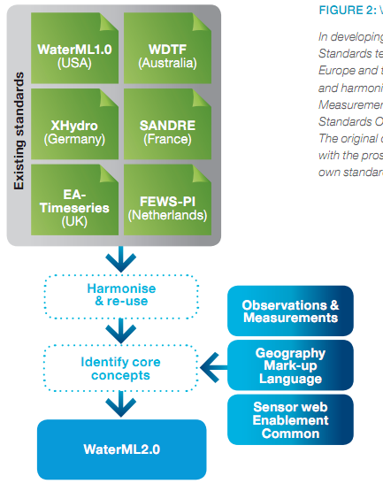
Harmonization
Scope
Requirements
Design
Do Stuff
Constraints
A new environment
Best practices

Slide 7
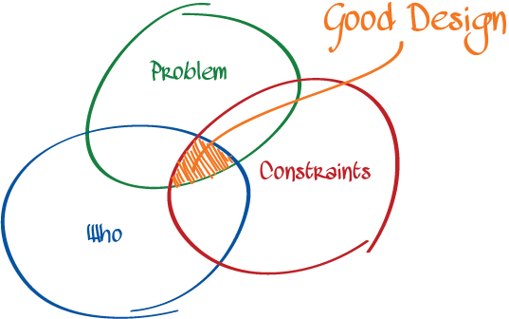
Requirements &
Constraints
http://spin.atomicobject.com/2012/01/26/understand-design-or-fail/

Slide 8
Requirements & constraints
Initial scope:
Exchange of point-based time series data
Includes processed data such as forecasts, aggregations etc.
Include relevant information on monitoring points, procedures and context
Working in an OGC – ISO – WMO context
Need to re-use existing work where possible
Be consistent
Assist in developing existing standards if they are not sufficient
Corollary
You need to know what the standards do and how they work

Slide 9
Relevant standards
The Sensor Web
Web of interconnected sensors
From micro to macro
Enhance ‘situation awareness’
Initial concepts emerged from NASA¹ (Delin et at.)
Intraconnected sensor pods
1. http://www.sensorwaresystems.com/historical/resources/sensorweb-concept.pdf

Slide 10
OGC’s Sensor Web
A service-based approach to providing an interoperability layer on the Web for accessing, controlling and discovering sensors
Sensor Web Enablement (SWE)

Slide 11
SWE version 1.0
Catalog
CS-W
WPS
Encodings
Services
TML
SensorML
O&M
WNS
SOS
SAS
SPS
SweCommon
Acronym heaven…

Slide 12
OGC (SWE) standards evolution
Acronym | Name | Status
TML | Transducer ML | 1.0. No longer developed.
O&M | Observations & Measurements | 2.0. ISO version approved.
SWE Common | Common data model | 2.0 approved.
SensorML | Sensor and process descriptions | 2.0 approved.
SAS | Sensor Alert Service* | 0.9 best practice
SPS | Sensor Planning Service | 2.0 approved.
WPS | Web Processing Service | 2.0 in progress.
CSW | Catalog Service for the Web | 2.0.2 adopted; 3.0 in progress.
WNS | Web Notification Service* | 0.9 best practice
* Sensor Event Service / OGC Eventing / PubSub SWG / WS-N. See OGC 11-088r1

Slide 13
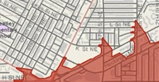

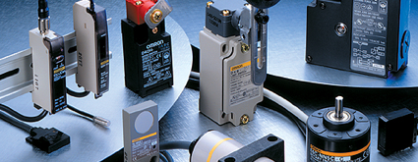
Common views on data
Features exist, have attributes and can be spatially described – ‘discrete’ or ‘vector’
Features
Continuous phenomena, varying in space and time – ‘raster’.
A function: spatial, temporal or spatio-temporal domain to attribute range
Coverages
An act that results in the estimation of the value of a feature property, and involves application of a specified procedure, such as a sensor, instrument, algorithm or process chain
Observations

Slide 14
Observations & Measurements
Now ISO19156 – Observations & Measurements.
Conceptual (UML) model
The XML encoding is OGC O&M 2.0 XML (10-025r1)
The most relevant standard within the OGC suite for WaterML2.0

Slide 15
Where do time series fit?
OGC lacked a common definition of time series, and specifically how they relate to coverages, observations and SWE
O&M has the concept of discrete coverage observations:
Observations where the result varies depending on spatial or temporal variation
This links observations, coverages and features
An in-situ time series may be viewed as a spatially fixed, temporally varying coverage
This view is consistent with netCDF (discrete sampling geometries)

Slide 16
WaterML 2.0 overview
WaterML2.0 consists of
Conceptual (UML) model
XML Schema (GML compliant)
Specification document
Requirements
Conformance classes
Conformance tests
XML Schematron rules
Vocabulary definitions
Only a subset relating to time series

Slide 17
WaterML 2.0 overview
Time series structures
O&M Observation specializations (roughly a variable)
Monitoring points
Collections of monitoring points
E.g. networks
Observation procedures
Generic collections

Slide 18
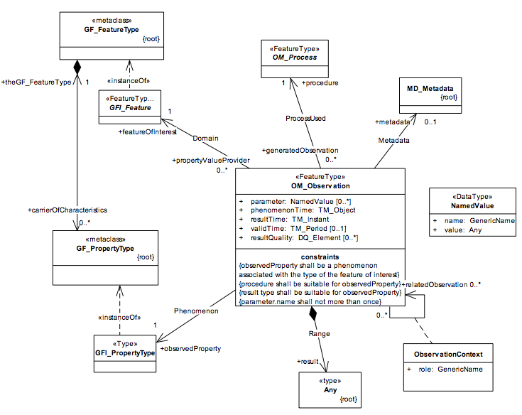
Observation (O&M)
Feature
Process
Metadata
Phenomenon
Related Observations
Result

Slide 19
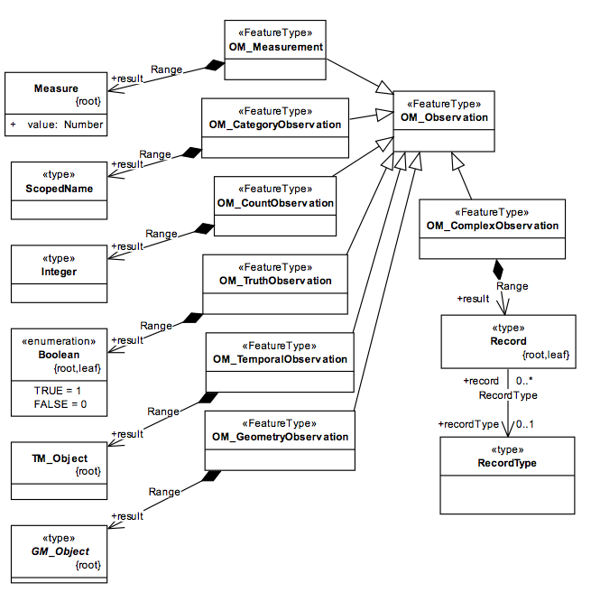
Observation types
Time series?
Option 1:
Collection of Observation elements
Option 2:
Time series as a result
Timeseries Observation
Timeseries

Slide 20
Coverage Observations
Interleaved timeseries (TVP)
Domain-range timeseries (TVP)

Slide 21
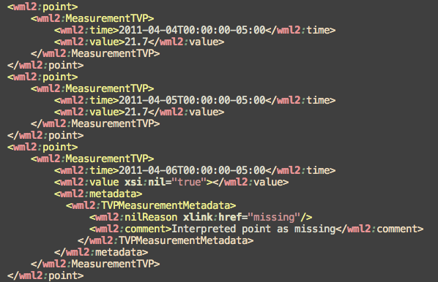
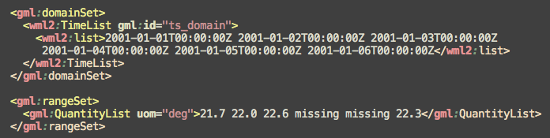
XML structure
Interleaved
Domain-range

Slide 22
Measurement timeseries
A Timeseries…
Consists of many time-value (measure) pairs…
With metadata and annotations.

Slide 23
Timeseries metadata

Slide 24
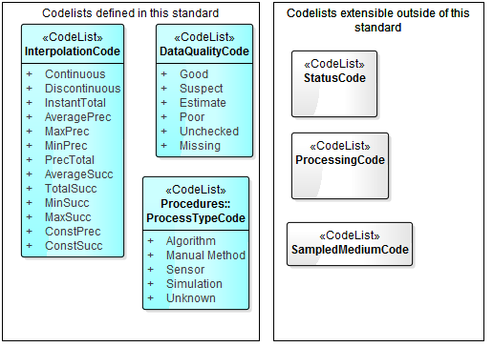
CodeLists (proposed for TimeseriesML)

Slide 25
Sampling features
The domain feature is often not directly measured but estimated through a proxy, or a sampling, feature
E.g. Measuring water quality of an aquifer involves sampling at a bore or well site.
E.g. Measuring river level at a station is sampling the river at a point
Linking of sampling features to domain features allows closer interaction with GIS systems

Slide 26
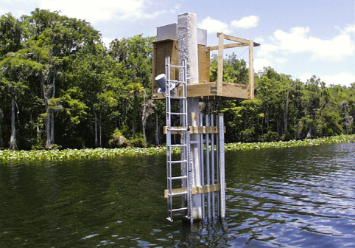
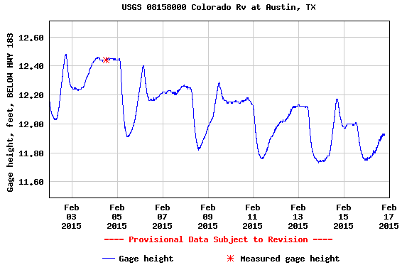
Using OGC O&M model for water level …
(WaterML2 Part 1)
GFI_Feature
Stream Gage
1
+featureOfInterest
sampling feature
River is a
sampled feature
0..*
Stage Height
OM_Observation
GF_PropertyType
+
phenomenonTime
1
+
resultTime
+observedProperty
+
validTime [0..1]
+
resultQuality [0..*]
+
parameter [0..*]
0..*
1
+procedure
+result
Time series of values
OM_Process
Any
Water level measurement
Source: USGS
An Observation is an action whose result is an estimate of the value of some property of the feature-of-interest, obtained using a specified procedure

Slide 27
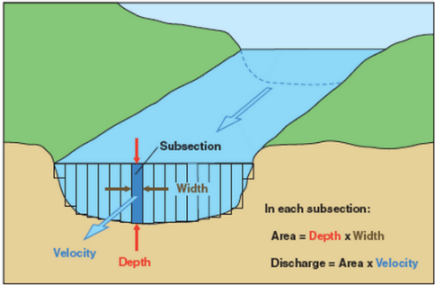
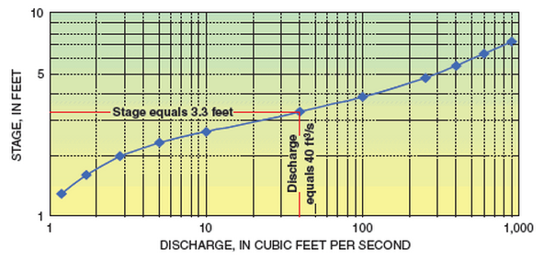
Treating rating curves as a measurement …
(WaterML2 Part 2)
GFI_Feature
Gage Location
1
+featureOfInterest
sampling feature
(Stage, Discharge) pair
0..*
OM_Observation
GF_PropertyType
+
phenomenonTime
1
+
resultTime
+observedProperty
+
validTime [0..1]
+
resultQuality [0..*]
+
parameter [0..*]
0..*
1
+procedure
+result
OM_Process
Any
(Stage, Discharge) tuples
Observation or Conversion Method
Source: USGS
An Observation is an action whose result is an estimate of the value of some property of the feature-of-interest, obtained using a specified procedure
Notes:
Rating curves are developed on a planned & as-needed basis, by taking direct measurements of depth and flow, and plotting the curve from this data. The curve is then used to convert real-time measurements of depth into real-time values of discharge.
The object of WaterML 2.0 Part 2 is to apply the OGC O&M conceptual model and WaterML XML schema to convey the set of (stage, discharge) values.
Source: http://water.usgs.gov/edu/measureflow.html
See also: OGC 13-021r3 WaterML 2.0 – Part 2.

Slide 28
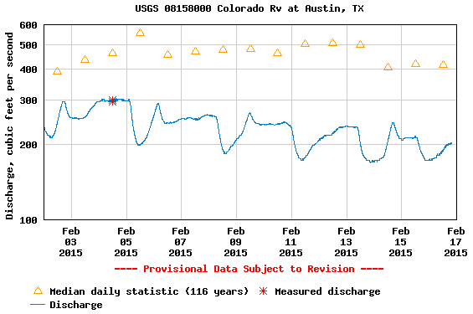
The stream flow can then be determined from the rating curve
(WaterML2 Part 1)
GFI_Feature
Stream Gage
1
+featureOfInterest
sampling feature
River is a
sampled feature
0..*
Discharge
OM_Observation
GF_PropertyType
+
phenomenonTime
1
+
resultTime
+observedProperty
+
validTime [0..1]
+
resultQuality [0..*]
+
parameter [0..*]
0..*
1
+procedure
+result
Time series of values
OM_Process
Any
Flow rate conversion
Source: USGS
An Observation is an action whose result is an estimate of the value of some property of the feature-of-interest, obtained using a specified procedure
Notes:
Graph source: http://waterdata.usgs.gov/nwis/uv?cb_00060=on&cb_00065=on&cb_00065=on&format=gif_default&site_no=08158000&period=&begin_date=2015-02-02&end_date=2015-02-16

Slide 29
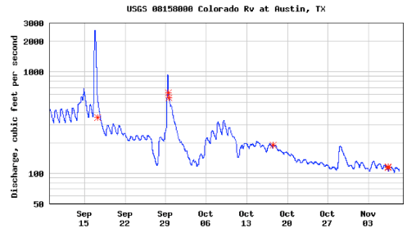

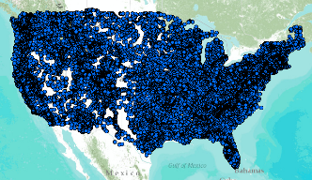
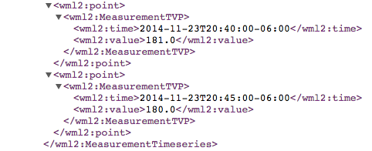
WaterML Web Services CUAHSI, USGS, OGC, WMO…
Water time series data on the internet
24/7/365 service
For daily and real-time data
. . . Operational water web services system for the United States
http://waterservices.usgs.gov/nwis/iv/?format=waterml,2.0&sites=08158000&period=P1D&parameterCd=00060
Notes:
Increasingly, national water data is being published using WaterML to describe time series of observations and model results. This is the current output from the US Geological Survey for one of their tens of thousands of river gauges (this one is on the Colorado River in Austin TX).

Slide 30
Putting into practice

Slide 31
Web Services
A logical fit with OGC’s Sensor Observation Service (SOS) 2.0
May be used with other services,
WaterOneFlow
Generic web services
RESTful services
Prototypes from Interoperability Experiments:
Groundwater IE
Surfacewater IE
Forecasting IE
(Updated Aug 2015, DArctur)

Slide 32


Specificity
Some parts of WaterML2.0 need further definition for particular usages
Focus was on getting core structures defined and consistency
Best practices and related standards
OGC Best Practice: Sensor Observation Service 2.0 Hydrology Profile
OGC Best Practice: WaterML-WQ – an O&M and WaterML 2.0 profile for water quality data (1.0)
WaterML 2.0 Part 2 – Ratings, Gaugings & Sections has been adopted and is in final stages of publication
OGC Hydrology Domain Working Group public wiki:
http://external.opengis.org/twiki_public/HydrologyDWG/WebHome
(Updated Aug 2015, DArctur)

Slide 33
Evolution
Convergence of various communities:
GIS, ‘feature’ view
Atmospheric, oceanographic – multi-dimensional, coverages
Satellite/Sensor-centric view
Hydrologists
WaterML 2.0 provides a step in the right direction for the hydro domain; TimeseriesML generalizes this for multiple domains
Given the increasingly multidisciplinary nature of science, it helps to align our ‘data world views’
Tension between community-specific requirements and abstract, flexible models – each have their role

Slide 34
Future work
Relationship of WaterML 3.0 (?) to TimeseriesML
NetCDF mapping (in progress; some applications exist)
Gap analysis leading to extensions &/or restrictions for satellite data
JSON, SWE Common encodings
Controlled vocabularies
Multiple variables per time series
(Updated Aug 2015, DArctur)

Slide 35
Timeseries Profile of OGC O&M / TimeseriesML – Open Call for Public Comment
Call for Comments (closes 9-17-2015)
Members of the Open Geospatial Consortium (OGC®) request comments on proposed OGC standards for the representation of observations as timeseries, that is, a sequence of data values which are ordered in time.
The OGC Timeseries Profile of Observations and Measurements candidate standard is a conceptual model for the representation of observations data as timeseries, with the intent of enabling the exchange of such data sets across information systems.
An accompanying OGC candidate standard defines an XML encoding (OGC TimeseriesML 1.0 - XML Encoding of the Timeseries Profile of Observations and Measurements). Other encodings may be developed in future.
Downloads
Timeseries Profile of Observations and Measurements (15-043r1)
TimeseriesML 1.0 - XML Encoding of the Timeseries Profile of Observations and Measurements (15-042r1) – includes schema

Slide 36

Community
The Hydro & Met-Ocean Domain Working Groups
Common problems being solved – let’s pool our resources!
Open standards, and source, come into their own when critical mass is reached
A governance framework linking with OGC and WMO
Temporal DWG and Timeseries SWG
Let’s grow the international community of practice for sharing time series data

Slide 37
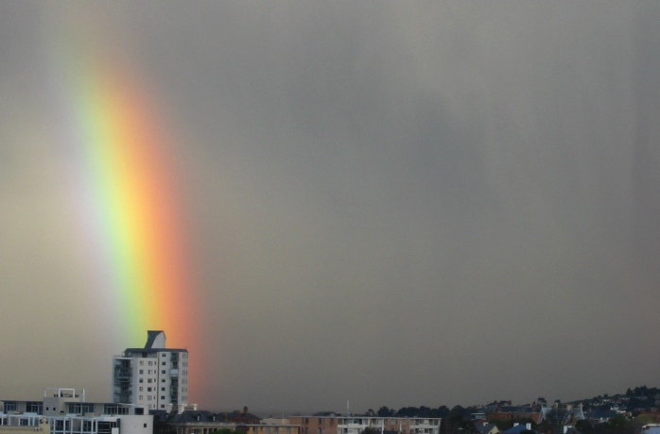
Thank you
CSIRO ICT Centre
Pete Taylor
Email: peter.taylor@csiro.au
Web: www.csiro.au/science/TasICTCentre.html
University of Texas at Austin
David Arctur
Email: david.arctur@utexas.edu
Notes:
37

