Slide 1
WaterML 2.0 Overview & discussion
Peter Taylor
Research Engineer, CSIRO
1st February, 2012, HIS teleconference

Slide 2
What I’ll cover
History
Requirements and constraints
Overview of the information model
Usage
Future work & discussion

Slide 3
The problem
Hydro Jack
Need flow data!
Don
I’ll ring Don, he Has Data
*RING RING*
Hi Don, I need some upper Derwent flow readings for my geochemical model. Any ideas?
To: Jack
01/02/09, 3.2, 3, 1
01/02/09, 3.1, 3, 1
Hmm, I’ve got one site. I’ll send it through…
*RING RING*
Ok. Got the data. Where is the site located?
10 minutes…
10 minutes…
Oh, it’s at laughing jack bridge.
Ummm. (papers shuffle)
147.123 -41.588
Coordinates?
What reference system??
I think it’s GDA94
Ok. What sensor is used?
It’s calculated from the stream gauge reading using a rating curve..
Oh…how accurate is that?
Umm......
DON?
*CLICK*

Slide 4
A brief history
2007 – WaterML 1.0 discussion paper to Open Geospatial Consortium
2008-2009 – Discussions between CUAHSI and CSIRO: harmonized water observations standard
2009 – Formation of joint WMO-OGC Hydrology Domain Working Group
2010 – OGC Discussion paper: “Harmonizing Standards for Water Observations Data”
2011 – Formation of OGC Standards Working Group (SWG) for WaterML2.0 development
2012 – OGC call for public comment on WaterML2.0 candidate standard

Slide 5
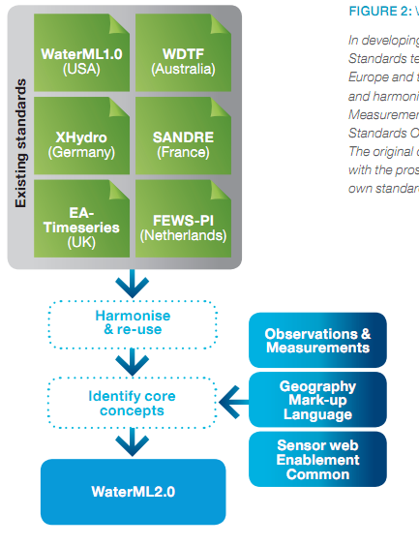
Harmonization
Scope
Requirements
Design
Do Stuff
Constraints
A new environment
Best practices

Slide 6
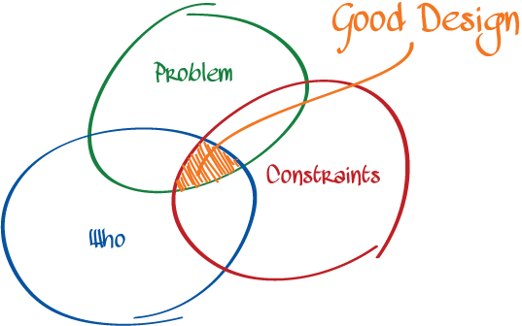
Requirements &
Constraints
http://spin.atomicobject.com/2012/01/26/understand-design-or-fail/

Slide 7
Requirements & constraints
Initial scope:
Exchange of point-based time series data
Includes processed data such as forecasts, aggregations etc.
Include relevant information on monitoring points, procedures and context
Working in an OGC – ISO – WMO context
Need to re-use existing work where possible
Be consistent
Assist in developing existing standards if they are not sufficient
Corollary
You need to know what the standards do and how they work

Slide 8
Relevant standards
The Sensor Web
Web of interconnected sensors
From micro to macro
Enhance ‘situation awareness’
Initial concepts emerged from NASA¹ (Delin et at.)
Intraconnected sensor pods
1. http://www.sensorwaresystems.com/historical/resources/sensorweb-concept.pdf

Slide 9
OGC’s Sensor Web
A service-based approach to providing an interoperability layer on the Web for accessing, controlling and discovering sensors
Sensor Web Enablement (SWE)

Slide 10
SWE version 1.0
Catalog
CS-W
WPS
Encodings
Services
TML
SensorML
O&M
WNS
SOS
SAS
SPS
SweCommon
Acronym heaven…

Slide 11
OGC (SWE) standards evolution
Acronym | Name | Status
TML | Transducer ML | 1.0. No longer developed.
O&M | Observations & Measurements | 2.0. ISO version approved.
SWE Common | Common data model | 2.0 approved.
SensorML | Sensor and process descriptions | 2.0 approved.
SAS | Sensor Alert Service* | 0.9 best practice
SPS | Sensor Planning Service | 2.0 approved.
WPS | Web Processing Service | 2.0 in progress.
CSW | Catalog Service for the Web | 2.0.2
WNS | Web Notification Service* | 0.9 best practice
* Sensor Event Service / OGC Eventing / PubSub SWG / WS-N. See OGC 11-088r1

Slide 12
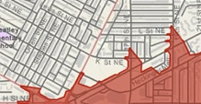

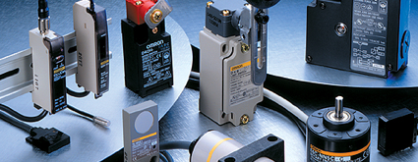
Common views on data
Features exist, have attributes and can be spatially described – ‘discrete’ or ‘vector’
Features
Continuous phenomena, varying in space and time – ‘raster’.
A function: spatial, temporal or spatio-temporal domain to attribute range
Coverages
An act that results in the estimation of the value of a feature property, and involves application of a specified procedure, such as a sensor, instrument, algorithm or process chain
Observations

Slide 13
Observations & Measurements
Now ISO19156 – Observations & Measurements.
Conceptual (UML) model
The XML encoding is OGC O&M 2.0 XML (10-025r1)
The most relevant standard within the OGC suite for WaterML2.0

Slide 14
Where do time series fit?
OGC lacks a common definition of time series, and specifically how they relate to coverages, observations and SWE
O&M has the concept of discrete coverage observations:
Observations where the result varies depending on spatial or temporal variation
This links observations, coverages and features
An in-situ time series may be viewed as a spatially fixed, temporally varying coverage
This view is consistent with netCDF (discrete sampling geometries)

Slide 15
WaterML 2.0 overview
WaterML2.0 consists of
UML model
XML Schema (GML compliant)
Specification document
Requirements
Conformance classes
Conformance tests
XML Schematron rules
Vocabulary definitions
Only a subset relating to time series

Slide 16
WaterML 2.0 overview
Time series structures
O&M Observation specializations (roughly a variable)
Monitoring points
Collections of monitoring points
E.g. networks
Observation procedures
Generic collections

Slide 17
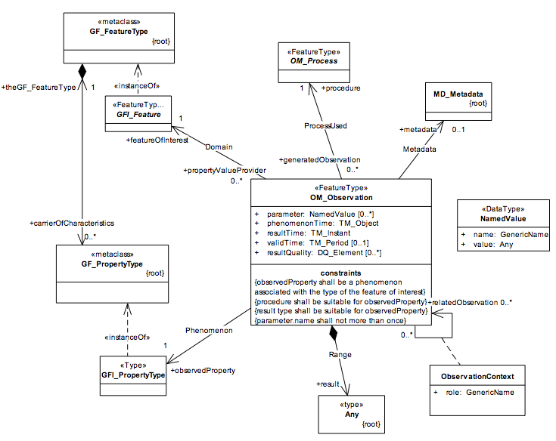
Observation (O&M)
Feature
Process
Metadata
Phenomenon
Related Observations
Result

Slide 18
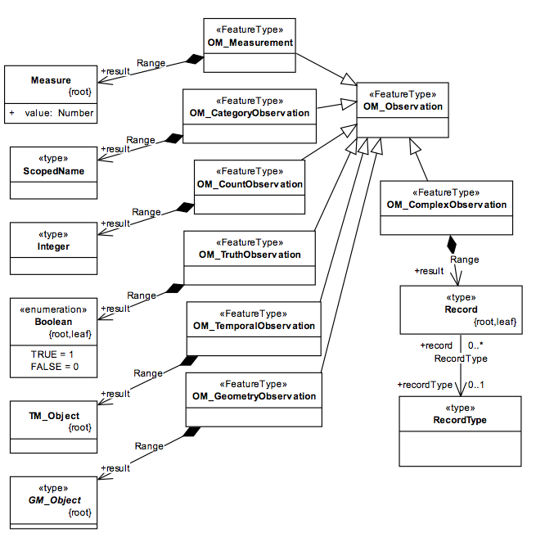
Observation types
Time series?
Option 1:
Collection of Observation elements
Option 2:
Time series as a result
Timeseries Observation
Timeseries

Slide 19
Coverage Observations
Interleaved timeseries (TvP)
Domain-range timeseries (TvP)

Slide 20
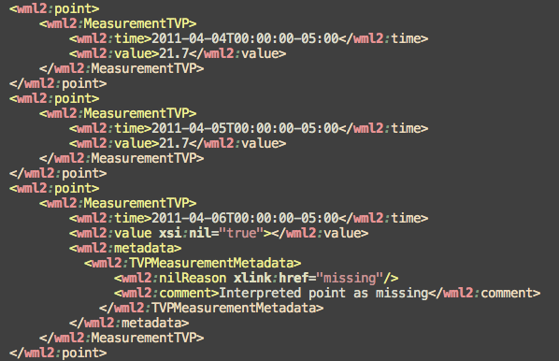
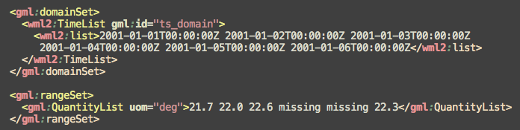
XML structure
Interleaved
Domain-range

Slide 21
Measurement timeseries
A Timeseries…
Consists of many time-value (measure) pairs…
With metadata and annotations.

Slide 22
Timeseries metadata

Slide 23
Sampling features
The domain feature is often not directly measured but estimated through a proxy, or a sampling, feature
E.g. Measuring water quality of an aquifer involves sampling at a bore or well site.
E.g. Measuring river level at a station is sampling the river at a point
Linking of sampling features to domain features allows closer interaction with GIS systems

Slide 24
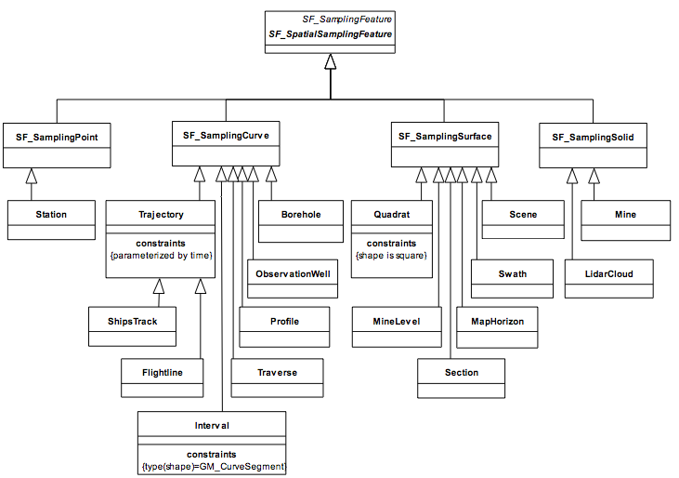
Example sampling features

Slide 25
Putting into practice

Slide 26
Web Services
A logical fit with OGC’s Sensor Observation Service (SOS)
Version 2.0 is being voted on by OGC
May be used with other services,
WaterOneFlow
Generic web services
RESTful services
Prototypes from Interoperability Experiments:
Groundwater IE
Surfacewater IE
Forecasting IE

Slide 27


Specificity
Some parts of WaterML2.0 will need to be defined for particular usages
Focus was on getting core structures defined and consistency
Best practices and future iterations to come
OGC network pages a starting ground:
http://www.ogcnetwork.net/node/1748

Slide 28
Evolution
Convergence of various communities:
GIS, ‘feature’ view
Atmospheric, oceanographic – multi-dimensional, coverages
Sensor-centric view
Hydrologists
WaterML2.0 hopes to provide a step in the right direction for the hydro domain
Given the increasingly multidisciplinary nature of science, it helps to align our ‘data world views’
Tension between community-specific requirements and abstract, flexible models – each have their role

Slide 29
Future work
Interest in exchange of ratings, gaugings (and cross sections)
Hydro DWG will be kicking off something in the space soon…
Water quality specific encodings
NetCDF mapping is in progress
JSON, SWE Common encodings
Controlled vocabularies

Slide 30

Community
The Hydro Domain Working Group
Common problems being solved – let’s pool our resources!
Open standards, and source, come into their own when critical mass is reached
A governance framework linking with OGC and WMO
Let’s grow the international community of practice for sharing water data

Slide 31
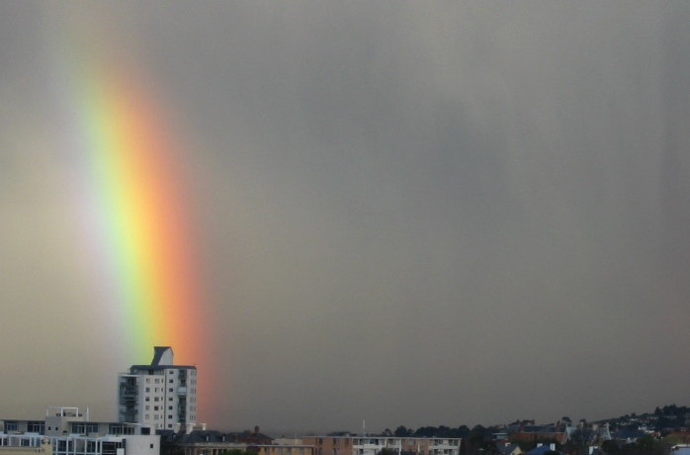
Thank you
CSIRO ICT Centre
Pete Taylor
Phone: +61 3 6232 5530
Email: peter.taylor@csiro.au
Web: www.csiro.au/science/TasICTCentre.html
Contact Us Phone: 1300 363 400 or +61 3 9545 2176 Email: Enquiries@csiro.au Web: www.csiro.au
Notes:
31

Slide 32
Backup slides

Slide 33
Type #1 - Vertical in procedure
Observation 1
FeatureOfInterest=SamplingPoint1
Procedure=Proc1_1m_temp_sensor
ObservedProperty=temperature
Result=MeasureTimeseries(
01/01/01T12:00:00,2.3
01/01/01T12:00:00,2.3)
Observation 2
FeatureOfInterest=SamplingPoint1
Procedure=Proc1_2m_temp_sensor
ObservedProperty=temperature
Result=MeasureTimeseries(
01/01/01T12:00:00,1.1
01/01/01T12:00:00,1.2)
Implications:
- Have to create a unique procedure for each series
- Height is embedded in procedure definition (e.g. sensorsML)
Multiple observations returned for GetObs(foi, obs_prop)
Result type is simple (tvp, measure)
SensorSystem
FeatureOfInterest=SamplingPoint1
Procedure=Proc1_2m_temp_sensor
ObservedProperty=temperature
Result=(MeasureTimeseries
01/01/01T12:00:00,1.1
01/01/01T12:00:00,1.2)
Monitoring Point (x,y)
Proc1_1m_temp_sensor
Proc1_2m_temp_sensor

Slide 34
Type #2 – 3D coordinates
Observation 1
FeatureOfInterest=SamplingPoint1 (x,y,1)
Procedure=temperature_sensor
ObservedProperty=temperature
Result=MeasureTimeseries(
01/01/01T12:00:00,2.3
01/01/01T12:00:00,2.3)
Observation 2
FeatureOfInterest=SamplingPoint2 (x,y,2)
Procedure=temperature_sensor
ObservedProperty=temperature
Result=(MeasureTimeseries
01/01/01T12:00:00,1.1
01/01/01T12:00:00,1.2)
Implications:
Have to handle 3D coordinates
May end up with a lot of sampling points
Groups of samplings points required if the relationship is to be explicitly captured (it’s naturally captured with spatial proximity and same observed property)
Can query explicitly for each sampling point
Result structure is simple (tvp, measure)
Sampling Group
member=SamplingPoint1
member=SamplingPoint2
Procedure=temperature_sensor
SamplingPoint1 (x,y,z)
SamplingPoint2 (x,y,z)

Slide 35
Type #3 – Observation metadata
Observation 1
FeatureOfInterest=SamplingPoint1
Parameter={verticalHeight=1m}
Procedure=temp_sensor
ObservedProperty=temperature
Result=MeasureTimeseries(
01/01/01T12:00:00,2.3
01/01/01T12:00:00,2.3)
Observation 2
FeatureOfInterest=SamplingPoint1
Parameter={verticalHeight=2m}
Procedure=temp_sensor
ObservedProperty=temperature
Result=(MeasureTimeseries
01/01/01T12:00:00,1.1
01/01/01T12:00:00,1.2)
Implications:
A generic procedure type is used
Cannot query for vertical height natively (without extension)
No site specific procedure information can be provided
Multiple observations returned for a site: client needs to understand why they are different
SamplingPoint1 (x,y)
procedure=temp_sensor
procedure=temp_sensor

Slide 36
Type #4 – Height as timeseries
Composite Observation
FeatureOfInterest=SamplingPoint1
Procedure=temp_sensor
ObservedProperty=CompoundProperty
Result=MeasureTimeseries(
01/01/01T12:00:00,2.3,1.0
01/01/01T12:00:00,2.3,2.0
01/01/01T12:00:00,2.2,1.0
01/01/01T12:00:00,2.2,2.0 )
Vertical offset
Implications:
A generic procedure type is used
Querying for vertical height would require a result filter (vertical height not first class)
No site specific procedure information can be provided
Single observation returned for site.
Result type is more complex (tvp, measure, height)
SamplingPoint1 (x,y)
procedure=temp_sensor
procedure=temp_sensor

Slide 37
Measuring on either side of river bank
Observation 1
FeatureOfInterest=SamplingPoint1
Procedure=level_sensor
ObservedProperty=gage height, stream
Result=MeasureTimeseries(
01/01/01T12:00:00,2.3
01/01/01T14:00:00,2.4)
SamplingCollection
- SamplingPoint1
- SampingPoint2
Unknown location
SamplingPoint1 (x₁,y₁)
- Right bank
SamplingPoint1 (x₁,y₁)
SamplingPoint2 (x₂,y₂)
- Left bank
Observation 1
FeatureOfInterest=SamplingPoint1
Procedure=level_sensor
OObservedProperty=gage height, stream
Result=CompositeTimeseries(
01/01/01T12:00:00,2.3, Left
01/01/01T12:00:00,2.3, Right
)
Bank identifier
Observation 2
FeatureOfInterest=SamplingPoint2
Procedure=level_sensor
ObservedProperty=gage height, stream
Result=MeasureTimeseries(
01/01/01T12:00:00,2.3
01/01/01T14:00:00,2.4)
Same example holds for upstream/downstream sensors where they are both part of the same ‘site’ and coordinates may not be known.

Slide 38
Integrating with Hydrologic Features
“Sampled Feature” is not always obvious
Use cases of real locations, raw data streams processing and delivered data products
Use domain scientists to extract implied information to sampled features.

Slide 39
Measuring upstream and downstream
Observation 1
FeatureOfInterest=SamplingPoint1
Parameter={upstream}
Procedure=level_sensor
ObservedProperty=stage ,stream
Result=MeasureTimeseries(
01/01/01T12:00:00,2.3
01/01/01T14:00:00,2.4)
Sensor1 (x₂,y₂)
-Upstream
Weir
SamplingPoint1 (x₂,y₂)
-
Observation 2
FeatureOfInterest=SamplingPoint
Parameter={downstream}
Procedure=level_sensor
ObservedProperty=gage height, stream
Result=MeasureTimeseries(
01/01/01T12:00:00,2.3
01/01/01T14:00:00,2.4)
sensor2 (x₂,y₂)
-downstream
Same sampling feature, but multiple sensors may be observing a different sampled feature

Slide 40
Tidally influence filtered
Raw Data – 15 minute average
Processing
Processed - Daily Average
Observation 1
FeatureOfInterest=SamplingPoint1
Procedure=level_sensor
InterpoloationType=Preceeding Average
Period=15 min
ObservedProperty=Gauge Hieight
Result=MeasureTimeseries(
01/01/01T12:00:00,2.3
01/01/01T14:00:00,2.4)
Observation 2
FeatureOfInterest=SamplingPoint1
Procedure=Velocity sensor
InterpoloationType=Preceeding Average
Period=15 min
ObservedProperty=Veliocity, stream
Result=MeasureTimeseries(
01/01/01T12:00:00,2.3
01/01/01T14:00:00,2.4)
SamplingPoint1 (x₁,y₁)
SamplingPoint1 (x₂,y₂)
-
Observation 1
FeatureOfInterest=SamplingPoint1
Procedure=72137 Discharge, ltide ftrd(Mean)
IntepolationType=Succeeding Average
Period=1 day
OObservedProperty=Discharge,
Result=CompositeTimeseries(
01/01/01T12:00:00,2.3,
01/01/01T12:00:00,2.3,
)
Observation 2
FeatureOfInterest=SamplingPoint1
Procedure=Dsscharge sensor
InterpoloationType=Preceeding Average
Period=15 min
ObservedProperty=Discharrge, stream
Result=MeasureTimeseries(
01/01/01T12:00:00,2.3
01/01/01T14:00:00,2.4)

