Slide 1
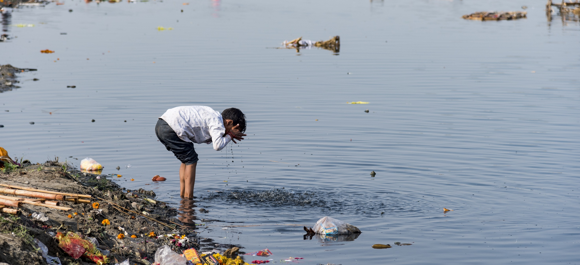







Workshop Series on Water Quality Monitoring – Opening Workshop
Interoperability and interconnection of the existing Water Quality Data Systems
Sylvain Grellet - BRGM, pôle INSIDE
WEATHER CLIMATE WATER
Notes:
s

Slide 2


? Interconnecting systems ? -> hydrology example
Let’s go there : https://external.ogc.org/twiki_public/HydrologyDWG/DarmstadtTc2009
2009_Sept_Darmstadt_HarmonisationObservations_PeterT.ppt

Slide 3
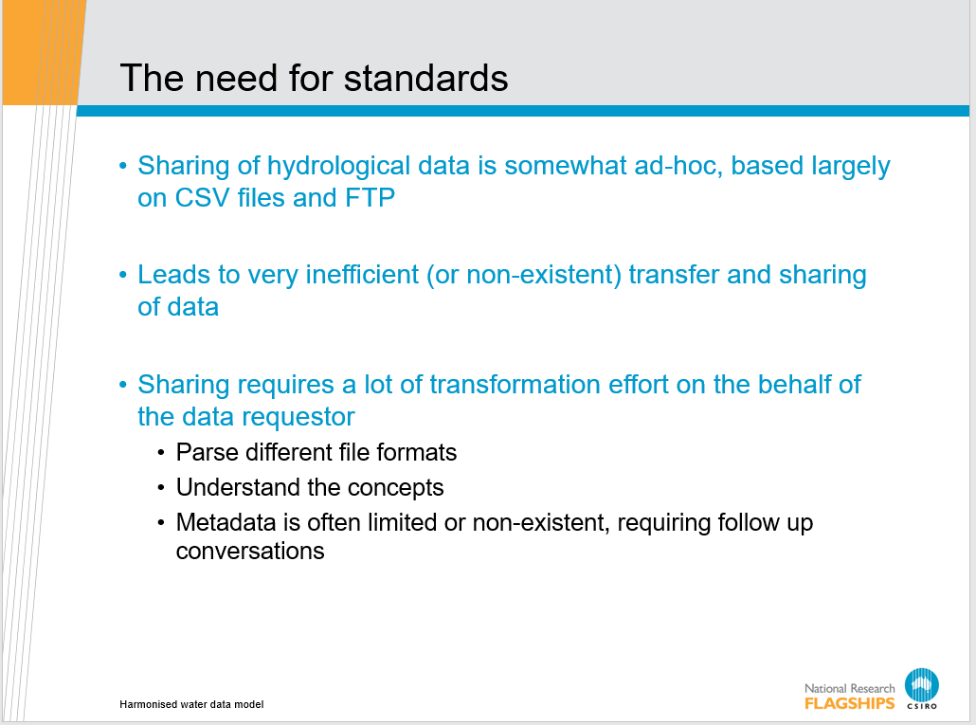
? Interconnecting systems ?

Slide 4
? Interconnecting systems ?
Hydro Jack
Need flow data!
Hmm maybe Don can help…
*RING RING*
Hi Don, I need some upper Derwent flow readings for my geochemical model. Any ideas?
To: Jack
01/02/09, 3.2, 3, 1
01/02/09, 3.1, 3, 1
Hmm, I’ve got one site. I’ll send it through…
*RING RING*
Ok. Got the data. Where is the site located?
10 minutes…
10 minutes…
Oh, it’s at laughing jack bridge.
How often have you been Hydro Jack
(or Don) ?
Ummm. (papers shuffle)
147.123 -41.588
Coordinates?
What reference system??
I think it’s GDA94
Ok. What sensor is used?
It’s calculated from the stream gauge reading using a rating curve..
Oh…how accurate is that?
Umm......
DON?
*CLICK*

Slide 5
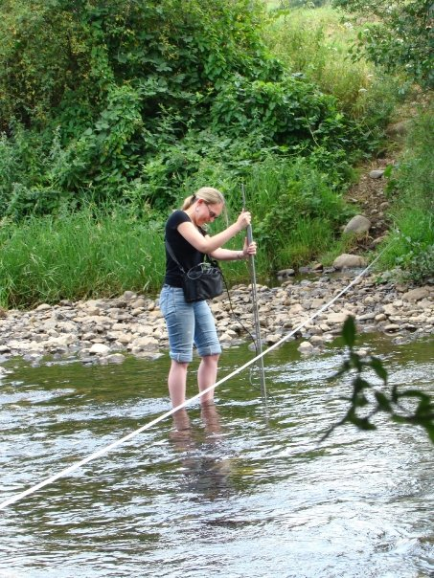
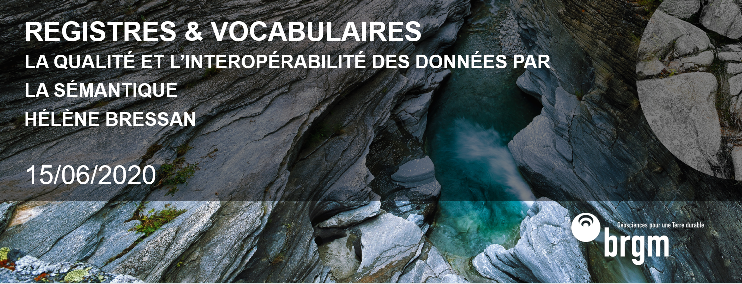
? Interconnecting systems ? -> geoscience example
BRGM : Scientific programme sessions

Slide 6

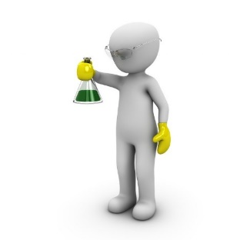


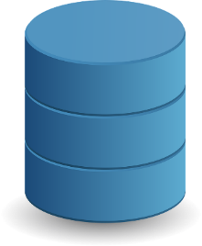

? Interconnecting systems ?
Which Beaulieu ? In France ? Is it a city ? In Cantal ? In Ardèche ?
So…, Mispickel what is it ? Should I store it with Fe and et As analysis ?
L’Arsenopyrite and « la dalarnite » are they other minerals ?
I observe on this outcrop the possibility of presence of Mispickel (FeAsS), near Beaulieu
Let’s analyze heavy metals in this sample sampled near Beaulieu:
As, Fe, Pb, …
This Iron found is it the same as the one observed at the lab ?
I observe on this outcrop the possibility of presence of Arsenopyrite
Data consumer
Quelle belle dalarnite !
Digging here, I discovered iron !

Slide 7
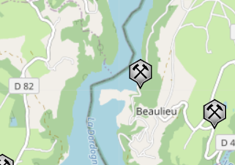
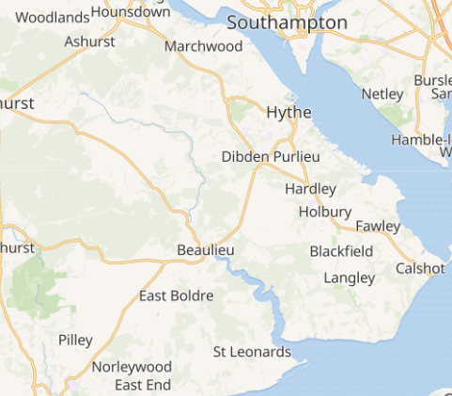
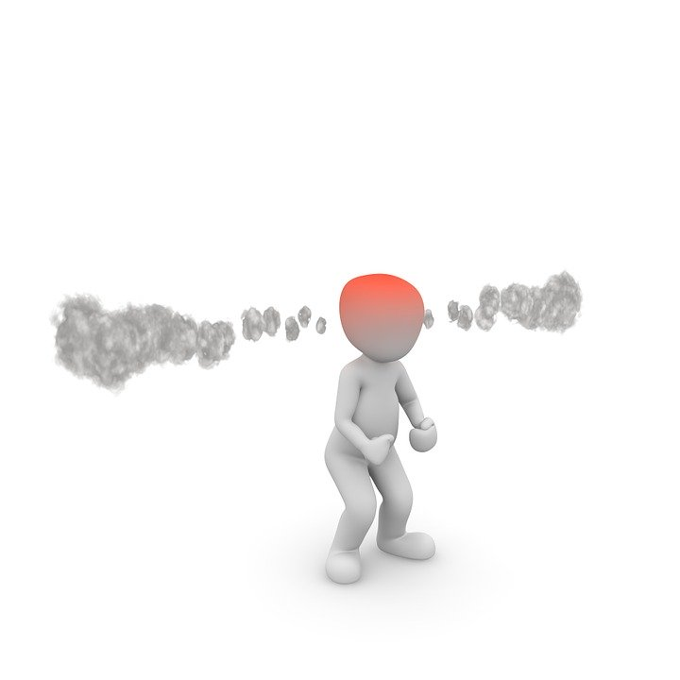
? Interconnecting systems ?
Which Beaulieu ? In France ? Is it a city ? In Cantal ? In Ardèche ?
So…, Mispickel what is it ? Should I store it with Fe and et As analysis ?
L’Arsenopyrite and « la dalarnite » are they other minerals ?
I observe on this outcrop the possibility of presence of Mispickel (FeAsS), near Beaulieu
France
Let’s analyze heavy metals in this sample sampled near Beaulieu:
As, Fe, Pb, …
This Iron found is it the same as the one observed at the lab ?
I observe on this outcrop the possibility of presence of Arsenopyrite
Data consumer
Quelle belle dalarnite !
Digging here, I discovered iron !
UK

Slide 8

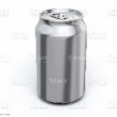
I observe on this outcrop the possibility of presence of https://data.geoscience.fr/ncl/Minls/22
(FeAsS), near http://id.insee.fr/geo/commune/15020
? Interconnecting systems ?
I observe on this outcrop the possibility of presence of Mispickel (FeAsS), near Beaulieu
Let’s analyze heavy metals in this sample sampled on https://environment.data.gov.uk/catchment-planning/WaterBody/GB520704201400, then, https://data.geoscience.fr/ncl/ObjParSubs/3183, https://data.geoscience.fr/ncl/ObjParSubs/3177, Pb, …
Location
Let’s analyze heavy metals in this sample sampled near Beaulieu:
As, Fe, Pb, …
Observations and measures
Minerals
I observe on this outcrop the possibility of presence of Arsenopyrite
I observe on this outcrop the possibility of presence of https://data.geoscience.fr/ncl/Minls/22
Share semantics
to describe and exchange data
Quelle belle dalarnite !
Quelle belle https://data.geoscience.fr/ncl/Minls/22 !
Chemical composition
Digging here ,
I discovered iron !
I discovered https://data.geoscience.fr/ncl/AnthroMat/62
Iron made
Object

Slide 9

I observe on this outcrop the possibility of presence of https://data.geoscience.fr/ncl/Minls/22
(FeAsS), near http://id.insee.fr/geo/commune/15020
Let’s analyze heavy metals in this sample sampled on https://environment.data.gov.uk/catchment-planning/WaterBody/GB520704201400, then, https://data.geoscience.fr/ncl/ObjParSubs/3183, https://data.geoscience.fr/ncl/ObjParSubs/3177, Pb, …
I observe on this outcrop the possibility of presence of https://data.geoscience.fr/ncl/Minls/22
No more siloed
data
Interoperable
data
Share semantics
to describe
and exchange
data
Quelle belle https://data.geoscience.fr/ncl/Minls/22 !
I discovered https://data.geoscience.fr/ncl/AnthroMat/62

Slide 10
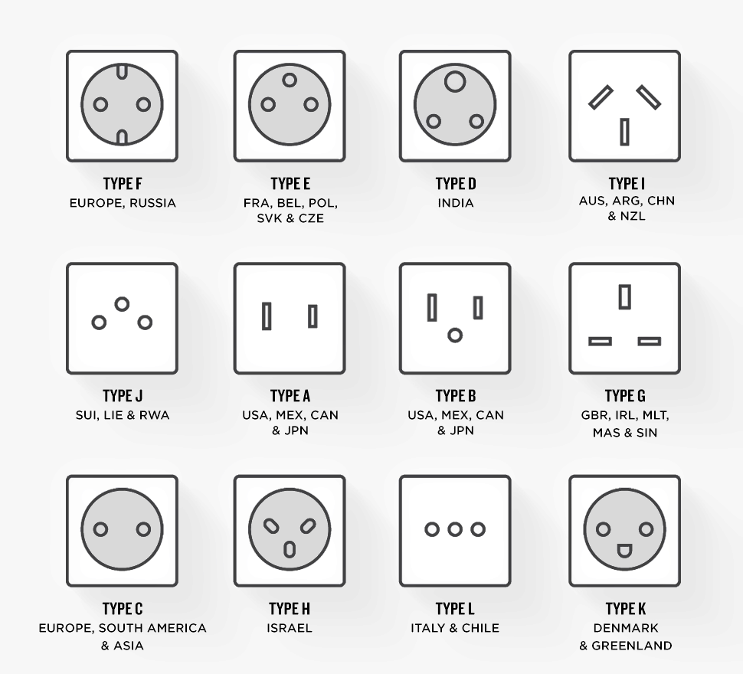





? Interconnecting systems ? -> everywhere in our daily life
Simple thing done everyday
Shared driving signs*
Simple because normalized, we can easily
plug our water boiler at home or at the office
Adaptators exist when need be
With local specificities
* let’s not discuss who is driving on the good(right) side of the road please ☺

Slide 11
? Interconnecting systems ? -> benefits
2 folds aspects:
Either we have legal constraints (ex : EU environmental reportings)
But when no constraints exist, how to set up a WQ Data Sharing culture?
Creating the necessary organizational context to opening / sharing data is already quite an endeavor.
So, when this point is reached, the technical aspects should be straightforward.

Slide 12
? Interconnecting systems ? -> an urgent need
Context
Climate change
Health crisis
Reduced funding
Organizations cannot afford to reinvent their own wheel locally
Even more when we have 90% of the solutions at hand
Experience show that it’s not a matter of IT issues (those can always be fixed)
It’s a matter of organizing communities & chaging behaviours

Slide 13
Workshop Series on Water Quality Monitoring – Opening Workshop
Thank you!
WEATHER CLIMATE WATER

