Slide 1
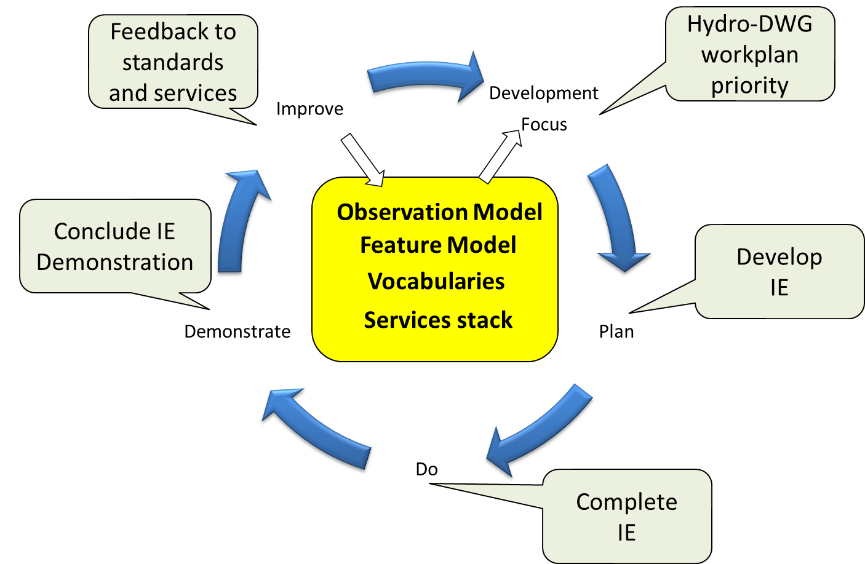

International Standardization for Water Data
Hydrology Domain Working Group
standards for water data: WaterML2 suite
organizing Interoperability Experiments (IEs) focused on different sub-domains of water
Chairs:
Ilya Zaslavsky (USA)
Tony Boston (Australia)
Silvano Pecora (Italy)
Iterative Development
http://external.opengis.org/twiki_public/bin/view/HydrologyDWG/WebHome

Slide 2
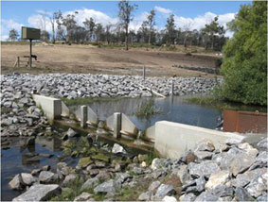
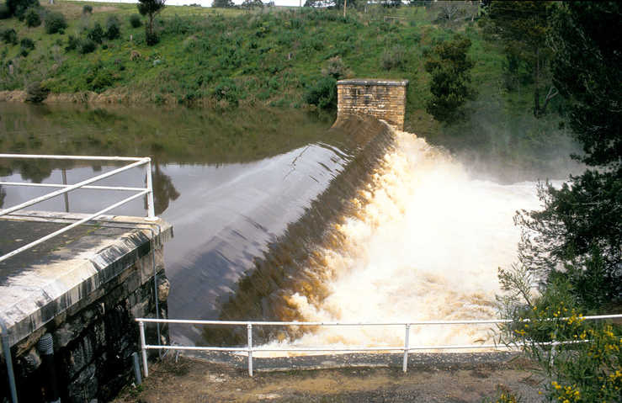
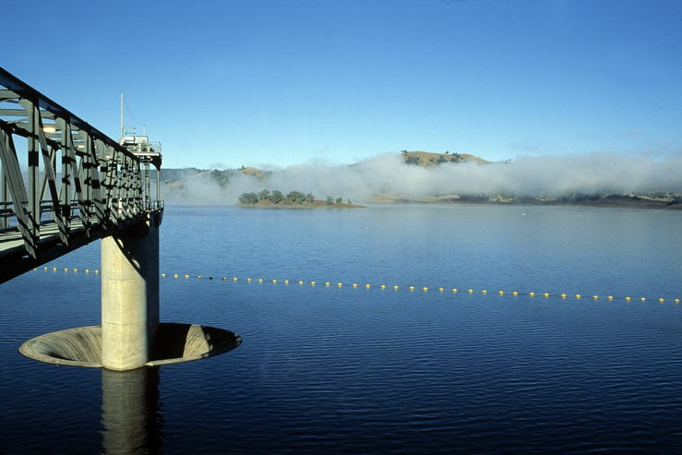
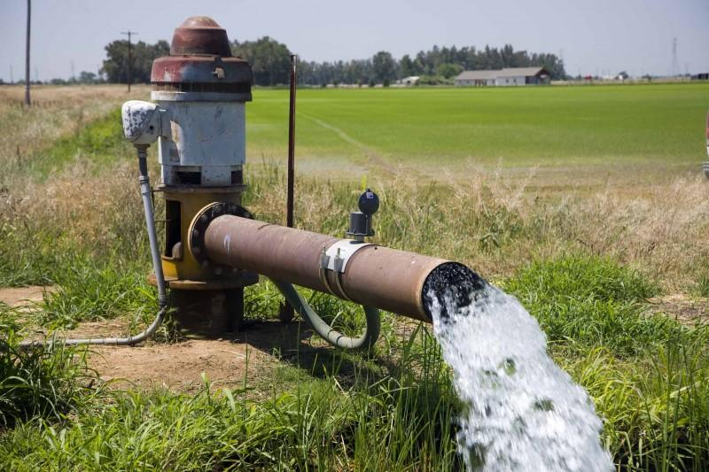
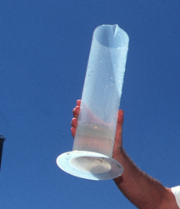
WaterML2 standards
Part 1 – Timeseries
Observation
Part 2 – Ratings, Gaugings and Sections
Part 3 – Surface Hydrology
Features
Part 4 – Groundwater
Features
Part 5 –
Water Quality Observation (best practice)

