Slide 1

Groundwater data - France
Ninth Hydrology DWG Workshop
Geneva, Switzerland
S.Grellet - BRGM
18 September 2018

Slide 2
Setting the scene
GroundWater data
Various ‘monolithic’ silos
Well / borehole
Piezometer
Quality / quantity observations
Raw / validated observations
Other…
Some are than 20 years old
With lot of databanks/specific tools associated
French Water
Information
System
- data
BRGM data

Slide 3
Setting the scene
GroundWater data
National data repository VS research ‘one-shot’ acquired data
Various regulations
National water law
Various EU directives
Environmental: ex : 2000/60/EC Water Framework Directive
Data exchange: INSPIRE (2007/2/EC), …
French Water
Information
System
- data
BRGM data

Slide 4
Challenges
Water does not (often) stay in its compartment…
Groundwater Information Network data highly linked to other information systems
ex : surface/ground interaction, freshwater abstraction, agricultural practices …
Our goal
Not breaking (too much) previous system…
Opening this up using interoperability

Slide 5
How
Work in defining internationally agreed standards
Semantic / technical
EU : INSPIRE, EU projects/reportings
OGC : HydroDWG , SWE, IEs, GeoscienceDWG
Apply/demonstrate those at national level
Map national standards to those
Have those de facto used when starting new projects

Slide 6
How
Have tools support those standards
Enhance tools
52N SOS :
GroundWaterML 2.0 – GW_GeologyLog
SOS GetDataAvailability V2 (from INSPIRE)
FraunhoferIOSB/FROST-Server (SensorThings) :
INSPIRE requirements for Env. Monitoring Facility
GeoServer app – schema :
link to SolR indices to support WFS on big volumes (ex : Millions of Borehole)
QGIS GMLAS application schema toolbox
Test new approaches
BLiV (BRGM Linked Data viewer) : started during ELFIE

Slide 7
How
Demonstrate
A game changer : working on small data labs
Faster, does not require to refactor preexisting system(S) to be able to show something
Videos are fantastic communication methods
More friendly than a presentation
Easier to pass around (spreading the word when you are not around)
Many examples (endpoints / links to video) on this page
https://external.opengeospatial.org/twiki_public/HydrologyDWG/GINsForWMOCHy
Under “French Groundwater Information Network”

Slide 8
How
Leverage funding / capacity
INSIDE research pole
French joint research center between BRGM, French Biodiversity Agency, IFREMER, MNHN
https://github.com/INSIDE-information-systems (recent GitHub, will push more content there)
BRGM research capacity
https://github.com/BRGM
EU research projects
Publications, RDA help : but costs time
why are not OGC standards recognized as such ?
Funding from other national projects

Slide 9
How
Create close collaboration network
With sister agencies
With active SMEs in open source / interoperability world
With institutions
Ex : INSPIRE maintenance

Slide 10
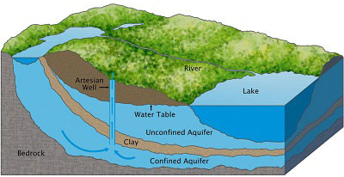

Concrete examples
French GIN – linked data use case
To provide stable and resolvable links to resources
To allow reference / data citation
Independant from underlying technologies used to provide data
I am #Piezometre/00634X0147/PZ1.2
attached to #Borehole/00634X0147/PZ1.2
I have a lot of #GroundWater Levels observations regarding #EntiteHydroGeol/107AK01
I am #Piezometre/00634X0147/PZ1.2
attached to #Borehole/00634X0147/PZ1.2
I am #EntiteHydroGeol/107AK01
I am monitored by #Piezometre/00634X0147/PZ1.2
I am #EntiteHydroGeol/107AK01
#GroundWater Levels obs. from #Piezometre/00634X0147/PZ1.2

Slide 11






Concrete examples
Resolver
overview
URI
MimeType
& a bit of semantics
app-schema

Slide 12
Concrete examples
Resolver
overview
https://data.geoscience.fr/id/hydrogeounit/121AS01
text/html
gml+xml
ld+json | rdf+xml | text/turtle
rdf+xml | text/turtle
ld+json
app-schema
Files, ldproxy

Slide 13
Concrete examples
Resolver
overview
https://data.geoscience.fr/id/hydrogeounit/121AS01
text/html
gml+xml
ld+json | rdf+xml | text/turtle
rdf+xml | text/turtle
ld+json
app-schema
Files, ldproxy

Slide 14
Concrete examples
Resolver
mechanics
HTTP Server and cache
cache
Load balancing
Load balancing
Rewrite proxy
Rewrite proxy

Slide 15



Concrete examples
Resolver
mechanics
cache
Rewrite
rules

Slide 16
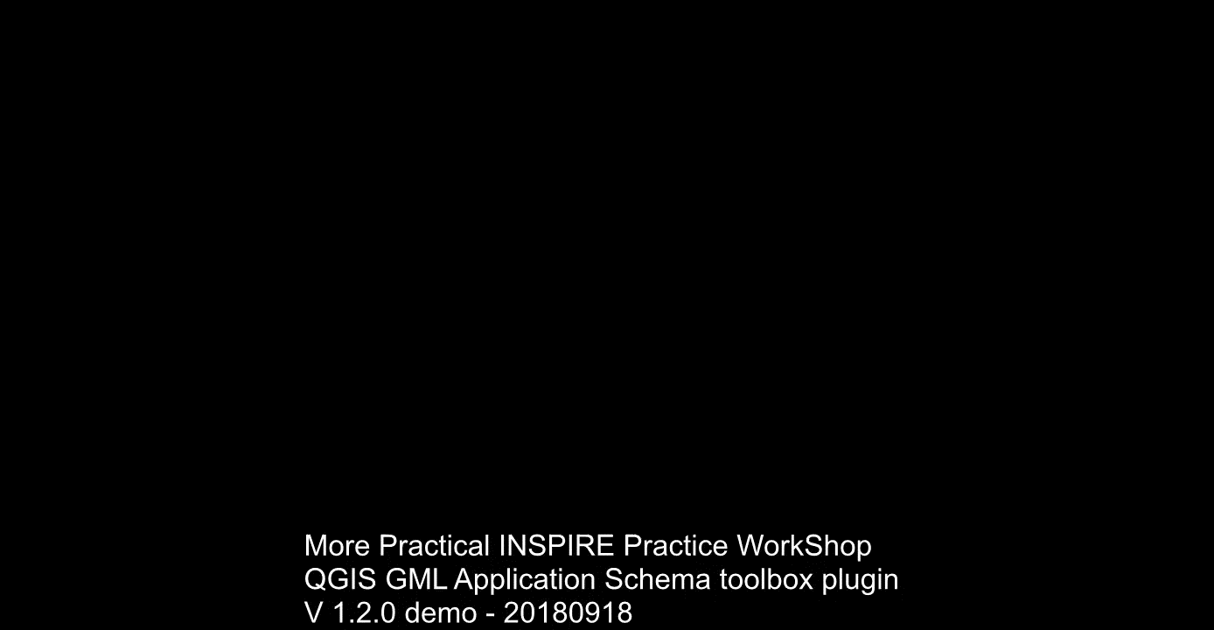
Concrete examples
QGIS GML application schema toolbox

Slide 17
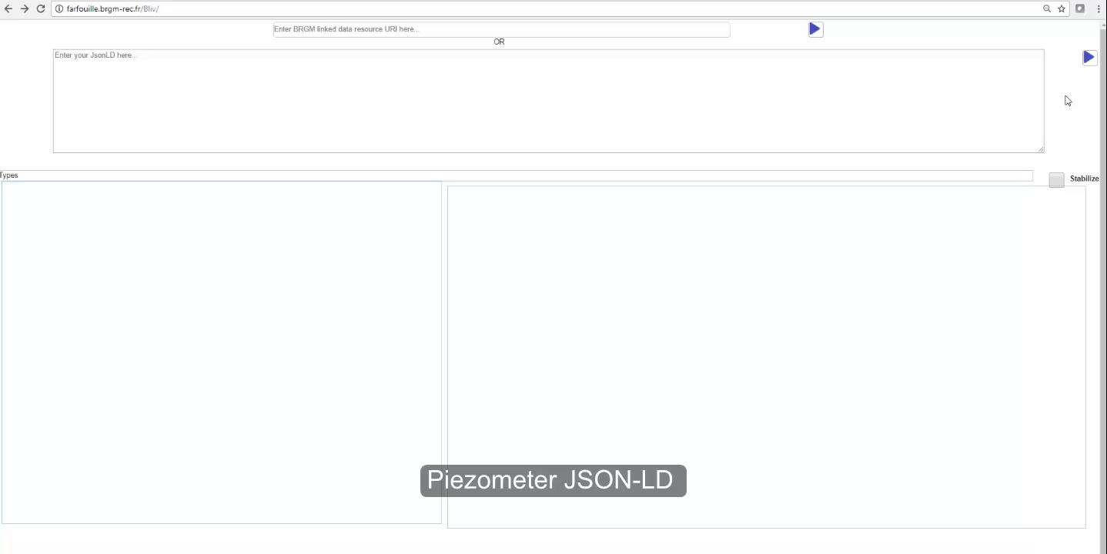
Concrete examples
BLiV – ELFIE videos
Surface-ground water networks interaction
Surface/groundwater related monitoring networks

Slide 18
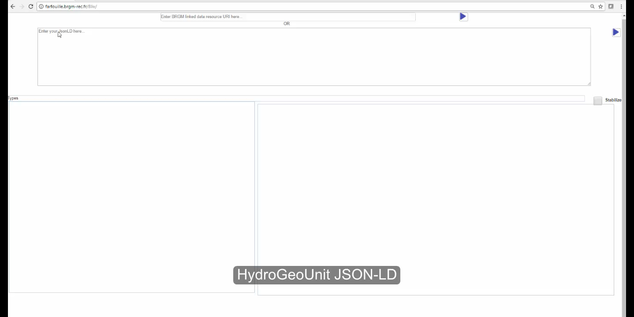
Concrete examples
BLiV – ELFIE videos
Surface-ground water networks interaction
Surface/groundwater related hydro systems

Slide 19
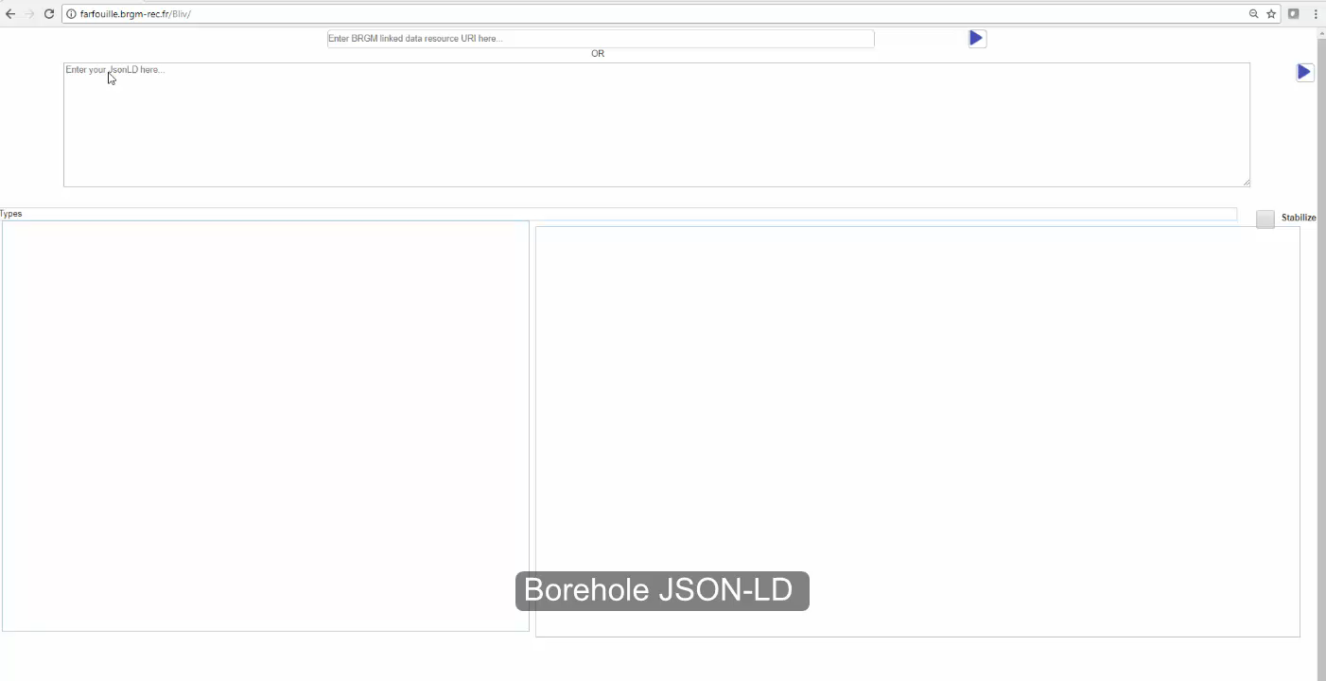
Concrete examples
BLiV – ELFIE videos
Monitoring facility / feature of interest / observations

Slide 20
Concrete examples
LinkedData Registry
BRGM recent decision to implement / contribute to ukgovld registry (https://github.com/UKGovLD/registry-core)
RDFying French national registries and mapping to sister agencies and international one
Example here :
Chemical parameter (nitrate) : https://data.geoscience.fr/ncl/par/1340
Taxa naming (salmo trutta fario) : https://data.geoscience.fr/ncl/apt/2221
Units of measure (milligrams per cubic meter) : https://data.geoscience.fr/ncl/urf/133
More details in tomorrow’s session : “Vocabularies in water, particularly for freshwater quality measurements”

Slide 21
Remaining
THE challenge: Research & Development -> production
Easier
for URI / linked data registry
when new project/ try to have interoperability standards de facto adopter
Hard
Refactoring historical database (closer to interop standards)
Success
Raw groundwater quantity observation dabase (many hydroDWG pres),
Groundwater level forecast (MeteauDesNappes -> hydroDWG pres),
URI resolver
LinkedData registry

Slide 22
Coming up
Data & API
Logs (hydrogeology, geology, ?soil?)
All exposed using GWML2 GW_GeologyLog
OGC SensorThings API Part 1 :
in production on French national observation database
Ex : http://sensorthings.brgm-rec.fr/SensorThingsGroundWater/v1.0
authorised as an INSPIRE endorsed download service :
Paper ( https://doi.org/10.3390/geosciences8060221)
Now need official production services,
have a QGIS plugin

Slide 23
Coming up
Linked data
Linked data registry
Finance ukgovld evolutions, Use it in every project
Contribute to the upcoming EU register federation (http://inspire-regadmin.jrc.ec.europa.eu/ror/ )
Continue our linked data experimentation under INSIDE :
see tomorrow’s pres
Push ELFIE’s outcomes
ER, Implement ER recommendations
Google dataset search worksession during INSPIRE conference this week
Analyse server logs :
Whats happening on our URIs (used ? By whom ?)

Slide 24
Coming up
Patience
Things specified in INSPIRE took around 8/10 years to start being used ☺

Slide 25
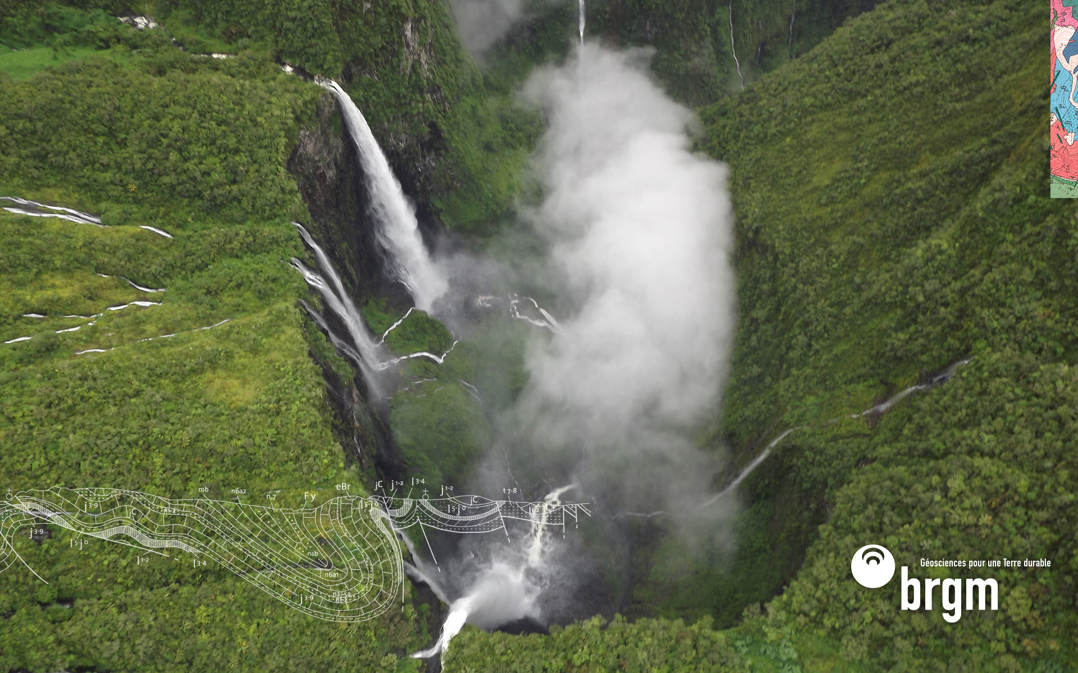
Thank you
s.grellet@brgm.fr

