Slide 1
Global Water Information IG
Matt Fry, Sylvain Grellet, Tony Boston, Ilya Zaslavsky

Slide 2
Research Data Alliance
Scope of global research data
Bridging technological, social barriers to improve management and access to research data
Operates through Working Groups and Interest Groups
Generally with technical focus or domain focus
Working groups aim to produce outputs – generally recommendations which are then put to RDA for endorsement
Twice-yearly plenaries

Slide 3
Global Water Information Interest Group
Value proposition:
facilitate dissemination of water data standards from HDWG;
explore and compare eInfrastructures for water data sharing;
address infrastructure issues out of the scope of HDWG;
facilitate application of RDA recommendations in the water domain;
explore policies for water data sharing
understand best practices of data systems in other domains
coordinate with other RDA groups on addressing common issues
organize water data-related use cases;
attract academic researchers, and participants from outside HDWG

Slide 4
Website
GWIIG:
https://www.rd-alliance.org/groups/global-water-information-interest-group.html-0
Adoption:
https://www.rd-alliance.org/recommendations-outputs/adoption-recommendations

Slide 5
Current focus
Water data portals
Dynamic data citation
Vocabularies
Data rescue

Slide 6

Water data portals and water data discovery
Harald von Waldow and Janet Hering
Scratching an itch:
“Search results (Google) are frustratingly imprecise. There is no good list of freshwater data portals. Let’s make one.”
=> list of bookmarks
“Maybe put it in a shape so that others can profit from it too.”
=> https://osf.io/8mn3q/

Slide 7
Water data portals and water data discovery
Harald von Waldow and Janet Hering
https://osf.io/8mn3q/: A Google spreadsheet
Table with 38 entries / 13 columns
Much more entries necessary => search/filter capability
=> meaningful and systematic attributes for each site.
=> very difficult!
One result: Only very few portals have an API
=> This will remain a list, no automatic data extraction, etc.

Slide 8
Water data portals and water data discovery
Harald von Waldow and Janet Hering
Does something like that not already exist?
a) dataset aggregators, e.g.
hydrosphere.org
data.gov
GEOS geoportal
CINERGI geoportal
data.cuahsi.org
=> different aim
b) data repository directory: re3data.org
=> doesn't perform

Slide 9
Water data portals and water data discovery
Harald von Waldow and Janet Hering
Hypothesis:
"To make such a list or directory useful, it has to be continuously curated by domain experts."
How to get there?
Provide a suitable online tool (e.g., like
copdessdirectory.osf.io)
define scope and criteria for attributes of data portals ,
collect use-cases, characterize audience(s)

Slide 10
Water data portals - discussion
To support the practical aim, we might want to do some conceptual work:
Understand types of water data portals; explore their interoperability; understand why RE3Data and expert-compiled portals are so different; figure out best practices for different types of portals
A broader definition: online interactive multi-user environment supporting some or all of the following functions: resource publication and sharing, resource discovery, resource retrieval, resource transformation and editing, analysis, modeling, and sharing/collaboration on research results and publications, primarily designed for hydrologists.
Types of objects accessed through portals: hydrologic models and model instance packages; publications and discussions; hydrologic features; observations under different aggregation models; software and services; specifications and best practices; packaged hydrologic projects; validation/compliance assessment services…
Write up a review paper?

Slide 11
Water data portals - discussion
Shall we expand structural descriptions? Which of the following would be interesting?
Query interface: map search; time sliders; full-text; simple and advanced search; facets; semantic rewriting/term expansion; granularity levels (observations, samples, time series, datasets, etc.); etc.;
Construction of data discovery workflows;
Information models, encodings and protocols used, and their standards-compliance
Visibility to search engines;
How search results are presented: relevancy, links to related features, ability to transform results into other formats; show search results statistics; show provenance; preserve queries and show usage stats; show related queries and/or results;
Ability to annotate results; ability to incorporate results into workflows and/or publications, provide data previews and introspection; provide APIs into lower granularity levels; letting users subscribe to updates,…
Management aspects: data sources; life cycle; sustainability; funding; stewardship arrangements; curation; licensing and use restrictions
Technology platform for the portal
Stated success criteria, and portal evaluation; maximizing ROI in portals
An initial attempt of a more structured representation: https://docs.google.com/spreadsheets/d/1AfuxRg4LIiDXsXnjagS3wD1VpO93naGXVgx9MmVxNDw/edit#gid=1919540330&fvid=1867225195

Slide 12
Water data portals - discussion
Characteristics that <may be> specific to water portals
A set of hydrologic features and observations at several hierarchical levels
Special types of relationships (eg upstream, downstream, other relations in a hydrographic network) – may be time-dependent
Additional feature-of-interest relationships such as parameter proxies (these are context-dependent)
Compare to RDA Data Discovery best practice guidelines?

Slide 13
Water Data Portals - Next Steps
Update the list of WDPs; coordinate with potential stewards of the list (GEO?) and portal owners
Settle on additional fields and create structured descriptions of WDPs (both general and water-specific)
Which groups need to be involved (in hydrology? In RDA?) How do other domains deal with this?
Towards developing best practices for domain portals
Crowdsourcing ?

Slide 14
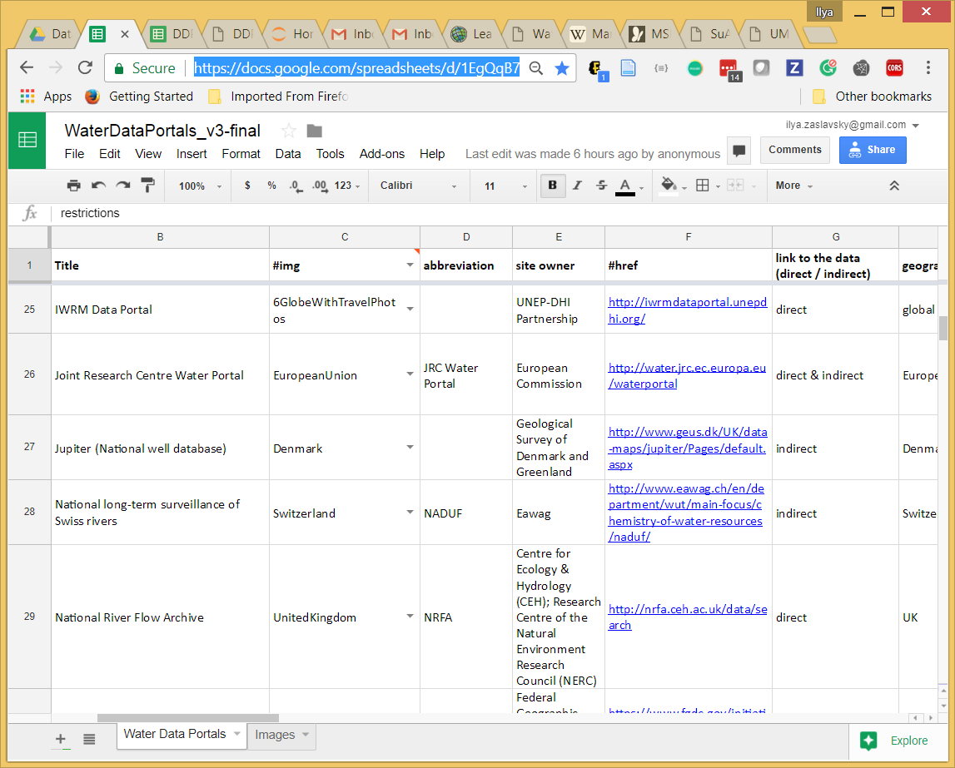
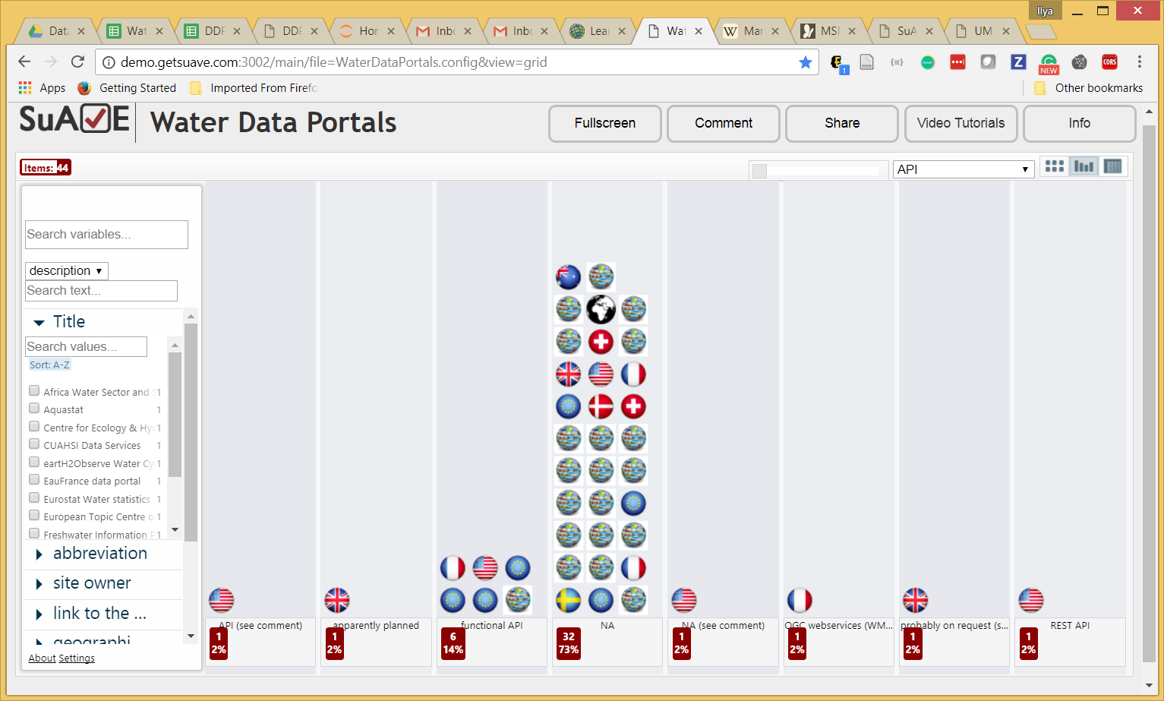
Crowdsourcing portal registry
https://docs.google.com/spreadsheets/d/1EgQqB7raI3wbKRB9Mdr4bj9t1PDsgK6crtFHKSs2B44/edit#gid=326880346
http://demo.getsuave.com:3002/main/file=WaterDataPortals.config&view=grid

Slide 15
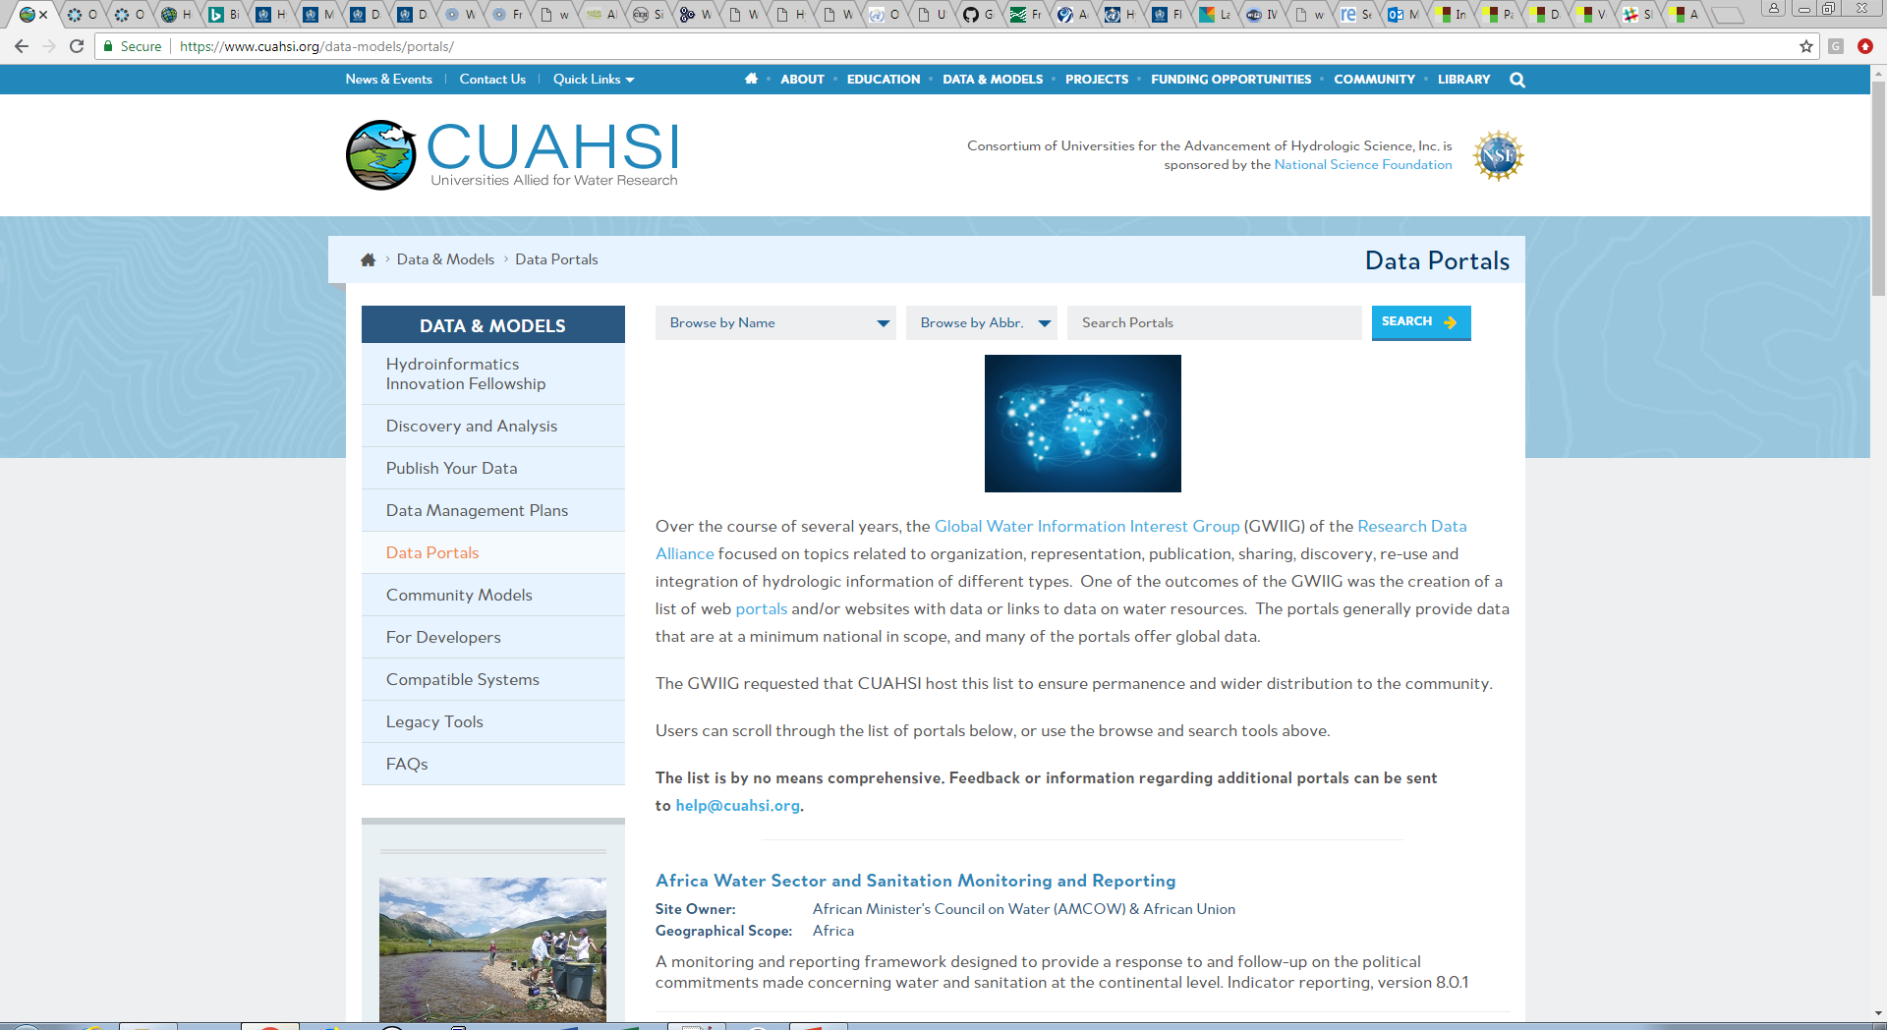
Online searchable list
https://www.cuahsi.org/data-models/portals/

Slide 16
Dynamic data citation

Slide 17
Dynamic Data Citation
Collaboration with the Dynamic Data Citation WG
UK National River Flow Archive:
Developed RDBMS-based versioning system and tested Dynamic Data Citation WG recommendations
Initial work presented at Denver P8 plenary GWIIG meeting
Presented as part of P8 DDC session
Further work hoped to be presented as part of DDC webinar series (TBC)
Call for other GWIIG examples of versioning / dynamic data citation (e.g. CUAHSI HydroShare)

Slide 18
Data Citation recommendations
RDA output: Scalable Dynamic Data Citation Methodology
The solution supports a query-centric view of the issue, and comprises the following core recommendations:
Data Versioning: For retrieving earlier states of datasets the data needs to be versioned. Markers shall indicate inserts, updates and deletes of data in the database.
Data Timestamping: Ensure that operations on data are timestamped, i.e. any additions, deletions are marked with a timestamp.
Data Identification: The data used shall be identified via a PID pointing to a time-stamped query, resolving to a landing page.

Slide 19
Examples of uptake
Series of webinars from different adopters
Range of domains (health, ecosystems, atomic and molecular data, climate change)
Range of technologies (RDBMS, csv, netCDF)
Range of approaches (archiving all queries, versioning + checksum of subsets of data)

Slide 20
UK National River Flow Archive
RDBMS of river flow time series and metadata (~20M daily flow records), only 5-10GB
Currently most edits are audited, but reconstruction is complex
Many users downloading small subsets via an API – too many queries to log / checksum them all individually
We would like to allow citation of a subset, but principally citation of a version
We would also like users to be able to query older versions via API

Slide 21
Current progress
Workflow defined for creating new versions at appropriate intervals, expect ~2 per year (based on our data update schedule)
Database table definitions created
Automation of processes to create versions
Implementation of versioning throughout data access code, including API
Working to further “clean” the structure prior to go-live, as structural changes will be complex in future
Still questions over checksum mechanism and how versions will be citable

Slide 22
RDA Data Rescue

Slide 23
Data Rescue Use Cases in Hydrology
Initiated discussion with Elizabeth Griffin of DR IG
DR IG is considering thematic focus on data rescue, with water being an option for a theme
GWIIG will identify past successes and future need for data rescue in hydrology
Presented at DR IG in Montreal
Ran UK (focused) data rescue meeting at Harwell following PV2018 conference

Slide 24
UK Data Rescue meeting
General focus on environmental data (also solar records)
Talks from major UK data rescue efforts (Rob Allan, Met Office; Ed Hawkins, Uni Reading)
Project presentations from range of domains (hydrology, sea levels, marine ecology…)
Discussion with UK research funders around what’s needed to get a data rescue project funded (innovation, tapping into technology, demonstrating how it will be used for new science, public engagement)

Slide 25
Hydrological data rescue:
benefits, examples and future needs
Matt Fry (describing the work of many others)
Centre for Ecology and Hydrology, UK
RDA Plenary 10, Data Rescue Interest Group meeting

Slide 26
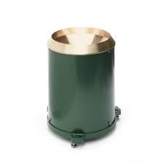
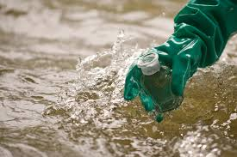
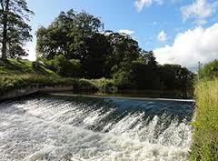
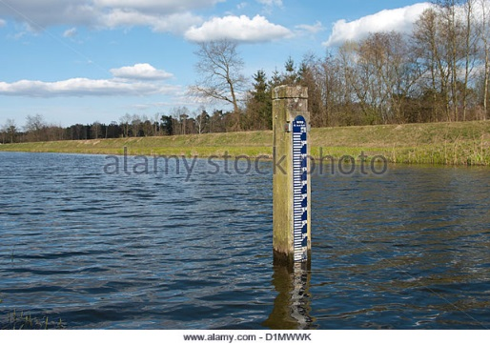
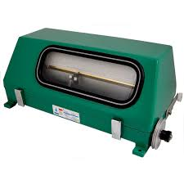
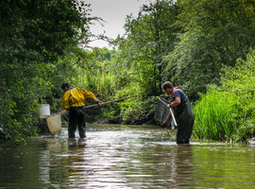
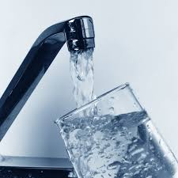
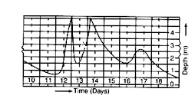
Hydrological data
Rainfall
Water quality
Lake levels and chemistry
Streamflow
River levels
Hydro-ecology
Water use
Soil moisture, evaporation, ….
Notes:
By hydrological data we mean data that is needed for the understanding of the water cycle:
Rainfall data are more usually considered meteorological, but are obviously essential to understanding the water cycle. There’s huge scope for more digitisation of met variables to help understand water.
River levels – usually tables or traces
River flows
Lake levels
Water quality
Water use
Soil moisture
Range of other hydro-meteorological measurements

Slide 27
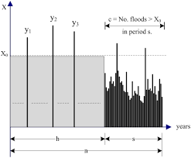
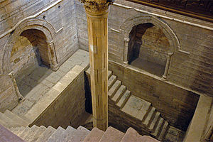
Hydrological data rescue is a good idea
Water is essential to life. Understanding it through data is key to properly managing it.
Long records are needed to understand frequency of events (floods and droughts)
Climate change impacts require longer records
Measurements are expensive
Many long records exist, and data rescue efforts have been limited
Potential impacts, scientific and societal, are huge
Notes:
Clearly water is hugely important to human life, and an understanding of the hydrological cycle is essential to managing water.
Long records are needed to understand frequency of events (droughts and floods). A one in 100 year event can’t be properly understood from a 30-year record
Impacts of climate change are also increasingly important, and longer records are needed.
There are long hydrological records out there: - there was a huge growth in networks in the pre-digital era of the 1950s and 1960s, and there are records for larger rivers back into the 19th Century.
River flow measurements are expensive, requiring a lot of effort over time – there is value in making use of existing measurements
Rainfall data can be used to reconstruct river flow records to gain understanding even where no actual flow records exist (more later)
Meteorological data rescue has had a lot of effort put into it, to improve international historical datasets, but there has been limited effort in hydrology.
There are definite opportunities, and the potential impacts are large, both scientific, and societal

Slide 28
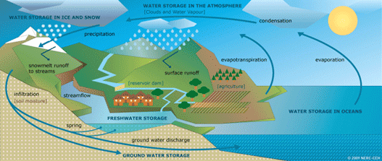
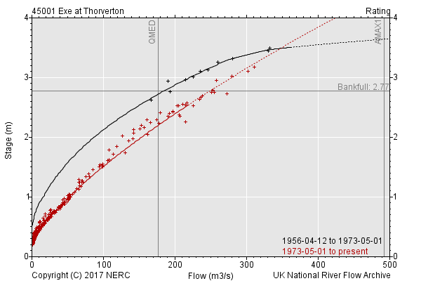

…but it has its difficulties
Changing human impacts can mean old measurements can’t be related to present day or the future
Processing to usable data can require additional metadata, processing, and interpretation
Water can often be considered a national asset and there are sensitivities around data sharing
Notes:
Unlike rainfall, changes in the extent of impact of human influence can mean historic data is hard to relate to current measurements
Relating raw river levels to flows is not always simple, and needs additional data / metadata and can require a great deal of processing and interpretation
Hydrological data often relates to a national asset, and therefore countries can be reticent about sharing it

Slide 29
Some recent examples
Notes:
Some recent examples close to me – there are many others

Slide 30
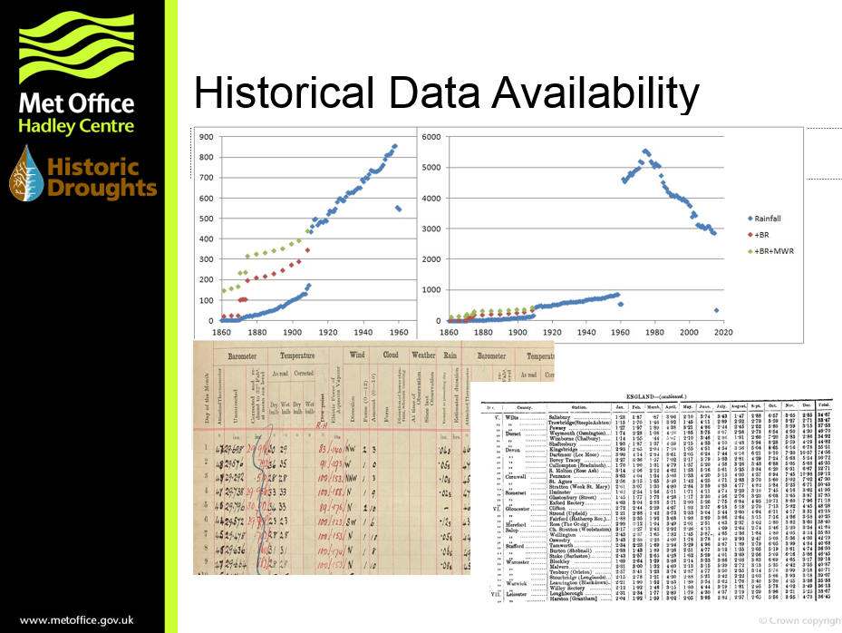
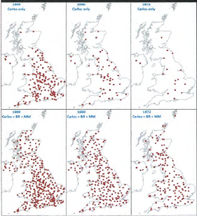
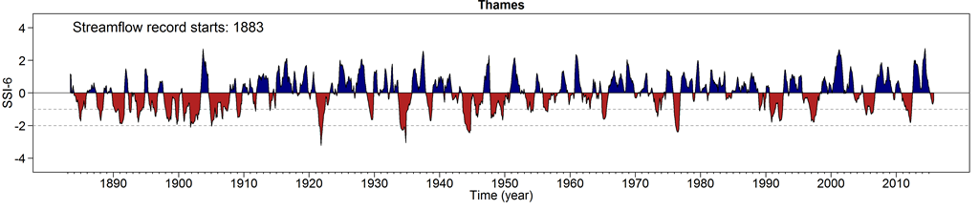
Example: Historic Droughts project
1872
1891
1909
UK Met Office is digitising historic rain gauge data
Pre-digitisation
Now
CEH is reconstructing river flows through modelling using new (old) data to understand change in drought frequency
http://historicdroughts.ceh.ac.uk
Notes:
The Historic Droughts project, being run by CEH, is looking back in time at a number of data sources to increase our understanding of past droughts.
As part of this project the UK Met Office is digitising rain gauge data in its archives to improve the spatial representation in earlier records – pre-1910
Approximately 175 monthly rainfall stations have been added to the period 1891 – 1909, with fewer earlier (16 in 1860s). 39 daily stations being added to the digital archive.

Slide 31
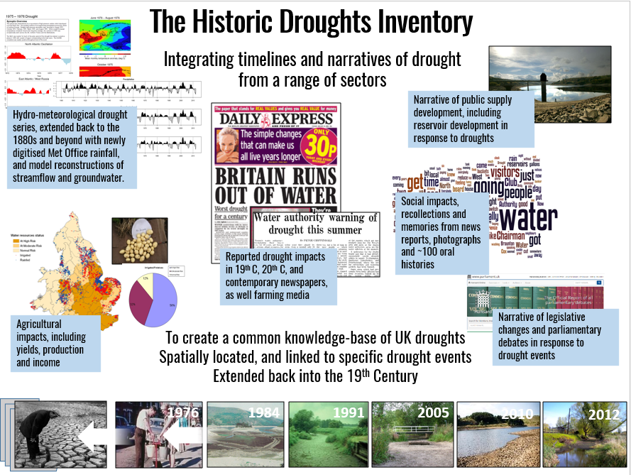
Example: Historic Droughts project
Range of social, economic, media information being digitised to help understand past droughts back to 1800
http://historicdroughts.ceh.ac.uk
Notes:
The project is also digitising information from a wide number of other sources: newspapers, parliamentary records, etc. to try to piece together better information on impacts of droughts.

Slide 32
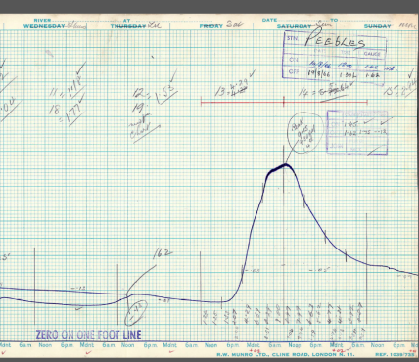
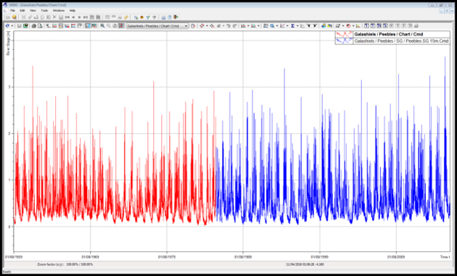
Example: Scottish river levels and flows
Scottish Environmental Protection Agency has been digitising selected early records (charts, microfiche, punch tapes)
Additional records add understanding to UK national flood risk estimates
The UK National River Flow Archive is helping make the data available to the public and researchers
www.sepa.org.uk , nrfa.ceh.ac.uk
Notes:
SEPA has put effort into digitising older records. For some of these periods only peak flood values were available.
Digitising the record allows reinterpretation of the entire record to produce improved flood peaks, as well as wider use of 15-minute data
Improved data is included in the dataset used in UK flood risk estimates, including flood risk maps
NRFA provides access to the UK-wide dataset for research users as well as engineers and the public
EA is also looking at the need to digitise earlier records

Slide 33
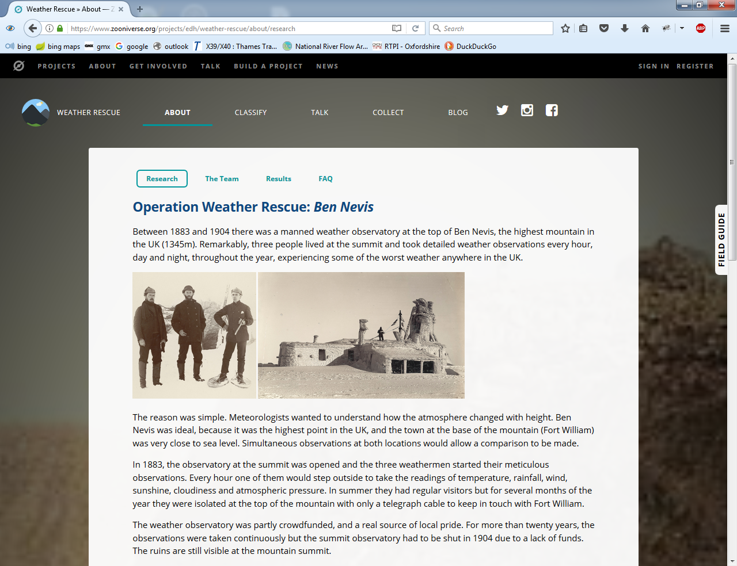
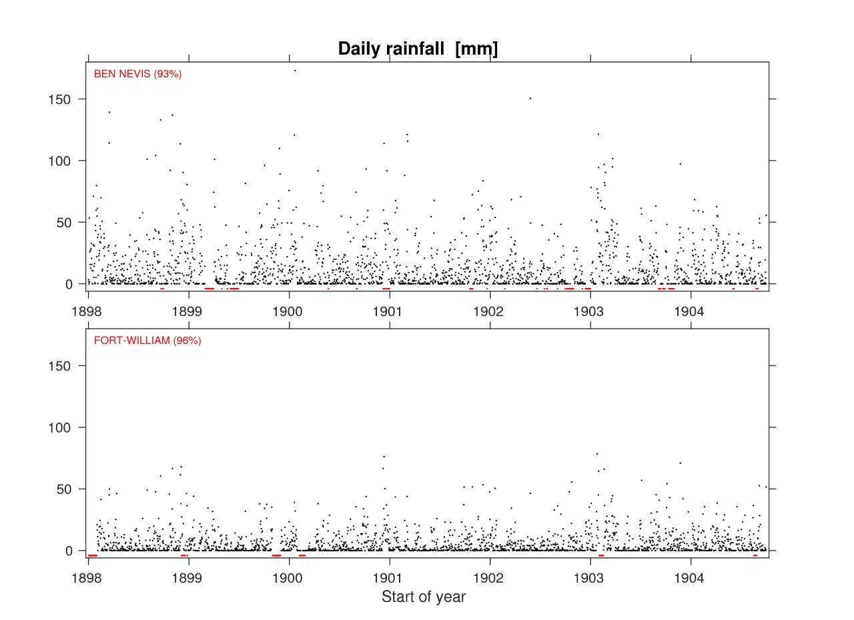
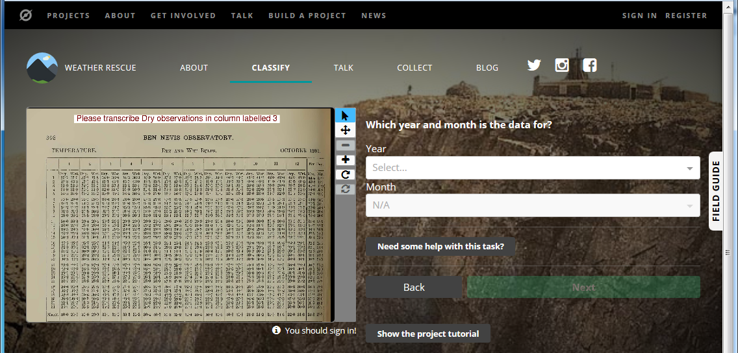
Example: Scottish mountain meteorology
University of Reading are leading a citizen science approach to data rescue
20 years of weather data from the top of UK’s highest mountain
Zooniverse system allows users to digitise results (2 million observations over 3500 pages)
http://weatherrescue.org/ , http://www.bbc.co.uk/news/science-environment-41166778
Professor Ed Hawkins: http://www.met.reading.ac.uk/~ed, https://twitter.com/ed_hawkins
Notes:
By hydrological data we mean data that is needed for the understanding of the water cycle:
Rainfall data are more usually considered meteorological, but are obviously essential to understanding the water cycle
River levels – usually tables or traces
River flows
Lake levels
Water quality
Water use
Soil moisture

Slide 34
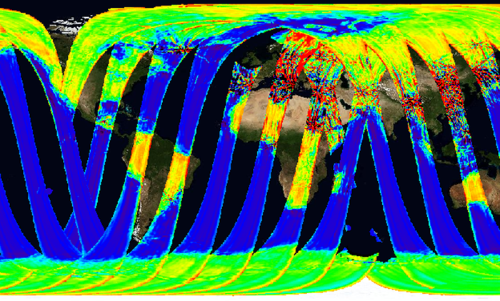
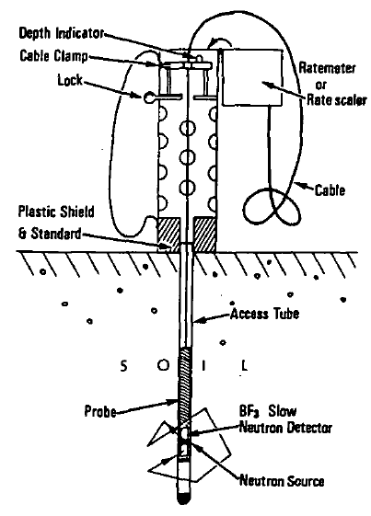
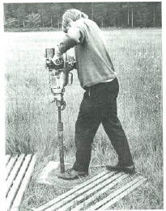

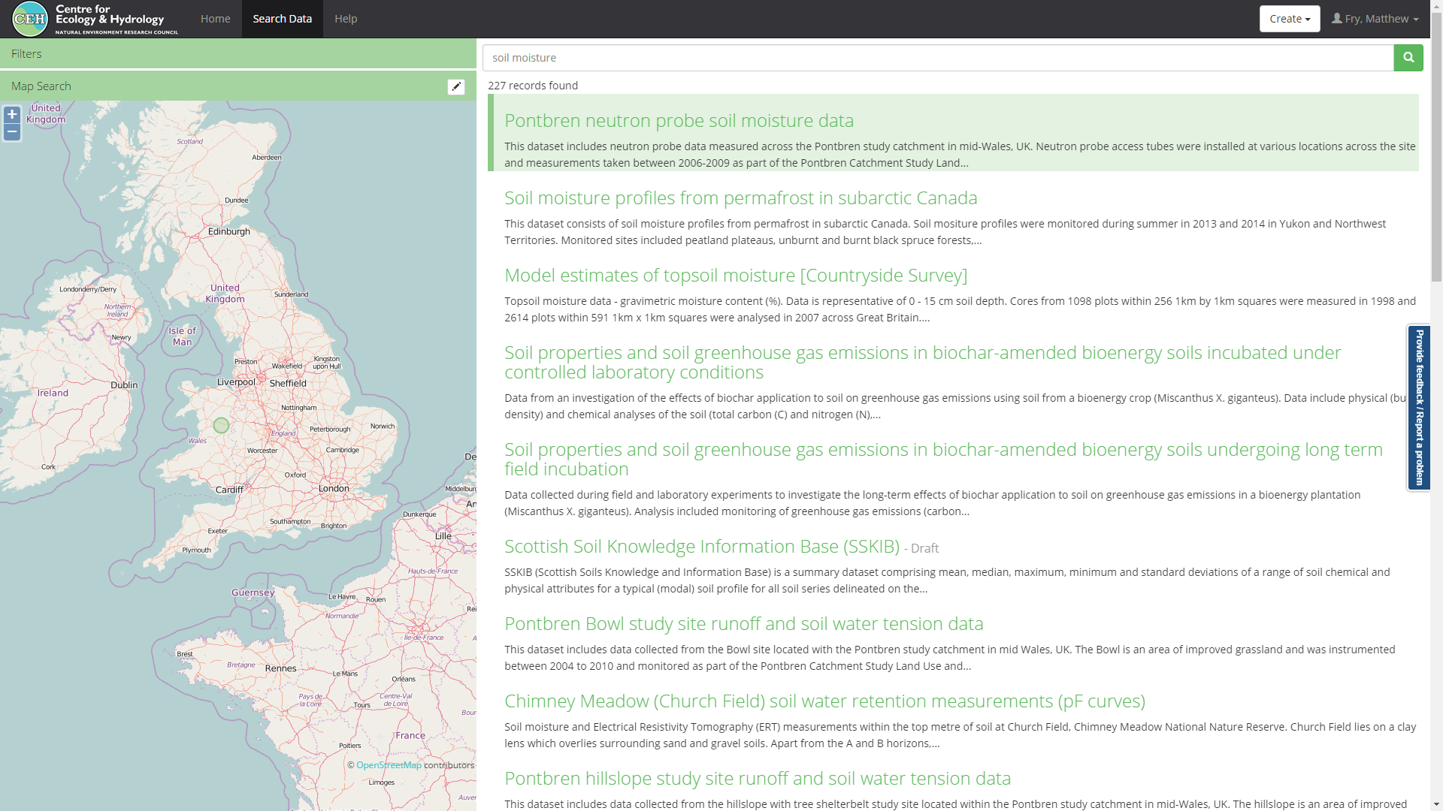
Example: soil moisture data bank
An essential part of the hydrological cycle, with few measurements
356 tubes across
64 sites
1966 - 2013
Useful for hydrological modelling and validation of new satellite products
Historic dataset identified
Measurements were sparse in space and time, and required effort
Will be stored in long-term data centre, with DOI
Notes:
Soil moisture data bank.
Soil moisture is a missing measurement in the hydrological cycle
Useful for validating new satellite products as well as hydrological models
Measurements were time consuming – involving radioactive sources in some cases – but they do exist
CEH found a historic dataset on magnetic tapes, which were digitised to create a good dataset over time
These are being stored in the research data centre for the long-term

Slide 35
Guidelines on Hydrological Data Rescue
World Meteorological Organisation published new guidelines on hydrological data rescue in 2014.
General guidelines of digitisation projects, with some specific considerations for hydrological data
https://library.wmo.int/pmb_ged/wmo_1146_en.pdf

Slide 36
Data Rescue Survey
World Meteorological Organisation commissioned a survey on its members data rescue needs around 2007.
Huge need from developed as well as developing countries.
Many of these countries currently have few records in internationally available river flow datasets
Fry, Matthew. 2010 Hydrological Data Rescue – the current state of affairs. In: Servat, Eric; Demuth, Siegfried; Dezetter, Alain; Daniell, Trevor, (eds.) Global Change: Facing Risks and Threats to Water Resources. IAHS, 459-464. (IAHS Publ, 340).
Summarised in appendix of WMO guidelines: https://library.wmo.int/pmb_ged/wmo_1146_en.pdf
Notes:
Prior to the development of the guidelines, WMO commissioned a survey of all its members (National Hydrological Services) to identify the need for data rescue
XX NHS’ responded
The number of developed countries identifying a need was surprising
Requirements ranged from paper records to older digital (e.g. tape) data, and much associated background metadata
Many of the countries requiring river flow data rescue had little flow data within the main international database (Global Runoff Data Centrre)
There’s a clear need

Slide 37
What can we do?
Better demonstrate the potential benefits and impacts of data rescue for water
Identify further detail on data rescue need and the potential benefits
Potentially following up data rescue survey needs, and asking for further examples?
Raise awareness of the need for this data rescue to be achieved
Identify avenues to make it happen
How can the IG Data Rescue take this forward?

Slide 38
Data rescue session at P10
Future aims:
Gather more successful examples and impacts (and disasters)
Publish examples – RDA output
Gather further information – how funding was found, etc.
In water data:
Identify “hit list” of known datasets at risk and also identifying where data is needed
Try to build wider international water data rescue network

Slide 39
Data rescue session at P10
RDA at Botswana Plenary:
Ideas…
Regional use cases?
Data portals within the region – review. Or data availability more generally?
Data rescue

