Slide 1
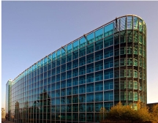

Vocabularies in water - freshwater quality measurements
Ninth Hydrology DWG Workshop
Geneva, Switzerland
S.Grellet, A.Feliachi, H.Bressan - BRGM
19 September 2018

Slide 2
Water vocabularies RDA activity
Many people interested across RDA GWIIG and OGC community (HydroDWG, ELFIE, GeoScienceDWG, …)
Goals:
Identify water-related ontologies
Engage with RDA Vocab Services IG
Use cases, Service and practice documentation
Recs on vocab publication and APIs
Encourage publication of exemplar water-related vocabularies using best practice methods
Activity started 1 year ago
Presentation at Montreal P10 (Sept 2017) and Orléans TC/Berlin P11 joint session (March 2018)

Slide 3
Water vocabularies RDA activity
2 core aspects
A: International standards (GWML2, HY_Features, Observations & Measurements, …) do define an overarching conceptual view on the domain that could lead to reference ontologies
B: But those standards do not enumerate list of possible values for a given information element (taxonomy)
Ex : GWML2 defines how/where to describe porosity of a HydrogeoUnit but not the reference vocabulary to be used

Slide 4
Water vocabularies RDA activity
A: from OGC standards to reference ontologies
See Rob’s presentation from yesterday
Ad’hoc meeting in Orléans after March 2018 TC (see https://external.opengeospatial.org/twiki_public/GeoScienceDWG/WebHome -> OGC TC Orleans - UML to OWL ad'hoc meeting)
=> Main outcomes will be added as an annex to ELFIE ER
Process = a mixture of automatic owl generation from the OGC logical model (using ISO 19150-2 within ShapeChange) + manual edits and ontology expertise
Concerned model : HY_Feature, GWML2, GeoSciML
For O&M : SOSA and om-lite/sam-lite are already a good basis for work

Slide 5
Water vocabularies RDA activity
B: nomenclature / codeList / thesaurus
Many national references
Rarely exposed according to linkeddata/websem practices
Few commonly agreed continental/international ones
Even in Europe where we have so many environmental eportings
Exception : INSPIRE codeList register that provides a pan-European starting point on many themes. + the will to create a European register federation (http://inspire-regadmin.jrc.ec.europa.eu/ror/)
Some research organization expose their registry

Slide 6
Ongoing test in France
Expose surface water quality observation using
A/ the recently generated available ontologies
O&M lite/SOSA, HY_Features, GWML2, GeoSciML
B/ national taxonomies
Rdfied and mapped whenever possible to external ones
March 2018 Orléans TC/ Berlin P11 : work on handmade test files
Since then : deployed the approach on the French river quality database
Quality observation=
Chemical
Hydrobiological (Taxon)

Slide 7

Ongoing test in France
1/ Rdfied content
A/ French WIS reference datasets
Rivers : HY_Feature
Stations : SOSA/smod:ef
B/ Taxonomies
Chemical/hydrobiological parameters
Taxon naming
Observation Method
Units of measure
Many data model specific nomenclatures
Etc…
Tool used : Datalift

Slide 8
Ongoing test in France
2/ Map/align those taxonomies
to international ones
Units of measure : QUDT
Chemical parameters ChemID+
to sister organization ones
in France : IFREMER (Marine Agency), MNHN
for Taxon naming both provides the link to international reference dataset
CSIRO

Slide 9
Ongoing test in France
2/ Map/align those taxonomies
Chemistry
CHEBI/17632
Sandre PAR/1340
ChemID+/14797-55-8
« Nitrate »
CAS code
14797-55-8
PubChem/943

Slide 10
Ongoing test in France
2/ Map/align those taxonomies
Chemistry
CHEBI/17632
http://purl.obolibrary.org/obo/CHEBI_17632
Sandre PAR/1340
ChemID+/14797-55-8
« Nitrate »
skos:exactMatch
https://data.geoscience.fr/ncl/par/1340
https://chem.nlm.nih.gov/chemidplus/rn/14797-55-8
PubChem/943
https://pubchem.ncbi.nlm.nih.gov/compound/943

Slide 11
Ongoing test in France
2/ Map/align those taxonomies
Taxon naming
MNHN TAXREF-LD/67778
Sandre APT/2221
« Salmo trutta fario »
WoRMS/ 293723

Slide 12
Ongoing test in France
2/ Map/align those taxonomies
Taxon naming
MNHN TAXREF-LD/67778
skos:exactMatch
http://taxref.mnhn.fr/lod/name/67778
Sandre APT/2221
« Salmo trutta fario »
WoRMS/ 293723
skos:exactMatch
https://data.geoscience.fr/ncl/apt/2221
http://www.marinespecies.org/aphia.php?
p=taxdetails&id=293723

Slide 13
Ongoing test in France
AlgeaBase
2/ Map/align those taxonomies
Taxon naming
MNHN TAXREF-LD/67778
skos:exactMatch
Sandre APT/2221
WoRMS/ 293723
« Salmo trutta fario »
skos:exactMatch
GBIF
skos:exactMatch
ToBe refined
IFREMER (French Marine Agency) / Quadrige² / 126281
Encyclopedia of Life
Catalogue of Life
EUNOMEN PESI

Slide 14
Ongoing test in France
2/ Map/align those taxonomies
Content exposed in a linked data registry
https://data.geoscience.fr/ncl/
Result
Hard to have an external reference that
Is community endorsed
Have the same domain scope
Provides resolvables URI and also semantic web artefacts (SPARQL endpoint, content negociation,…)
Sometimes one alignement provided a hook to many other repo in a given domain
Ex : chemical parameters (ChemId+)

Slide 15
Ongoing test in France
3/ apply the approach on top of the French river quality database
Water quality observation
SOSA/O&M
A lot of related observations
Simplified view
Taxon indice (ex : river fish indice)
Taxon score
Taxon field observation (I counted a Eel)
Related obs
Related obs
Related obs
Related obs
Taxon field observation (I counted 2 Salmo trutta fario)
Taxon score

Slide 16
Ongoing test in France
4/ Results – chemical observation
Video available here: https://github.com/INSIDE-information-systems/EnvironmentalSemanticWeb/blob/master/demos/chemical_observation.mp4

Slide 17
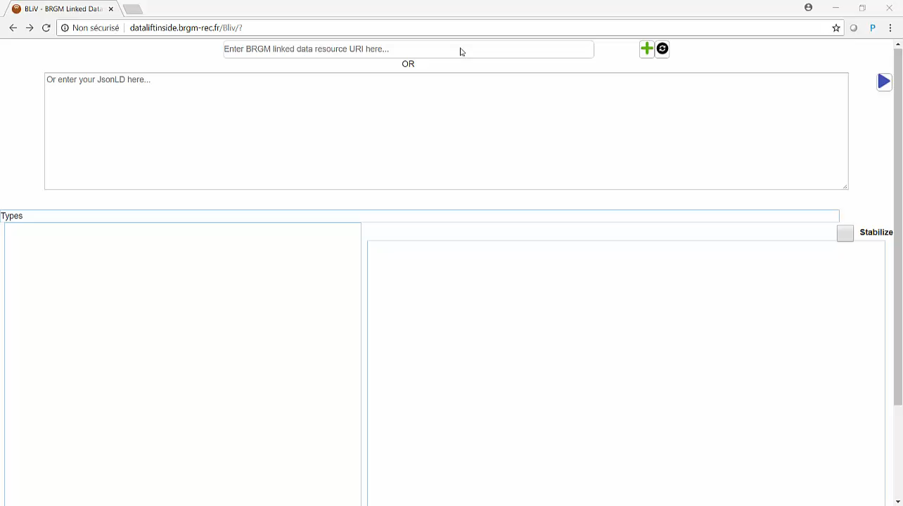
Ongoing test in France
4/ Results – content negociation to external registry

Slide 18
Ongoing test in France
4/ Results – hydrobiological observation (Taxon occurrence)
Video available here: https://github.com/INSIDE-information-systems/EnvironmentalSemanticWeb/blob/master/demos/bio_observation.mp4

Slide 19
Ongoing test in France
5/ Next
Refine mappings
Especially for properties that are not covered in a ‘generic approach’(and specific from a topic)
Hopefully identify new candidate vocabs thanks to hydro community
Move from research to (pre)production
involve more domain colleagues (to have certified mappings)
especially the rdfied codeList
Communicate
OGC/RDA
Github : https://github.com/INSIDE-information-systems/EnvironmentalSemanticWeb

Slide 20
Globally
Hopefully identify new candidate vocabs thanks to hydro community
Have more people involved
Communicate
OGC/RDA
Github : https://github.com/INSIDE-information-systems/EnvironmentalSemanticWeb

Slide 21
Links
INSIDE research pole – funding test in France
French joint research center between BRGM, French Biodiversity Agency, IFREMER, MNHN
https://github.com/INSIDE-information-systems/EnvironmentalSemanticWeb (recent GitHub, will push more content there following our progress)
BLiV – BRGM Linkeddata Viewer
Viewer used in the videos
https://github.com/BRGM/BLiv

Slide 22
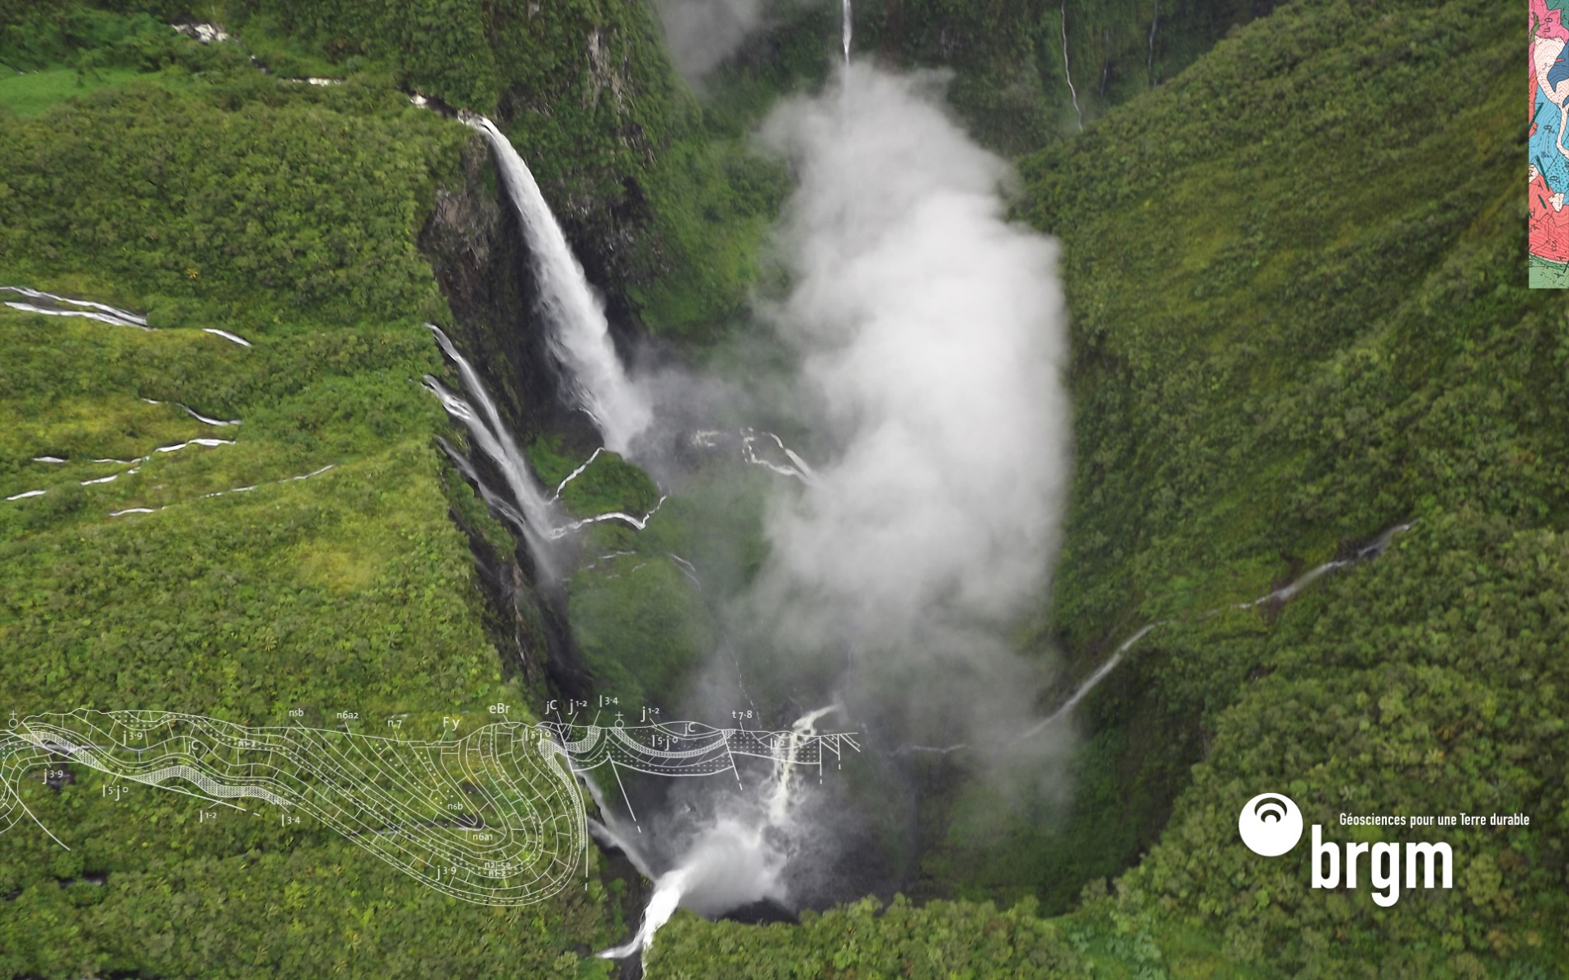
Thank you
s.grellet@brgm.fr
a.feliachi@brgm.fr
h.bressan@brgm.fr

