Slide 1
Introduction to the WMO Integrated Global Observing System (WIGOS) and OSCAR/Surface;
Lars Peter Riishojgaard
WMO Secretariat, Geneva

Slide 2
Outline
Introduction to WIGOS; what, why, when?
The Rolling Review of Requirements (RRR);
The Observing Systems Capabilities and Review tool (OSCAR);
The WIGOS Data Quality Monitoring System (WDQMS);
Regional WIGOS Centers;
Vision for WIGOS in 2040;
Summary and conclusions.
WMO

Slide 3
What is the WMO Integrated Global Observing System (WIGOS)?
WMO foundational activity addressing the observing needs of the weather, climate, water and environmental services of its Members
A framework for integrating all WMO observing systems and WMO contributions to co-sponsored observing systems under a common regulatory and management framework
WIGOS is not:
Replacing or taking over existing observing systems, which will continue to be owned and operated by a diverse array of organizations and programmes, national as well as international.
WIGOS homepage

Slide 4
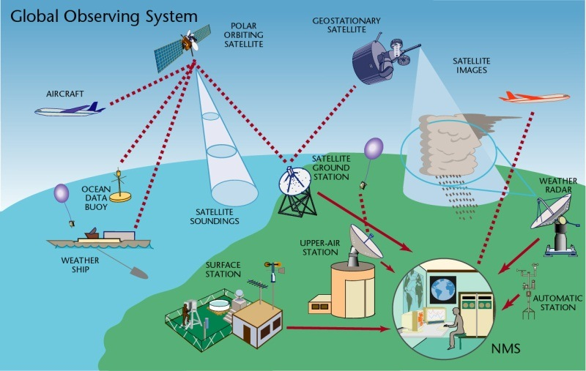
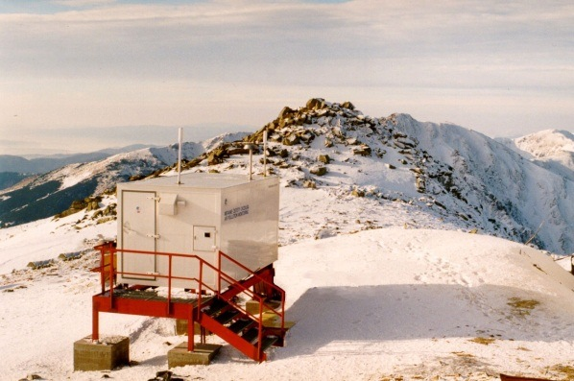
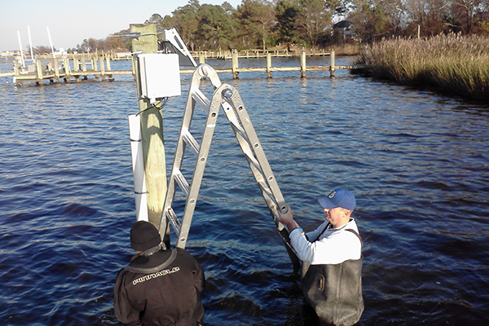
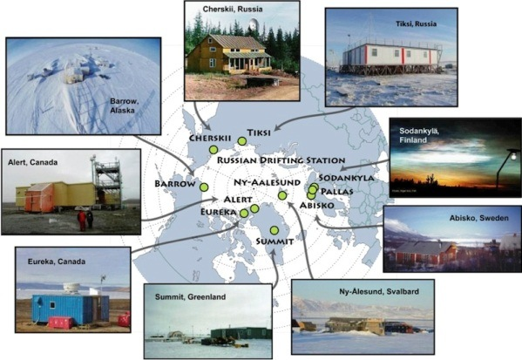
WIGOS Components
(by discipline)
Global Observing System (WWW/GOS)
Observing component of Global Atmospheric Watch (GAW)
WMO Hydrological Observations (including WHYCOS)
Observing component of Global Cryosphere Watch (GCW)

Slide 5
Why do we need WIGOS?
I. NMHS mandate typically broader now than when the World Weather Watch and the GOS were created, including e.g.
Climate monitoring, climate change, mitigation
Air quality, atmospheric composition from urban to planetary scales
Oceans
Cryosphere
Water resources
II. Technical and scientific advances:
Observing technology
Telecommunications
Numerical modeling and data assimilation
Increased user demand to access and use observations in decision making

Slide 6
Why do we need WIGOS?
III. Economic realities
Budgetary pressure on many NMHS, in spite of expanding mandates and increasing demand for services
Efficiency by exploiting synergies
Integration of observing networks across disciplines (e.g. weather and climate)
Integration across organizational boundaries, e.g. between different national ministries/departments operating observing systems
Integration across technological boundaries, e.g. between surface- and space-based systems

Slide 7
What do we mean by Integration?
Integrated network design, e.g. across national borders:
Radar and lightning detection networks
Radiosonde networks designed together with those of neighboring countries
Integration across disciplines: Multi-purpose networks
No separate networks for application areas that rely on measurements of the same variables, e.g. weather and climate
Integration across organizational boundaries:
Take advantage of other organizations outside the NMHS that operated observing systems; partner with them where possible

Slide 8
What do we mean by Integration? (II)
Integration across technological boundaries; space- and surface-based observing system as one
Space-based components provide excellent spatial and temporal coverage
Ground-based components provide fine-scaled structure, in situ validation and can provide measurements not possible from space
Integration across different levels of performance; concept of tiered networks can include e.g.
Crowd-sourced data, IoT observations (massive amounts of data, poor or unknown quality)
Standard networks; routine, operational quality data
Reference networks with data traceable to SI standards (fewer data, very high quality)

Slide 9
The WIGOS Pre-Operational Phase (2016-2019) decided by Cg-17 in 2015
Increased emphasis on regional and national activities
Five main priority areas:
WIGOS Regulatory Material, supplemented with necessary guidance material
WIGOS Information Resource, including the Observing Systems Capabilities analysis and Review tool (OSCAR), especially OSCAR/Surface
WIGOS Data Quality Monitoring System (WDQMS)
Regional Structure; Regional WIGOS Centers
National WIGOS Implementation, coordination and governance mechanisms

Slide 10
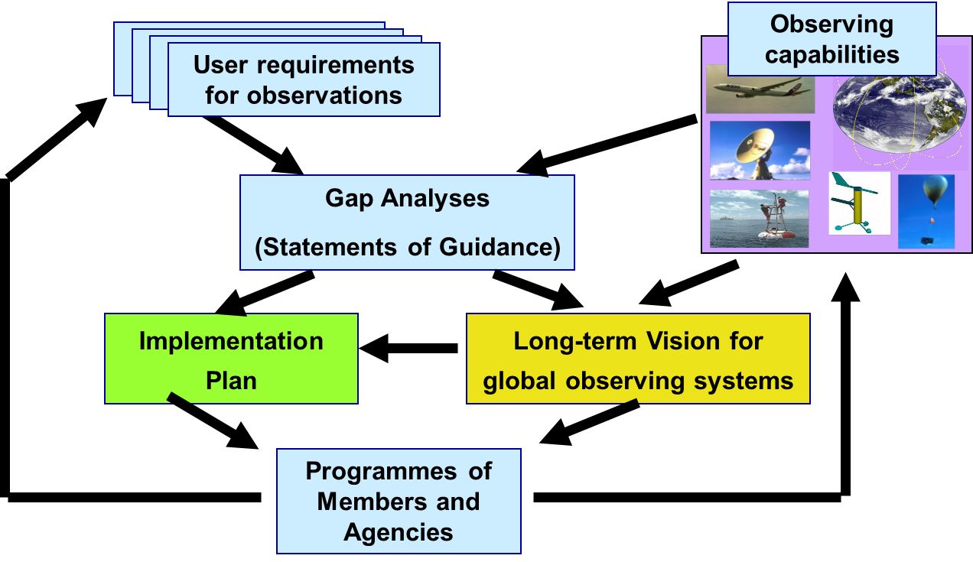
Rolling Review of Requirements (RRR)
WMO Congress: All WMO and WMO co-sponsored observing systems shall use the RRR to design networks, plan evolution and assess performance.
The RRR is the process used by WMO to collect, vet and record user requirements for all WMO application areas and match them against observational capabilities
Rolling Review of Requirements

Slide 11
WMO Application Areas listed in the RRR
Global numerical weather prediction
High-resolution numerical weather prediction
Nowcasting and very short range forecasting
Seasonal and inter-annual forecasting
Aeronautical meteorology
Forecasting atmospheric composition
Monitoring atmospheric composition
Atmospheric composition for urban applications
Ocean applications
Agricultural meteorology
Hydrology
Climate monitoring (currently under revision by GCOS and WCRP)
Climate applications (currently under revision by GCOS and WCRP)
Space weather

Slide 12
Rolling Review of Requirements: Four levels of tools
Databases; OSCAR (Observing Systems Capability Analysis and Review Tool) User requirements: http://www.wmo-sat.info/oscar/requirements Space-based capabilities: http://www.wmo-sat.info/oscar/spacecapabilities Surface-based observing (under development): https://oscar.wmo.int/OSCAR/index.html#/
Gap Analyses (Statements of Guidance, SoGs) http://www.wmo.int/pages/prog/www/OSY/GOS-RRR.html#SOG
Vision: http://www.wmo.int/pages/prog/www/OSY/gos-vision.html
Implementation Plan, EGOS-IP: http://www.wmo.int/pages/prog/www/OSY/gos-vision.html#egos-ip

Slide 13
OSCAR
The RRR is supported by three key databases of OSCAR, the Observation Systems Capabilities and Review tool :
OSCAR/Requirements, in which “technology free” requirements are provided for each application area, expressed in units of geophysical variables (260 in total currently), not measurands; not just atmosphere, also terrestrial, ocean, cryosphere, …
OSCAR/Space, listing the capabilities of all satellite sensors, whether historical, operational or planned
OSCAR/Surface, list surface-based capabilities; developed by MeteoSwiss for WMO, operational since May 2016
OSCAR homepage

Slide 14
OSCAR/Requirements
The following requirements are listed for each of the (currently 14 application) areas and for all relevant geophysical variables (currently more than 200):
Spatial (horizontal and vertical) and temporal resolution, uncertainty, data latency, required coverage area, source, and level of confidence
Each requirement is expressed in terms of three separate values:
Threshold (observations not useful unless this is met)
Break-through (optimum cost-benefit ratio)
Goal (exceeding this provides no additional benefit)
OSCAR/Requirements information content is assembled by CBS and other WMO Inter-Program Expert Teams and Task Teams and is informed by the broader scientific community

Slide 15
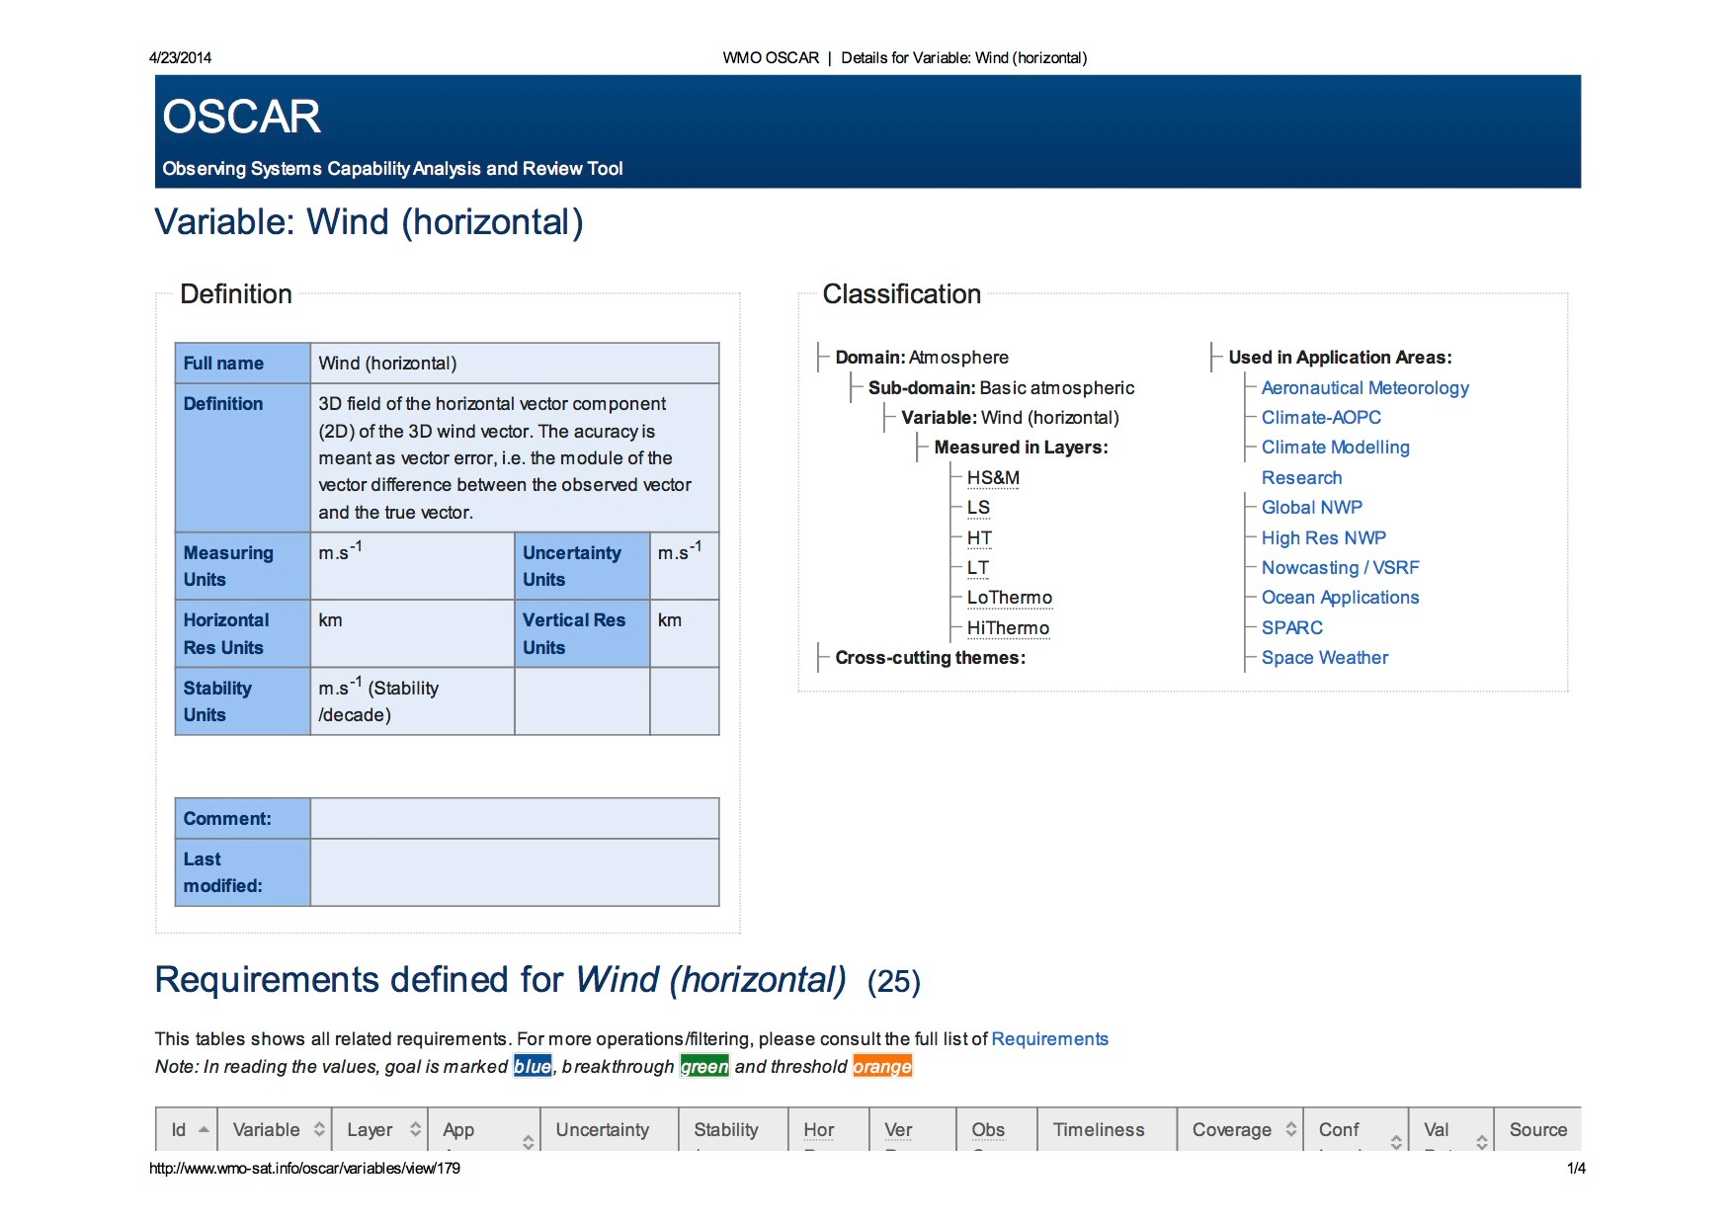

Slide 16
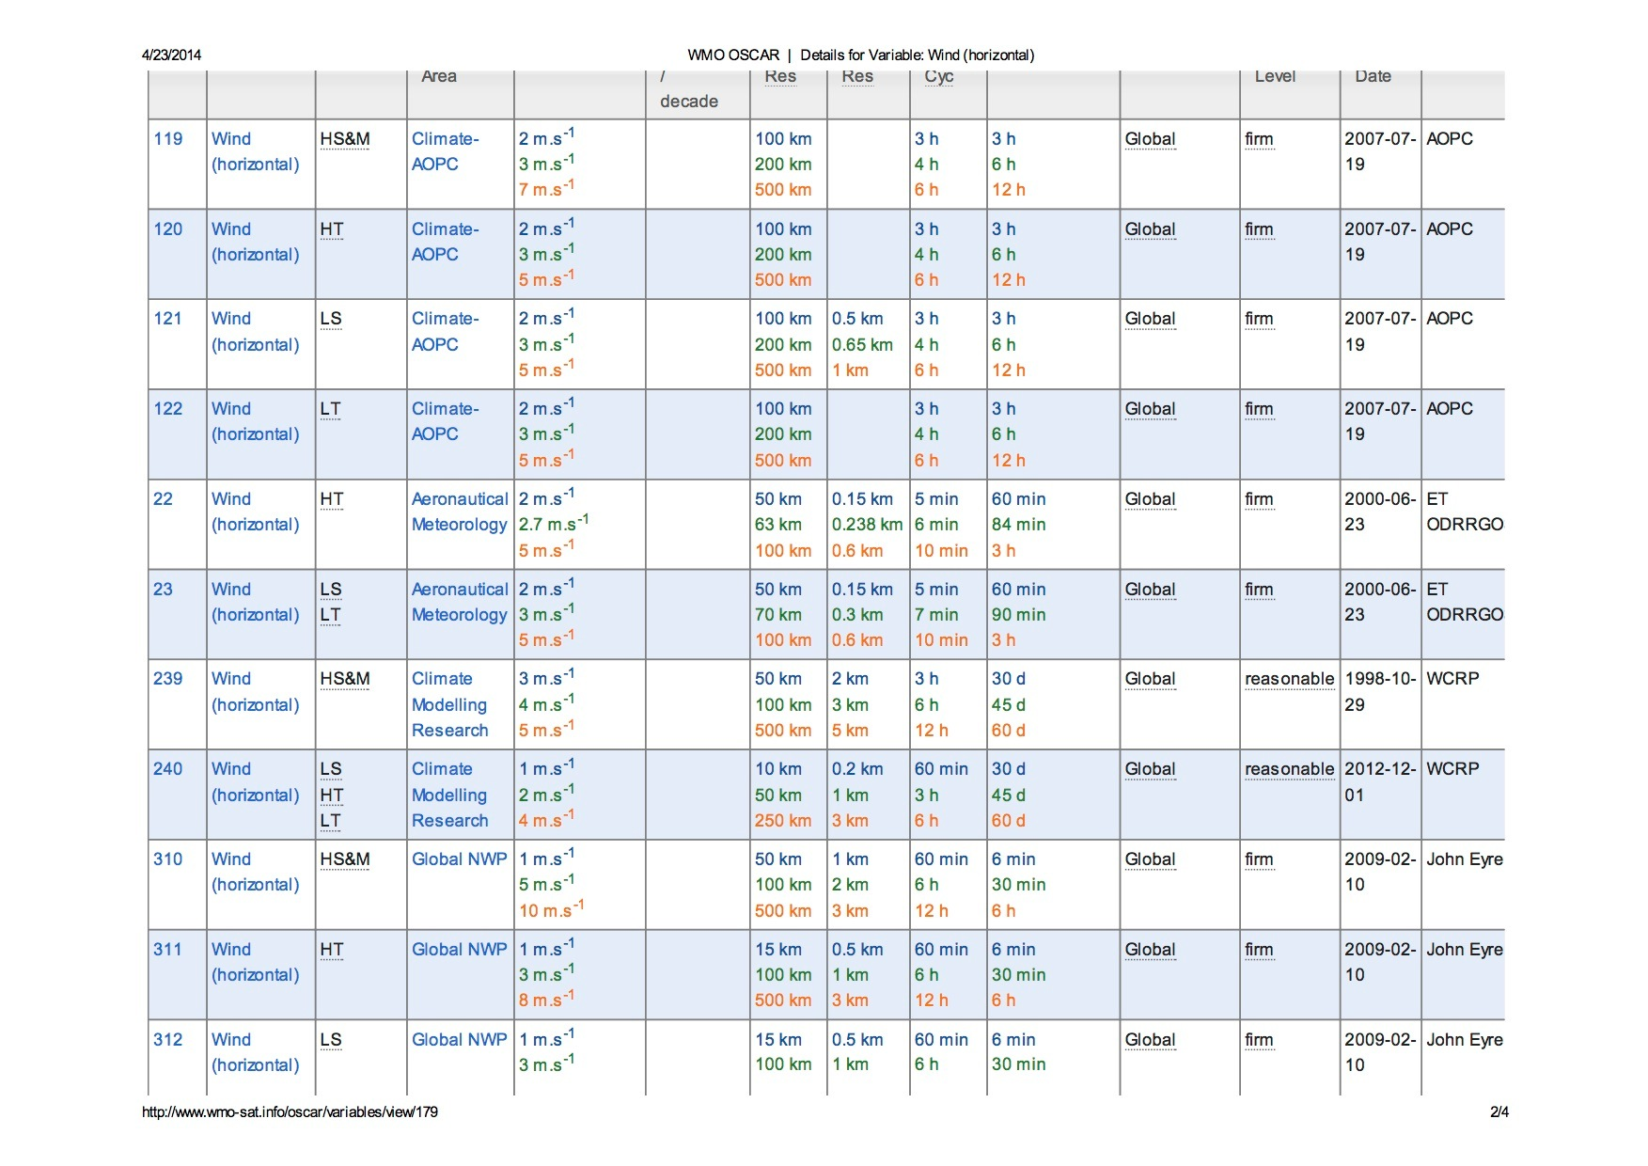

Slide 17
OSCAR/Space
Repository of metadata about all satellite sensors (past, present and future) relevant to WMO Programs and Application Areas
Instrument type, measurement technique, high-level characteristics (mass, power, data rate)
Programmatic information, e.g. agency, measurement program, operating period, heritage, etc.
Orbit, coverage, repeat frequency, resolution
Capabilities, expressed in terms of geophysical variables that can be derived from the measurements provided by the sensor, listed in order of decreasing fidelity
OSCAR/Space 2.0 released in June 2016
Objective, rule-based assessment of capabilities
Unique to OSCAR/Space

Slide 18
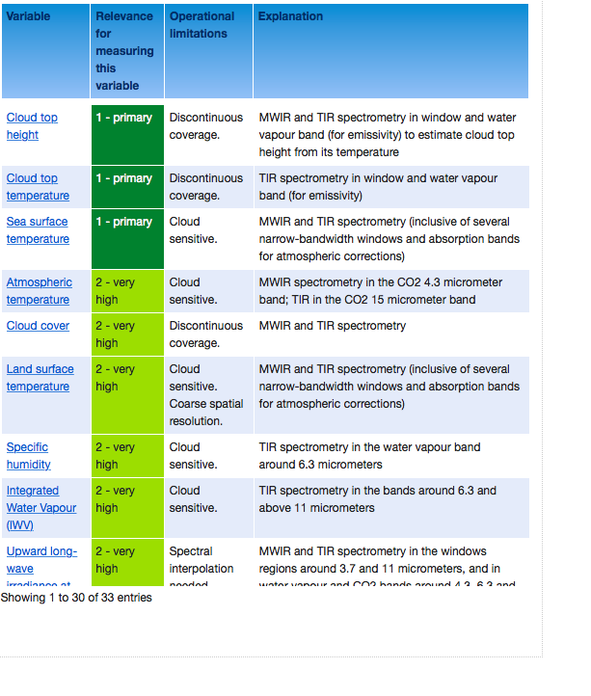
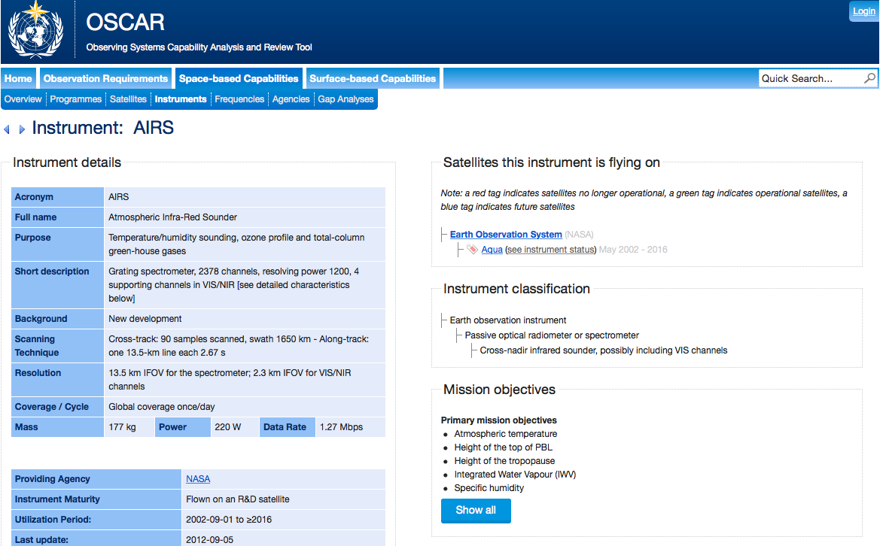

Slide 19
OSCAR/Surface
(“What is WIGOS?”)
Implementation layer of the WIGOS Metadata Standard: Modern, electronic, searchable inventory of metadata for all observing stations/platforms under WIGOS
OSCAR/Surface will replace WMO Pub. 9, Volume A, but will also include information from similar inventories for other (non-GOS) components of WIGOS
Developed jointly by WMO and MeteoSwiss, with the Swiss government providing the major part of the funding
Operational since May 2016
Education and training Members in populating, editing and using OSCAR/Surface is a major priority for 2016-2019 financial period

Slide 20
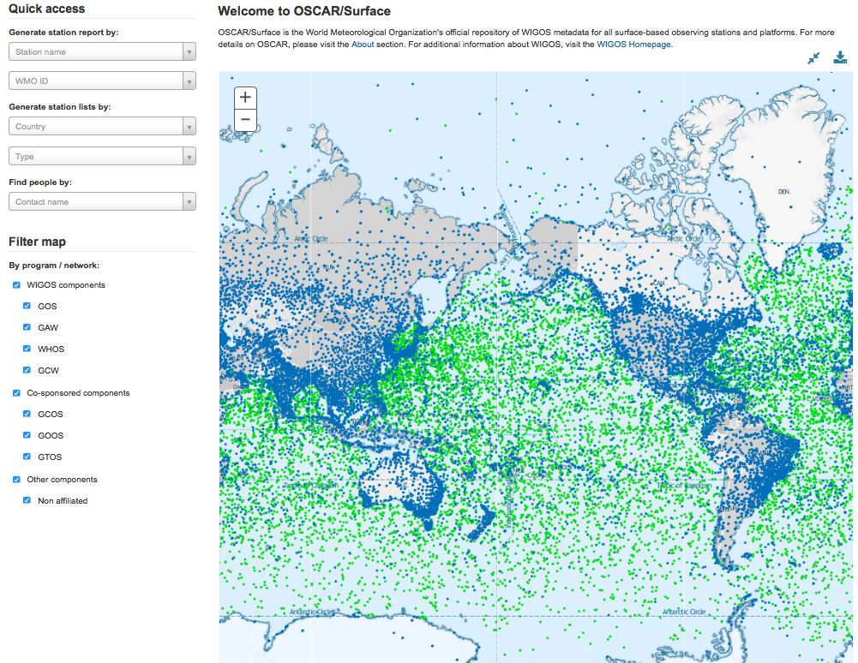

Slide 21
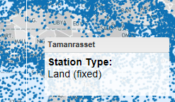
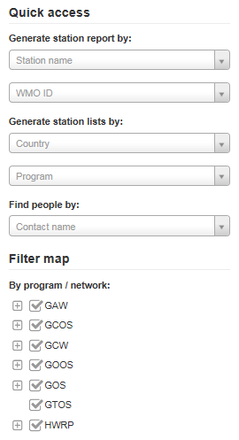
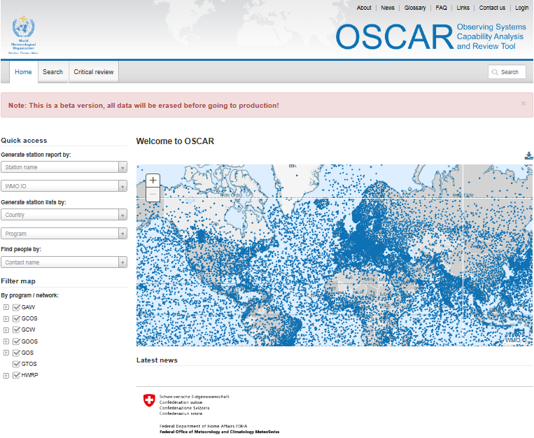
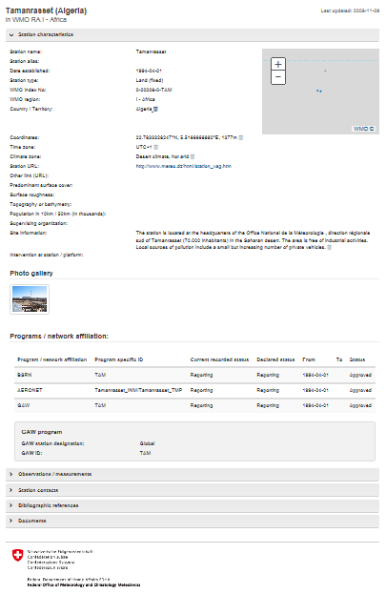
OSCAR quick access & reports
Quick access
&
Map filter
+ click
=
Detailed station report

Slide 22
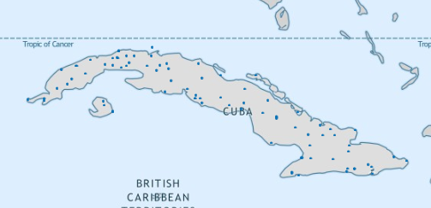
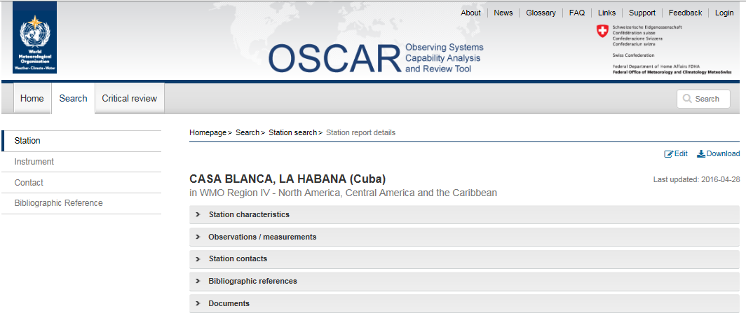
OSCAR/Surface Station Report (I)

Slide 23
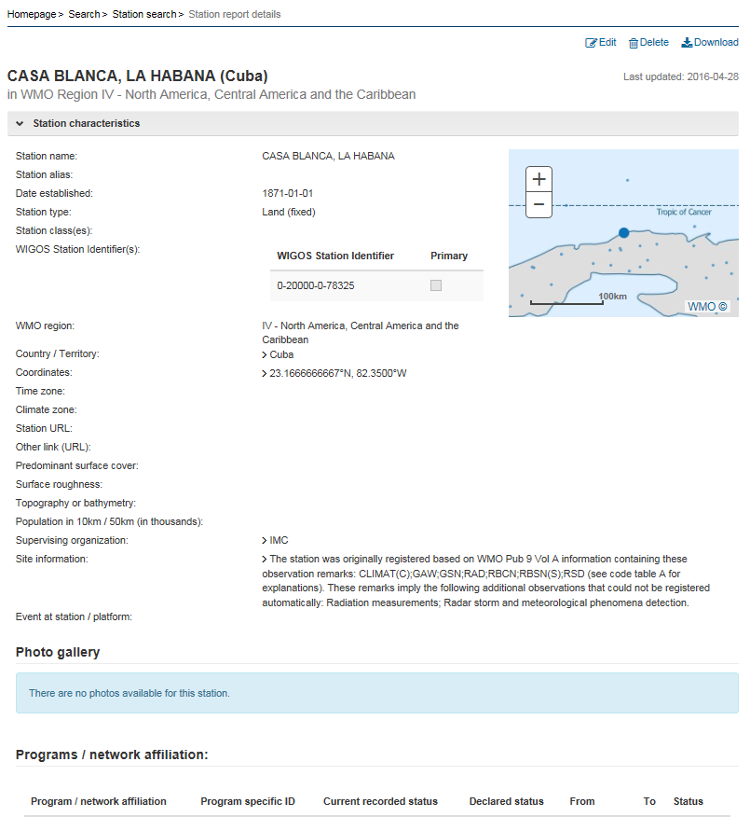
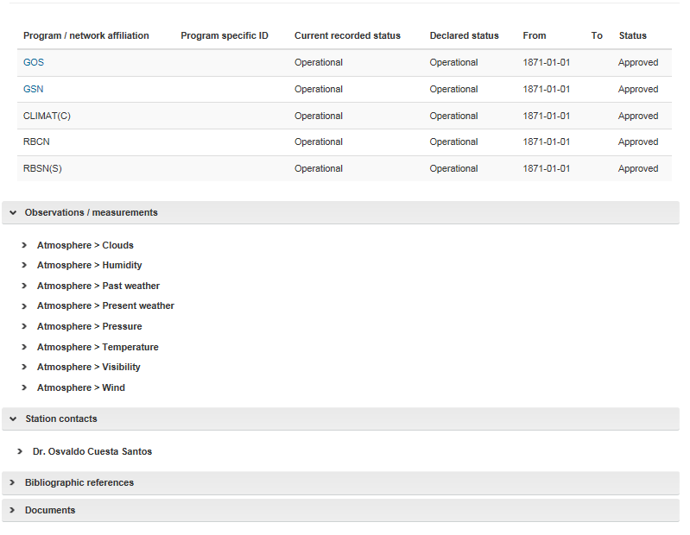
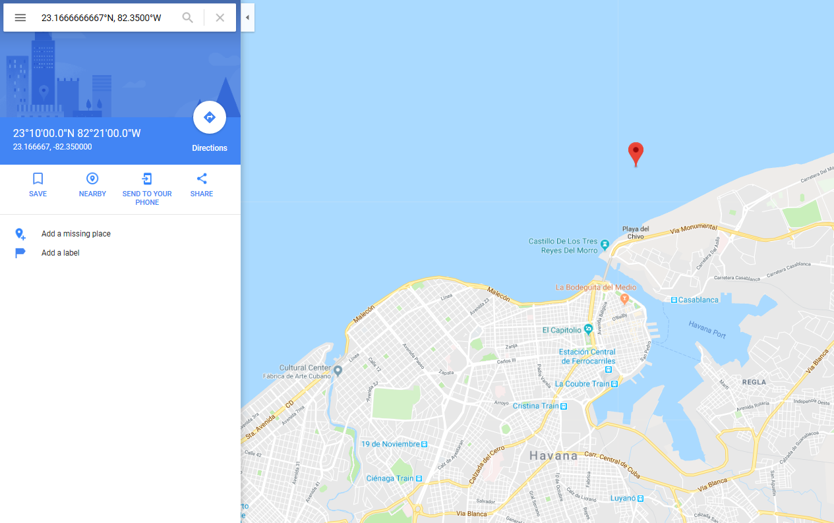
OSCAR/Surface Station Report (II)

Slide 24
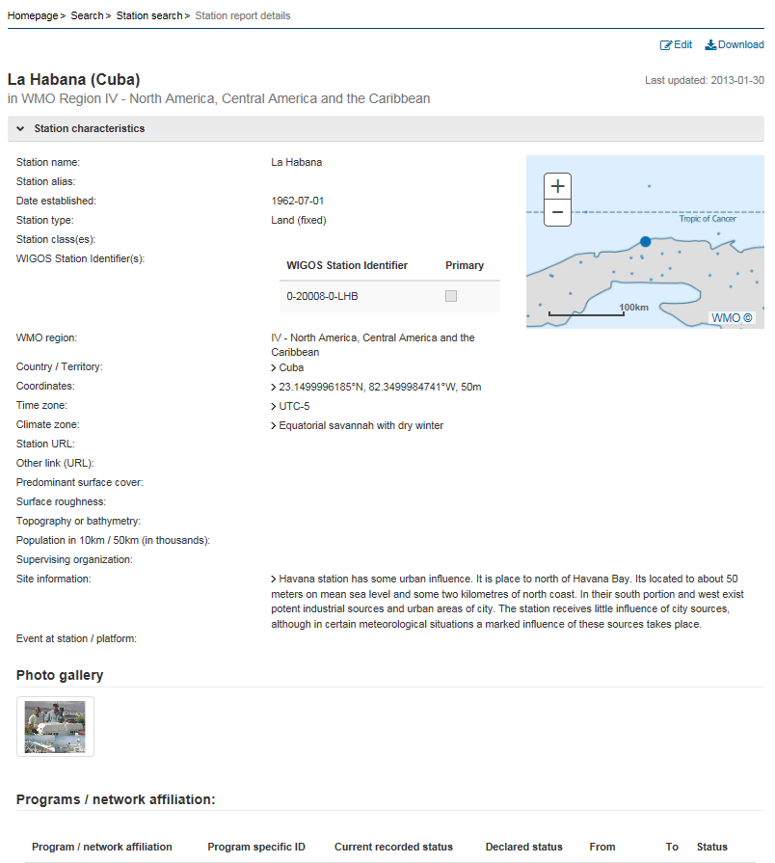
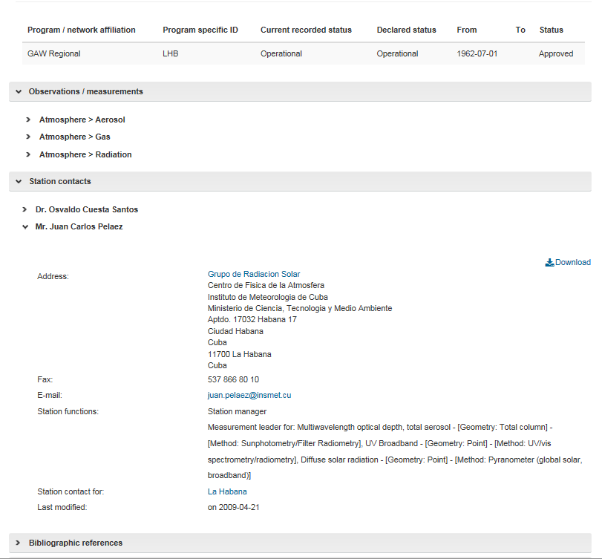
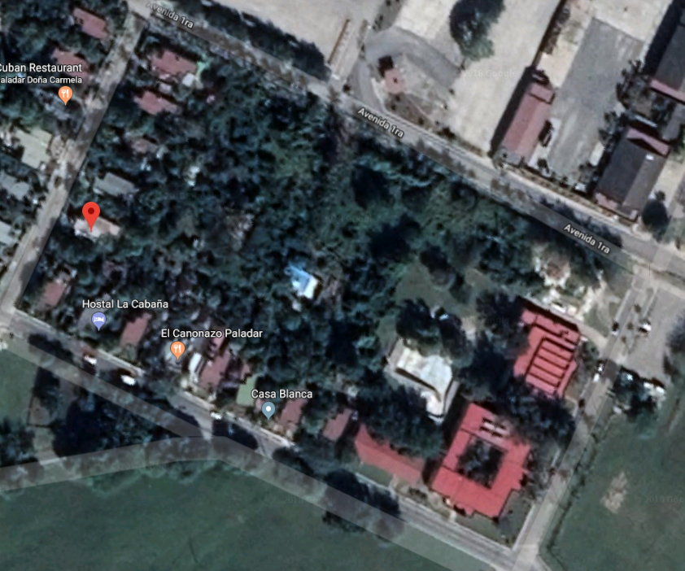
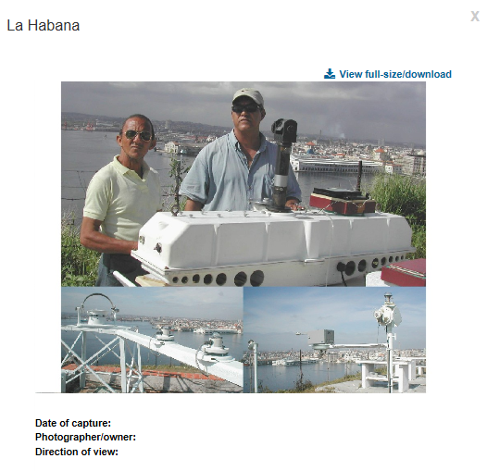
OSCAR/Surface Station Report (III)

Slide 25
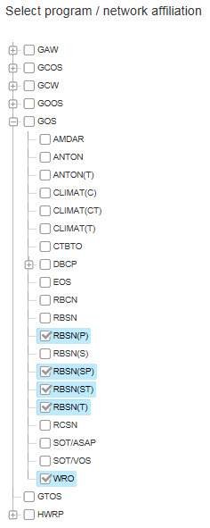
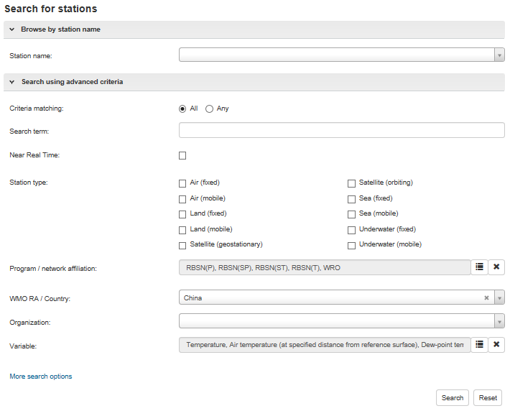
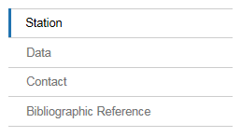
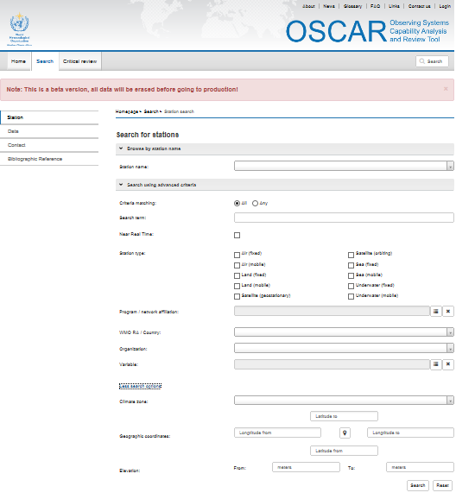
OSCAR detailed search
Various search targets
Instruments (soon)
Finely tuned search

Slide 26
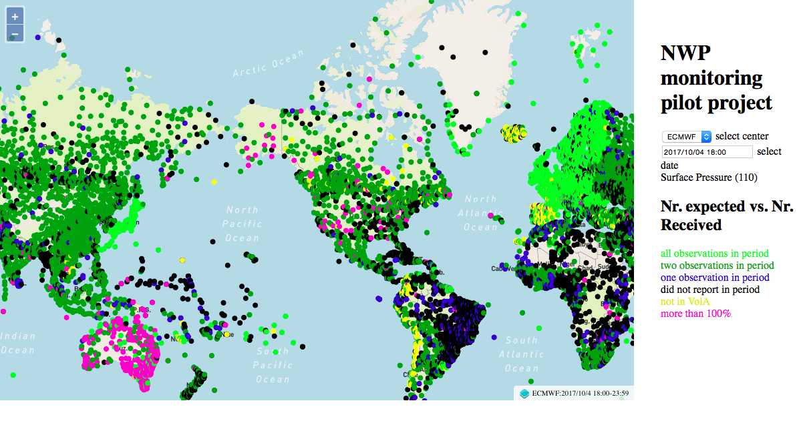
WIGOS Data Quality Monitoring System (WDQMS)
Real-time monitoring of performance (data availability and data quality) of all WIGOS components, searchable by region, country, station type, period, etc.
Delayed mode monitoring of data quality as measured against reference sources of information will be included for non-real time observations
Incident management component for mitigation of performance issues
The WDQMS will provide a complete description of how well WIGOS is functioning
Current activities
Pilot project on NWP-based monitoring; ECMWF, NCEP, DWD, JMA
RA-I Demonstration Project of monitoring and incident management involving Kenya and Tanzania running through 2017

Slide 27
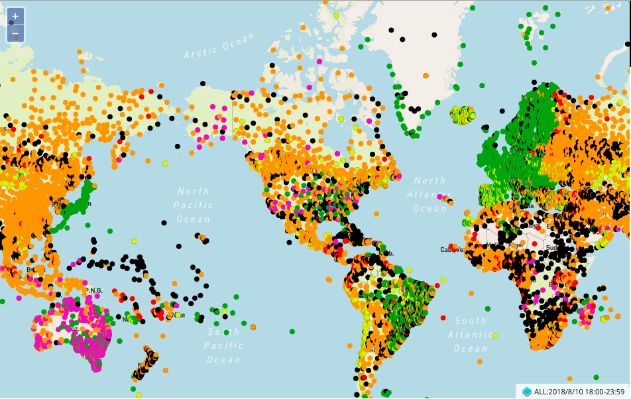
Current status of WDQMS NWP pilot (example)
Green: Fully reporting (hourly)
Orange: Partly reporting (mostly 3-hourly)
Red: Few reports (mostly daytime only)
Black: Silent stations
(Purple or yellow: metadata problems)
Current availability of critical data for global NWP (example: Surface pressure observations received by global NWP Centers on August 10 2018, 18Z)

Slide 28
Regional WIGOS Centers (RWC)
Why?
Many WMO Members requesting support from Secretariat for national implementation efforts
Can be addressed more efficiently and effectively at regional level
What?
Initial role or RWC will be to support national WIGOS Implementation efforts, in particular as concerns
OSCAR/Surface; ensuring metadata input and QC
WDQMS; especially fault management component
How?
To be decided by individual WMO Regions - will likely take place primarily at the sub-Regional level, aligned with existing cultural, linguistic and/or political groupings of countries

Slide 29
Regional WIGOS Centers (II)
Region I: Interest (e.g. Morocco, Tanzania); limited national resources, WMO seeking donor funds; sub-regional basis;
Region II: Interest from China, Saudi Arabia; will be done on a sub-regional basis;
Region III: Plans for Virtual RWC maturing; Region VI used as model;
Region IV: No way forward yet;
Region V: RWC to be operated in pilot mode by Australia and Singapore, tentatively with contributions from Fiji and/or Indonesia; will be discussed during RA-V-17 in Tonga, Oct 2018;
Region VI: successful RWC operating in pilot mode at DWD thanks to EUTMETNET engagement; interest from Croatia (marine observations) and Belarus (Eurasian countries in RA II and RA VI).

Slide 30
Why a Vision for WIGOS in 2040?
To serve as reference for WMO Members and other observing system operators, providing context and expected boundary conditions relevant for observing system developments
To inform long-term planning of satellite agencies about expected evolution of user requirements
This drives the 2040 timeline; current 2025 Vision too near-term
To inform planning efforts of users of observations (NHMSs, NWP centers, …) regarding systems development and required computing and communication capabilities

Slide 31
A few of the key drivers behind new Vision
External (societal)
Climate change; new requirements for information on all time scales
Support for Paris Agreement, SDGs. Sendai Framework, …
New application areas, renewed emphasis on existing application areas
Demographic changes (urbanization, mass migration, …)
Increasing overall demand for meteorological information
Internal to the world of meteorology
Evolving technical capabilities (sensing, telecommunication, computing)
Move toward integrated earth system modeling
Increasing recognition of economic value of meteorological information
Private sector interested in owning and operating observing systems

Slide 32
Document Structure
Chapter I; context, purpose, scope
Why a new vision, what are the main drivers of change; what does the concept of “integration” in WIGOS entail;
Chapter II; Space-based WIGOS components
Trends in Requirements and Capabilities; text and tables introducing the four tiers of space-based systems contributing to WIGOS;
Chapter III; Surface-based WIGOS components
Trends and issues (technology, requirements, private sector involvement, commoditization of sensors, processing, communication, …); tables of available and emerging technologies.

Slide 33
Next steps
On June 22 WMO Executive Council endorsed Vision development as part of its WIGOS deliberations and recommended submitting document in its final form to Congress-18 in 2019;
Final round of consultation to take place prior to translation into all WMO languages and dissemination to all Members for review in preparation for Congress;
Consultations will include all WMO technical commissions and program areas, (GCOS and GCW), CEOS, other UN agencies (FAO, UNESCO, UNDP,…) and major contributing programs such as Copernicus;

Slide 34
Summary and Conclusions
WIGOS is a global framework for integrating all WMO observing systems under common regulatory and management umbrella;
Purpose is to help WMO Members provide and gain access to more observational data at reduced cost via integrated approach;
Regulatory material and technical systems implemented by WMO and is still undergoing further development;
Strong involvement from Members is necessary; beginning to happen;
Regional WIGOS Centers to provide important support functions for Members;
Due to its origin and heritage, WIGOS is still weather (and to some extent) climate-dominated;
Integration workshop held in 2017 to facilitate integration of observing systems for hydrology, atmospheric composition, cryosphere;
Second integration workshop planned for 2019.

