Slide 1

Ninth Hydrology Domain Working Group Workshop
WMO
Geneva, Switzerland
17-20 September 2018

Slide 2
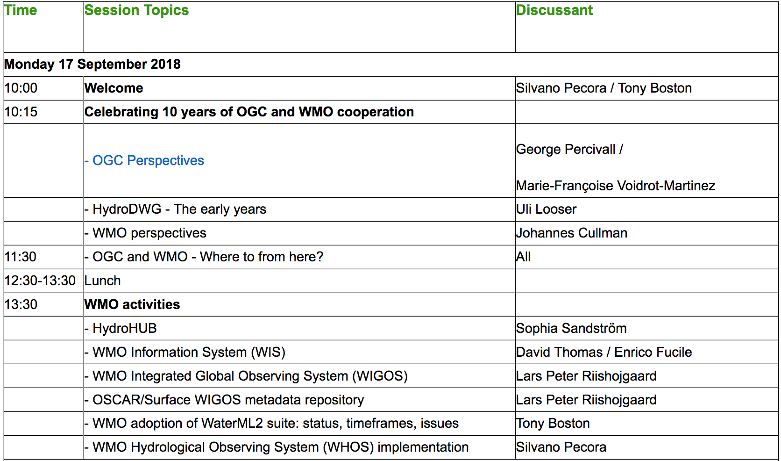
Draft Agenda
Day 1

Slide 3
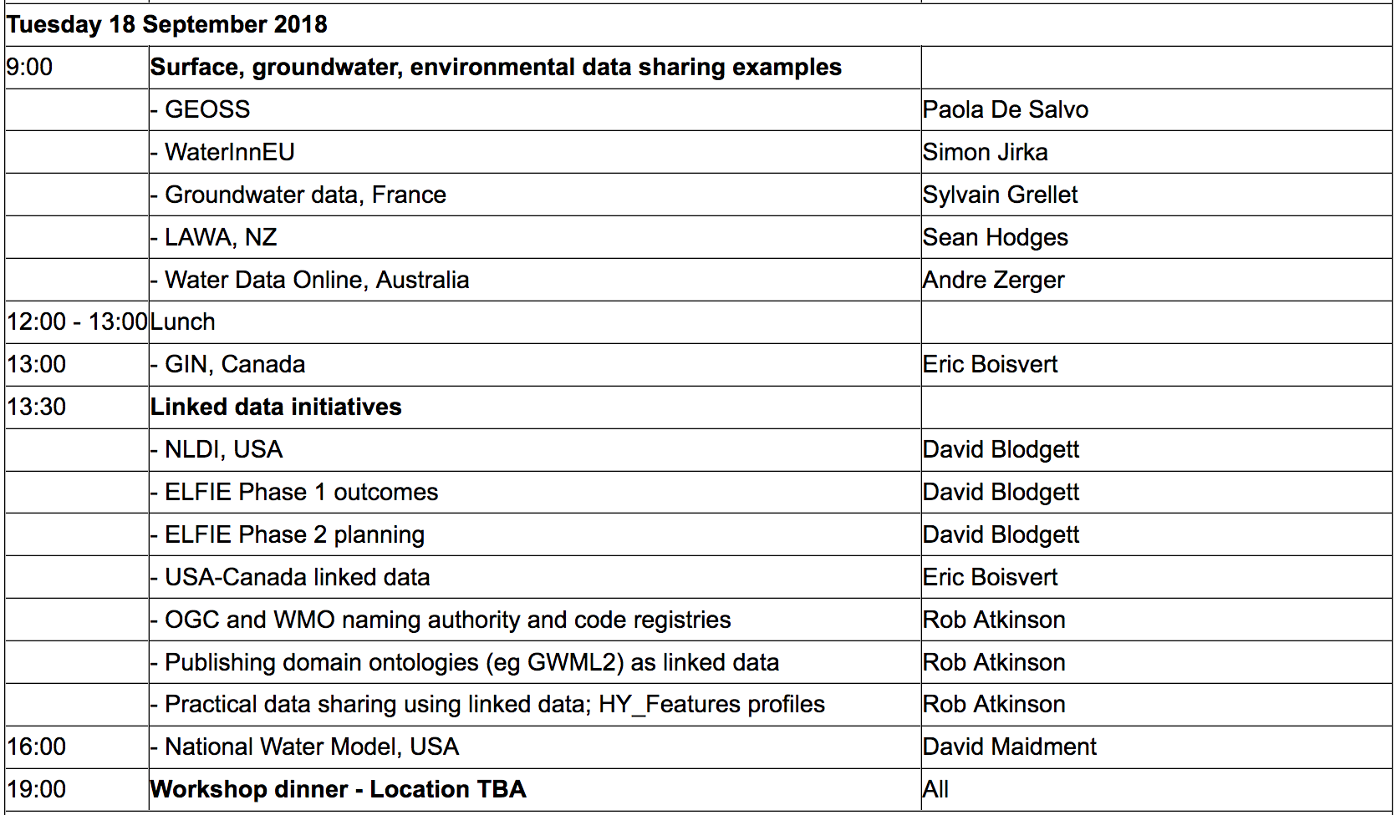
Draft Agenda
Day 2

Slide 4
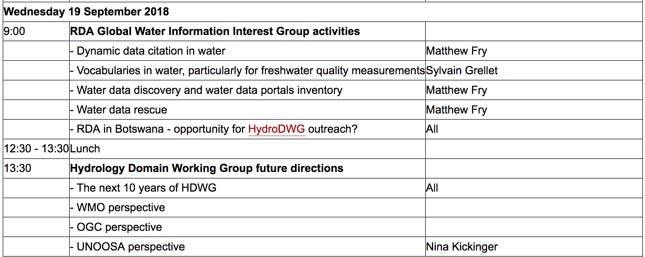
Draft Agenda
Day 3

Slide 5
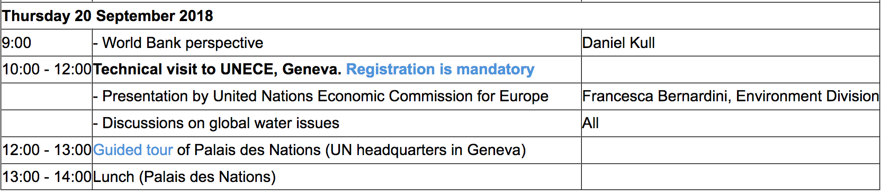
Draft Agenda
Day 4

