Slide 1
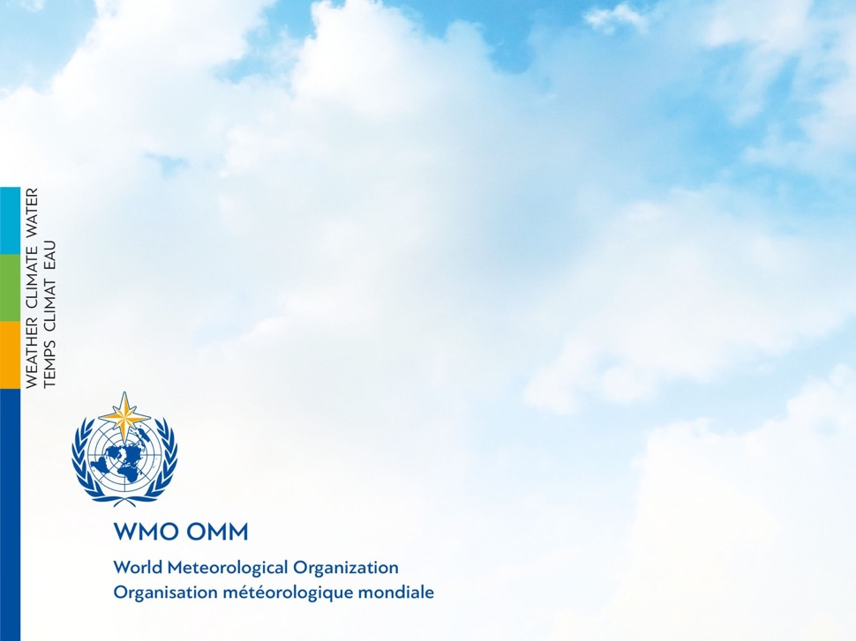
WHOS IMPLEMENTATION
Silvano Pecora
Vice-President of CHy
HDWG Workshop
WMO, Geneva, Switzerland
17-21 September 2018

Slide 2
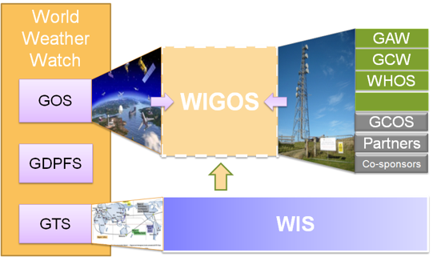
WMO INTEGRATED GLOBAL OBSERVING SYSTEM (WIGOS) and WMO HYDROLOGICAL OBSERVING SYSTEM (WHOS)
In June 2015 the President of CHy informed Cg-17 of CHy proposal to develop WHOS as the CHy contribution to WIGOS
Congress welcomed the effort and urged the president of CHy to continue guiding WHOS to full implementation
Congress urged the promotion of WHOS among NHSs and the hydrological community

Slide 3
WMO Hydrological Observing System (WHOS)
Implementation:
Phase 1:
Map interface with links to those NHSs that make their real-time and historical stage and discharge data available online. implemented in August 2015.
Phase 2:
A fully WIS/WIGOS compliant services-oriented framework linking hydrologic data providers and users through a hydrologic information system enabling data registration, data discovery, and data access.
Beta version for CHy-15 review and endorsement (Dec 2016)
Initial implementation for EC approval (June 2018)

Slide 4
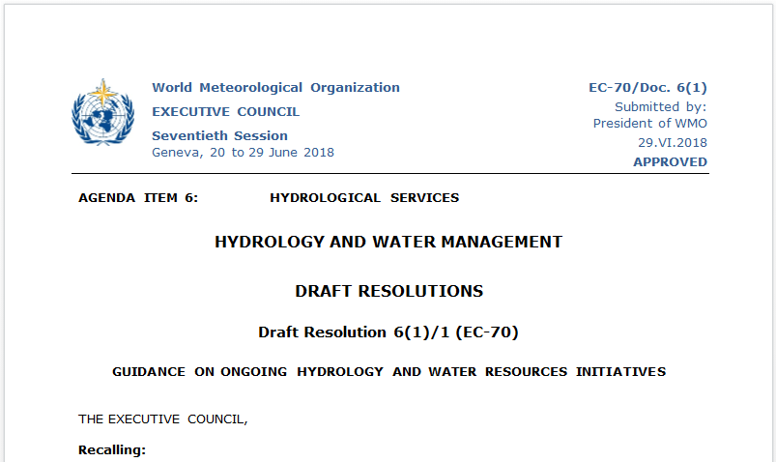

Slide 5
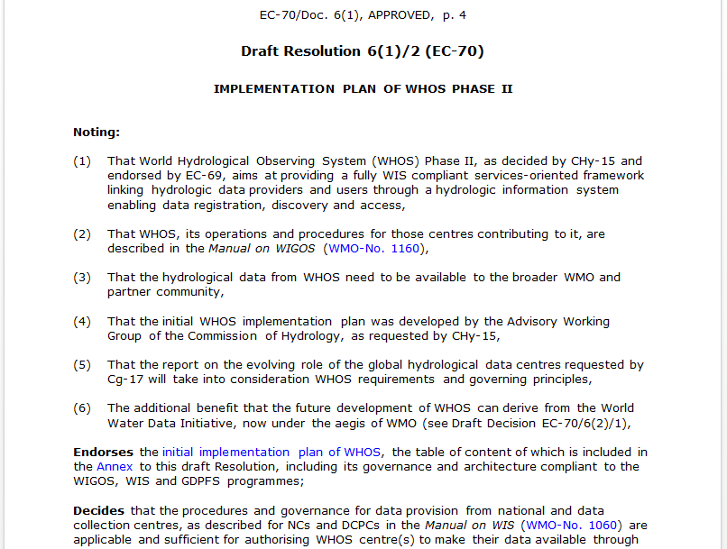

Slide 6
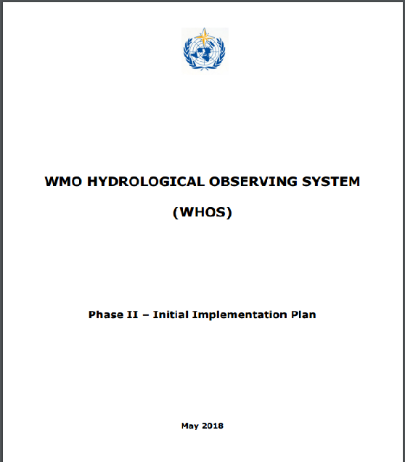
EC-70 DOCUMENT on THE INITIAL IMPLEMENTATION
http://www.wmo.int/pages/prog/hwrp/chy/whos/documents/WHOS_Phase-II_Initial_Implementation_Plan.pdf

Slide 7
THE SEVEN COMPONENTS OF WHOS

Slide 8

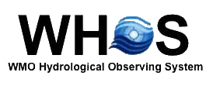





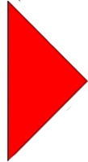






it’s not a software

Slide 9

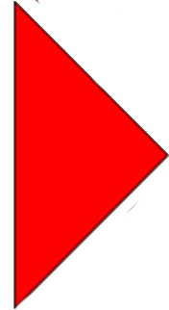
DATA
The ultimate goal of data collection in hydrology, be it precipitation measurements, water-level recordings, discharge gaugings, groundwater monitoring and water quality sampling, is to provide a set of sufficient good quality data that can be used in decision-making in all aspects of water resources management, in the wide range of operational applications as well as in research.
Decisions may be made directly from raw data measurements or based on derived statistics or on the results of many stages of modelling beyond the raw data stage, but it is the collected data that form the basis for these decisions. Data sets are of great intrinsic value as they are collected through a huge commitment of human and financial resources and often during a long period of time, and they acquire also a use value when are made available in an usable form to the final users to respond to their specific needs.

Slide 10
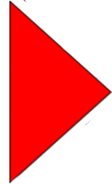
FORMAT
Resolution 25, adopted in May 1999 by the Thirteenth World Meteorological Congress, commits WMO Members to broaden and enhance, whenever possible, the free and unrestricted international exchange of hydrological data and products. In 2005, a Global Climate Observing System (GCOS) report identified standards as a key problem in data exchange in global hydrological and atmospheric networks. Thus, in 2009, WMO and the Open Geospatial Consortium (OGC) jointly formed a Hydrology Domain Working Group (HDWG) to address this issue.
In particular, activities of the WMO/OGC Hydrology Domain Working Group are providing technical and institutional solutions to the challenge of exchanging data describing the state and location of water resources, both above and below the ground surface, with a number of standards associated with WaterML 2.0 such as WaterML 2.0:Part 1 – Time Series; WaterML 2.0:Part 2 - Ratings, Gaugings and Sections; WaterML-WQ; GroundwaterML 2.0; among others.

Slide 11
SERVICE
Utilizing a collection of WMO and OGC Web services, WHOS is designed as a “services stack framework” that shares catalog data, metadata and data with the user. The services stack framework identiﬁes three types of services as essential to sharing water information across the web:
catalog services
metadata services
data services.
These three services work together to completely index, describe and provide access to water information (e.g. time series). Catalog services provide users with an index of hydrologic metadata, metadata services identify collections of time series available over a domain of space and time, and data services provide the user with the raw data for a speciﬁed temporal period and spatial area. This framework is designed to publish and distribute time series, but it can be extended to include grids and coverages as well.

Slide 12
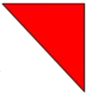
ONTOLOGY
The WMO Hydrological Ontology is a formal naming and definition of the types, properties, and interrelationships of entities that really or fundamentally exist in the domain of hydrology; in particular, it compartmentalizes the variables needed in hydrology and establishes the relationships between them. The ontology is encoded using OWL, and all its elements (classes, properties and individuals) are defined as RDF resources, and identified by URIs. The WMO Hydrological Ontology provides semantic access to linked data by incorporating OWL reasoning within the SPARQL syntax. The adopted development approach takes into account not only semantics, but a more general perspective in order to address possible future needs. The conceptual challenge concerns the enablement of new ways of searching and the adopted methodology is essentially supported by the approach of enriching the searchable information that is associated
with hydrological data and information.

Slide 13


MEDIATOR
Data interoperability is the capacity to move data and information across heterogeneous sources and destinations, in such a way that the receiver is able to restore the original representation of information. This problem can be tackled through the mediated approach, that is identifying the existing heterogeneity boundaries and implementing suitable adaptation logic by means of specialized, lightweight components.
WHOS is supported by a mediation-based federated solution, which has proven suitable for implementing data interoperability in the Hydrology domain.
The adopted solution includes discovery services, relating and combining data from sources characterized by heterogeneous models and encodings, and presenting the users a uniform federal view of metadata and data. A mediator-wrapper component transforms the flowing XML resources from the local to the federal schema, by means of ad-hoc structural mappings. The federal model is based on the ISO TC 211 conceptual model, which is nowadays fairly consolidated and captured in well accepted standards.

Slide 14


BROKER
The Brokering approach is based on the following principles:
a) Autonomy: Keep the existing disciplinary infrastructures as autonomous as possible, not asking them to implement any “more general” service bus.
b) Subsidiarity: Supplement but not supplant disciplinary infrastructure mandates and governance arrangements by interconnecting and mediating their service buses.
c) Interconnection: Build incrementally on existing infrastructures and introduce distribution and mediation functionalities to interconnect the heterogeneous service buses characterizing any domain speciﬁc or other infrastructure.
d) Low entry barrier: Minimize the barrier for both users and resource providers of any disciplinary infrastructure.
e) Flexibility: Be ﬂexible enough to accommodate existing and future information systems and information technologies that will augment the service bus implemented by any discipline.
f) Effectiveness: Address the full range of information exchange needs (discovery, access, semantics, workﬂow, etc.).

Slide 15

CLIENT
The final component of WHOS is the web or desktop client. The client is the component that allows for the harvesting of hydrologic information at the locality of one’s own computer or analytical system as per Manual on WIS (WMO No.1060) section 3.6.7 “Provide access to information”.
The client is a platform located on the user’s machine and communicates with both data services and the registry.
Users can directly download hydrologic information from data providers if they already know of their existence or can search the registry for data that they might not know about.
Once the data of interest has been discovered, users can download the information onto their local databases.

Slide 16

WHOS
FORMAT
BROKER
DATA
CLIENT
MEDIATOR
ONTOLOGY
SERVICE
reshaping data in hydrology

Slide 17
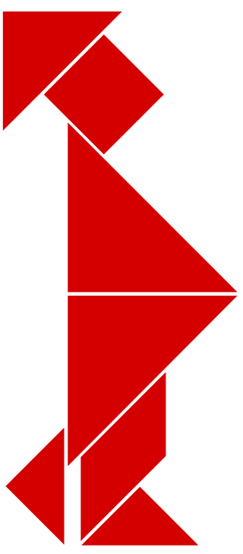
WHOS at LOCAL SCALE

Slide 18
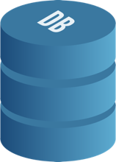

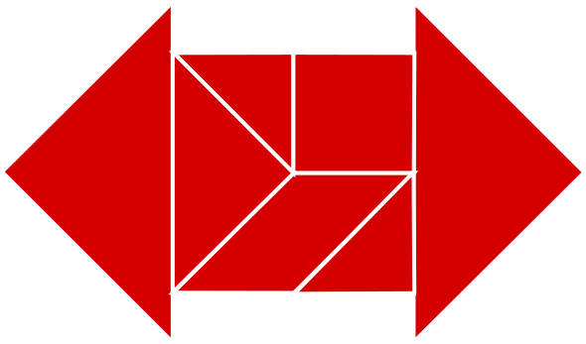

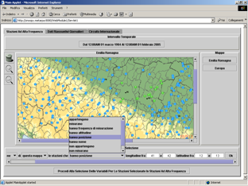
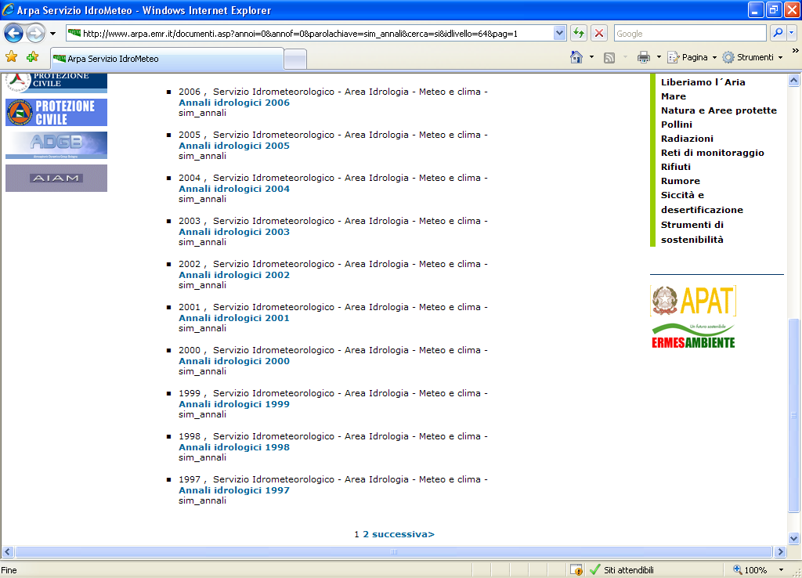
Hydrological Yearbooks

Slide 19

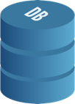
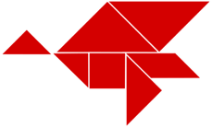
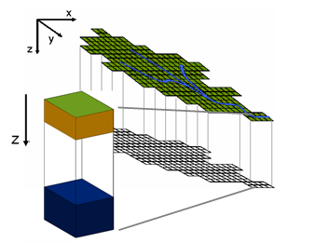
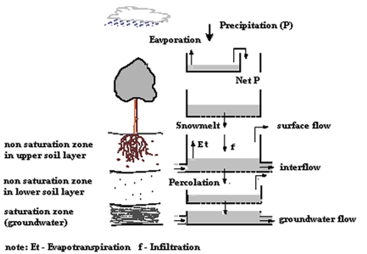
Hydrological Models

Slide 20

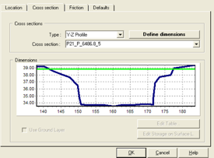
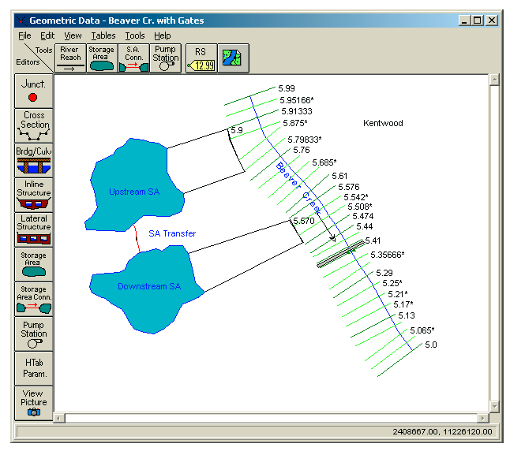
Hydraulic Models

Slide 21

WHOS at NATIONAL SCALE

Slide 22
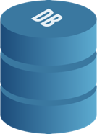
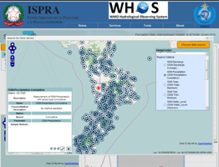
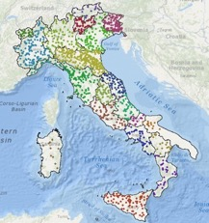
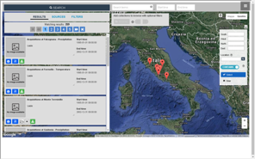

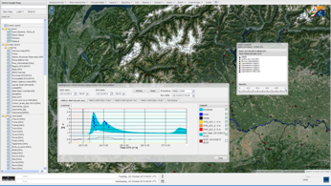
Federation of National Hydrological Data

Slide 23

WHOS at TRANSBOUNDARY SCALE

Slide 24
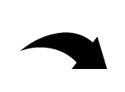
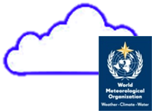


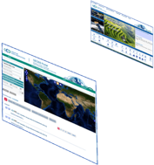

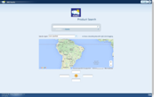
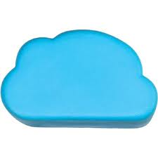









Federation of Basin Hydrological Data
CIC
Home Page
GISC Brasilia
Home Page
Argentina
Bolivia
PLATA HIS Portal
5 national
brokered systems
Brasil
Paraguay
Systems
Registry
Semantic engines
Uruguay
...
.. .
Brokered Data Providers (capacities, systems, networks, etc.)
.. .
.. .
Hydrologic tools (tested interoperability)

Slide 25

WHOS at REGIONAL SCALE

Slide 26
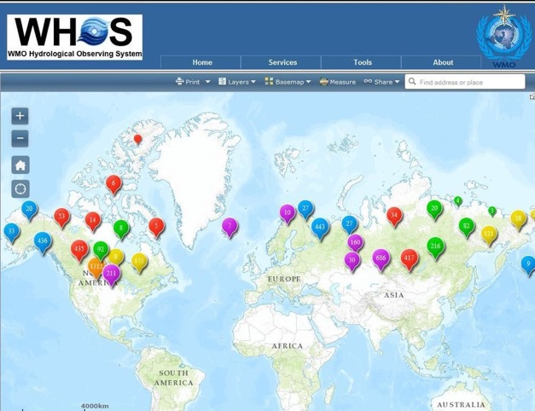
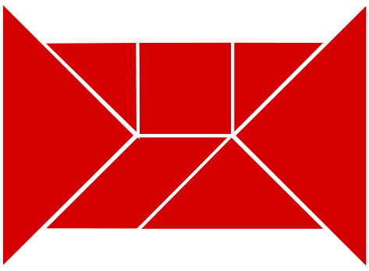
Federation of Regional Hydrological Data

Slide 27
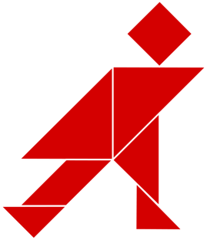
WHOS at GLOBAL SCALE

Slide 28
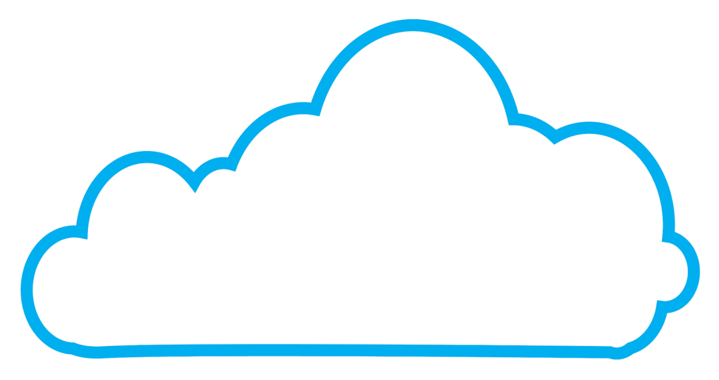






Interoperability and Information Flow
Special Data View
Common Ontology services
Regional nodes synchronization service
Community Nodes
… .
… .
Regional Nodes
… .
National/Local Data Systems
Europe
Africa
Asia

Slide 29
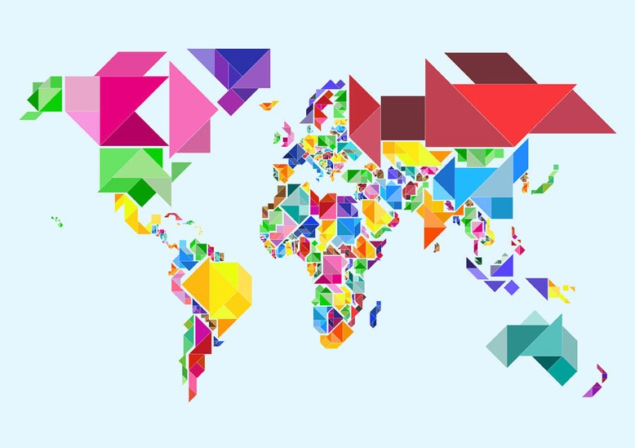

Slide 30
AN OPERATIONAL PROTOTYPE

Slide 31
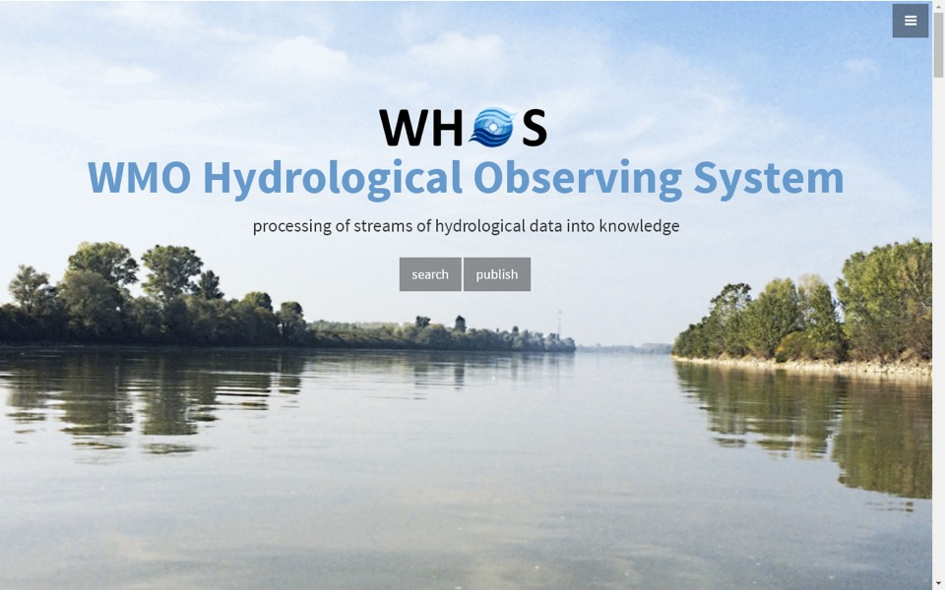
http://hydrolite.ddns.net/whos/

Slide 32
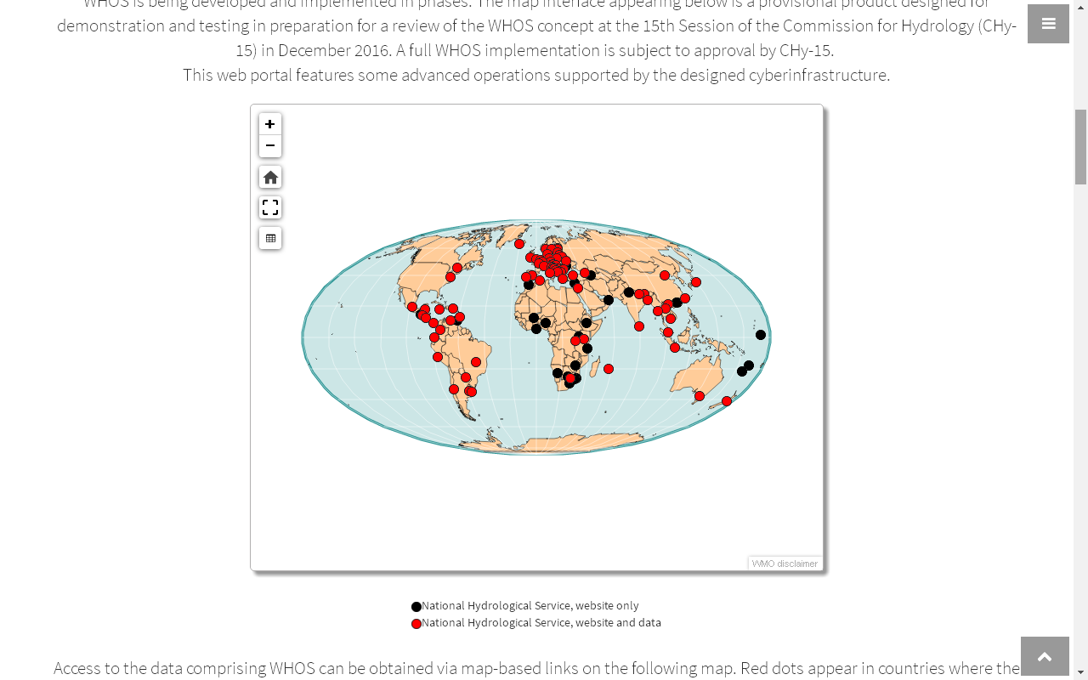

Slide 33
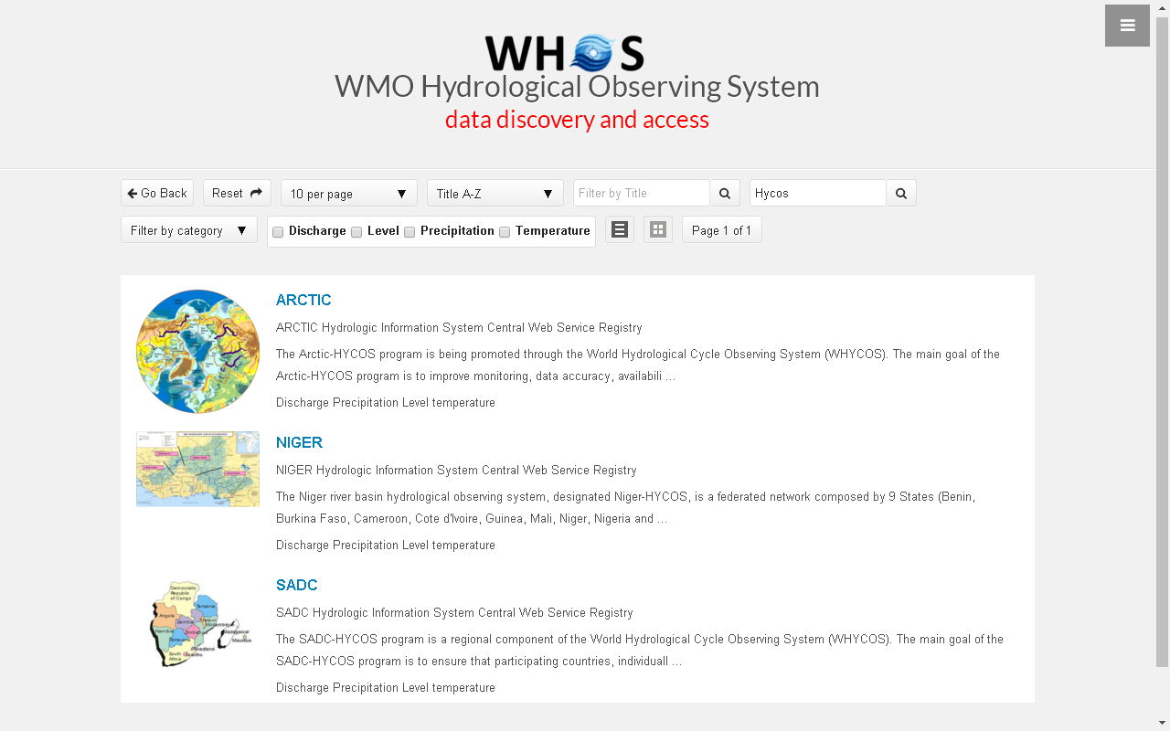

Slide 34
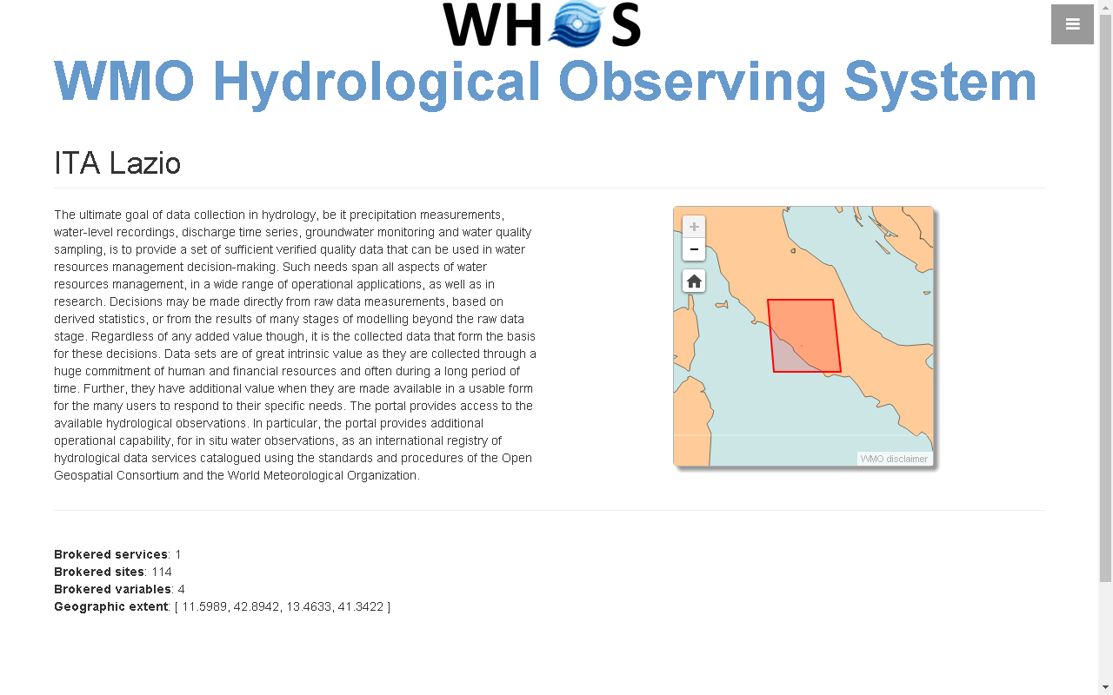

Slide 35
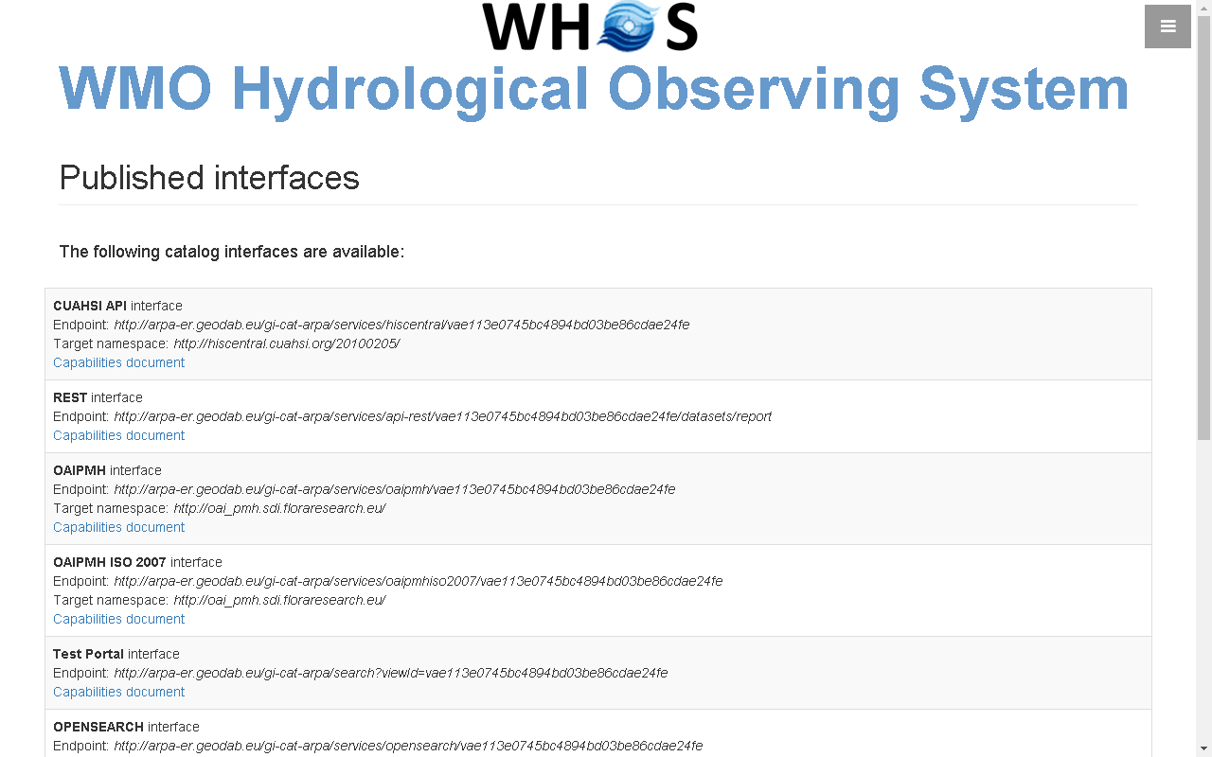

Slide 36
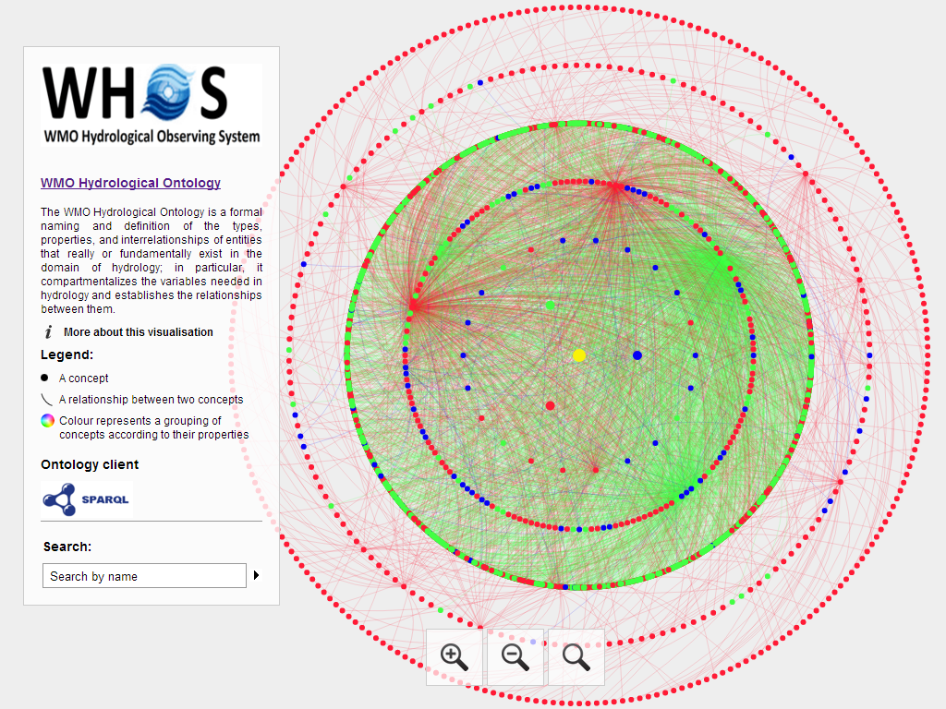
Notes:
hiscentral.ddns.net:8088/ontology/

Slide 37
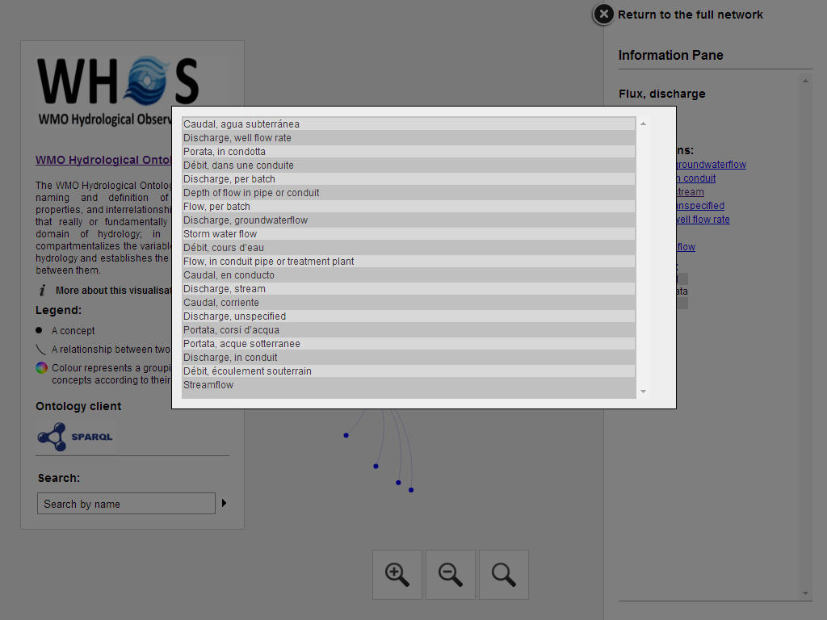

Slide 38
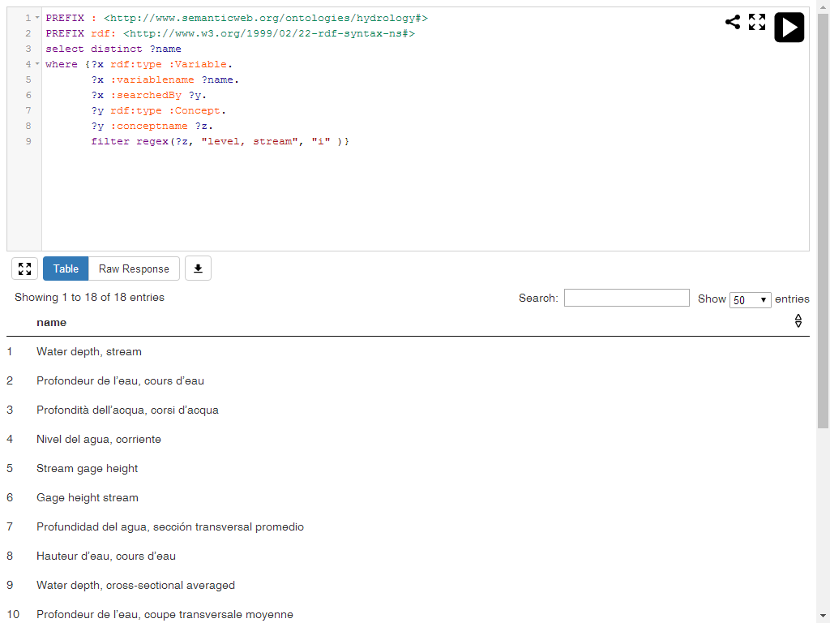
Notes:
PREFIX : <http://www.semanticweb.org/ontologies/hydrology#> PREFIX rdf: <http://www.w3.org/1999/02/22-rdf-syntax-ns#> select distinct ?name where {?x rdf:type :Variable. ?x :variablename ?name. ?x :searchedBy ?y. ?y rdf:type :Concept. ?y :conceptname ?z. filter regex(?z, "level, stream", "i" )}

Slide 39
WIGOS Metadata Standard - Approved at Cg-17 June 2015
Source: https://www.wmo.int/pages/prog/www/wigos/documents/Cg-17/WIGOS_Metadata.pdf

Slide 40
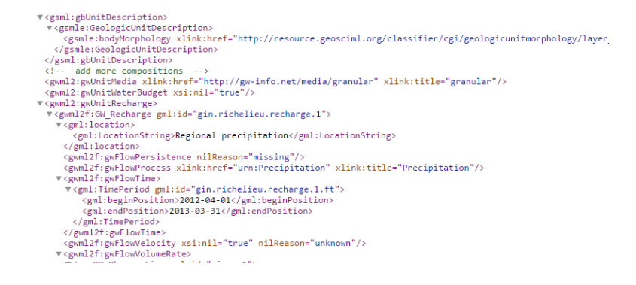
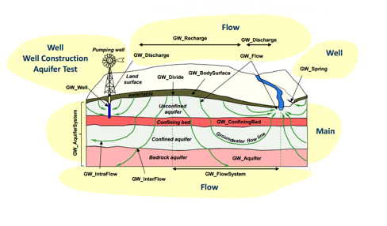
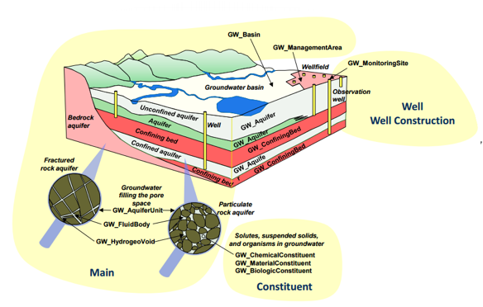
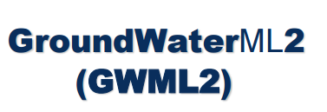

Slide 41

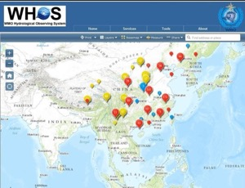
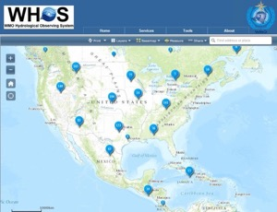






STANDARDIZED DATA EXCHANGE IN HYDROLOGY

Slide 42
WHOS PLATA

Slide 43
Hydrologic Information System in the Plata basin
CIC
Home Page
GISC Brasilia
Home Page
Argentina
Bolivia
PLATA HIS Portal
5 national
brokered systems
Brasil
Paraguay
Broker
and
Mediator
Systems
Registry
Semantic engines
Uruguay
...
.. .
Brokered Data Providers (capacities, systems, networks, etc.)
.. .
.. .
Hydrologic tools (tested interoperability)

Slide 44








Slide 45

HIS in La Plata Basin

Slide 46







Slide 47
DEVELOPMENT OF WHOS PLATA

Slide 48

System of Systems: Supply-chain model
Data/information is the new “oil”

Slide 49



Supply-chain SECO
Human Computer Interface
Harmonization capacity
WMO CHy Programmes
WMO CHy Projects
Other
Apps
DOWNSTREAM
APIs
APIs
APIs
APIs
Brokering/Mediation Platform
Thematic/International Federation systems
APIs
APIs
APIs
APIs
Workflow/Processing systems
MIDSTREAM
Regional/National Data Nodes
APIs
APIs
APIs
APIs
Data systems
UPSTREAM

Slide 50











Multi-Organization Effort
Human Computer Interface
Harmonization capacity
WMO CHy Programmes
WMO CHy Projects
Other
Apps
DOWNSTREAM
APIs
APIs
APIs
Brokering/Mediation Platform
Thematic/International Federation systems
Workflow/Processing systems
APIs
APIs
APIs
MIDSTREAM
Regional/National Data Nodes
APIs
APIs
APIs
Data systems
UPSTREAM
…

Slide 51




Ecosystem: Supply-chain model
Governance
Sourcing
Quality Check
Harmonization, Quality Assessment, Ranking, Enrichment
Warehousing
Transformation
Distribution
Retailing,
Corporate selling
Users uptake
Feedbacks
UPSTREAM
MIDSTREAM
DOWNSTREAM
Resource Providers
Interoperability Platform
Intermediate Users
Final Users

Slide 52



















System of Systems
Governance
WF/Processing
Systems
Community Portals & Appl.s
Brokering framework
Customization Tools
Data Systems
Sourcing
Quality Check
Harmonization, Quality Assessment, Ranking, Enrichment
Warehousing
Transformation
Distribution
Retailing,
Corporate selling
Users uptake
Feedbacks
UPSTREAM
MIDSTREAM
DOWNSTREAM
User-centered Appl.s
Resource Providers
Providers Registry
Interoperability Platform
Intermediate Users
Final Users
Platform APIs

Slide 53
WHOS Plata System
A System of Systems to provide a unique entry point for Client Applications to discover and access Hydrological data published by the contributing Data Nodes.
Client Applications access the system utlizing the preferred service protocol/APIs.
Data Nodes publish their data utilizing the preferred service protocol/APIs.
Contribute to WMO Hydrological Observing System (WHOS)

Slide 54


WHOS Plata – Main Functional Requirements
Implement interoperability with service protocols/APIs utilized by the Data Nodes
Publish service protocols/APIs required by Client Applcations
Metadata mapping
Data transformation
WHOS Plata

Slide 55
WHOS Plata – Main Non-Functional Requirements
Quality of Service
Availability
Scalability
Response Time
Throughput
Extensibility, in particular to support new service protocols/APIs, metadata schemas/encodings and data models/formats
WHOS Plata

Slide 56






WHOS Plata System Overview
Application
Application
Application
Application
App Icons made by Maxim Basinski from www.flaticon.com is licensed by CC 3.0 BY
WHOS Plata
Data Node
Data Node
Data Node
Data Node

Slide 57



Brokering a Data Node
The choice of which service
or API to use is up to the Data Node
WHOS Plata
Data Node
Data Discoverability
Data Accessibility
Connectivity
The Data Node is reachable on the Web
It is possible to discover data
It is possible to download discovered data
If needed, one or more cycles of tuning/tests can take place
Publishes data
Interoperability Tests
Data Node becomes part of the System of Systems

Slide 58




Connecting an Application
Applications will interact with the System as if it were a single server
The System must support required services/APIs utilized by the different Applications
Application
App Icons made by Maxim Basinski from www.flaticon.com is licensed by CC 3.0 BY
WHOS Plata
Publishes a set of web services/APIs
Can use any service/API to connect to the System
Accesses the entire content of the System and displays it to user

Slide 59
BROKER OF WHOS PLATA

Slide 60



Plata Broker Configuration at INMET
Distributes incoming requests to the node with the lightest workload
Periodically checks health of each node
When a node is found unhealthy, it removed from load balancer
Public DNS
Clusterizing
broker.hisplata.org
Routing Service
Load Balancing Service
Monitoring Service
Unreachable from DNS
IP Address
IP Address
IP Address
GI-suite
GI-suite
GI-suite

Slide 61










GI-suite powered architecture
Additional clients
WIGOS
OSCAR/Surface
M2M Interface
CUAHSI
HydroServer
CUAHSI
HydroServer
jOAI-PMH
GI-portal
CUAHSI
HydroServer
CUAHSI
HydroServer
GI-suite
52 North
Helgoland
Brokering
Framework
52 North
SOS Service
CUAHSI
HydroDesktop
… Other existing & future networks ...
Unidata
THREDDS
?
Brokered architecture

Slide 62
CLIENTS OF WHOS PLATA

Slide 63


HYDRODESKTOP
Notes:
63

Slide 64

HydroExplorer

Slide 65

Brokered OGC network client
Additional resources coming from
HIS Servers!

Slide 66


Tethys GRACE App
- GRACE Data
- GLDAS Data
- Calculated Groundwater Data
Notes:
All 4 layers (Total, Surface Water, Soil Moisture, and Groundwater storage) will be available with all of the current functionality of GRACE application
Generate a time series for a user defined point(map interaction)
Regional analysis based on user uploaded shapefile
Animation to view changes over time

Slide 67





Streamflow Prediction App

Slide 68
PORTAL OF WHOS PLATA

Slide 69




















NASA SERVIR PORTAL
ICIMOD NEPAL PORTAL
APP WAREHOUSE
WMO LA PLATA PORTAL

Slide 70


























Stakeholders – They Make the Decisions
Spatial
Databases and Tools
ECWMF/Glofas Forecasts
Model Files
Streamflow Forecast Services
Bangladesh Transboundary Flows
Custom Python Scripts
Your Custom Web App
Flood Impact Mapping
Streamflow Prediction Tool
Simple Web Interfaces
Engineers, Decision Makers, Advocacy Groups, Public
ICIMOD, DHM, FFWD, BWD, Pakistan, Mercy Corps, Practical Action, Others
Notes:
This isn’t successful unless we transfer to you the capacity in a sustainable way to use the information and tools
We MUST know and understand your needs, capacities, gaps in order to be sure we are not a solution looking for a problem

Slide 71

Thank you for your attention

