Slide 1
Modernizing Hydrological Services in Developing Countries
Daniel Kull
Senior Disaster Risk Management Specialist
World Bank Geneva Office
dkull@worldbank.org

Slide 2
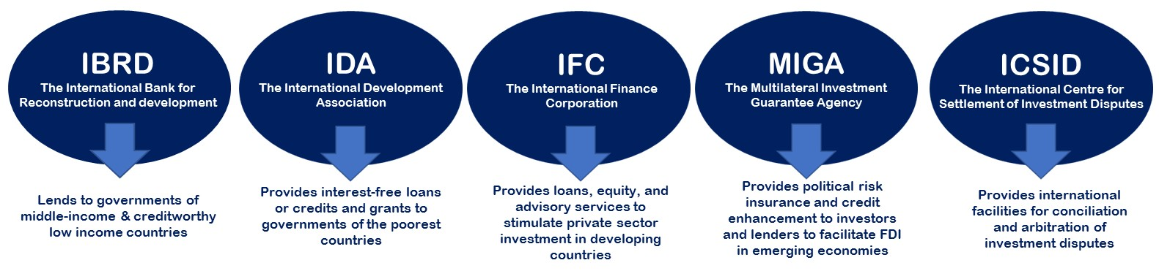
Introduction to the World Bank Group
Two goals to achieve by 2030:
End extreme poverty by decreasing the percentage of people living on less than $1.90 a day to no more than 3%
Promote shared prosperity by fostering the income growth of the bottom 40%
Public Sector (“The World Bank”)
Private Sector

Slide 3



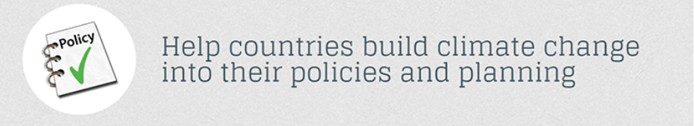
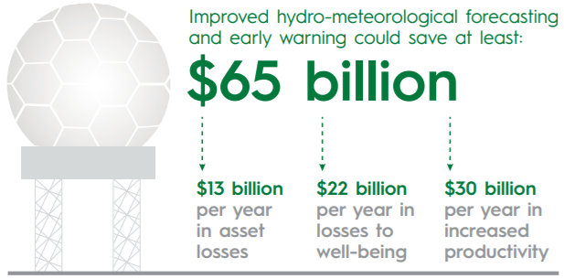
Our Interest in Hydrological Services
Climate Change Action Plan 2016-2020

Slide 4
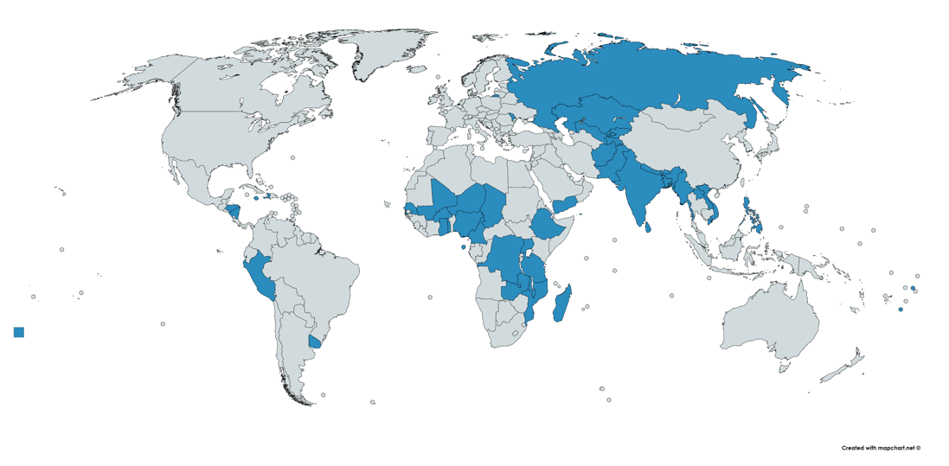
Growth in Investment
Significant growth since 2010 (WCC-3 in 2009)
Tripling of World Bank investments
Green Climate Fund (GCF) also increasing investment
Hot spots: West Africa and South Asia
Estimate that $500 million of investment per year is needed for modernizing public NMHSs
Investment is growing but still insufficient
2010
25 projects
US$ 270 million
2017
67 projects
US$ 870 million

Slide 5
NHSs Face Significant Challenges
Fragmented and myopic policy environments;
Insufficient budgets;
Inability to attract, train, and retain qualified staff;
Limited and often declining hydrometeorological monitoring networks;
Insufficient maintenance of hydrological infrastructure;
Inadequate data management systems;
Insufficient integration between hydrological and meteorological services;
Poor connection with users;
Inability to develop and provide hydrological products; and
Unsatisfactory service delivery.
Source: World Bank & GFDRR (2018) - Assessment of the State of Hydrological Services in Developing Countries

Slide 6
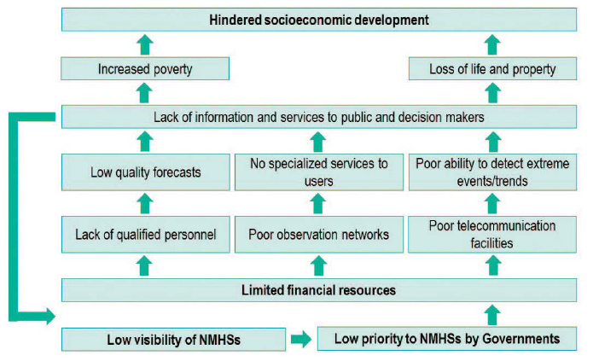
NHS “Poverty Trap”
Source: World Bank & GFDRR (2018) - Assessment of the State of Hydrological Services in Developing Countries

Slide 7
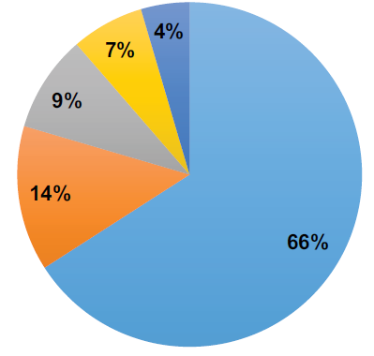
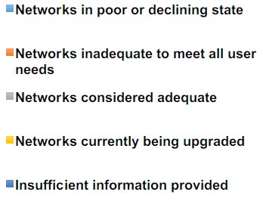
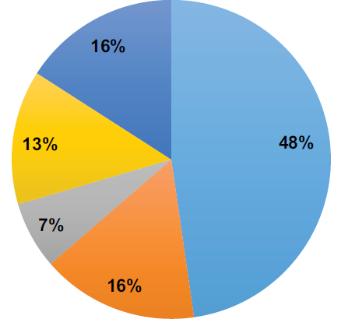
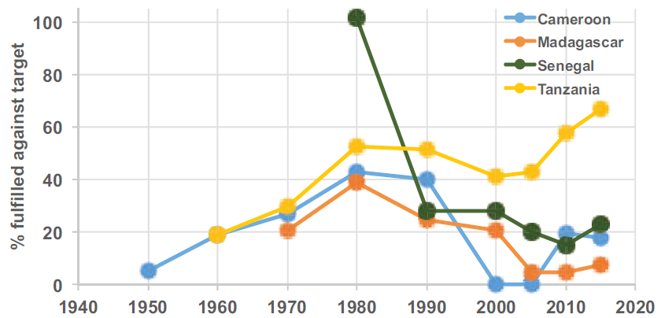
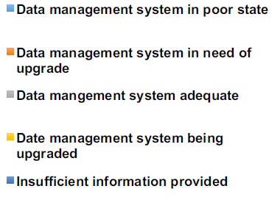
Observation Systems in Decline
Source: World Bank & GFDRR (2018) - Assessment of the State of Hydrological Services in Developing Countries

Slide 8
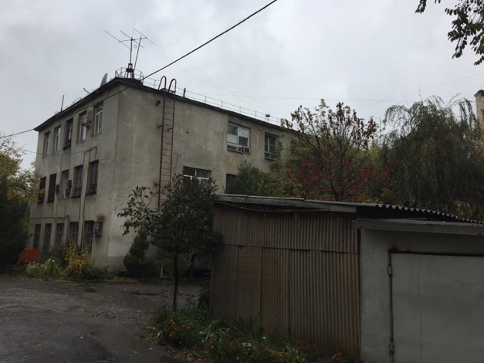
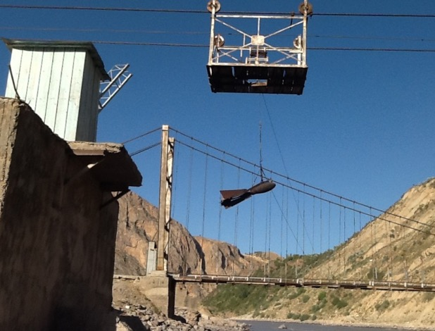
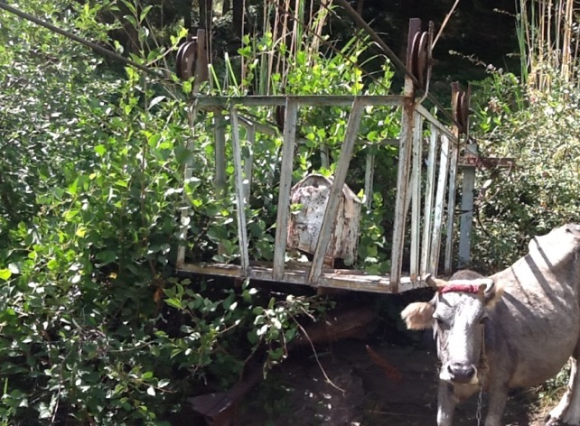
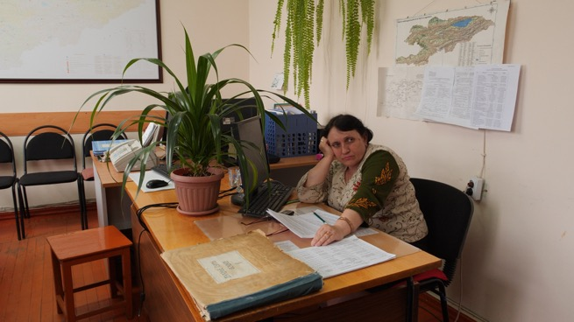
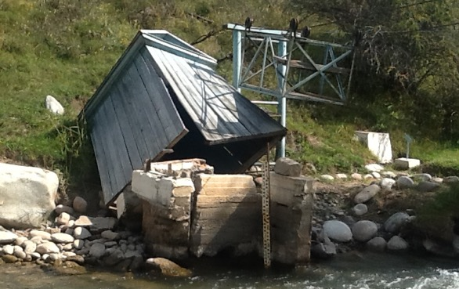
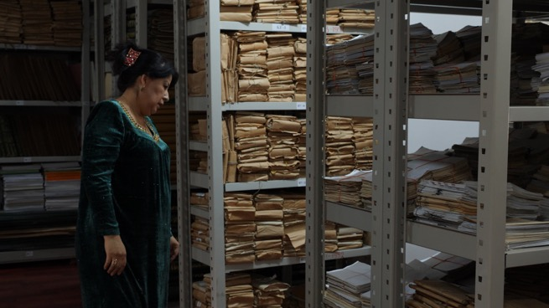
Perspectives from the Field

Slide 9

Investment Approach
Modernization investment must be substantial to achieve transformation.
Users
Service Delivery
Institutional Strengthening
Modernization of Infrastructure

Slide 10
Investment Policy Lessons
Modernization of NHSs is high value, delivering a broad range of benefits, however often it is not easy to demonstrate this to governments.
Building infrastructure is less challenging than building institutions, strengthening capacity and sustaining them.
Long-term engagement (10 years+) is needed.
Invest in capacity and service delivery orientation, from management to technical (“change in mindset”…which often requires a generation).
Long-term resourcing of O&M is always a challenge, undermining sustainability.
Designing and implementing a sustainable integrated NMHS-wide system is difficult.
Modernization of separate elements may bring improvements but can create bottlenecks or inefficiencies.
There are internal disincentives for good projects.
Source: World Bank & GFDRR (2018) - Assessment of the State of Hydrological Services in Developing Countries

Slide 11
Investment Project Lessons
Need strong and visionary NHS leadership.
Strong user interface leads to better and more sustainable services.
Prioritize public services – open data approach best.
Consider sensitivities, challenges and opportunities of public-private partnership.
Approach fee-based services with great caution.
Leverage international and regional systems.
Leverage and coordinate international and domestic partners.
Everyone talks about the weather, floods and disasters, this does not mean they are hydromet experts: operational verses “soft” and/or siloed expertise.
Innovation verses reliability, scale and sustainability.
Procurement is challenging – getting the right stuff to do the right thing for the right people at the right cost.
Source: World Bank & GFDRR (2018) - Assessment of the State of Hydrological Services in Developing Countries

Slide 12





Supporting Initiatives
Global Weather Enterprise (GWE)
Engagement between public, private and academic sectors and not a legal entity
The goal is to provide accurate and reliable weather information and services that save lives, protect infrastructure and enhance economic output.
The GWE is fully aligned with the requirements of the universally-agreed Sustainable Development Goals of the UN 2030 Agenda for Sustainable Development.
Alliance for Hydromet Development
Collective commitment and framework for scaled-up, coordinated, sustained, and more impactful action, aiming at improving capacity, collaboration, relevance, innovation, sustainability and accountability.
Tender Specifications
Improving the quality of hydromet equipment procurement through user-friendly WMO-compliant guidance and templates.

Slide 13
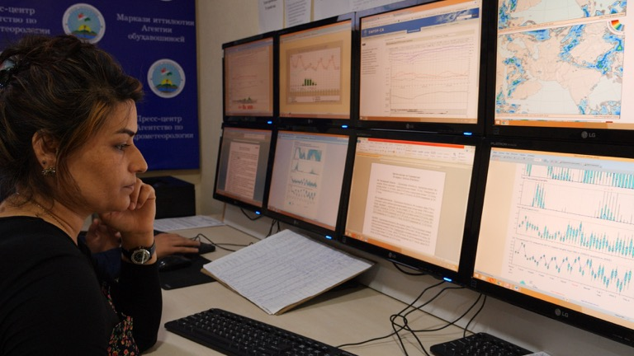
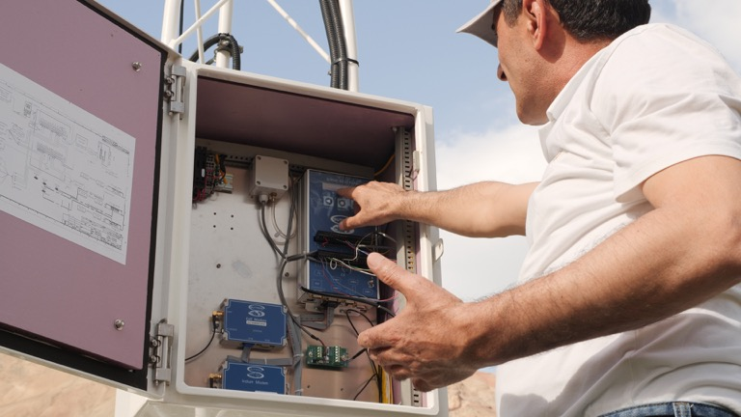
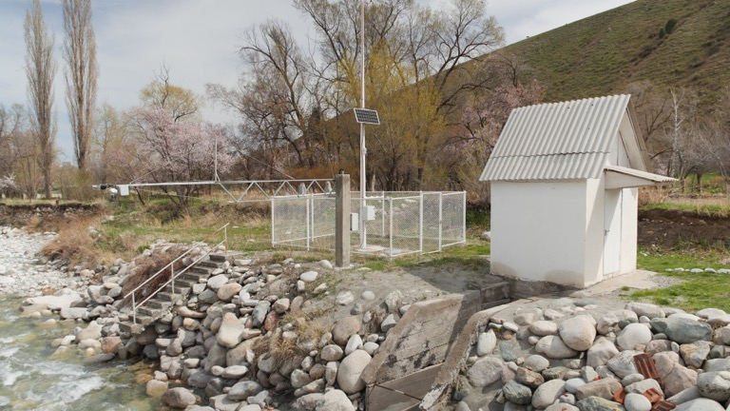
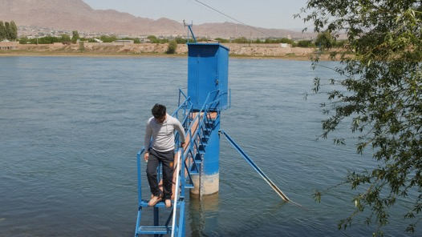
Thank You

