Slide 1

Drin Information Management System
GEF Project “Enabling Transboundary Cooperation and Integrated Water Resources Management in the Extended Drin River Basin”

Slide 2
GEF Project “Enabling Transboundary Cooperation and Integrated Water Resources Management in the Extended Drin River Basin”
UNECE has been promoting transboundary water cooperation in the Drin River basin since 2008.
Drin Dialogue 2009-2011 – multi-stakeholder consultation process supported by GWP-Med and UNECE
The signature of the MoU IN 2011 by the Riparians on a Shared Strategic Vision for the Sustainable Management of the Drin River Basin
The GEF project will support the further development of cooperation in the Drin Basin and the achievement of the objectives of the Drin MoU
A Drin Basin Water Monitoring Program, which will be established under the project is compatible with the UNECE Guidelines on Monitoring and Assessment of Transboundary Rivers and the Shared Environmental Information System

Slide 3
Technical Support for Development of Information Management System (IMS)
Sustainable development in the Drin basin identified in the Drin MoU:
The need for “improving access to comprehensive data and adequate information to fully understand the current state of the environment and water resources and the hydrological system (including surface and coastal waters) as well as ecosystems of the Drin Basin” (Drin MoU Article 3i).
Priority actions:
“improvement of information exchange through the establishment of a system for regular exchange of relevant information among competent authorities of each party” (Drin MoU Article 4: c).

Slide 4


Drin IMS Aims
Establish:
Repository of data collected and produced through Transboundary Diagnostic Analysis (TDA)
Platform to enable joint data collection, storage and exchange, including GIS functions (as per Drin MoU and Drin project)

Slide 5
Expert Working group on Monitoring and Information Exchange
Facilitate information and data exchange through establishment of IMS among the competent authorities on the state of environment; water resources; and hydrologic system (including surface, underground and coastal waters)
Decide on the set of data and information to be collected and exchanged (EWG agreed with the list of priority datasets (hydrological, meteorological, pollution and water level)
Form of the information and data for exchange to be used
Reporting format
Frequency of exchange
Institutions and authorities in each Party to be involved

Slide 6
Tasks completed
Task 2. Determine IMS thematic datasets and set of standards for exchanging basin and water management data
List and specifications of IMS themes, data-sets objects and layers
The feature catalogue
IMS data model
Standards to be used within IMS
IMS data exchange protocols
Task 3: Development of the IMS Architecture
Specifications of the IMS
Draft proposal regarding the architecture of the IMS
Design the system architecture
Task 1. Analysis of the “present state” and definition of “desired state” for basin and water data management in each of the beneficiary Riparians
Detailed analysis report regarding current state and desired state
Task 5: Develop ToR for the development of the IMS
Terms of reference for the phased development of the IMS (work/service/supply)
Task 4: Develop the IMS Implementation plan
Implementation plan for the development of the IMS
Report from the Implementation plan meeting(s) with the beneficiary Riparians

Slide 7
Gaps in data / information exchange
Continuous data acquisition and regular update, sufficient data quality control, data verification and validation is not in place, matter of routine and performed to the prescribed extent and frequency.
Hydrological monitoring is not available for all catchments, wetlands and floodplains
Quality of hydrological monitoring data is often hindered by a number of factors including fragmentation of data.
Water quantity and quality and other important hydrological data are needed especially for the calibration of hydrological models.

Slide 8
On-going developments
Agreement on the exchange of priority datasets
hydrological, meteorological, pollution and water level – Drin Core Group
Finalization of thematic reports
Hydrology
Pollution
Institutional and legal setting
Biodiversity and ecosystems
Water-Food-Energy-Ecosystems Nexus
Socio-economics (completed)
Terms of Reference for Development of the Drin IMS

Slide 9
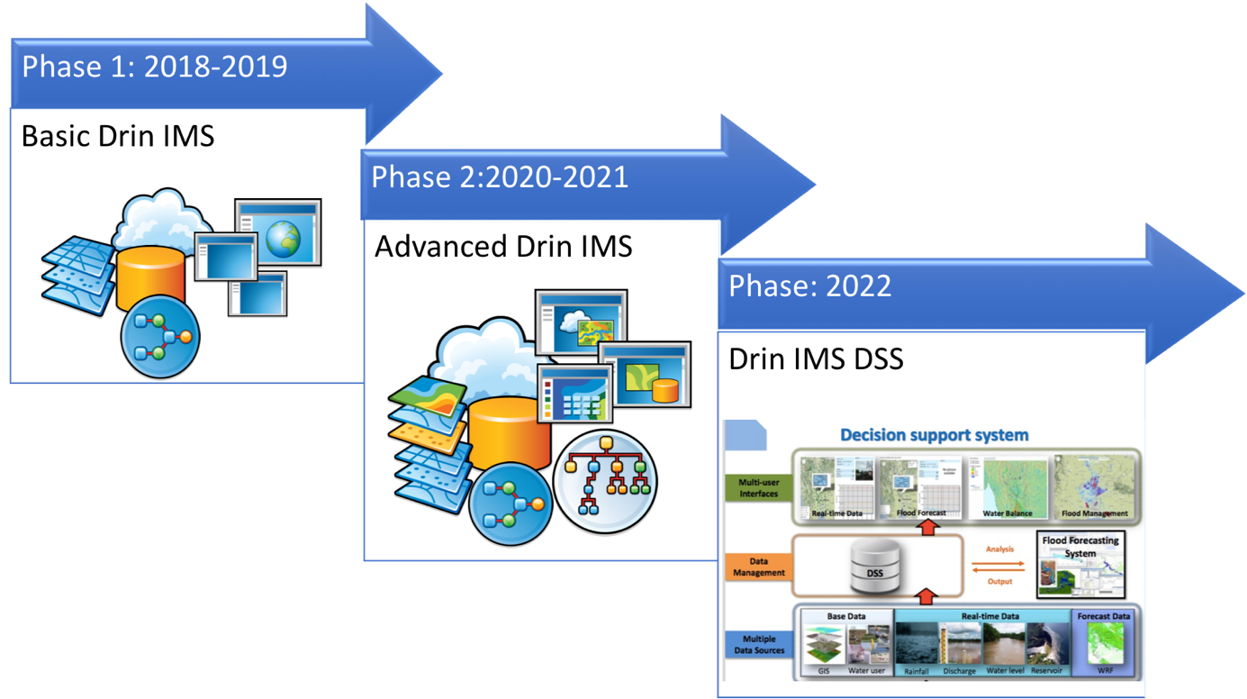

Slide 10
2018 – 2019
Drin Geodatabase developed and populated with all collected data;
Application modules, tools and geoportal for data processing, analysis and dissemination designed, developed, tested and deployed in operational (Drin IMS production) environment;
Information services for data exchange and metadata flow are established;
Users trained to use and administrate of Drin Geodatabase and Geoportal;
Technical and user documentation prepared and delivered.

