Slide 1
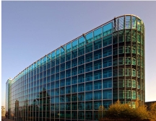
Groundwater Information Network Groundwater Geoscience Program
Ninth Hydrology DWG Workshop
Geneva, Switzerland
Eric Boisvert & Boyan Brodaric
18 September 2018

Slide 2
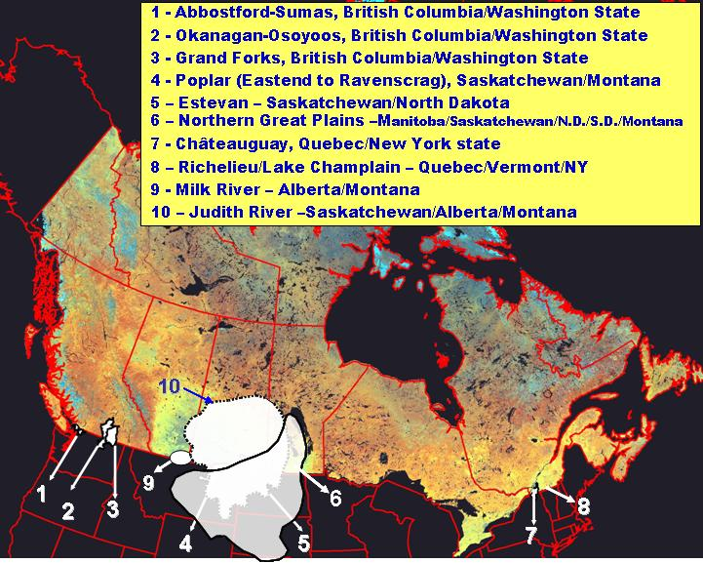
Groundwater in Canada
~25% of Canadians rely on groundwater
population > 20M affected near border
gaps in data for key aquifers
(Rivera, 2009)

Slide 3
GW data in Canada
Distributed, Uncoordinated data
Feds (< 10), provs & terrs (<50), municipalities (100s?), watershed authorities (100s?), academics (?)
Heterogeneous data
Data use, content, structure, systems (databases, sensors)
Variable Volume
Use (e.g. extraction, vulnerability): ?
Budgets (e.g. regional recharge): 100s?
Reservoirs (e.g. aquifers): 100s – 1000s
Observations (e.g. wells, monitoring): 1Ms – 10Ms – 1Bs?
Variable Quality
Completeness, consistency, methods, positioning

Slide 4
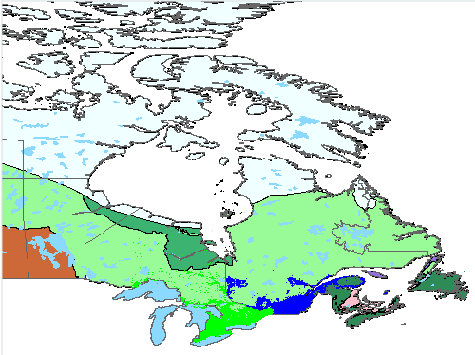
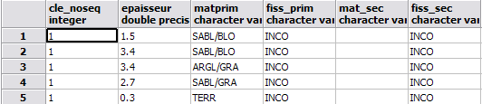
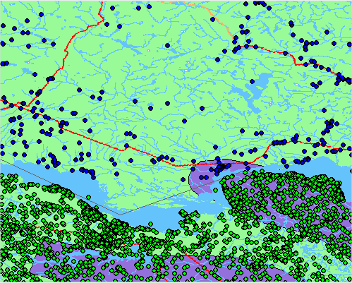
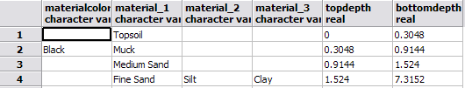
GW data in Canada: heterogeneity
Ontario & Quebec
syntactic, schematic, semantic heterogeneity in water-well data
Quebec rock type
Ontario rock type

Slide 5
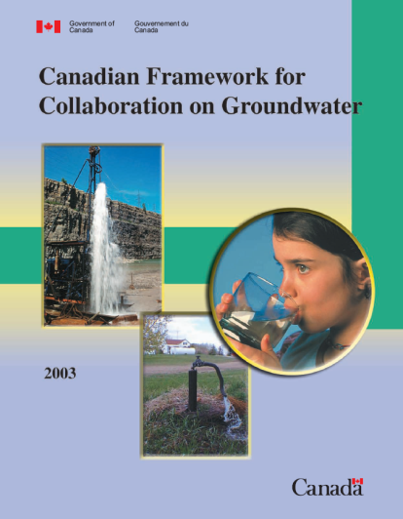
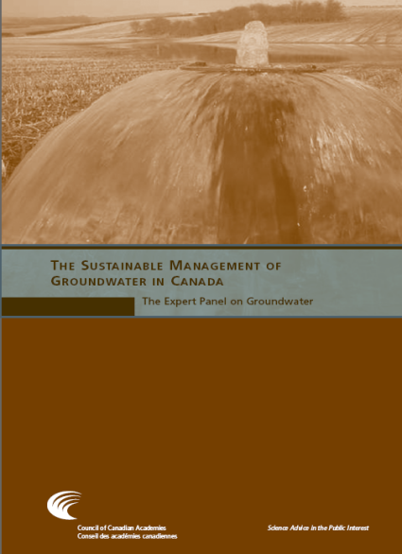
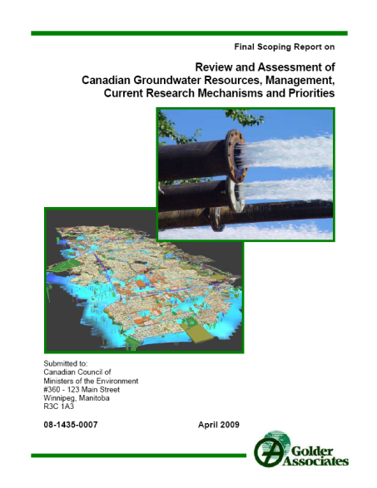
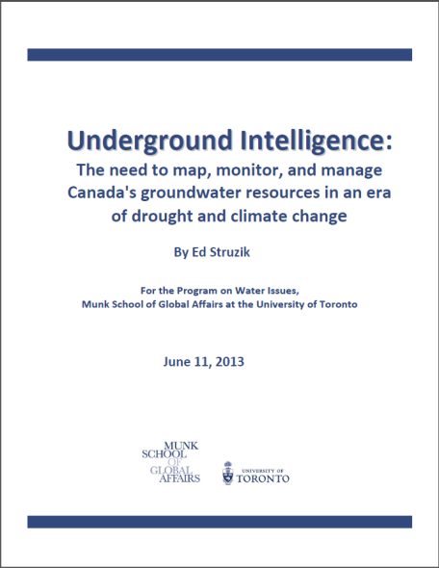
2003-2013: Recommendations
Findings
Data is hard to find & use
Data gaps & poor quality
Recommendations
More online access
Consolidate data
More data (use, monitoring)
Better data quality

Slide 6
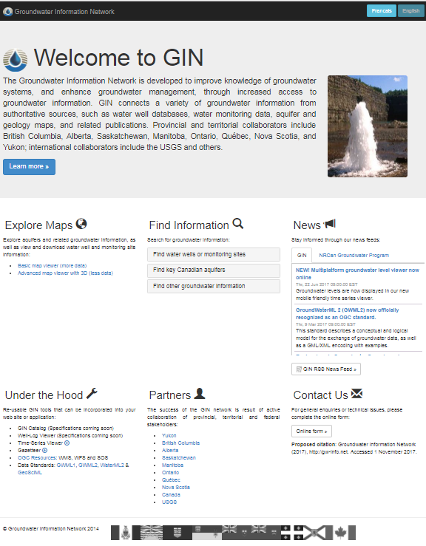
GIN
Groundwater Information Network
Fed-prov-terr-int’l collaboration to disseminate groundwater data online, through the use of international standards and leading geospatial methods, aligned with GOC Open Data and Open Science initiatives.

Slide 7
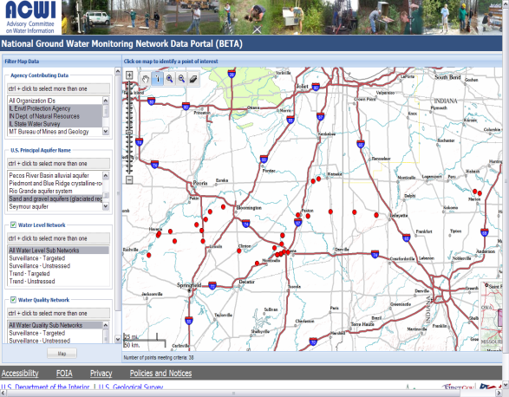
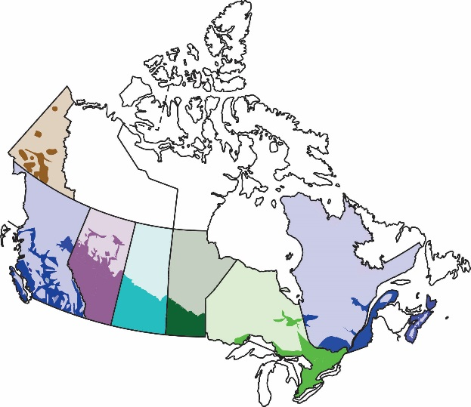
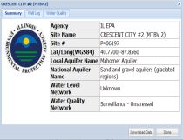
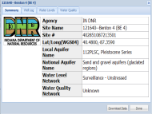
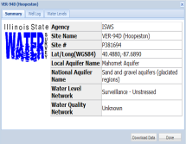
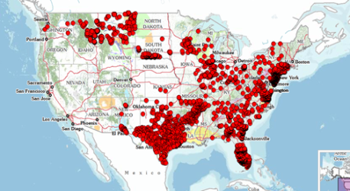
Emerging Spatial Data Infrastructures
Canadian Groundwater Information Network
US National Groundwater Monitoring Network
Approach
Network-hybrid: part cache
Standards: OGC, WMO
Distributed: many sources
Seamless: transparent
Multi-access: many portals
Multi-data: wells, aquifers, monitoring, geology maps
= interoperability within and
between nat’l data networks

Slide 8
Solutions: central vs distributed
Central Database
GIN
Hybrid
standards
Spatial Data Infrastructure

Slide 9
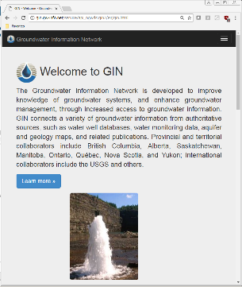
Spatial Data Infrastructures
Network solution
WMS, WFS, SOS
Web Service / API
GWML2
WaterML2
Web Service / API
Bi-directional mediation (queries and responses)
Standards
GW Database
GW Database

Slide 10
Spatial Data Infrastructures
Reengineered GIN
Addresses technical issues of original design
Performance
Complexity
Data provider preferences
Better support for multiple APIs
GWML2
WaterML2
(WFS, SOS)
Cache
Web Service / API
Web Service / API
Unidirectional mediation
Periodic update from heterogenous sources
GW Database
GW Database

Slide 11
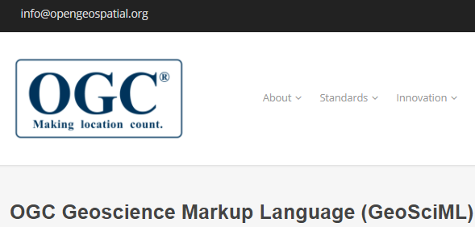
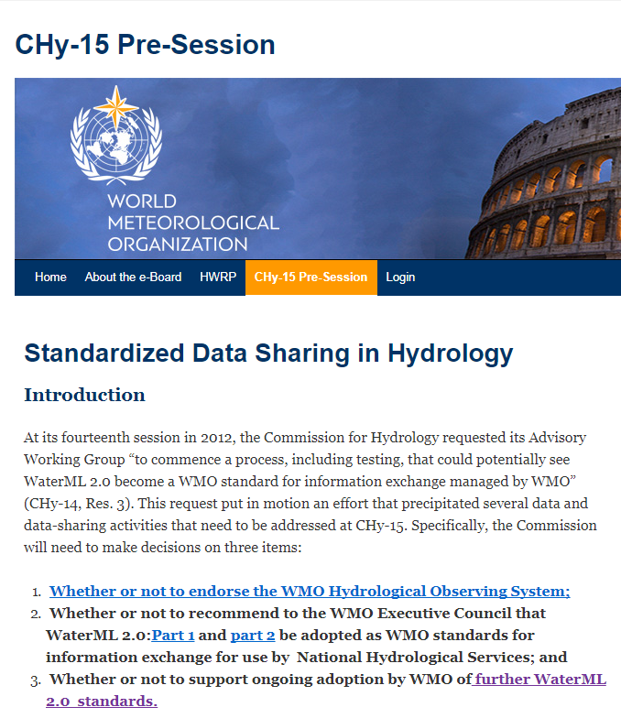
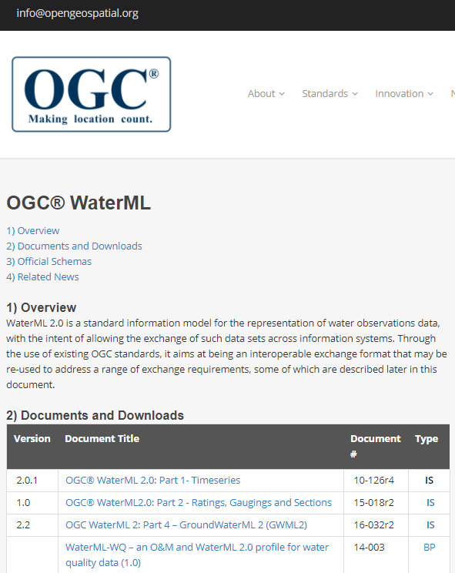

Data standards
GroundWaterML2

Slide 12
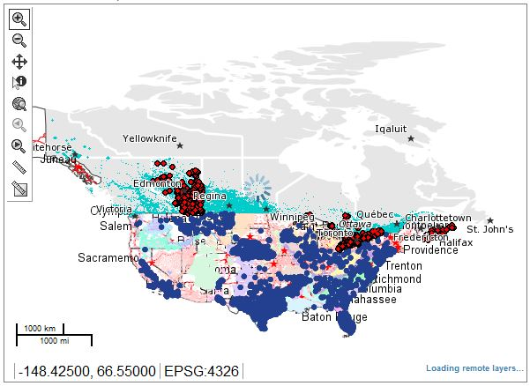
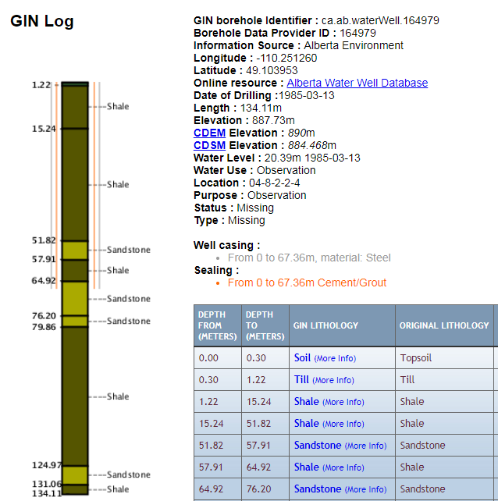
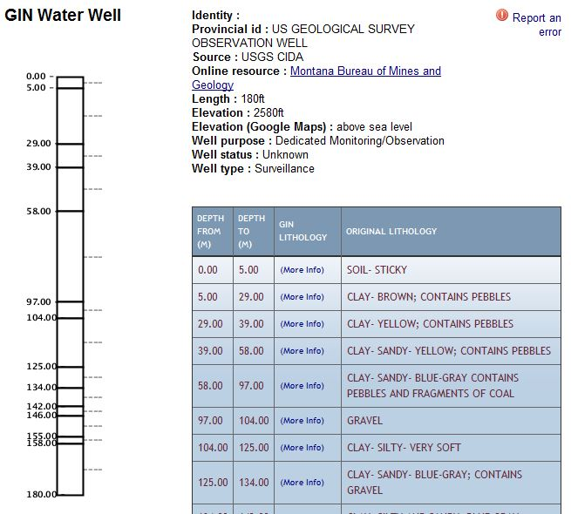
GW Interoperability: wells
CAN: water wells (9 provinces)
USA: water wells (USGS, 50+ states)

Slide 13
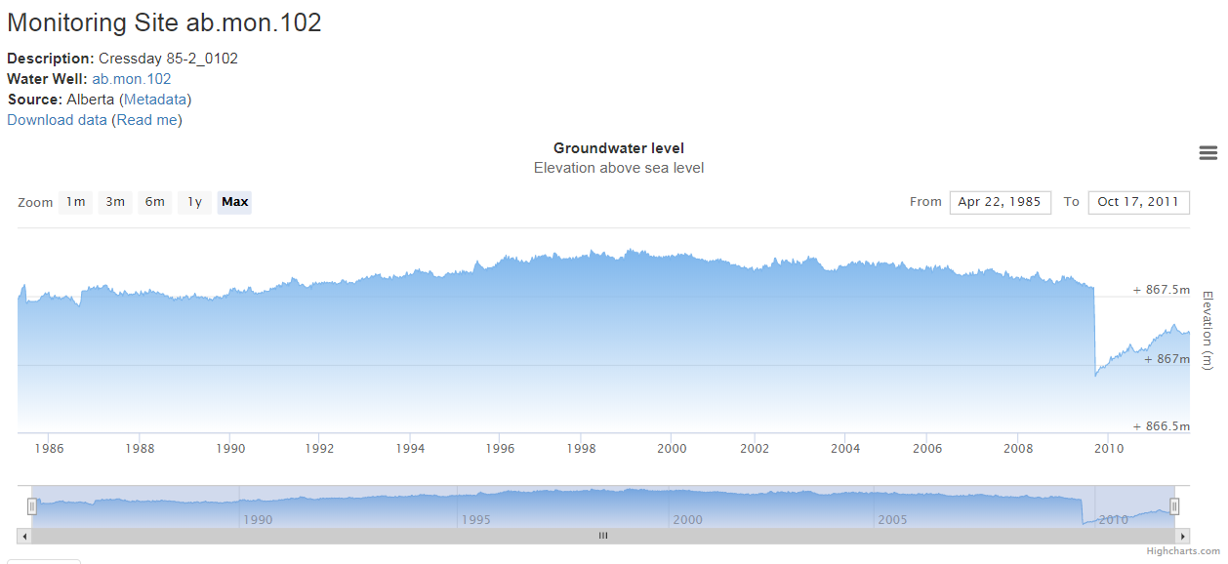
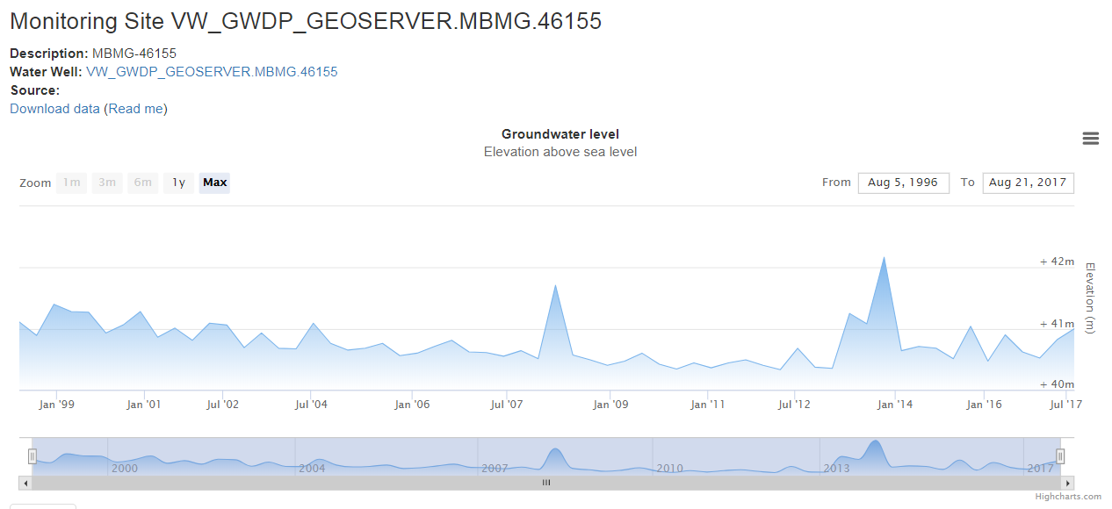
GW Interoperability: monitoring data
CAN: groundwater level (5 provinces)
USA: groundwater level & quality (USGS, 50+ states)

Slide 14
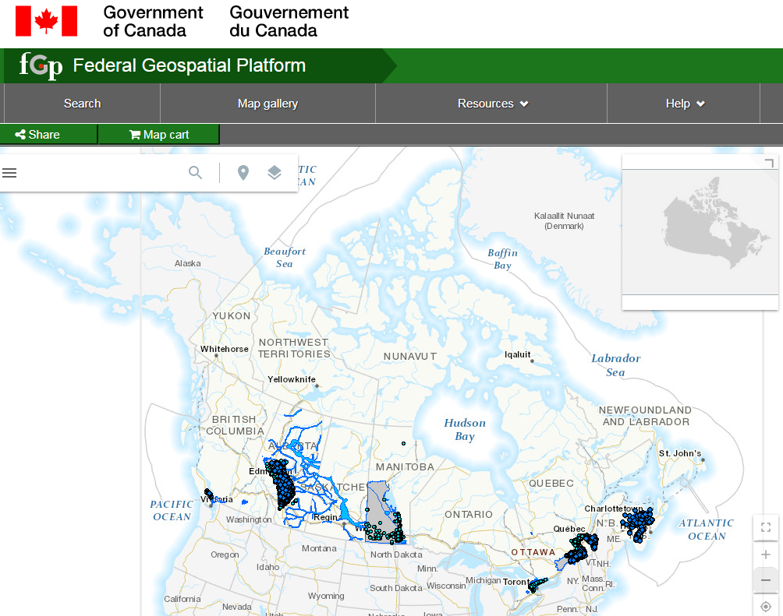
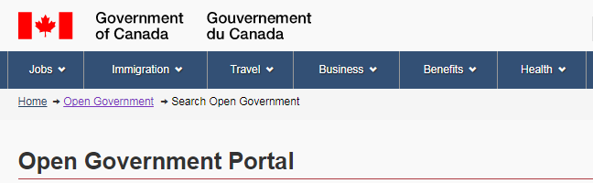
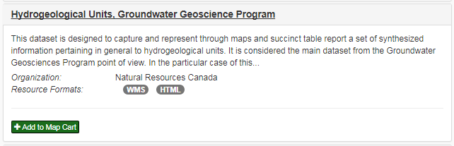
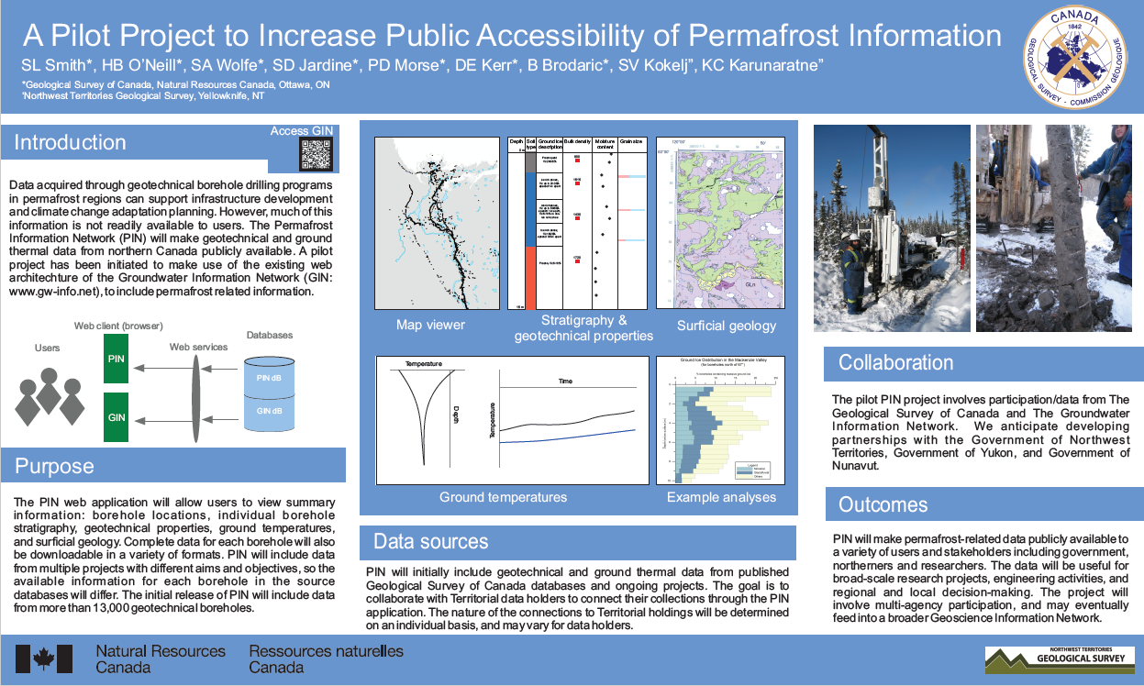
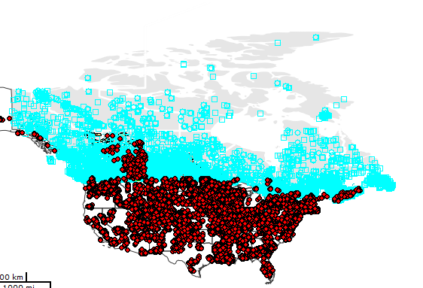
Interoperability: other, national
FGP (Federal Geospatial Platform)
Open GOC Portal
PIN (Permafrost Info Network - CCGP)
surface water: hydrometric network
…coming soon

Slide 15



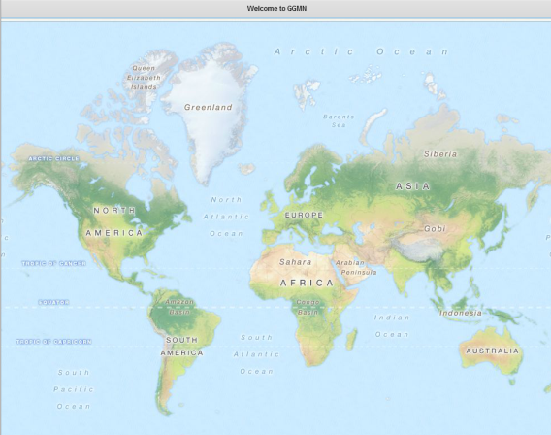
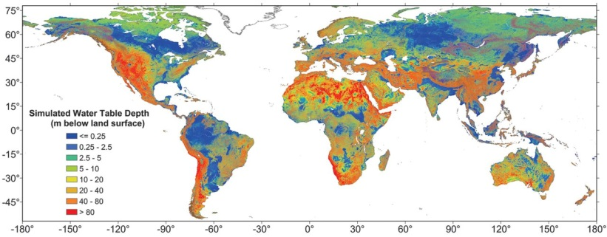
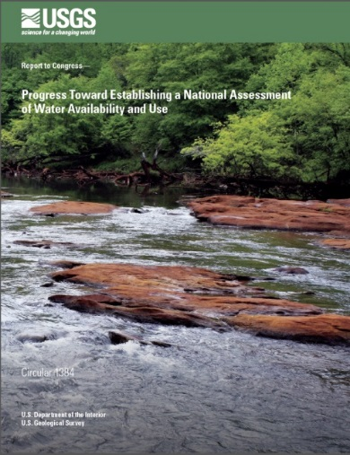
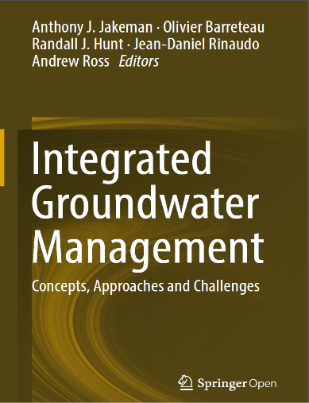
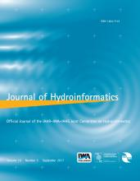
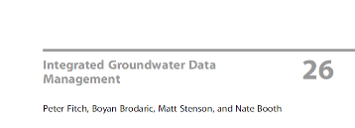

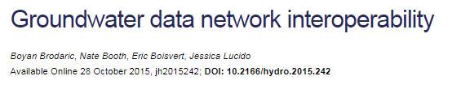
Applications: international
global groundwater modeling
global groundwater monitoring
national water accounting
interoperability: international
…coming soon

Slide 16
Challenge: full water cycle support
“…effective land and water management requires a clear understanding of the linkages between ground water and surface water as it applies to any given hydrologic setting.”
Robert M. Hirsch, Chief Hydrologist, USGS From USGS Circular 1139

Slide 17
Final Thoughts
Canadian national Groundwater Info Network is operational and thriving
Spatial Data Infrastructure + Linked Data technologies
“Open Data” and “Open Science” foundations
Toward a North American groundwater data network
Best practice candidate for geoscience data management and distribution

Slide 18

Thank you – Merci GIN: CAN Groundwater Information Network
Groundwater Geoscience Program
http://gw-info.net
GIN Team Eric Boisvert
Boyan Brodaric (Lead)
Héryk Julien
Francois Létourneau
Charles Logan
Alex Smirnoff
Notable Contributors Yves Michaud
Christine Rivard
Alfonso Rivera
Hazen Russell
David Sharpe
GGP project leaders (past, present)

