Slide 1

Linked Data: Google-like connection and discovery of hydrological data on the web
Boyan Brodaric, Eric Boisvert, Marie-Eve Martin, Mark Sondheim & Mike Major
Natural Resources Canada

Slide 2
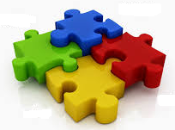

Toward a National Hydro Data Infrastructure
connect, find, retrieve any data for CAN hydro features
streams
watersheds
gauges
models
aquifers wells

Slide 3
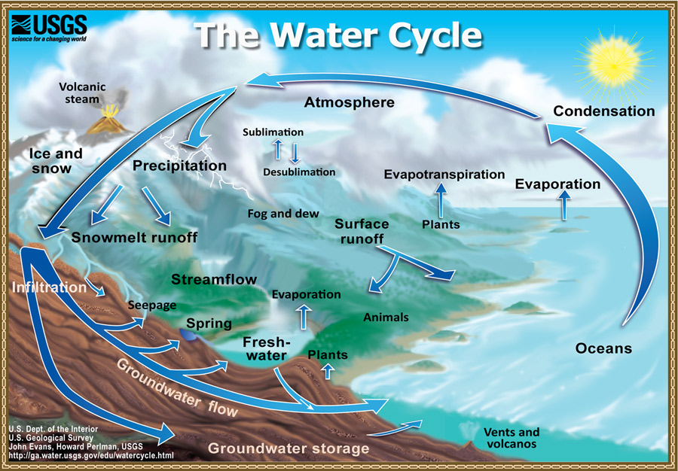
Motivation
Integrated resource management → integrated data

Slide 4
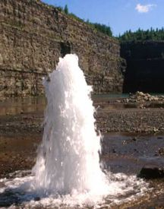
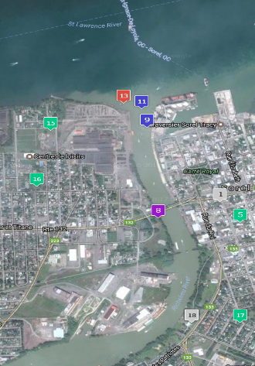
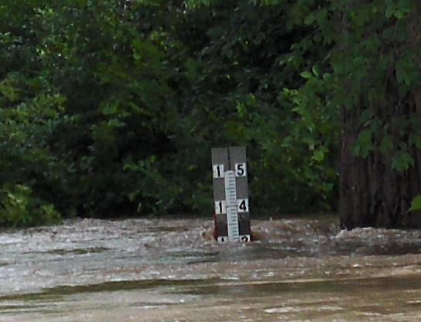
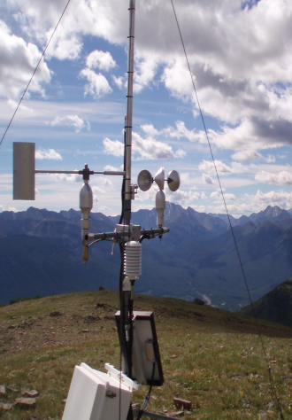
Problem
Surface, subsurface, atmospheric hydro data silos
SDI
SDI
SDI
SDI
geonames.org
geonames.org
LD
LD
LD
http://www.summitpost.org/environment-canada-weather-station/349643
groundwater
aquifers, wells, gauges…
GW Info Network
(www.gw-info.net)
surface water
rivers, lakes, watersheds,…
Nat’l Hydro Network
(www.geobase.ca)
surface water
gauges,…
Nat’l Hydrometric Network
(www.wateroffice.ec.gc.ca)
atmospheric water
gauges,…
Climate data
(www.http://climate.weather.gc.ca)

Slide 5

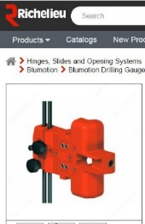
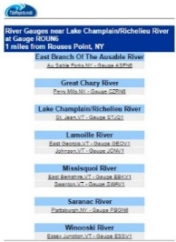
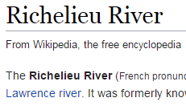
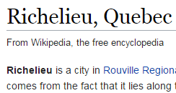
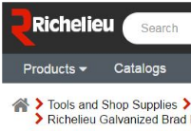
The Web
“gauges on the Richelieu”
HTML
gauges
hyperlink
HTML
Richelieu
?? on, beside, near ??
river
city
company
nails
drilling
river gauge

Slide 6
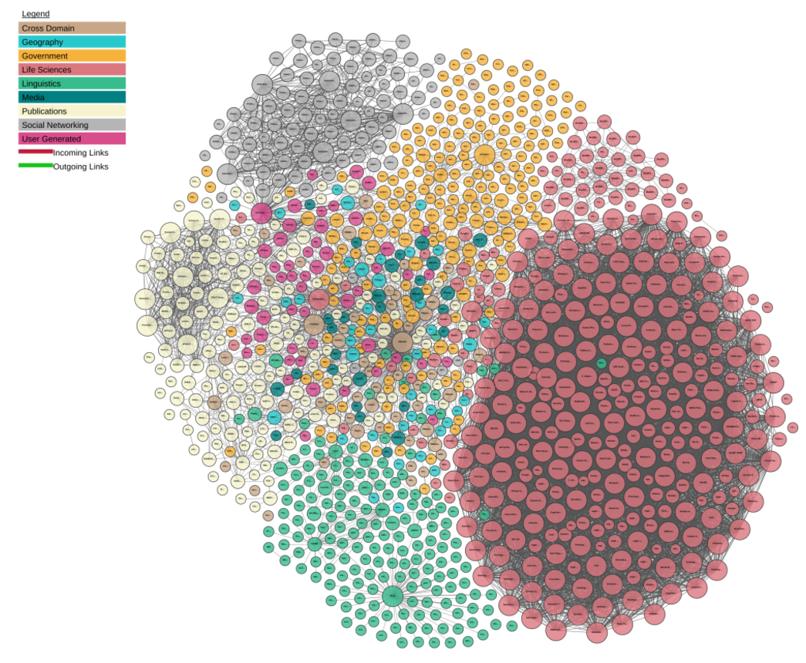
Emerging Trend
Semantic Web – Linked Data
the web is the database
Linking Open Data cloud diagram 2017, by Andrejs Abele, John P. McCrae, Paul Buitelaar, Anja Jentzsch and Richard Cyganiak. http://lod-cloud.net/

Slide 7
The Semantic Web
links things, types, pages
HTML
STJQ7
hyperlink
HTML
Richelieu River
pages
(representations)
things
(features, datasets)
STJQ7
on
Richelieu River
ontologies
types
(e.g. feature types)
River Gauge
on
Water Body

Slide 8
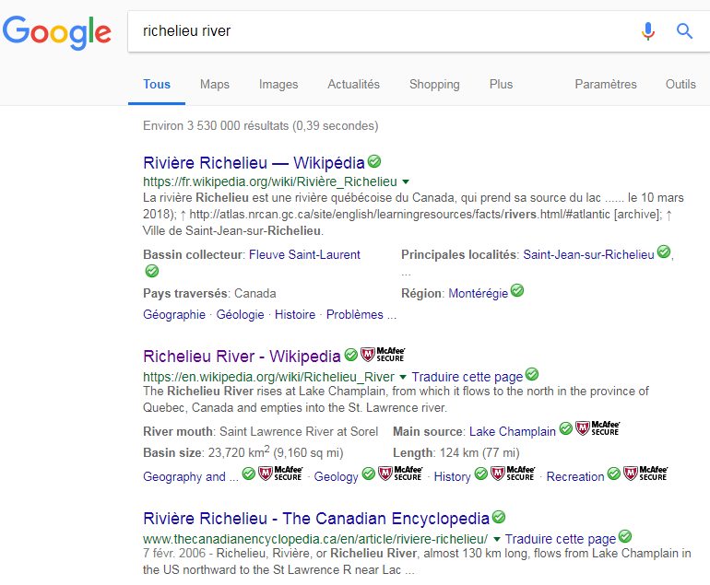
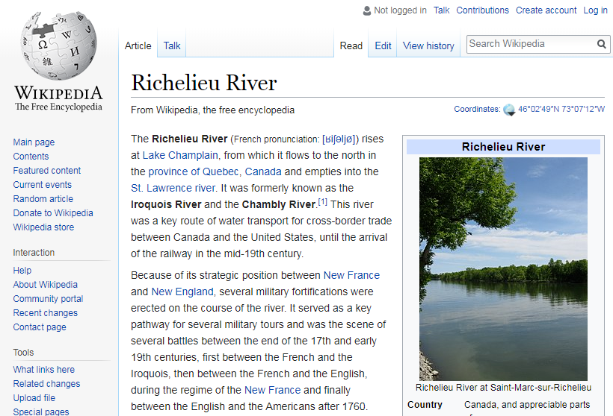
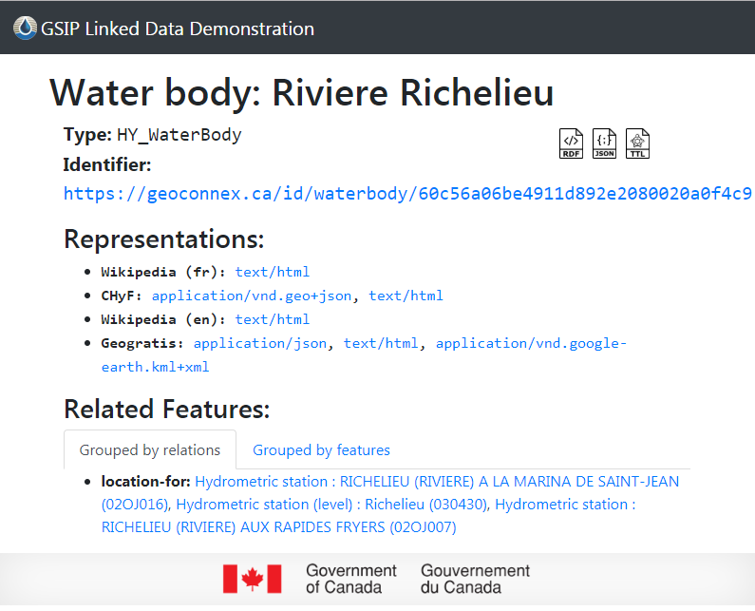
Linked Data Example
Water body: Riviere Richelieu
https://geoconnex.ca/id/waterbody/60c56a06be4911d892e2080020a0f4c9

Slide 9
Benefits
SDI
LD
Discover
Web Portal / Catalog
e.g. GIN
Search Engine
e.g. Google
Connect
Disconnected
wells / gauges / rivers
Connected
e.g. wells upstream of gauge on river
Access
Datasets
e.g. GIS layers
Features
e.g. aquifers, wells, rivers, gauges
Use
Expert
Non-expert
Maintain
Closed World
Open World

Slide 10
Benefits – connectivity
Link Aquisition
Current: manual
Future: (semi)automatic
aquifer overlaps catchment
aquifer overlaps waterbody
aquifer hydraulically-connects waterbody
aquifer contains water well
aquifer contains gw-station
aquifer [CAN] hydraulically-connects aquifer [US]
catchment contains water well
catchment contains hydrometric-station
catchment contains gw-station
waterbody [CAN] downstream-of waterbody [US]
hydrometric-station measures waterbody
hydrometric-station near waterbody
hydrometric-station downstream-of hydrometric-station
hydrometric-station downstream-of city

Slide 11



Architecture
URL Broker
https://geoconnex.ca/...
GML, HTML, JSON, RDF …
RDF
GML, HTML, JSON, RDF …
OGC / REST Web Service
SPARQL API
OGC / REST Web Service
Gauge Network
Link Db
Rep Db
Stream Network

Slide 12
Data Providers
how does one join?
Develop community URLs (ids) for things
to supplement, not replace, local URLs
2.
Provide web (service) access to things
web pages (html), others (xml, json)
3.
Develop links between things
add links to link Db

Slide 13
Federal Climate Science Plan project
Objectives:
Nat’l hydro infra:
make hydro data easier to find & use
Methods:
semantic web tools to boost connectivity, discovery, access
Deliverables:
LD proof-of-concept: CAN and CAN-US
Timelines:
CAN (2017) [Richelieu] CAN-US (2018)
Participants:
GSC, CCMEO, ECCC, IJC, USGS [NHN←→NHD]
Related Initiatives:
IJC CAN-US data harmony
Current Status:
team building (✓), architecture (in progress), links and data (in progress)

Slide 14
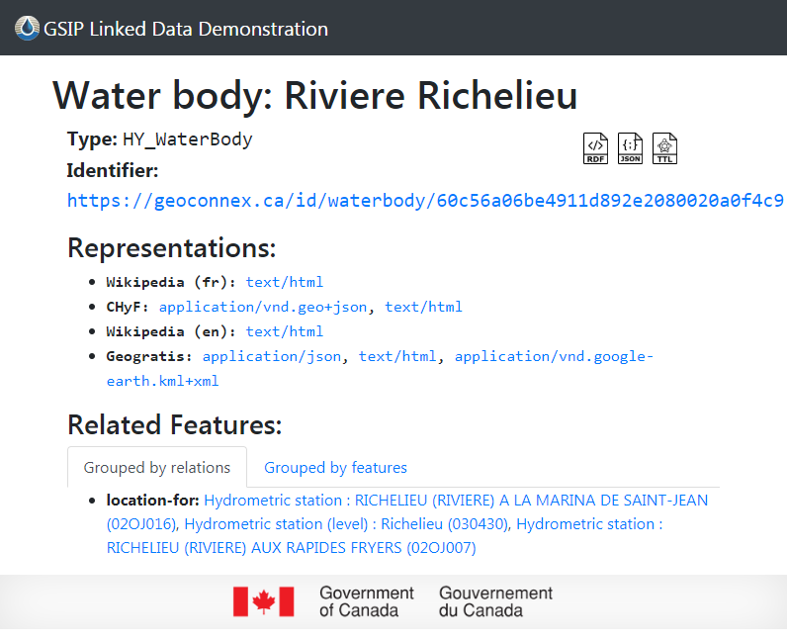
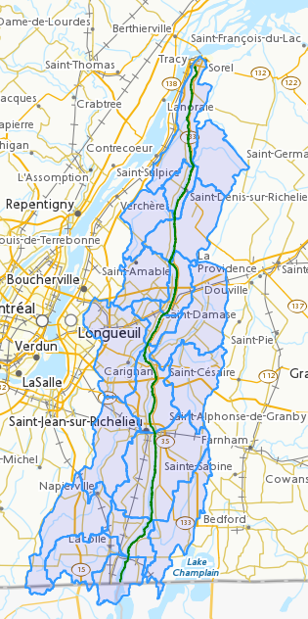
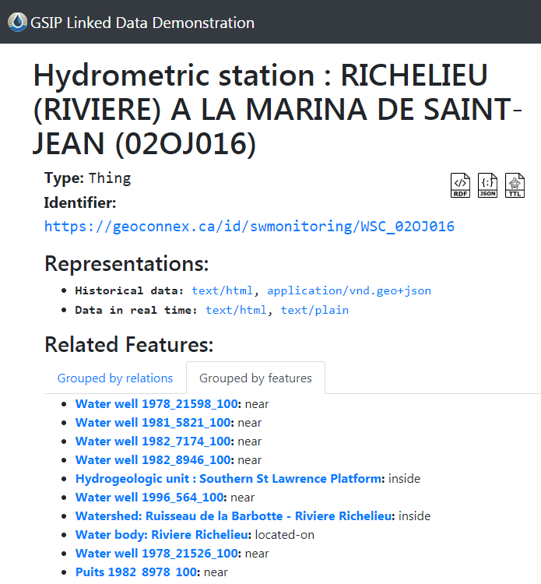
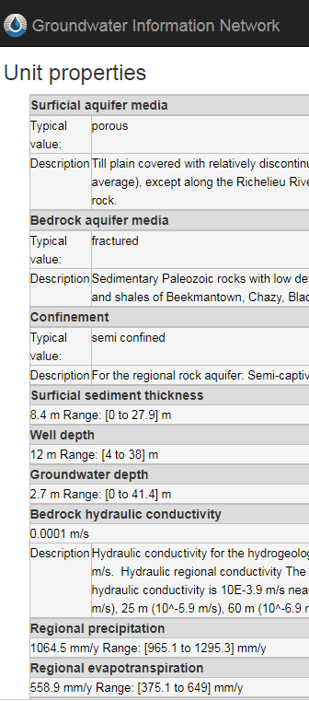
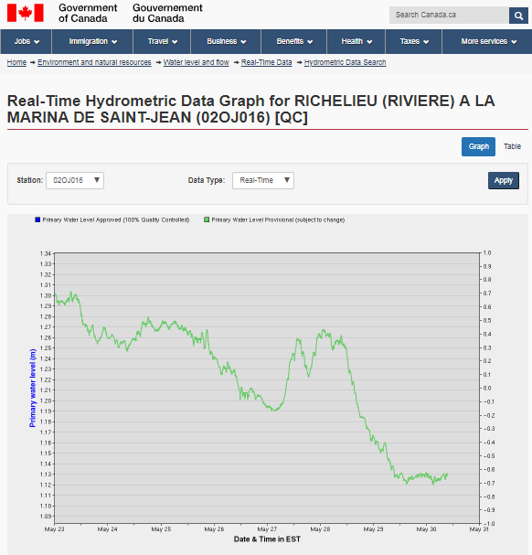
Example: gauges on Richelieu

Slide 15
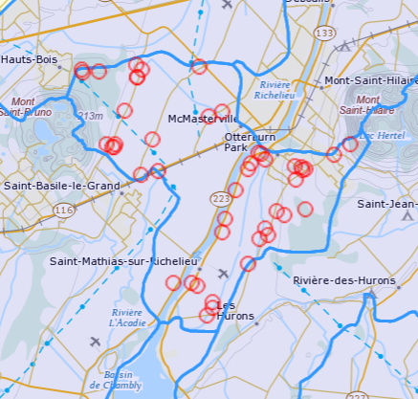
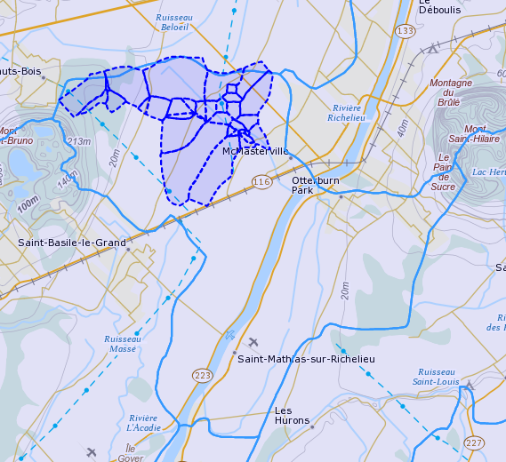
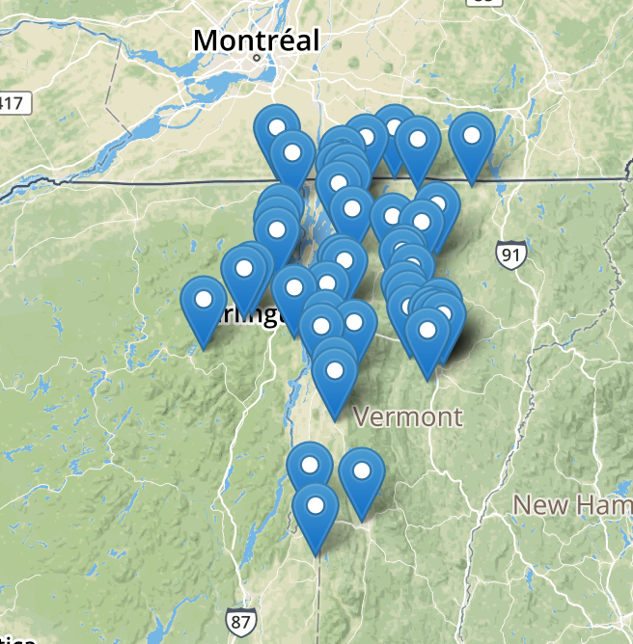
Example: integrated gw & sw
water wells inside watershed
watersheds downstream of well (near river)
gauges upstream on Richelieu (CAN-US)

Slide 16
Final thoughts
Progress re: prototype for CAN linked hydro data
Richelieu watershed
Toward a national infrastructure for hydro data
CAN-US expansion in-progress
Coordination with ongoing IJC activities
Demo: https://geoconnex.ca/gsip/app/index.html

Slide 17





Acknowledgements
Boyan Brodaric
Eric Boisvert
Heryk Julien
Alex Smirnoff
Mike Major
Mark Sondheim
Marie-Eve Martin
Denis Boutin
David Lagüe
Doug Stiff
Lingling Liu
Tom Kralidis
Dave Blodgett
Al Rea
Susan Buto
Wayne Jenkinson
Michael Liatta

Slide 18
Thank you!
Questions?

