Slide 1

Interoperability Directions
Rob Atkinson
(Metalinkage and OGC)

Slide 2
Overview
OGC and WMO Naming Authority and code registries
Publishing domain ontologies
(eg HY_Features) as linked data
Practical data sharing using linked data
profiles
HY_Features profiles

Slide 3
OGC Naming Authority
Manages identifiers in OGC scope
Many, many (many) independent activities
Inconsistency and impossibility to use those identifiers for any run-time actions
Common needs to define patterns
Terms
Specification components (requirements, “conformance classes”)
Ontologies
OGC takes responsibility for dereferencing identitfiers
But what to?
OGC Definitions Server

Slide 4
OGC Definitions Server
Linked Data
HTML view for browsers
Json view for web apps
RDF view for semantic apps
XML for web service integration
“Content-negotiation”
Web architecture best practice
Lower level APIs also available
SPARQL endpoint
REST (non-standard)

Slide 5
Linked Data (IMHO) is…
NOT! Converting data into RDF
(a new religion)
NOT! Web scale computable (Semantic Web)
Another religion
Forcing unambiguous identifiers
A way to link data and services using these identifiers
An “index” into heterogenous fit-for-purpose resources
XML, JSON, RDF
Different profiles for different communities

Slide 6
Content
Data organized into “ConceptSchemes”
SKOS standard baseline
Users can download a coherent subset – a “register”
Or access definition by definition
i.e. information space is modular
we are working through devolving and delegating governance to working groups
WG can make up their own rules once they have a base URI
RDF store can hold information from other namespaces
And we can hold richer data models:
Application Schema
Profile descriptions
Variable definitions
Etc.

Slide 7
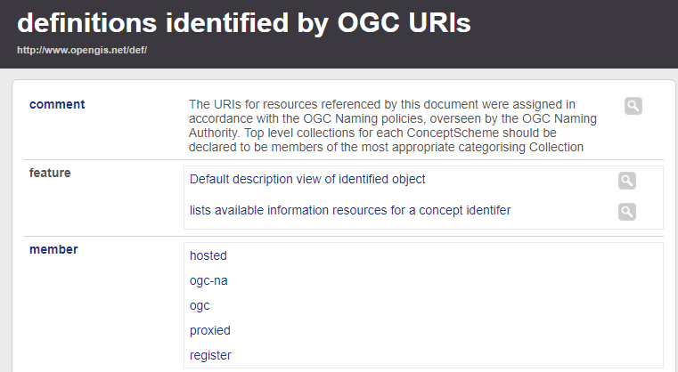
High level organisation

Slide 8
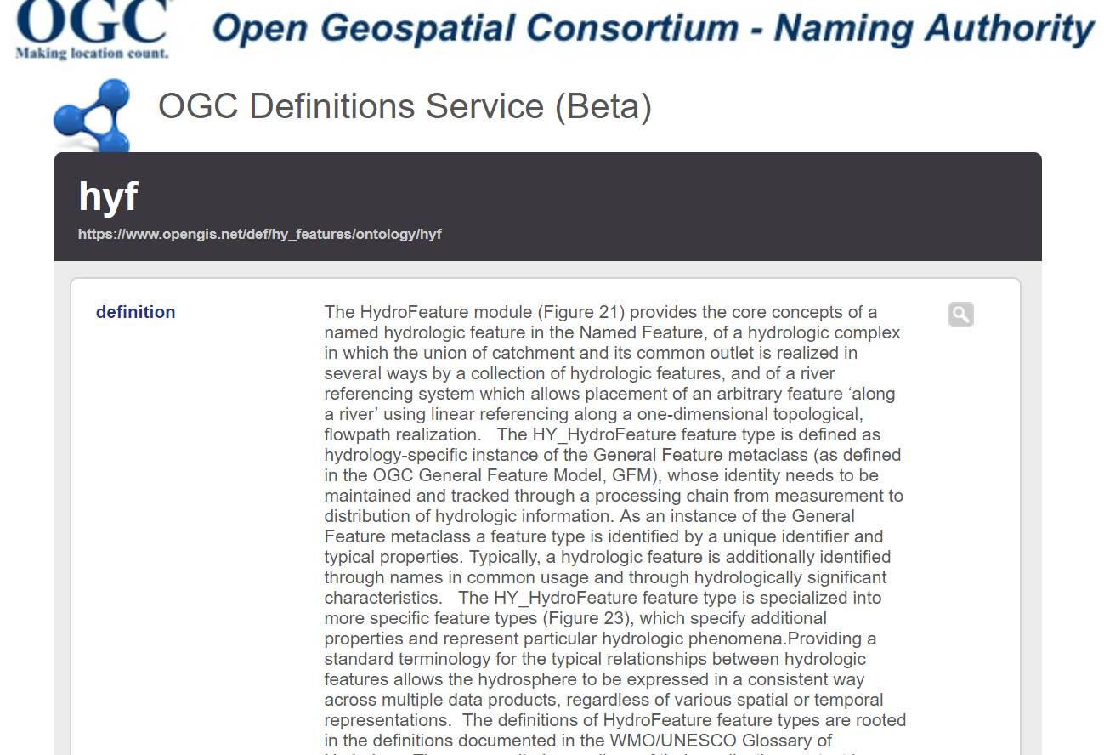

Slide 9
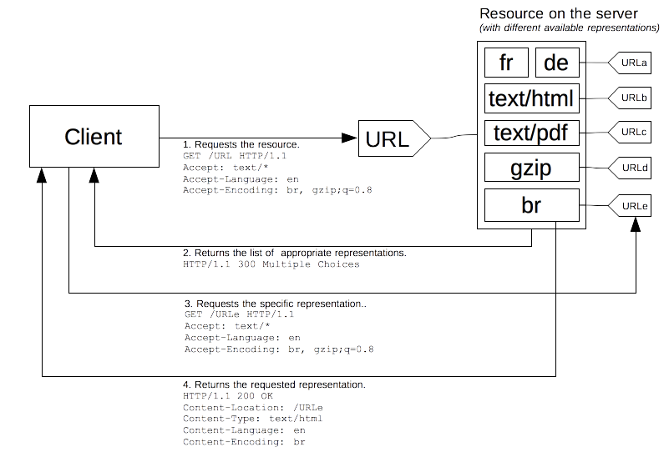
Content negotiation

Slide 10
OGC negotiation concerns
Profiles
Eg GML SF vs GML nested (profile)
Point vs polygon representation (geometry type)
Generalised outline vs detailed
DGGS refinement level (resolution)
Centroid vs property street address (geometry semantics)
CRS
… ?
Am working to make sure W3C does not preclude OGC specific negotiation domains in future

Slide 11
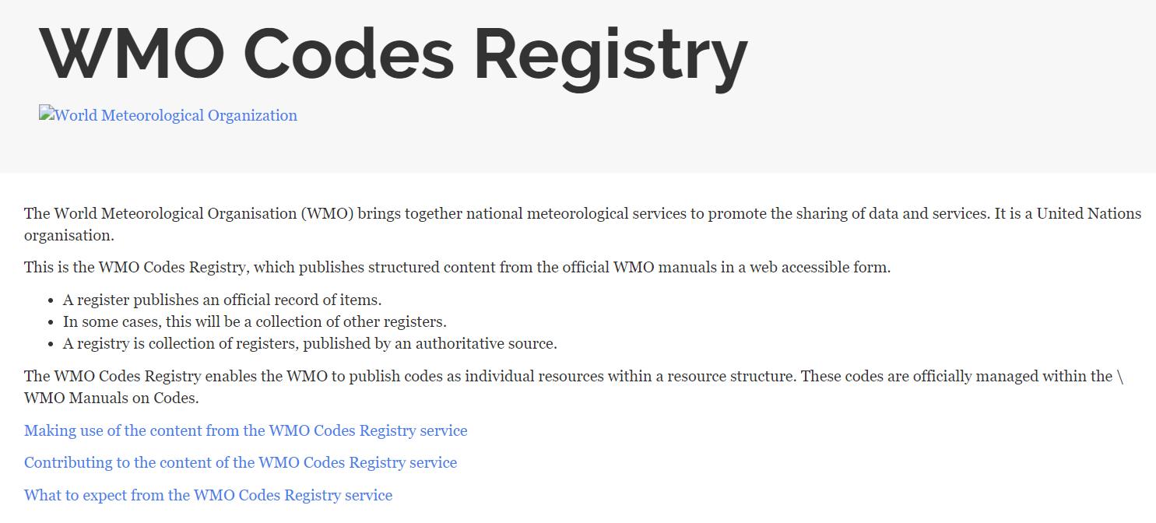

Slide 12
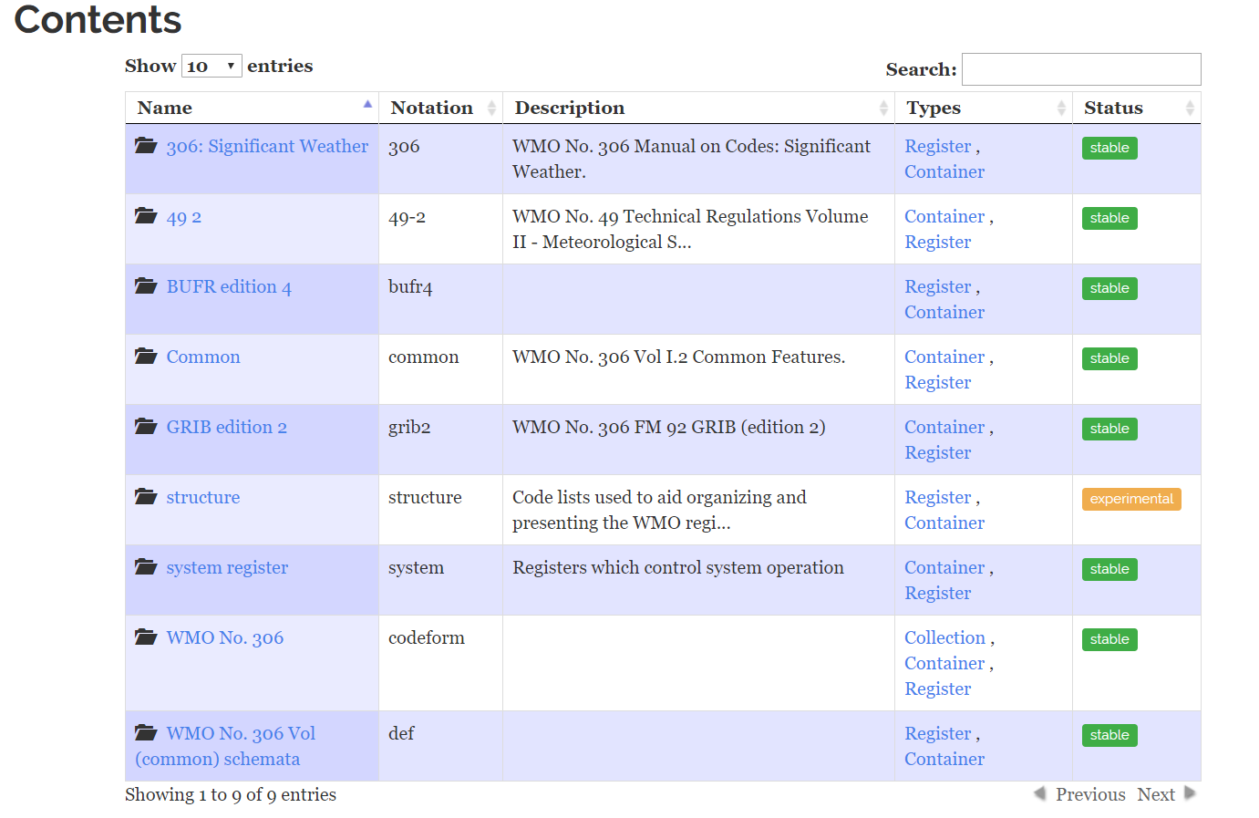
http://codes.wmo.int

Slide 13
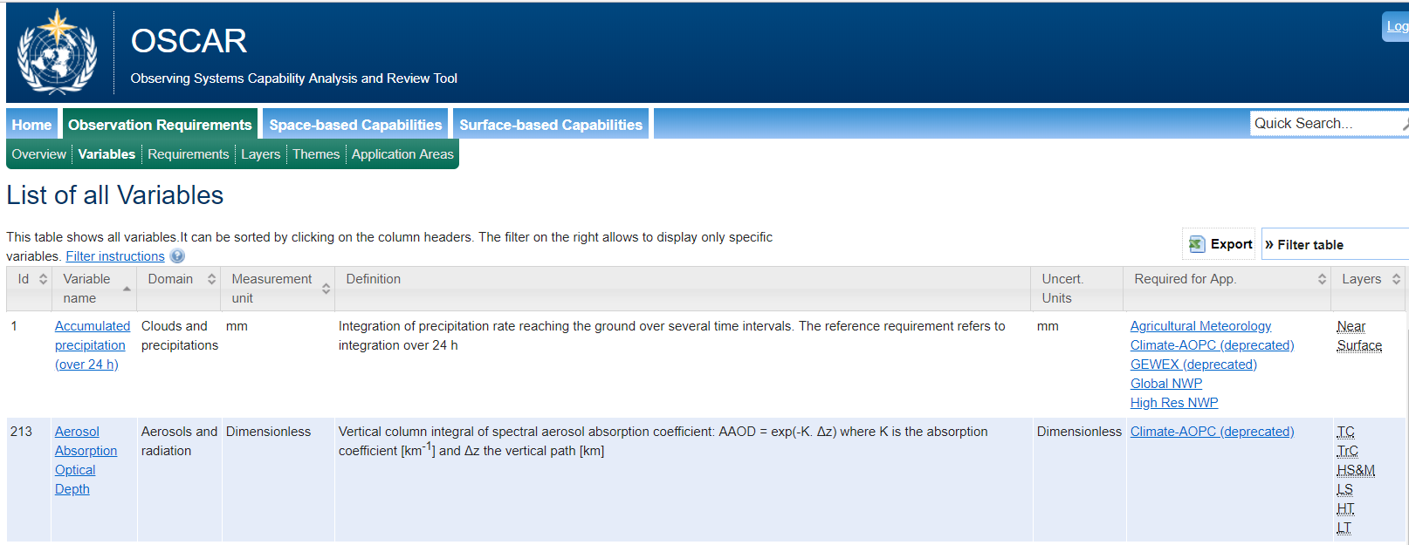
More definitions – in different forms..

Slide 14
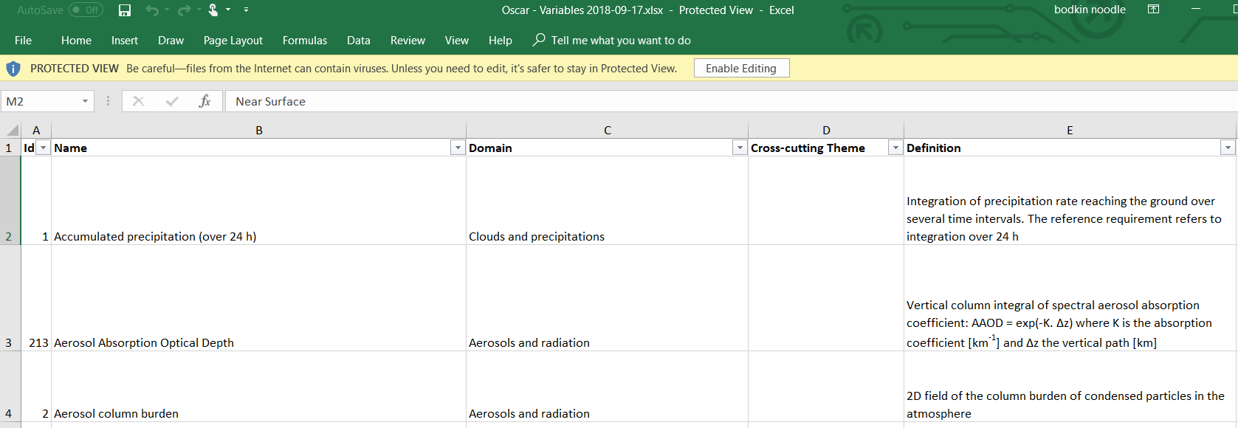
Custom schema and choice of format

Slide 15
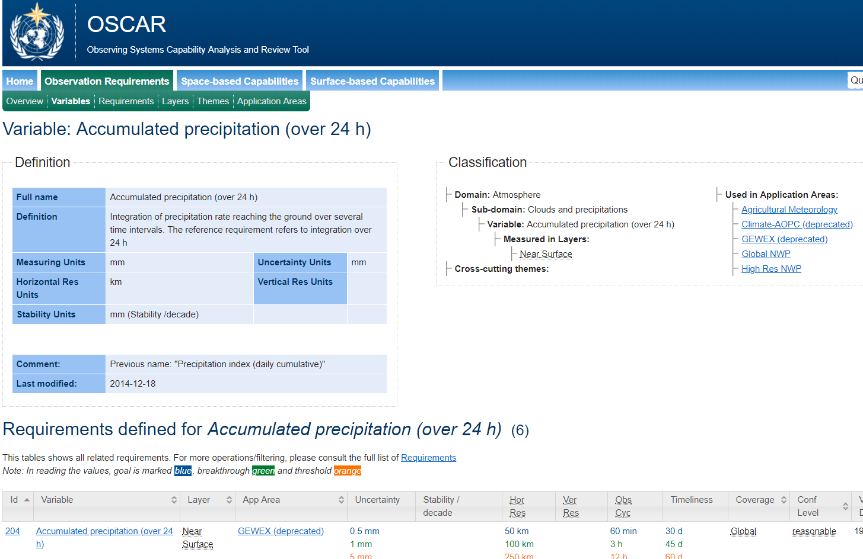
Definitions + model

Slide 16
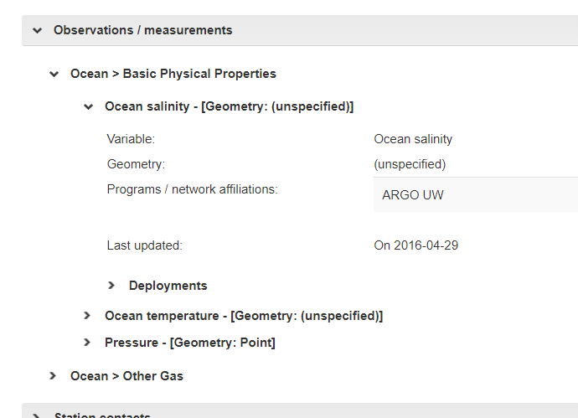

Slide 17
Summary
Emerging “best practice”
Current offerings diverse (not very interoperable)
OGC defs server at the “most flexible” end of the spectrum
Tracking (and driving) W3C standards
Lots to learn for all parties
Need to have some good clients
Out of current OGC roadmap

Slide 18
OGC activities
Definitions Server (OGC-NA)
Citizen Science IE
ELFIE 2
(??) dimensional synthesis across coverages and observations
E.g. space and in-situ (COPERNICUS & INSPIRE)
“Datacubes”
Standards relevant to OSCAR design – can the _metadata_ be shared and federated?

Slide 19
Publishing Domain Ontologies
We want definitions to be
Simple and standard
Rich models if available
Packaged in a way to suit different systems
Reconciled by Linked Data and content-negotiation
From user perspective
Maintenance headache?

Slide 20
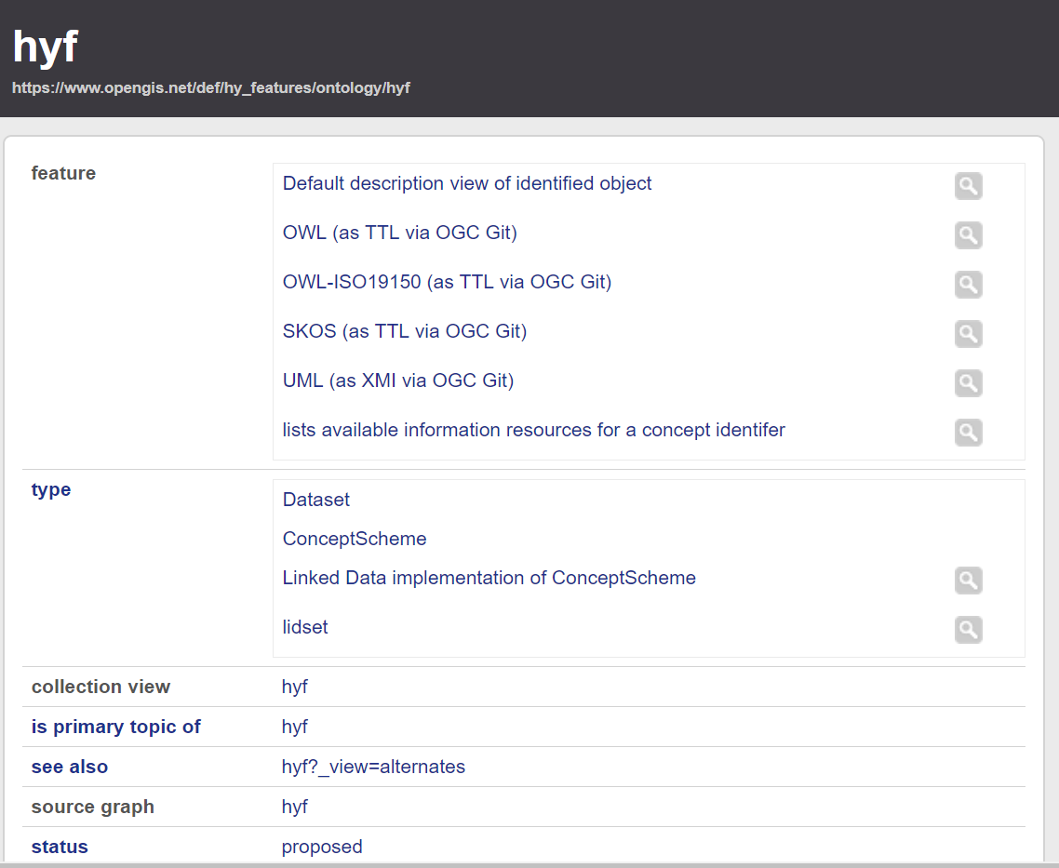

Slide 21

Automated inferencing
This a AppSchema ;
sourceFile <URL> ;
user X ;
createDate D .
Metadata
Ontology
CMS
ISOLATE
FOR
TESTING
(Reusable) custom service chain (managed in CMS)
Source
Document(s)
Service Chain
Linked Data
Additional Ontology
REST API
REST API
SPIN rules for SKOS
inferencing
repository
public
repository
SPIN rules for metadata and links
Custom rules
Specific rules
Standard rules
AppSchema txform
Specific rules

Slide 22
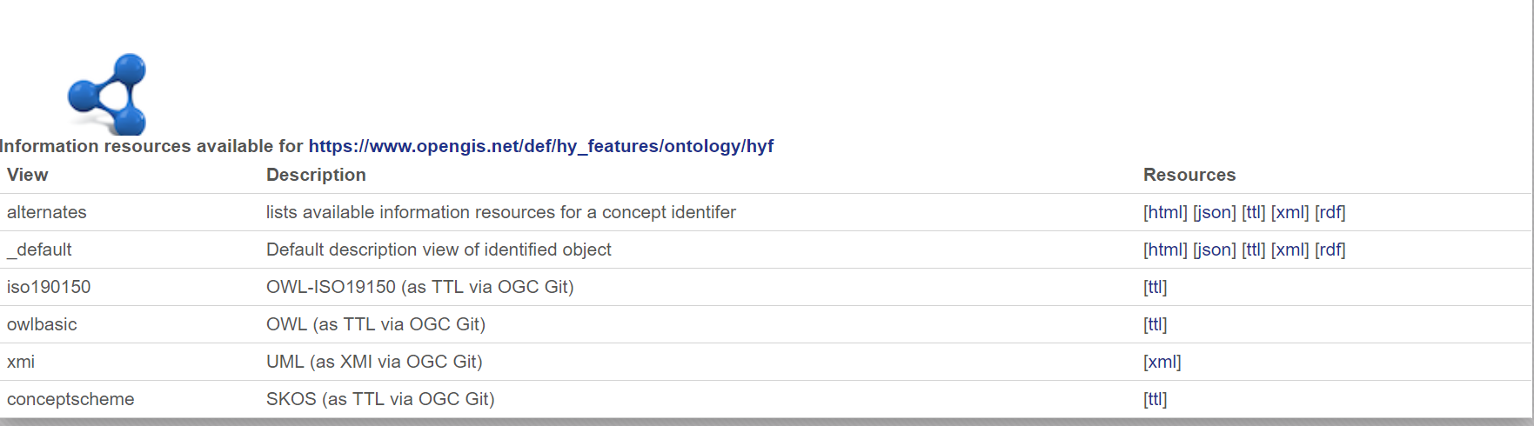
Profiles

Slide 23
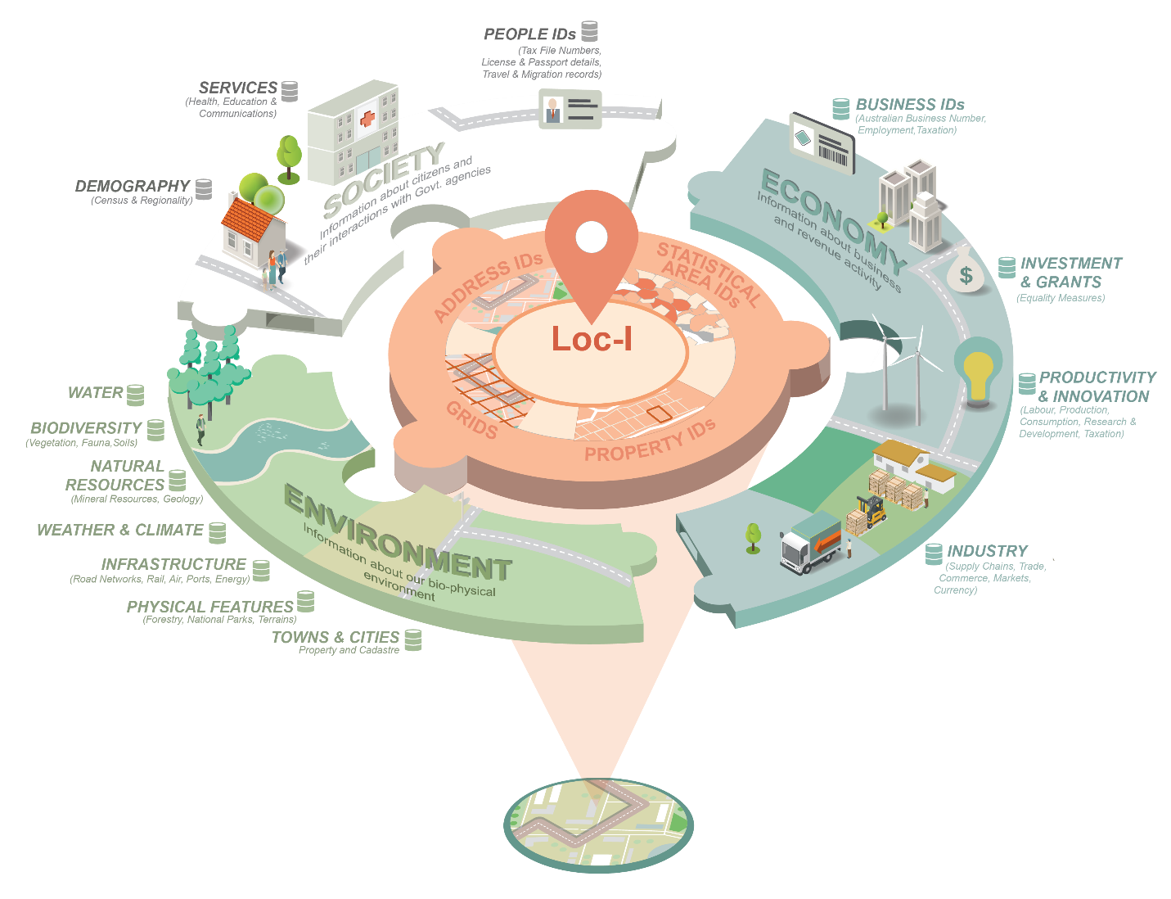
Australian Government Identifiers work

Slide 24
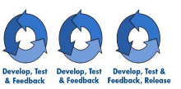
Loc-I Project Process Map - overview
Discovery
Build
Explore
Evaluate
Hypothesis
Validate
Loc-I 1.0
Analyst types
Intent
……………………
Requirements
Current state &
assumptions
Demonstrator Prototype
Phase 1 - 18/19
Phase 2 19/20
July 18
Dec 18
Apr 19
June 19
June 20
G-NAF ASGS Geofabric Cadastre
Links
Links
Information architecture
- Spatial indexes & grids
Technical architecture
- Systems and APIs
Social architecture
Institutional arrangements
User adoption and support
Data provider adoption

Slide 25

Practical sharing
What data?
Where is it?
What do these terms mean?
How do I get it?
What schema?
How do they relate to my terminology?
What content inside that schema?
What will it work with?

Slide 26
Supporting HDWG
HDWG standards
As ontologies, linked to more usual forms
Definitions server with machine readable data ready to be consumed
Profiles of HDWG standards
Vocabularies needed for these
Content – or delegated redirections
Or just metadata objects describing external sources
“Variables”
Could link out to WMO system(s)
Publish with URIs and multiple formats as required.
Cross references to other variables – e.g.

Slide 27
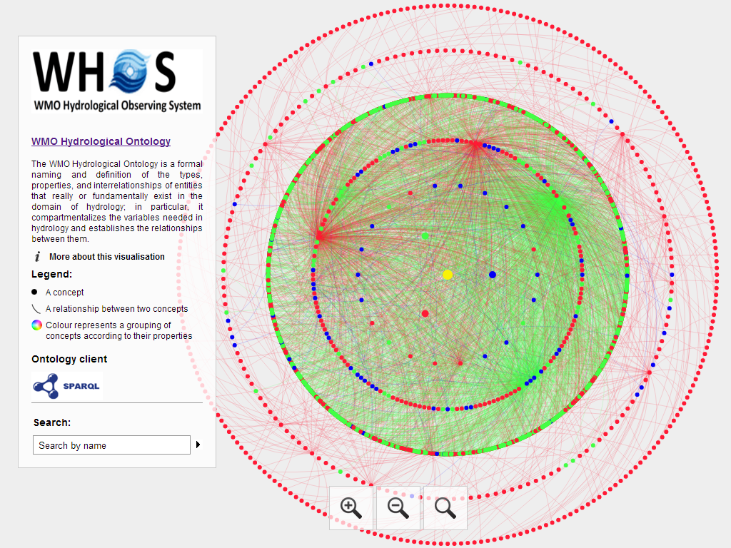
Notes:
hiscentral.ddns.net:8088/ontology/

Slide 28
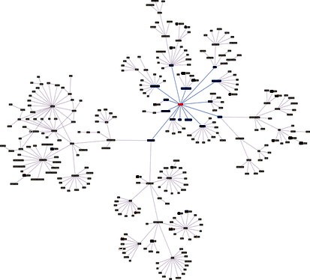

Data Models
Cross-references
Profiles
Taxonomies (SKOS)
Delegated subdomains
This Photo by Unknown Author is licensed under CC BY-SA

Slide 29
Summary – a Game Changer?
OGC Definitions Server is
Example of best practice
Standards
Flexibility
Source of useful (low level tech) definitions
A place where “community” can publish resources needed to exploit OGC interface standards and data models
Flexible to handle special cases
Variables
Data dimensions

Slide 30
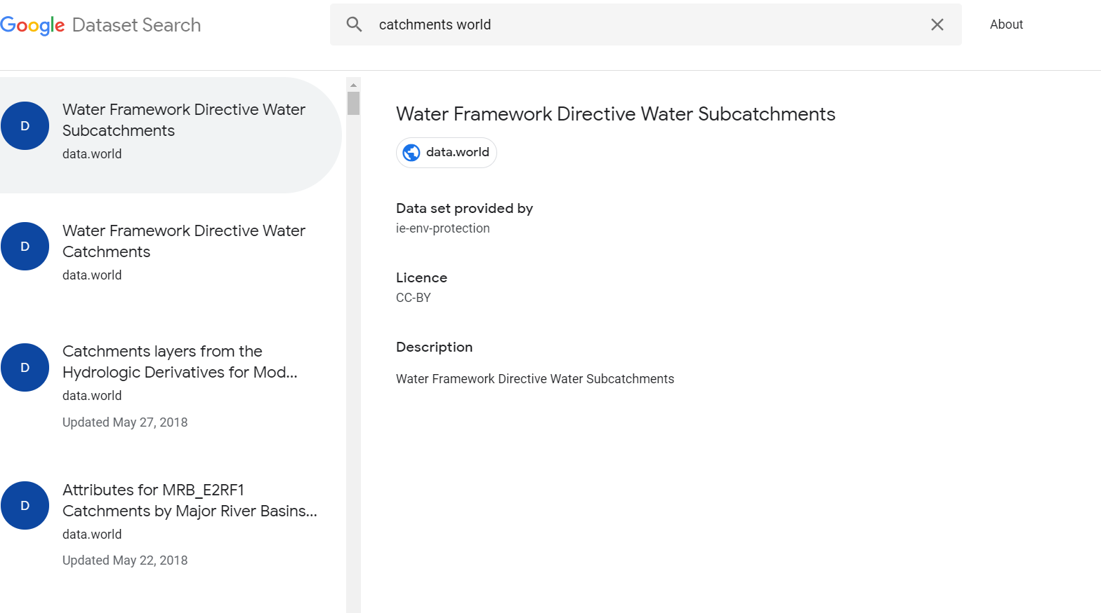
Why do we need this again?

