Slide 1

Bureau of Meteorology Water Data & Water Data Online
September 18th 2018

Slide 2
1
Overview
Historical context
Current status – water data and ingest summary, WDO
Future state
DataConnect
APIs & integration
Analytics & metrics
Enhancement & integration – flood, met + water
A national infrastructure

Slide 3
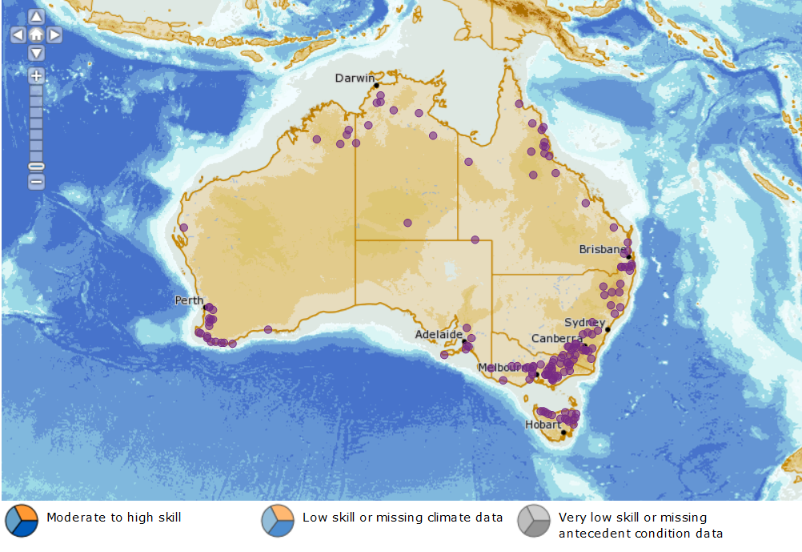
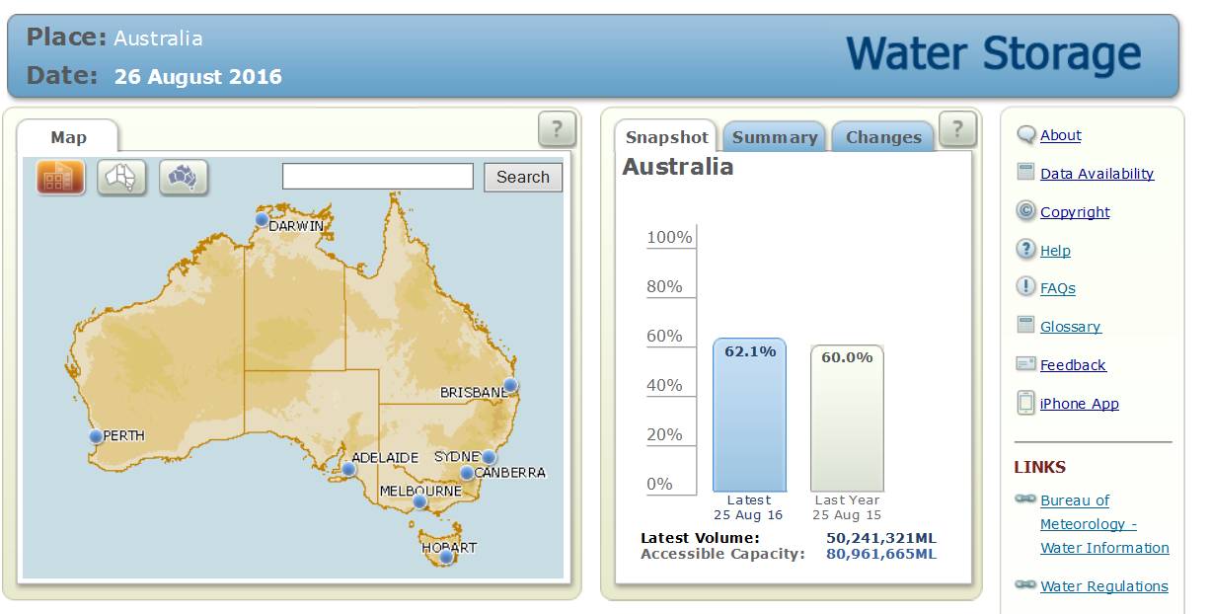
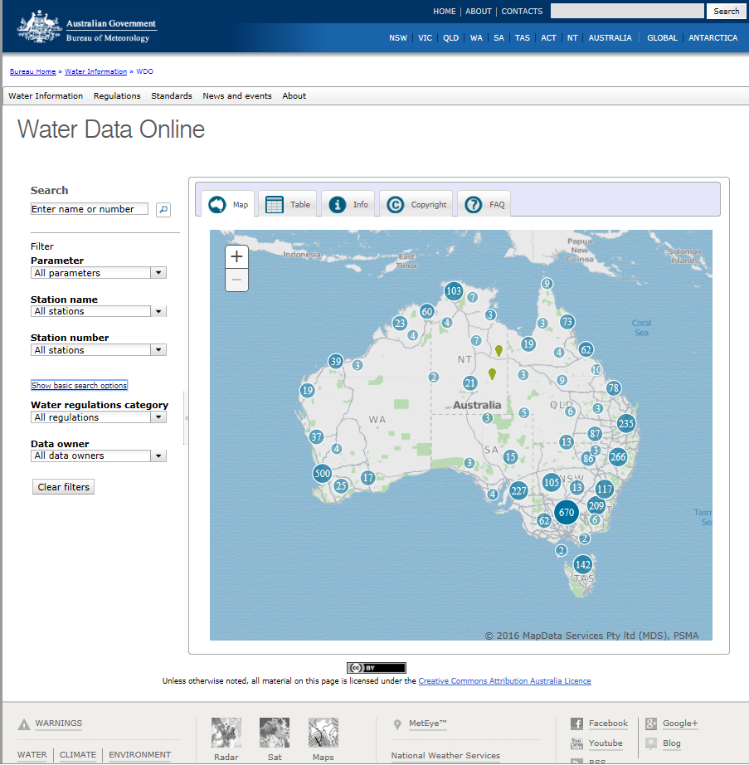
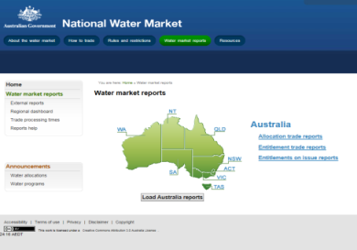
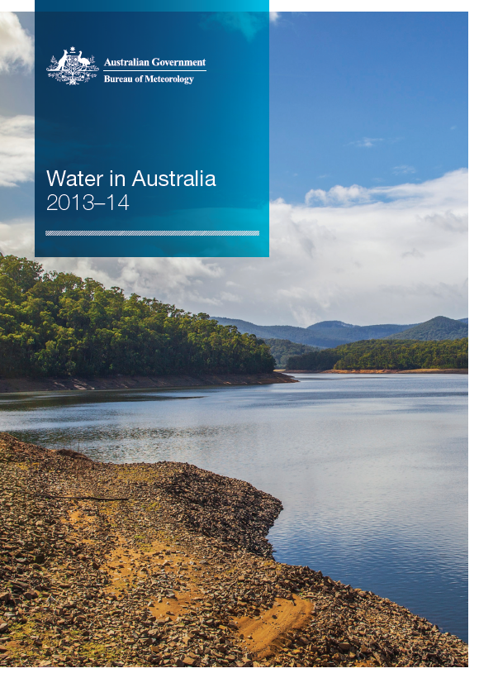
2
Historical context
Water information program established
AWRIS1 goes live
WDTF legislated for lead water agencies
Water Data Online released
AWRIS2 and water data online SOS2 service released
First water quality release – water data online
2007
2010
2012
2014
2016
2018
National groundwater
Water storages
WDO
National water markets
Water in Australia
Page 2 of 7

Slide 4
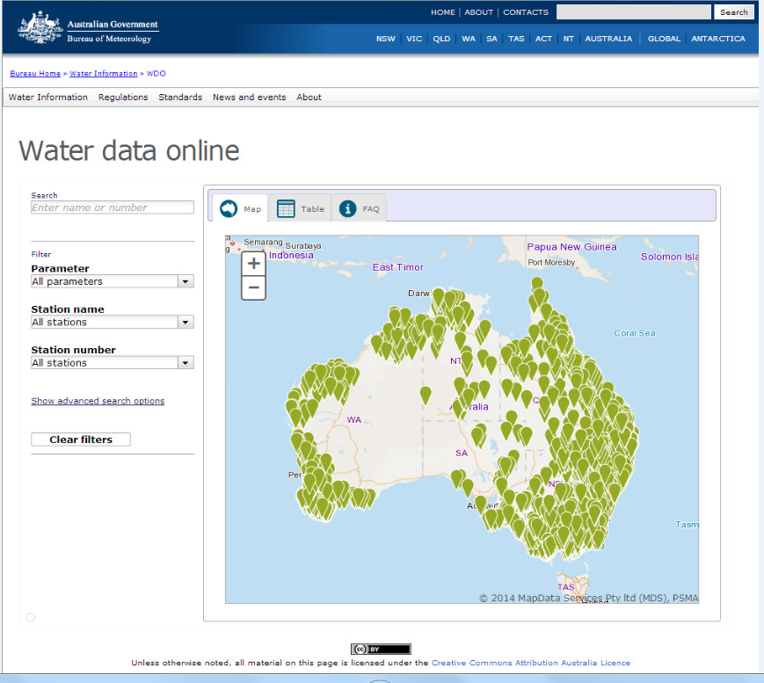
3
Water data online - current status
Data | Parameter | Agencies | Stations
Surface water | Level | 28 | 4500
 | Discharge | 28 | 4500
Water storage | Storage level | 32 | 540
 | Storage volume | 32 | 490
Water quality | Electrical conductivity | 19 | 1500
 | Turbidity | 9 | 700
 | pH | 9 | 600
 | Water temperature | 10 | 2000
Meteorological | Rainfall | 10 | 1500
Page 2 of 7

Slide 5
4
Surface water ingest summary
The Bureau of Meteorology over the last ten years had developed the ability to ingest and disseminate a variety of water data parameters. The table below summarises the details regarding format and frequency of ingestion, databases where data are hosted and how to access data externally. Contacts: Todd.Lovell@bom.gov.au, Mattew.Walker@bom.gov.au
Parameter | Regs | Format - Depending on category of person | Frequency of ingest | Database | Preferred Delivery | External Access | Notes
Surface water level | 1a | Water Data Transfer Format or other formats (e.g. CSV) | Daily | AWRIS | FTP | Water Data Online | Only valid WDTF data is ingested
 |  |  |  |  |  | API (SOS2) | Refer to SOS2 Guide for access
Surface water discharge | 1b | Water Data Transfer Format or other formats (e.g. CSV) | Daily | AWRIS | FTP | Water Data Online | Only valid WDTF data is ingested
 |  |  |  |  |  | API (SOS2) | Refer to SOS2 Guide for access
Licensed and otherwise surface water take | 5a-d | CSV (preferred, but other formats allowed) | yearly | In development | FTP DataConnect* | Regional Water Information | Cat 5 data requirements
Surface water license to extract, allocation announcements and permits to extract | 6a, 6d, 6g | CSV or other formats | yearly (or on announcement) | AWRIS | FTP DataConnect* | Water markets* | Cat 6 data format requirements
* Capability under development

Slide 6
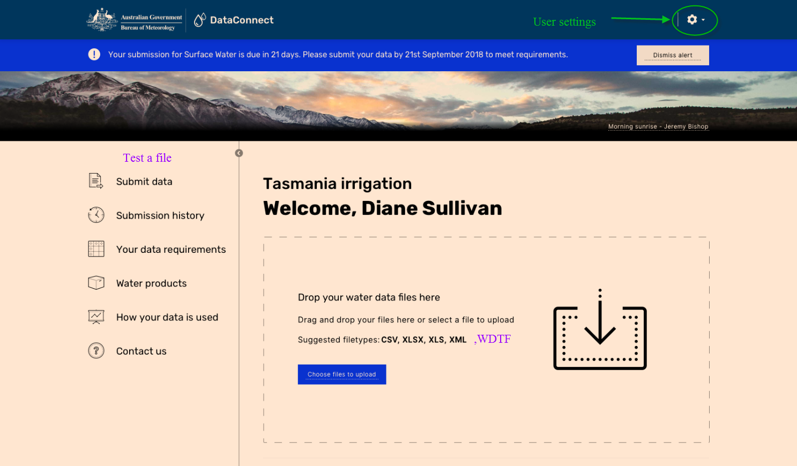
5
Future state - DataConnect

Slide 7
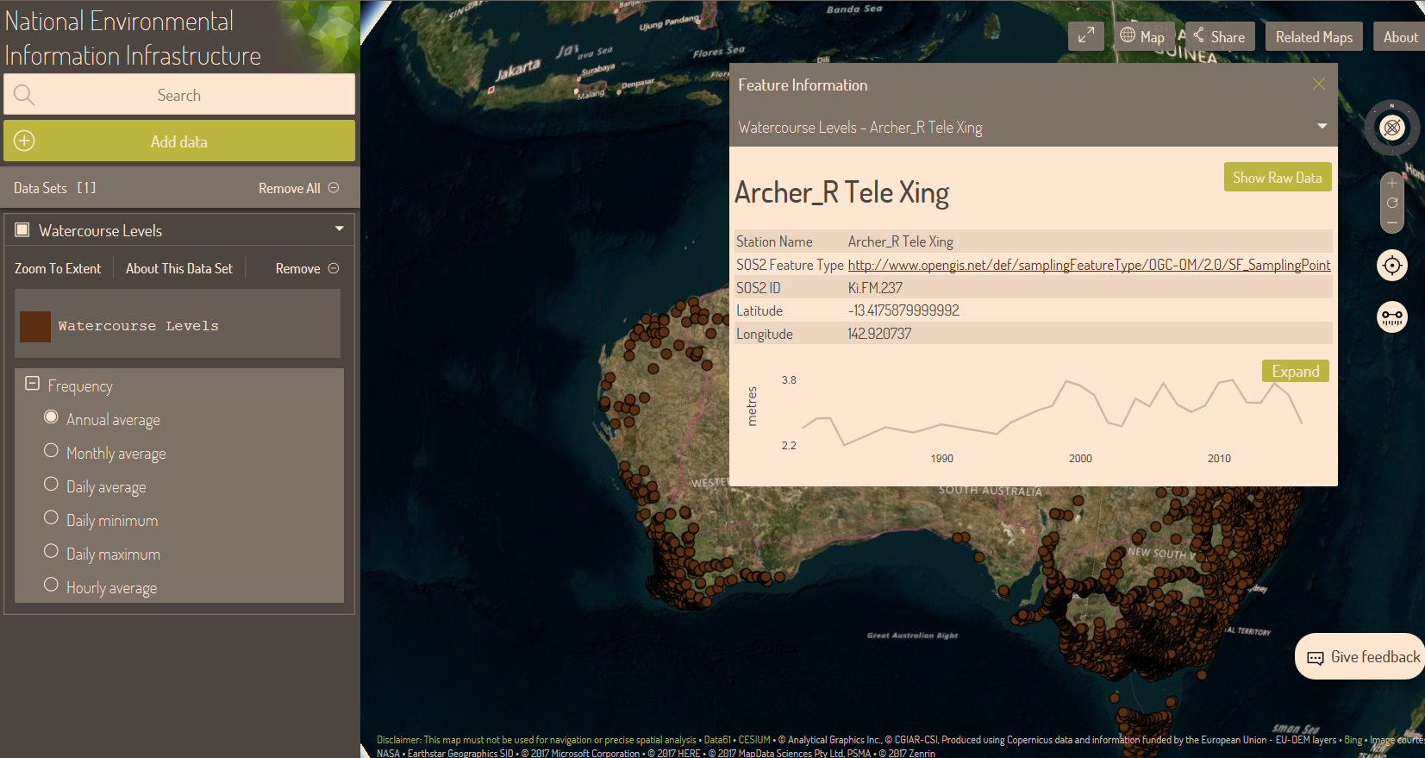
6
Future state – APIs and integration
Page 2 of 7

Slide 8
7
Future state cont.
Enhancements (e.g. authentication gateway, bulk data download)
Analytics & metrics
Enhancement & integration – flood, met + water
A national water data infrastructure

Slide 9
6
Further information
Further information regarding the Bureau's water data capability is available at
http://www.bom.gov.au/water/
Or by contacting:
waterdata@bom.gov.au
Page 7 of 7

