Slide 1

Introduction to the WMO/OGC Hydrology Domain Working Group
Tony Boston (Australia), Silvano Pecora (Italy), David Blodgett (USA)
HDWG Co-Chairs

Slide 2
Benefits of open standards
Prevents a single group from controlling a standard
Facilitates competition
Stimulates innovation
Customers benefit from not being locked into a particular supplier
Source: Open Standards, Open Source, and Open Innovation: Harnessing the Benefits of Openness, April 2006. Committee For Economic Development. www.ced.org
Notes:
Prevents a single, self-interested party from controlling a standard
Facilitates competition by lowering the cost of entry
Stimulates innovation beyond the standard by companies that seek to differentiate themselves.
Customers value the interoperability that open standards provide and generally benefit from not being locked into a particular supplier.

Slide 3
What is the OGC?
The Open Geospatial Consortium, Inc. (OGC) is a non-profit, international voluntary consensus standards organization that is leading the development of standards for geospatial and location based services.
The OGC facilitates a consensus process in which government, private industry, NGOs, and academia collaborate to create open and extensible software application programming interfaces for geospatial and other mainstream information technologies
Notes:
The OGC is a not for profit consortium dedicated to the development of specifications that enable geospatial technologies to “plug and play” across any device, platform or network. The OGC consists of 380+ members - geospatial technology software vendors, systems integrators, government agencies and universities - participating in a consensus process to develop, test, and document publicly available interface specifications and encodings for the geospatial industry. Open interfaces and protocols defined by OpenGIS® Specifications are designed to support interoperable solutions that "geo-enable" the Web, wireless and location-based services, and mainstream IT, and to empower technology developers to make complex spatial information and services accessible and useful to all kinds of applications.

Slide 4
OGC Snapshot
A Voluntary Consensus Standards Organization, founded in 1994.
520 members
50+ adopted standards
Hundreds of product implementations
Broad user community implementation worldwide
Alliance partnerships with 30+ standards & professional orgs
OGC Membership Distribution

Slide 5
Standards
An OGC standard is a document, established by consensus and approved by the OGC Membership, that describe rules, guidelines or characteristics for interfaces and encodings aimed at the achievement of the optimum degree of interoperability.
Domain Working Groups (DWG or WG) provide a forum for discussion of key interoperability requirements and issues, discussion and review of implementation specifications, and presentations on key technology areas relevant to solving geospatial interoperability issues.
Standards Working Groups (SWG) have specific charter of working on a candidate standard prior to approval as an OGC standard or on making revisions to an existing OGC standard.

Slide 6
Other Document Types
Best Practices Documents contain discussion of best practices related to the use and/or implementation of an adopted OGC standard and for release to the public. Best Practices Documents are an official position of the OGC and thus represent an OGC Member endorsement of the content.
Discussion Papers (DP) provide discussion of some technology or standards development activity in the OGC approved for release to the public. Discussion Papers are not the official position of the OGC and contain a statement to that effect.
Public Engineering Reports (ER) are documents that report on some technical activity in an OGC Interoperability Program Initiative. A public ER is an ER that the OGC Members have approved for public release. An ER is not an official position of the OGC.

Slide 7
OGC Web Services
Service endpoints
Catalogue Services (CSW)
Web Map Service (WMS)
Web Feature Service (WFS)
Web Coverage Service (WCS)
Web Processing Service (WPS)
Sensor Observation Service (SOS)
etc…
Information Models/Encodings
Geography Markup Language (GML)
CityGML
GML Simple Features
Observations & Measurements (O&M)
Sensor Web Enablement Common (SWE Common)
Sensor Model Language (SensorML)
WaterML2: Part 1, 2, 3, 4…
TimeseriesML
GeoSciML
GroundWaterML2
KML
NetCDF
etc…

Slide 8
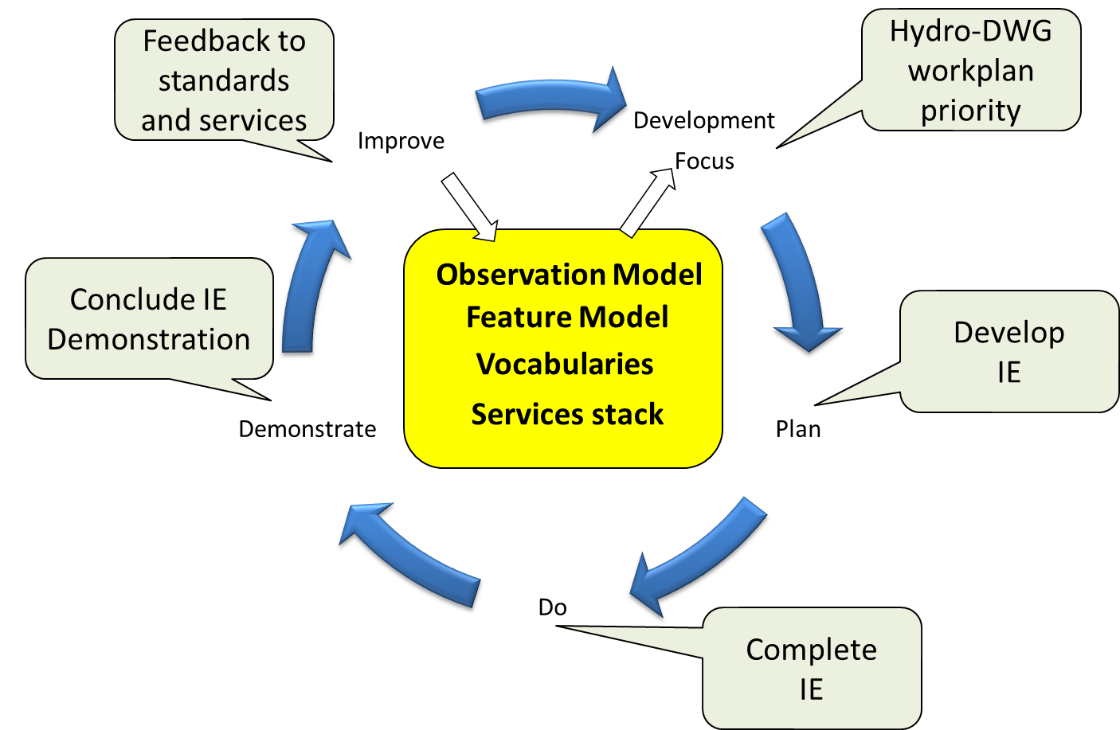
International Standardization for Water Data
Hydrology Domain Working Group
standards for water data: WaterML 2.0 suite
organizing Interoperability Experiments (IEs) focused on different sub-domains of water
Chairs:
Tony Boston (Australia)
Silvano Pecora (Italy)
David Blodgett (USA)
Iterative Development
http://external.opengis.org/twiki_public/bin/view/HydrologyDWG/WebHome

Slide 9
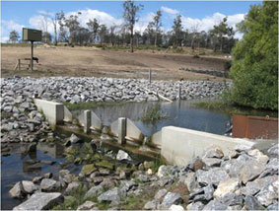
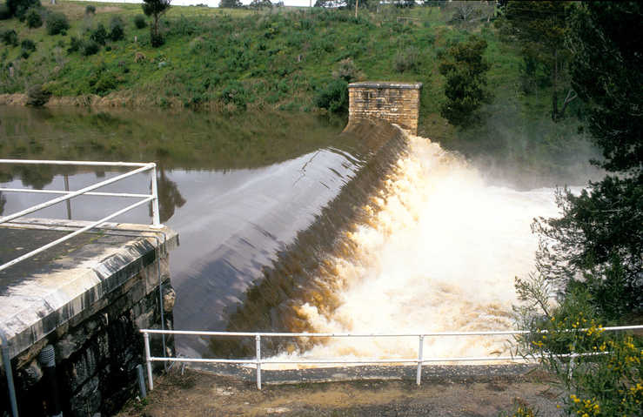
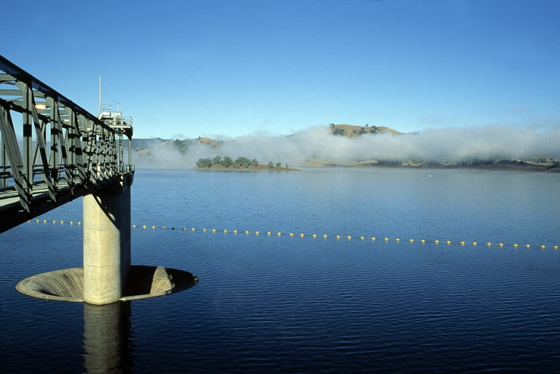
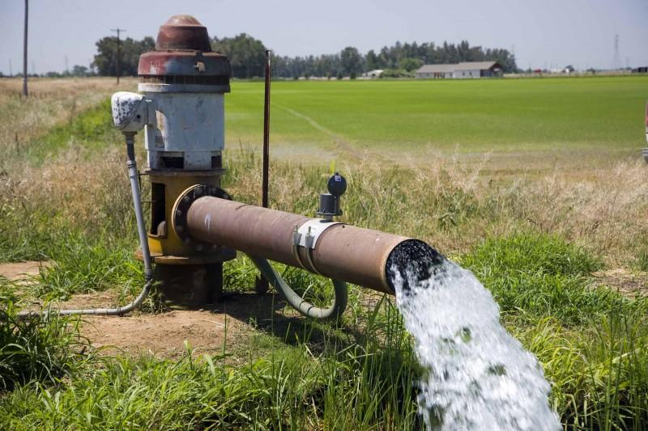
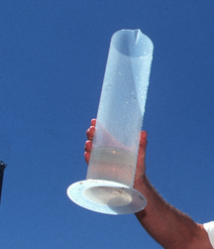
WaterML2.0 standards
Part 1 - Timeseries
Part 2 – Ratings, Gaugings and Sections
Part 3 – Surface water features
Part 4 – Groundwater
Part 5 –
Water quality (best practice)

Slide 10
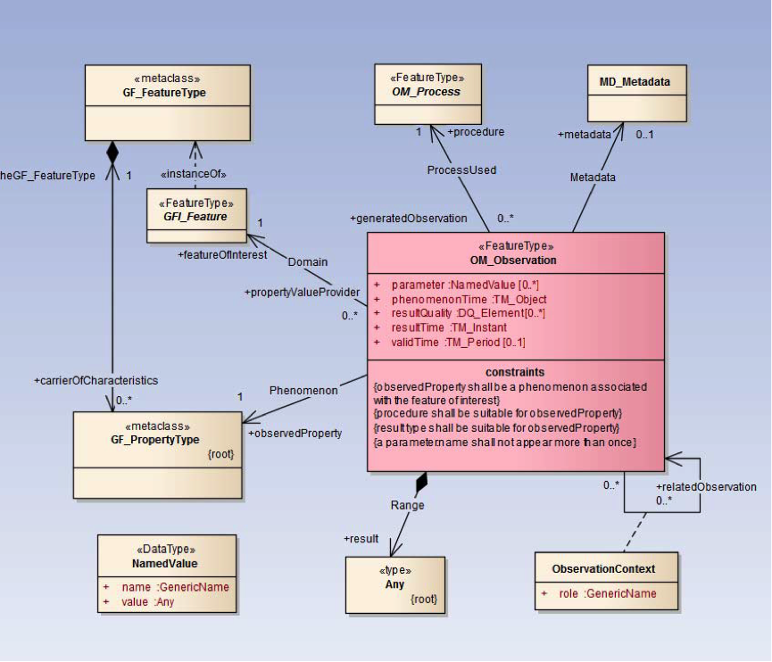
WaterML2: Part 1 – Timeseries
Profile of O&M, reusing ISO
and OGC standards
UML model
XML Schema (GML compliant)
Specification document
Requirements
Conformance classes
Conformance tests
XML Schematron rules
Vocabulary definitions
Only a subset relating to time series
Notes:
An Observation is an action whose result is an estimate of the value of some property of the feature-of-interest, obtained using a specified procedure.
WaterML2: Part 1 focuses on hydrologic timeseries observations, which are the result of measurement of say water level or discharge at a stream gauging station on a river within a particular catchment

Slide 11
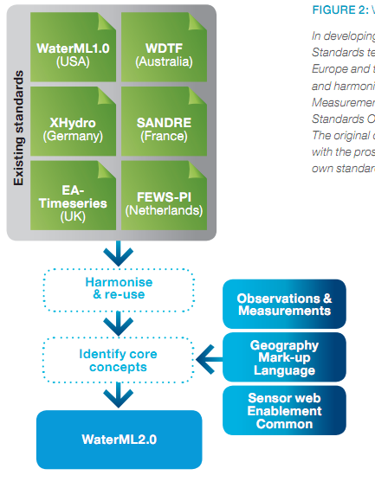
Harmonization
Part 1 - Timeseries

Slide 12
Adoption of WaterML2: Part 1
WaterML2 announcement regarding US national strategy for civil earth observations:
http://www.opengeospatial.org/pressroom/pressreleases/1831
US Federal Geographic Data Committee (FGDC) endorses WaterML2:
http://www.fgdc.gov/standards/news/WaterML
WaterML2 recommended in EU legislation on data sharing (page 5):
http://eur-lex.europa.eu/LexUriServ/LexUriServ.do?uri=OJ:L:2013:331:0001:0267:EN:PDF
USGS implements WaterML2 in national water information system:
http://help.waterdata.usgs.gov/news/april-10-2014

Slide 13
Adoption by WMO
WMO Executive Council 69th session meeting in May 2017 formally adopted WaterML2 Part 1 & 2 standards (p.133-134)
Decides:
To amend the Manual on Codes, Volume I.3 to introduce WaterML2 Parts 1 and 2 as data representations that are suitable for the exchange of hydrological information, as specified in Annex 1 of the Annex to Recommendation 12 (CBS-16);
To amend the Guide to Hydrological Practices, Volume I as specified in Annex 2 of the Annex to Recommendation 1 (CHy-15);
Requests:
WMO representatives to the Hydrology Domain Working Group of the OGC to work with that group to revise the non-normative (informative) material in the WaterML2 standards to address concerns of CHy
Notes:
EC-69: https://library.wmo.int/opac/doc_num.php?explnum_id=3645
CHy-15: https://library.wmo.int/doc_num.php?explnum_id=3404

Slide 14
2018 WMO/OGC Hydrology DWG Workshop
25 attendees, local and remote
Participants from USA, Canada, Australia, New Zealand, Germany, France, Austria, Switzerland, United Kingdom
Focus on strengthening links between WMO and OGC
10 years since collaboration commenced
Planning key future activities
Presentations on:
WMO systems including HydroHUB, WHOS
Environmental data sharing in USA, Canada, Australia, NZ, France
New technologies for linking hydrological data across basins (ELFIE)
Vocabularies and ontologies for hydrological data
RDA Global Water Information Interest Group activities including data citation, water data portals and data rescue

