Slide 1


LAWA
Ninth Workshop of the WMO/OGC Hydrology DWG Geneva, 18 September 2016
Surface, groundwater, environmental data sharing in New Zealand
Sean Hodges
Brent Watson
Horizons Regional Council, NZ

Slide 2
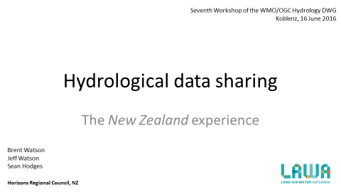
2016

Slide 3
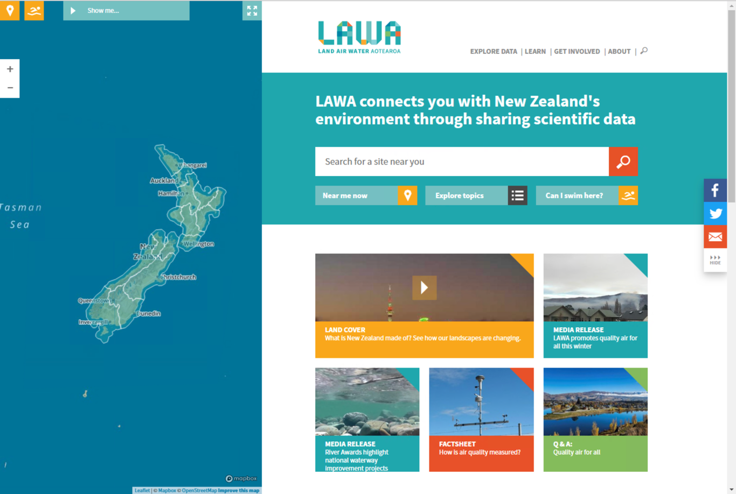

Slide 4
Outline
NZ setting
LAWA history and influences
State of play 2018
Projects going forward

Slide 5
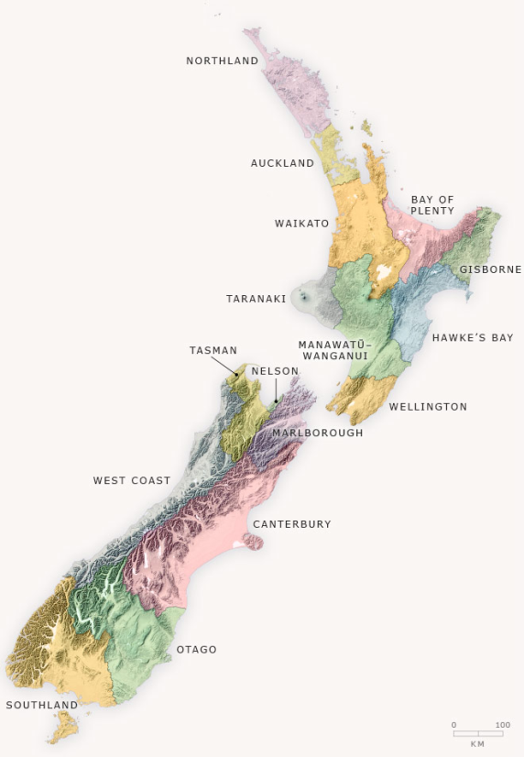
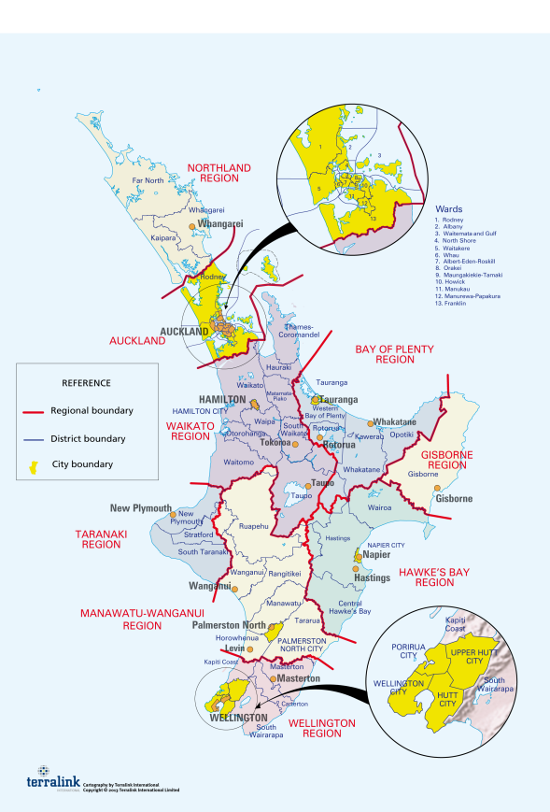
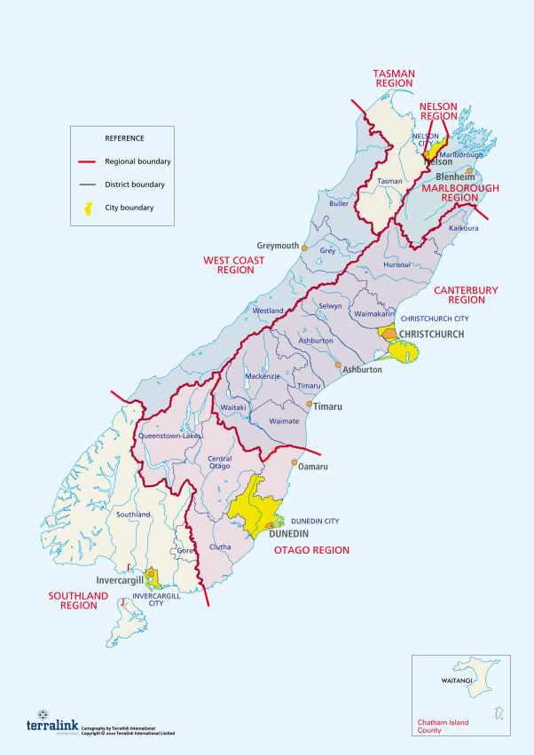
NZ Local Government

Slide 6
Drivers
National Reporting
Consistent data
Reliability
Public access to actionable information

Slide 7
9 years ago
One Chief Executive’s
“I have a dream” instruction
to four staff

Slide 8
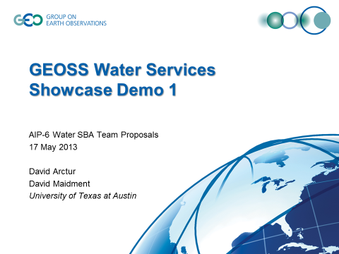
5 years ago
With acknowledgements to Dr’s Arctur & Maidment

Slide 9
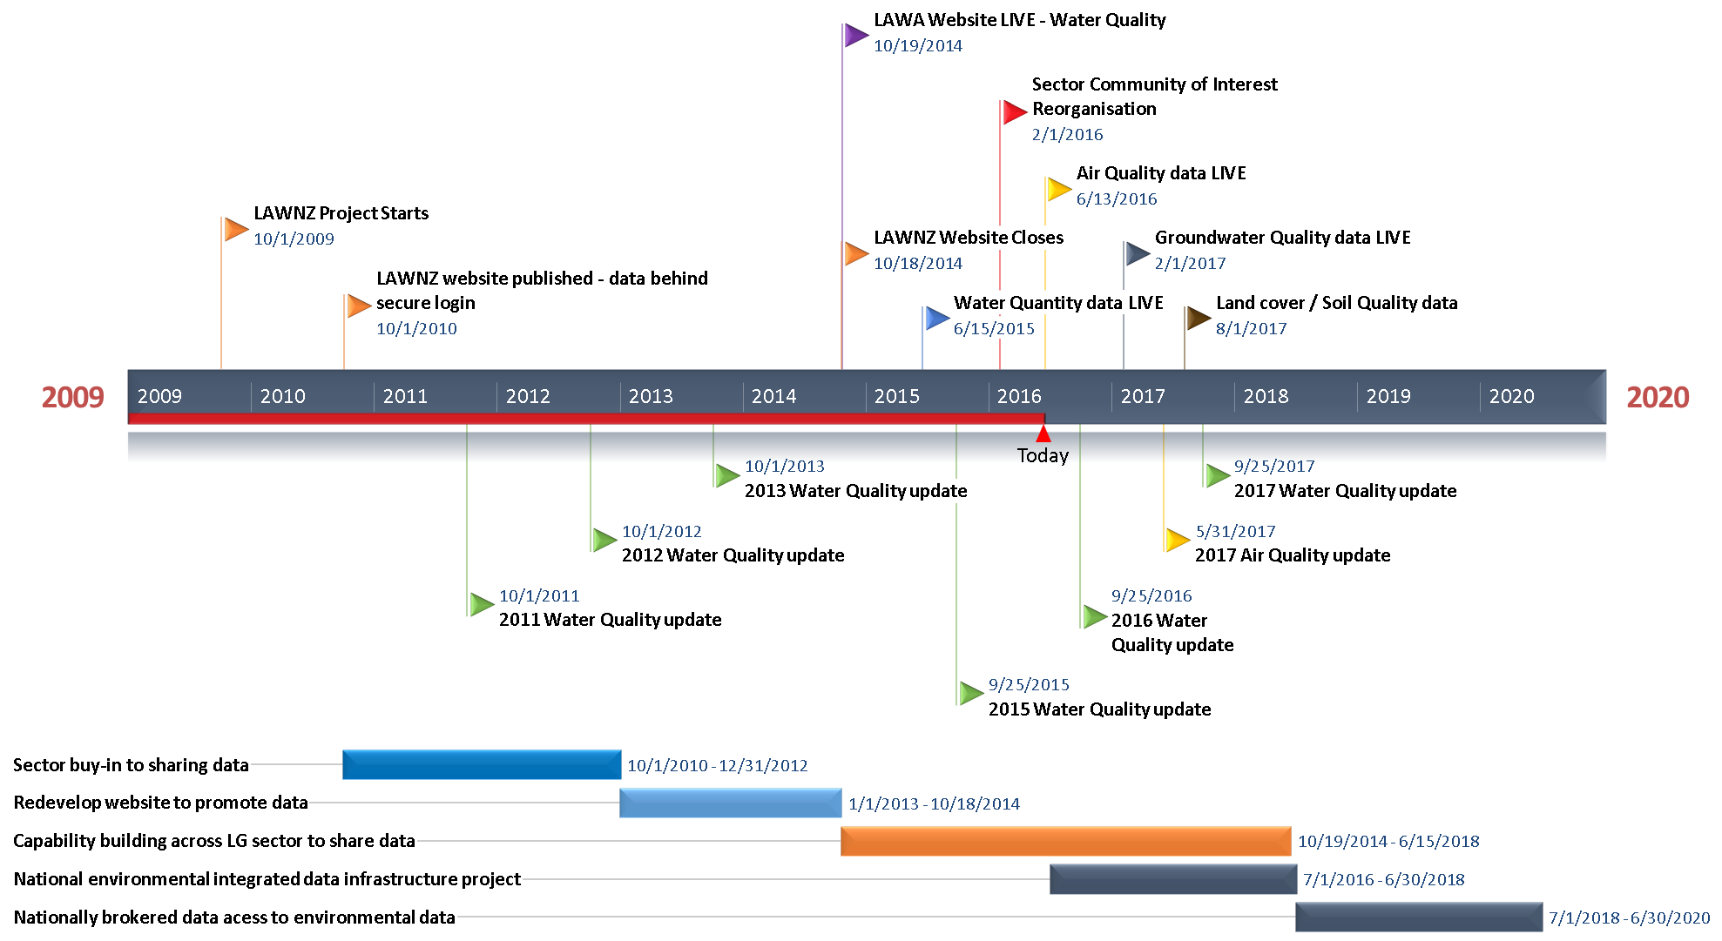
Timeline
2016

Slide 10
Timeline
2017

Slide 11
Timeline
2018

Slide 12
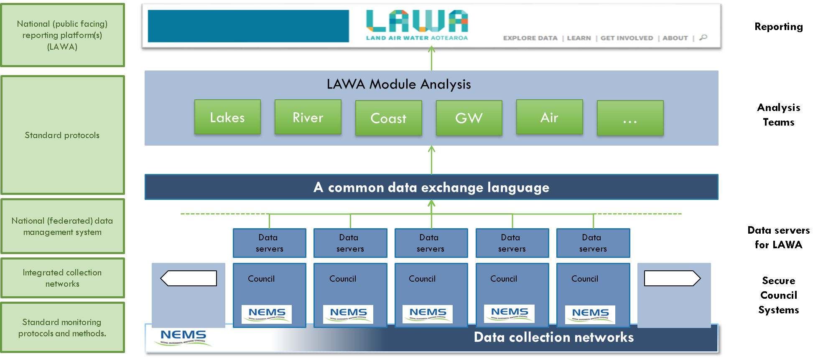

Slide 13
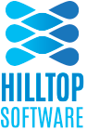





Products in use
Hilltop (13)
Kisters (2)
Aquatic Informatics / 52 North (1)
ESRI (16)
OGC Standards, notably WaterML 2.0
Proprietary Restful API’s as required

Slide 14
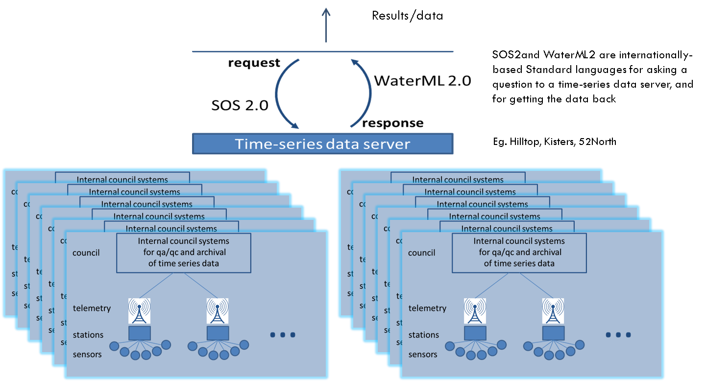
Client
Limitations here
Constraints here – water quality

Slide 15
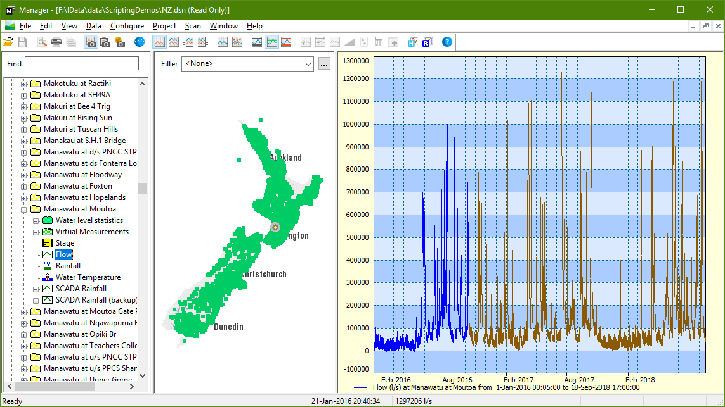

Slide 16
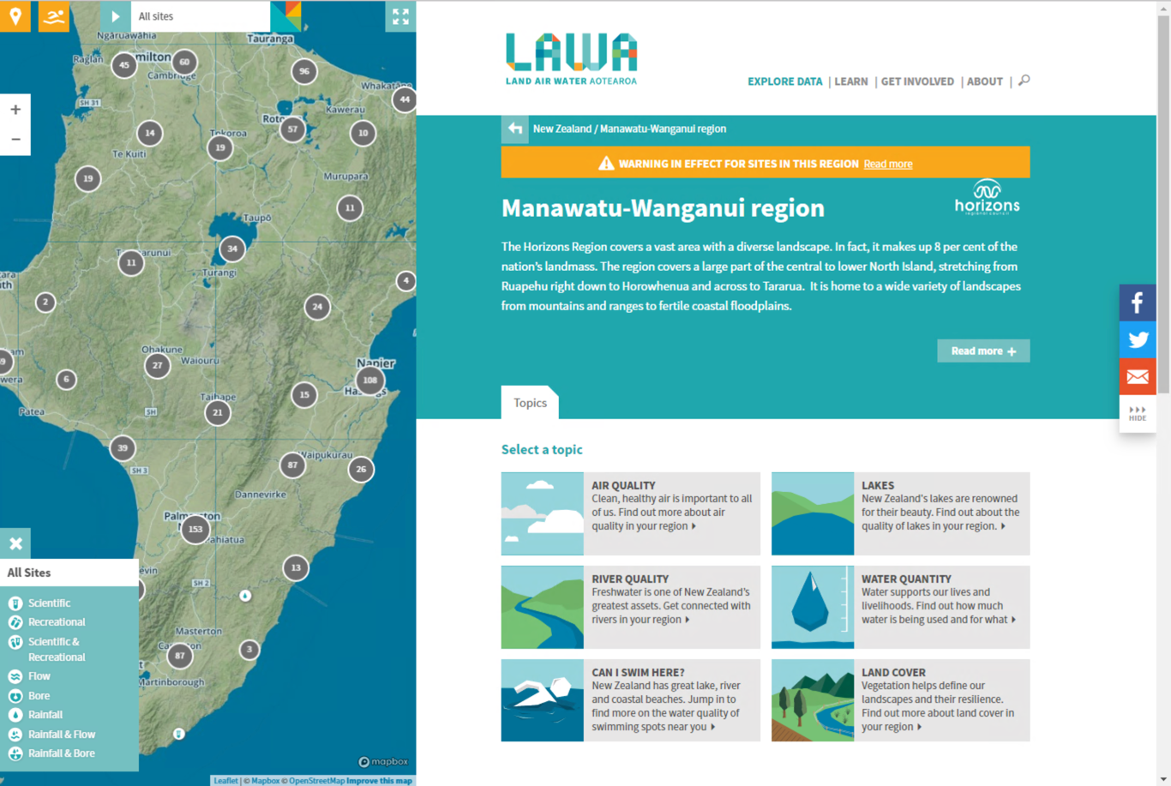

Slide 17
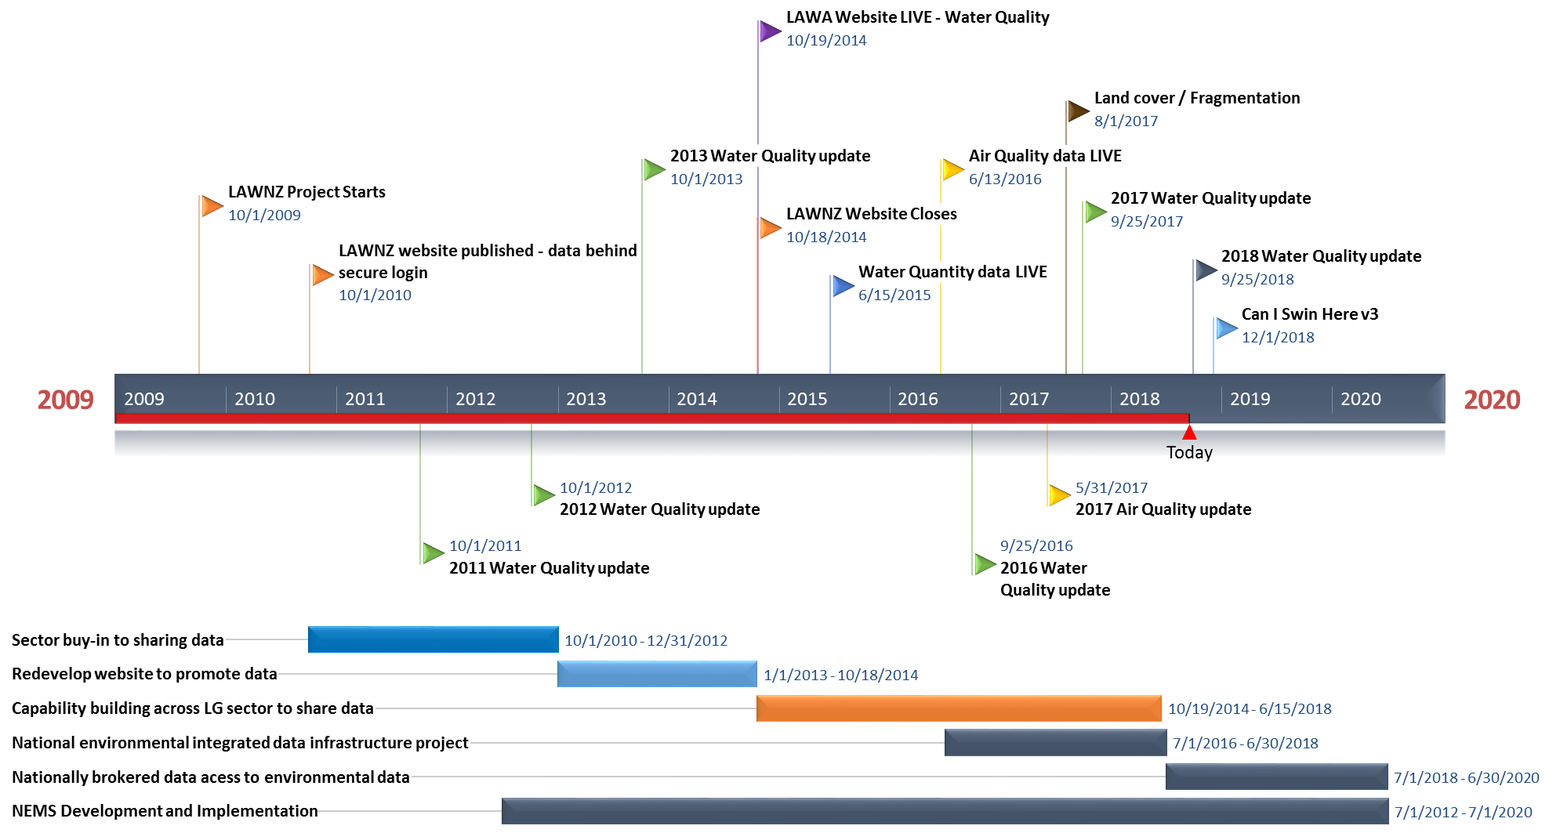
Timeline
2018

Slide 18
One destination

Slide 19
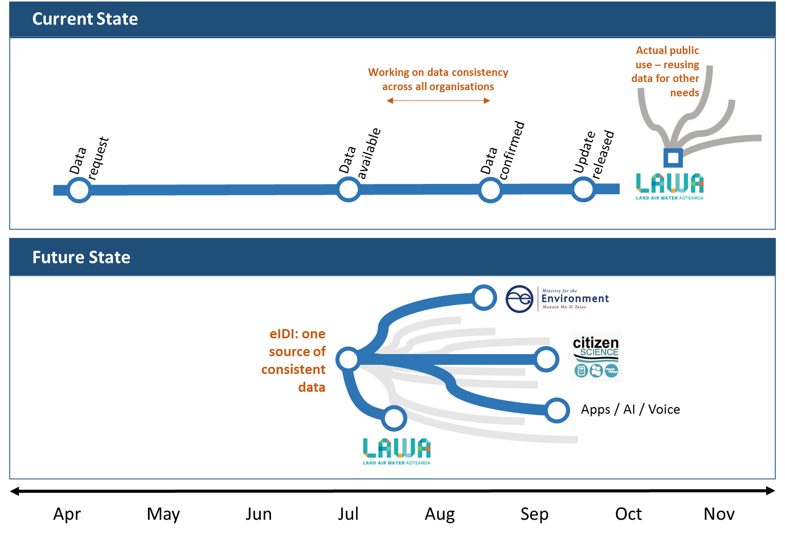

Slide 20
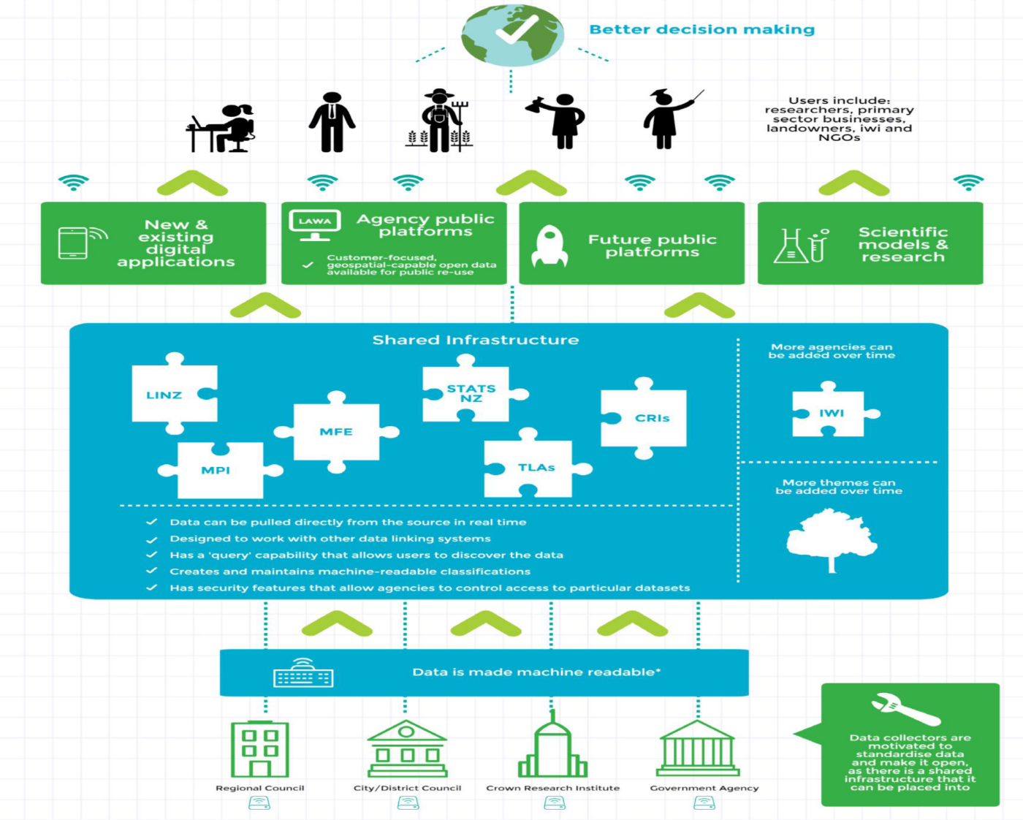
Goal
Many destinations

Slide 21
e-IDI
Single point of access, irrespective of source
+
CRI’s + Govt + Tertiary

Slide 22
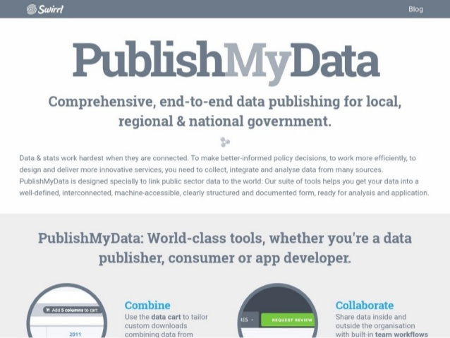






e-IDI

Slide 23
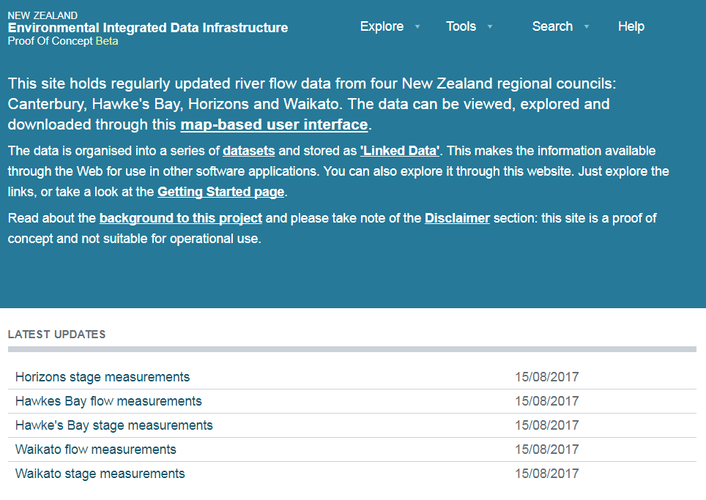
e-IDI

Slide 24
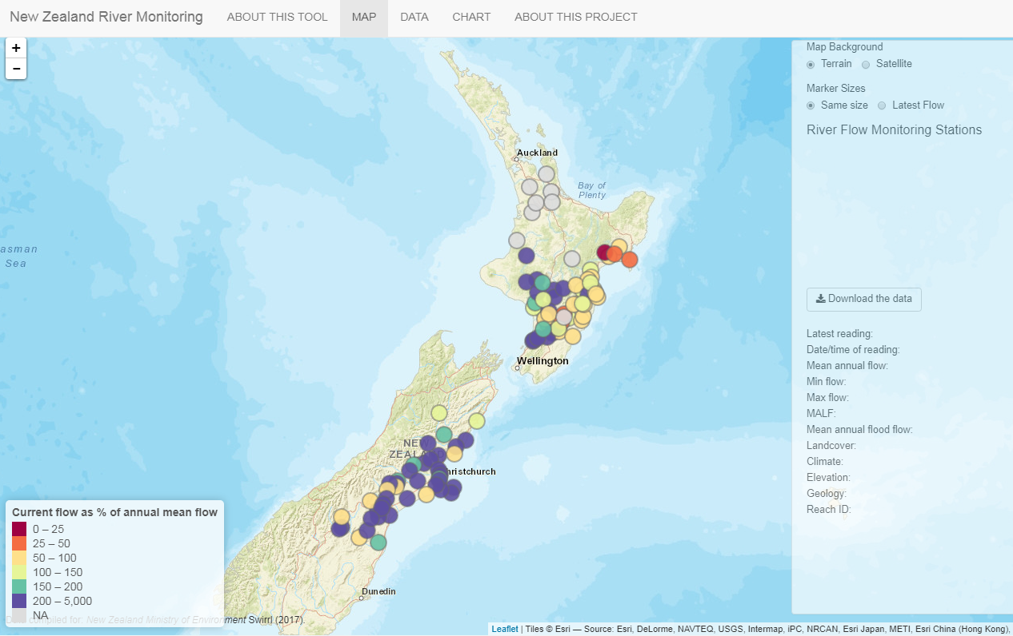
Example
Example

Slide 25
Next Phase
Operationalising the eIDI for the entire regional sector
Single data-broker to supply multiple uses
Underpinned by OGC standards
Persistent URI’s may be step too far in NZ, as yet

Slide 26
Outstanding issues (still)
Data delivery methodology for agencies
Confusion within and between different domain working groups
Cross pollination improving within organisations
Still lacking consistency
No persistence
Lacking connectivity across domains
Naming conventions
No easy discoverability (failing NZ Inc).

Slide 27
Supporting sector goals
Reliance on:
Governance model:
Reporting (EMaR)
Coms of interest (SIGs – Domain Experts)
Standards (NEMS):
Promotion of interactions between the Governance model and the SIGs

Slide 28
Discovery
This is the next challenge!!!
Profile O&M, not fully implemented yet
GetDataAvailablity.
Stats rather than full, large volume timeseries.
MORE Focus on PUBLIC CONSUMPTION
>90% users don’t/cant handle large datasets.

Slide 29
Ongoing challenges
Biological data
Genus, species, counts, etc
TimeseriesML partnered with other containers
Linked data

Slide 31
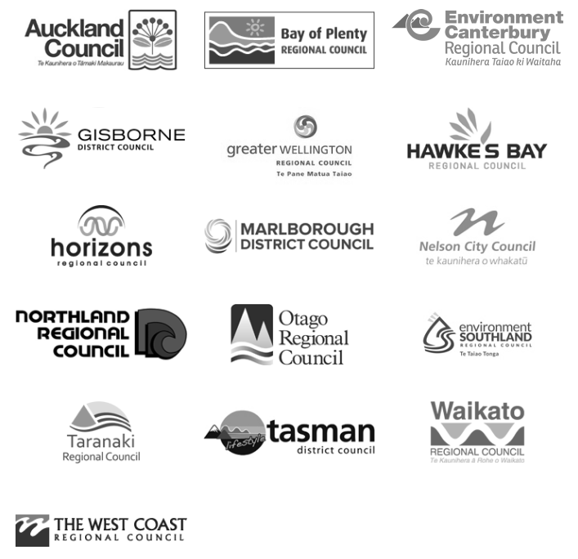







Partners / Providers

