Slide 1
WMO Information System
Present and Future
Matteo Dell’Acqua
Chair CBS OPAG on ISS
(presentation at the 1st WMO Workshop on Information Management, Oct. 2017)

Slide 2
About WIS
WIS is about finding, accessing and exchanging information. It has three parts :
Part A. Continued evolution of the GTS to support the exchange of operational and time critical data and products
Part B. Discovery, access and retrieval. A service that allows data, products and services to be registered
Part C. Information management (Cg-17)
WIS includes original, repackaged and redistributed data

Slide 3
WIS Communities
Users.
WIS provides data to any authorized user
WIS provides public access to data that is registered to be freely available
Data providers
WIS data providers are the National Centres (NCs) and the Data Collection or Production Centres (DCPCs)
Data providers register the availability of their data in WIS’s Global Information System Centres (GISCs)
WIS encourages data providers to use WMO data formats (eg GRIB BUFR NetCDF) , but can exchange any file format
Data providers set the data policy on services and products registered and available through WIS

Slide 4



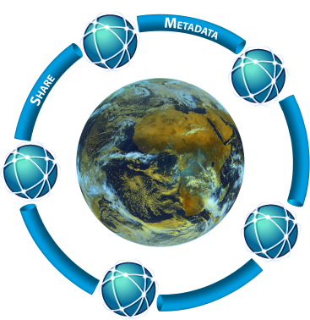















WIS Communities
GISC
Supply Data
Subscription
Publish Metadata
Supply Data
DCPC
Or NC
Service registery
Data processing
And packaging
Publish Metadata
Discover product
NC or
DCPC

Slide 5
WIS Status
WIS intended to support all WMO Programmes
Reality is that only World Weather Watch is well represented
WIS is a network for expert (centres from WWW)
Difficult to put new data on WIS
Difficult to find data
Difficult to know that WIS exist
In its current form, the WIS, and mainly the GTS, is a niche infrastructure that supports the expert meteorological community

Slide 6
Towards WIS 2.0 - Trends
Constant increase in the flow of data to exchange and information to be disseminated to various users mean that it is necessary to re-think how data is process, managed and shared
Data volumes created by earth observing and numerical prediction systems continue to grow considerably faster than the performance of telecommunications networks
Other sources of information are becoming available that may have data volumes that exceed those of traditional data sources, such as indirect information and crowd sourcing
Users expect to access weather, water and climate information and services through the same mechanisms that they use for other types of information, using familiar interfaces and applications
Users wish to combine mobile, cloud and social technologies to access a wider range of information sources and to collaborate in new and different ways

Slide 7
Towards WIS 2.0 - Trends
Common data sharing platforms and technology are a prerequisite
Risk reduction and emergency response requires collaboration with multiple agencies
Assessing the impact of environmental hazards requires meteorological data to be combined with other socio-economic data
Changes in data supply patterns and user expectations present new challenges that the current WIS struggles to meet
FTP protocol is no longer an appropriate method of delivering information on time
At the same time, changes in technology present new opportunities

Slide 8
Towards WIS 2.0 - Opportunities
Increasing use of the Web as a data sharing platform
Commercial infrastructure providers offer
stable, secure and cost-effective ‘cloud’ hosting of virtualized computing resources
Search engines (Google, Bing, Yahoo etc.) remain the common entry point for discovery of information
Application Programming Interfaces (APIs) and Web Services are now very common solutions for process and exchange of data
Messaging services and protocols offer new opportunities for sharing meteorological data in real-time based on common industry practices
Applications such as Dropbox indicate that file distribution services have become commoditized and are no longer the domain of specialized applications such as GTS message switching

Slide 9
WIS 2.0
Information System operated by Members built on commercially available services and industry standards
To exchange at the right moment the relevant information and avoid moving unnecessary large volumes of data between centres
To broaden the range of information available and improve data producers and data consumers experience
To simplify access to the information and make its use easier in order to develop new products, applications and services
Providing applications/services infrastructure alongside the data, and a catalogue of information and services
Avoiding duplication through use of shared components built on infrastructure
Allowing to use infrastructure and services to build services that meet the needs of domestic stakeholders
A virtual one stop shop of weather, water and climate information

Slide 10
WIS 2.0
All WIS data will be
Managed
Documented & Discoverable
Accessible and Easy to use
API to improve selection and granularity of requested data sets
Services to visualize or process the data and only ingest the required information

Slide 11
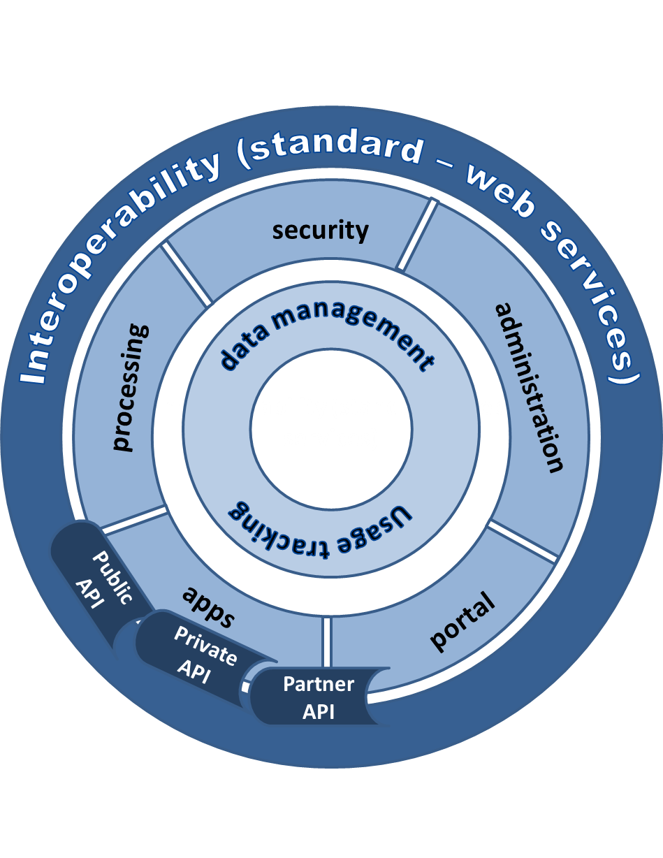
WIS 2.0 - the platform
A global information management, processing and sharing platform
Acquisition
Dissemination
Collaboration
Change in user behaviour from downloading a copy of information for local processing to using services that process the information at its source

Slide 12
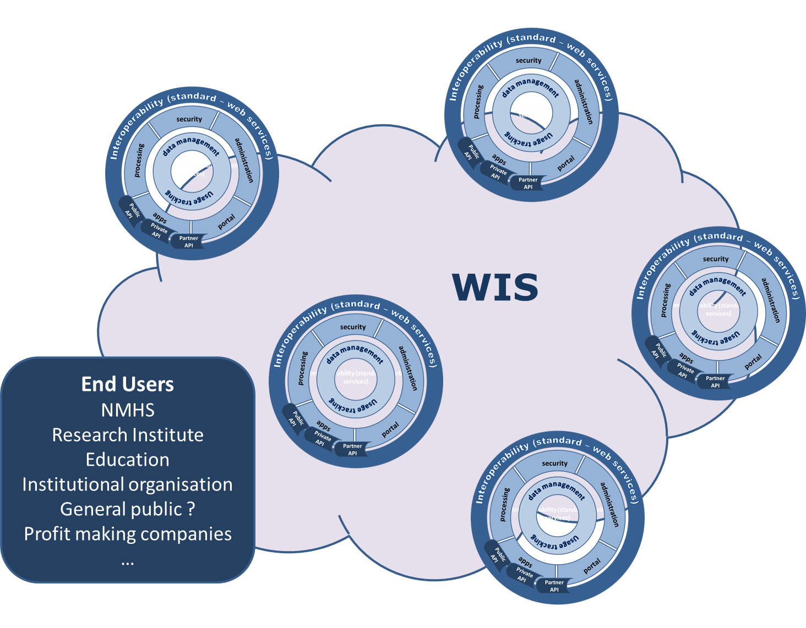
WIS 2.0 - The ecosystem !
Opened to new partners from different business (energie, health, value-added service provider..) to develop the use of WMO information

Slide 13
WIS 2.0 - Data Lifecycle Management
Information activities
Create
Documenting
Store
Cataloging
Quality control
Share
Acquisition, dissemination, access services
Use
Processing services
Usage tracking
Archive
Preservation
Dispose
WIS 2.0 platform will be complemented by a set of principles to standardize best-practice in data life cycle management by the WMO community

Slide 14

Thank you
Merci

