Slide 1
WMO/OGC Hydrology DWG
“The early years”
9th Workshop of the WMO/OGC Hydrology Domain Working Group
Geneva, Switzerland
Ulrich Looser
17 September 2018

Slide 2
Towards the Hydrology DWG
March 2007
  CUAHSI submits WaterML as OGC Discussion paper
September 2007 (Canberra, Australia)
  34 participants, 18 organizations, (Oceania, North America, Europe)
  Meeting coordinated by NR Canada and CSIRO looking at international activities, methodologies, technologies for the exchange of hydrologic data and information
  Agreement that time was right to establish working group to move forward
Early 2008
  Much discussion between CSIRO, CUAHSI, OGC and WMO
September 2008 (Atlanta)
  First ad-hoc
  Agreement to develop charter for HydroDWG (CSIRO lead)
December 2008 (Valencia)
  3 Presentations (CSIRO, GRDC, OGC)

Slide 3
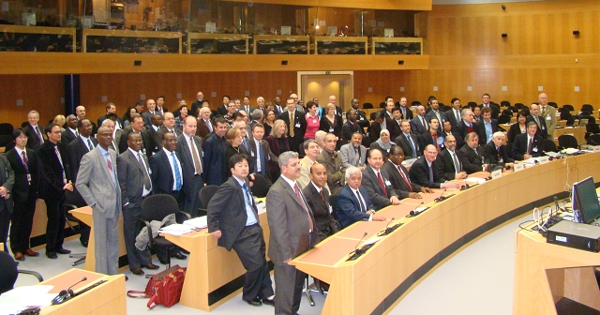
Towards the Hydrology DWG
November 2008
  First OGC Observer (David Arctur) at WMO CHy-13 Session

Slide 4
Towards the Hydrology DWG
Early 2009
  CUAHSI and CSIRO start working on WaterML2.0
March 2009 TC Meeting Athens
  6 presentations (EEA, INSPIRE, WMO, GRDC, CUAHSI, CSIRO)
  TC agrees to Charter
OGC/WMO Hydrology Domain Working Group is formed

Slide 5
Since Formation
June 2009 TC Meeting Boston
  First official meeting
  Motion: Ilya Zaslavsky elected co-chair
  Groundwater IE proposed
September 2009 TC Meeting Darmstadt
  Presentation of Water Data Exchange Formats Harmonisation Report by Peter Taylor (Basis for WaterML 2.0 Part 1 – Timeseries)
November 2009
  MoU signed between WMO and OGC
December 2009 TC Meeting Mountain View
  Surface Water IE proposed
  David Lemon and Ulrich Looser WMO nominated co-chairs

Slide 6
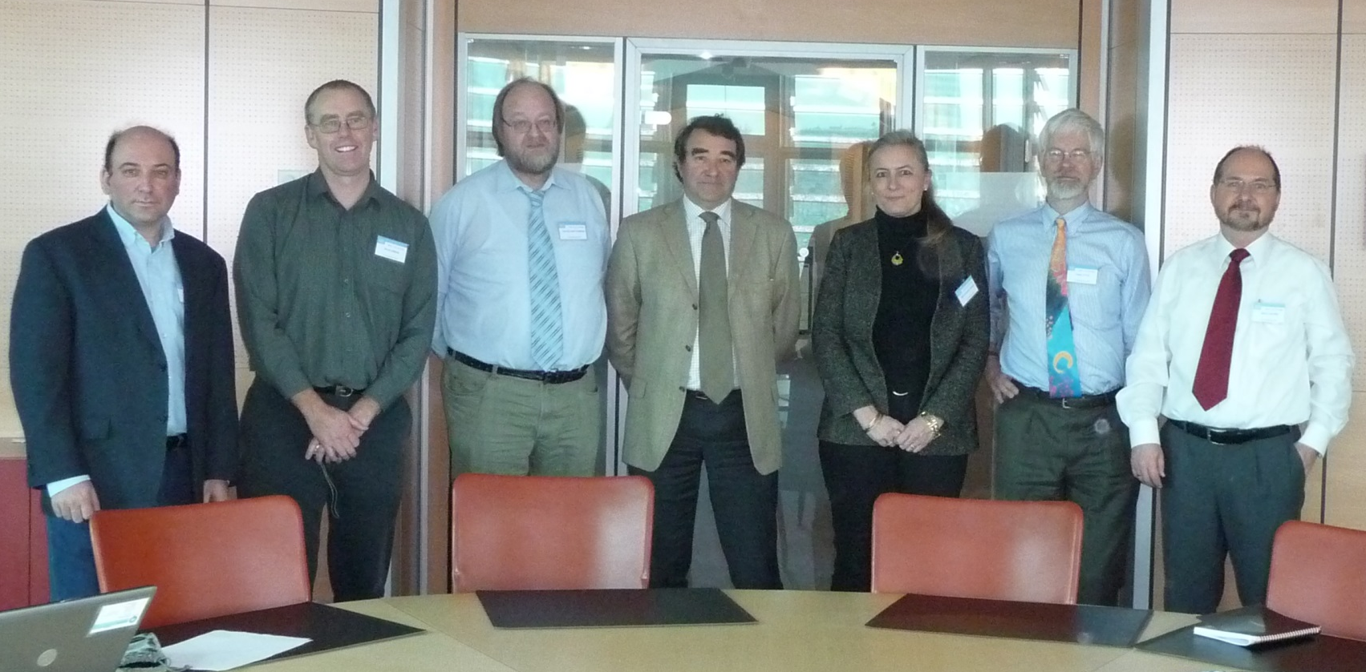
Since Formation
February 2010
  First Meeting of Hydro- and Met/Ocean co-chairs at WMO

Slide 7
Since Formation
2010 TC Meetings
  June 2010 TC Meeting Silver Spring
  September 2010 TC Meeting Toulouse
  September 2010 Mini HydroDWG at TC Meeting in Toulouse
  December 2010 TC Meeting Sydney
2010 Activities
  June 2010 WaterML 2.0 Part 1 submitted as a discussion paper
  June 2010 Surface Water IE2 launched
  December 2010 Surface Water IE2 final report as Best Practice Paper

Slide 8
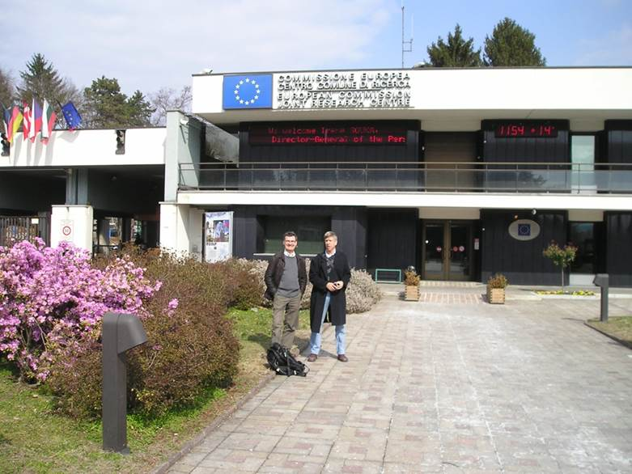
Since Formation
March 2010 (Ispra) 1st Hydro DWG Workshop
24 participants from UN, Oceania, North America, Europe
Vendors, Government, Research
Looking at
  Methodologies, patterns
  and technologies
  Current activities
  Futures

Slide 9
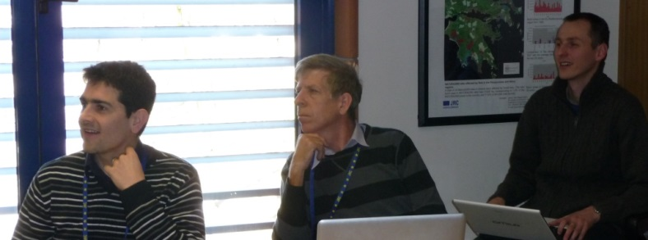
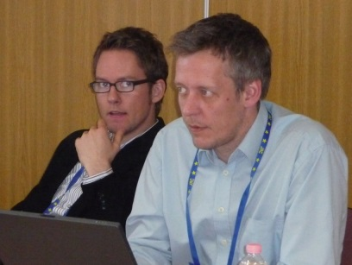
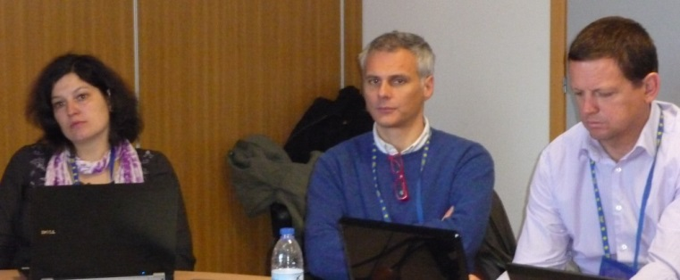
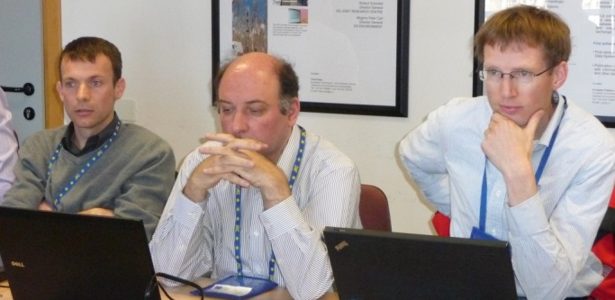
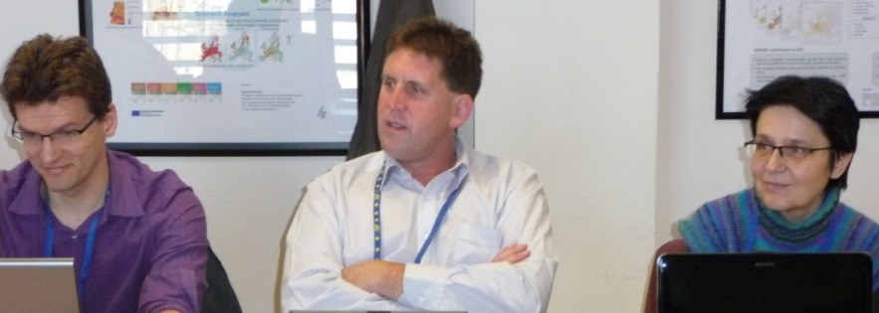
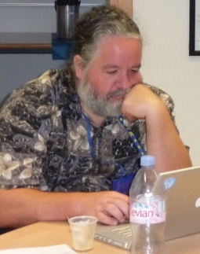
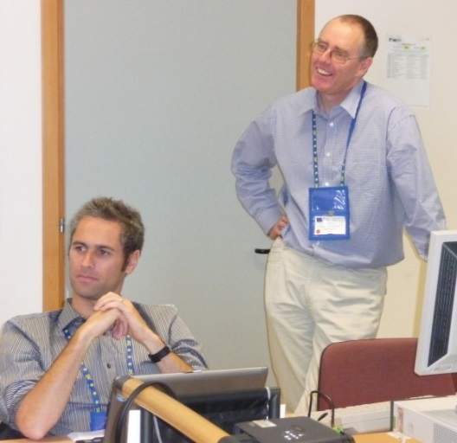
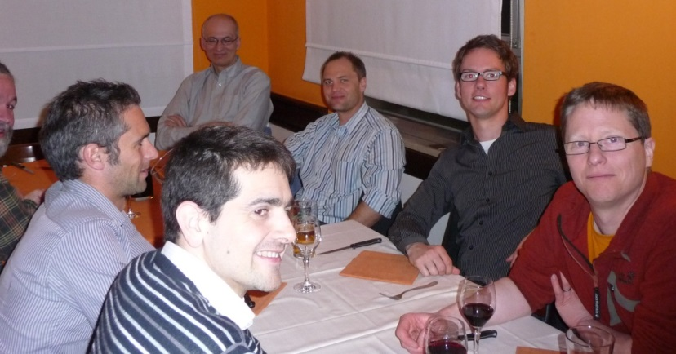
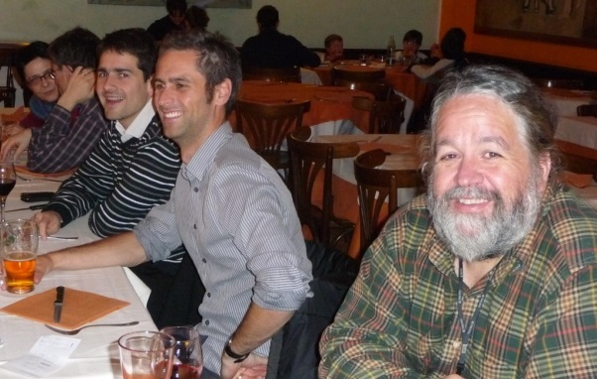
March 2010 (Ispra) 1st Hydro DWG Workshop
Impressions

Slide 10
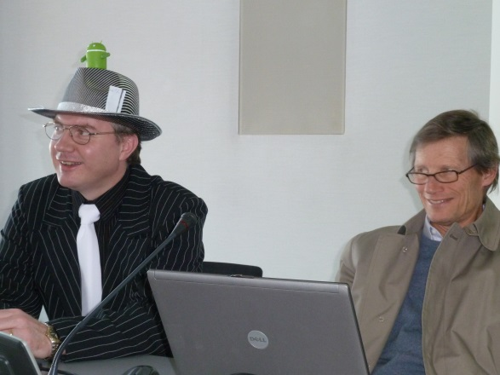
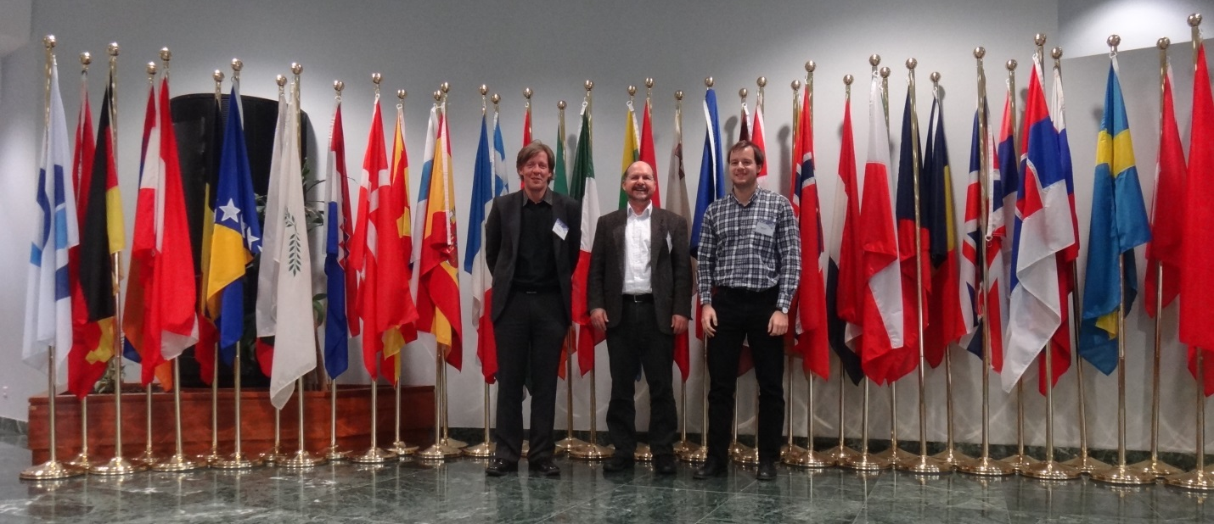
Since Formation
2011 TC Meetings
  March 2011 TC Meeting Bonn
  June 2011 TC Meeting Taichung
  September 2011 TC Meeting Boulder
  September 2011Oceans/Met/Hydro Water Cycle Summit at Boulder TC Meeting
  December 2011 TC Meeting Brussels

Slide 11
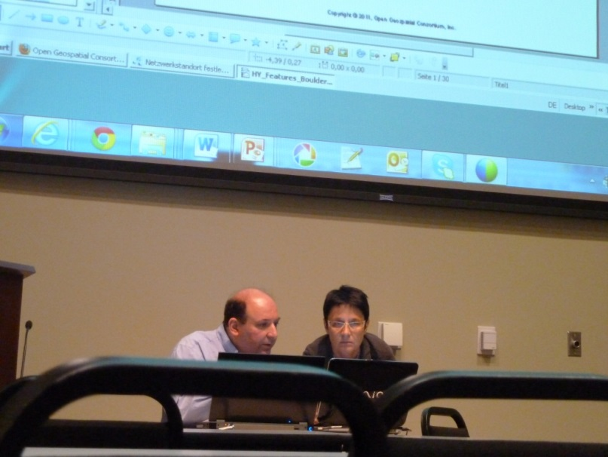
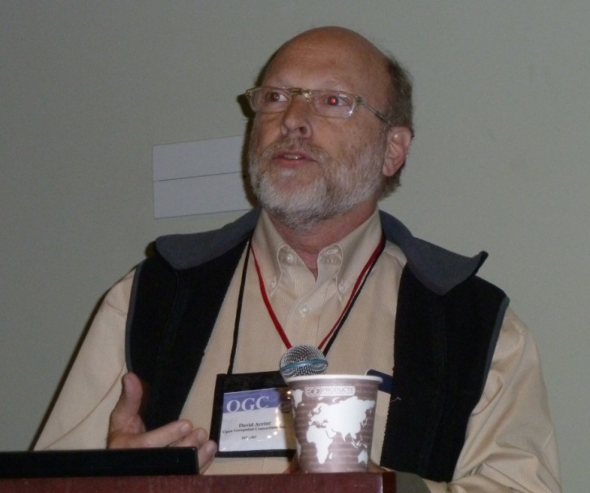
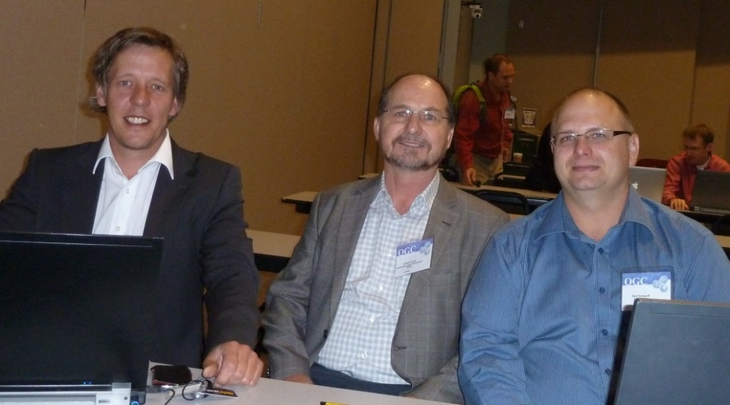
September 2011Oceans/Met/Hydro Water Cycle Summit at Boulder TC Meeting - Impressions

Slide 12
Since Formation
2011 Activities
  March 2011 Establishment of WaterML 2.0 Part 1 SWG
  June 2011 Surface Water IE2 final report

Slide 13
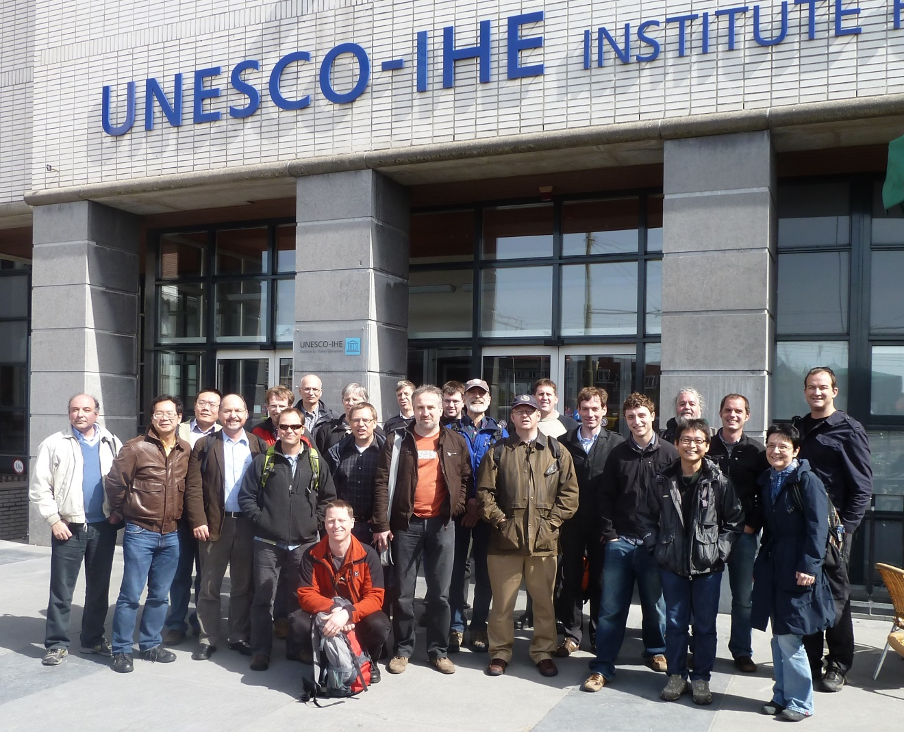
Since Formation
April 2011 (Delft) 2nd Hydro DWG Workshop
~ 25 participants from UN, Oceania, North America, Europe

Slide 14
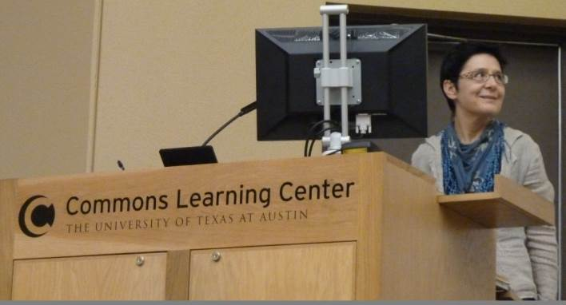
Since Formation
2012 TC Meetings and Activities
  March 2012 TC Meeting Austin
  March 2012 “HY_Features: Common Hydrological Feature Model” as an OGC Discussion Document
  March 2012 “Surface Water Interoperability Experiment Final Report” as an OGC Engineering Report
  September 2012 “CHISP-1 Engineering Report” as an OGC Public Engineering Report
  September 2012 “HY_Features: Common Hydrological Feature Model” as a revised OGC Discussion Document
  September 2012
    OGC® adopts the OGC WaterML 2.0 Part 1: Timeseries
    Encoding Standard as an official OGC Implementation Standard

Slide 15
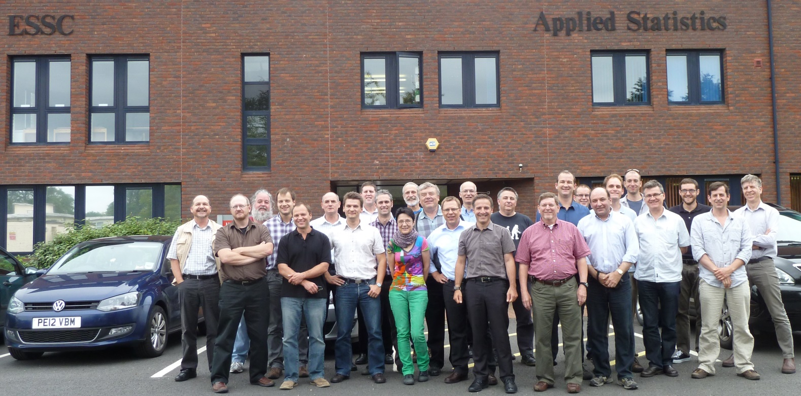
Since Formation
June 2012 (Reading) 3rd Hydro DWG Workshop
~ 25 participants from UN, Oceania, North America, Europe

Slide 16
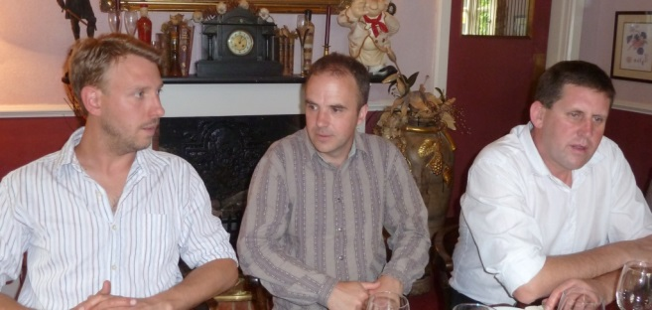
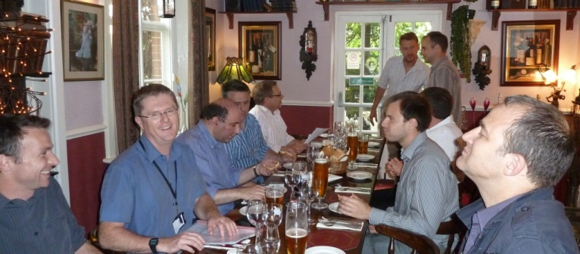
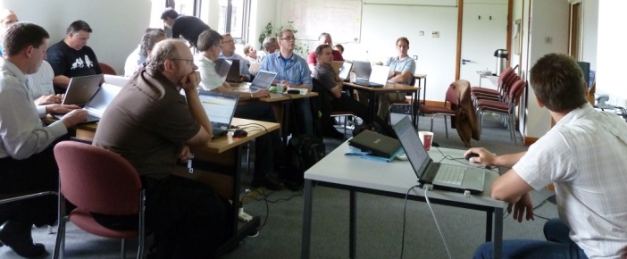
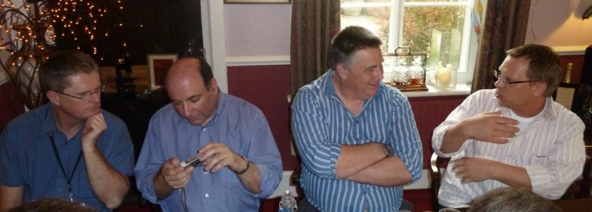
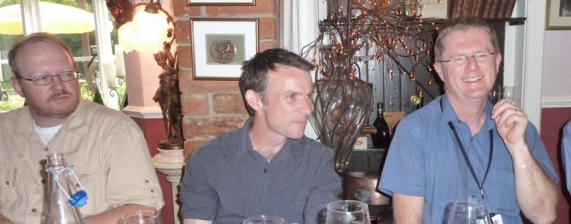
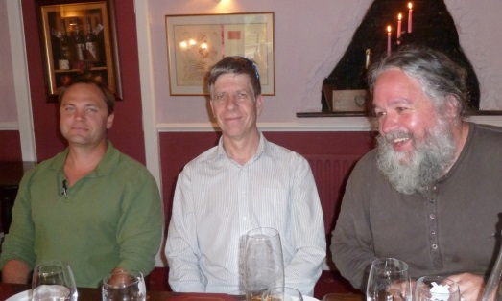
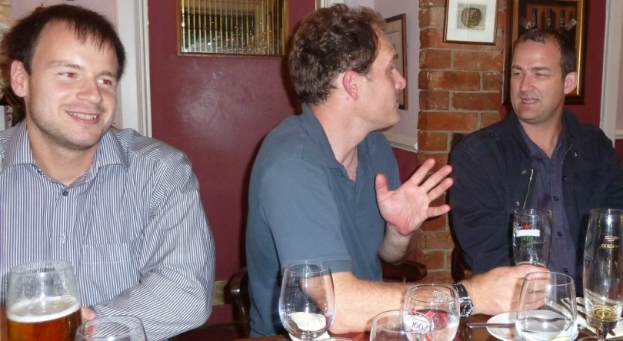
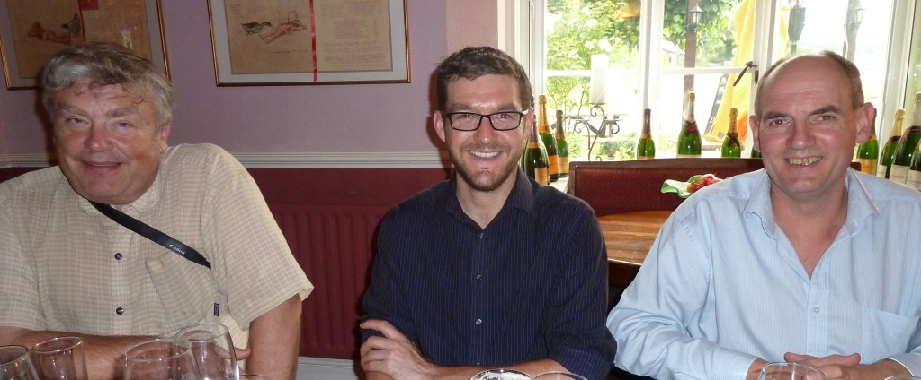
June 2012 (Reading) 3rd Hydro DWG Workshop
Impressions

Slide 17
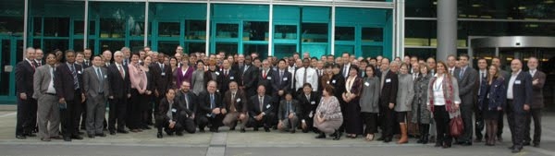
Since Formation
November 2012
  Adoption of Resolution 3 at CHy-14
  “Proposed adoption of WaterML 2.0 as a standard”
  CHy… decides to commence a process…that could see the potential adoption of the WaterML 2.0 as a WMO standard for information exchange managed by WMO (supported by the WMO/OGC Memorandum of Understanding), and to register this standard as a joint WMO/ISO standard…

Slide 18
Since Formation
2013 TC Meetings
  June 2013 TC Meeting Redlands
  September 2013 TC Meeting Frascati
  2013 and Activities
  June 2013 WaterML2.0 - part 2: Ratings, Gaugings and Sections OGC Discussion Paper
  December 2013 Ratings, Gaugings, and Cross-Sections (WaterML 2.0 Part 2) IE

Slide 19
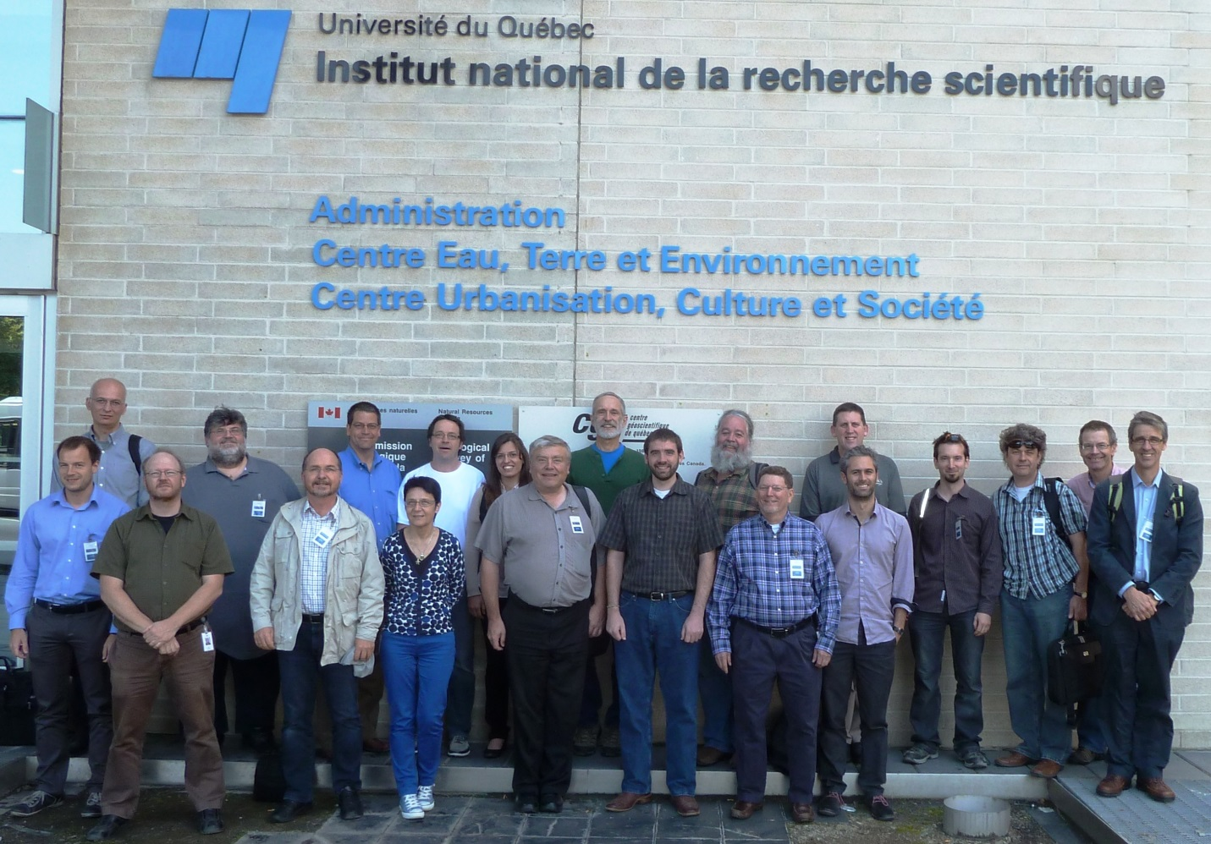
Since Formation
June 2013 (Quebec City) 4th Hydro DWG Workshop
~ 25 participants from UN, Oceania, North America, Europe
Tony joins the HDWG as WMO nominated co-chair replacing David Lemon

Slide 20
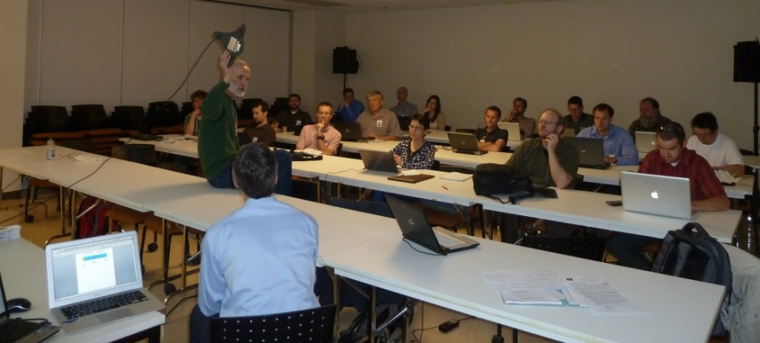
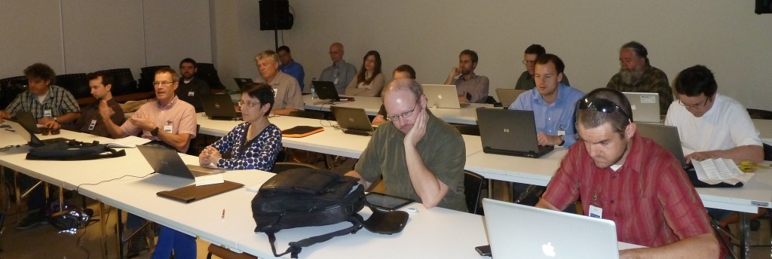
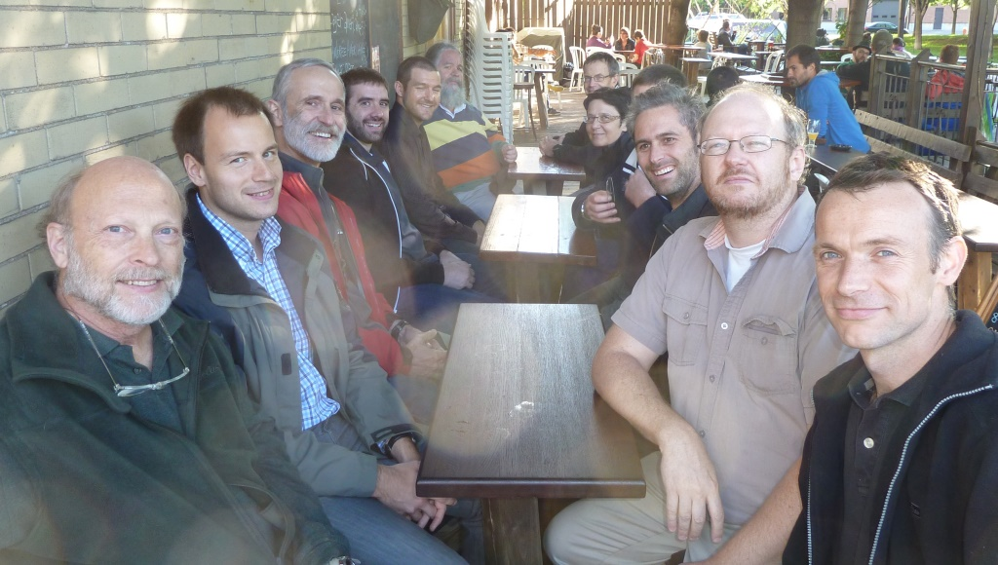
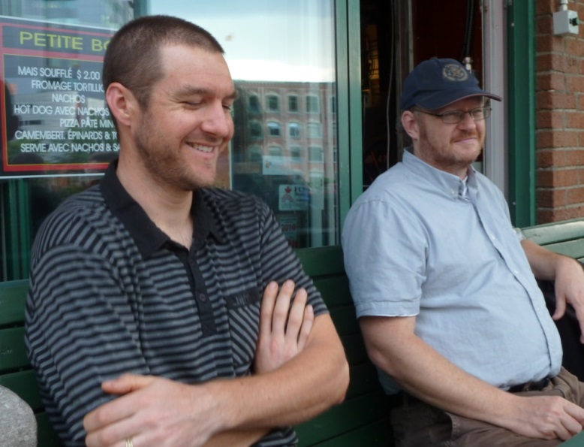
June 2013 (Quebec City) 4th Hydro DWG Workshop Impressions

Slide 21
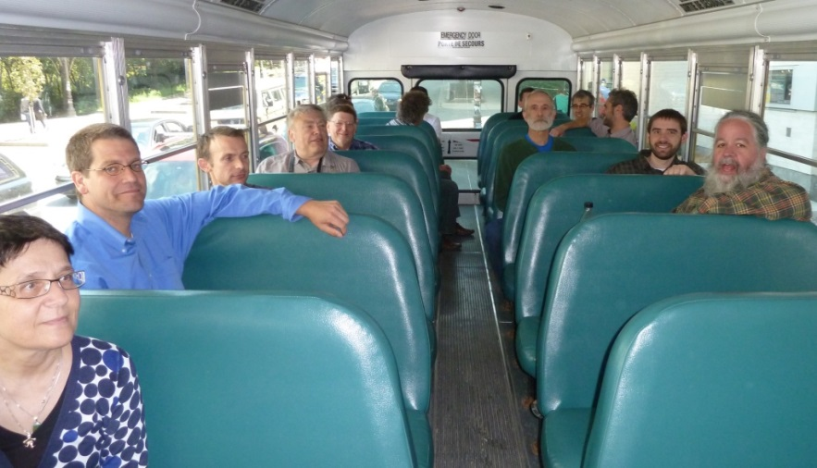
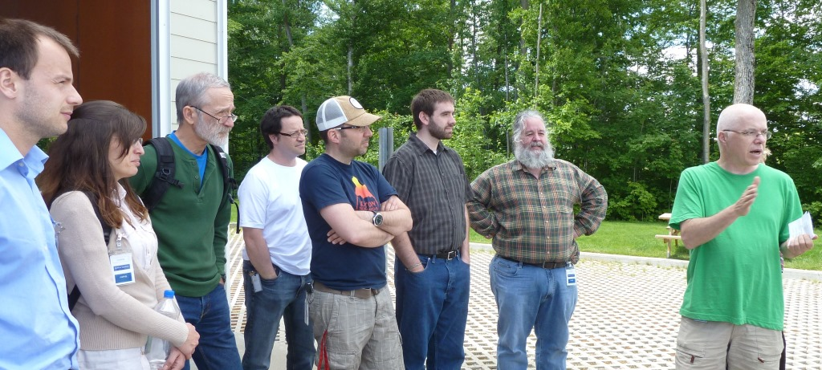
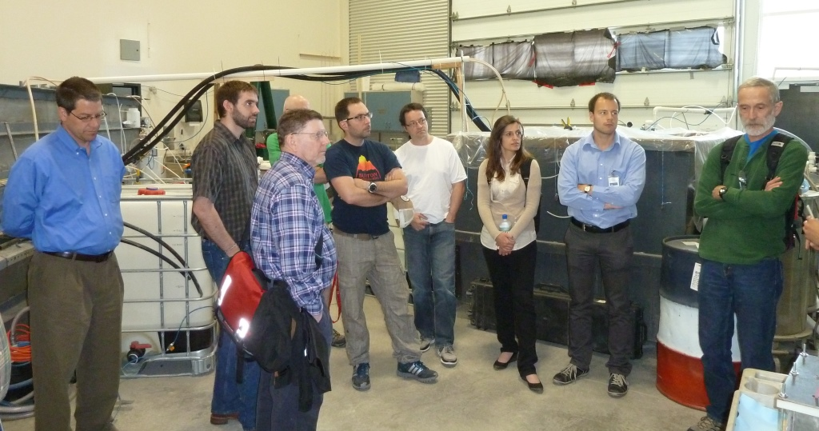
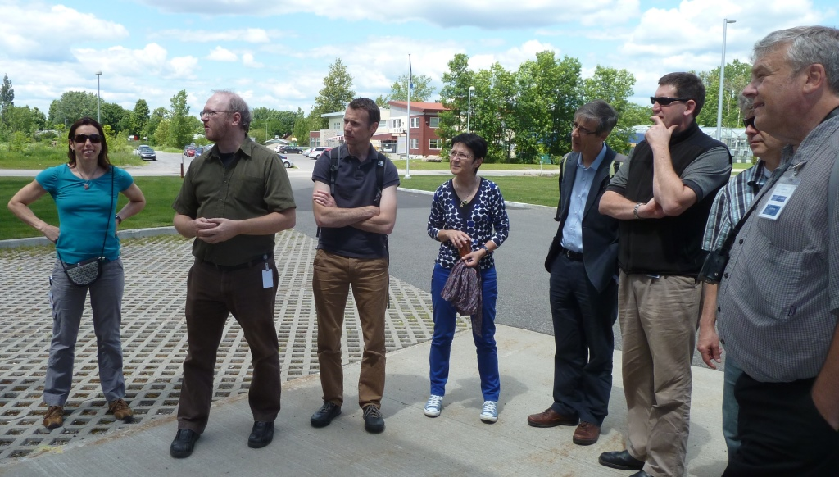
June 2013 (Quebec City) 4th Hydro DWG Workshop Impressions

Slide 22
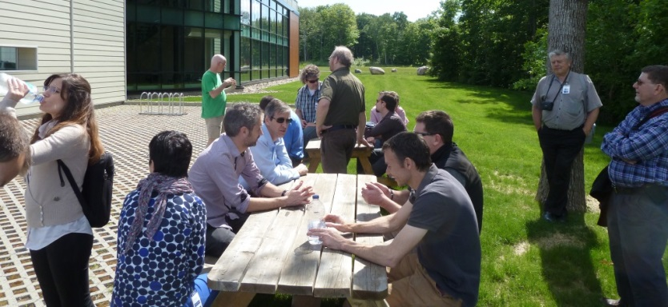
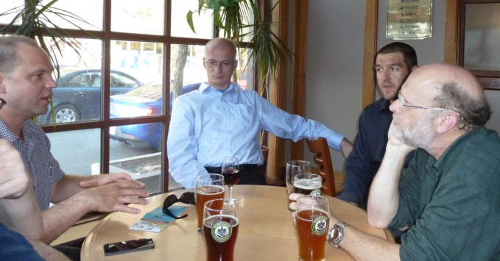
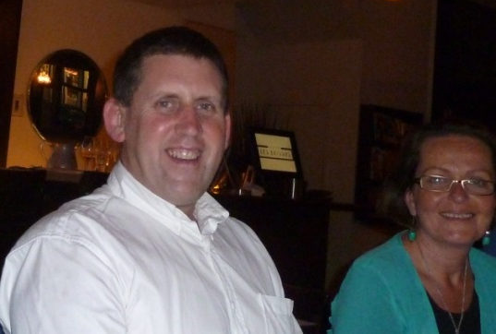
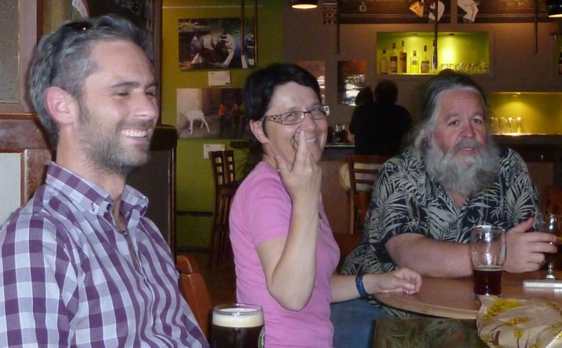
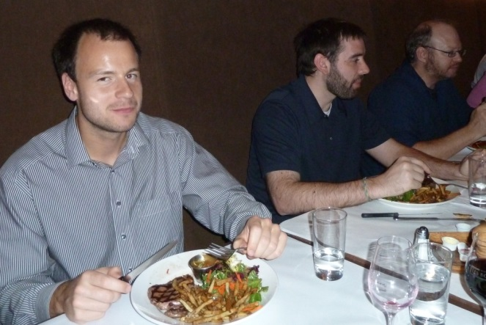
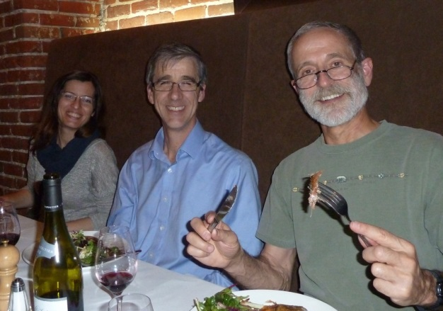
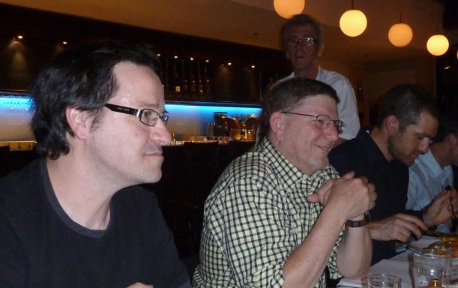
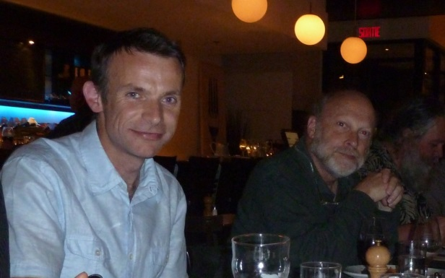
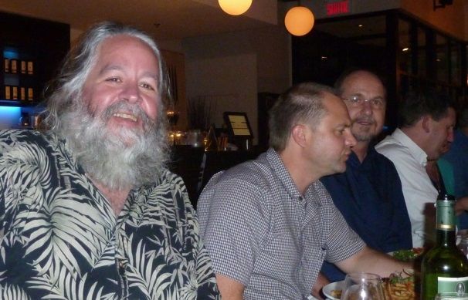
June 2013 (Quebec City) 4th Hydro DWG Workshop Impressions

Slide 23
Since Formation
2014 TC Meetings
  March 2014 TC Meeting Arlington
  June 2014 TC Meeting Geneva (Silvano Pecora joins the HDWG as WMO nominated co-chair replacing Ulrich Looser)
2014 Activities
  March 2014 “WaterML-WQ - an O&M and WaterML 2.0 profile for water quality data” as an OGC Best Practice Document
  March 2014 “Sensor Observation Service 2.0 Hydrology Profile” as an OGC Discussion Document
  June 2014 “Sensor Observation Service 2.0 Hydrology Profile” as an OGC Best Practice Document
  June 2014 “OWS-10 CCI Hydro Model Interoperability Engineering Report” as an OGC Engineering Report
  August 2014 5th HydroDWG Workshop, New York City
  August 2014 HydroDWG Tutorial at HIC 2014 in NYC
  …

Slide 24
Since Formation
Achievements first 5 years (selection):
    WaterML 2.0 Part 1: Time Series as an official OGC standard
    HY_Features: Common Hydrological Feature Model as an OGC Discussion Document
    WaterML2.0 - part 2: Ratings, Gaugings and Sections as an OGC Discussion Document
    WaterML-WQ - an O&M and WaterML 2.0 profile for water quality data as an OGC Best Practice Document
    Sensor Observation Service 2.0 “Hydrology Profile” as an OGC Best Practice Document
    Numerous IE‘s (Groundwater, Surface Water, Water Quality…)
    Participation in several cross-domain projects (AIP’s, OWS’s, CHISP-1 (Climatology-Hydrology Information Sharing Pilot), etc.
    Platform for showcasing numerous activities in the water and related domains
    …list too long to mention everything

Slide 25
Since Formation
Tasks lying ahead (2014):
  Standard development - WaterML2.0 - part 2: Ratings, Gaugings and Sections
  Standard development – RiverML (Channel and floodplain geometry)
  Standard development GroundWaterML2
  Standard development WaterML2-WaterQuality
  Standard development HY_Features
  Addressing a Water Suite of standards
  Many other issues waiting for champions to take them further…

Slide 26
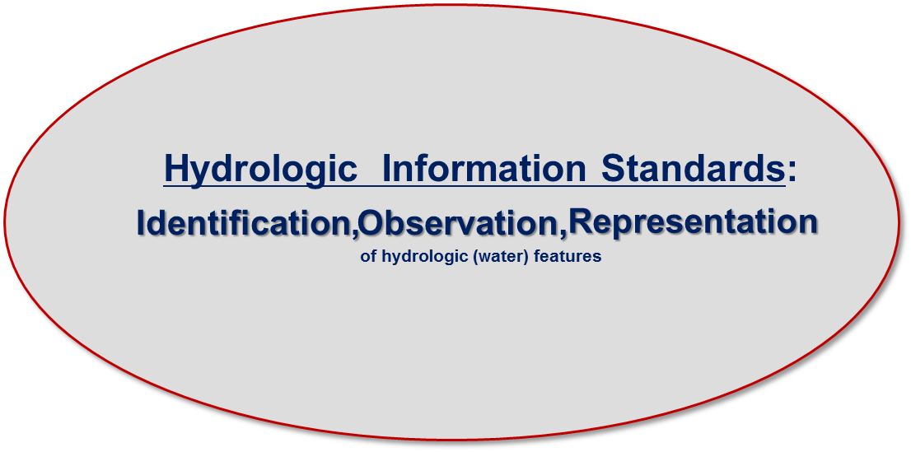
Current status
WMO/OGC Hydrology Domain Working Group
WaterML2 suite
TimeseriesML 1.0
Timeseries
(OGC IS 15-042r3)
(OGC IS 15-043r3)
WaterML2 Part 2: Ratings, Gaugings and Sections
(OGC IS 15-018r2)
WaterML2 Part 3: Surface Hydrology Features
HY_Features
(OGC IS 14-111r6)
WaterML2 Part 1:
Timeseries
(OGC IS 10-126r4)
SOS 2.0
Hydrology Profile
(OGC BP 14-004r1)
WaterML2 Part 4: GroundWaterML 2 Features GroundwaterML2 (OGC IS 16-032r2)
WaterML2 Part X:
WaterML-WQ
– an O&M and WaterML2.0 profile for water quality data
(OGC BP 14-003)
SoilML component:
Soil-water (collaboration tbd)
…(RiverML)…:
Channel Geometry
(continuation tbd)
WaterML2PartX: River Network Topology
(OGC IS YY-XXX)
CSML3 component:
Atmospheric-water
(collaboration tbd)

Slide 27
Lessons learned
  Great to work in a diverse team (countries, organisations, languages) with common interests
  Changing composition of WG depends on needs addressed
  Maintain open communication channels
  Maintain links between OGC and WMO structures (ensure exchange of user needs and technical solutions)
  Difficult (but possible) to match decision cycles between OGC and WMO
  Each task needs a champion to be turned into a success
  Addressing common issues across (water cycle) domains is critical
  … lets continue the dialog and exchange….

Slide 28
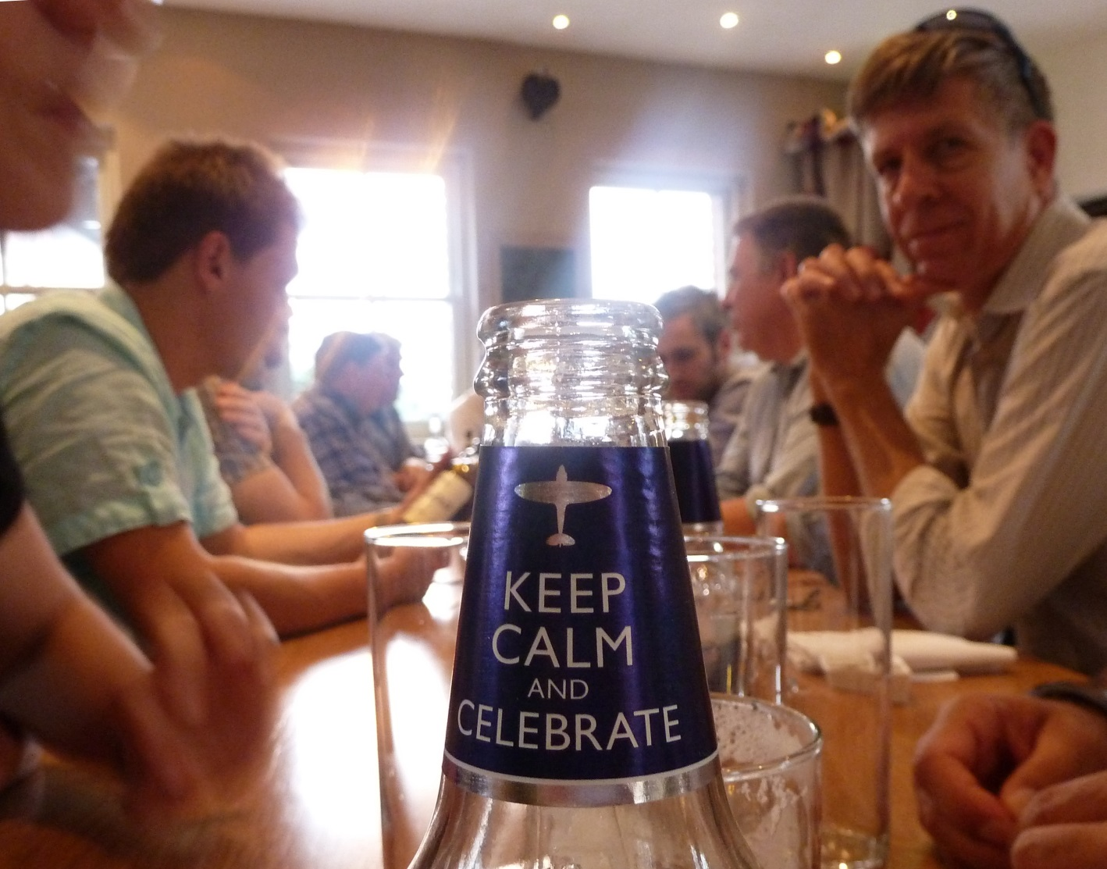
Thank you for your attention !

