Slide 1
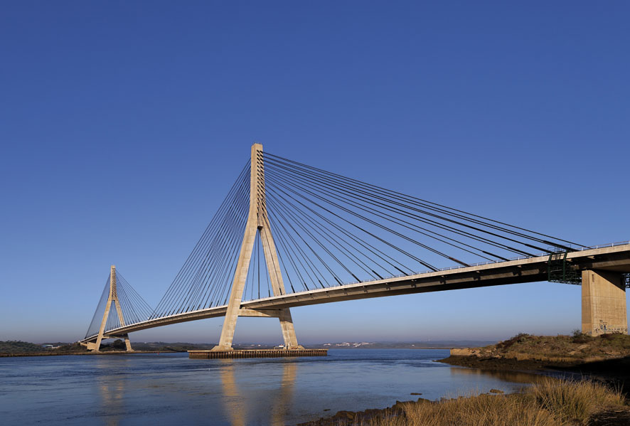

The Water Convention Obligations on information sharing and monitoring and Monitoring the implementation of transboundary cooperation under SDG6
Francesca Bernardini
Secretary, UNECE Water Convention
20 September 2018

Slide 2
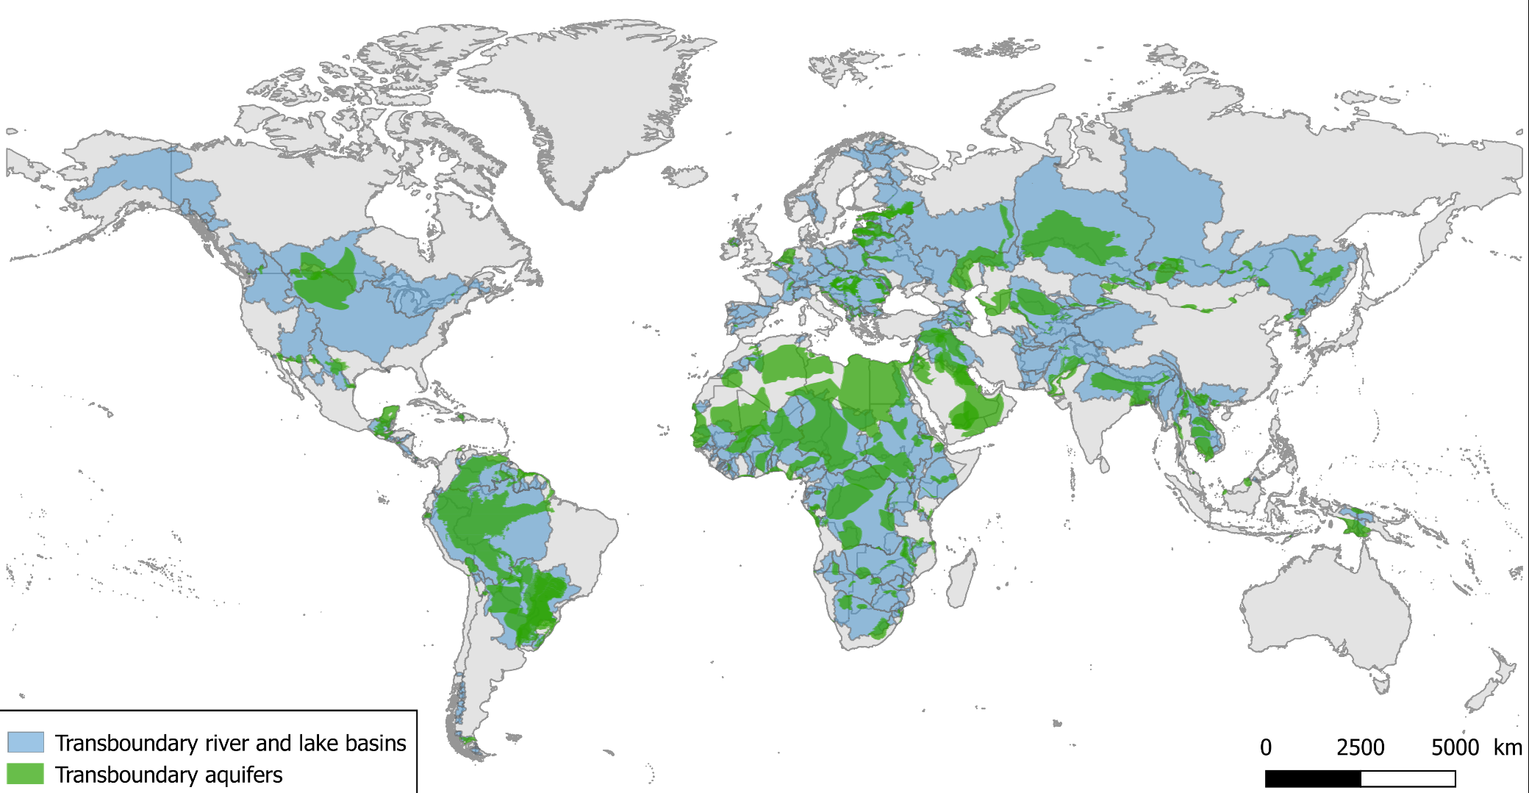
Water resources are essentially transboundary
Most of the world’s water resources are shared.
Development and management of water resources has impacts across transboundary basins
Cooperation is required
Source: UNESCO-IGRAC (aquifers); GEF-TWAP (river and lake basins)

Slide 3
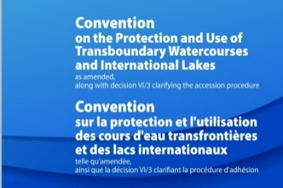
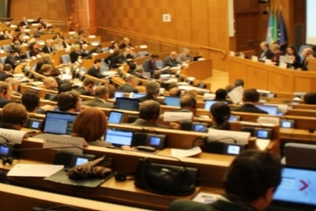
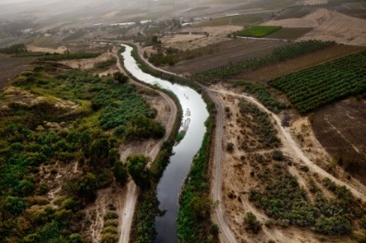
Purpose, scope and content of the Water Convention
Purpose
Foster cooperation over transboundary waters in order to ensure that they are sustainably and equitably managed
Three key principles of the Convention
Principle of prevention
Principle of equitable and reasonable utilization
Principle of cooperation
A sound legal framework
An active institutional framework
Activities and projects ‘on the ground’

Slide 4
Institutional framework
Meeting of the Parties to the Water Convention
Implementation Committee
Working Group on Integrated Water Resources Management
Working Group on Monitoring and Assessment
Bureau
Legal Board
Task Force on Water & Climate
Task Force on Water-Food-Energy-Ecosystems Nexus
Expert Groups
IWAC
Secretariat (UNECE)

Slide 5
Status of ratification of the Water Convention
Chad Party since 23 May 2018
Senegal deposited the instrument of accession 31 August 2018
Soon 43 Parties

Slide 6
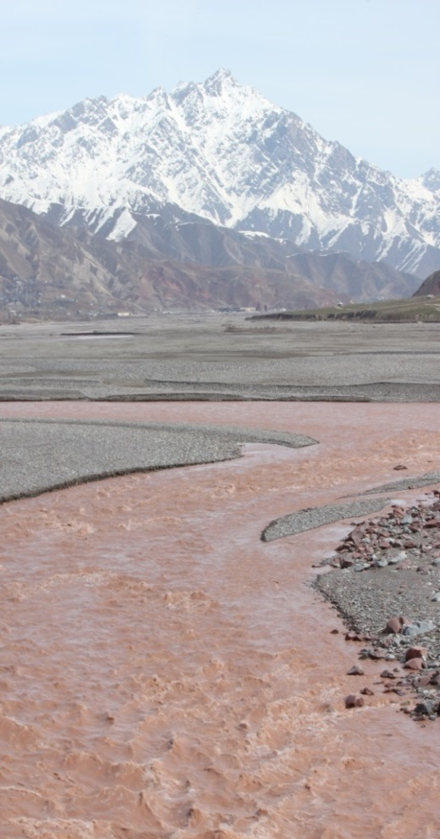
Information exchange under the Water Convention
General obligation to all Parties to «provide for the widest exchange of information, as early as possible on issues covered by the provisions of the Convention»
Protection of information related to «industrial and commercial secrecy, including intellectual property, or national security»
Obligations for riparian Parties, in the framework of agreements and joint institutions to:
Carry out joint monitoring and assessment of transboundary waters (quantity and quality)
Exchange information
Make assessment information available to the public
Water Convention encourages continuously expand the range of information to be exchanged

Slide 7
Scope of the data and information to be exchanged between Riparian Parties (art. 13)
Conditions of transboundary waters
Experience on BAT and research results
Emission and monitoring data
Measures taken or planned to prevent, control and reduce transboundary impacts
Permits or regulations for wastewater discharges
National regulations
Exchange of readily available information should be free of charge
If not readily available, there could be a reasonable charge for the processing of the information

Slide 8
Why information on the status of water resources is necessary?
Information is the basis for decision-making and policy development
To guide management efforts — accurate identification of pressure sources, determining suitability of waters for use etc.
To verify effectiveness of measures taken
To increase efficiency in allocating funds
In shared waters, comparable information across the basin is needed to form a comprehensive picture of the situation
To provide evidence to inform inter-sectoral and transboundary dialogue (e.g. agricultural and energy policies impact on waters)

Slide 9
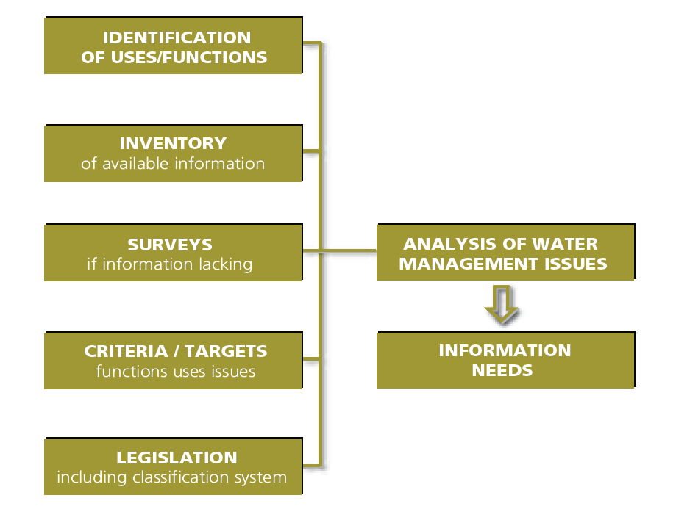
Diverse information needs to support water management
Information needs derive from:
- main water uses and functions
- main issues
- management objectives
Prioritization of issues → prioritization of information needs

Slide 10
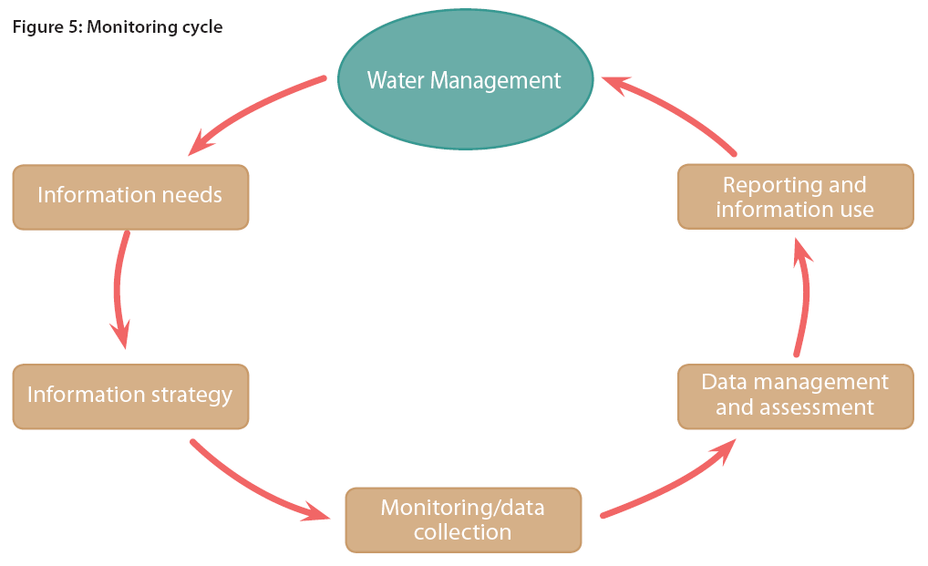
Monitoring Cycle
Information needs evolve as water management develops, targets are met or policies change

Slide 11
Gradual evolution of data and information in transboundary cooperation
Status of transboundary waters
quality
Pressures & cooperation
Pollution
Flow regulation
Joint modelling
sectoral policies
nexus
Indirect effects on waters
quantity
scenarios
vulnerability assessments

Slide 12
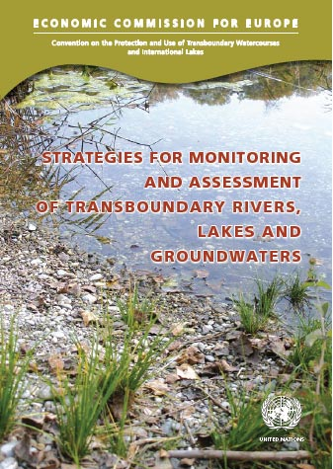
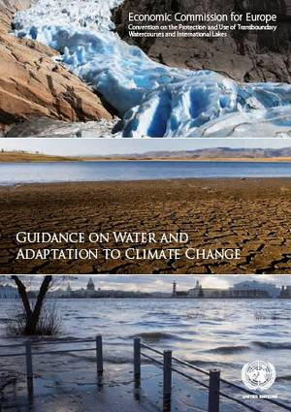

Guidelines and guidance documents
Guidelines on water-quality monitoring and assessment of transboundary rivers (1996)
Guidelines on Monitoring and Assessment of Transboundary Groundwater (2000)
Monitoring and Assessment: Transboundary river guidelines (2001)
Guidelines on Monitoring and Assessment of Transboundary and International Lakes: (2002)
Strategies for monitoring and assessment of transboundary rivers, lakes and groundwaters (2006)
Guidance on Water and Climate (2009)
Policy guidance on benefits of transboundary cooperation (2015)
Methology for assessing the water-food-energy-ecosystems nexus in transboundary basins (2015)

Slide 13

Measuring transboundary water cooperation SDG indicator 6.5.2
Target 6.5: By 2030, implement integrated water resources management at all levels, including through transboundary cooperation as appropriate.
Indicator 6.5.2: Proportion of transboundary basin area with an operational arrangement for water cooperation.
Complements indicator 6.5.1 which measures the advancement of Integrated Water Resources Management (IWRM)
Custodian agencies: UNECE and UNESCO
Tier II indicator: reviewed at 5th IAEG-SDG meeting in 2017
Operational arrangement
Treaty, convention, agreement or other formal arrangement
Joint body for transboundary water cooperation
Annual meetings
Annual exchange of data and information
Adoption of joint/co-ordinated water management plan, or joint objectives

Slide 14

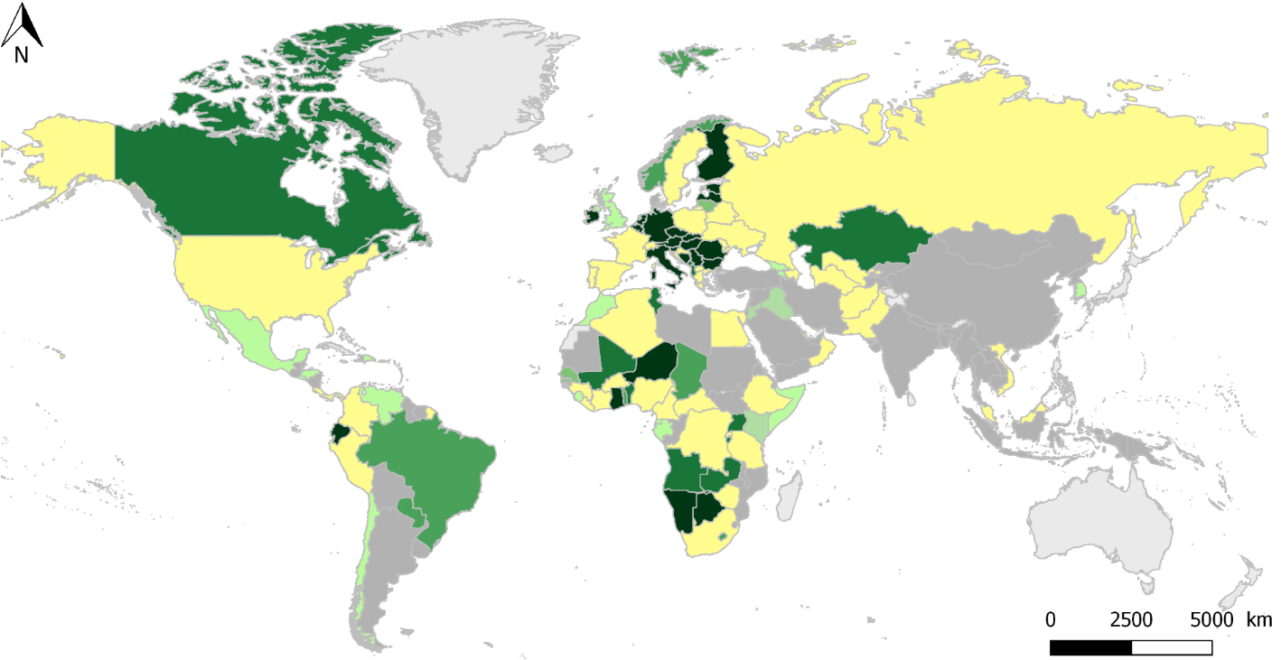


Initial results of the first reporting on SDG 6.5.2
107 country responses by March 2018 (out of 153 countries sharing transboundary waters)
Indicator 6.5.2 available for 62 countries (transboundary river & lake basins and aquifers)
87 countries provided accurate data for transboundary river & lake basins, and
64 countries for transboundary aquifers
38 out of 40 Parties under the Water Convention
59% = average of the national percentage of transboundary basins covered by an operational arrangement
17 countries with all transboundary basins covered by operational arrangements
Significant effort needed to ensure that operational arrangements cover all transboundary waters, especially aquifers

Slide 15
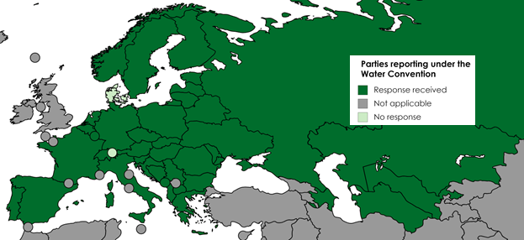
Reporting under the Water Convention
Introduced in 2015 by Decision VII/2 reporting at last Meeting of Parties
Establish regular reporting mechanism under the Water Convention
2017 first pilot reporting exercise cycle. Lead in parallel with the reporting process on SDG indicator 6.5.2
Template developed to assess:
National law and policy framework
Arrangements at basin level and their implementation
Challenges and achievements in transboundary water cooperation
38 out of 40 Parties reported under the Water Convention
High level of responses: 95%

Slide 16
Initial results of the first reporting under the Water Convention: Data and information exchange (Art. 6 & 13)
Data and information exchange takes place in nearly all the reported transboundary waters, although there are at least 7 river and lake basins where it does not appear to take place at basin level.
84% of the responses confirmed data and information exchanged with riparian
Only 24% of the responses indicated that a shared database or information platform is in place
Main difficulty identified: harmonization of national data management and processing
Other difficulties included: lack of resources and capacities, insufficient monitoring networks, and no actual agreement or arrangement in place.
Data exchange is still a challenge even under the Convention

Slide 17
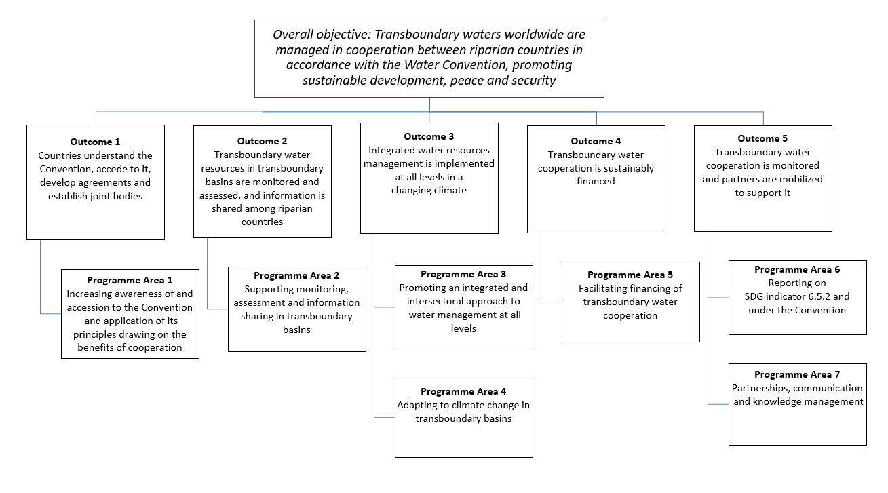
Overview Programme of work for 2019-2021

Slide 18
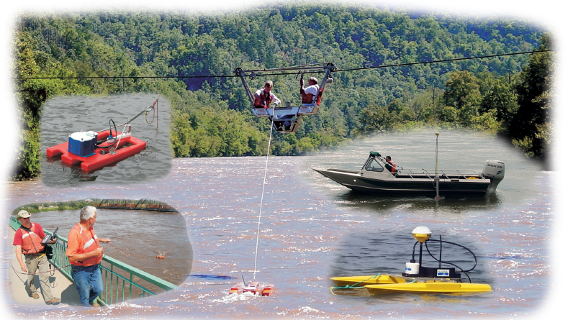
Programme Area 2: Supporting monitoring, assessment and information sharing in transboundary basins
Lead Parties: Finland, Senegal (tbc)
2.1 Organize a global workshop on data and information exchange, publish substantive background paper
2.2 Tailored assistance and experience-gathering
Targeted assistance to cooperation processes on monitoring and assessment (eg studies and expert support) *
Promote exchanges/ twinning * *
Use the different activities, especially basin activities, to collect information on common challenges and needs to guide future review of guidance under the Convention**
Key: *Global level, *Regional/basin-level, *National level

Slide 19
Discussion
What issues should the work on information sharing cover from your perspective?
Do you have specific suggestions?
Do you see areas of interest in the Convention’s programme of work for 2019-2021?
Would you be interested in collaborating?

Slide 20
Thank you for your attention !
Contact:
Water Convention Secretariat
Palais des Nations, Geneva, Switzerland
water.convention@un.org

