Slide 1

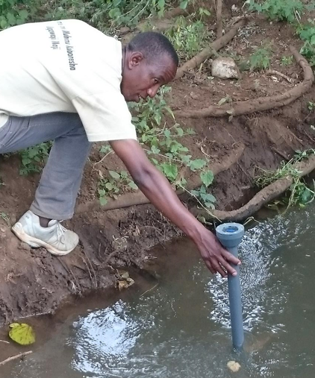
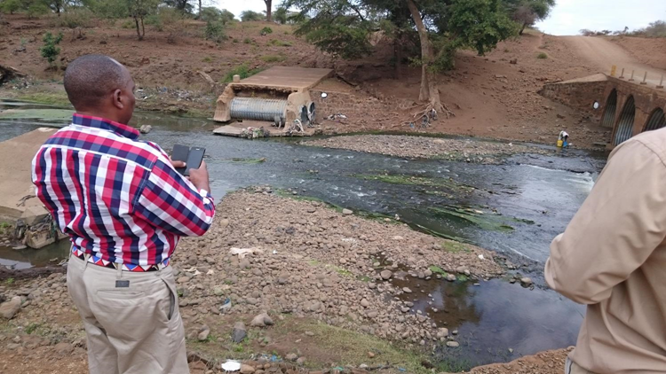
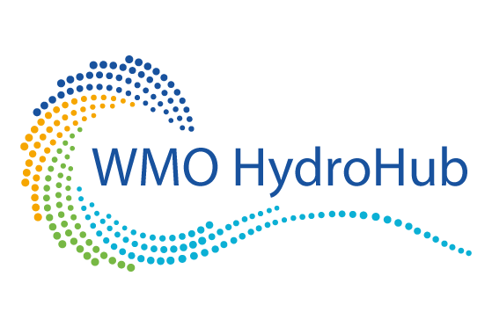
Global Hydrometry Support Facility
(WMO HydroHub)

Slide 2

Who we are
Water-related decision-making
Innovative technologies and approaches
Hydro-met data
The Global Hydrometry Support Facility (WMO HydroHub)
makes the portfolio of expertise among WMO Members – from science to technology to services –
available to support access to end-users of hydrometeorological data and services from various economic sectors
as tailored services.

Slide 3
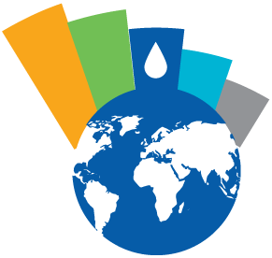
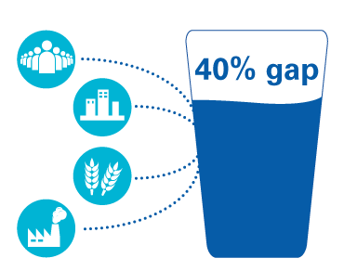
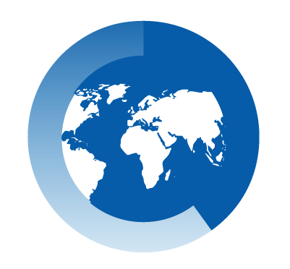

The Hydrological Monitoring Network Challenge
Increasing demand for water may lead to a 40% gap between water supply and demand by 2030
Water crisis is the #3 global risk we face in terms of impact
60% of countries report declining numbers of observing stations
Reliable data is critical for making effective and timely decisions

Slide 4
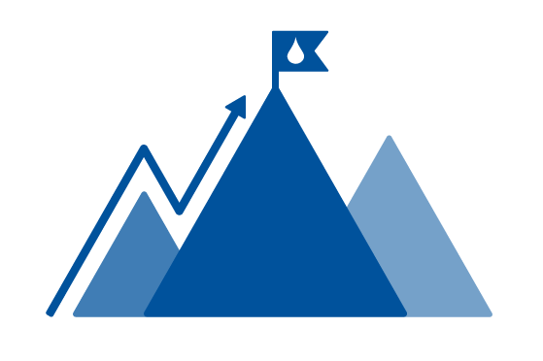
Our Mission
To help expand a reliable and sustainable base of hydrometeorological data and information services in support of informed decision and policy-making in water management.

Slide 5
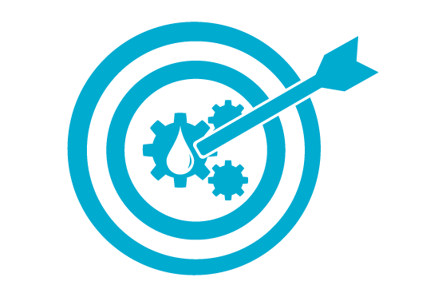


Our Objectives
1. Enhance and sustain efficient and innovative hydrological monitoring systems around the world
2. Foster the use of hydrometeorological data for evidence based policy and decision-making in support of Integrated Water Resources Management and Disaster Risk Reduction, especially in transboundary settings
3. Facilitate the modernization and improvement of operational hydrology through operational uptake of innovative hydrometric technologies and services by National Meteorological and Hydrological Services

Slide 6
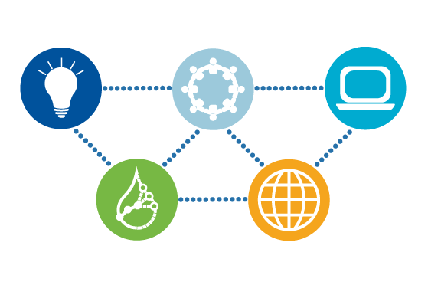
Our Strategic
Priority Areas
Building Hydrological Monitoring Capacity
Embedding Innovation in Hydrometry
Enabling Hydrological Data Sharing
Connecting the Global Water Monitoring Community
Providing a Global Focal Point for Hydrometry

Slide 7
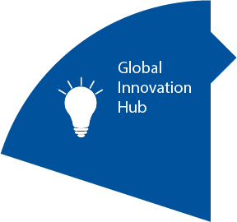
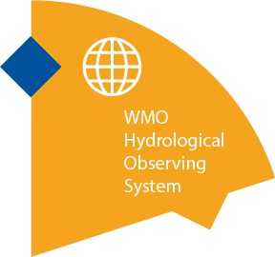
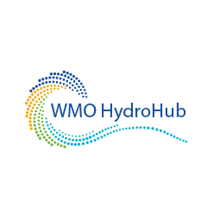

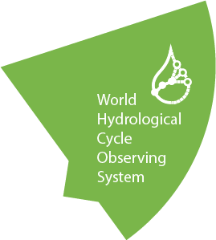
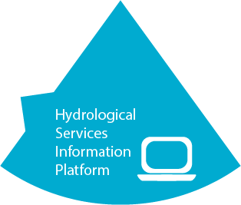
Our Components

Slide 8
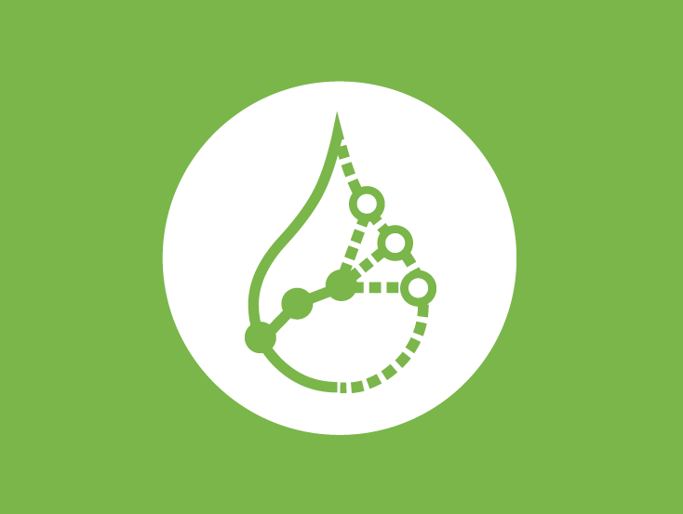
World Hydrological Cycle Observing System (WHYCOS)
Strengthens the technical, human and institutional capabilities of NMHSs in hydrological data collection and information product development and dissemination.
HYCOS: Independent regional projects tailored on the needs expressed by countries, the building blocks of the WHYCOS programme.
GUIDELINES: A common approach to the development, implementation and governance of HYCOS components.
TRAINING MATERIALS: A broad range of presentations, documents and publications about all aspects of hydrological observations.

Slide 9

Global Innovation Hub
Strengthens fit-for-purpose and sustainable monitoring capabilities through innovation.
Key innovation areas:
HYDROMETRY: Operational uptake of innovative technologies and emerging monitoring schemes, such as crowd sourcing.
DATA MANAGEMENT: Pragmatic solutions to introduce new technologies and paradigms into the operational routines of National Meteorological and Hydrological Services (NMHSs) and other stakeholders.
MANAGEMENT PROCESSES: Good management practices, including case studies, guidance material, templates for recurring administrative tasks and other knowledge products.

Slide 10

Community of Practice for Hydrometry
Allows NMHSs and others to exchange experiences and provide mutual support in relation to their hydrometeorological data collection and management activities.
PARTNERSHIP: Support to experts to identify the right partners for discussion to solve common practical problems and to foster dialogue among practitioners.
EXISTING NETWORKS: Approximately 3000 experts from the WMO working bodies of Technical Commissions and Regional Associations.
PLATFORM: Web-based tools to allow the global hydrometry community to share knowledge and provide technical assistance to each other.

Slide 11

Hydrological Services Information Platform
Provides potential funders of hydrometeorological projects with current information on governmental and non-governmental water monitoring organizations, and their capabilities, structure, and network- and data-sharing characteristics.

Slide 12

WMO Hydrological Observing System (WHOS)
A premier online portal to near real-time and historical data made freely and openly available by National Hydrological Services around the world.
INTERACTIVE MAP: A map interface with links to those NMHSs that make their real-time and historical stage and discharge data available online.
PROTOTYPES: Regional examples currently being developed for Arctic HYCOS and La Plata basin in South America.
WIGOS: A service-oriented framework linking hydrologic data providers and users through an information system enabling data registration, data discovery, and data access.
Notes:
WIGOS: WHOS is the hydrological component of the WMO Integrated Global Observing System (WIGOS).

Slide 13
Our Partners
Civil Society
Multilateral and Bilateral Funding Agencies
UN Organization
Private Sector
Research and Academia
Projects on Water-related Data

Slide 14
How can you partner with us
As a Financial Partner
Through the HydroHub innovation fund:
flexible funding source;
fast and direct intervention;
identified needs;
long-term operations and re-usable technology;
adaptable to various applications and geographies.
As a Project Partner
projects tailored on the needs of WMO Members;
open dialogue with the WMO community;
incentives for and commitment of beneficiaries;
capacities of implementers.
Notes:
HydroHub Innovation Fund: Invest in a small but tailored building block that removes recurrent obstacles and fosters the uptake of innovative solutions.

Slide 15

Our Governance
Advisory Council
Members: Currently 9. Term of membership coincides with the intersessional period of CHy.
Chair: President of the WMO Commission for Hydrology (CHy).
Innovation Committee
Members: 13. Term of membership is 2 years.
Chair: An appointed CHy Advisory Working Group member.

Slide 16
Our Contacts
http://hydrohub.wmo.int
hydrohub@wmo.int

Slide 17

Thank you

