Slide 1
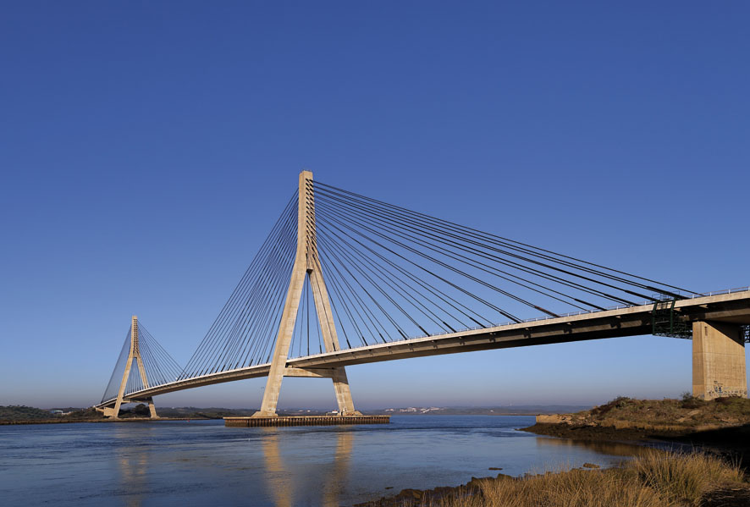

Activities on monitoring and assessment under the Water Convention : comprehensive and thematic assessment
Dr. Annukka Lipponen
Environmental Affairs Officer, UNECE Water Convention
20 September 2018

Slide 2
The basis: Monitoring and assessment activities under the Water Convention
Various guidelines on monitoring and assessment developed in the 1990s and 2000s; tested in pilot projects on both surface waters and groundwaters
Regional assessments: First Assessment of Transboundary Rivers, Lakes and Groundwaters (2007), Second Assessment (2011)
Working Group on Monitoring and Assessment
Lately monitoring and assessment has been integrated into thematic activities (e.g. adaptation to climate change, water-food-energy-ecosystems nexus), or has been a component in projects on the ground (e.g. Afghan-Tajik cooperation, the Drin GEF project)

Slide 3
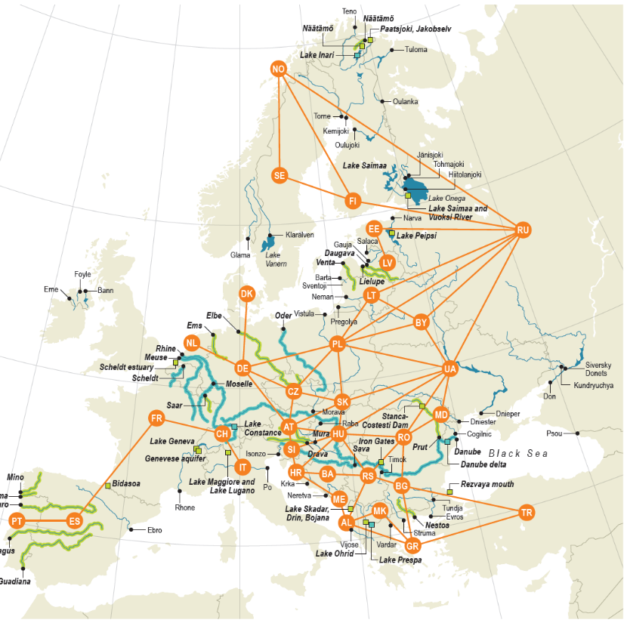
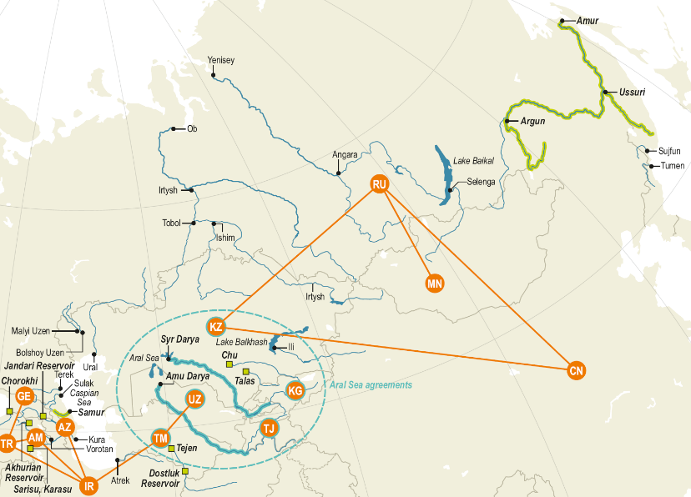
Second Assessment of transboundary waters (2011)
Covered: >140 rivers, 25 lakes, some 200 groundwaters and 25 Ramsar Sites & other wetlands of transboundary importance from W. Europe to Central Asia; also countries from outside UNECE (Afghanistan, IR Iran, Mongolia) participated & non-Parties
Process (2009-2011): subregional focus, extensive data collection using a questionnaire: 50 countries, 5 subregional workshops over >2 years, reviews by national administrations, e.g. basin commissions provided input

Slide 4
Information collected for the Second Assessment (2011) of transboundary waters
Surface and groundwater resources: distribution among the riparian countries within a basin/aquifer (delineation, renewable resources, distribution and variability of flow)
Pressures and their importance (water uses – consumptive and non-consumptive, polluting activities like wastewater discharges, diversion etc)
Quality and quantity status of waters (quality: with reference to national systems – to be improved)
Transboundary impacts (descriptive)
Cooperation: joint bodies, agreements, joint monitoring etc (descriptive)
Trends
Management response measures taken (descriptive)

Slide 5
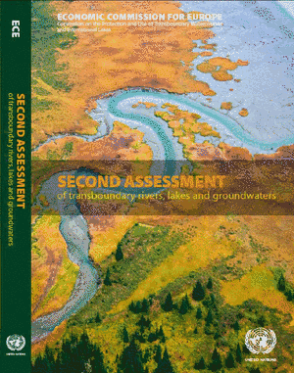
Second Assessment: about information and its exchange
Information exchange often irregular, intermittent, opaque and unstructured
Harmonization of information and approaches is a challenge
Joint monitoring & assessment hardly exist in many transboundary basins
Weak exchange of data between different national sector authorities
Information too often scattered and isolated and does not support sound management and decision-making
Basin level information commonly not available
Cost of and access to information is a major issue in many countries

Slide 6
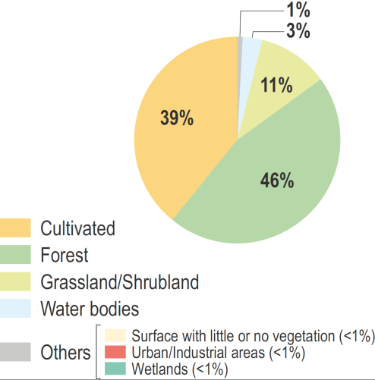
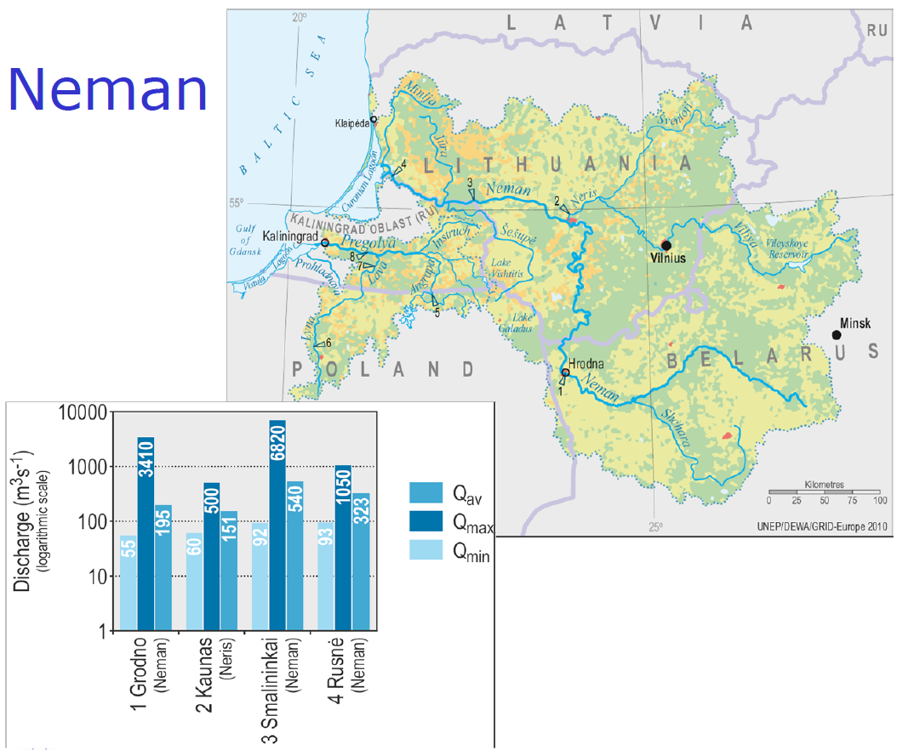
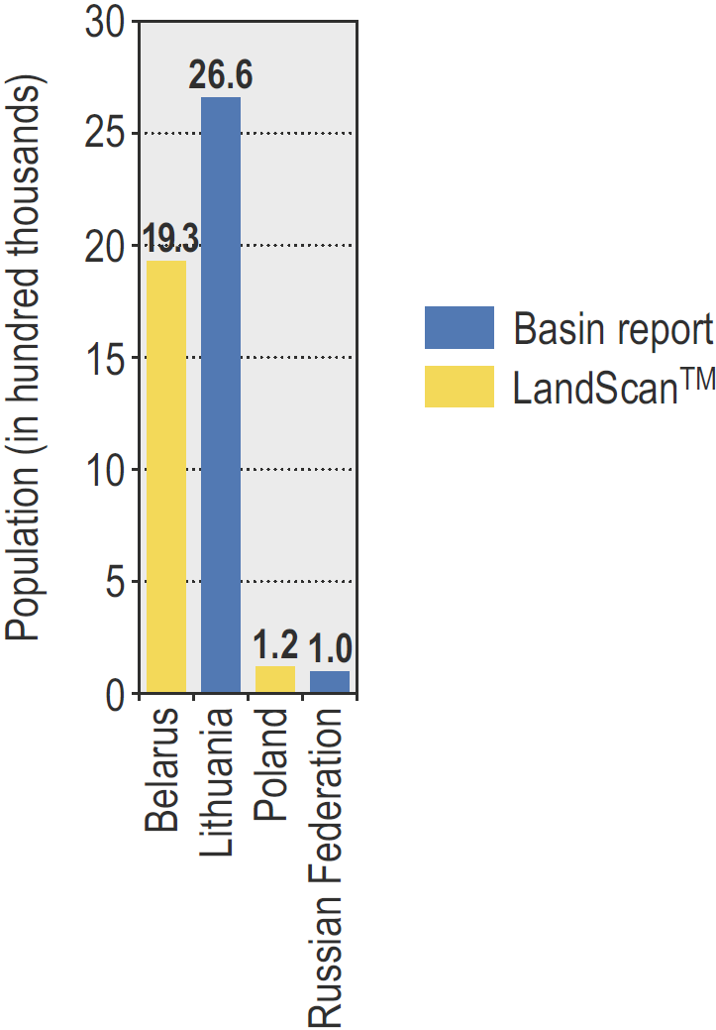
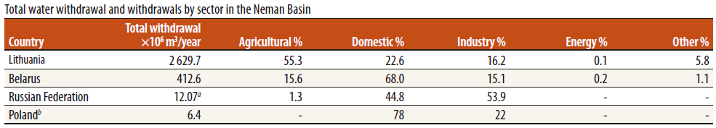
Basin example: water resources & the context of their use
Land use/
Land cover
Population
Discharge
Withdrawal

Slide 7
Benefits of common, clear methodologies for assessment of waters and reporting across the region
Comparability (across borders, notably)
A common basis for identifying challenges and needs for action — nationally, at basin level and regionally
Some pressures on water quality clearly (sub-)regional: air pollution, pollution of recipient seas from land-based sources
Benefit from a wider exchange of good practices/international experience
Promoting cooperation
Making information available saves effort
Increased public awareness & access to information (trust, legitimacy)
Serves to inform, guide and stimulate further action by different actors (including donors and the research community)

Slide 8
A possible third comprehensive assessment eventually?
Concept for a 3rd comprehensive Assessment of Transboundary Waters (mandated by 7th MoP) was developed:
Following an initial discussion in 2016, Expert Group met in May 2017 to hear expectations from countries, reviewed related initiatives and to develop the scope and main features
Draft concept prepared to inform the discussion at the Working Group on IWRM, but not included in the Programme of Work (PoW) 2019-2021
The approach proposed
Minimum common+ adjust the focus to the interest of the riparians and the level of existing cooperation; clustering of basins interested in a specific thematic (e.g. disaster risk reduction, ecosystems, nexus, sediments)
The assessment approach has to be a mix of qualitative, semi-quantitative and quantitative information. Adjusted to the data availability in each basin
The key: the information and the process makes the co-riparians revisit, discuss and agree about their challenges and possible responses

Slide 9
Lessons learned and challenges
Projects on the ground
Main challenge: resource-intensive, funding
Lessons: Practical testing is key to delivering solid guidance, technical cooperation can pave the way to the political level advancement in cooperation
Regional assessments
Challenges: basin level information, intersector access, cost, different approaches (e.g. to water quality classification). What shape should assessment take under the global Convention?
Served to exchange views & experience, harmonize approaches, keep the status of transboundary waters under scrutiny
Monitoring and information components in thematic activities
Monitoring, assessment and information has synergies with other thematic activities: highly complementary to e.g. reporting under the Water Convention
Projects contribute experience of wider applicability which needs to be consolidated into policy products like principles, guidelines, good practice etc.
Exchange of data and information is presently a major challenge!

Slide 10
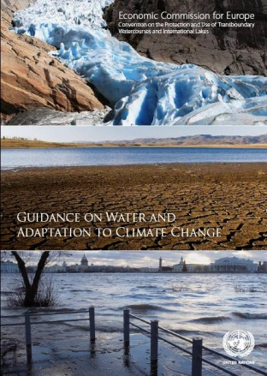

Climate change activities and related information under the Water Convention
Provisions of the Water Convention can help countries and basins adapt to climate change
Guidance on Water and Adaptation to Climate Change adopted in 2009
Programme of pilot projects on climate change adaptation in transboundary basins (Chu Talas, Neman, Dniester, Sava rivers): information and monitoring commonly among the key adaptation measures
(Global) Platform for exchanging experience: regular workshops
Global network of 14 basins working on climate change
Collection of good practices and lessons learned published in 2015
Policy work in global processes, such as UNFCCC COPs, ISDR

Slide 11
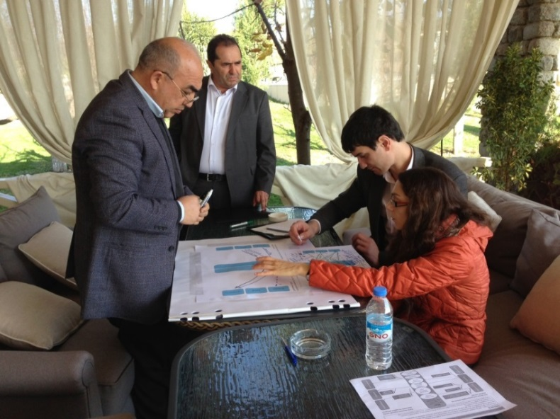
Nexus assessments under the UNECE Water Convention: the framework
As the Programme of Work, 2 cycles of intersectoral basin assessments - 2013-2015 to 2016-2018: the Alazani/Ganykh, Sava &Drina, Syr Darya, NWSAS, Drin
Task Force on the Water-Food-Energy-Ecosystems Nexus guides the work and provides oversight;
Aims: Foster transboundary cooperation (intersectoral synergies & measures to reduce tensions); assist countries (resource use optimization, capacity building);
Demand-driven assessments basins selected responding to expressions of interest from riparian countries or cooperation organizations;
Meeting of the Parties endorsed the methodology & general conclusions (November 2015)

Slide 12
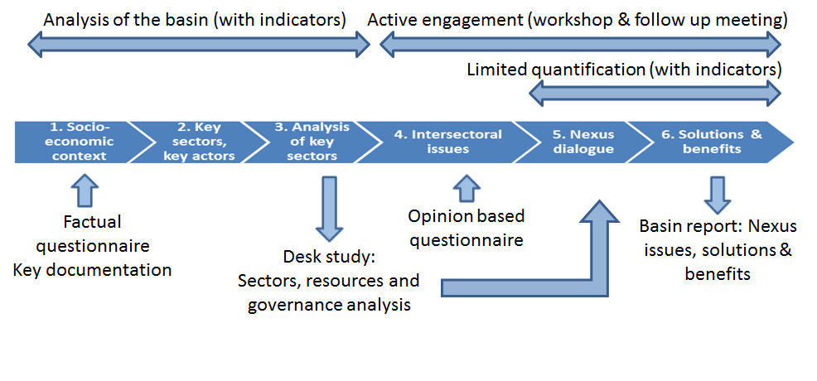
Nexus assessment methodology developed under the Water Convention
Provides for participatory intersectoral assessment at transboundary level informed by analysis, prepared in close cooperation with national governments
Adapts to the context and the issues specific to the basin
Applicable to surface water basins and aquifers

Slide 13
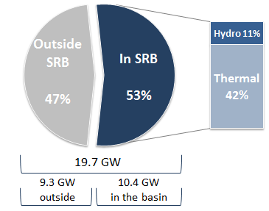
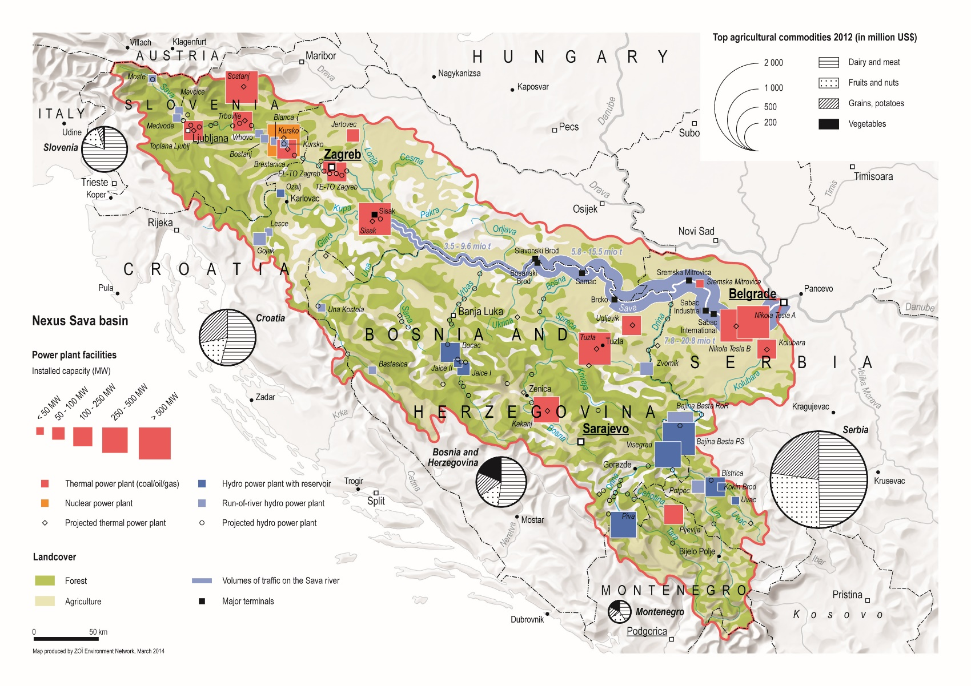
Balancing different water uses in the Sava Basin
Basin water resources are of paramount importance for the energy security
FLOW REGULATION
TO ACCOUNT NOT
ONLY HYDRO BUT
ALSO COOLING
THERMAL &
NUCLEAR POWER
EXPANSION OF
IRRIGATION
PLANNED
INCREASED
WATER SCARCITY
PREDICTED
NAVIGABILITY
NEEDS TO BE
ENSURED
WETLANDS SERVE FLOOD
PROTECTION
SMALL AND MEDIUM
HYDROPOWER DEVELOPMENT
ON THE TRIBUTARIES

Slide 14
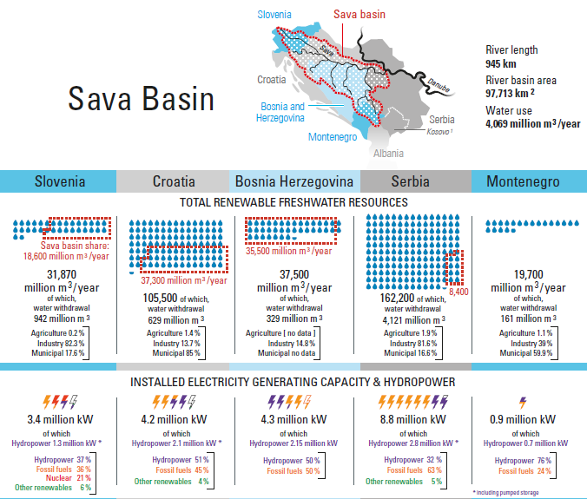
Water resource and energy indicators Complementarity at the transboundary level to capitalize on!

Slide 15
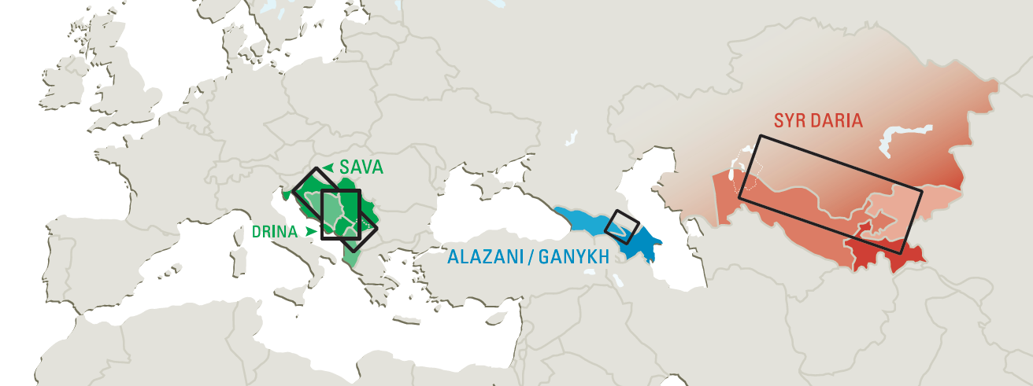
Nexus opportunities (examples) Many ways to address hydropower related issues…
Sava & Drina Develop hydropower sustainably and integrate other renewable energies; coordinate operation of hydropower plants (for flood control, for energy system benefits) and development of new capacities | Alazani/Ganykh Facilitate access to modern energy sources and energy trade; minimize impacts from new hydropower development; catchment management to control erosion | Syr Darya Promote restoring and vitalizing energy market, develop the currently minimal trade in agricultural products; improve efficiency in energy generation, transmission and use; improve efficiency in water use (esp. in agriculture)

Slide 16
Example from the Drina Basin:
Quantification of the benefits of
(Co-)optimizing flow regulation
Approach
Developing multi-country model of the three riparian countries (Bosnia and Herzegovina, Montenegro and Serbia) with the focus on Drina river basin, using the Open Source energy MOdeling SYStem (OSeMOSYS).
Drina Water – Energy Model (DWEM):
Energy System
Focus:
Cost optimal electricity generation to meet the demand.
Soft linking of water flow in electricity generation system.
HPP
Hydrological System

Slide 17
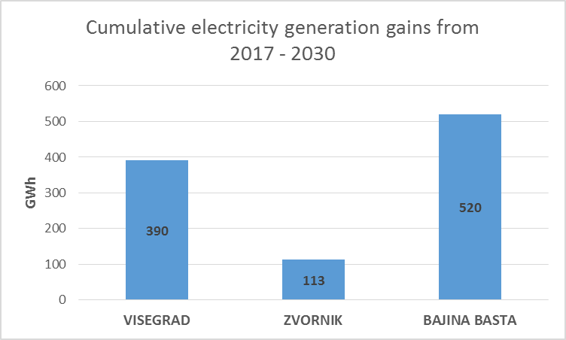
Gains in electricity generation (Cooperation vs. Base scenario)
Compare the Cooperative operation HPPs with non-cooperative (uncoordinated) scenario.
Better cooperation allow for better water availability in the river.
Reduce thermal generation and reduce the overall system cost.
Suggested Policy Direction
Improving cooperation between the DRB countries on flow regulation in the operation of hydro power plants, mitigation risks against floods, reducing the stress on hydro and thermal generation through the implementation of energy efficiency measures and non-hydro renewables.

