Slide 1

WMO adoption of WaterML2 suite: status, timeframes, issues
Ninth Hydrology DWG Workshop
Geneva, Switzerland
Tony Boston
17 September 2018

Slide 2
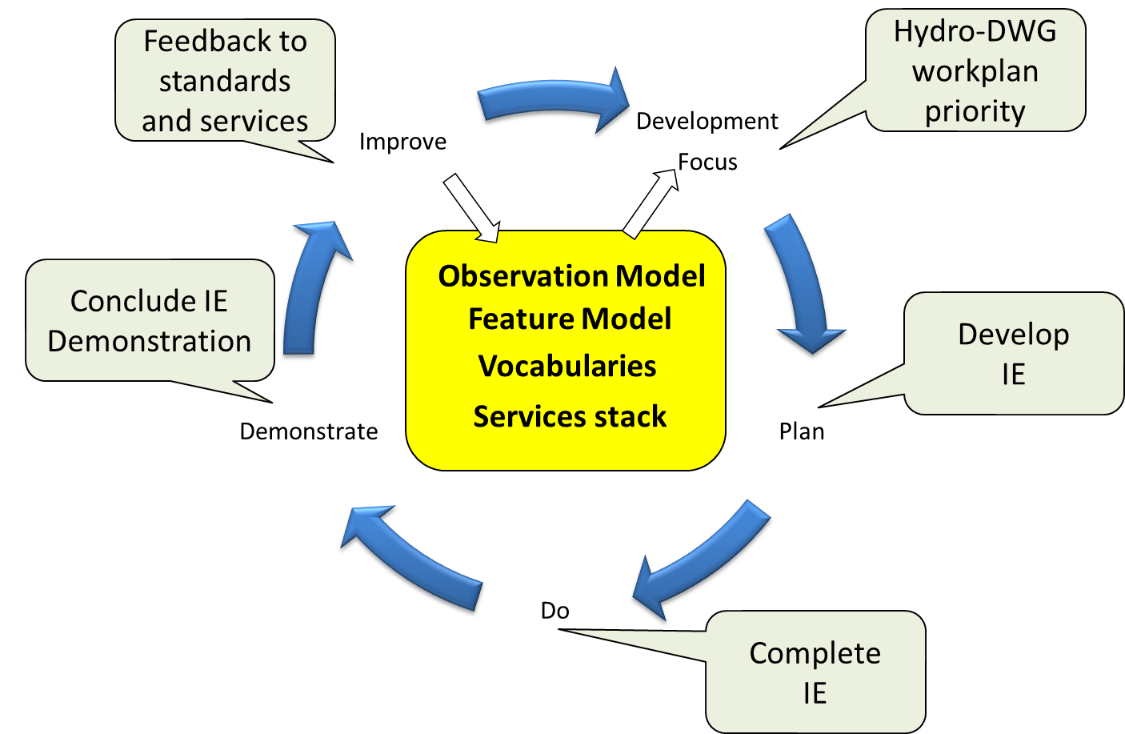

International Standardization for Water Data
Hydrology Domain Working Group
standards for water data: WaterML 2.0 suite
organizing Interoperability Experiments (IEs) focused on different sub-domains of water
Co-Chairs:
Silvano Pecora (Italy)
Tony Boston (Australia)
David Blodgett (USA)
Iterative Development
http://external.opengis.org/twiki_public/bin/view/HydrologyDWG/WebHome

Slide 3
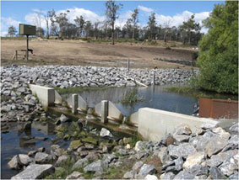
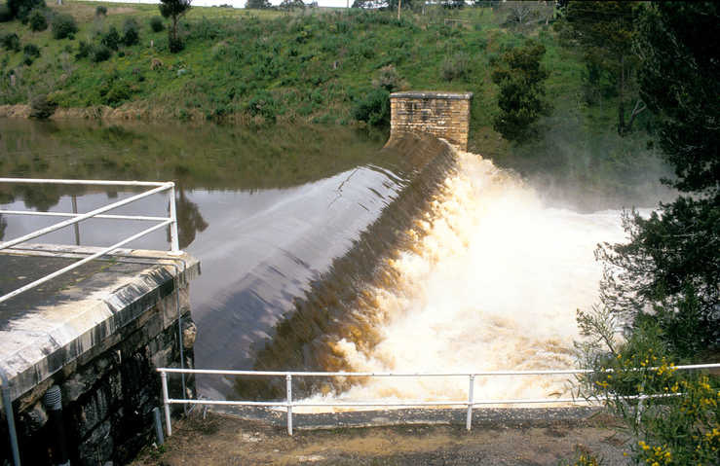
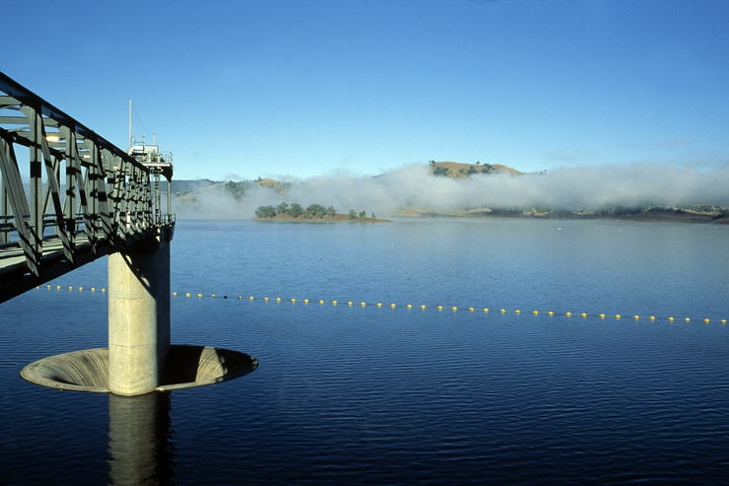
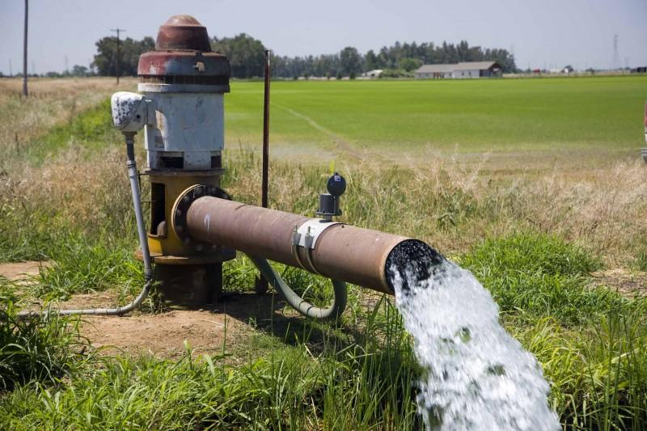
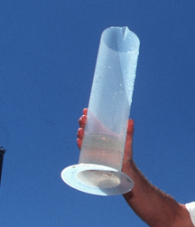
WaterML2 standards
Part 1 – Timeseries
Part 2 – Ratings, Gaugings and Sections
Part 3 – Surface Hydrology
Features
Part 4 – Groundwater
Features
Part 5 –
Water Quality Observation (best practice)

Slide 4
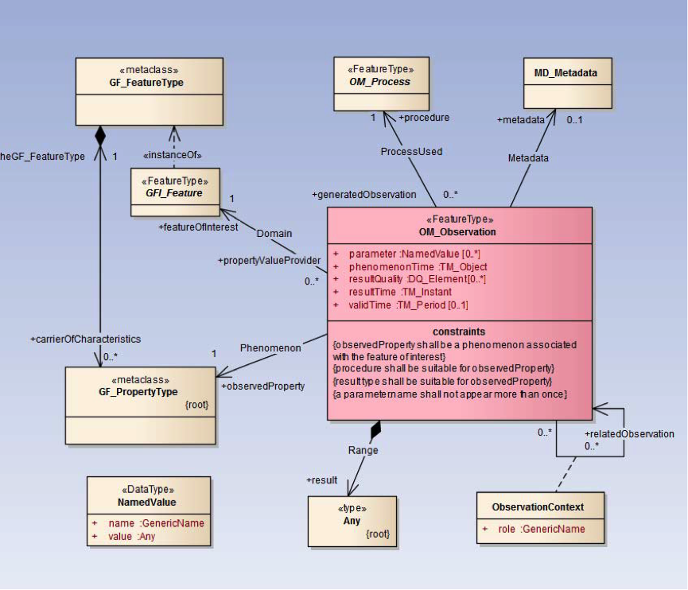
WaterML2: Part 1 – Timeseries
Profile of O&M, reusing ISO
and OGC standards
UML model
XML Schema (GML compliant)
Specification document
Requirements
Conformance classes
Conformance tests
XML Schematron rules
Vocabulary definitions
Only a subset relating to time series
Notes:
An Observation is an action whose result is an estimate of the value of some property of the feature-of-interest, obtained using a specified procedure.
WaterML2: Part 1 focuses on hydrologic timeseries observations, which are the result of measurement of say water level or discharge at a stream gauging station on a river within a particular catchment

Slide 5
Adoption of WaterML2: Part1
WaterML2 announcement regarding US national strategy for civil earth observations:
http://www.opengeospatial.org/pressroom/pressreleases/1831
US Federal Geographic Data Committee (FGDC) endorses WaterML2:
http://www.fgdc.gov/standards/news/WaterML
WaterML2 recommended in EU legislation on data sharing (page 5):
http://eur-lex.europa.eu/LexUriServ/LexUriServ.do?uri=OJ:L:2013:331:0001:0267:EN:PDF
USGS implements WaterML2 in national water information system:
http://help.waterdata.usgs.gov/news/april-10-2014

Slide 6
WaterML2 in use
The WMO Hydrological Observing System will use WaterML2 standards for encoding and exchange of hydrological data between countries around the world
Government agencies in North America, Europe, Australia, New Zealand... have adopted WaterML2 standards
Major vendors of Hydrologic Information Systems are supporting WaterML2 standards

Slide 7
Adoption by WMO
WMO Executive Council 69th session meeting in May 2017 formally adopted WaterML2 Part 1 & 2 standards (p.133-134)
Decides:
To amend the Manual on Codes, Volume I.3 to introduce WaterML2 Parts 1 and 2 as data representations that are suitable for the exchange of hydrological information, as specified in Annex 1 of the Annex to Recommendation 12 (CBS-16);
To amend the Guide to Hydrological Practices, Volume I as specified in Annex 2 of the Annex to Recommendation 1 (CHy-15);
Requests:
WMO representatives to the Hydrology Domain Working Group of the OGC to work with that group to revise the non-normative (informative) material in the WaterML2 standards to address concerns of CHy
Notes:
EC-69: https://library.wmo.int/opac/doc_num.php?explnum_id=3645
CHy-15: https://library.wmo.int/doc_num.php?explnum_id=3404

Slide 8
Adoption by WMO (2)
How do new standards developed through the Hydrology Domain Working Group get adopted by WMO?
Part 3, 4, 5…
What is the need?
Priority, timeframe, issues?
Do new standards need to go to CBS and CHy session meetings and then to Congress or EC, or can they be added ‘out of session’ to the Manual on Codes?

