Slide 1

Inspire O&M & SWE requirements - profile
BRGM – S.Grellet

Slide 2
Context
Objectives
Refine the INSPIRE O&M & SWE guidelines document (D2.9) produced in 2011
based on inputs from experts coming from various EU organisations and outside. A dedicated meeting was held side by side OGC Hydro DWG workshop in Delft (2011)
restructure it to differentiate explanatory text on O&M & SWE from guidance (should/shall) -> OGC modular spec
Refine the INSPIRE SOS as an INSPIRE dowload service technical guidance
Better link together the two documents
Develop one reference implementation (52°N)
HDWG workshop Orléans 2015
Combine HDWG members knowledge about SWE to produce a best practice document on SWE for environmental monitoring
Link to NZ profile, EU Ambiant air quality reporting profile, …
Notes:
2
2

Slide 3
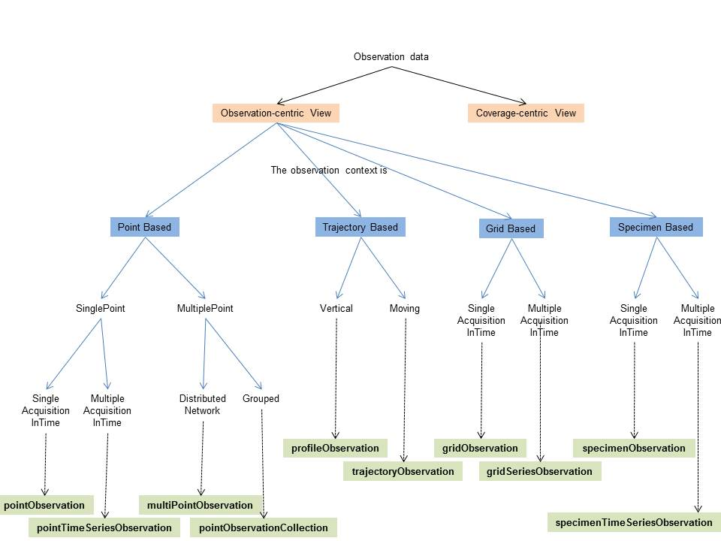
O&M Design patterns
Decision tree
Leading to specialisedObservations
Most of which derived from OM_DiscreteCoverageObservation
Notes:
2
2

Slide 4
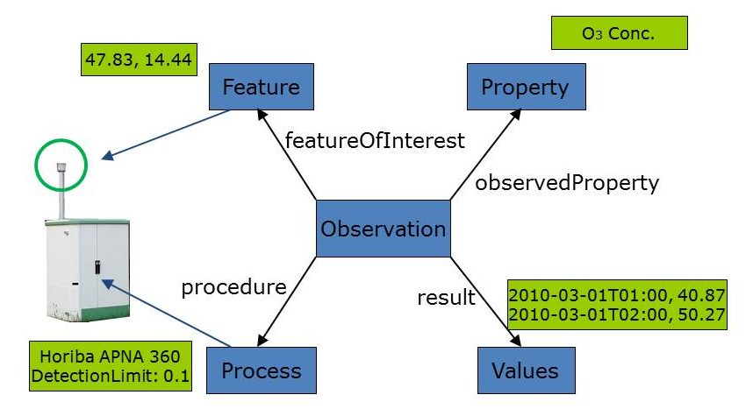
O&M Design patterns
specialisedObservation example
PointTimeSeries
An example of such case could be an air quality monitoring station providing ozone concentration measurements.
The featureOfInterest represents the direct surrounds of the air intake (i.e. the air bubble surrounding the air intake).
The location for the measurements is provided through this featureOfInterest.
As this design pattern usually provides a time series (temporal coverage) result,
the phenomenonTime and/or resultTime will often be provided together with the result values.
/req/inspire-om-design-patterns/pointTimeSeriesObservation | When the Observation represents a time-series of point measurements of a property at a fixed location in space the specialised observation ‘PointTimeSeriesObservation’ SHOULD be used
Notes:
2
2

Slide 5
O&M Design patterns
specialisedObservation
PointTimeSeries
Will be updated
Notes:
2
2

Slide 6
O&M Design patterns
Other specialised observations
point, multiPoint, pointObservationCollection
profile & trajectory
grid & gridTimeSeries
specimen & specimenTimeSeries
Notes:
2
2

Slide 7
O&M INSPIRE profile
Core Observation profile
Requirement classes : most of them are recommendations (only few are requirements)
OM_Observation : identifier, time (ISO 8601)
observedProperty :
communityVocabulary, SKOS
observableProperty (inspired from CSML3) initially recommended (in V2) : few implementation feedback available -> moved to informative annex.
featureOfInterest :
SF_SamplingFeature ,
provision of sampledFeature : either domain feature or Nasa SWEET entry
pattern for depth/elevation provision
Notes:
2
2

Slide 8
O&M INSPIRE profile
Core Observation profile
Procedure
sensorType not instance (as in SOS hydro profile)
dedicated Process specialisation in Inspire (xsd)
Link to monitoringFacility or monitoringNetwork generating the observation :
Pattern defined using om:parameter. With value pointing to URI of the facility/network
Metadata
No clear need identified
Notes:
2
2

Slide 9
Service Layer
Link to INSPIRE SOS technical guidance document
Work on updating GetDataAvailability in a V2
Adding offeringID, formatDescriptor (observationType, procedureDescriptionFormat), inspireExtension for resultNature in the response
See Simon Jirka’s presentation today : “ SOS 2.0 Hydrology Profile (further development)”
Notes:
2
2

Slide 10
Service Layer
Recommended service pattern (WFS / SOS)
1°/ WFS : access Monitoring Facility/Network description
2°/ SOS: getDataAvailability to test ground for observation available at the monitoring feature level
retrieve offeringID
3°/ SOS: getObservation on a given offeringID
Notes:
2
2

Slide 11
Service Layer
Result encoding
TimeSeriesML support: issue to be clarified is the backward compatibility with WaterML2 (specialised observation use it)
O&M JSON encoding (OGC BP)
Out-of-band issue not solved since previous version (a discussion paper was produced)
No decision was taken so far.
Keps as informative annex to the document produced
Notes:
2
2

Slide 12
Technical guidelines for SOS as an INSPIRE download service
Extended capabilities for metadata
Mapping Inspire terminology to SOS operations
Ex : INSPIRE dataset -> Offerings
DescribeSensor operation
Behaviour linked back to D2.9 recommendations
Observation identifier handling
getObservationById should reuse gml:identifier. Inspire ‘identifier’ is a dedicated type that is not gml:identifier…
Notes:
2
2

Slide 13
Next steps
Discuss within INSPIRE O&M & SWE maintenance group (MIWP-7a)
Polish the docs
Mainly D2.9, SOS TG 95% finished
Forward to INSPIRE MIG-T for comments
Communicate - raise awareness
Done : OGC Washington TC : SWE DWG (5’) , HydroDWG, HydroDWG Koblenz
OGC Dublin TC : SWE DWG (20’) To discuss into more details.
After TCs : circulate D 2.9 document to gather comments
OGC Orlando: push it as an OGC BestPractice ?
Notes:
2
2

Slide 14
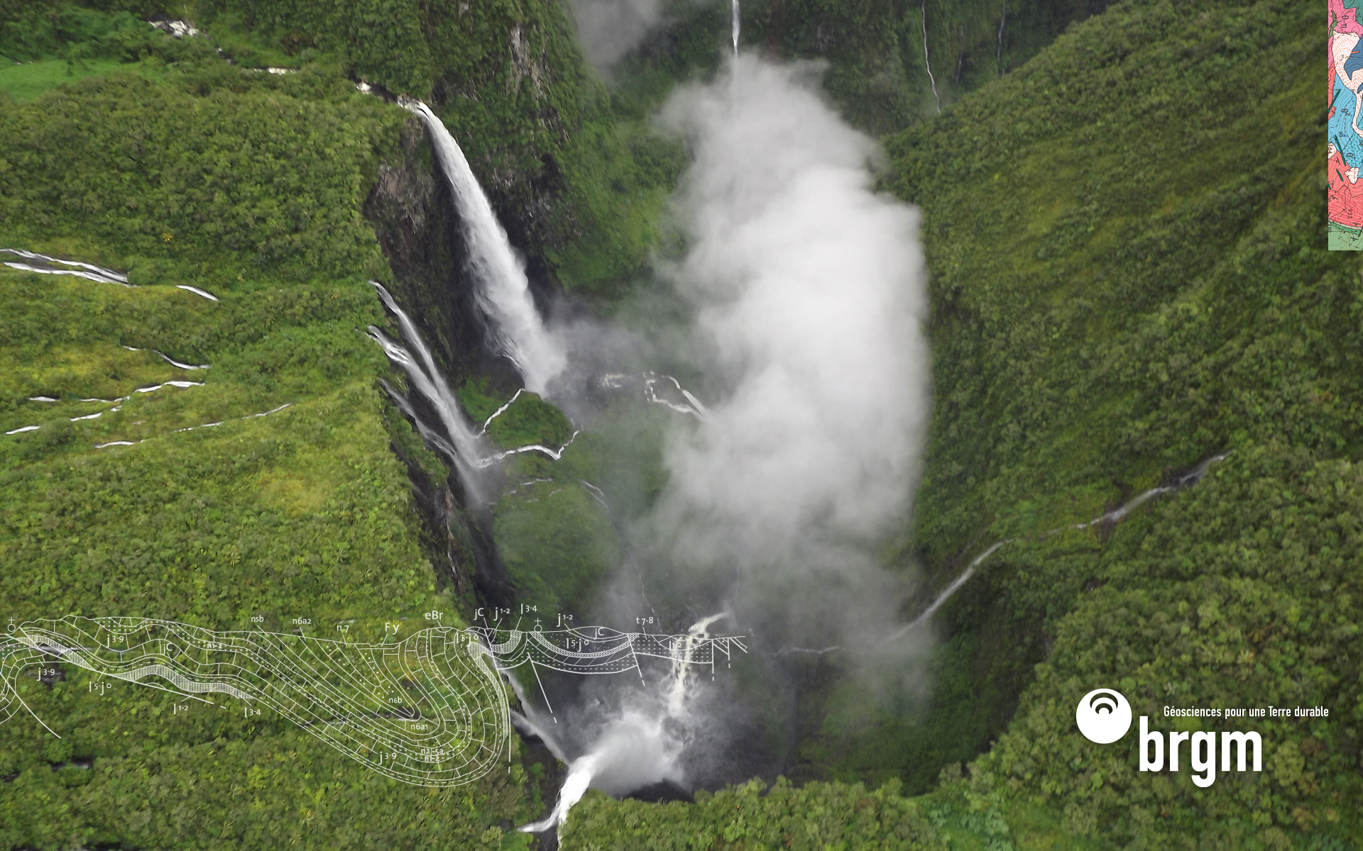
Thank you
s.grellet@brgm.fr
Notes:
2
2

