Slide 1

Supporting GML application compliant complex features in QGIS and beyond
BRGM – S.Grellet

Slide 2
Overall context
NO DATA
?
NO CLIENT
« another approach to demonstrate
the usefulenessof interoperable standards »
or
« having something to show to those
who consider XML is not sexy »
Notes:
2
2

Slide 3
Overall context
Few applications are able to handle GML flows compliant to an application schema
Appart when hardcoded
Initial idea :
A correct xml content points to its xsd(s )
Can we generate a database structure from what is declared in the xsd ?
Having a generic solution with no hardcoded configuration ?
Notes:
2
2

Slide 4

Overall context
Proof Of Concept exercise
Desktop open source application : QGIS
Use case :
Ground Water quantity monitoring
Reading data, not writing
Complex Feature Flows
WFS
Piezometers : Inspire Environmental Monitoring Facility theme
Aquifer : Inspire Geology-Hydrogeology, GWML2
SOS
WaterML2
Project started Fall 2015
With core QGIS commiters
Notes:
2
2

Slide 5
Technological choices
Input : XML File or URL
Solution to handle XML types
Xerces (C++) : supports “Schema API” and esp. “post-schema-validation infoset” to access schema information (thus types)
Xsd -> Object model conversion
Code Synthesis (C++) and PyXB (Python)
PyXB
XML parsing
Xsd caching
Well-formed XML = minimum. Degraded mode for ‘non-perfect’ xml
‘Content negociation’ on xlink:href
For codeLists : test on Inspire vocabulary registry, Sandre, …
For Features
Notes:
2
2

Slide 6
Technological choices
Database :
PostGIS / SpatialLite
Simplification / dynamic flatening parameter
Respecting application schema
Structure
Types
Referential integrity
Notes:
2
2

Slide 7
Results – data content context
Ex : Environmental Monitoring Facility : piezometers
Environmental Monitoring Facilities
http://inspire.ec.europa.eu/schemas/ef/4.0/
hasObservation:
Link from WFS to SOS
ISO 19156:2011
Observations and Measurements
INSPIRE O&M extensions
Notes:
2
2

Slide 8
Results – plugin modes
XML: handling the XML file as is with additionnal intelligence on top
Xpath to geometry(ies) information
Ability to handle hlink:href
Identification of TimeSeries
Relational database : creating database structure in SpatialLite
Maximum table merging depth parameter : dynamic flattening
adjust the verbosity of the resulting database structure
‘Merge unitary sequences’ : for Attributes with max cardinality * in the xsd but only present once in the xml
avoid un-necessary additional tables
Notes:
2
2

Slide 9
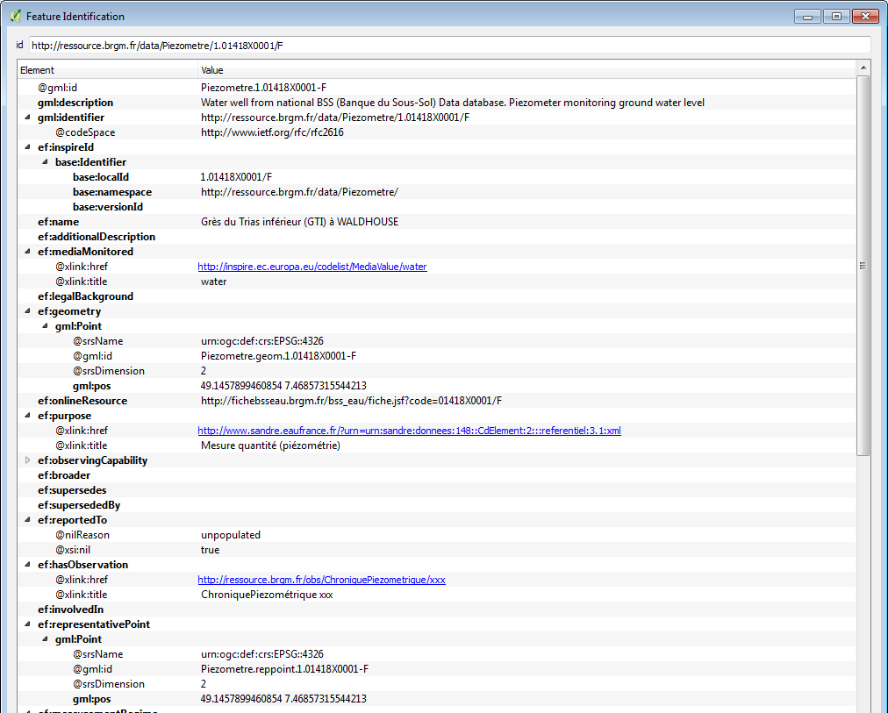
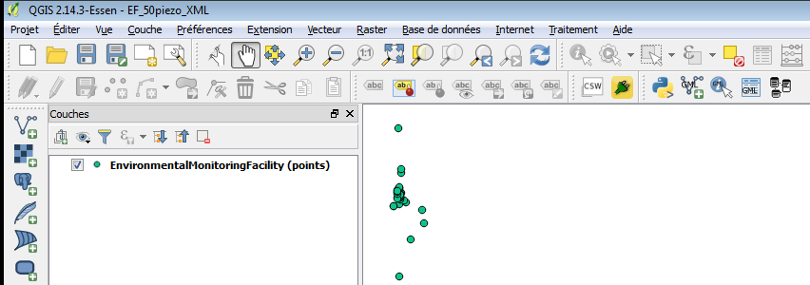
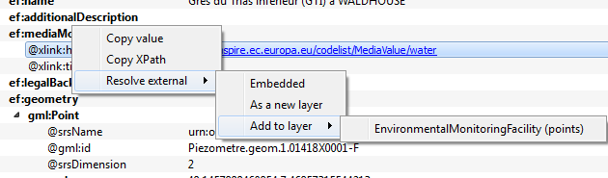
Results – XML Mode
On WFS flow
Notes:
2
2

Slide 10
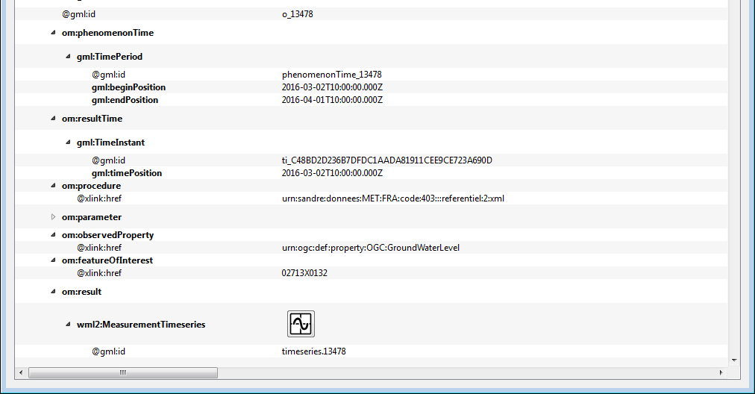
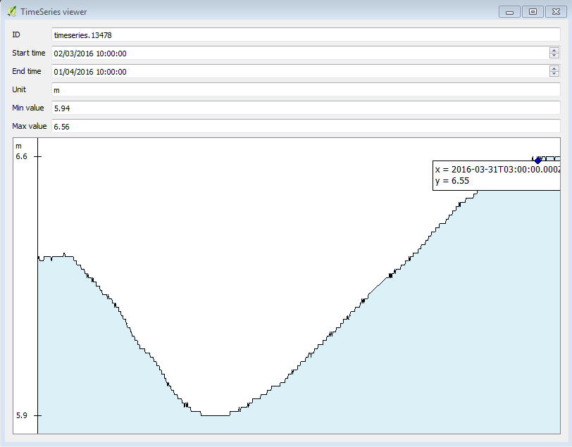
Results – XML Mode
On SOS flow
Notes:
2
2

Slide 11
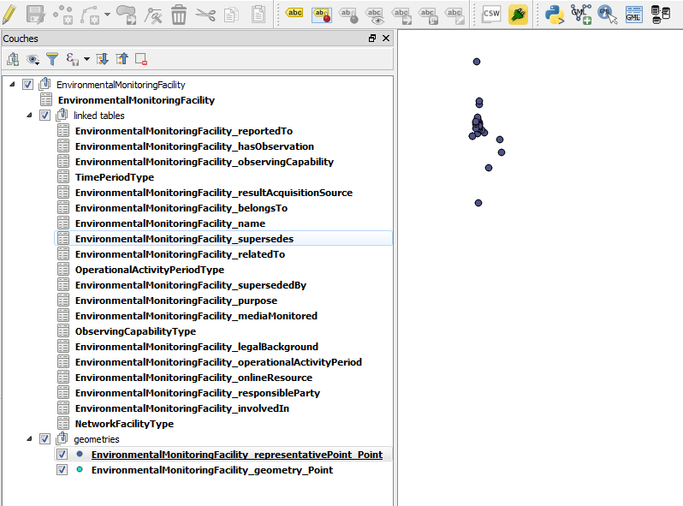
Results – Relational database Mode
ex : WFS flow
Notes:
2
2

Slide 12
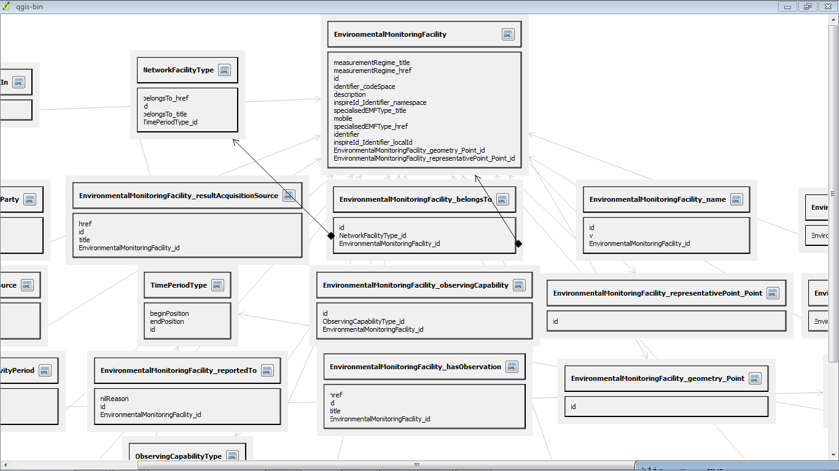
Results – Relational database Mode
ex : WFS flow
Schema representation within QGIS to ease navigation
Notes:
2
2

Slide 13
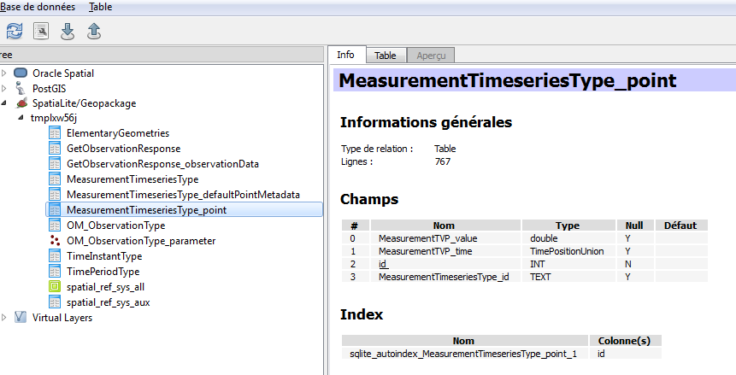
Results – Relational database Mode
ex : SOS flow
Data structure whithin Database Manager
Notes:
2
2

Slide 14
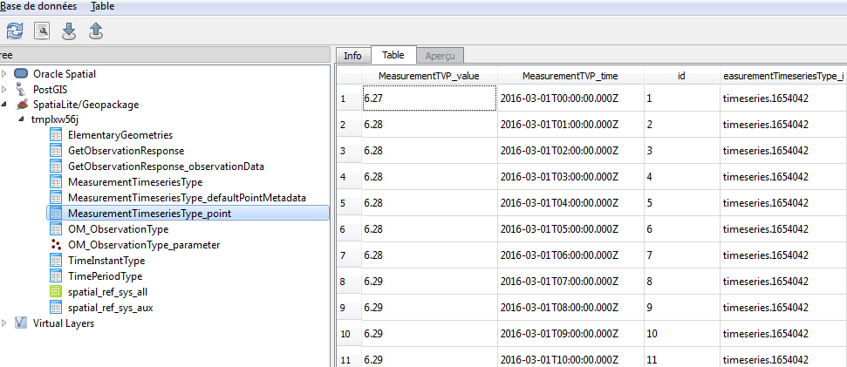
Results – Relational database Mode
ex : SOS flow
Data content is here
We can deploy domain plugins for our domain colleagues
Ex : analyse trends, correct values, …
Notes:
2
2

Slide 15
Further test results
Data structure generation is quite fast on reasonable datasets
Matter of seconds
Tested on others application schema compliant dataflows
Geology : European Geological Data Infrastructure
Inspire Geology
GeoSciML V4
Mineral resources : Minerals4EU
Inspire Mineral resources
Works quite well for a POC
Both modes have their utility
Notes:
2
2

Slide 16
Next steps
1a°/ Publish the plugin
Name : ‘QGIS GML Application Schema Toolbox’
In the official QGIS repository
1b°/ Gather feedbacks
HydroDWG, GeoSciML, ….
Inspire
Have people use it…
Notes:
2
2

Slide 17
Next steps
2°/ Enhance the work (whishlist)
Port the approach to GDAL/OGR
Enable application schema compliant writing
Improve the UI
Add domain useful widget (Hydrogeologists, …)
Nothing in the code is Inspire specific so this work could be useful to the overall OGC community.
Have other structures contribute to its development
Ex : Study under COPERNICUS umbrella to enhance INSPIRE data consumption/use within QGIS
Notes:
2
2

Slide 18
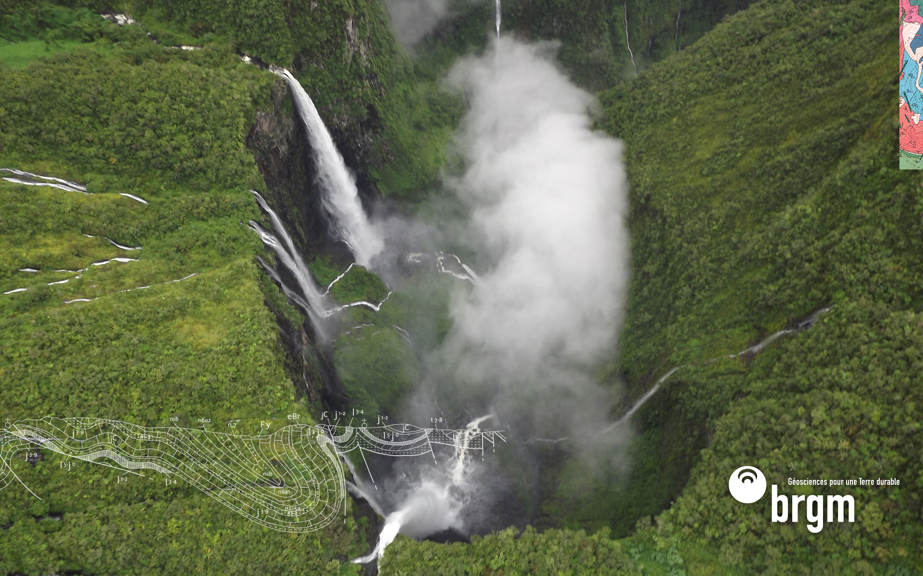
Thank you
s.grellet@brgm.fr
Notes:
2
2

