Slide 1
Catchment topology pattern in the HY_Features conceptual model
HDWG Annual Meeting, Koblenz, Germany
Irina Dornblut, HydroFeatures SWG
14 June 2016

Slide 2
Catchment topology pattern ?
scale-independent, consistent pattern that
is derived from hydrologic determination, governed by physical laws (unit having a common outlet to which all waters flow from within a bounding watershed)
can be ‘transferred’ to parallel interpretations of the conceptual catchment
can be applied to present the catchment interpretation representing the conceptual catchment
‘hydro topo’ comparable to the ISO topology model
‘transfer’ core topology of 19107 to catchment and catchment interpretation, ignoring the geometric representation
to support ‘realization’ of hydro topo using ISO geometry, when using the HY_Features model

Slide 3
Catchment and outfall – a topological closure
Catchment implies the occurrence of water inside of a boundary formed by inflow and outflow locations
‘directed’ catchment (inside)
proxy for an interpretation of catchment in a particular perspective
‘directed’ outfall (boundary)
proxy for an arbitrary location referenced as common outlet
orientation with the catchment (positiv in natural flow direction):
from inflow location of receiving catchment
to outflow location of contributing catchment
lower dimension than that of catchment (inside), such as
Edge (catchment) bounded by inflow and outflow nodes
Face (catchment) bounded by inflow and outflow edges
Solid (catchment) bounded by inflow and outflow faces
interaction with upper and lower catchment

Slide 4
Catchment and outfall – a topological closure
Catchment implies the occurrence of water inside of a boundary determined by inflow and outflow location
comparable with ISO 19107 topology concepts
Boundary: modelled as inflowNode and outflowNode – relating the Outfall to the corresponding Catchment
Coboundary: modelled as receivingCatchment and contributingCatchment – relating a Catchment to its Outfall
Center: modelled as networkLocation understanding the Outfall as proxy for an arbitrary reference location that is boundary of a catchment

Slide 5
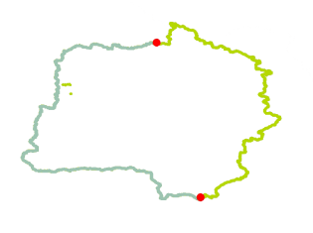
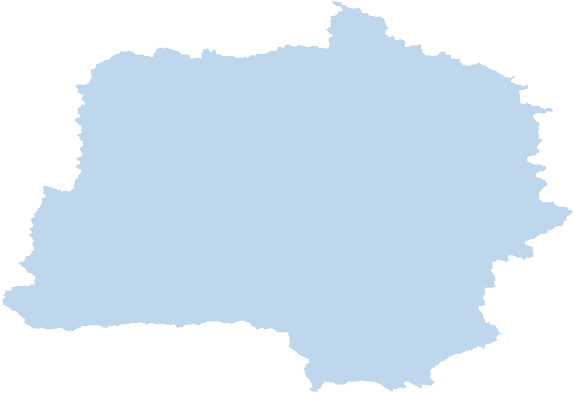
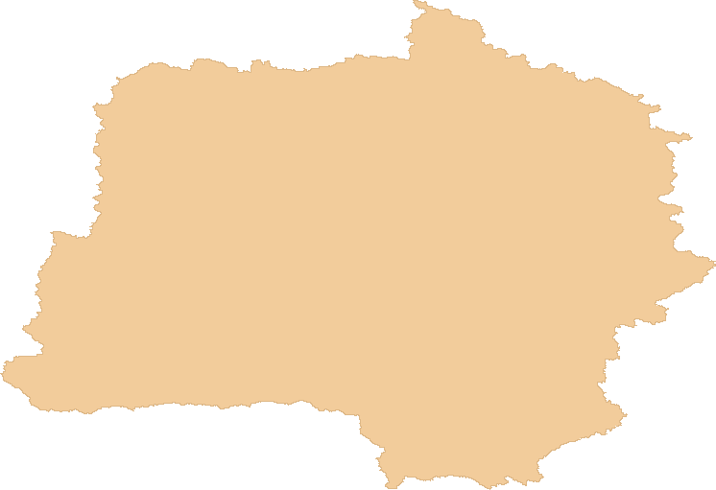
Catchment - inside and boundaries
Inflow (boundary) | Catchment (inside) | Outflow (boundary)
Node | Edge | Node
Edge | Face | Edge
Face | Solid | Face

Slide 6
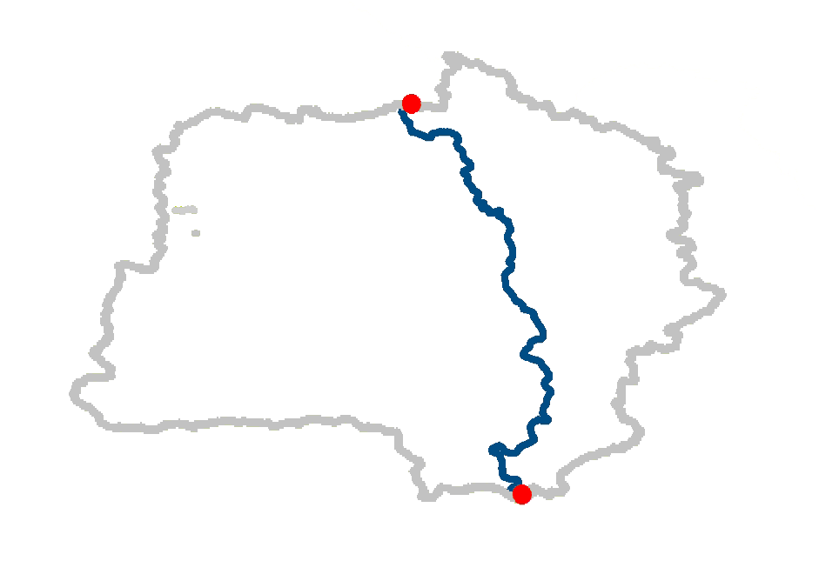
Catchment – edge bounded by node
bounded by directed outfalls
inflow node of a receiving (inside) catchment
outflow node of a contributing (inside) catchment
inflow node of a receiving catchment
is on boundary of another upper catchment contributing to this node → outflow node of the upper catchment
may be considered ‘0’, to allow for aggregation of multiple inflow
outflow node of a contributing catchment
is on boundary of another lower catchment receiving flow from this node → inflow node of the lower catchment
may be considered ‘0’ to allow for interior catchments
contributing catchment
inflow node
‘from’
receiving catchment
contributing catchment
‘to’
outflow node
receiving catchment

Slide 7
Special catchment types in HYF
Catchment type |  | Inflow (boundary) | Catchment (inside) | Outflow (boundary)
Dendritic Catchment |  | 0..1 | 1..1 | 1..1
Interior catchment |  | 1..1 | 1..1 | 0
does not exist by definition |  | 0 | 1..1 | 1..1
Catchment aggregate |  | 0 | 1..n | 0..1

Slide 8
Catchment relationships in HYF
Catchment A | A ∩ B | Catchment B | Catchment Interactions
Feature type |  | Feature association
Any catchment |  | upper catchment | inflow A meets outflow B
Any catchment |  | lower catchment | outflow A meets inflow B
Any catchment |  | conjoint catchment | inflow A meets catch B catch A meets catch B outflow A meets outflow B
Any catchment |  | distant catchment | no interaction
Any catchment |  | containing catchment | inflow A meets catch B catch A meets catch B outflow A meets catch B
Dendritic catchment |  | encompassing catchment | outflow A meets outflow B
Interior catchment |  | enveloping catchment | inflow A meets inflow B
B
A
A
B
A
B
A
B
B
A
A
B
B
A

Slide 9
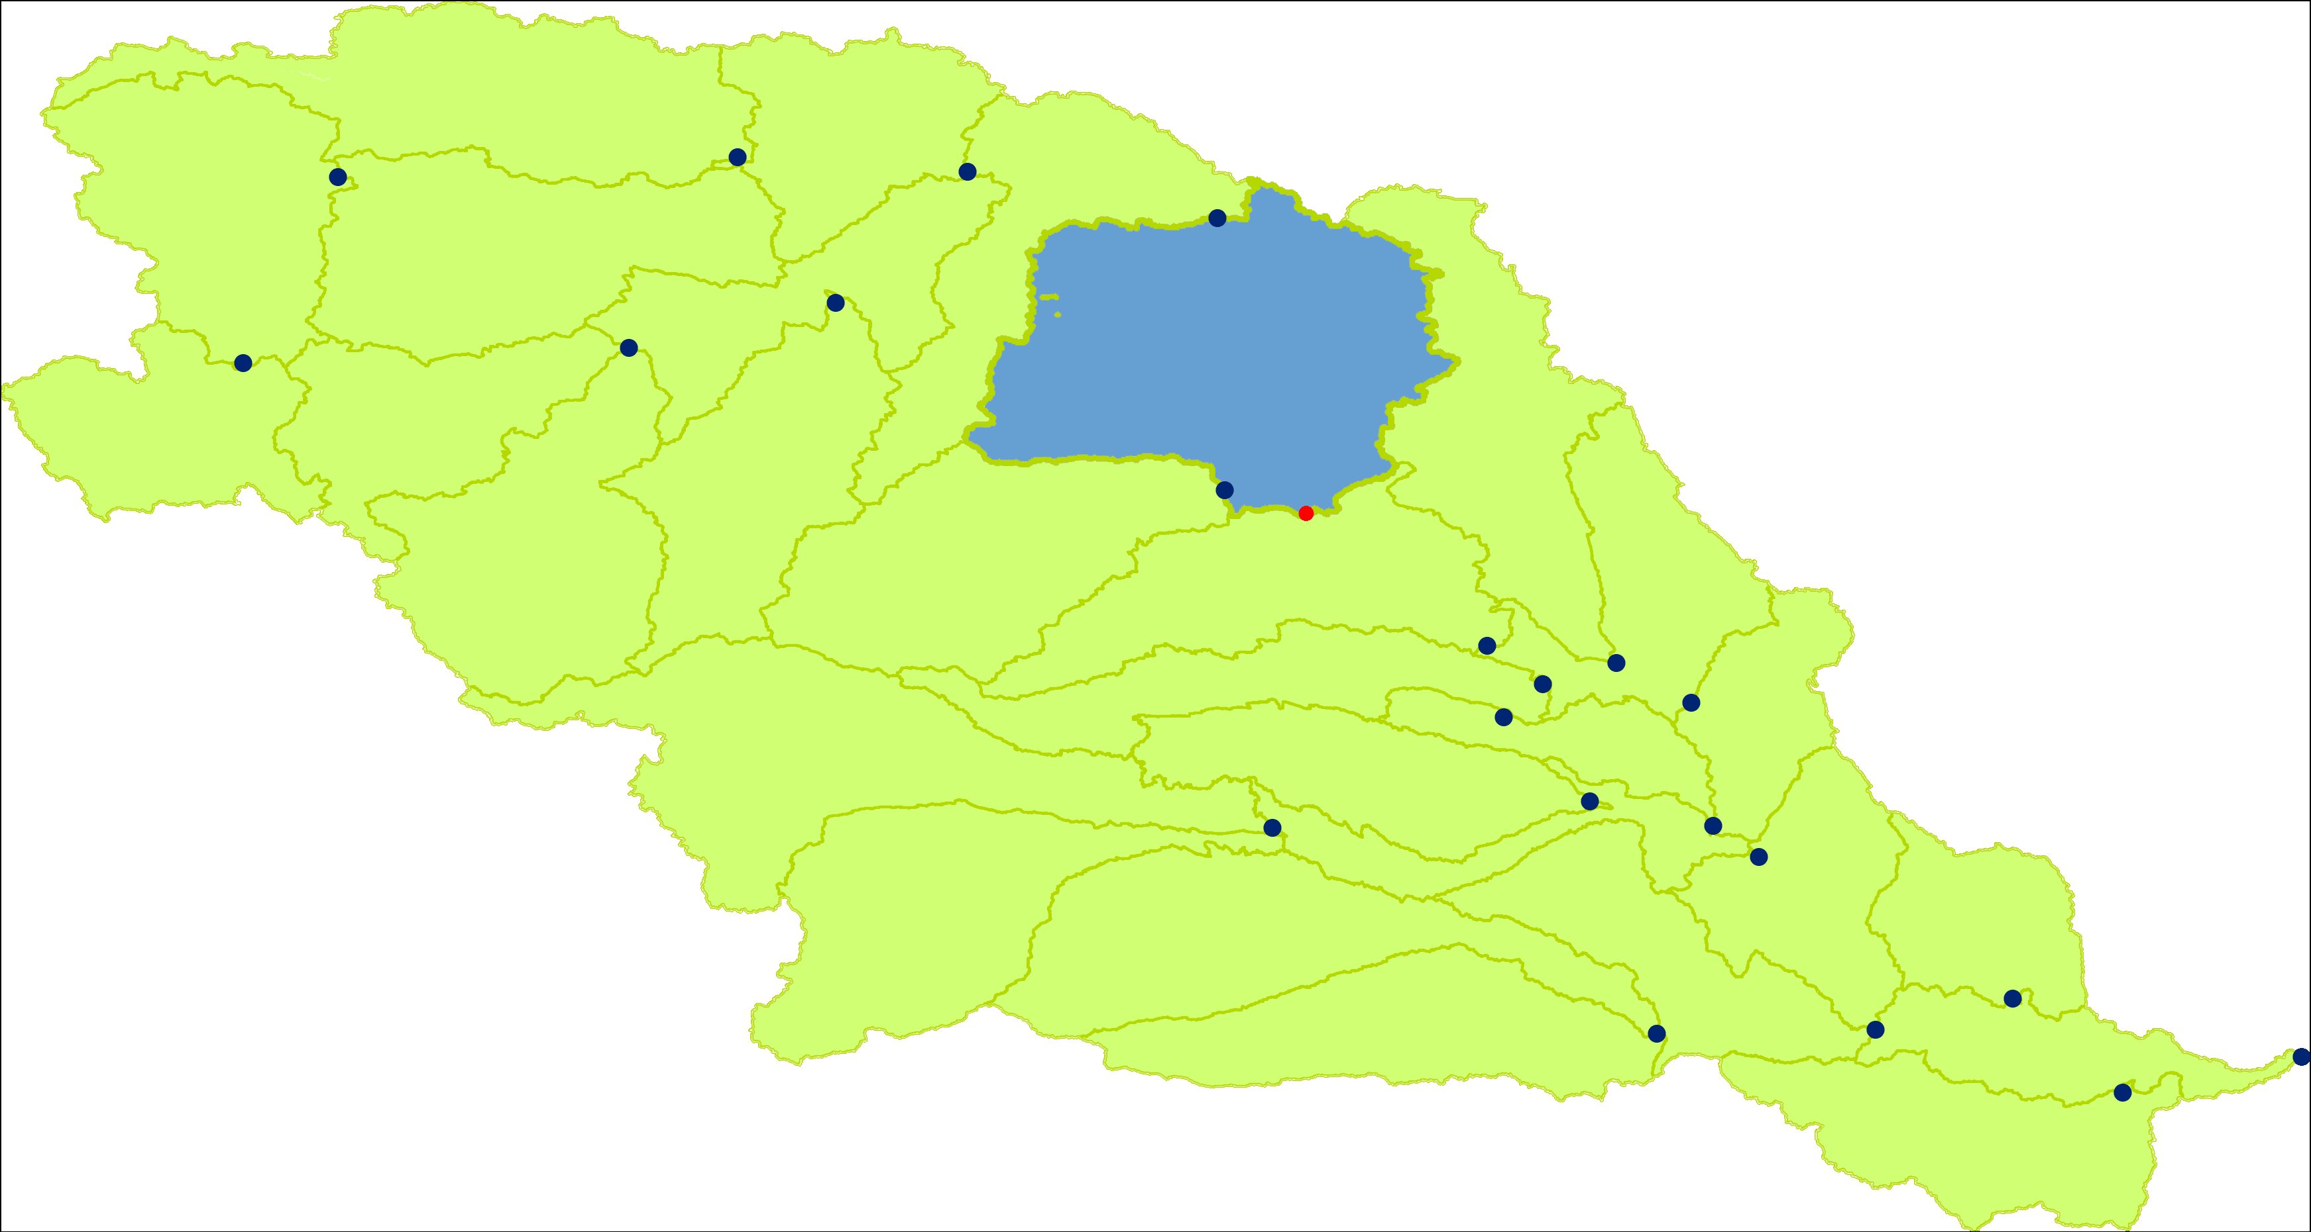
Catchment pattern replicated as necessary
Hierarchical network of catchments
Network of catchment interpretations
Network of catchment representations
Link multiple representations via topology

Slide 10
Catchment – interpretation and representation
conceptual catchment as proxy for a interpretation in the perspective of a particular study
catchment pattern may be ‘transferred’ to
Water body ‘bounded’ by a typical reference location, e. g. fixed landmark, etc.
Channel ‘bounded’ … by cross section, etc.
Station on river that forms boundary of a catchment
Hydrographic network interpretation of catchment network
…

Slide 11
Catchment – interpretation and representation
conceptual catchment as proxy for a representation in the perspective of particular reporting
catchment pattern may be ‘transferred’ to
Flowpath bounded by typical start and end such as ‘from-to’
Catchment area bounded by a summit line
Cartographic visualisation representing the catchment
…

Slide 12
Catchment – interpretation and representation
Catchment (hydrology) | Catchment (topology) | Interpretation (hydrography, …) | Representation (data product) | Expression (geometry)
unit of study where “hydro” takes place | occurrence of water inside of a boundary | catchment in the perspective of a study | presentation in the perspective of reporting | using ISO 19107
Dendritic catchment, Interior catchment | Node | e.g. Station | as part of network | as Point
Dendritic catchment, Interior catchment | Edge | e. g. Water body Channel | Flowpath | as Curve
Dendritic catchment, Interior catchment | Face | e.g. Drainage basin | CatchmentArea | as Surface
Dendritic catchment, Interior catchment | Solid | e.g. Hydro-Meteo, Hydro-Geo unit | not in HYF | as Solid
Catchment aggregate | Tree network | e.g. Hydrographic / Channel / Station network | Cartographic representation | as Composite

Slide 13
Questions

